Slide 1
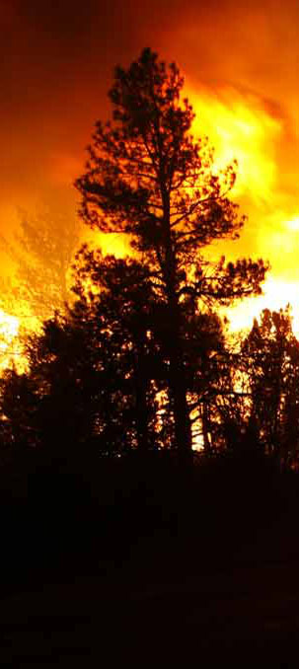
2022 NIROPS National Summary
Tom Mellin,
National Infrared Program Manager
NIROPS Closeout

Slide 2
2022 Fire Season
7.2 million acres burned, 43% acres in AK
98% of the ten-year US average (2012-2021)
66% of the ten-year CONUS average
PL4 on 9/6 thru 9/15
First mission – April 8th in NM
Last mission – Nov 4th in CA
Acres from IMSR 11/10/22
*PL = Preparedness Level (1 thru 5)
Notes:
2022 – 3.1 million acres in Alaska
2021 – Most days ever at PL4/5 – 99 days
2020 – 71 days at PL4/5, 147% of 10 year average
2019 – 4.6 million acres (56% in AK) 70% of 10 yr avg, never went to PL4 for first time since 2010
2018 – 8.8 million acres 132% of 10 yr avg, 49 days at PL 4/5

Slide 3
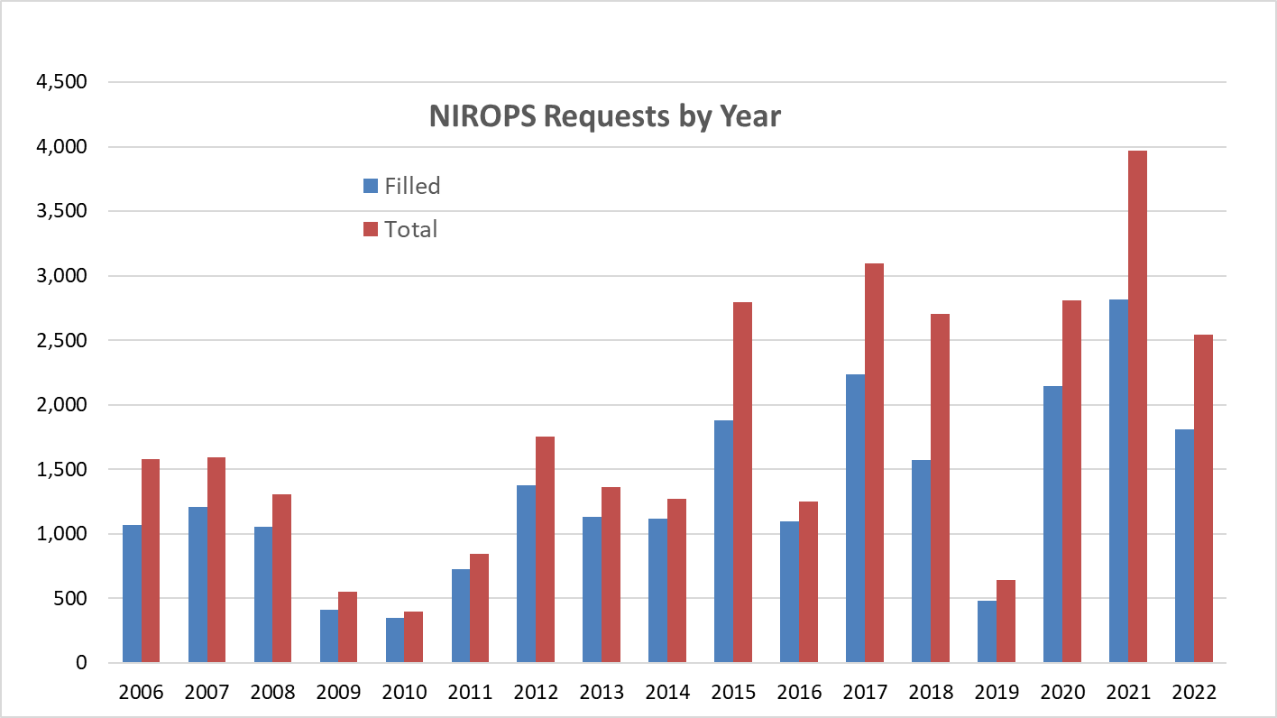
2022 NIROPS Requests
2,542 total requests with 1,811 filled
10 yr avg (2012-2021) 2,163 requests and 1,584 filled
5 yr avg (2017-2021) 2,643 requests and 1,850 filled
29% UTF rate,
17% non-Wx UTF
Aircraft 3 filled
13% of missions
Notes:
Numbers are final.
2018 – 42% UTF, 33% non-Wx UTF, AC3 15% of missions
2019 – 25% UTF, 13% non-Wx UTF, AC3 6%
2020 – 24% UTF, 20% non-Wx UTF, AC3 2%
2021 – 29% UTF, 16% non-Wx UTF, AC3 1%

Slide 4
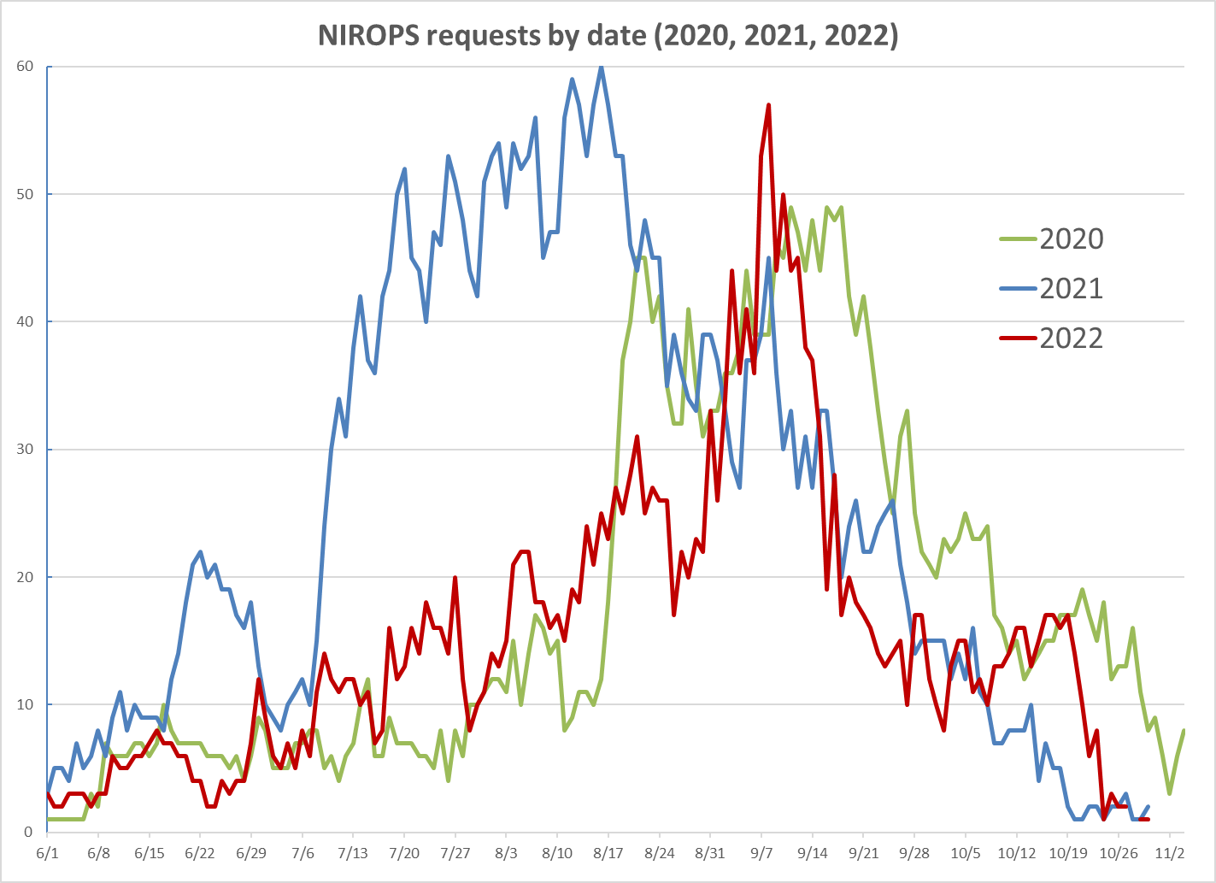
Notes:
57 requests on 9/8
Mid-April thru May averaged about 5 requests a night in the SW
2017 peak was 69 requests
2015 peak was 63 requests

Slide 5
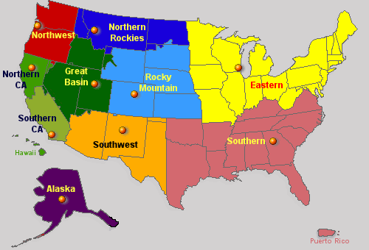
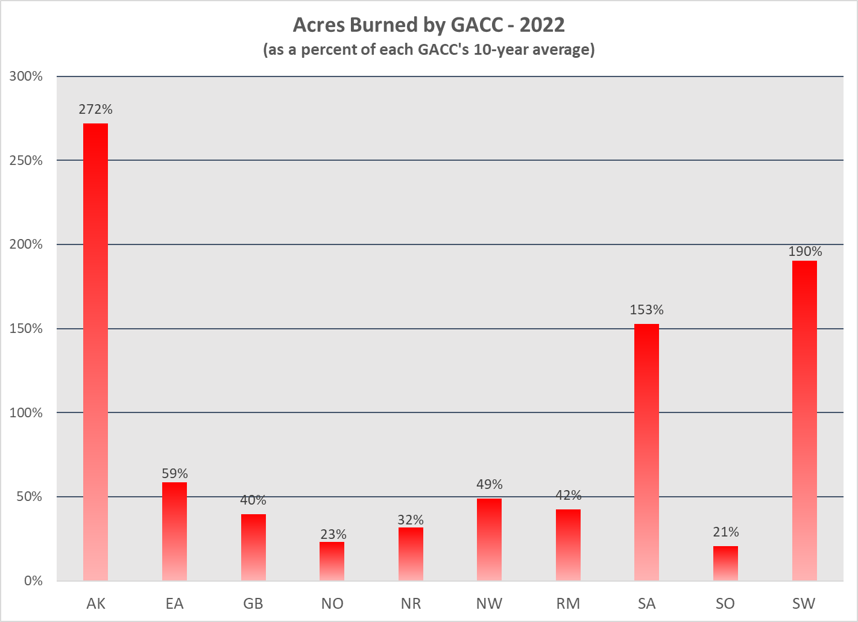
Fire Activity by GACC
Notes:
11/20/22
SW – two largest fires in NM history, Hermits Peak and Black 666,871 acres combined

Slide 6
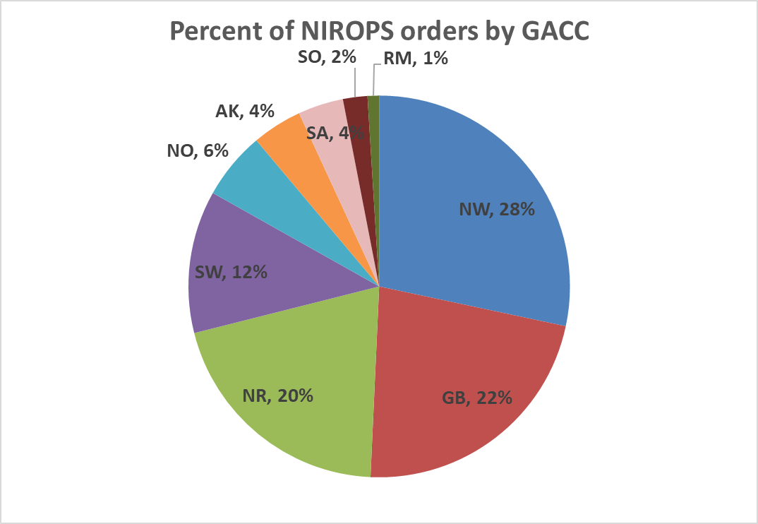
2022 – Orders by GACC

Slide 7
“Busiest” Night – Sept 9th, 29 Fires
FS 149Z (5 fires)
  Moose, Ross Fork, Williams Creek (ID)
  Trail Ridge, Murray (MT)
Tenax 350SM (10 fires)
  White River, Irving Peak, Boulder Mtn, Alligator, Goat Rocks (WA)
  Diamond Watch, Kootenai River Cx, Four Corners (ID)
  Lemonade, Bull Gin Cx (MT)
Tenax 350FV (10 fires)
  Rum Creek, Crockets Knob, Sturgill, Cedar Creek, Nebo, Double Creek, Jones Creek, Windigo, Van Meter (OR)
  Barnes (CA)
Aircraft 3 (4 fires)
  Mosquito, Red (CA)
  Chilliwack Cx, NW Pasayten Cx (WA)
Notes:
2021 Busiest night was 8/15 with 48 fires flown
2020 Busiest night was 9/5 with 38 fires flown
2019 Busiest night was 8/6 with 16 fires flown
2018 Busiest night was 8/23 with 40 fires flown
2017 Busiest night was 9/1 with 48 fires flown

Slide 8
IR Mapping Contracts
Exclusive Use – Tenax (Boise, ID)
  350SM from 5/20 to 9/9
  350FV from 7/9 to 11/11
End Product (suspended as of 7/19)
  Courtney Aviation (Columbia, CA)
  Kolob Canyon (St. George, UT)
  Hood Tech (Hood River, OR)
  Owyhee Air (Nampa, ID)
  Aspen Helicopters (Oxnard, CA)
Notes:
AC3 covered SW fires from 4/8 – 5/11
N149Z started on 5/2
End Product started
Tenax 350SM started on 5/20
Tenax 350FV started on 7/8

Slide 9
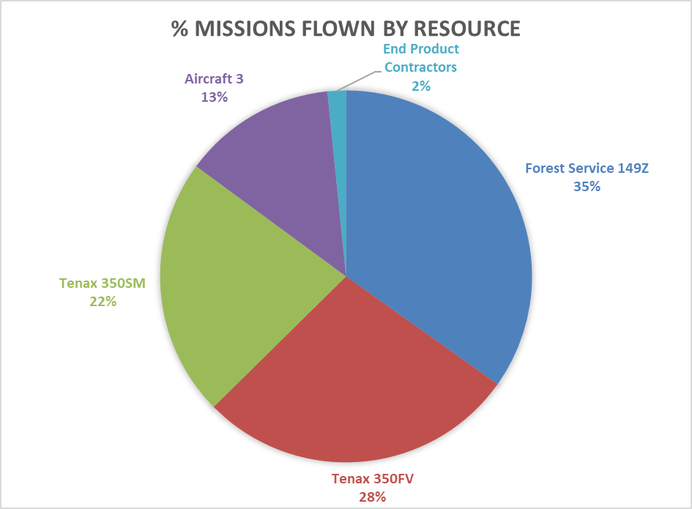
All Hands On Deck
Notes:
AC3 covered SW fires from 4/26 and provided all support to AK
N149Z started on 5/2
End Product started but had to be suspended 7/19

Slide 10
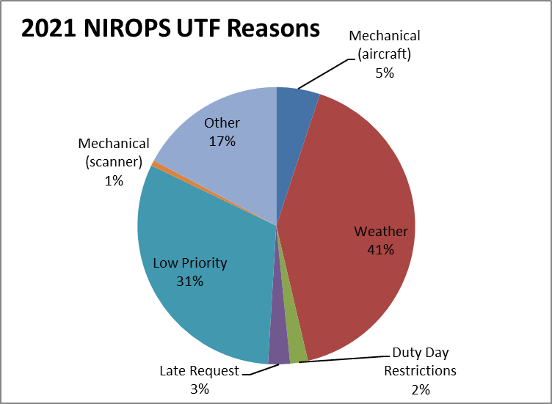
UTFs (Unable to Fill)
628 total UTFs (not incl. AC3)
UTF rate drops from 29% to 17% when weather UTFs are not counted
Other includes many fires <50 acres, directed to IAA portal
Notes:
2021 – Weather 46%, duty day 27%, Mechanical aircraft 16%
2020 – Duty day restrictions 69%, weather 14%
2019 – weather 51%, Mechanical aircraft 29%
2018 – mechanical aircraft 28%, required maintenance 24%, weather 22%
2017 – mechanical aircraft 31%, weather 25%
2016 – weather 43%, 6% non-weather UTF rate
2015 – duty day restrictions 45% due to pilot staffing issues, 26% non Weather UTF rate

Slide 11
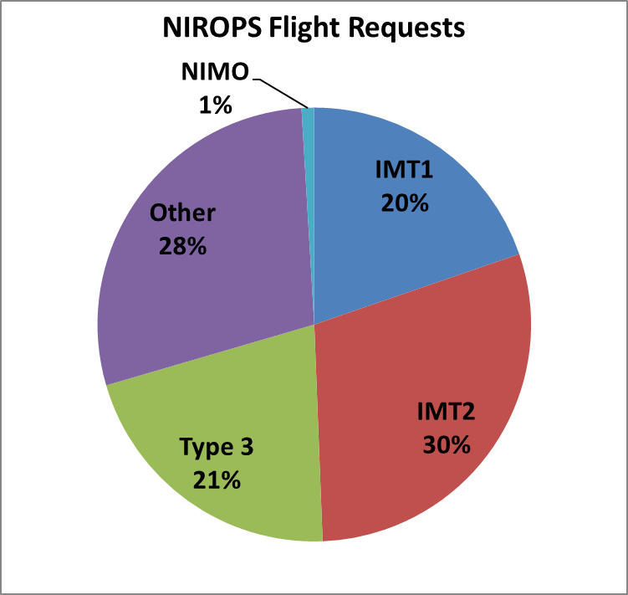
Who is Requesting?
Prioritization is key
Notes:
2021 – IMT1 26%, IMT2 37%, IMT3 22%, Other 14%
2020 – IMT1 31%, IMT2 38%, IMT3 21%, Other 10%
2019 – IMT1 18%, IMT2 33%, IMT3 36%, Other 12%, NIMO 1%
2018 – IMT1 29%, IMT2 35%, IMT3 22%, Other 12%, NIMO 2%

Slide 12
Prioritization of Fires for IR
Type of team assigned – Type 1, 2, 3, etc.
Values at risk, WUI, evacuations
Priority listings in National IMSR
GACC priority listings
Geographic location and grouping of fires
Activity during the day
  Satellite fire detections – MODIS, VIIRS
  Plume activity – visible satellite
Consultation with NICC
Heat detected from previous NIROPS flights
Expected weather over incident
Feedback from IRINs

Slide 13
Extended Support to Incidents
Moose (ID) – 69 flights
Hermits Peak (NM) – 67 flights
Cedar Creek (OR) – 67 flights
Mosquito (CA) – 46 flights
Ross Fork (ID) – 43 flights
Wolf Fang (ID) – 41 flights
Woodtick (ID) – 41 flights
Diamond Watch (ID) – 39 flights
Four Corners (ID) – 38 flights
SRF Lightning Cx (CA) – 37 flights

Slide 14
It Takes a Team!
IR Techs - 9 person FS, 10 Tenax
Pilots – 3 FS fulltime, 7 Tenax
27 different IRINs, 3 trainees got assignments
Vendors
  Exclusive Use – Tenax
  End Product – Courtney, Kolob, Hood Tech, Owyhee, Aspen Helo
Virtual National IR desk activated ABQ and SLC
Aircraft 3 (Firehawk) - AC3 liaison at GTAC and NGA and USGS analysts
R4 Aviation maintenance crew
Fire Imaging Program Manager key for interacting with vendors and briefing GACCs and IMTs on IR options
Notes:
Pilots - Dan Johnson (retired 7/26 after 23 years), Don Boyce, Carl Helquist, Jeff Watts
Techs - Kaz Kazimir, Michael Mann, Jill Keunzi, Rob Navarro, Josh Bayok, Mark Rhodes, Brian Monroe, Ed Guzman, Bart Littlefield
Will Royer AC3 liaison, Jan Johnson fill in on IR desk and AC3
AC3 analysts - Fire Imaging Program Manager – Zach Holder

Slide 15
Takeaways from 2022
Vendor support essential esp. with only one FS plane
Aircraft 3 essential for AK support and early season support
Plane is getting older every year!
  149Z – 38 years old (1985)
  2 new King Air 260s (181Z and 115Z), should be operational for 2023
Coordination with other IR resources is key
  IAA (Incident Assessment and Awareness) Portal
  Doesn’t necessarily reduce NIROPS requests
Notes:
IAA portal requests can be tasked to AA51, CO MMA, DRTI, other vendors

Slide 16
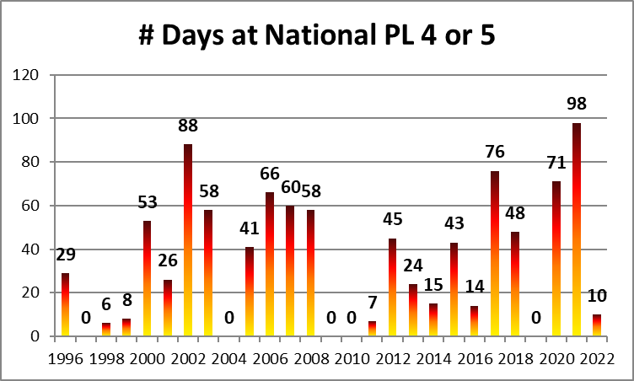
Next Year?......
Notes:
La Nina winter – drier and warmer across the southern US, cooler and wetter in the northern US

Slide 17
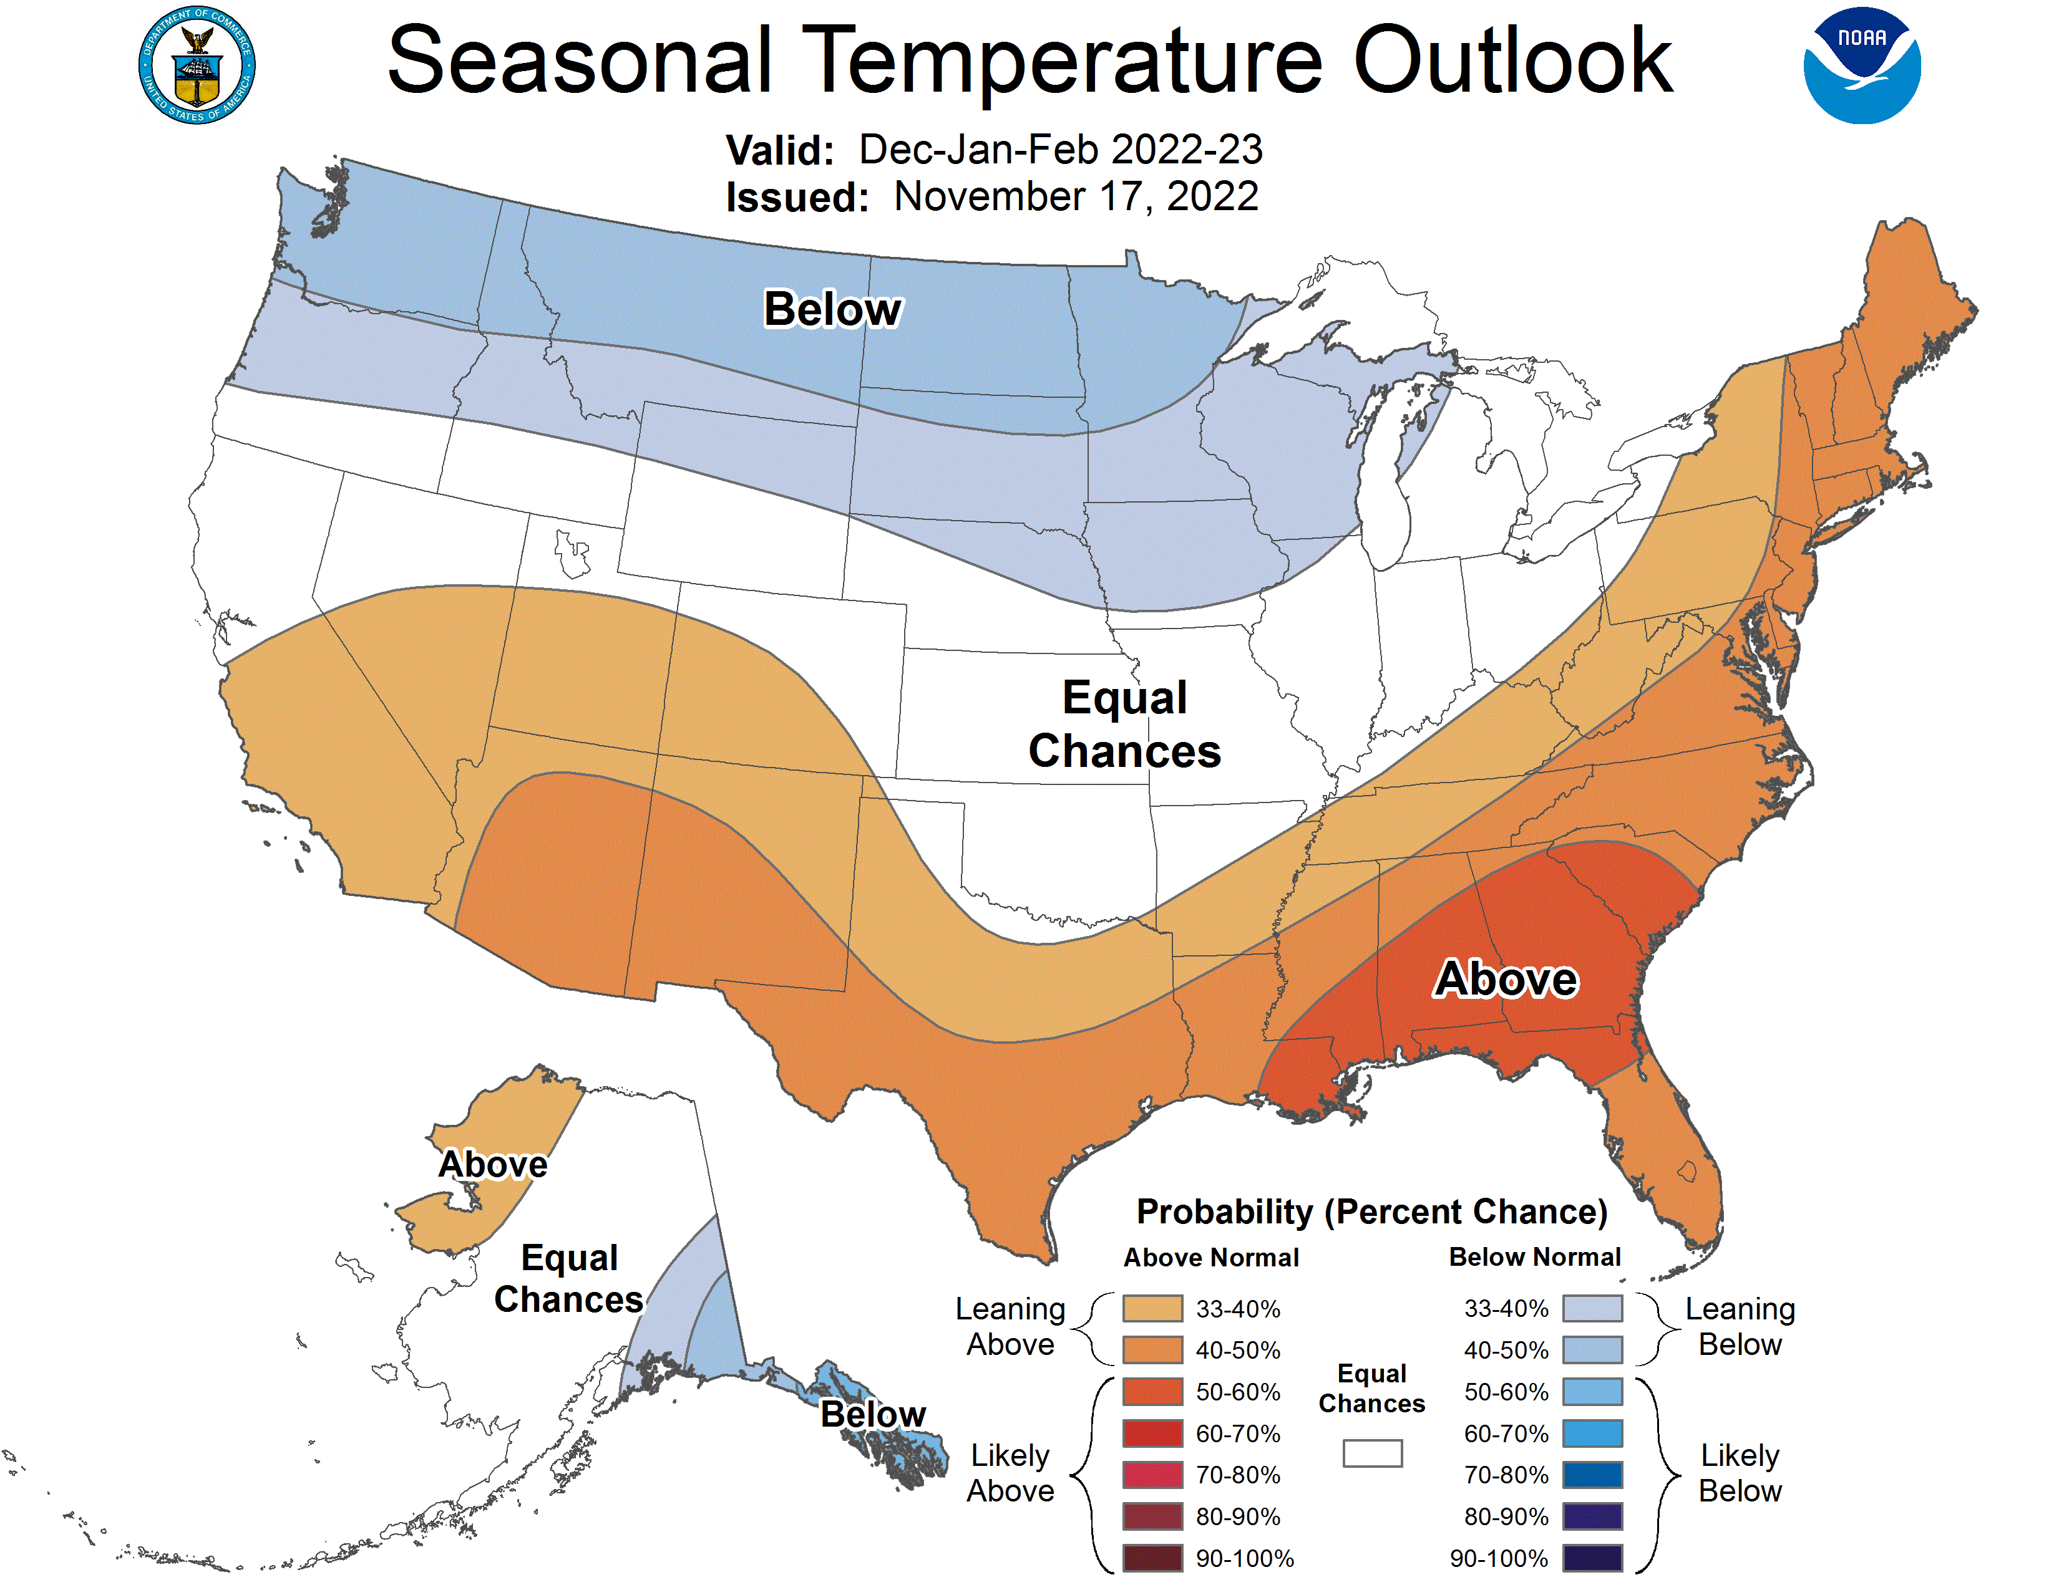
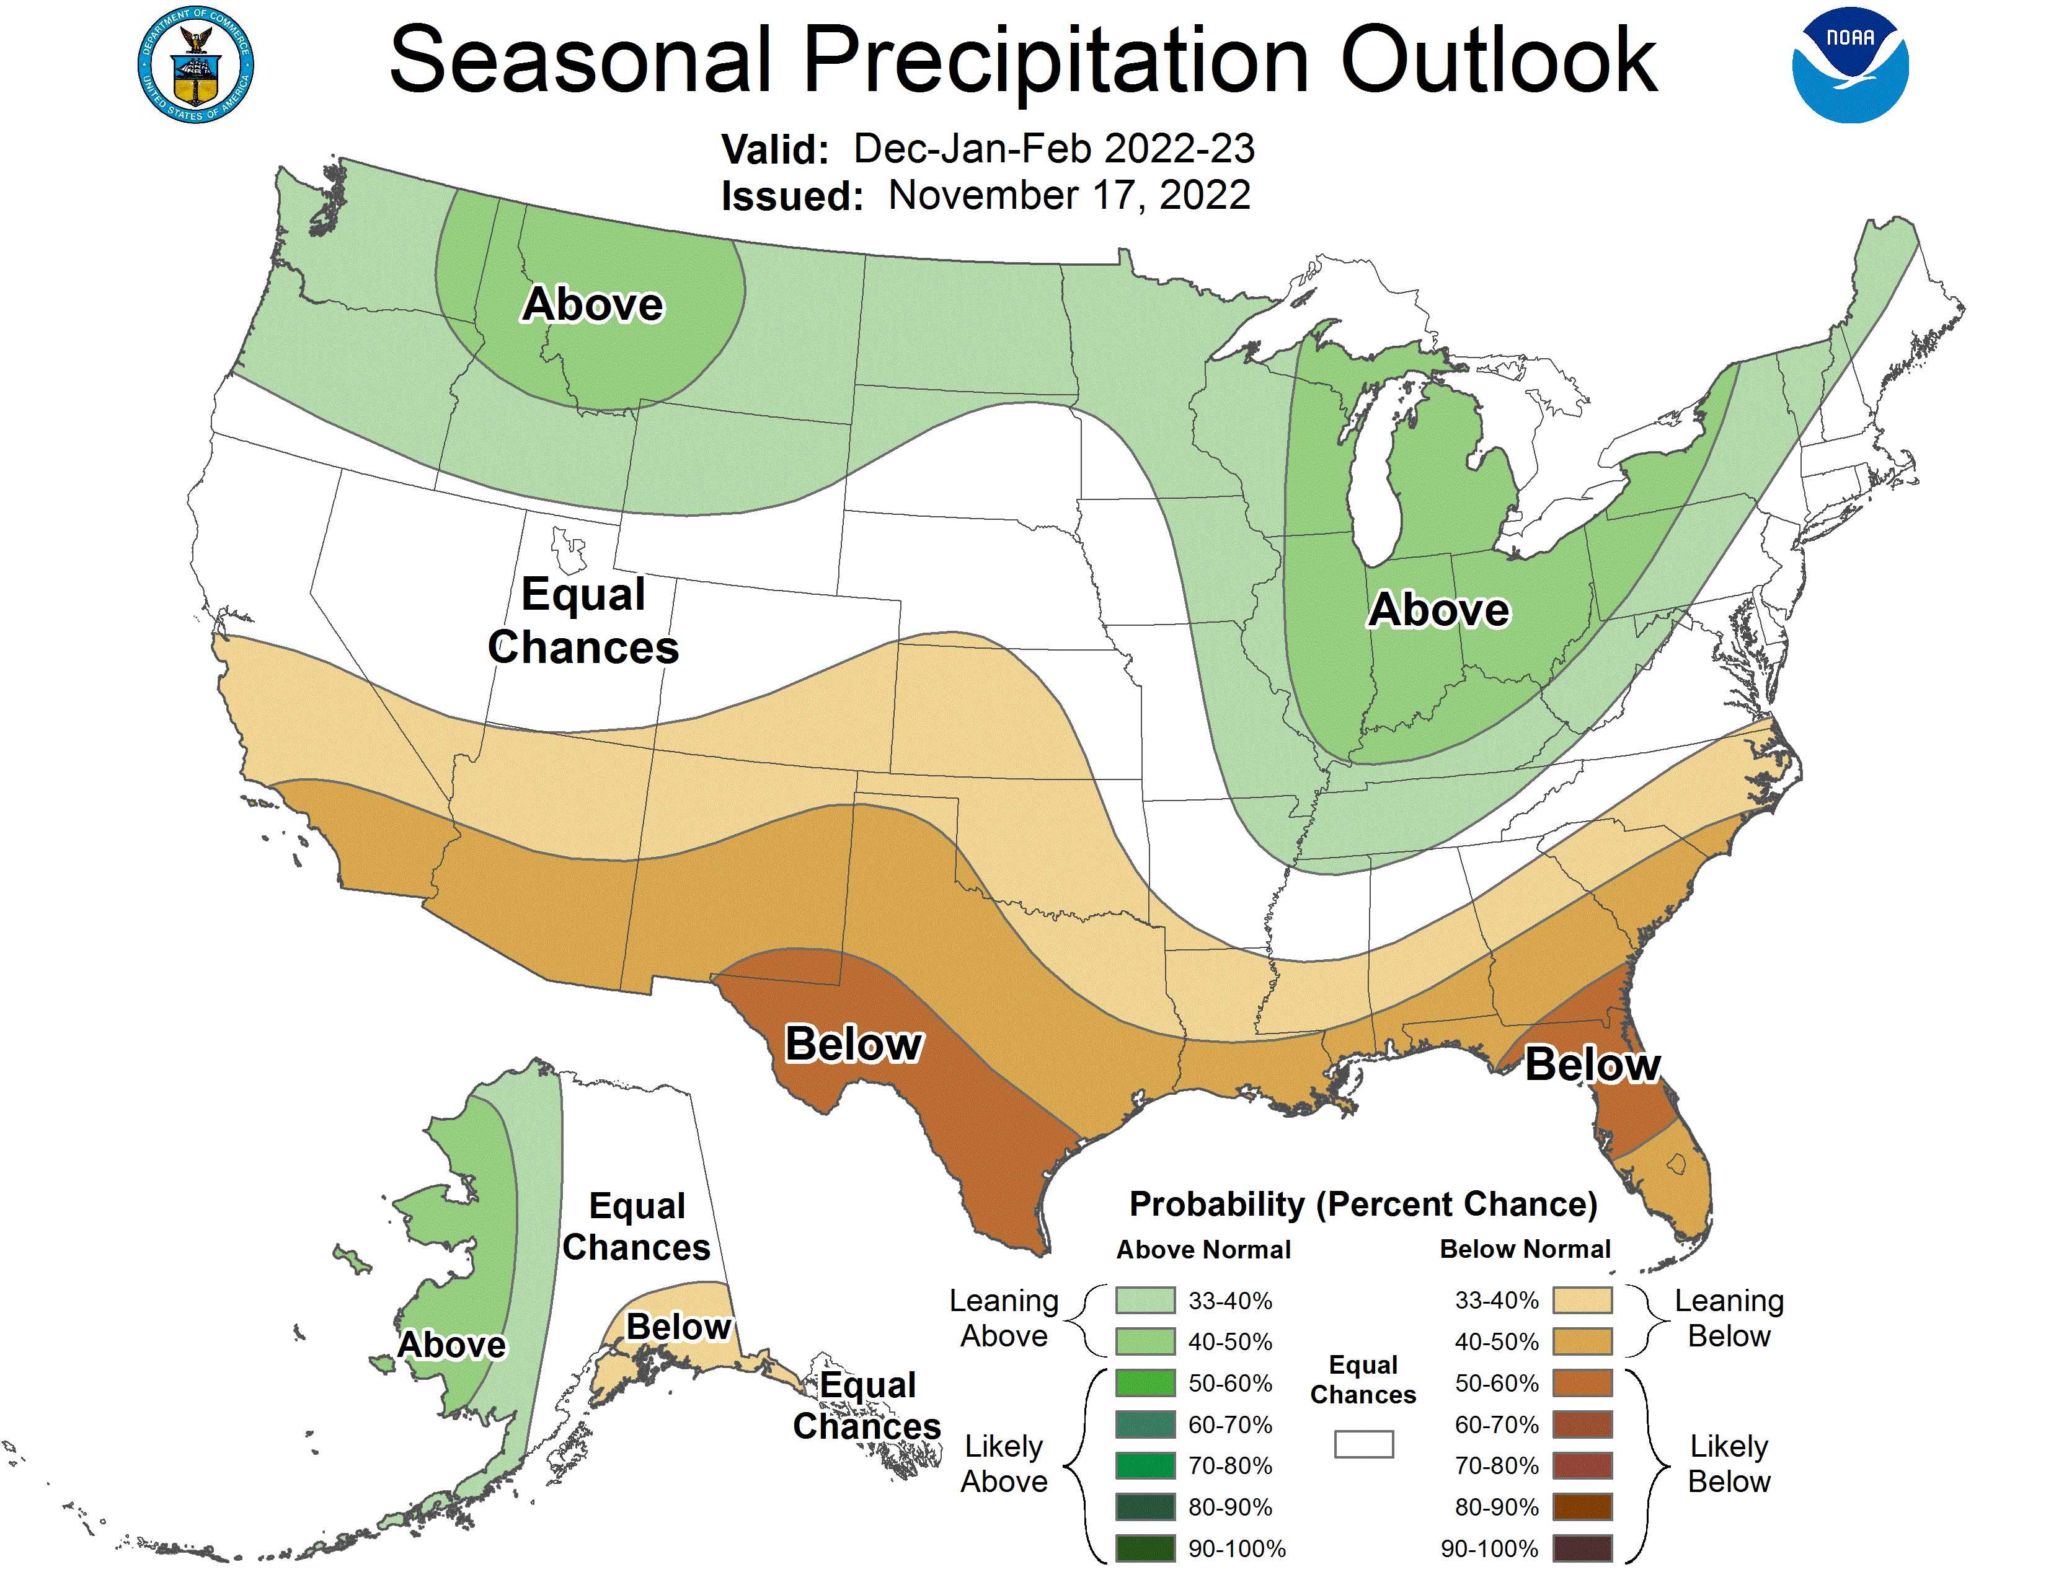
Triple-dip La Nina
Notes:
76% chance of La Nina Dec-Feb
La Nina winter – drier and warmer across the southern US, cooler and wetter in the northern US

Slide 18
Looking ahead to 2022
Two new FS King Air 260 planes
Full implementation of Phoenix NextGen
  Reduced footprint, improved processing
  Cryocoolers, no more liquid N!
FS owned TK-9 Overwatch sensor
Inmarsat quad channel datalink

