Slide 1
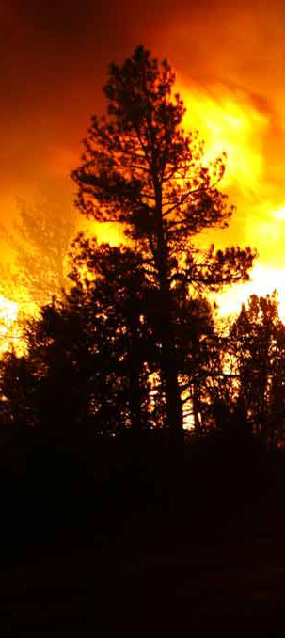
Phoenix System
Maintenance & Development
Michael Mann
Electrical Engineer, USDA FS
December 13, 2022
NIROPS Closeout, NIFC, Boise

Slide 2
Phoenix Operators
Thank You!
Kelli Gammons
Jill Kuenzi
Brian Teats
Rob Navarro
Ed Guzman
Mark Rhodes
Josh Bayok
Bart Littlefield

Slide 3
Season Overview
Complete Phoenix NexGen System
Successful integration of Phoenix NexGen and AMS Systems into new airplanes
Started Construction Optical Calibration Lab

Slide 5
Phoenix NexGen
Extended operational life
Improved system versatility and usage
Miniaturized and modern digital electronics
Repeatable/streamlined calibration
Standardized across aircrafts
Improved System Performance
Enhanced orthorectification
Improved image collection/resolution
Expected fire season 2023

Slide 6
Phoenix NexGen
New Motor and Controller
Ekinox INS/GNSS
Single Board Computer
Cryocoolers
Inmarsat Satellite Communications
New ADC/DSP
64-bit Operating system
New Pre-Amp and Signal conditioning
New Mirrors
New Application Software

Slide 7
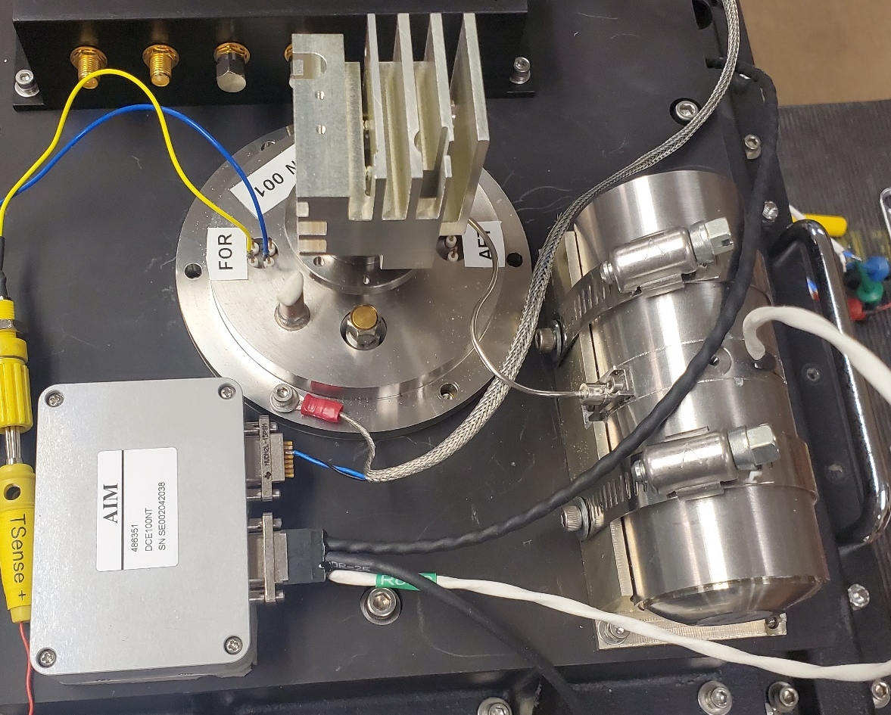
Cryocooler
Replace liquid LN2 cooling system.
Reduce height of scanner
Reduced RFI/EMI by 75%
Integrated Cold Shield
Cryocooler assembly. Compressor (right), Dewar and detectors (middle) and controller (left).

Slide 8
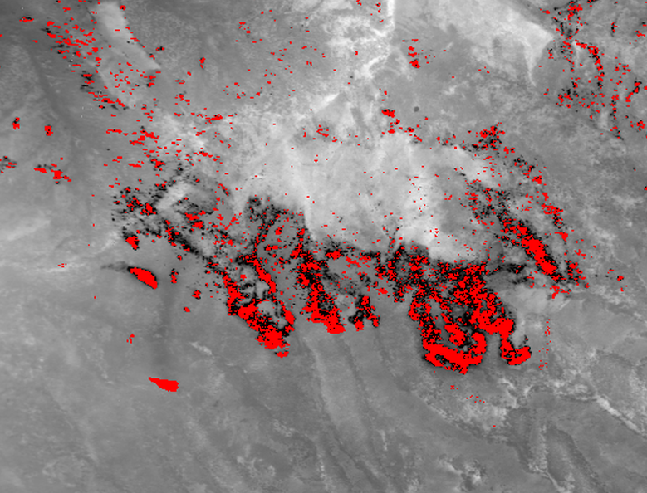
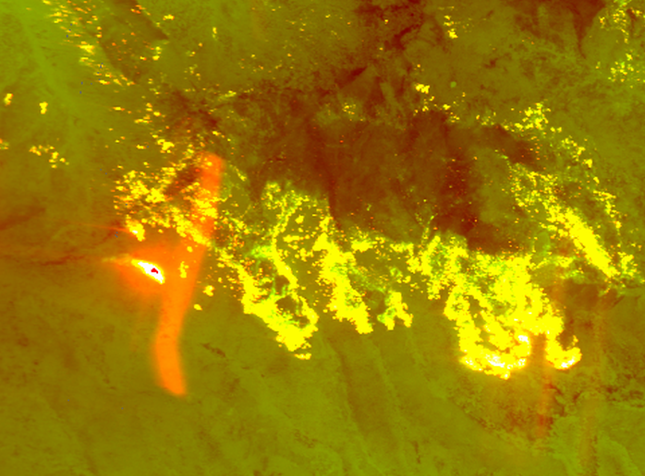
Cryocooler - Cool Shield
False trips off ghosting stray light path
Ghosting artifacts shown in raw color image
Decker Fire 2019 Ortho image
Decker Fire 2019 color image

Slide 9
Satellite Communications
Inmarsat’s quad channel network
Speeds of up to 2000 Kbps
(Previous speeds were 30 Kbps)
Necessary precursor to remote operation and automation.

Slide 10
Enhanced Orthorectification
Triggerable steady timing sync pulse
Stable scanline width with no horizontal line zig zag
Independently shrink or stretch scan lines left and right off nadir
Orthorectified image with noticeable zigzag

Slide 11
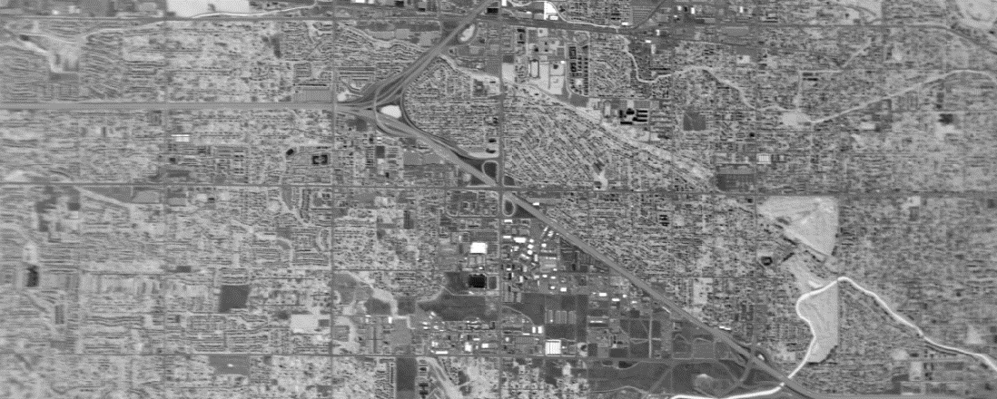
Enhanced Orthorectification
Orthorectified Image demonstrating an independently stretchable scanline
3D Model showing the optical path of the left and right of a scan line

Slide 12
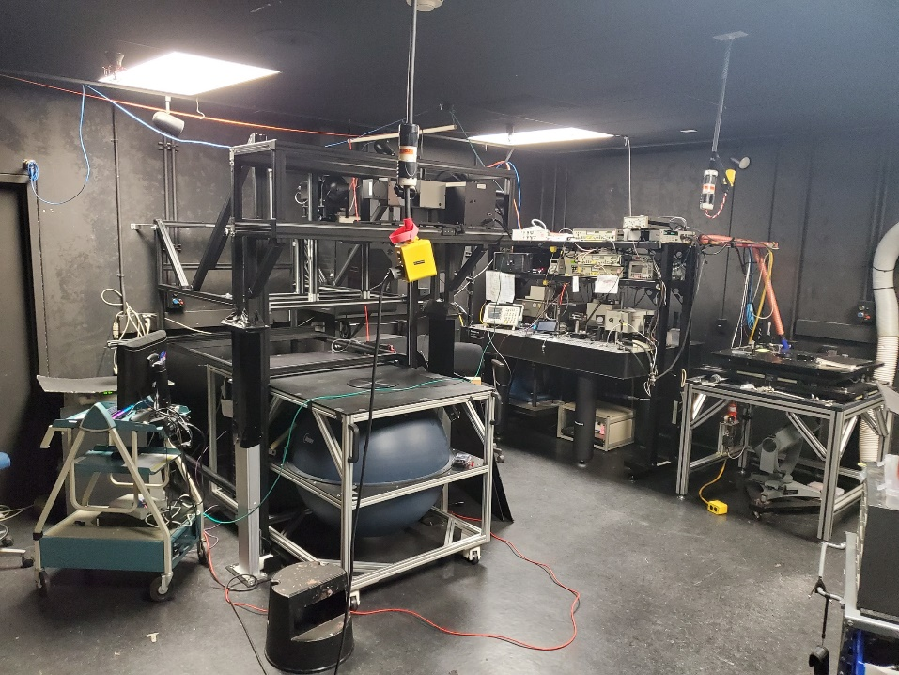
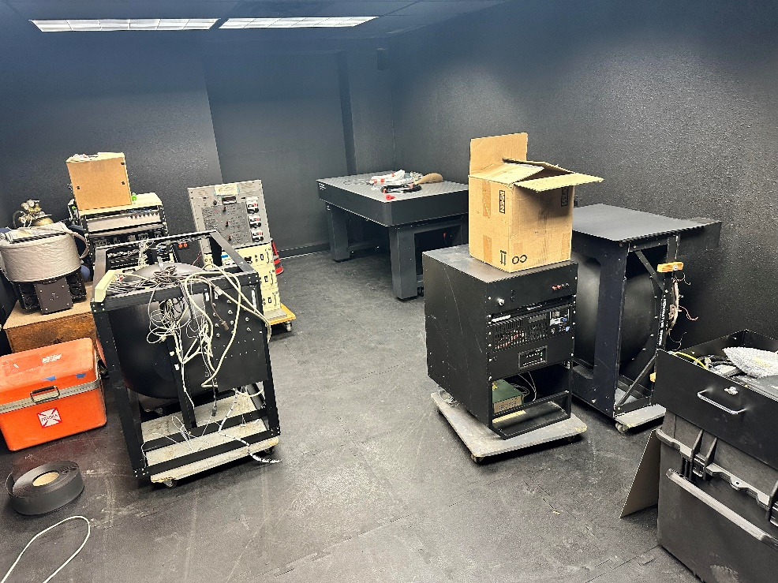
Optical Calibration Lab
Optical Calibration Lab, NASA AMS, Mountain View, CA
Optical Calibration Lab, NIFC Boise, ID

Slide 13
The End Thank You

