Slide 1

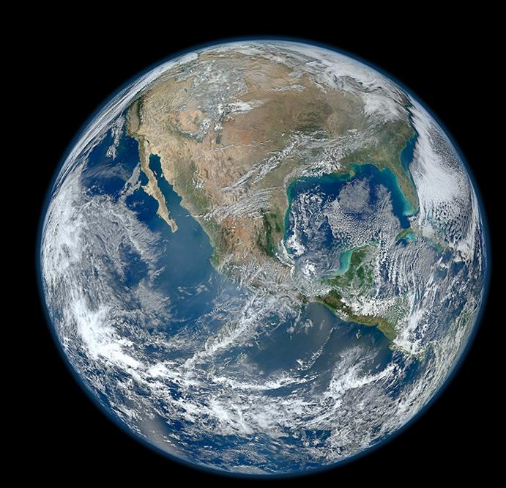
Civil Applications Committee Overview
Paul M. Young
Director, National Civil Applications Center
November 2019
U.S. Department of the Interior
U.S. Geological Survey

Slide 2
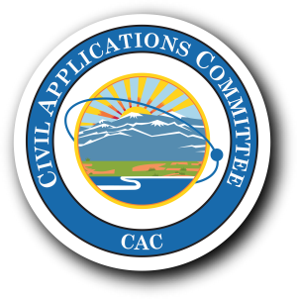
Civil Applications Committee
  Civil Applications Committee (CAC)
  Facilitates and oversees Federal civil agency access to and use of military and Intelligence remote sensing data and technology for domestic use
  Established by President Gerald Ford in 1975
    Charter signed by Director of National Intelligence and Secretary of the Interior
    USGS Director is CAC chair and provides Secretariat and image acquisition and analysis staff via the National Civil Applications Center.
  Engages with military and Intelligence Community governance structures via the National System for Geospatial Intelligence.
Notes:
Federal Civil agencies have access to:
Intelligence Community (IC) and Department of Defense (DoD) remote sensing data and capabilities, aka U.S. National Imagery Systems (since late 1960’s) and
National Geospatial-Intelligence Agency (NGA) procured high resolution, unclassified satellite images (since 2010)
Federal Civil agencies use these images to:
Support public safety and disaster response
Contribute to land, water, and resource management
Increase scientific knowledge about the Earth’s surface and processes
Access to the images:
Maximizes tax payer investment: sunk cost well spent
Efficiencies of scale with Federal government-wide procurement: for the tax payer - best price per pixel
Civil Applications Committee
Provides oversight and facilitation of civil agency use of IC and DoD remote sensing data and capabilities
Enables Federal agency use of IC and DOD remote sensing data, tools, applications, and other capabilities

Slide 3

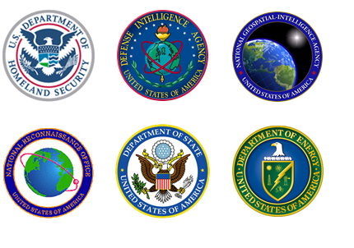




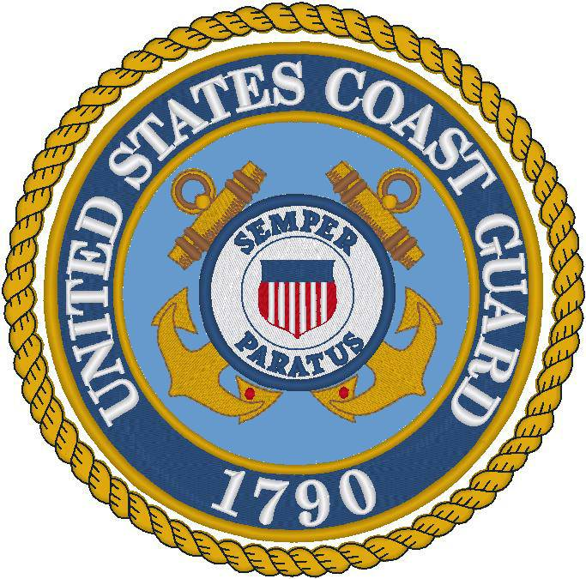
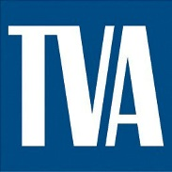
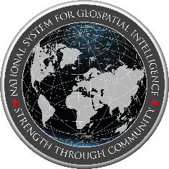

Civil Applications Committee Members
3

Slide 4
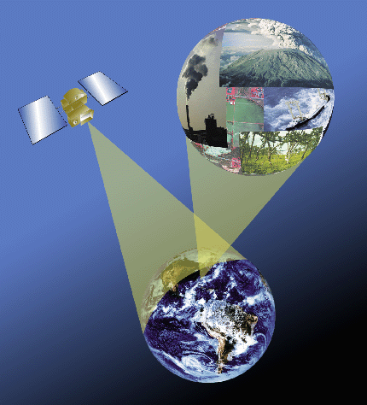
Use of the Data
  When using remote sensing data from the military and Intelligence Community:
  Must follow applicable laws and regulations protecting personal rights, personal privacy, and civil liberties
  Must be Federal Civil agency and within its statutory mission
  Proper Use Memoranda are required in limited circumstances; most agencies will maintain Civil Domestic Tasking Memoranda to oversee efforts/legal authorities
  Data generally not admissible in court
  Commercial data use and publications must follow license stipulations
4

Slide 5
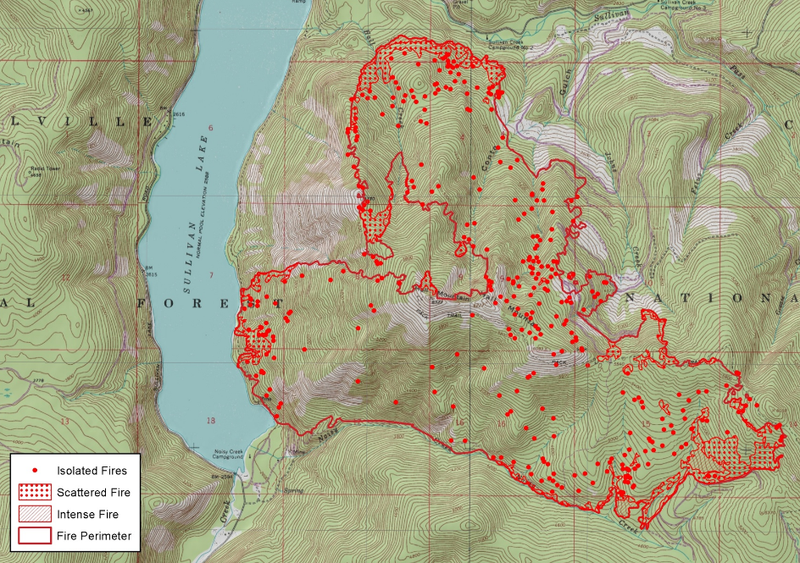
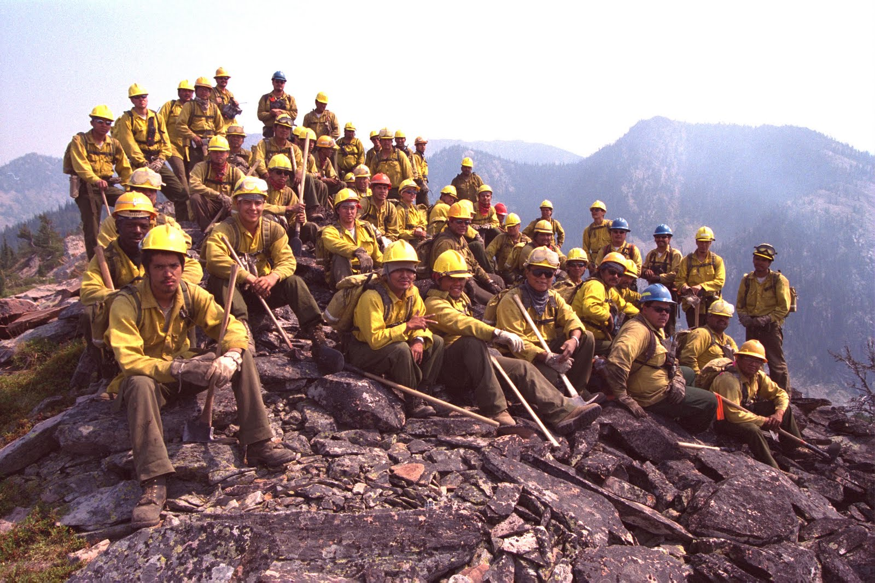
Firefighter & Public Safety
Detection: timely reporting of wildland fires
Response: fire perimeter map (right) used by the National Interagency Fire Center for incident command, daily planning, and dispatch
Restoration: remote sensing used for restoration efforts
March 2000
Noisy Creek Wildfire, Colville National Forest, WA, Aug. 8, 2017
Nov 2012

Slide 6
Wildland Fire
CAC Working Groups:
Historical Imagery Availability
Global Fiducials
Environmental Security
Thermal
Thermal Working Group
Works at the intersection of civil, military, and Intelligence communities to support wildland fire and other activities
CAC provides oversight of:
Hawkeye, Firefly (FireGuard), and Firehawk (Aircraft 3)
Access to unclassified, commercial data procured by DOD agencies
March 2000
Nov 2012
Digital Globe Proprietary. ©Digital Globe. All rights reserved

Slide 7
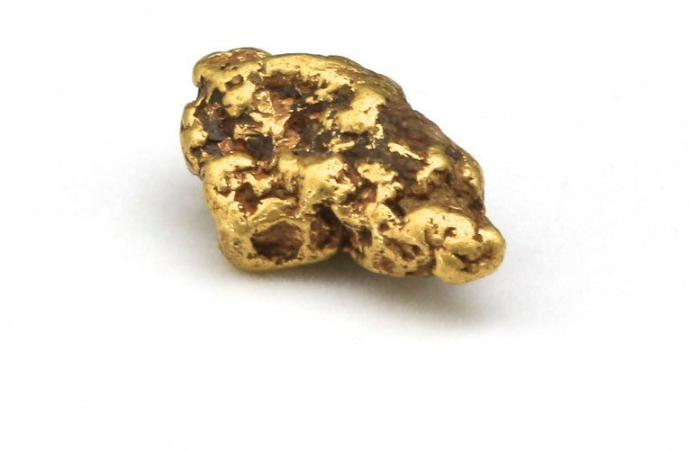
A Closing Thought
March 2000
Thank You Phil Mead for your outstanding service to the civil community as the TWG’s Business Operations Manager!
Nov 2012

Slide 8


Questions?
Contact:
Paul M. Young
Director, National Civil
Applications Center
pyoung@usgs.gov
703-648-5115

