Slide 1

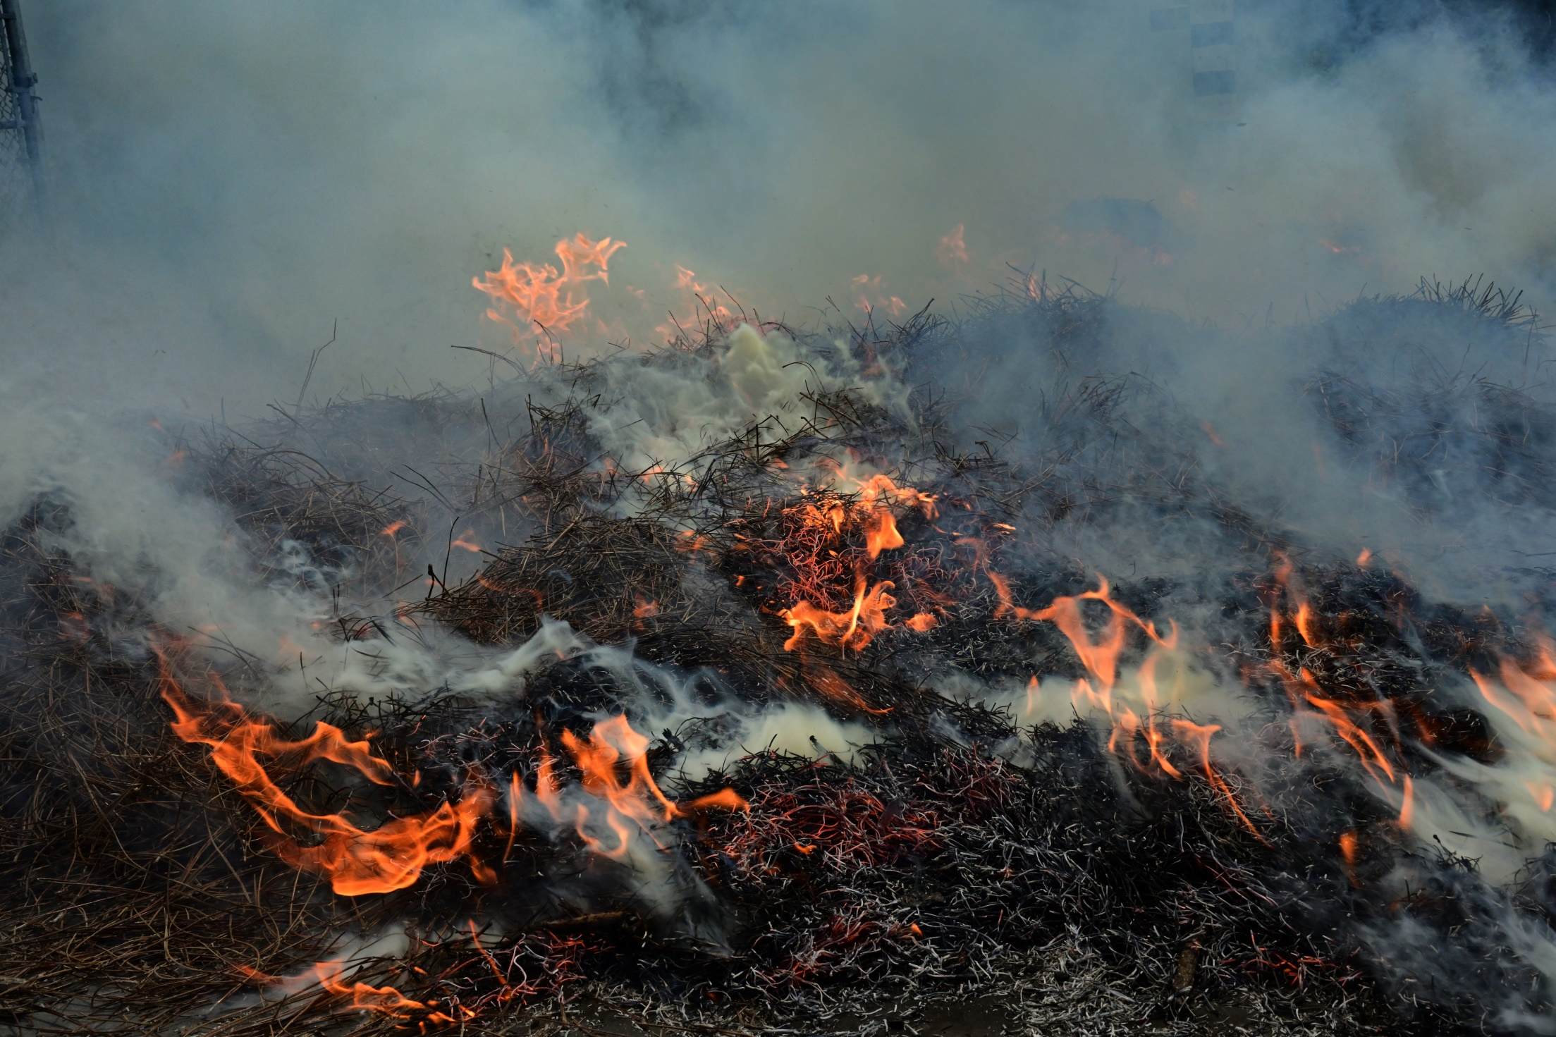
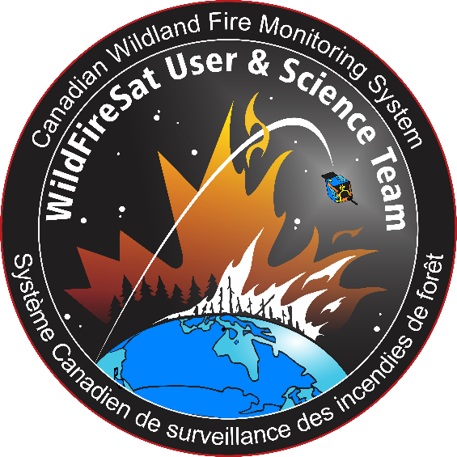
WildFireSat
Dr. Joshua M. Johnston
WildFireSat Principle Investigator,
Forest Fire Research Scientist
Natural Resources Canada
Canadian Forest Service

Slide 2
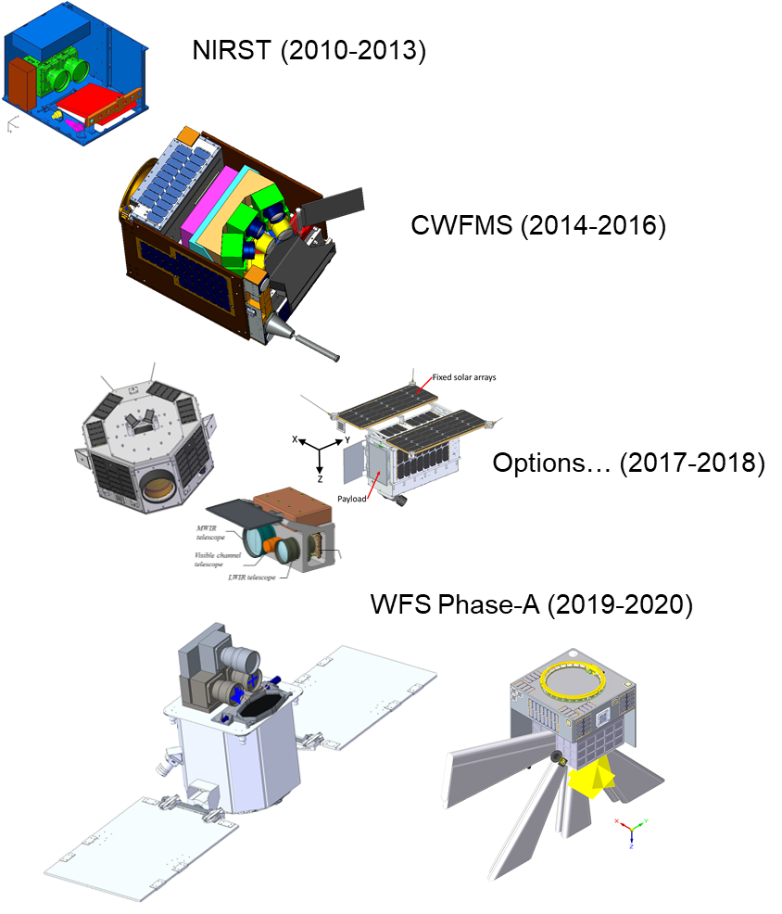
5
WildFireSat Origins
Unique Canadian sensor technology has enabled small-scale wildfire monitoring satellite systems
  CFS involvement dates back to 2010
WFS project began in 2018 to develop an operational wildfire and smoke monitoring system
  Wildfire and Emergency management in Canada
  Air quality monitoring and forecasting, and
  Carbon accounting
WFS is a significant economic stimulus
  CSA projects WFS will create > 250 Canadian jobs over the next 10 years
  Technologies already causing spinoff industrial work (e.g. INO-UAV work)
  Globally, since the announcement of WFS there has been a spike in commercial wildfire earth observation proposals
Notes:
Inevitability of more frequent disasters

Slide 3
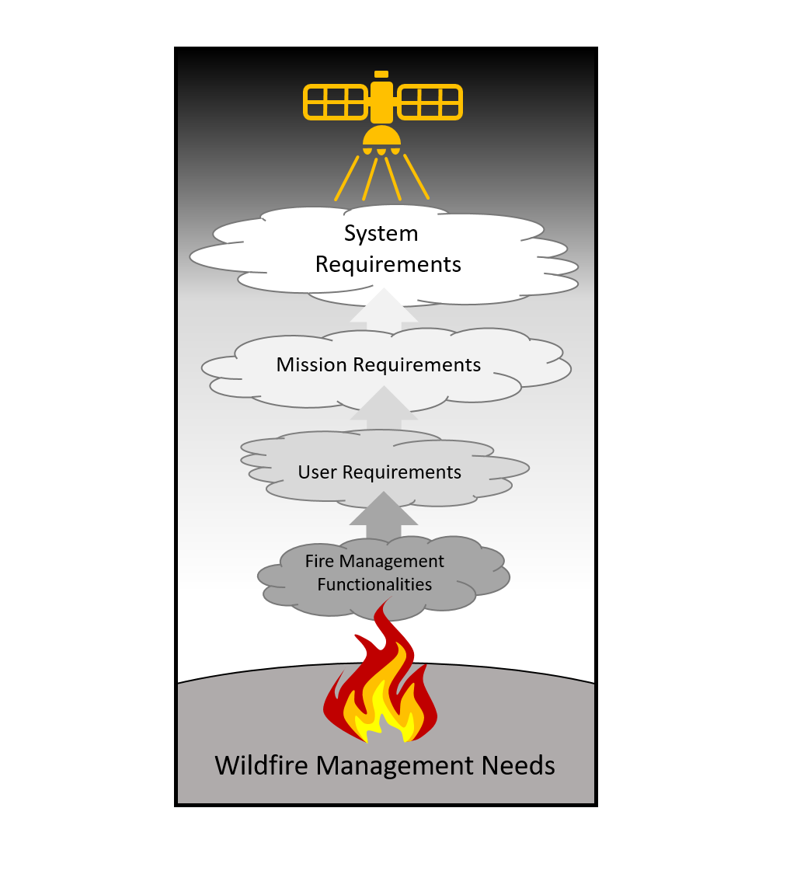
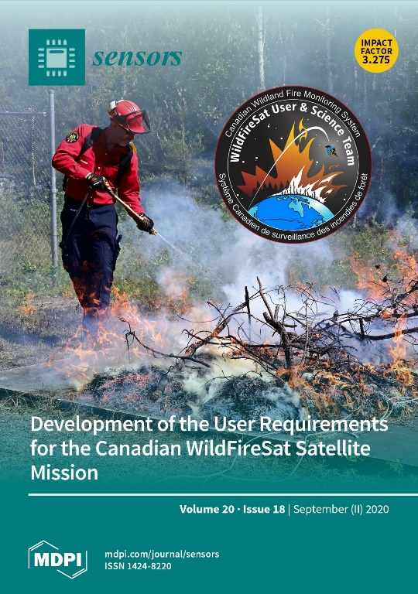
WildFireSat
“Initial Operational Capability”
Key Features:
VIS/NIR (200 m)
MWIR/LWIR (400 m);
Daily peak burn overpass;
FRP optimised;
Detection capacity at 15 x 15 m fire;
  *open canopy (Johnston et al, 2018)
30 min data latency.
Fire Monitoring Capability:
Near-real-time data delivery;
Early detection (remote access fires);
Active perimeter mapping and progression;
Perimeter mapping of ROS (m min⁻¹) when combined with VIIRS (Johnston, 2016);
Perimeter mapping of FI (kW m⁻¹), (Johnston et al, 2017);
Mapping of Fuel Consumption (kg m⁻²);
Near-real-time measurements of carbon emissions and smoke plume dynamics.
(Johnston et al, 2020)

Slide 4
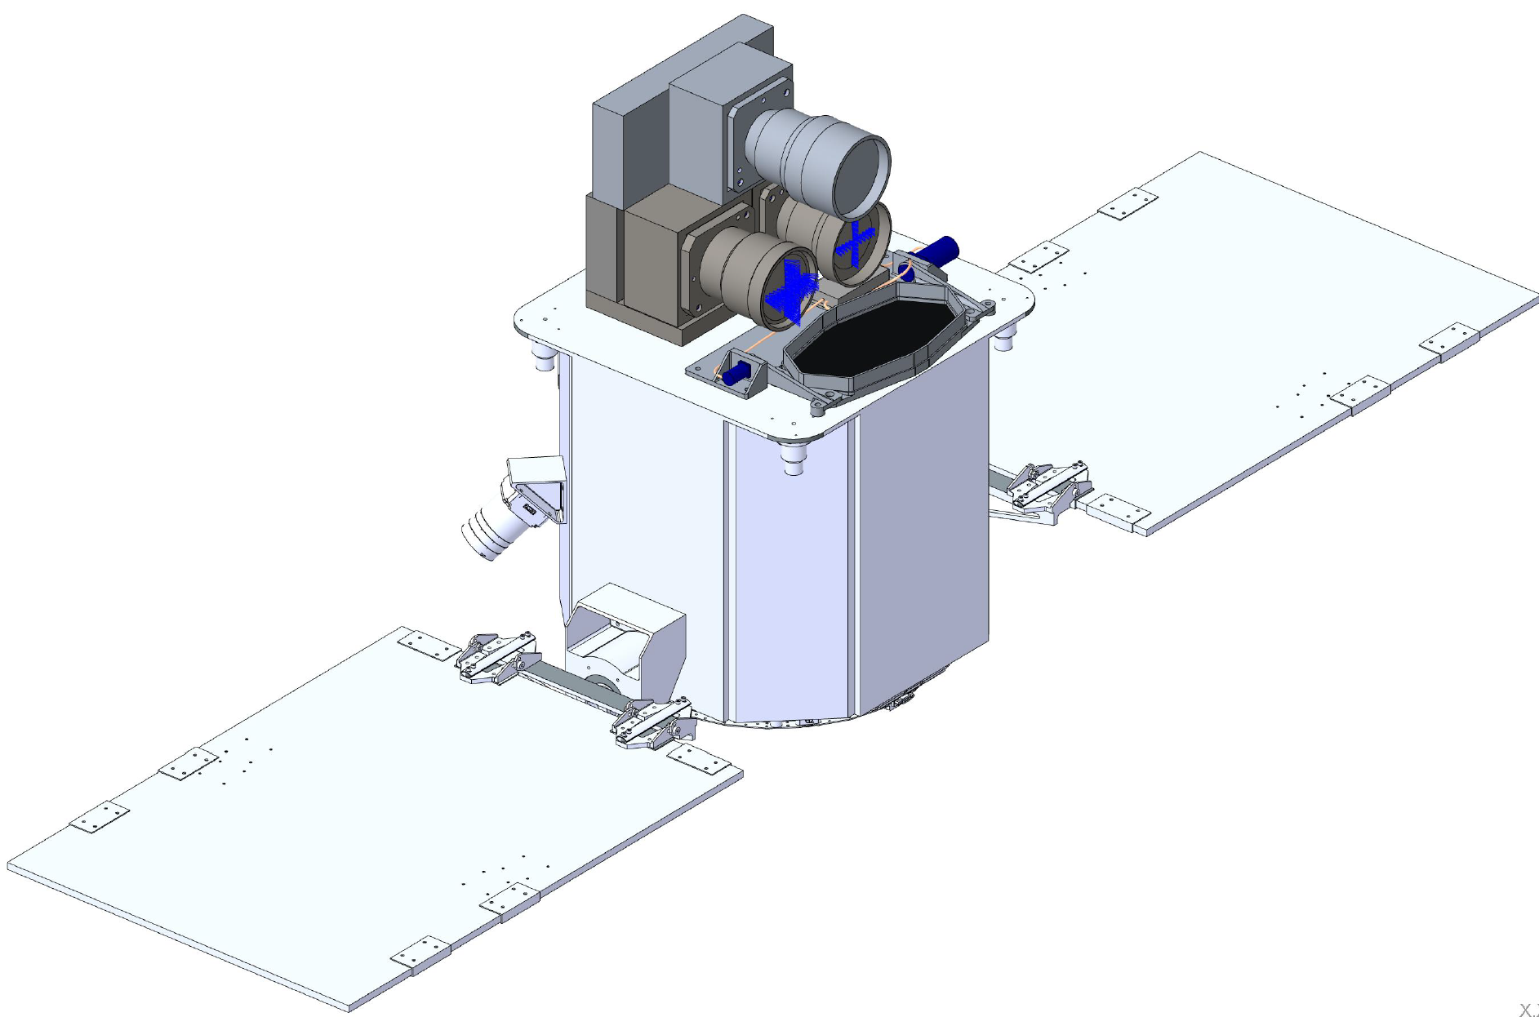
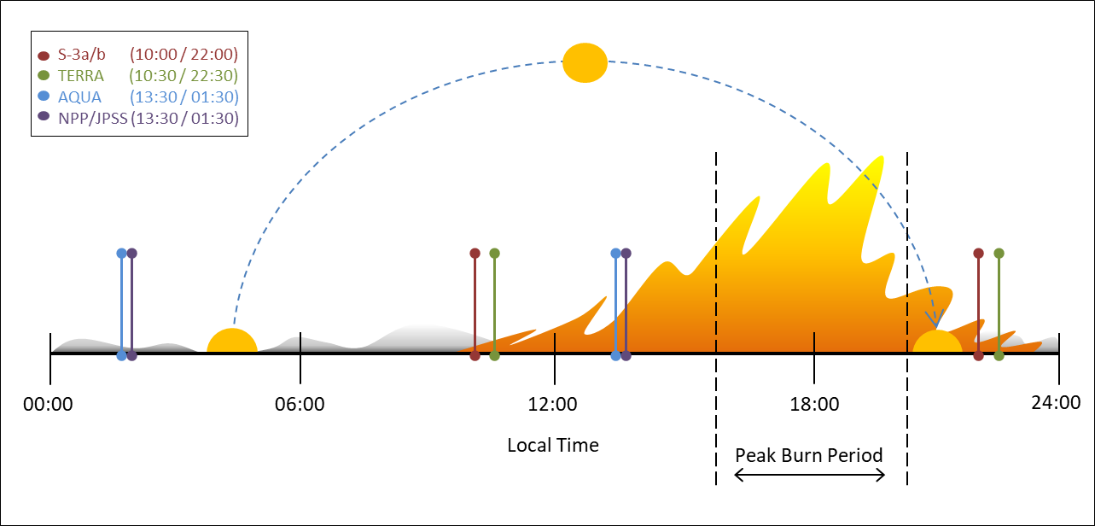
WildFireSat
“Initial Operational Capability”
Key Features:
VIS/NIR (200 m)
MWIR/LWIR (400 m);
Daily peak burn overpass;
FRP optimised;
Detection capacity at 15 x 15 m fire;
  *open canopy (Johnston et al, 2018)
30 min data latency.
Fire Monitoring Capability:
Near-real-time data delivery;
Early detection (remote access fires);
Active perimeter mapping and progression;
Perimeter mapping of ROS (m min⁻¹) when combined with VIIRS (Johnston, 2016);
Perimeter mapping of FI (kW m⁻¹), (Johnston et al, 2017);
Mapping of Fuel Consumption (kg m⁻²);
Near-real-time measurements of carbon emissions and smoke plume dynamics.
(Johnston et al, 2020)

Slide 5
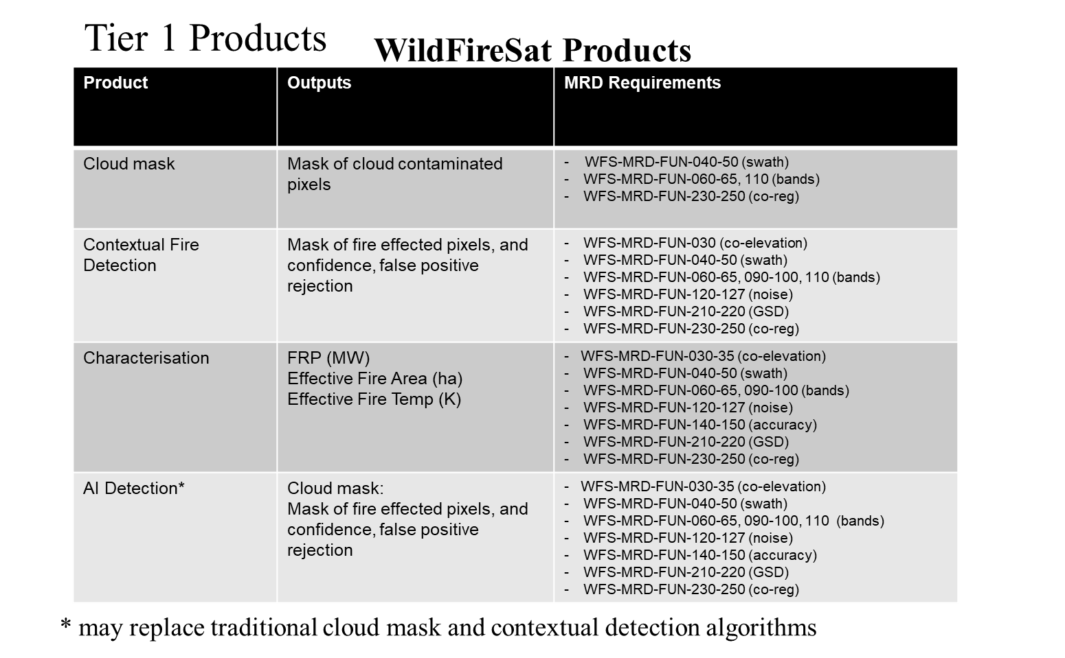

Slide 6
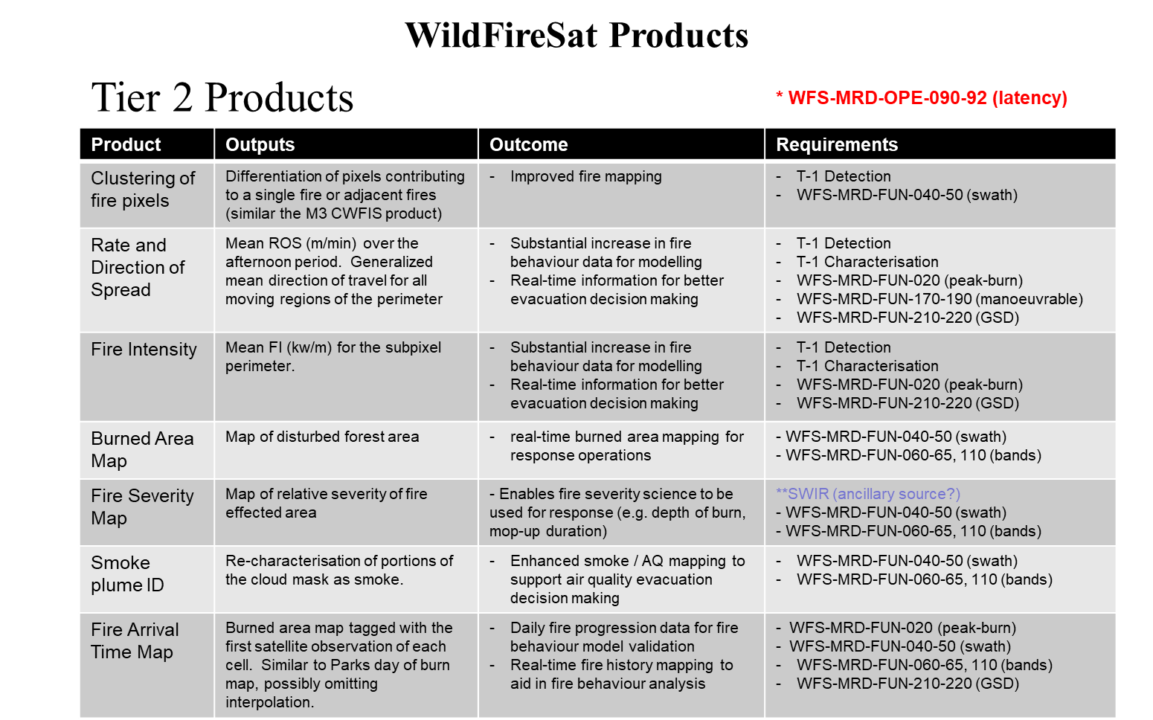
*NIR-MWIR Severity?

Slide 7
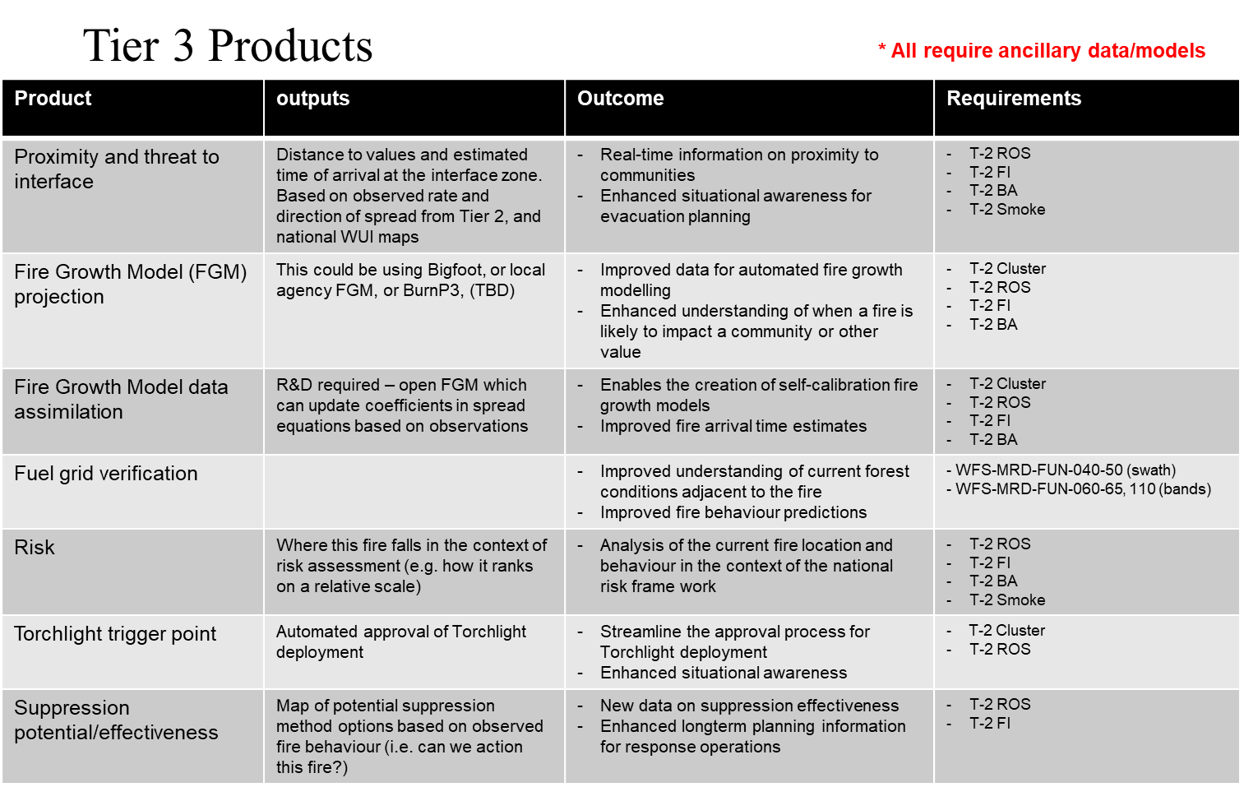

Slide 8
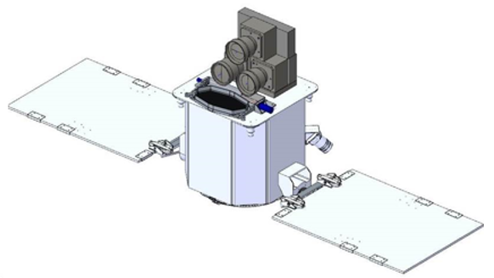
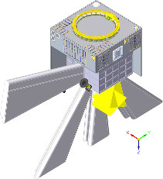
Outcome of Phase-A
Two industrial contractors gave two different design concepts:
Each system can be used to scan global landmass (instead of only the Canadian landmass) at small delta cost (~$0-3M)
Honeywell: 2-satellite system | MDA: 1-satellite system

Slide 9
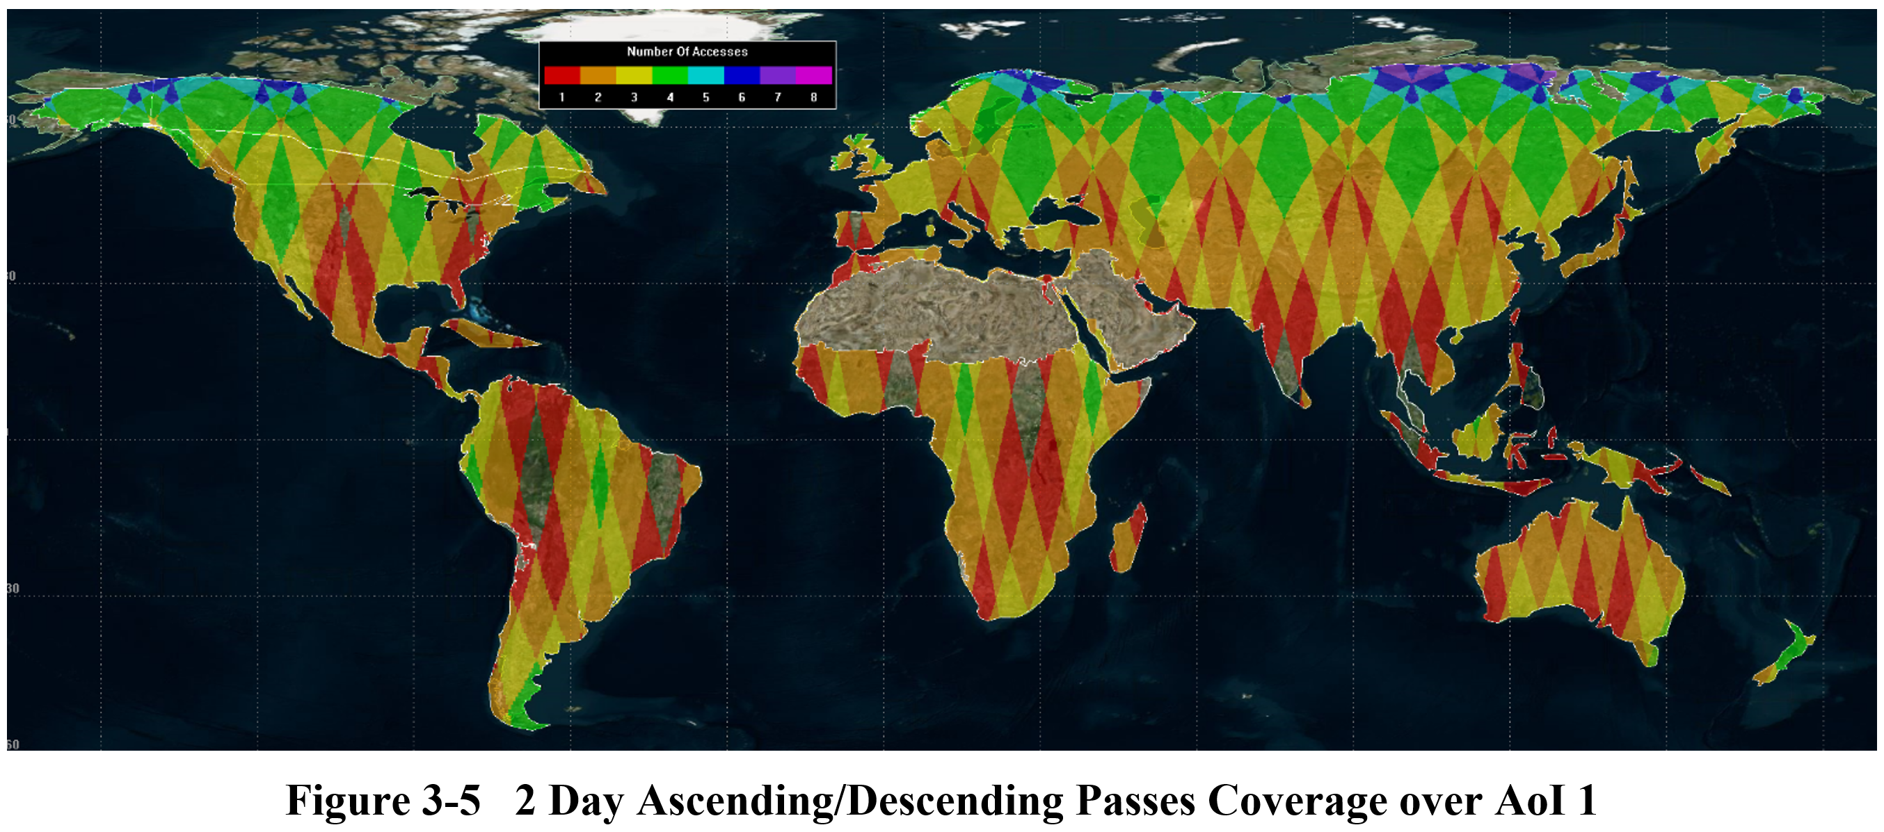
Coverage

Slide 10
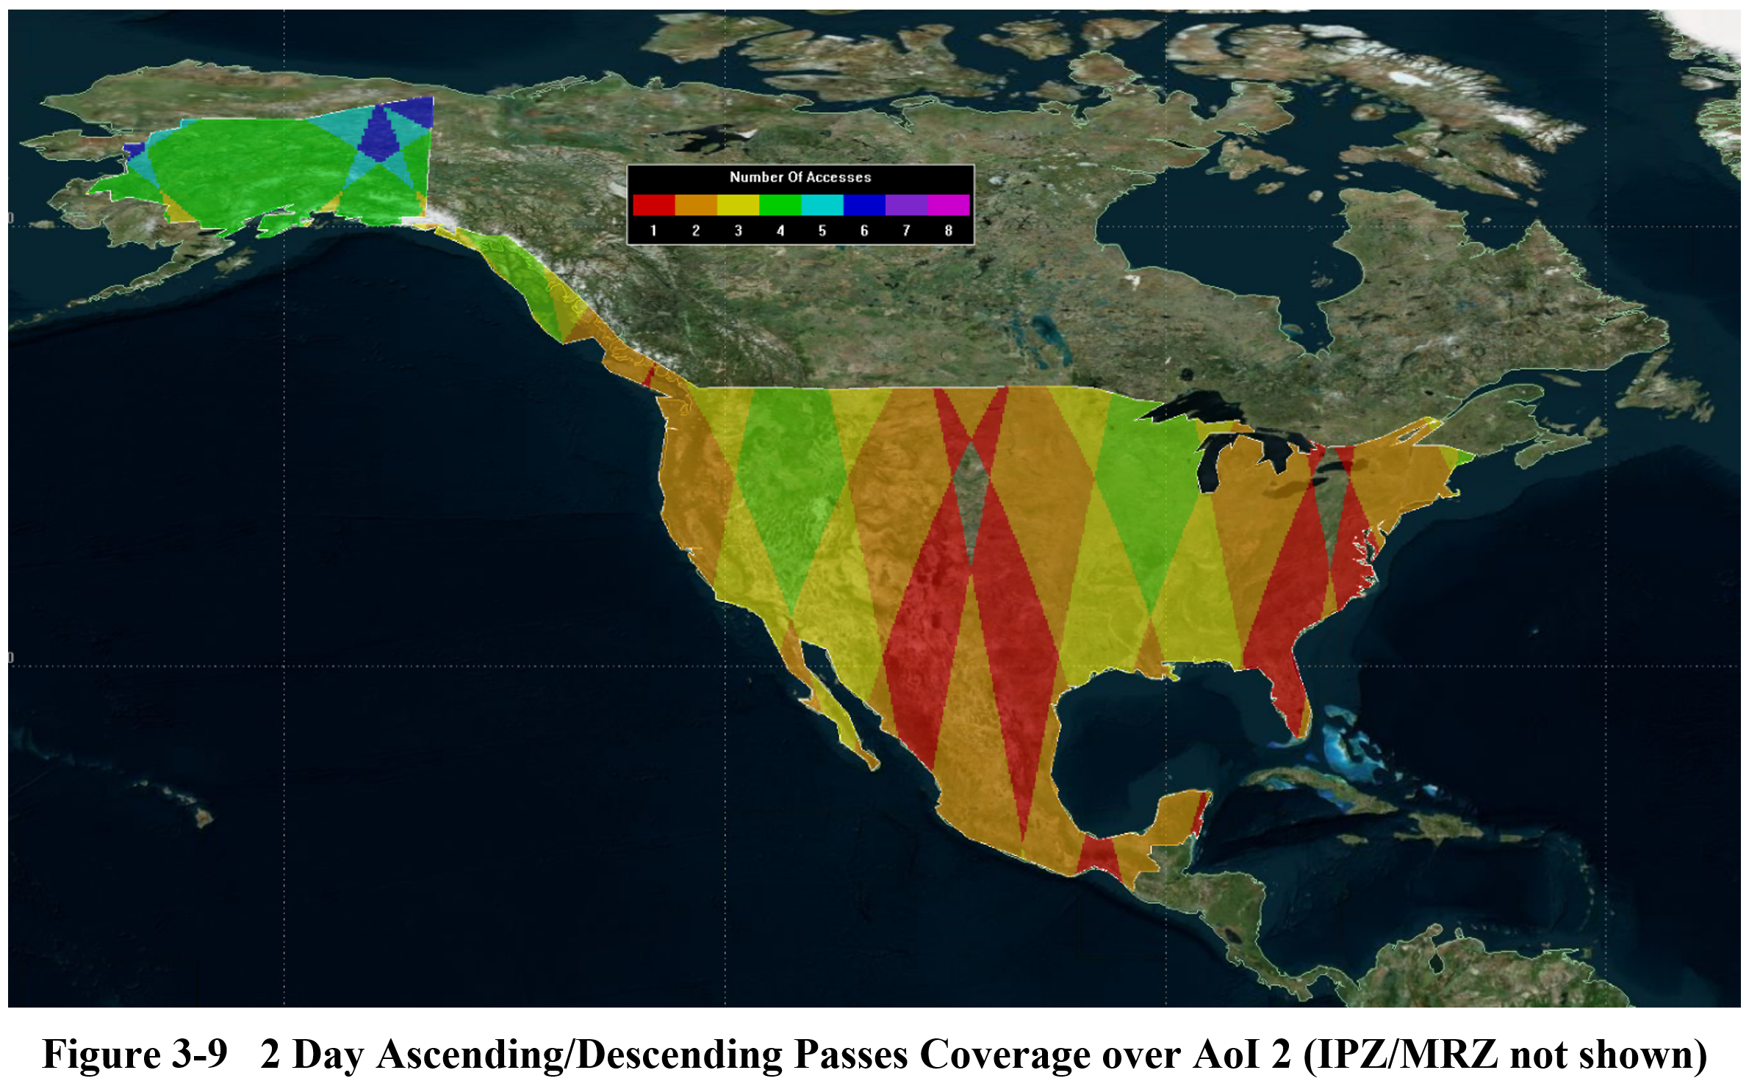
Coverage

Slide 11
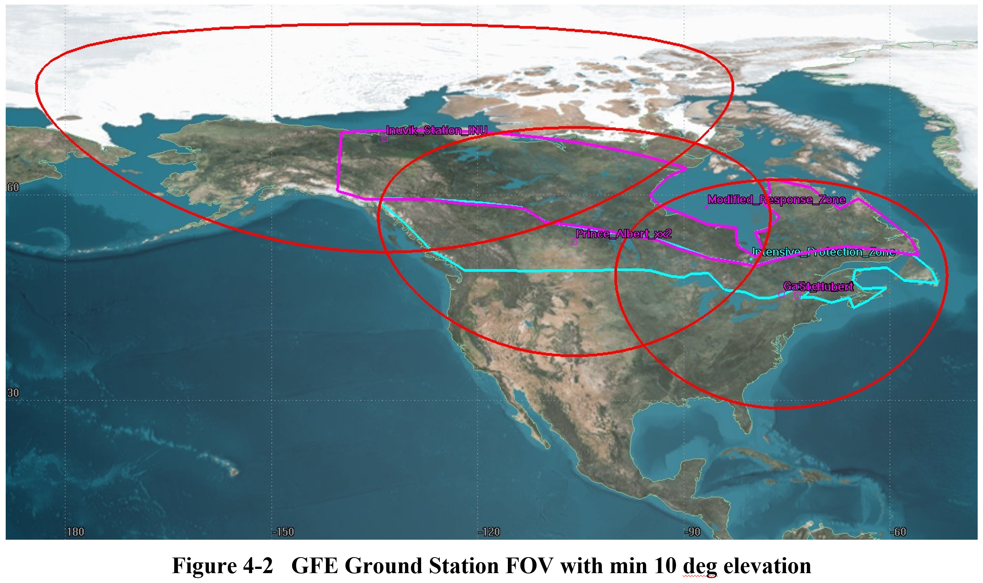
Downlink Gaps

Slide 12
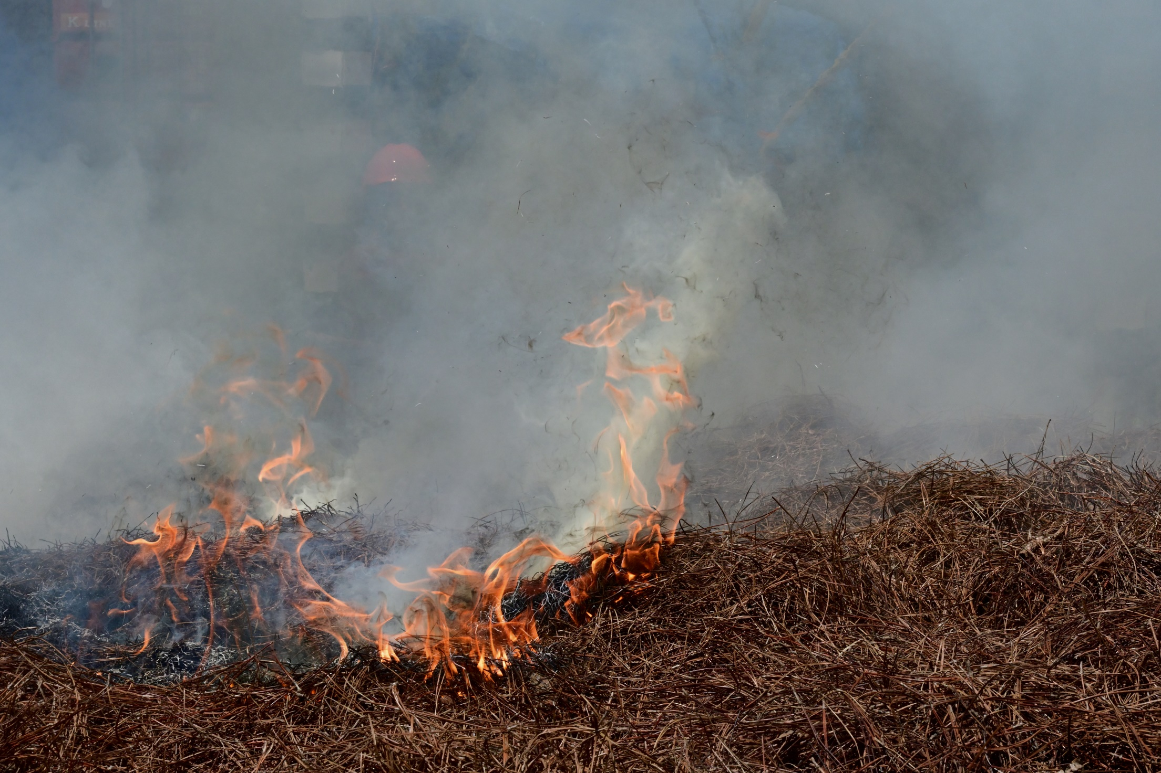
Thank You
Questions?

Slide 13
25
REFERENCES
Johnston, J. M. (2016). Infrared Remote Sensing of Fire Behaviour in Canadian Wildland Forest Fuels. Doctor of Philosophy, King's College London.
Johnston, J. M., N. Jackson, C. McFayden, L. Ngo Phong, B. Lawrence, D. Davignon, M. J. Wooster, H. van Mierlo, D. K. Thompson, A. S. Cantin, D. Johnston, L. M. Johnston, M. Sloane, R. Ramos and T. J. Lynham (2020). "Development of the User Requirements for the Canadian WildFireSat Satellite Mission." Sensors 20(8).
Johnston, J. M., L. M. Johnston, M. J. Wooster, A. Brookes, C. McFayden and A. S. Cantin (2018). "Satellite detection limitations of sub-canopy smouldering wildfires in the North American boreal forest " Fire 1(2): 28.
Johnston, J. M., M. J. Wooster, R. Paugam, X. Wang, T. J. Lynham and L. M. Johnston (2017). "Direct Estimation of Byram’s fire intensity from infrared remote sensing imagery." International Journal of Wildland Fire 26(8): 668-684.
Notes:
Wooster figures are taken over Argentina. Units are spectral radiance.
Airborne from Wooster et al. is an ITRES image of an Alberta fire

Slide 14
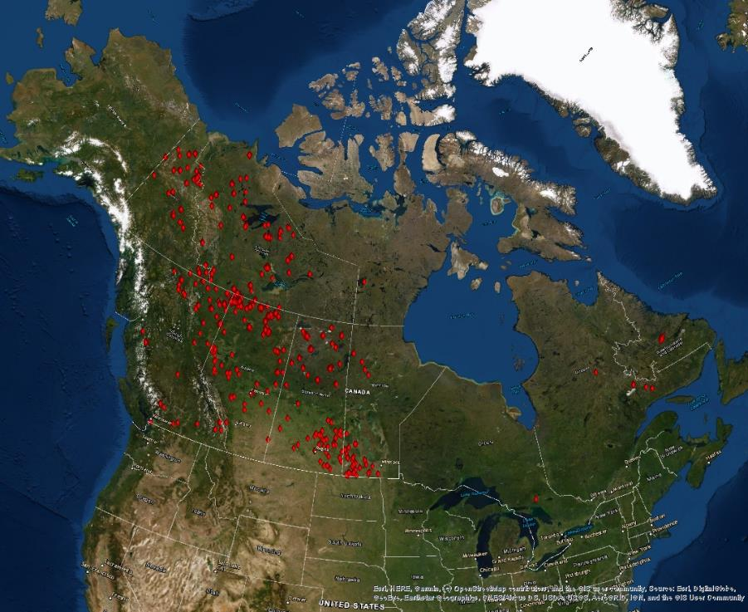
AI development dataset
~200 VIIRS images that contain confident positive hotspots (NFDB)
Data Augmentation
2 years of baseline L1B data processed in house

Slide 15
Semantic Segmentation with a U-Net
Encoder-Decoder
Using NRCan’s geo deep-learning repository (https://github.com/NRCan/geo-deep-learning)
256x256px patches of 5 375m I bands (geotiffs)
Geopackages for the targets
Day algorithm
Still tuning the parameters

Slide 16
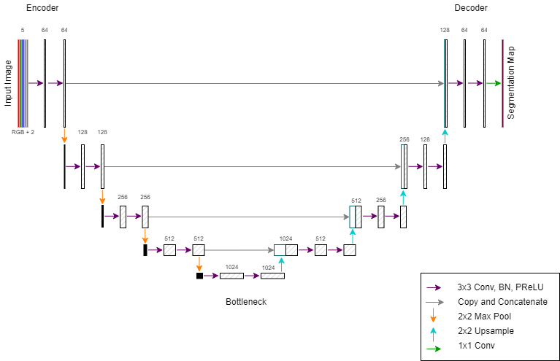

Slide 17
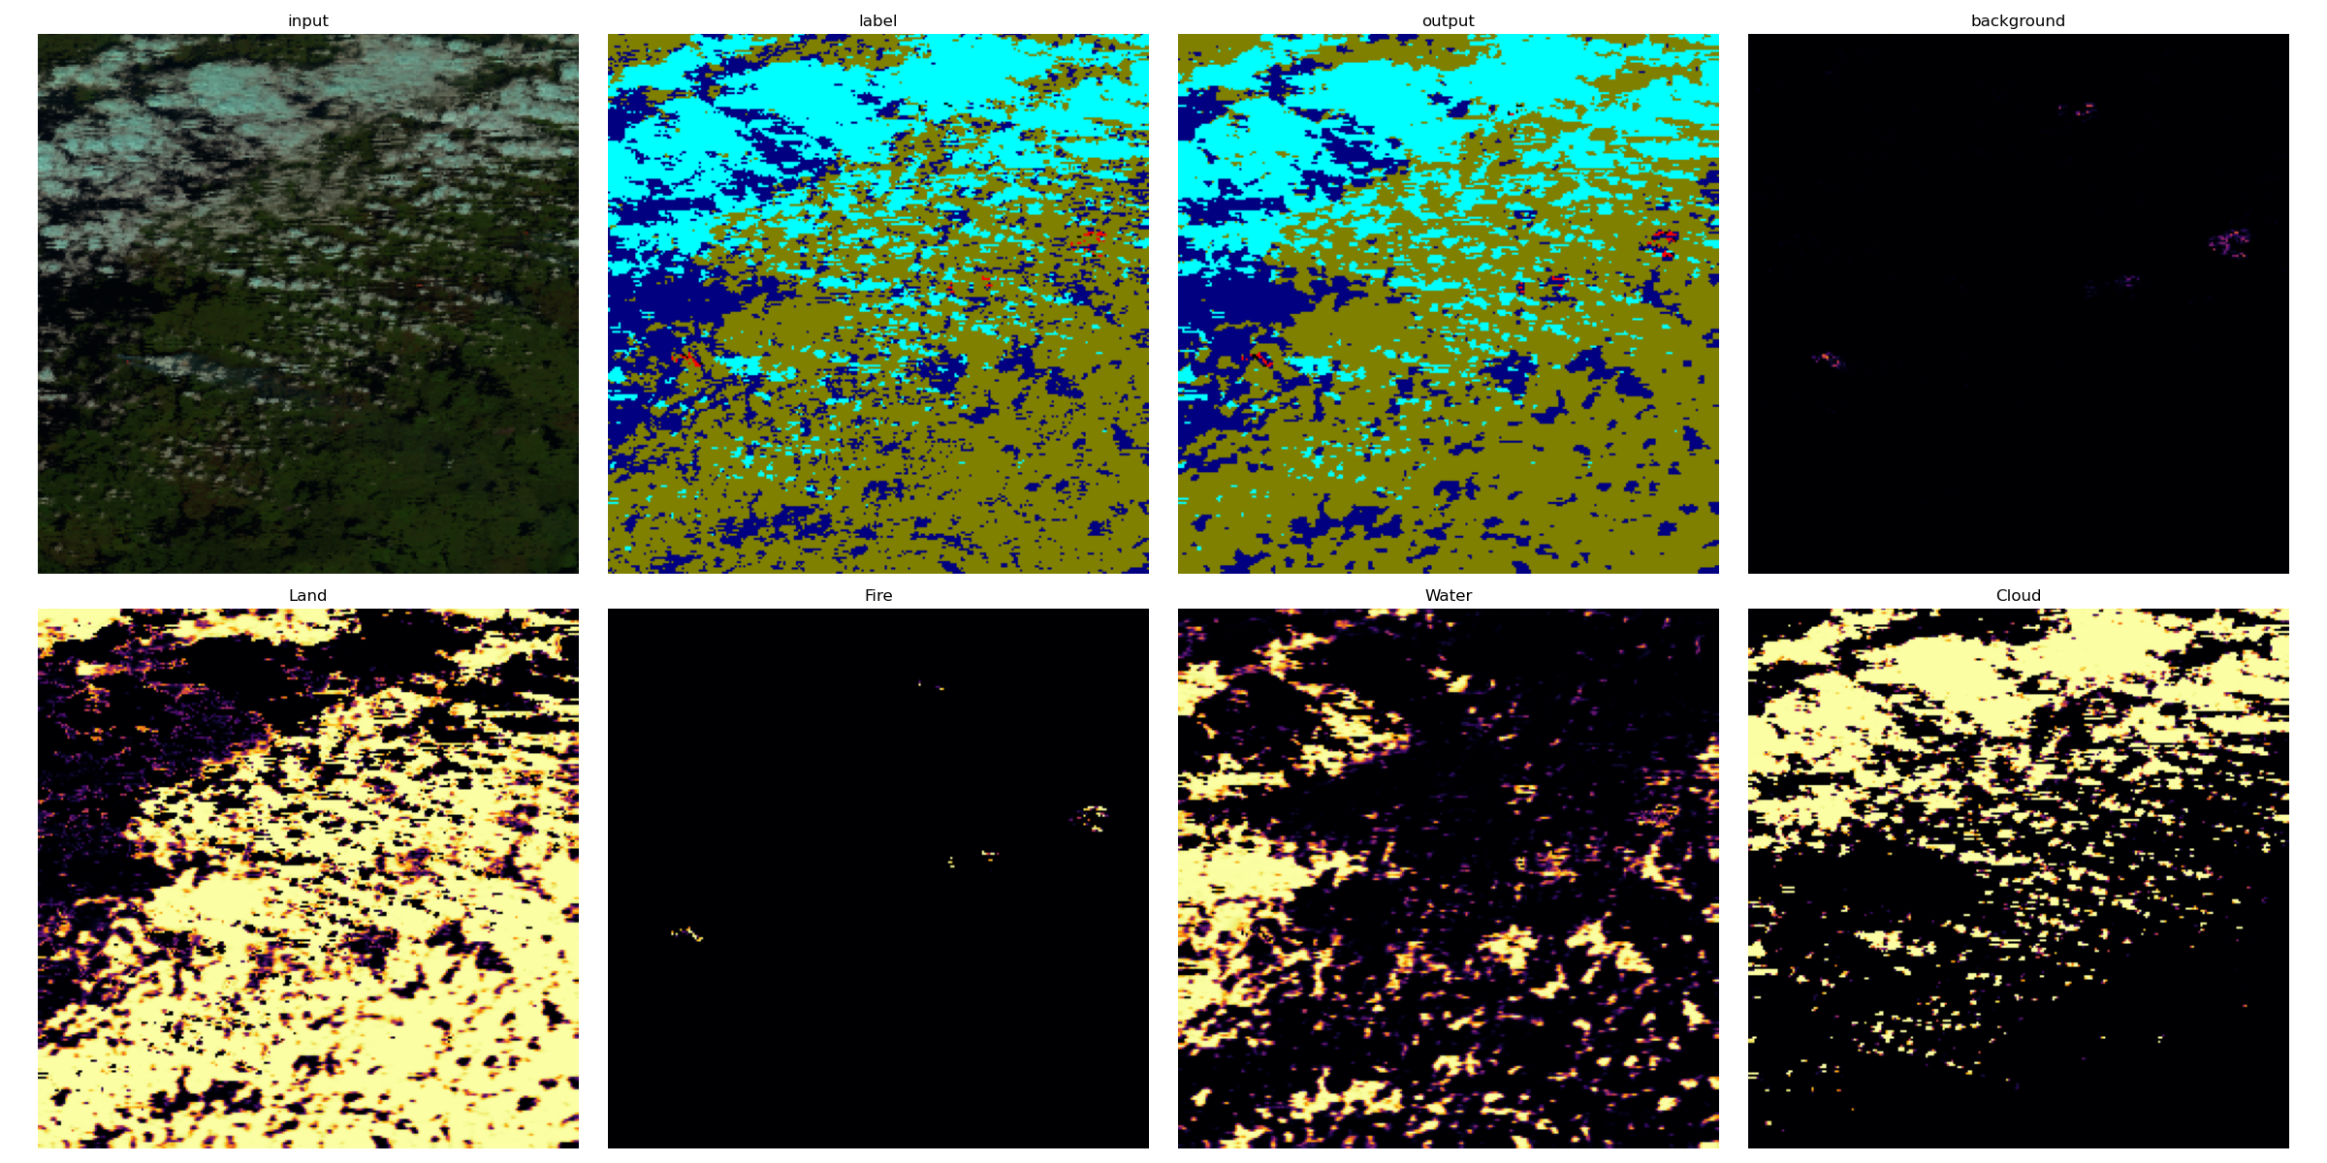

Slide 18
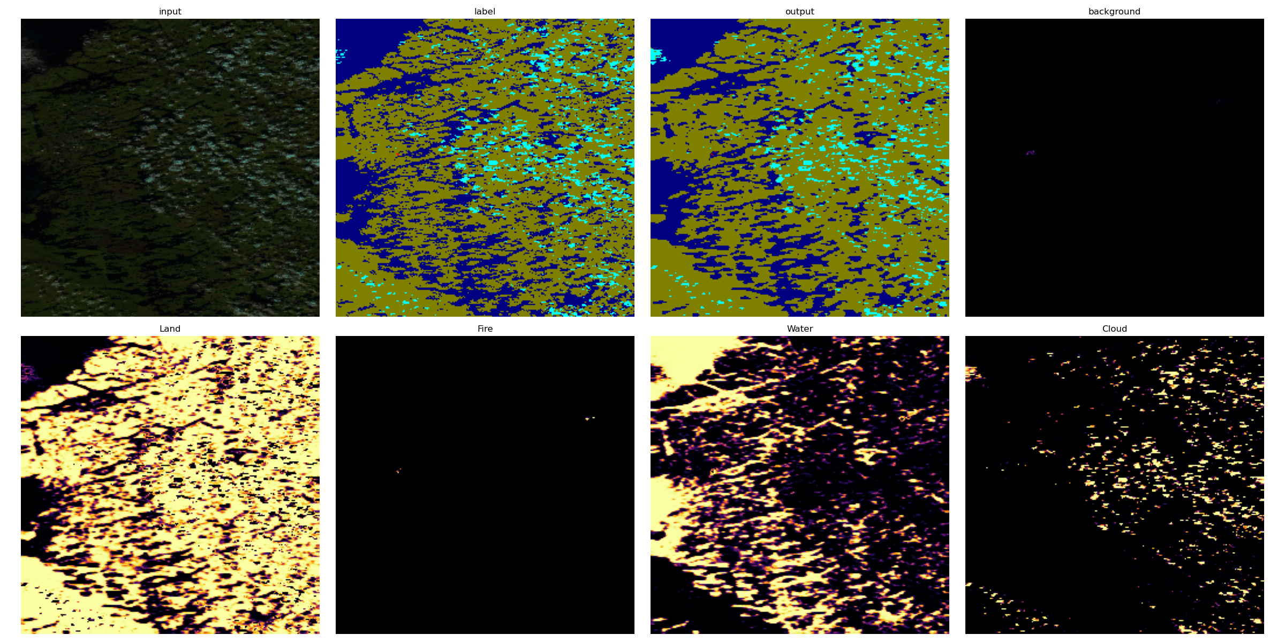

Slide 19
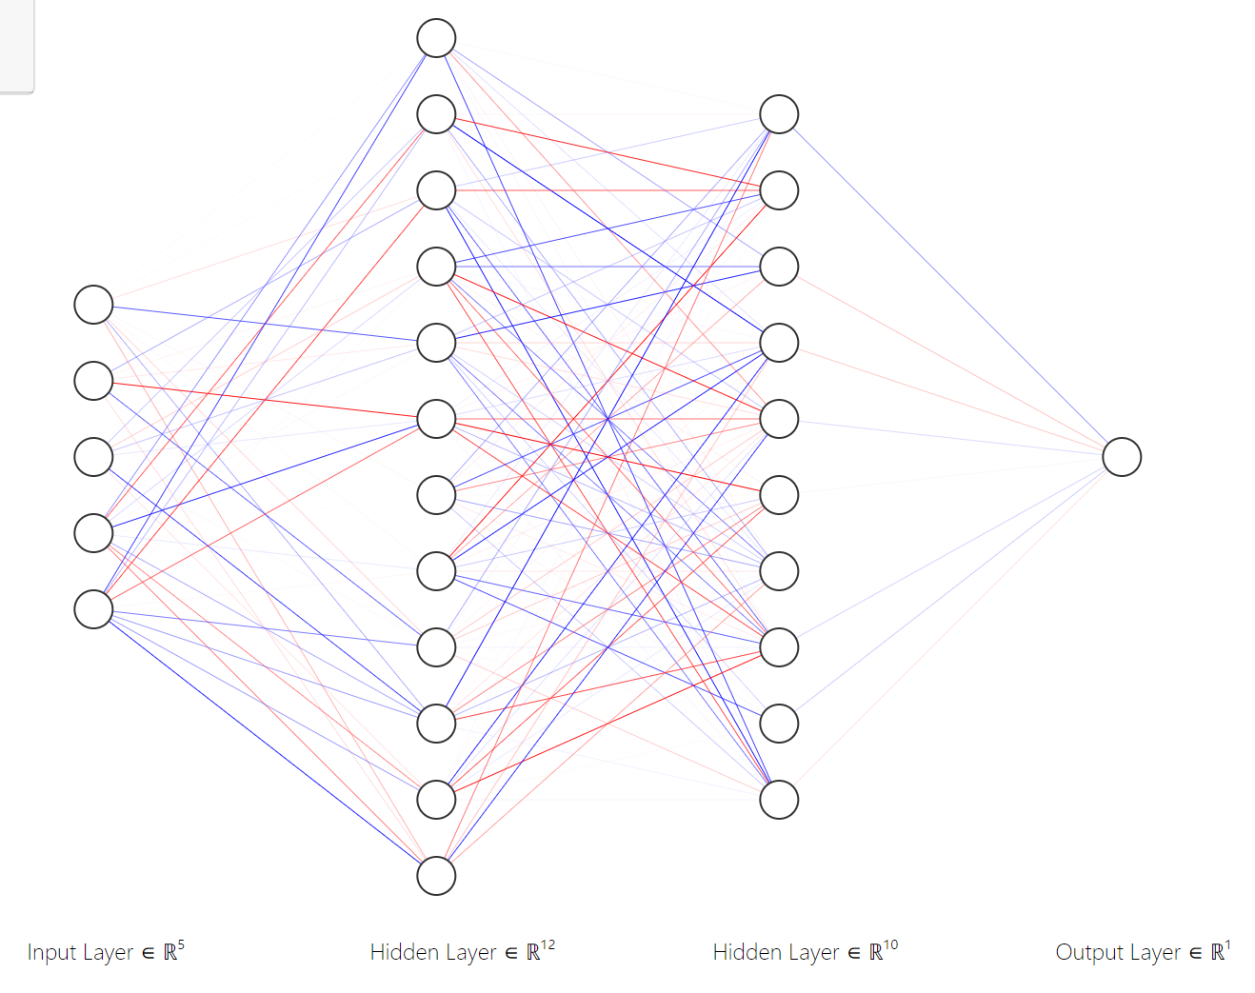
Mulitlayer perceptron (MLP)
Aiming to find even # of each
class, currently it’s unbalanced
Individual pixel classifier
Very fast to train

Slide 20
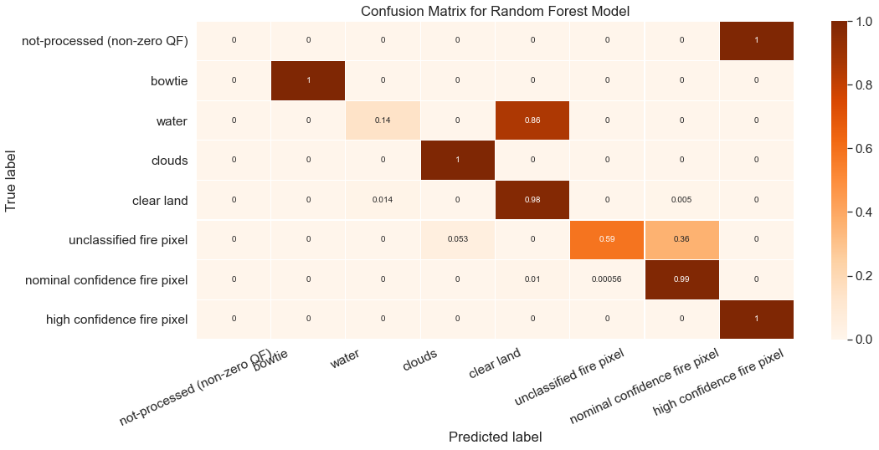
Non-NN implementations
Random Forest, SVM, Boosted trees
Individual pixel classifier
Increase data

Slide 21

Onboard AI
Can we embed some functionality onboard the spacecraft?
  Largely depends on the outcome of Phase-A design
  Faster to do it onboard?
    Or foil the bent-pipe data delivery plan?
  Create a VM to mimic onboard hardware

