Slide 1
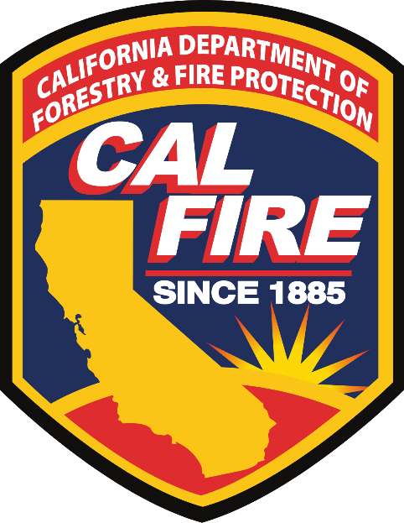
CALFIRE Overview
Notes:
Responsible for protection of 31 million acres, in 36 of the states 58 counties. Over 8,000 personnel, additional funding for 1,400 firefighters to bolster our fuels management and wildfire response efforts.
All risk all hazard agency 21 Units broken into 2 geographical locations, 95% of fires 10 acres or less
Nearly 14,000 lightning strikes
Over 20 major fires and complexes both FRA and SRA
4,197,628 Acres
Acres Burned
9,279 Incidents
Number of Wildfires
31 Fatalities
Confirmed Loss of Life
10,488 Structures
Structures Damaged or Destroyed
Fires
Floods

Slide 2
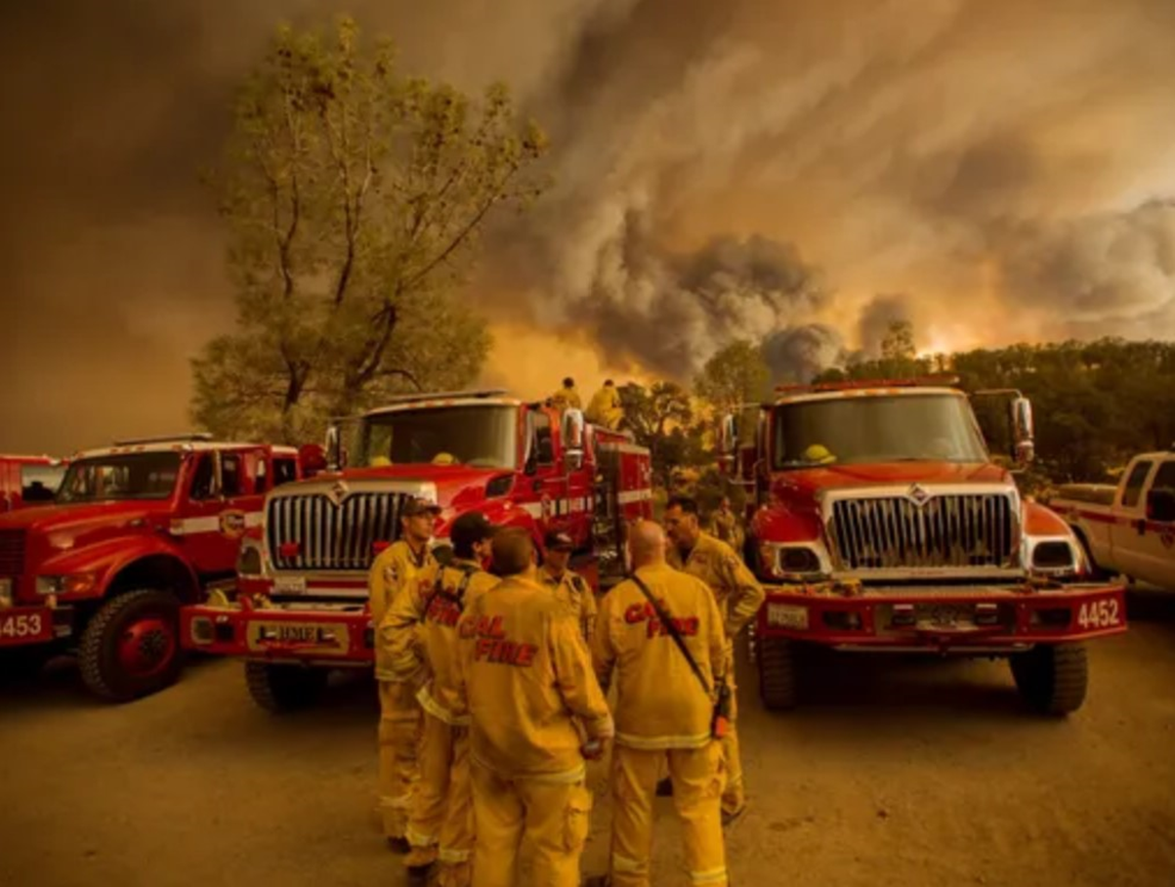
CAL FIRE Overview
Operate almost 1000 engines
356- State mission, Schedule B
617 – Local Government, Schedule A

Slide 3
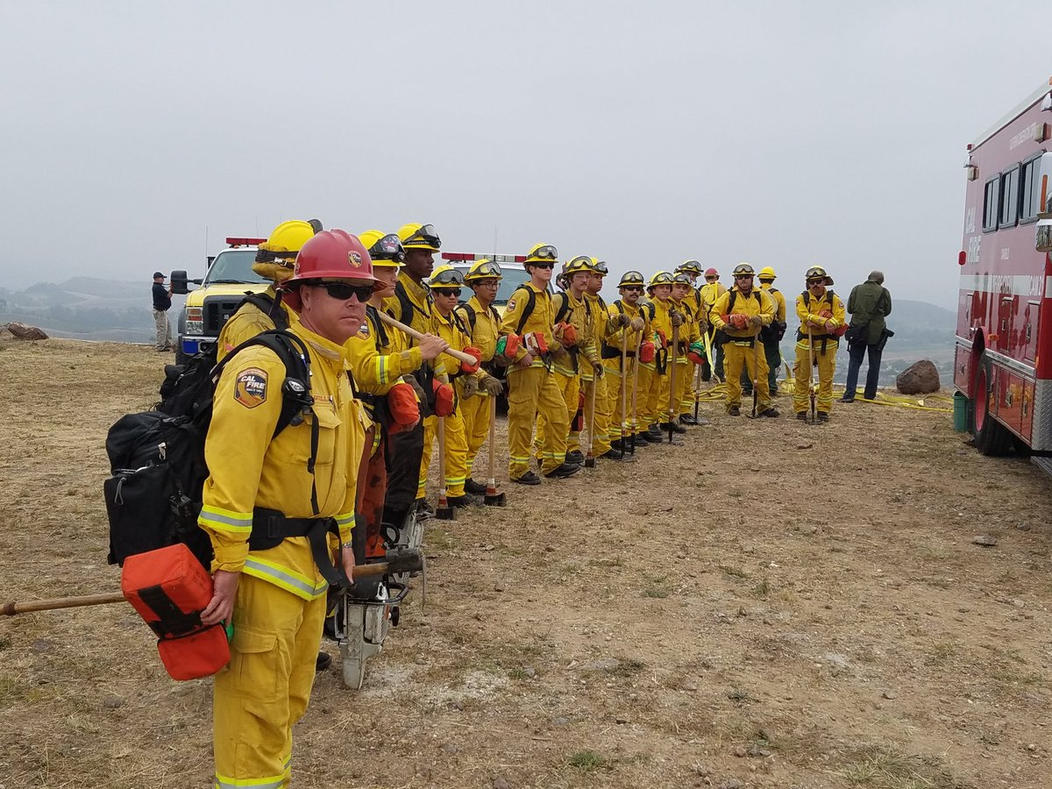
CAL FIRE Overview
Notes:
20 FF1 Hand Crews, 12 Perm and 8 Augmented March announcement of 30 additional crews
24 CCC Firefighting crew
13 “Rattlesnake” National Guard Crews
6 Fuels Reduction Crews
56 CDCR 5/5/2021

Slide 4
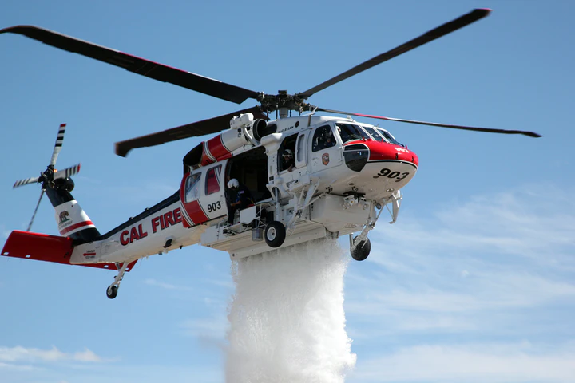
CAL FIRE Overview
Notes:
S70i
5 in our fleet
We anticipate the total of 12 by Dec 2021

Slide 5
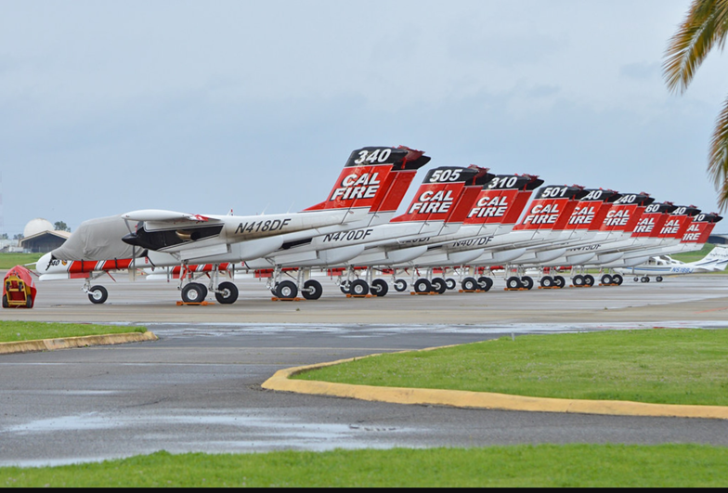
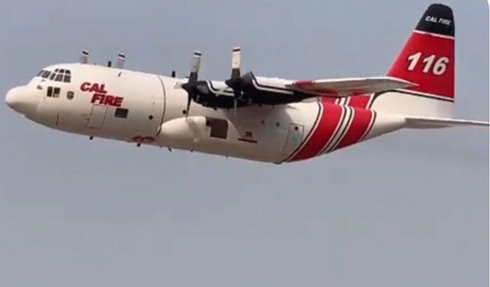
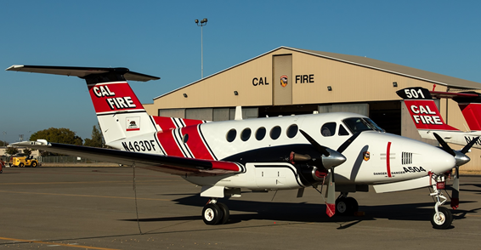
CAL FIRE Overview
Notes:
Continue to take delivery of the C-130s for the Coast Guard
Continue to train our pilots for Initial Attack certification
In contracting process between USAF and vendors for tanking of the aircraft
23 S2-Ts
2 King Air ATGS Training Platforms

Slide 6
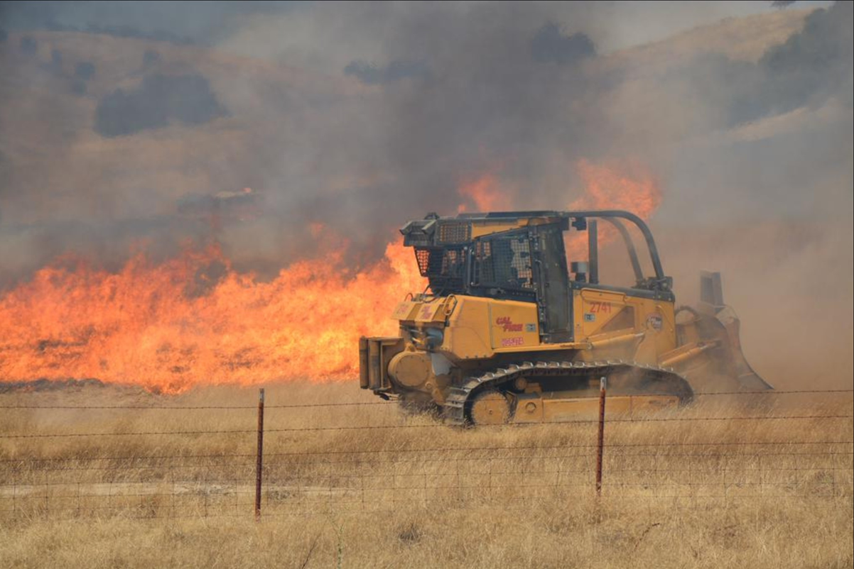
CAL FIRE Overview
58 Dozers State Wide

Slide 7
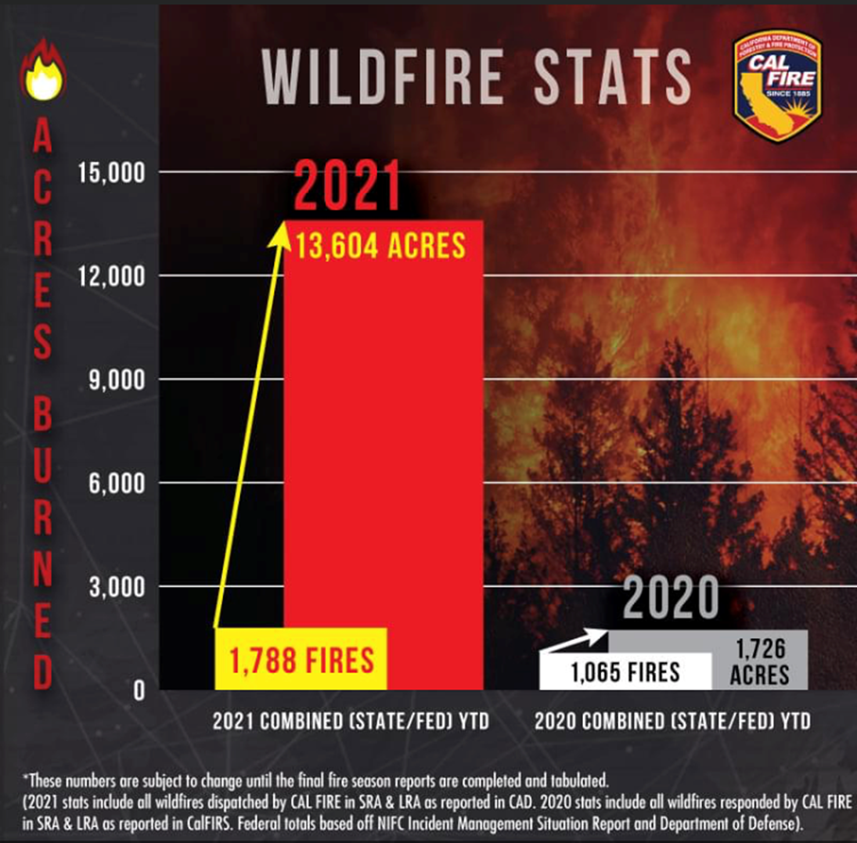
Fire Stats
Notes:
5000+ Acre Fire in SD
200 acre fire in Mendocino
Fire in LMU that was consuming 100 and 1000 hour fuels
Rx burn in BDU that was actively burning under Oaks and also consuming heavy fuels
5 of the top 6 largest fires occurred last year
5th most destructive fire fire this year “North Complex” as well as the deadliest

Slide 8
Technosylva Implementation

Slide 9
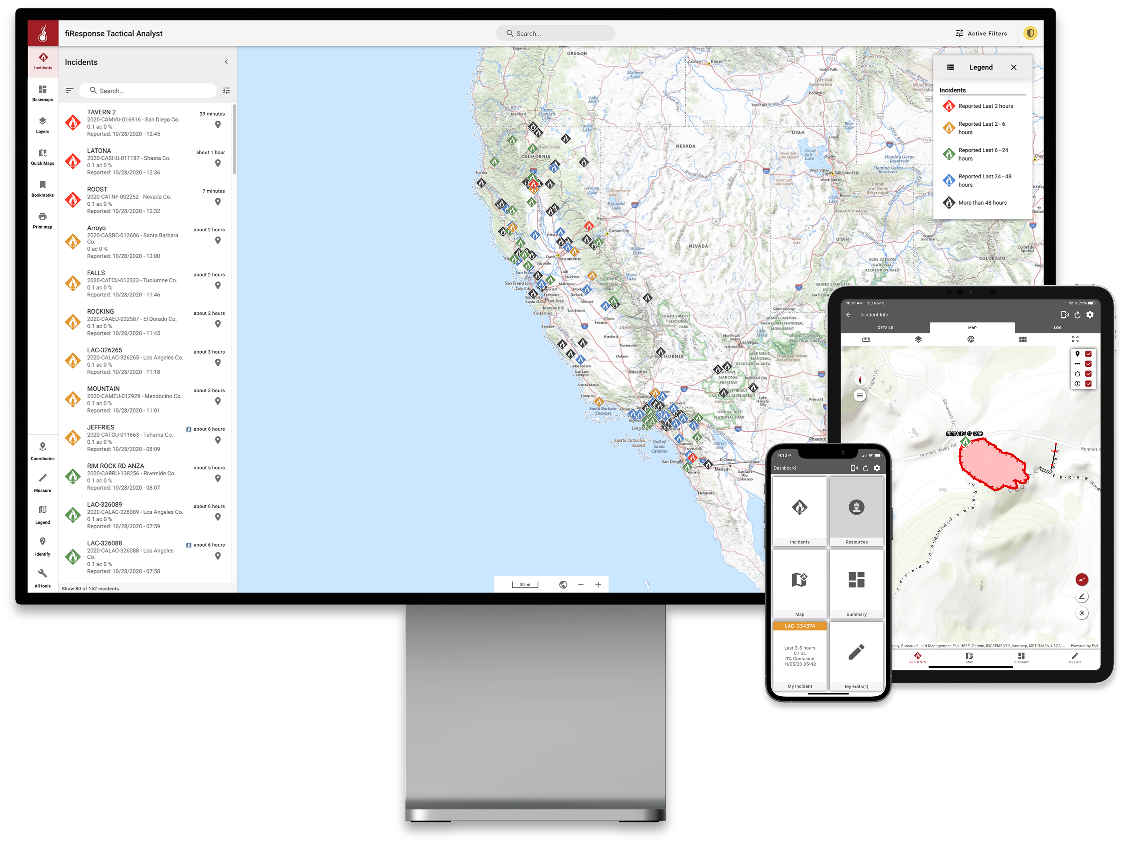
Technosylva fiResponse

Slide 10
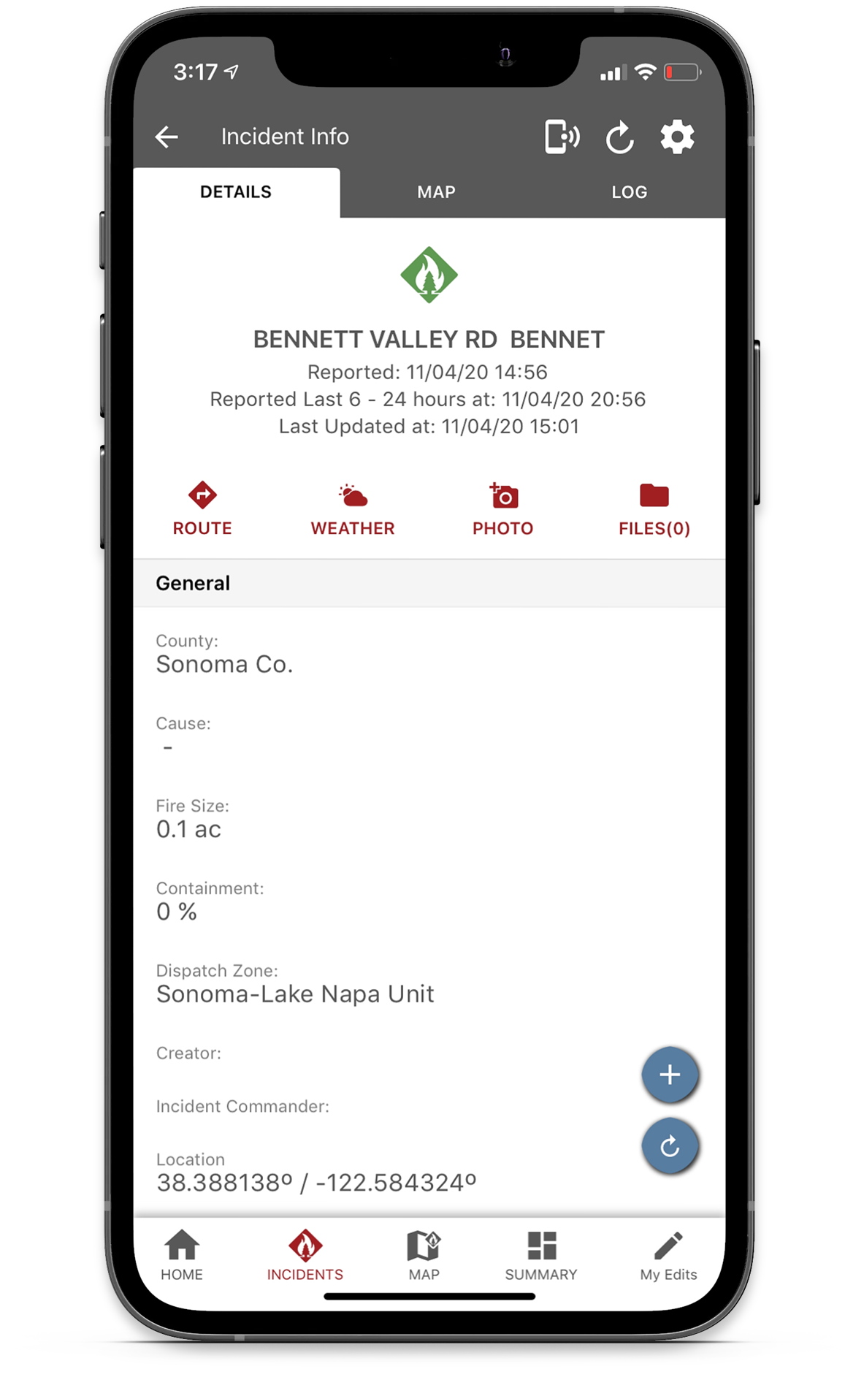
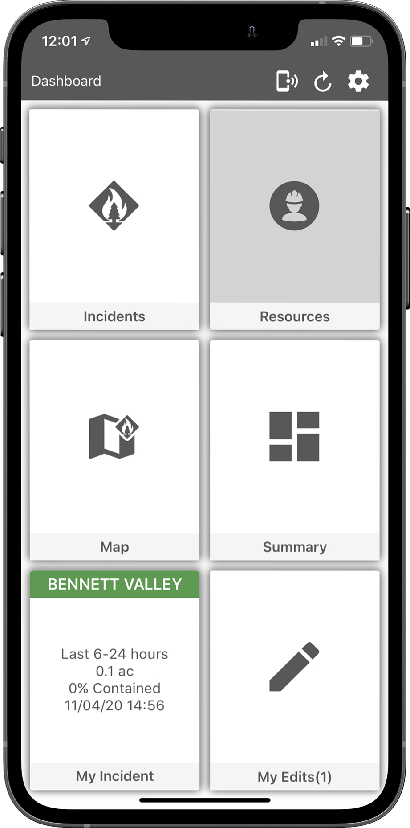
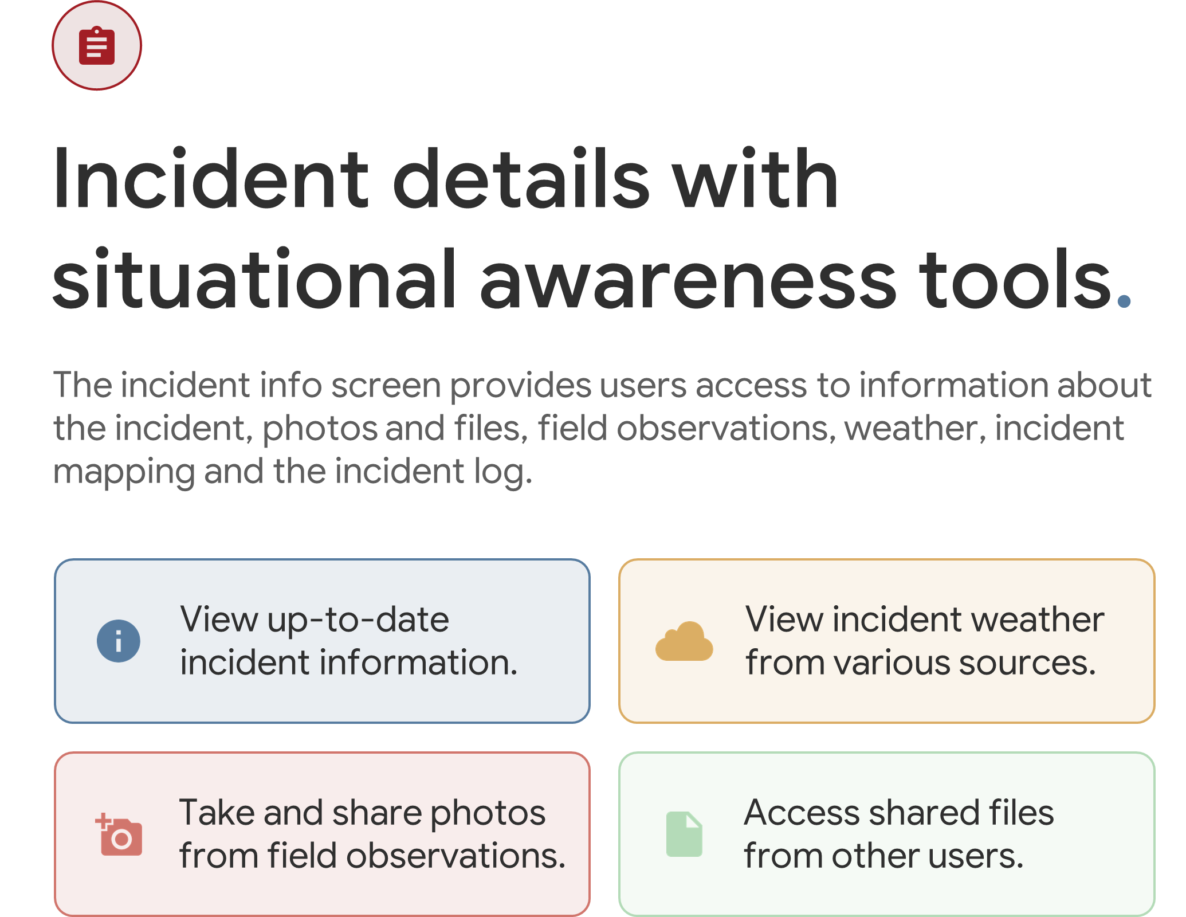
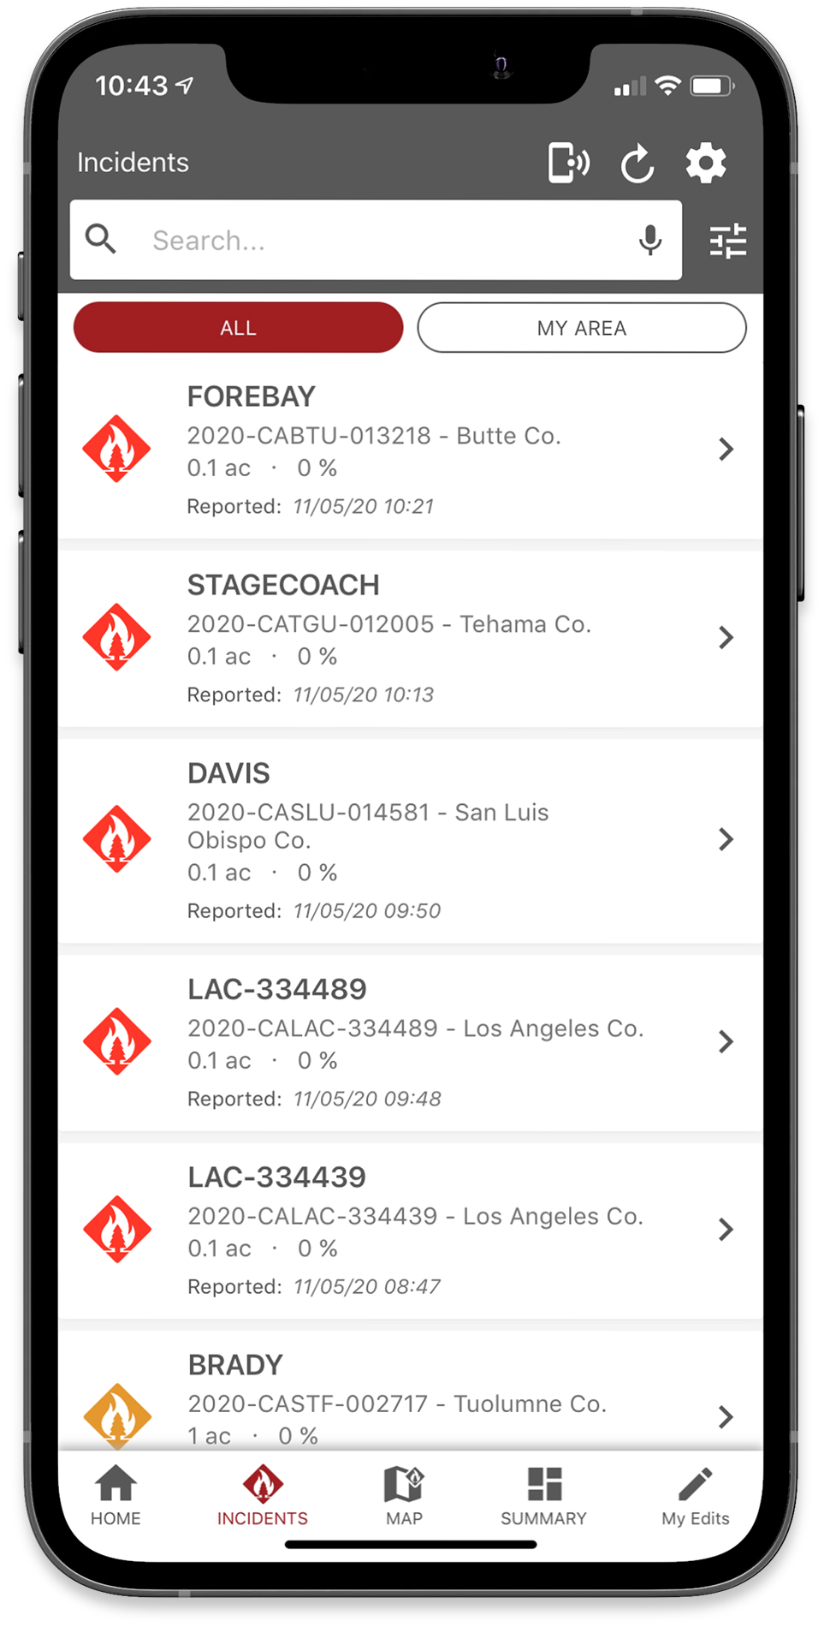
Technosylva fiResponse
Notes:
Fat finger design
Find incidents

Slide 11
Technosylva fiResponse
Notes:
Videos shows proposed line and fire perimeter

Slide 12
California National Guard FireGuard
Notes:
This slide showcases the collaborative efforts between the watchdesk and SOPS GACC

Slide 13
California National Guard FireGuard

Slide 14
California National Guard FireGuard

Slide 15
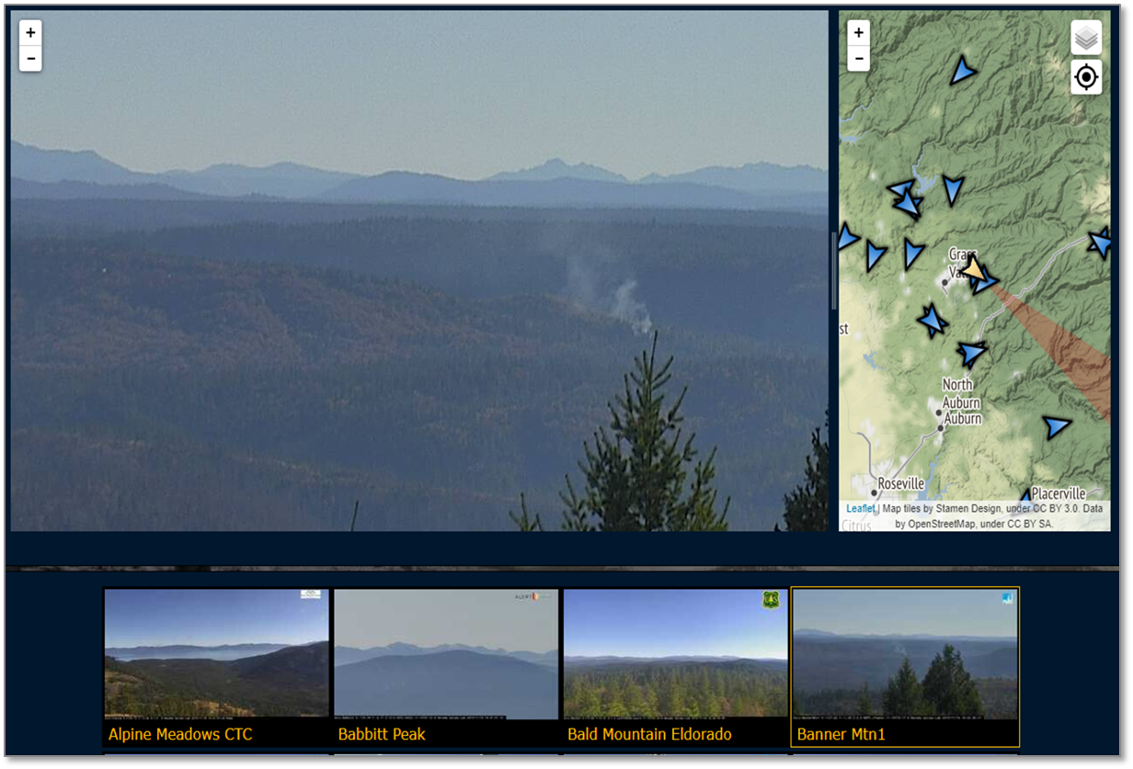
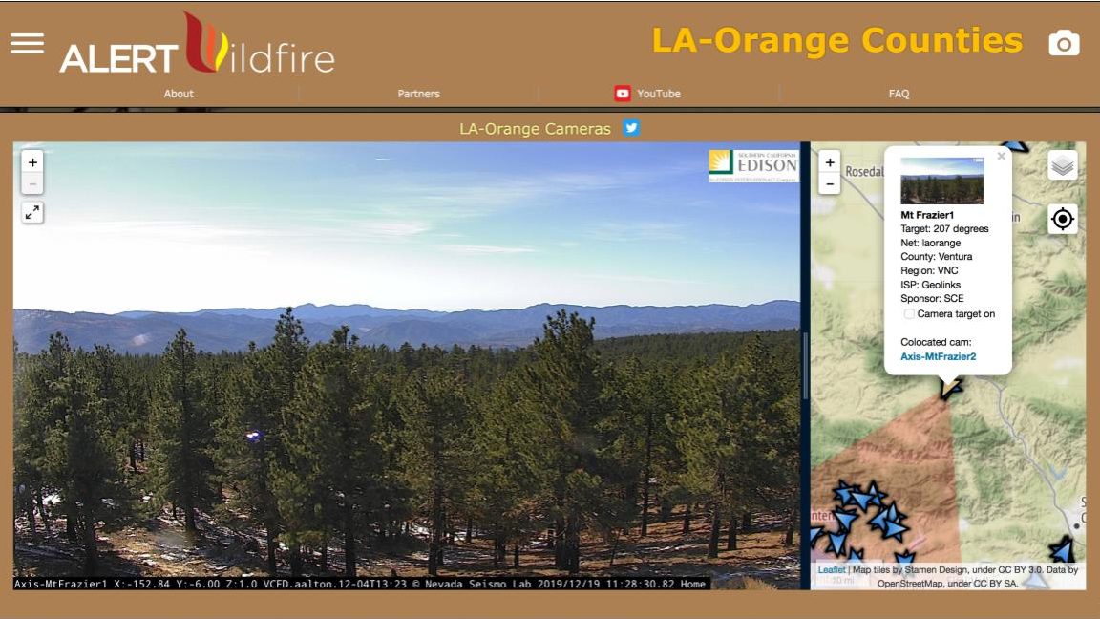
Notes:
Anyone can view the cameras at the link provided by any smart device.

Slide 16
xView2 project

Slide 17
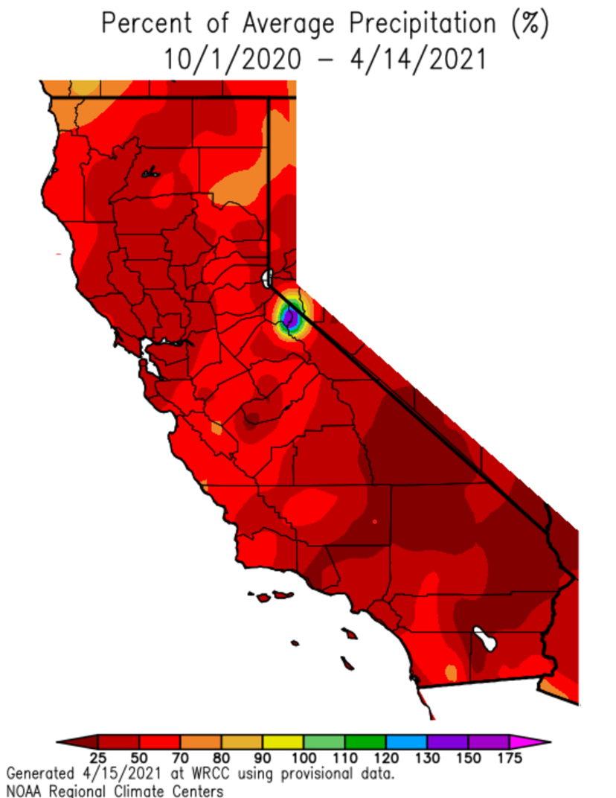
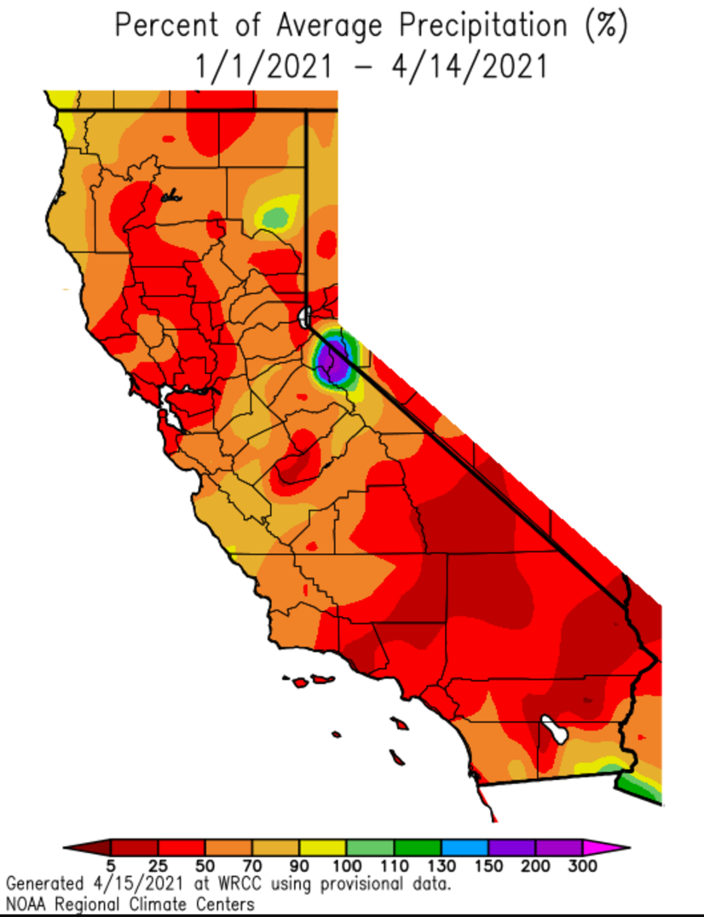
Percent of average precip.
Notes:
The rainy season, which begins on October 1st, has been drier than average across almost the entire state
Much of the State has received less than 50% of normal precipitation
Since January 1st rainfall has been a bit closer to normal in the far northwest and east with some of the large storms that came through in early February.
…but in general the drier than normal weather pattern has continued

Slide 18
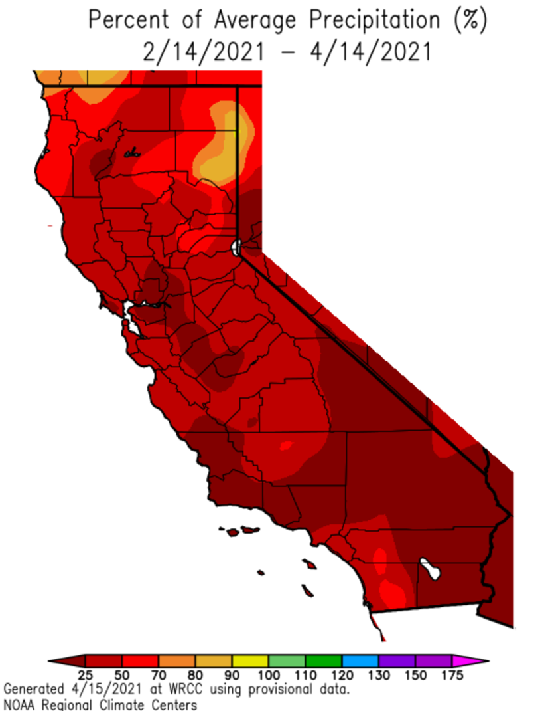
Percent of average precip.
Notes:
Slide high lights how dry its been since February

Slide 19
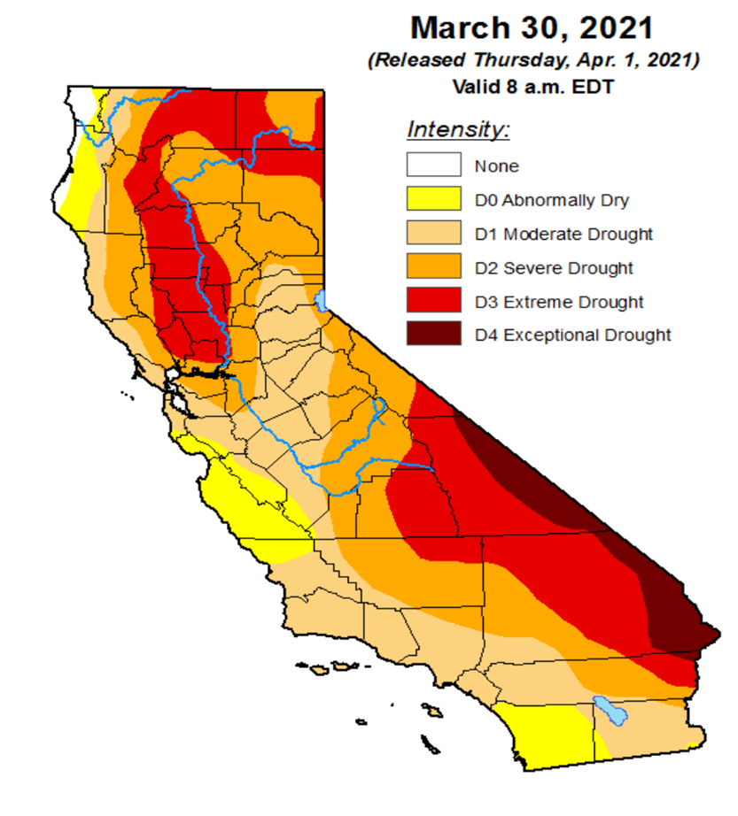
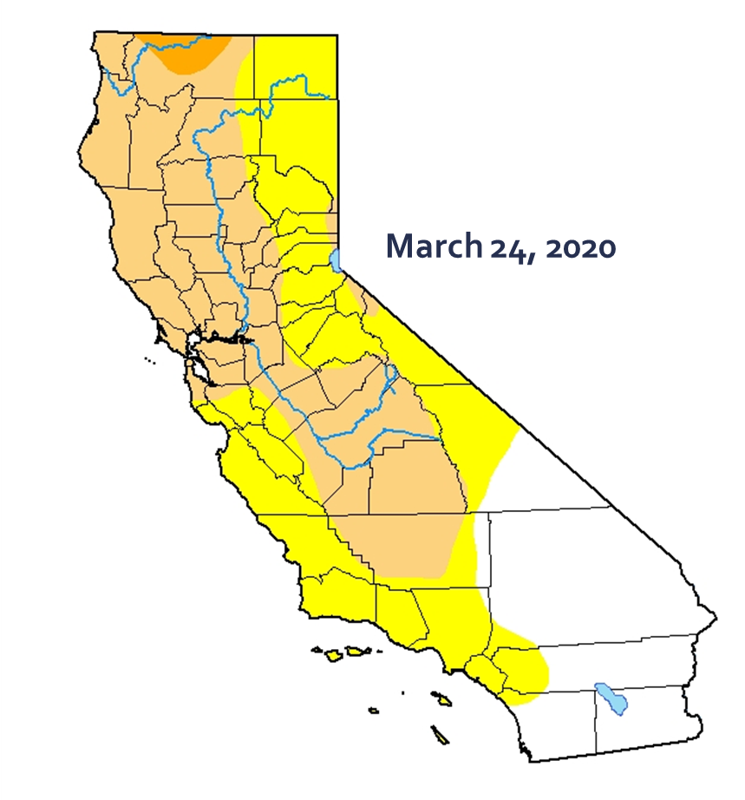
Drought Monitor – Precip. Deficit
Notes:
Comparing last year to this year, the state much larger precipitation deficit. This kind of deficit will effect our larger dead and down fuels sooner, stress live woody fuels, and cause the brush to reach critical fuel moisture levels sooner.

Slide 20
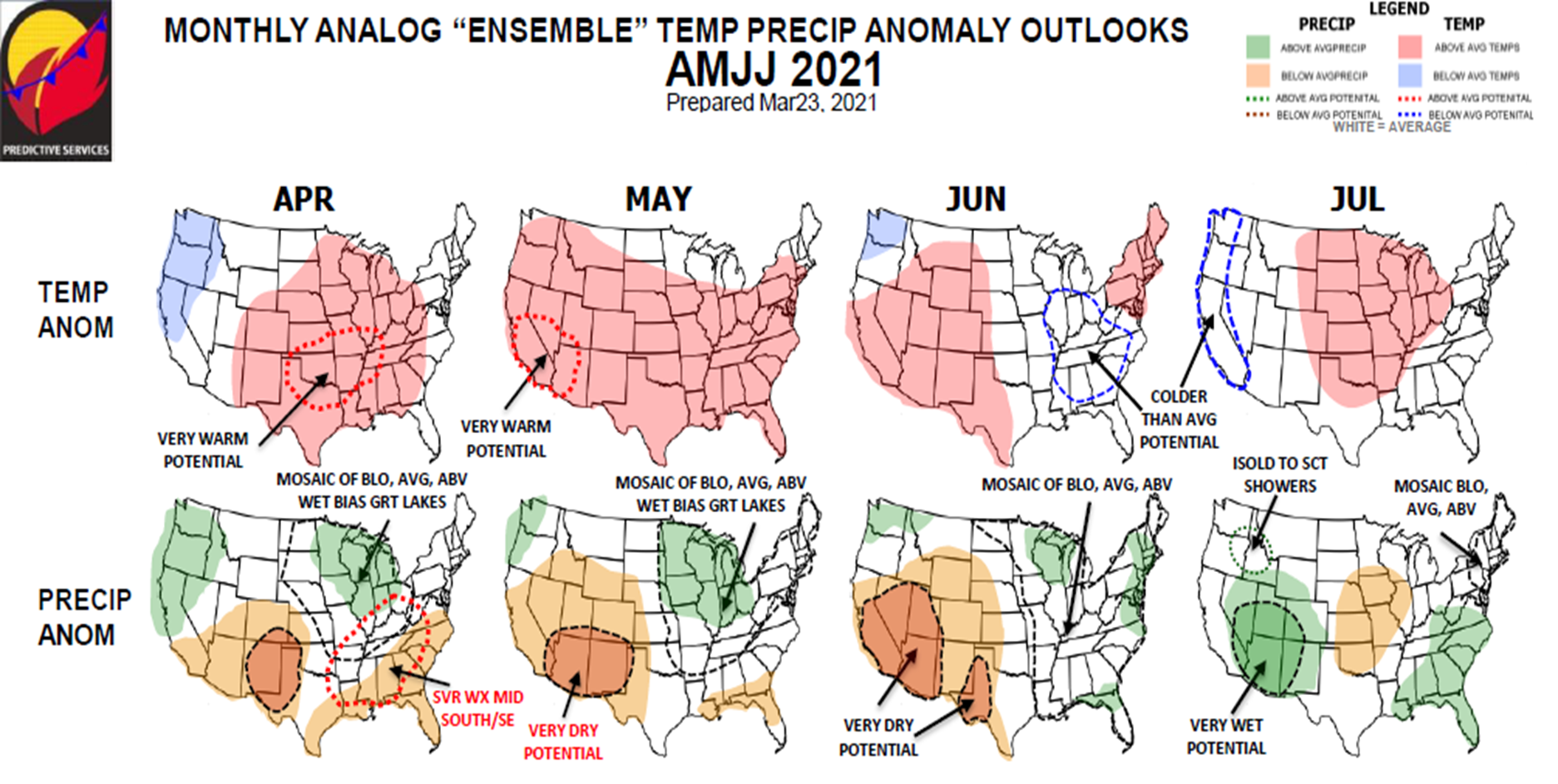
Drought Monitor – Precip. Deficit
Notes:
.
The current Predictive Services Outlook calls for generally drier and warmer…
…than average conditions in the North Ops region from through July
There may be some cool wet weather toward the end of April and early in May…This may this weekend, with a large Pacific low coming on shore.
…The potential for precipitation will have little seasonal effect on the current grass crop as it has headed out and has begun to cure. It may increase woody fuel moisture and push back the point for the brush to reach critical fuel moisture levels, depending on quantities and duration.

Slide 21
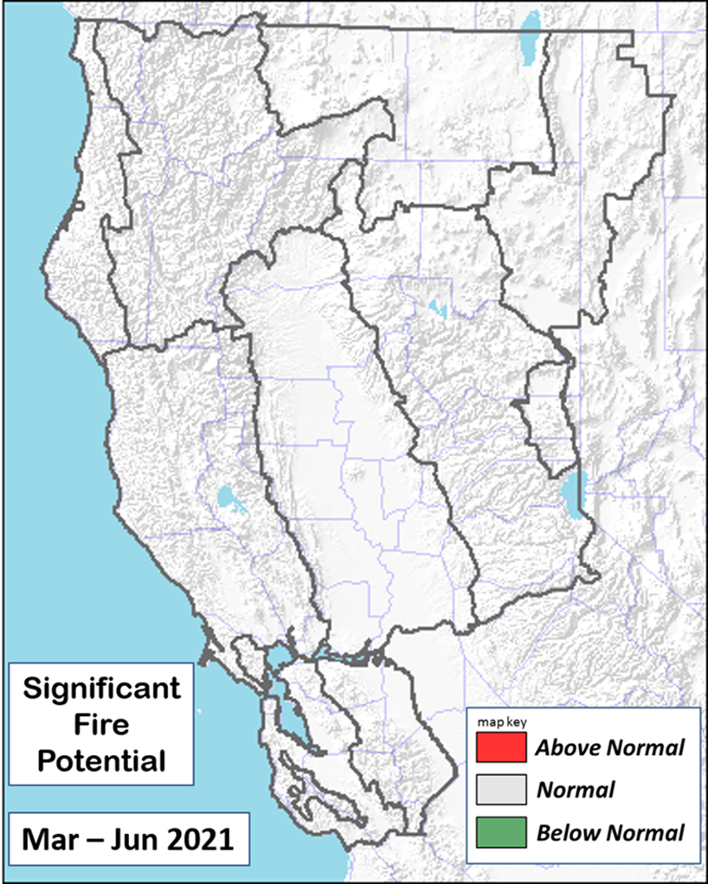
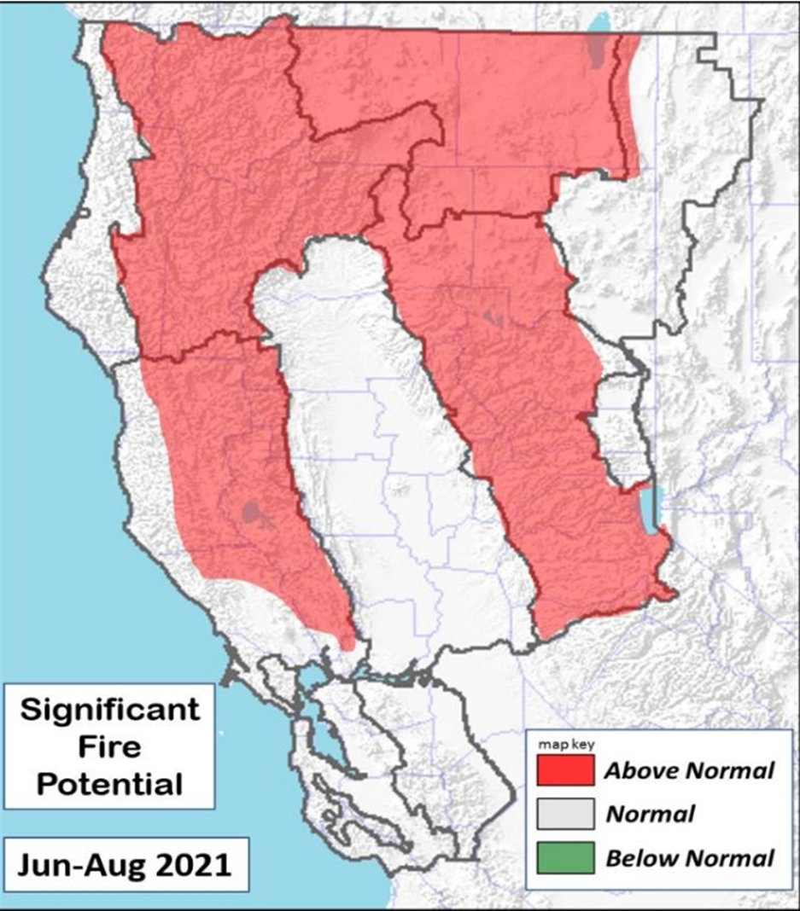
Significant Fire Potential
Notes:
For the 3-month period from April through June the Large Fire Potential for the North Ops region is Normal
Normal is defined as less than 1 large fire per PSA per month through May
In June Normal is defined as 2-2.5 large fires in the Sacramento Valley and Far Eastside PSAs and up to 1.2 large fires elsewhere
Although we are seeing higher than normal amounts of initial attack, and we expect that trend to continue…
For now we show June in the Normal category, but we will be watching for any indication of the need to switch some areas to Above Normal in June
In July middle and upper elevations are expected to become dry enough to be vulnerable to fire spread a few weeks earlier than usual
We usually see monsoon lightning events become more common in July and August, and any lightning will pose a threat of large fires

Slide 22
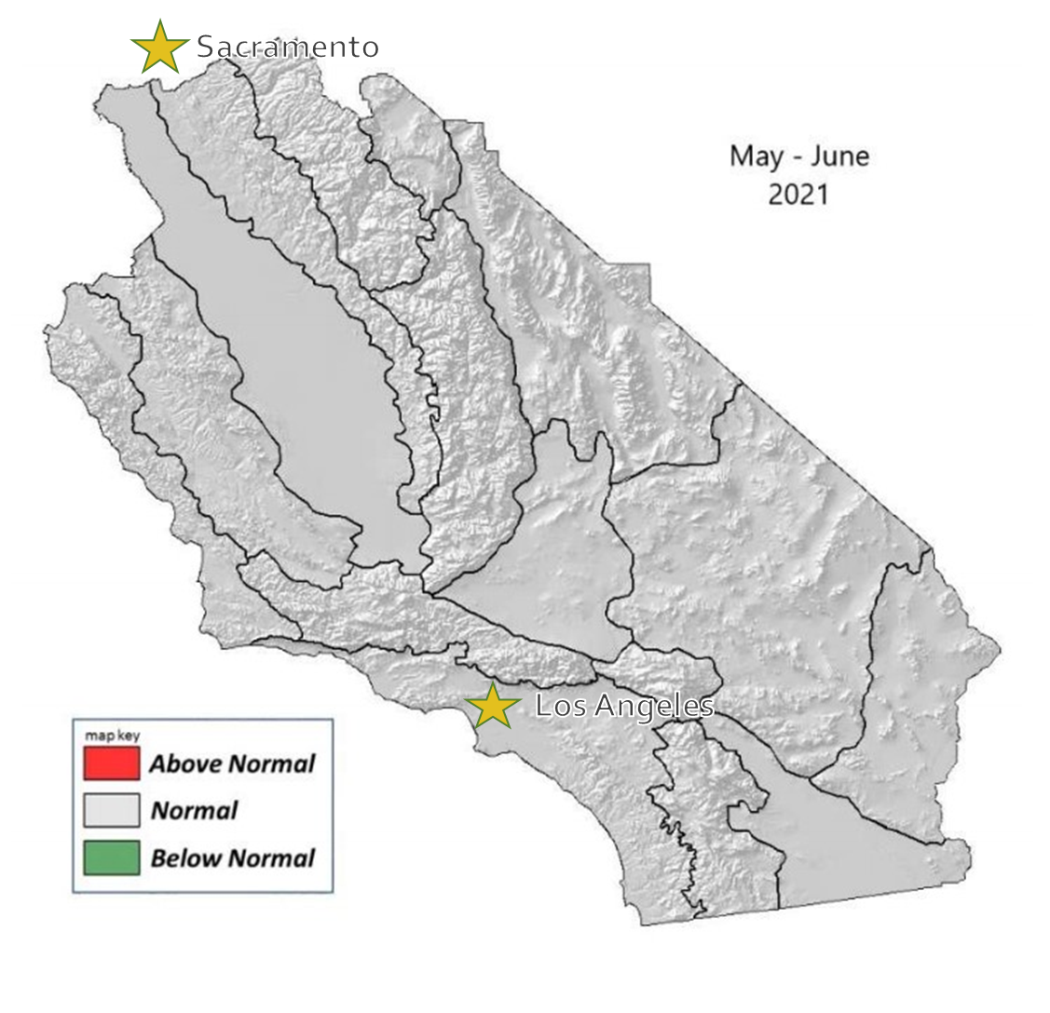
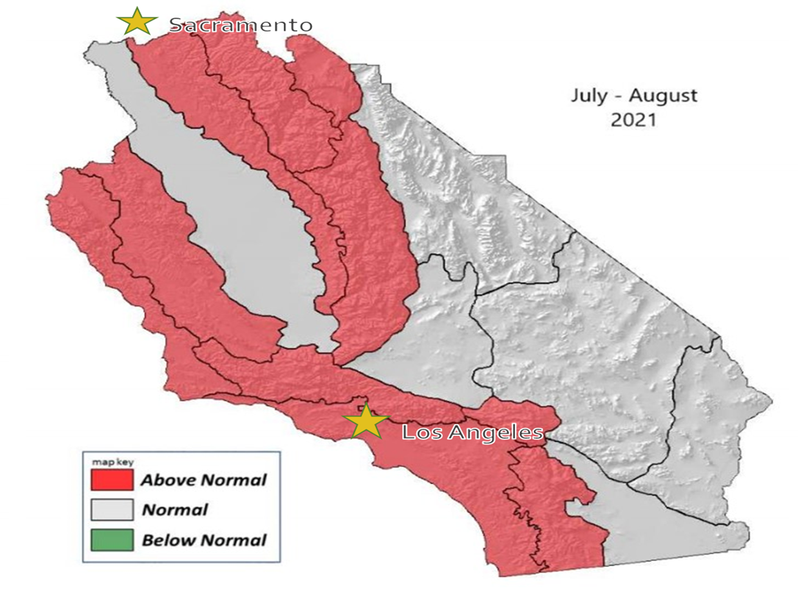
Significant Fire Potential
Notes:
• Rainfall will be a little below normal in April and then below normal May through June.
• Temperatures will be a little below normal.
• The marine layer will be deeper than normal across the coastal areas May and June.
Rainfall will be below normal July.
Temperatures will be a little below normal July.
Monsoonal showers and thunderstorms will be below normal in July.

Slide 23
In Summary
Grasses have cured in many areas and are receptive, larger dead fuels are near historical lows in SoCal, brush will reach critical fuel moisture levels earlier than normal.
Trends in precipitation and fuels forecasts indicate that 2021 is likely to have similar fire behavior to 2020.*
*The lighting events in 2020 created more than usual natural ignitions, across the regions.
Next Predictive Services Outlooks to be published June 1, 2021
These will include the statewide monthly and potential seasonal outlooks.
Fuel conditions are drier than normal for this time of year.
Many areas are seeing fire activity that would be expected closer to mid June.
Predictive Services assessments and forecasts of current fuels conditions and fire potential outlooks are available online: https://www.predictiveservices.nifc.gov/

