Slide 1
CAL FIRE Update

Slide 2
Wildfire Forecast and Threat Intelligence Integration Center

Slide 3
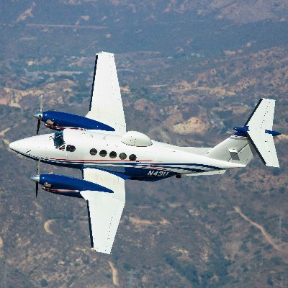
FIRIS and A503

Slide 4
Soil Moisture

Slide 5
AlertCA

Slide 6
Incident Awareness and Assessment Dashbaord

Slide 7
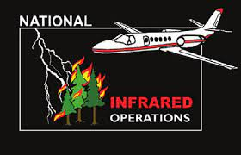
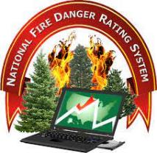
COP

