Slide 1
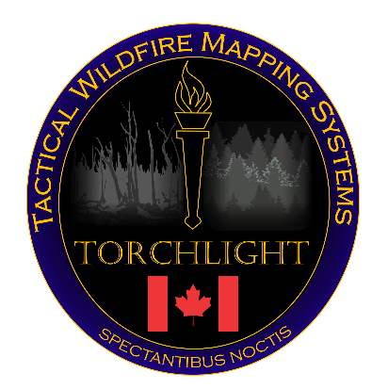
2019 Torchlight Update
Mr. Alan Cantin
Dr. Josh Johnston
Mr. Marc Lachance

Slide 2
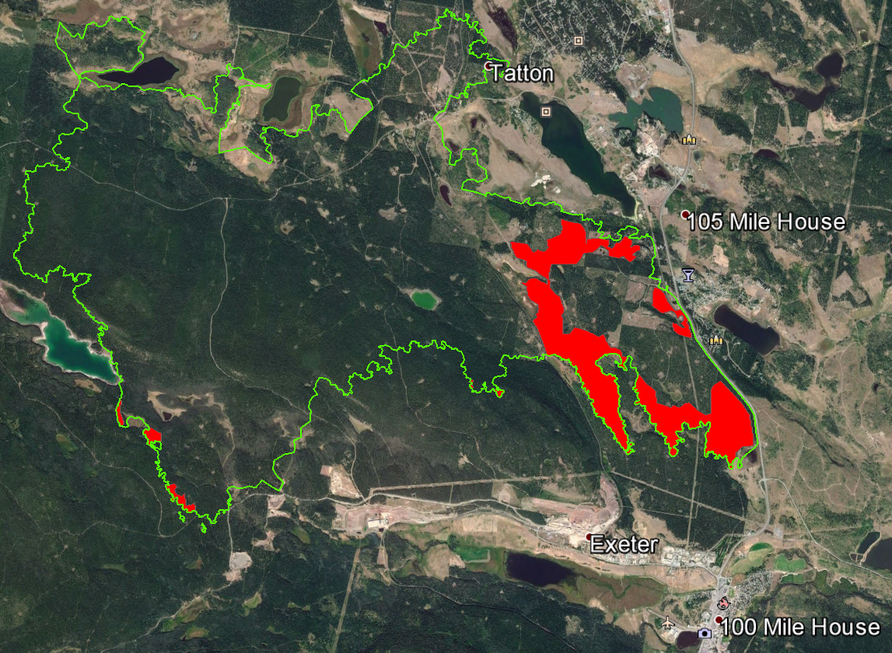
Tactical Wildfire Mapping in Canada
Support began in 2017 for emergency situations only, with 2000 person-hours, 72 days, and 215 maps for BC
Similar to NIROPS
Primary focus on creating fire perimeters
Added segmentation for intense, scattered, and isolated points

Slide 3
Enhancements from previous years
Mostly automated, we just have a single person validating the outputs
Converted to Python script with open source materials as opposed to ArcGIS dependent
Bigger focus on speed and fire segmentation over perimeter mapping
Added a contextual filter (similar to that in use for MODIS/VIIRS/AVHRR products)

Slide 4
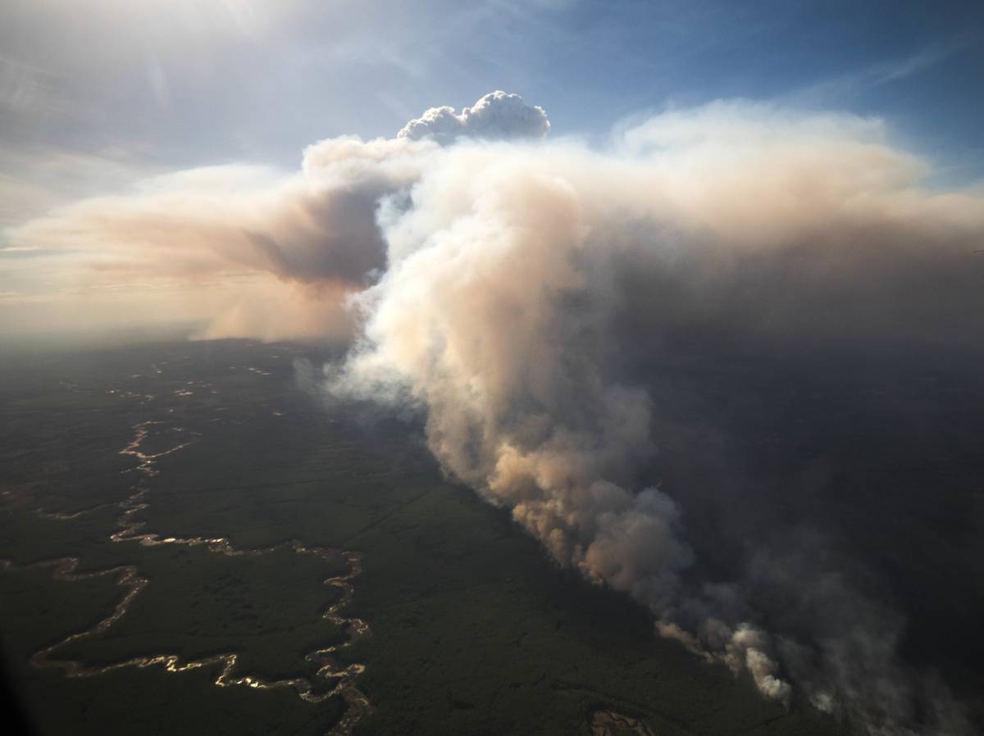
2019 Canadian fire season
Credit: Chris Schwarz/Government of Alberta

Slide 5
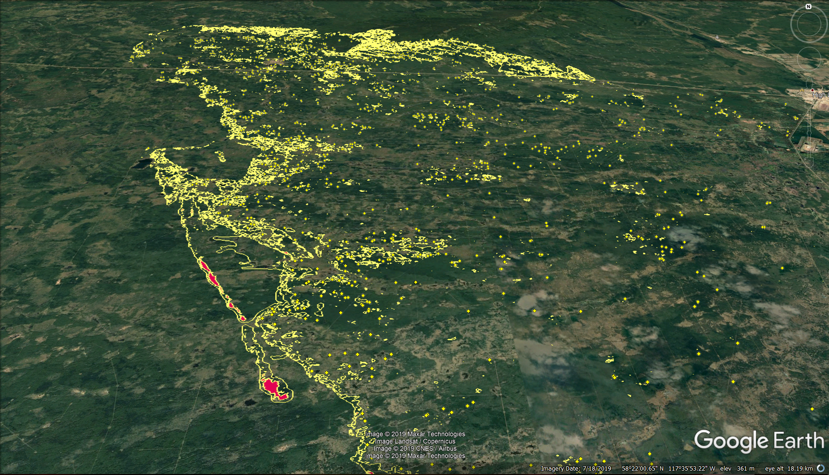
Chuckegg Creek wildfire (HWF042)
350,000+ ha burned
5,000 evacuated
State of emergency
Torchlight deployed
for 12 days
(starting May 20)

Slide 6
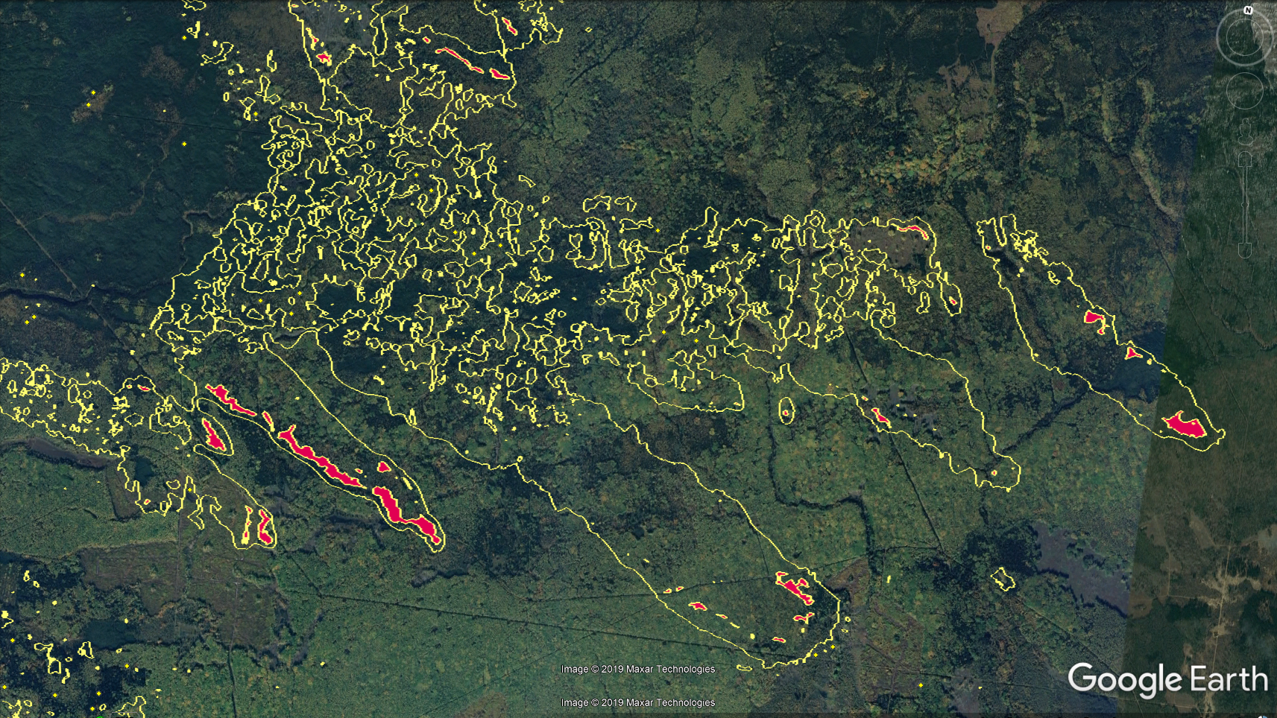
Chuckegg Creek wildfire (HWF042)

Slide 7
Chuckegg Creek Deployment
21 day deployment, 12 successful mapping days
First deployment for Alberta
Alberta is heavy airborne IR user
No feedback yet – hoping to discuss next week
SOP guidelines from previous year used here

Slide 8
Enhancements still to come…
Automatic Human structure detection and classification
Potential additional classification of “residual heat or cooling” and “hot gas”
Finalize and implement automated fire perimeter mapping

Slide 9
Biggest Challenges
Convince fire managers to use product
Retrieve cloud-free data
Commission/Omission errors
Algorithm efficiency

Slide 11
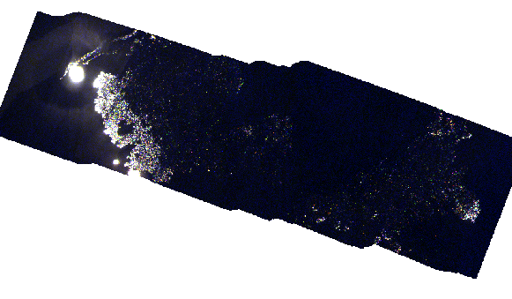
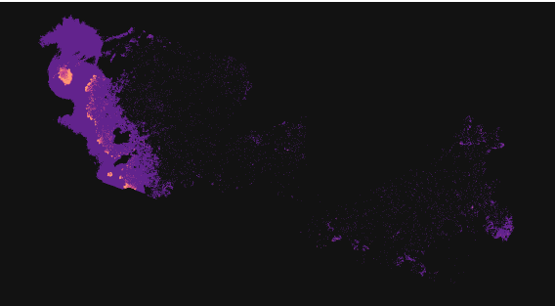
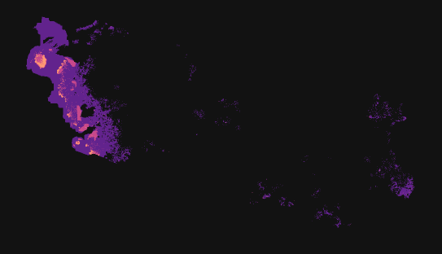
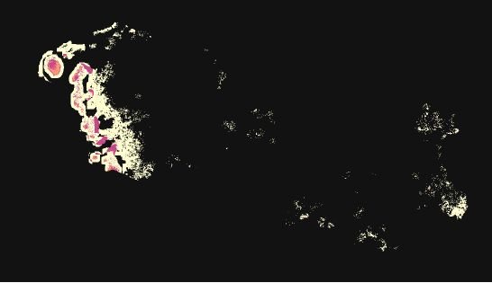
Airborne research campaigns

Slide 14
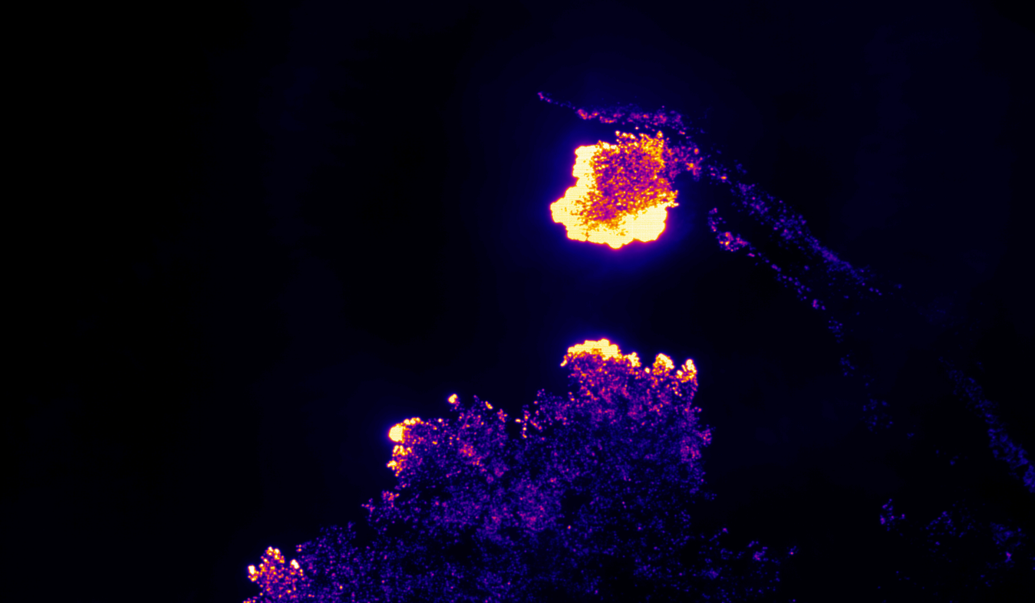

Slide 16
Edge detection
Canny Edge Detection
Reduce Noise (Smoothing)
Find the edge strength (gradient in both dimensions)
Find and relate edge direction to possible directions
Apply nonmaximum suppression
Hysteresis to eliminate streaking

Slide 17
Back edge removal

Slide 18
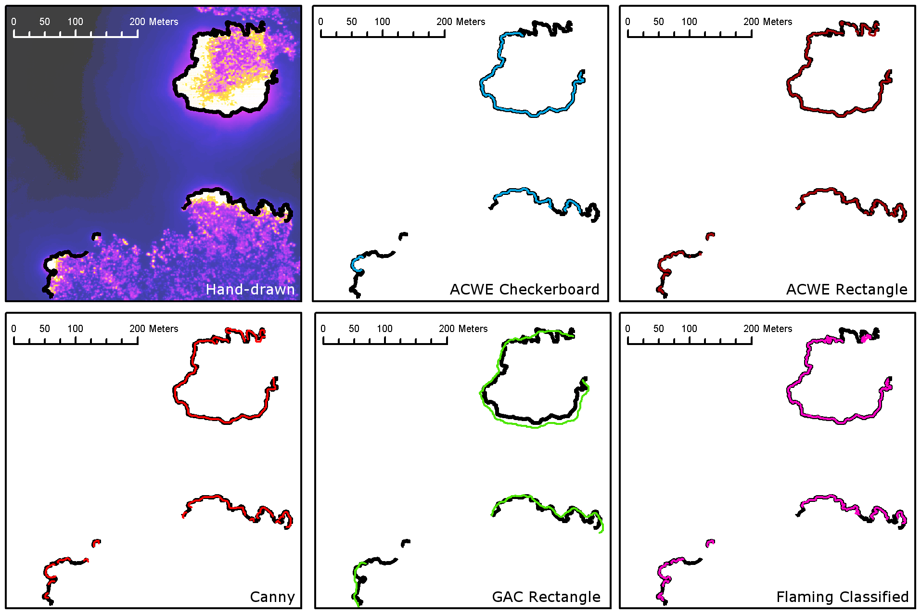

Slide 19
Questions?

