Slide 1

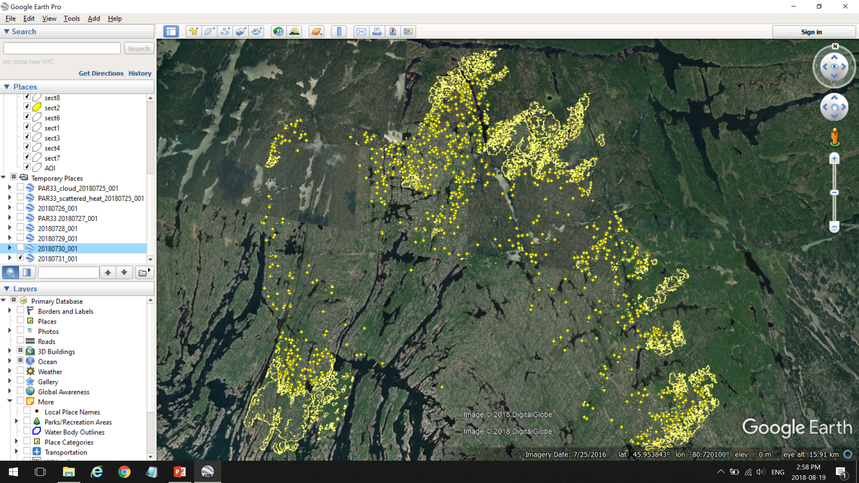
Torchlight 2018
Advancements and Lessons Learned

Slide 2

Torchlight: Automating the art of tactical wildfire mapping
Emergency use only
Overnight tactical mapping service with data delivery prior to 7am local time
Data released as shapefiles and as kmz files
Requires little human intervention, and soon will be fully automated
Uses a blend of computer vision and contextual remote sensing algorithms
Highly efficient (executes in under 5min on fires up to 100K ha)
Adaptable to most forms of airborne IR and is currently being modified for alternative data sources

Slide 3
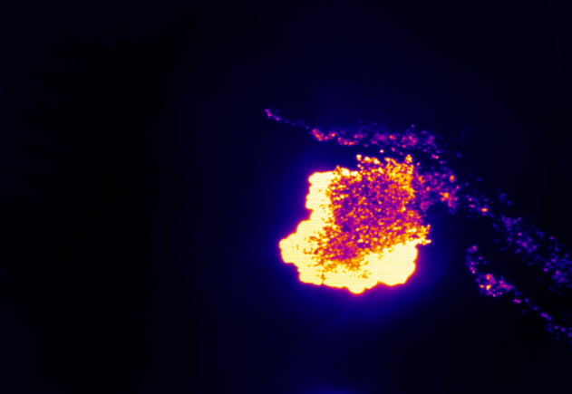
Information NOT Imagery

Slide 4
Information NOT Imagery
Intense Heat = flaming combustion

Slide 5
Information NOT Imagery
Intense Heat = flaming combustion
Scattered Heat = smoldering combustion

Slide 6
Information NOT Imagery
Intense Heat = flaming combustion
Scattered Heat = smoldering combustion
Isolated Heat = small heat clusters
at least 10m from other clusters

Slide 7
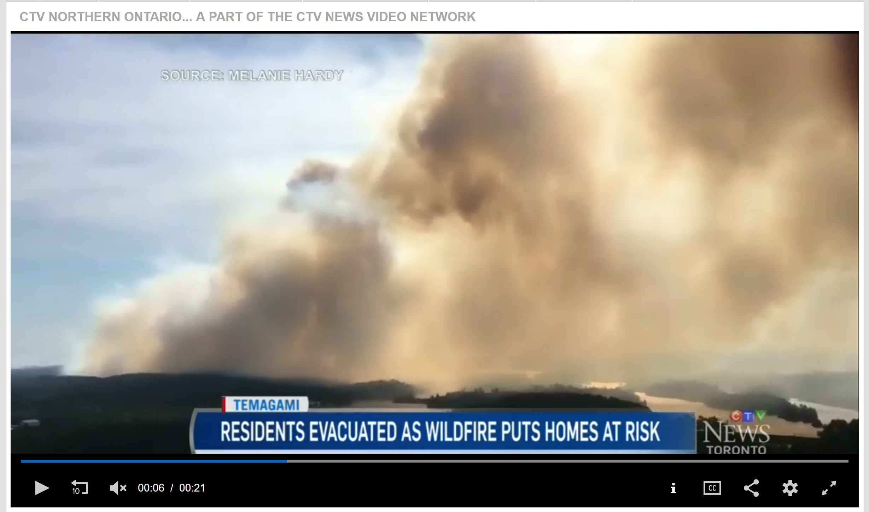
Temagami Area Evacuations

Slide 8
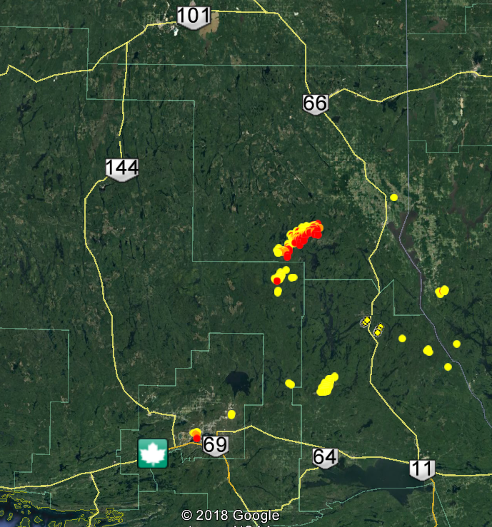
Temagami Area Evacuations
Requested to map multiple fires in the area
First 2 days no products were delivered due to technical difficulties
The first product was released as a single fire for all fires
When the kmz was opened by fire managers this is what they saw…
The service was cancelled.

Slide 9
Temagami Area Evacuations
Lessons Learned:
Emergency situations are not the right time to learn new things
There was no SOP for this type of data
Each fire requires a separate distribution
We need to do better on tech transfer
Action Items:
There needs to be a dedicated agency rep to manage and distribute these products during deployments
Develop an SOP for who receives the data and how to use it for different missions
Release each fire as a separate distribution
Training. Joint AARs. More involvement in operations where appropriate.

Slide 10
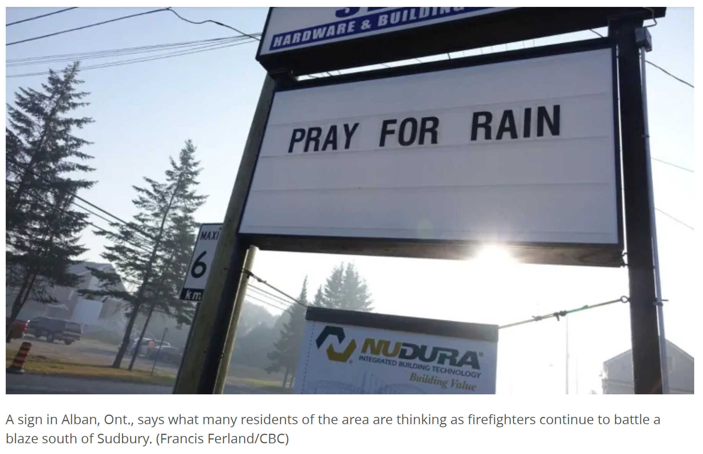
Parry Sound 33

Slide 11

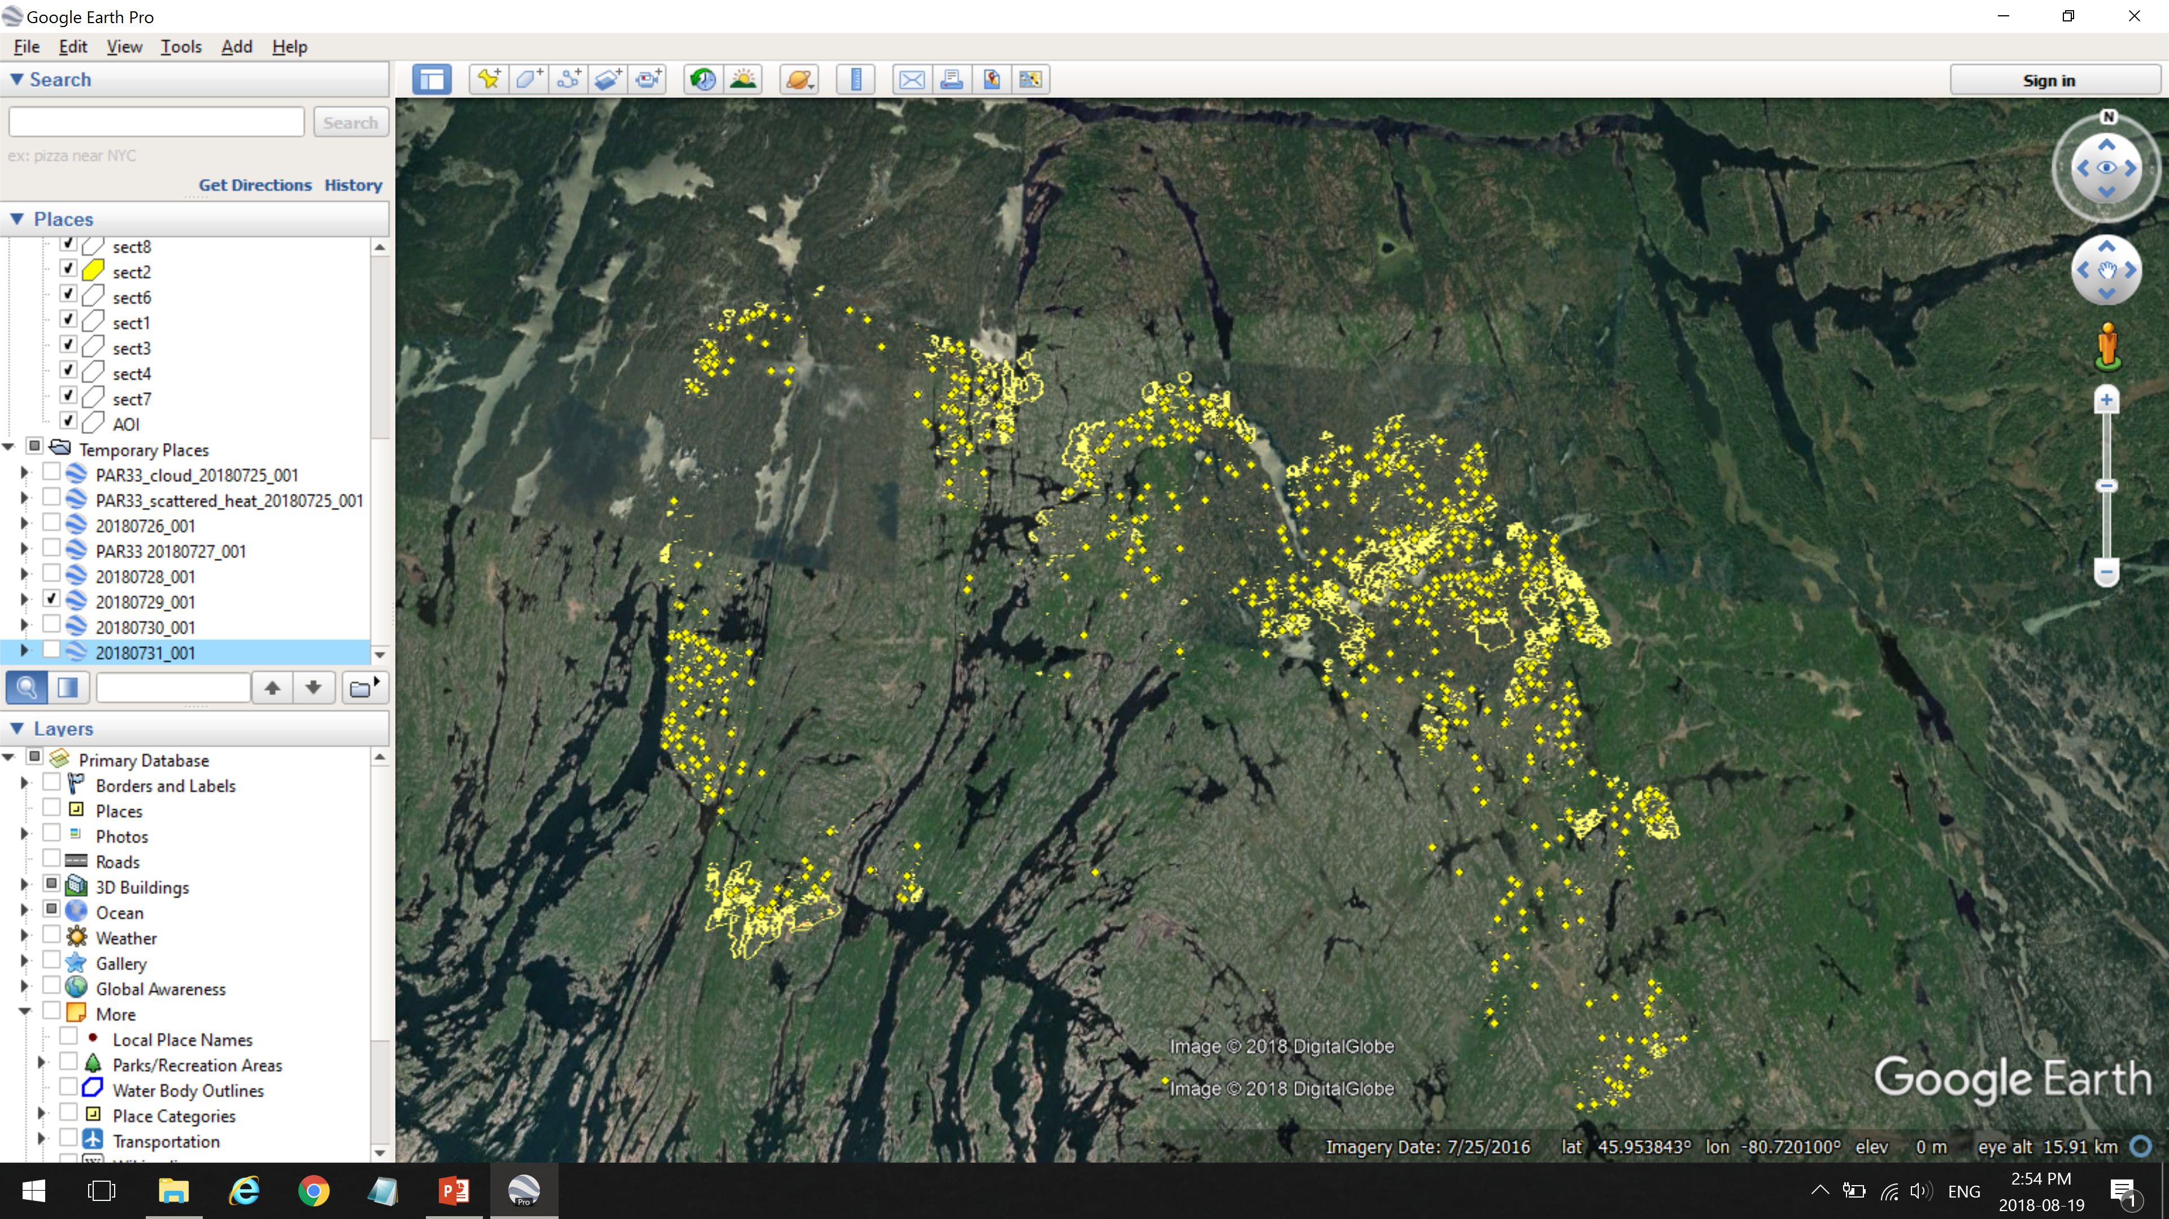
PAR-33 Torchlight Deployment

Slide 12
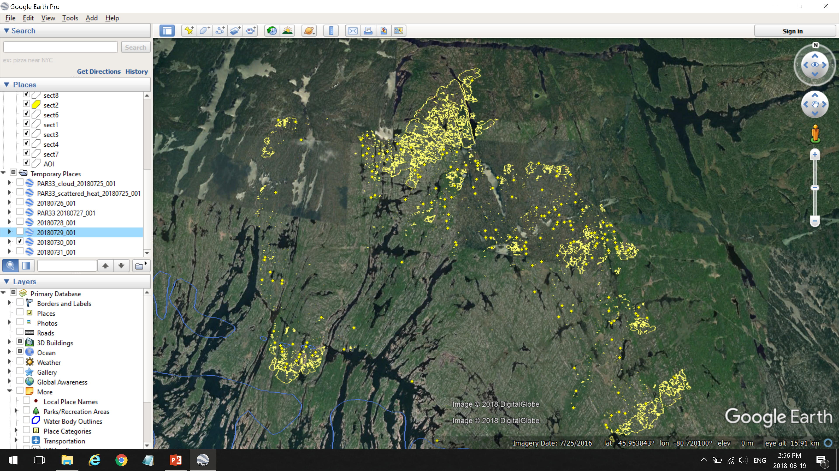
PAR-33 Torchlight Deployment

Slide 13
PAR-33 Torchlight Deployment

Slide 14
PAR-33 Torchlight Deployment
Differences:
The province dedicated people from their R&D division to facilitate data distribution and tech-transfer
Data was delivered directly to the IMTs as well as to other departments
Kmz maps were directly imported into crews avenza app and used on the fire line
Smoke prevented conventional mapping
Torchlight was used to brief the highest levels of government
The province documented feedback and uses thoroughly
A joint AAR is being held in Nov
SOP guidelines for other provinces are being developed for use next year

Slide 15
Enhancements to the algorithms
Converting to stand-alone python script
Adding a contextual thresholding filter to the front end to enhance sensitivity
  And possibly a new category of “cooling”
Human structure detection and classification

Slide 16

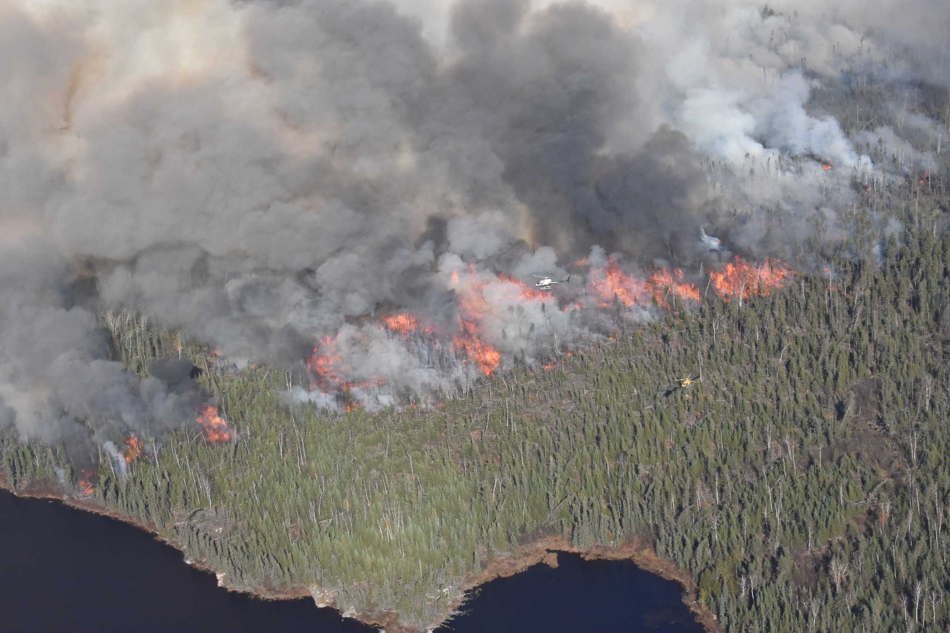
Thank you
Questions?
Photo: Natasha Jurko, CFS

