Slide 1
Cubesats for Earth Science Applications
Sreeja Nag
Bay Area Environmental Research Institute and NASA Ames Research Center, CA USA sreeja.nag@nasa.gov

Slide 2
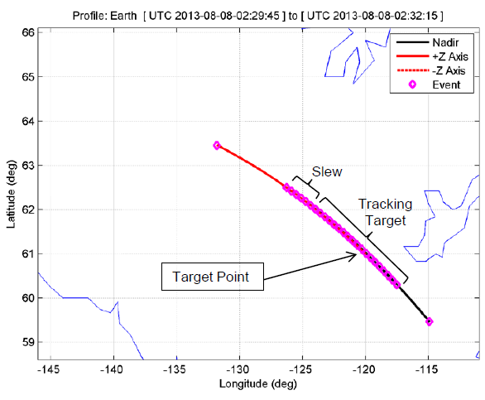
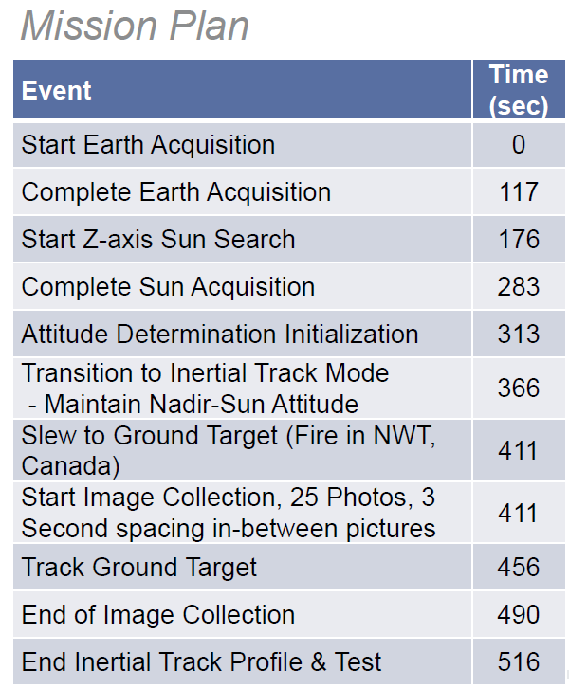
Examples of relevant EO CubeSats
AeroCube4 by Aerospace Corporation in a 450 x 750 km, 65 deg inclined orbit. 1U form factor. Used MODIS, AVHRR, GOES data to get fire info and image by pointing the satellite. Also tracked sunglint & eclipse + did drag formations.
Credits: CubeSat Developers’ Workshop, April 2014
Notes:
50 m to 500 m reso for aerocube… no wavelength ☺
10 cm aperture gives 25 m GSD at 600 km for 4 microns.

Slide 3
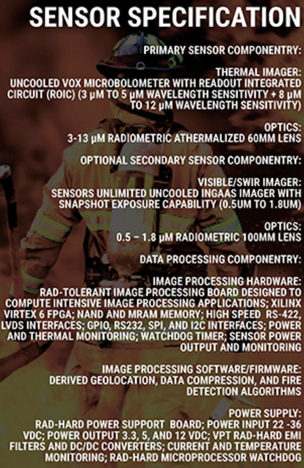
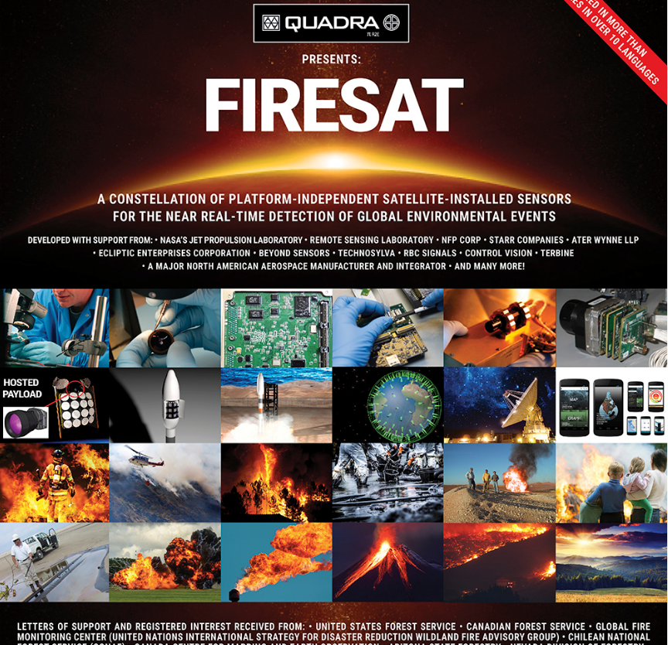
Examples of relevant EO CubeSats
AeroCube4 by Aerospace Corporation in a 450 x 750 km, 65 deg inclined orbit. 1U form factor. Used MODIS, AVHRR, GOES data to get fire info and image by pointing the satellite. Also tracked sunglint & eclipse + did drag formations.
JPL is formulating a constellation of 200 Cubesats (1.5 kg, 1U, 2.5W) to deliver data within 15 mins of occurrence.
Credits: http://www.firesat.info/
Notes:
50 m to 500 m reso for aerocube… no wavelength ☺
10 cm aperture gives 25 m GSD at 600 km for 4 microns.

Slide 4
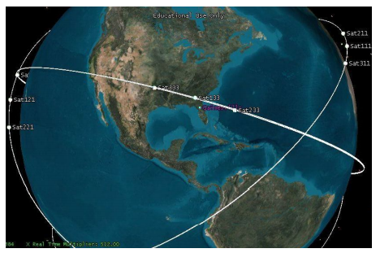
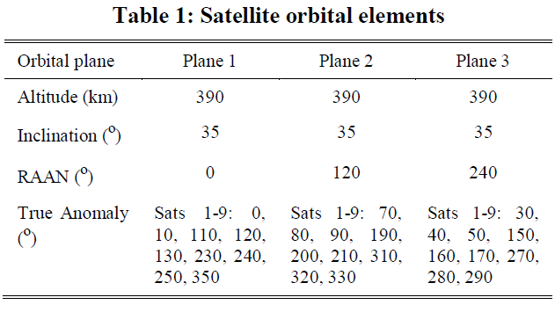
Examples of relevant EO CubeSats
AeroCube4 by Aerospace Corporation in a 450 x 750 km, 65 deg inclined orbit. 1U form factor. Used MODIS, AVHRR, GOES data to get fire info and image by pointing the satellite. Also tracked sunglint & eclipse + did drag formations.
JPL is formulating a constellation of 200 Cubesats (1.5 kg, 1U, 2.5W) to deliver data within 15 mins of occurrence.
Wildfire 3U Cubesat being designed by ClydeSpace inspired by FireBird by NH, Montana State, Los Alamos, AeroCorp. Two 1.5U sats 500 km apart. High inc orbit. Studies gamma ray bursts.
Constellation of nanosats by University of Florida of 27 sats in 3 orb planes with slewing capability.
Credits: AIAA Re-Inventing Space Conference 2012
Notes:
50 m to 500 m reso for aerocube… no wavelength ☺
10 cm aperture gives 25 m GSD at 600 km for 4 microns.

Slide 5
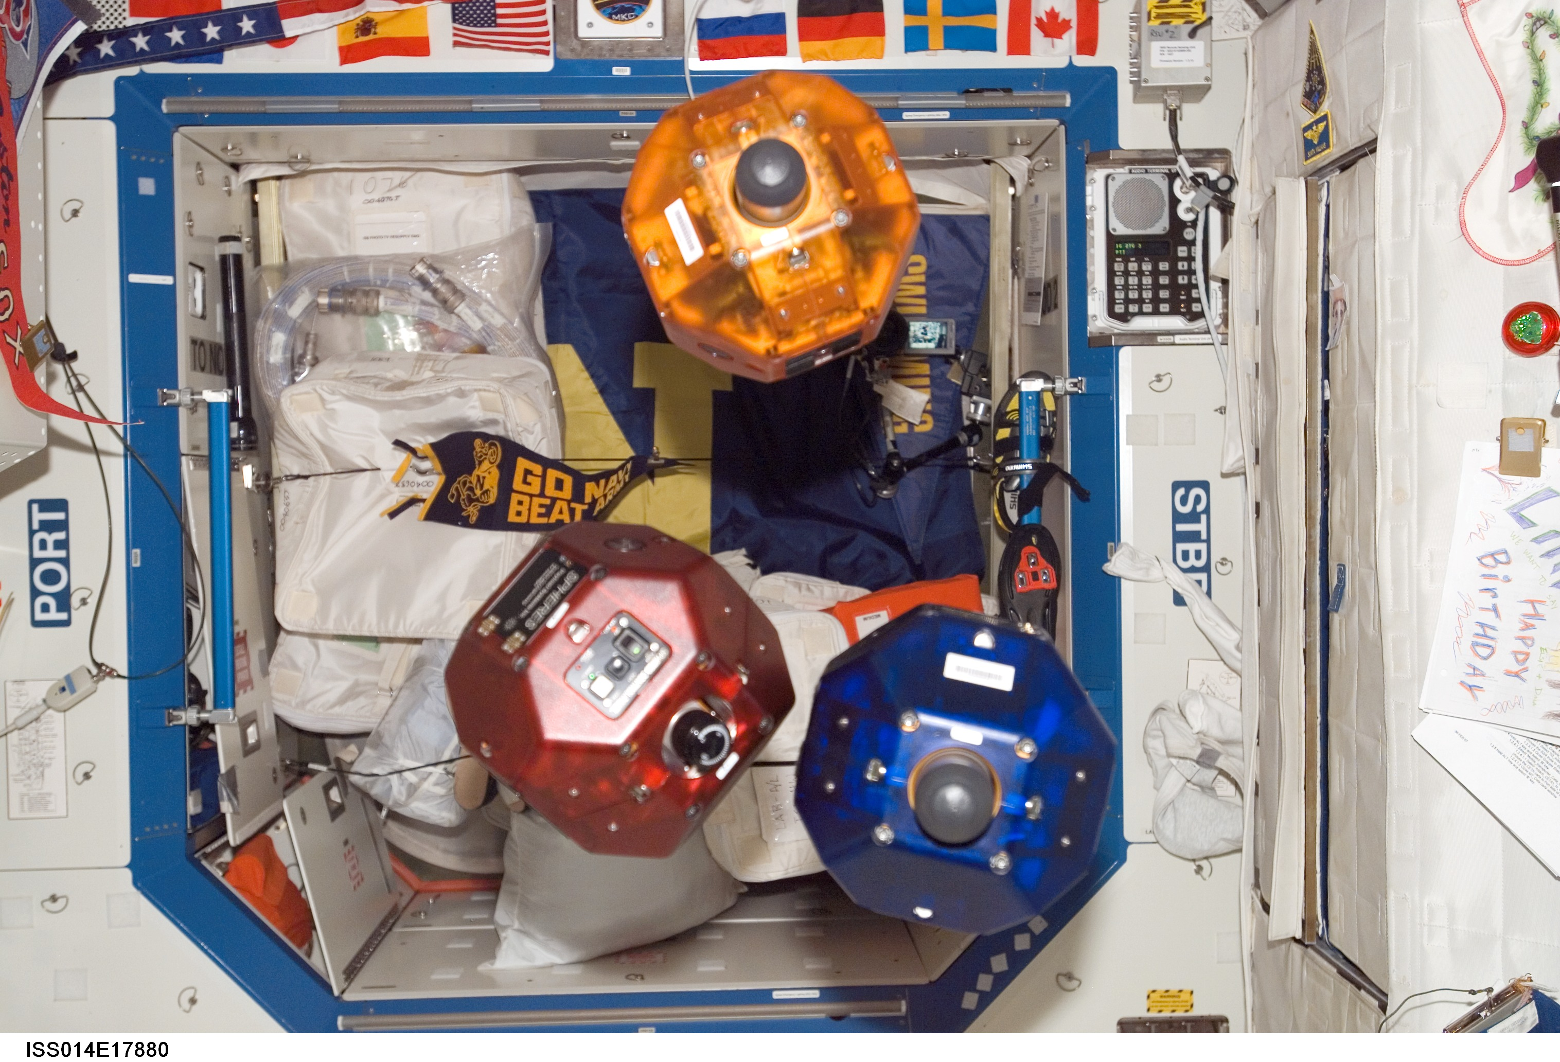
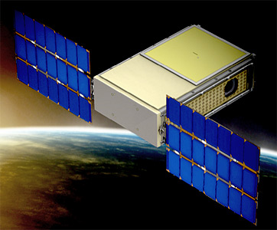
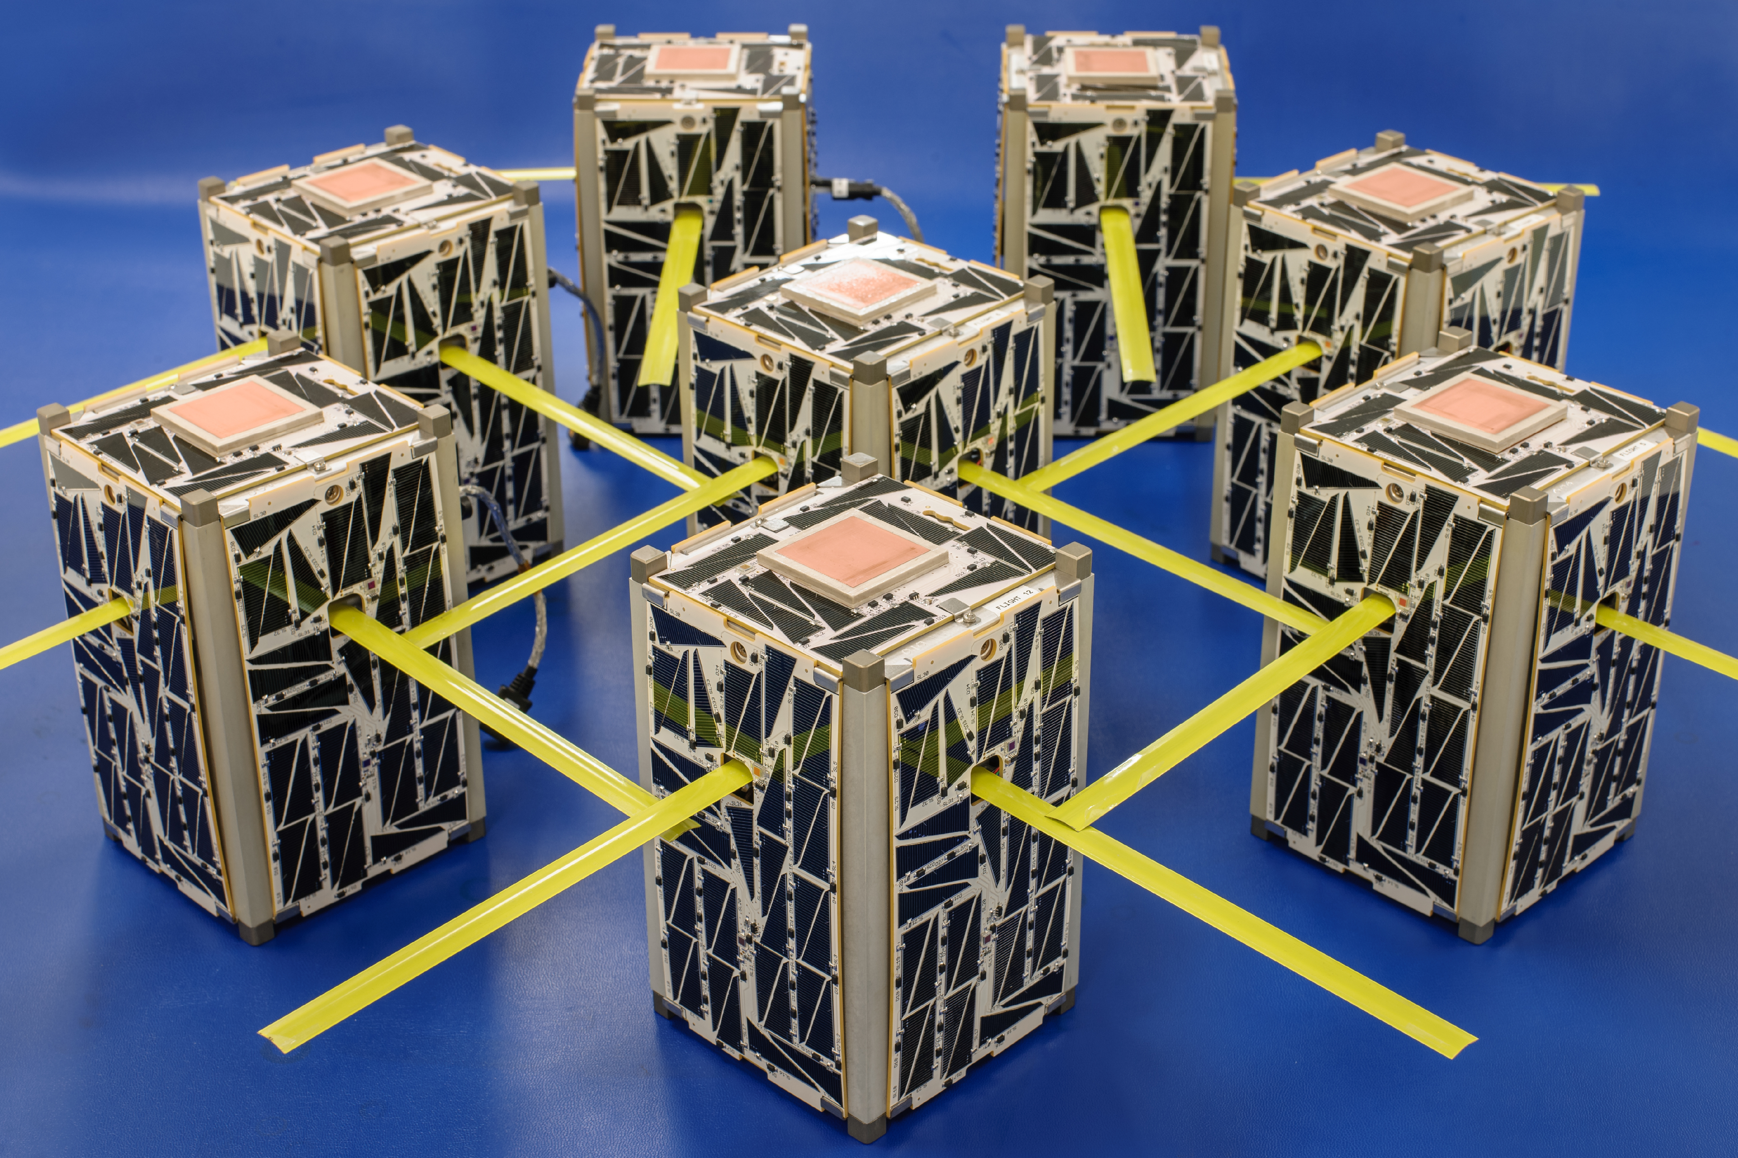
Why did SmallSats get popular?
CubeSats/NanoSats at NASA Ames
The advent of the CubeSat standard
Miniaturization of propulsion, power systems or electronics
Frequent and cheaper launch opportunities by emerging companies such as SpaceX and RocketDyne
Hosted payload opportunities on traditional rockets using the Evolved Expendable Launch Vehicle (EELV) Secondary Payload Adapter (ESPA)
Deployment mechanisms for CubeSat payloads using the PPOD launcher or NanoRacks
Increasing availability of ground stations
Deployment and operation of large numbers of small satellites more feasible than it ever used to be
SPHERES
Proposed and funded BioSentinel
Edison 1.5U satellites
Notes:
Small sats do not produce as much quality individually as the traditional flagships but with large numbers they can
Large numbers are possible because small sats are cheap and fast
Both cubesats and DSMs go hand in hand – prevalent in government industry and academia

Slide 6
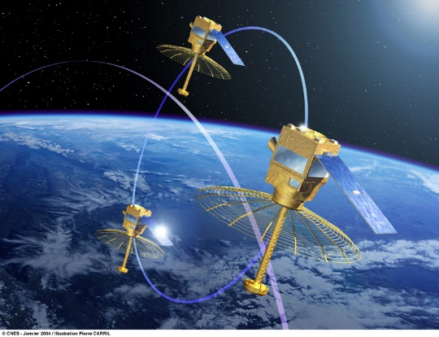
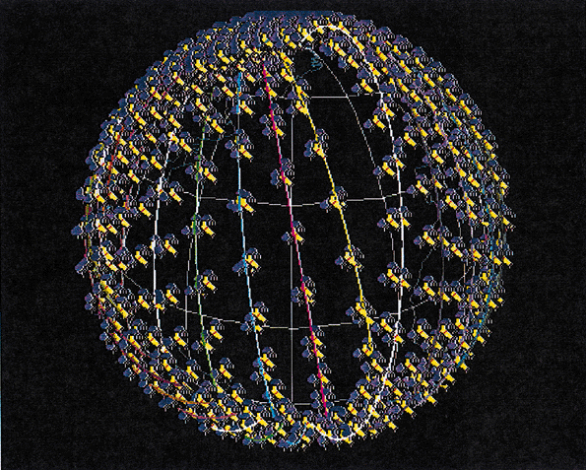
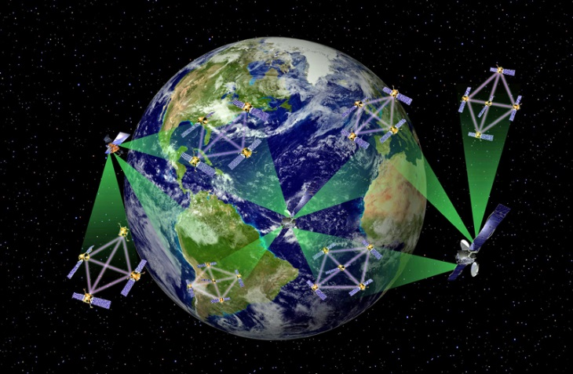
Why Multiple Satellites?
Distributed Space Missions (DSMs): Constellations, formations, ad-hoc constellation - home or hetero, cellularized systems, federated satellites
Performance: Improve sampling and range in spatial (synthetic apertures), temporal (constellations), spectral (fractionated S/C), angular (formations) dimensions
Cost: Need more inter-operability planning, autonomy, scheduling commands + data, ground station networks
Ilities in Operations: Flexibility, Reconfigurability, Scalability, etc.
Better Design: Many conflicting variables and objectives thus better methods needed in Phase A+ - coupled models, machine learning, planning/scheduling methods, etc.
Formation Image: CNES
Constellation Image: ESA
Fractionated S/C Image: DARPA
Slide #1
Notes:
Small sats do not produce as much quality individually as the traditional flagships but with large numbers they can
Large numbers are possible because small sats are cheap and fast
Both cubesats and DSMs go hand in hand – prevalent in government industry and academia

Slide 7
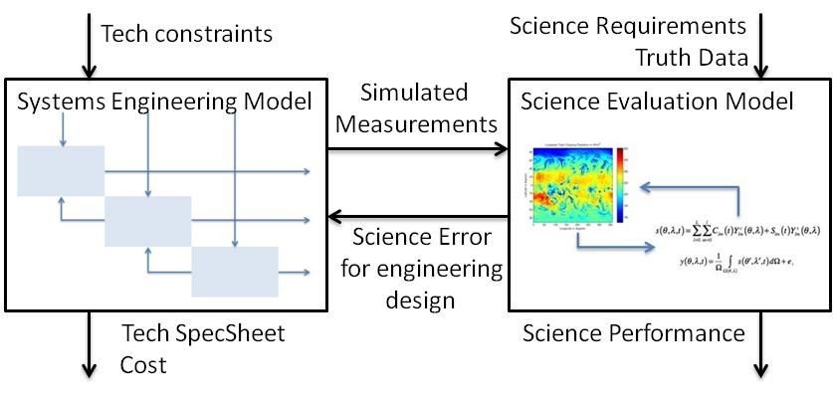
Constellation Design
Coupled and iterative Model Based Systems Engineering (MBSE) + Observing System Simulation Experiments (OSSE) as a function of tech requirements, biomes of interest, science applications
References: . S. Nag, J.J. LeMoigne, D.W. Miller, O.L. de Weck, "A Framework for Orbital Performance Evaluation
in Distributed Space Missions for Earth Observation", IEEE Aerospace Xplore 10.1109/AERO.2015.7119227,
ISBN: 978-1-4799-5379-0, March 2015
S. Nag, C.K. Gatebe, D.W. Miller, O.L. de Weck, "Effect of Satellite Formation Architectures and Imaging Modes
on Global Albedo Estimation", Acta Astronautica 126 (2016), 77-97, DOI:10.1016/j.actaastro.2016.04.00

Slide 8
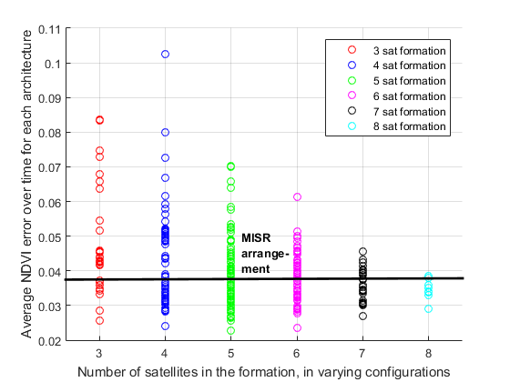
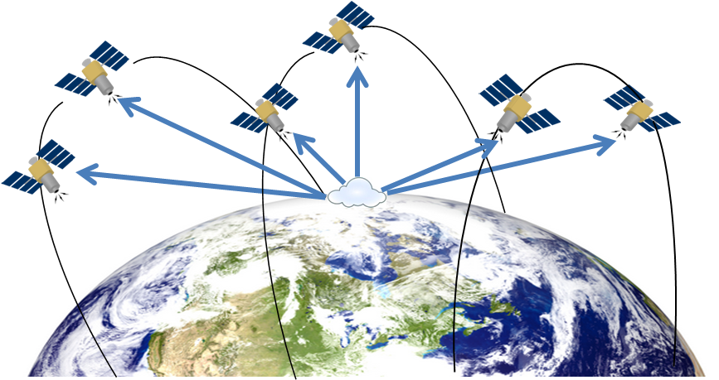
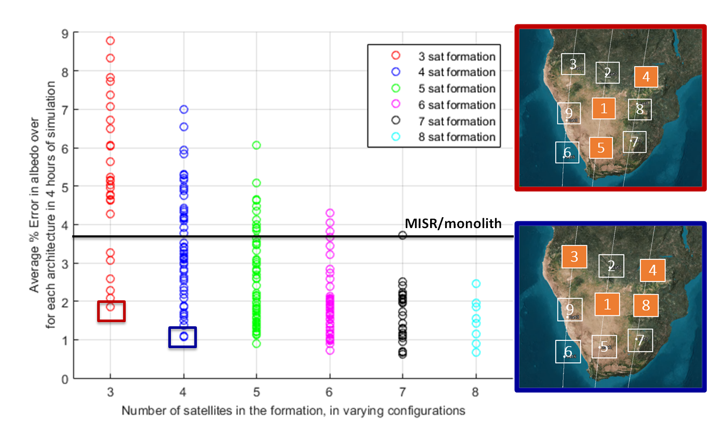
Formation Design - Applications
All products in Multi-Angular Remote Sensing are improved by co-pointing formations
Albedo
Estimation:
NDVI
Estimation:
References: S. Nag, C.K. Gatebe, T.Hilker, "Simulation of Bidirectional Reflectance-Distribution Function
Measurements using Small Satellite Formations", IEEE Journal of Selected Topics in Applied Earth Observations
and Remote Sensing, accepted in April 2016, in press
S. Nag, C.K. Gatebe, D.W. Miller, O.L. de Weck, "Effect of Satellite Formation Architectures and Imaging Modes
on Global Albedo Estimation", Acta Astronautica 126 (2016), 77-97, DOI:10.1016/j.actaastro.2016.04.00

Slide 9
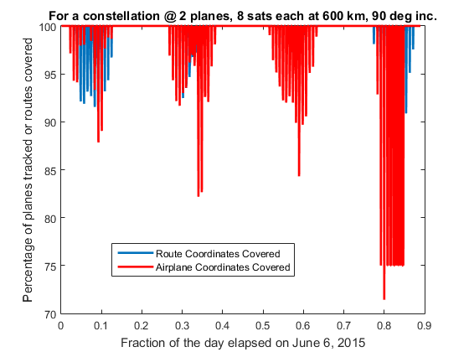
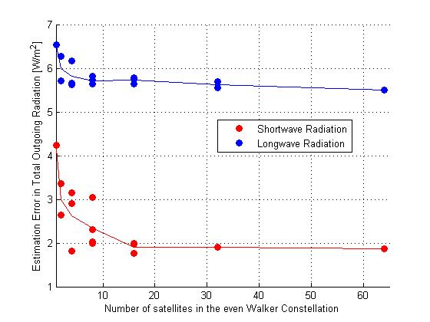
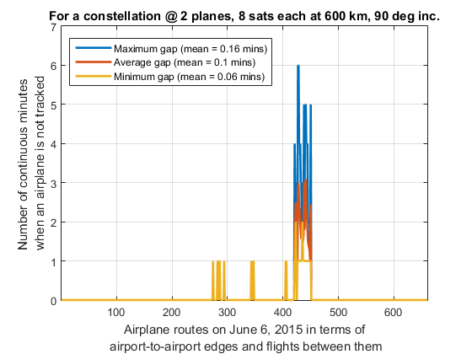
Constellation Design - Applications
All products in Time-Critical Remote Sensing are improved by Constellations
Total Global Outgoing radiation:
Orbit at 710 km, 130º FOV, 98.18º inc
Air Traffic
Monitoring:
CERES on TRMM errors: 15.37 W/m² for shortwave radiation and 34.31 W/m² for longwave radiation.
References: S. Nag, "Satellite Constellation Mission Design using Model-Based Systems Engineering and Observing System Simulation Experiments", AIAA/USU Small Satellite Conference, August 2014
S. Nag, J. L. Rios, D. Gerhardt, C. Pham, "CubeSat Constellation Design for Air Traffic Monitoring", Acta Astronautica, accepted in May 2016

Slide 10
Constellation Design – Optimize Pointing
OBJECTIVES:
Develop capability to scheduling pointing operations for NFoV sensors, for imaging, calibration and downlink, on Single spacecraft in known orbits and more importantly on Satellite constellations
Demonstrate value through two separate use cases
  Single and multiple satellites in the LandSat orbits with the existing FOVs
  Single and multiple CubeSats for coral reef monitoring at a few meters of resolution
APPROACH:
Refine orienteering and constraint programming algorithm initially developed for INTEX-B, to output:
  Scheduling of coverage of customized regions
  Trades between schedules and performance
  Consideration of multiple characteristics, including sensor FOV, satellite orbits and expected cloud cover
Implement tool in MatLab using Mixed Integer Linear Programming (MILP)
Simulate potential images for a given set of orbits using satellite toolkit
Example of improving coverage of localized area by scheduling the pointing of a single satellite in a 400 km circular orbit

Slide 11
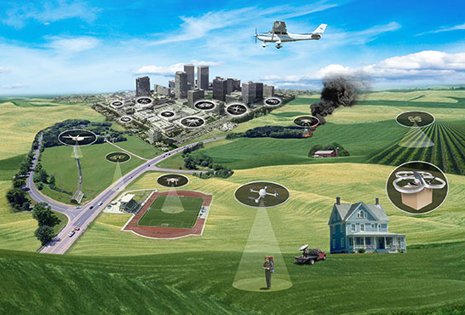
Constellation Design – Around UAVs
Coordinated communication of state info between UAV to ground stations using Automatic Dependent Surveillance Broadcast (ADS-B)
Detailed model of range and signal fidelity of every UAV with respect to operator, other UAVs and manned aircraft
Adding satellites to the model, especially those with intelligent and dynamic pointing abilities, will create a Sensor Web of remote sensing capability.
Unmanned Aircraft System (UAS) Traffic Management (UTM)
Enabling Civilian Low-Altitude Airspace and Unmanned Aircraft System Operations
Reference: S. Nag, J. L. Rios, D. Gerhardt, C. Pham, "CubeSat Constellation Design for Air Traffic Monitoring", Acta Astronautica, accepted in May 2016

Slide 12
Summary
Small sats and constellations are new technologies for Earth Observation and better science measurements
Wildfires can be identified using MODIS images 4 times a day but that is too long for effective fire monitoring. Geostationary satellites provide sub-hour coverage but at a spatial resolution of several kms. This spatio-temporal problem can be solved by CubeSat constellations
Wavelengths of interest: RGB, SWIR and the 4um band (from MODIS, VIIRS, can be changed). 4um allows 25m nadir pixels at a 500 km altitude using a 10 cm diameter aperture working at diffraction limit. Swath <10 km….
UAVs can cover a large portion of imaging for detected fires within Class G airspace < 1000 ft (UTM model from ARC can be modified). The rest can be covered using agile pointing CubeSats arranged in a constellation (tradespace analysis tool from GSFC available).
The performance to cost feasibility of such an approach is yet to be determined. How many satellites arranged how? Pointing schedules? Downlink schedules? Time to coverage and revisit? Spatial overlap?

Slide 13
Questions? sreeja.nag@nasa.gov

