Slide 1
Spatiotemporal Trends in Wildfires Across the Western United States
Keith T. Weber, GISP
GIS Director, ISU

Slide 2
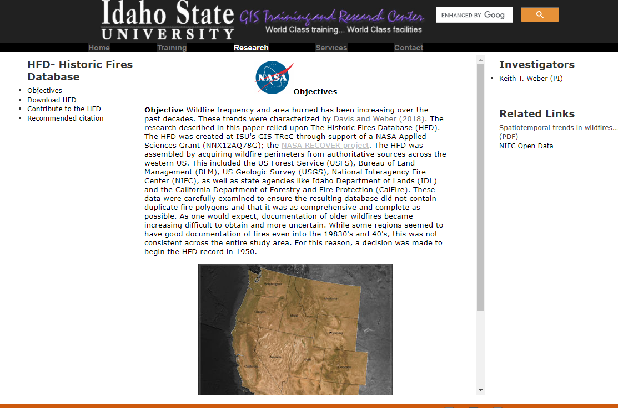
Lineage
This study is the result of the NASA RECOVER DSS, funded by NASA Applied Sciences
One dataset collected for RECOVER was past wildfires
This grew into the Historic Fires Database
  https://giscenter.isu.edu/research/Techpg/HFD/index.htm

Slide 3
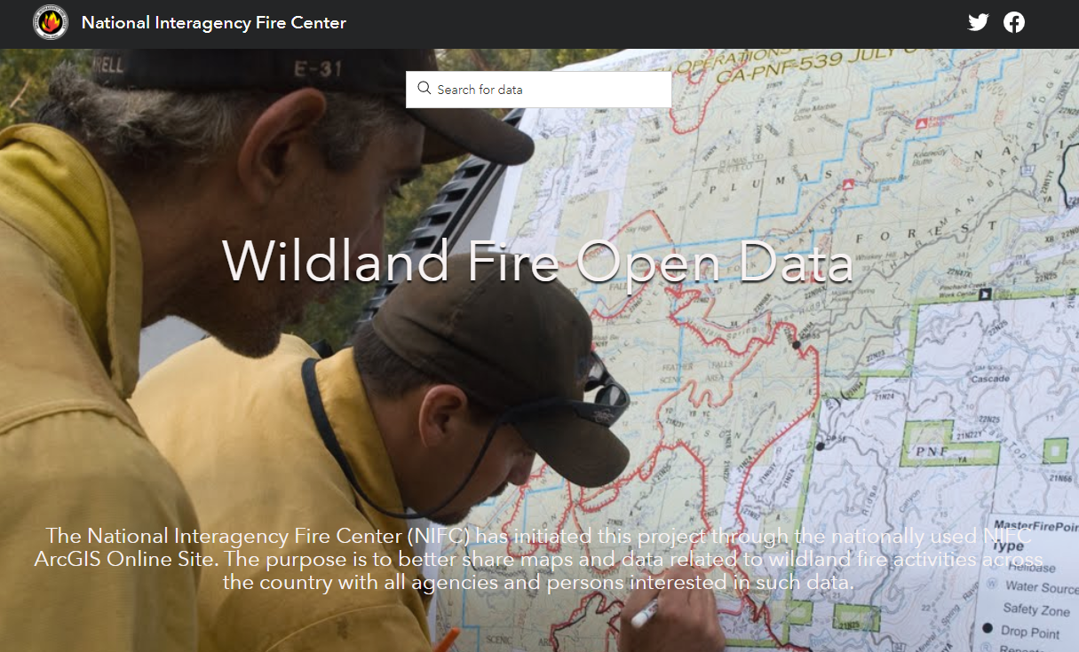
Historic Fires Database
Contains all documented wildfires (1950-2019)¹
Originally assembled from authoritative sources
  USGS GeoMac
  NIFC
  BLM
  USFS
  State Agencies (e.g., CalFire)
More recently, source data are acquired from NIFC Open Data
1- This database is not considered comprehensive but is as complete as possible

Slide 4
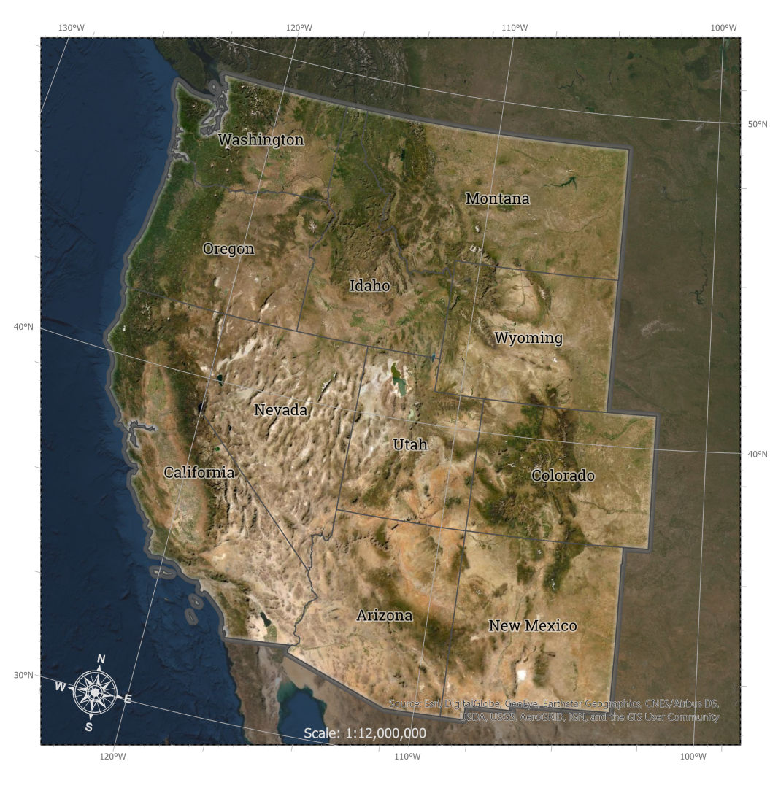
Extent/Scope
Spatial extent (11 western states)
Temporal extent (1950-2019)

Slide 5
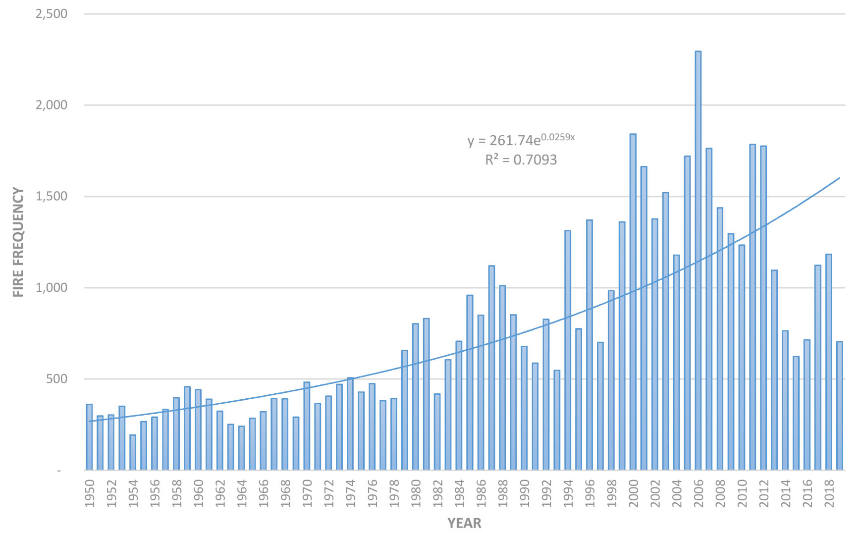
Wildfires Across Time
Frequency (count) of wildfires
Line of best fit is exponential
Possible bias toward underreporting (1950-1980)

Slide 6
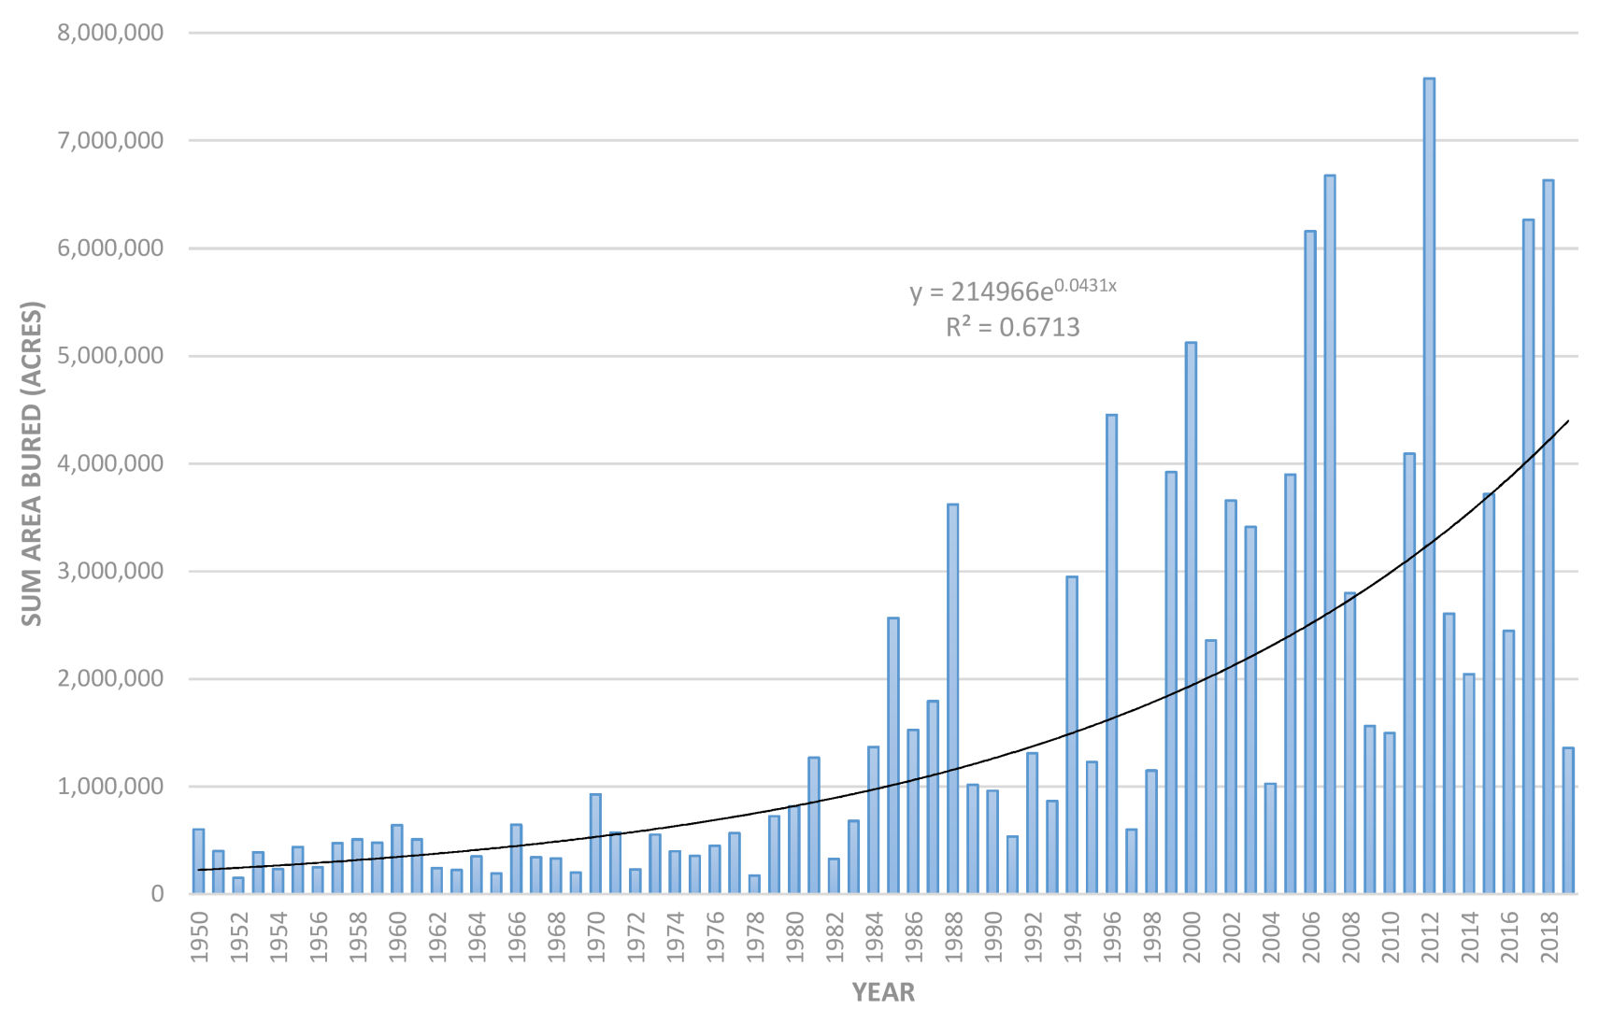
Wildfires Across Time (cont’d)
Total area burned
Line of best fit is exponential
Possible bias toward underreporting (1950-1980)

Slide 7
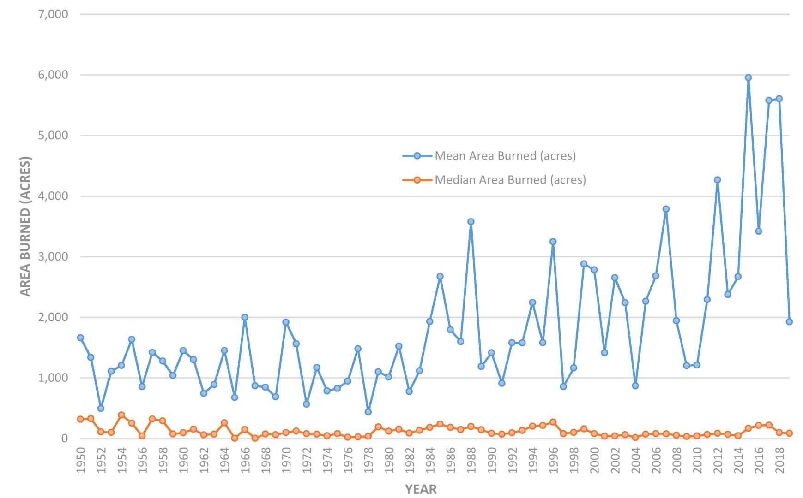
Area Burned is Not Normal
Divergence between mean and median

Slide 8
Mega-Fires
Fires burning > 100,000 acres (156 mi²)

Slide 9
Take Home Message
Wildfires are:
  More frequent
  Larger
The incidence of mega-fires is also becoming more frequent

Slide 10
Questions?
Links
  Contact: webekeit@isu.edu
  HFD: https://giscenter.isu.edu/research/Techpg/HFD/index.htm
  Published paper: https://giscenter.isu.edu/research/Techpg/HFD/pdf/remotesensing12_02959.pdf

