Slide 1






WildfireDLN
Wildland Fire Data Logistics Network (WildfireDLN)
A Demonstration of Resilient Data Sharing
Presented by:
Nancy French, Andrew Poley, Brad Schmidt
Project Leads:
Dr. Nancy HF French, PI
Michigan Tech Research Institute
Dr. Martin Swany Dr. Micah Beck
Dr. Ezra Kissel University of Tennessee, Knoxville
Indiana University
SPONSORED BY

Slide 2
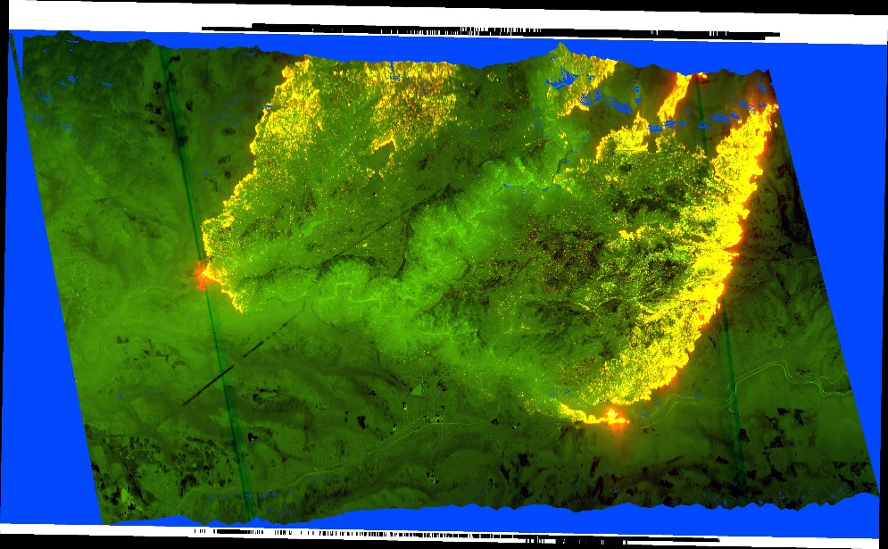
Project Motivation
  Wildland firefighting operations face challenges due to:
  Network coverage
  Data portability
Spaceborne & airborne systems routinely provide large data for decision support.
Access to large, high-value data files can be limited.
Transfer is slow or not possible for large files (e.g. satellite imagery, video)
  Insufficient bandwidth/storage
  Manual process is required
All data transfers are not possible
  limited/no connectivity due to:
    Infrastructure damage
    Power limitations
    Insufficient cell tower coverage
  Limitations of existing solutions:
  Manual transfer
    Physical transport
    Manual data manipulation
  Connecting cables and wires
  “Namespace integration”
  Data corruption (incomplete downloads) during transfer
Above: NIROPS image of the King Fire in Pollock Pines, CA.

Slide 3
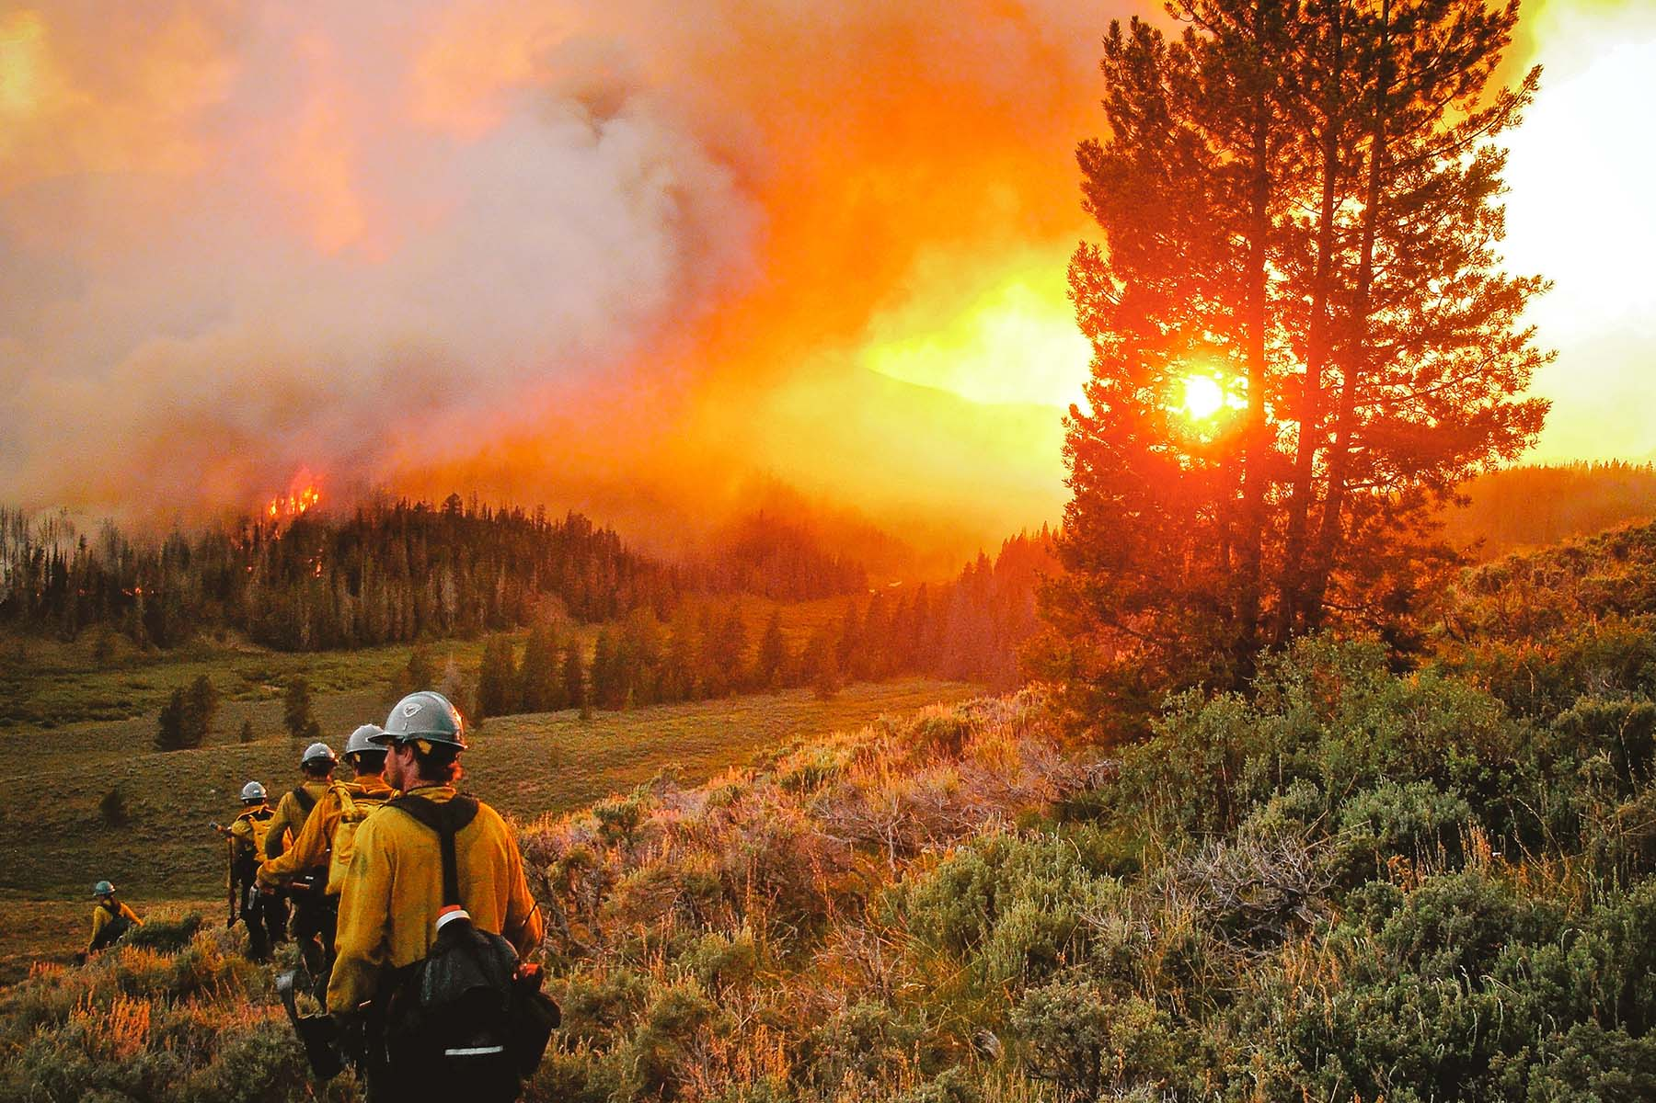


Project Goal & Impact
  Overarching Goal:
  To deliver rich and informative data with a robust system that supports file transfer and access across disconnected, heterogeneous networks.
  To enhance and extend current operational data sharing capabilities for:
Improved firefighter and public safety
Better wildland fire predictions
More informed fire operations
(wildfire and prescribed fires)
PSCR Vision:
Public safety services and mission critical systems will be able to function properly in situations of poor network connectivity due to natural interference or infrastructural faults.

Slide 4
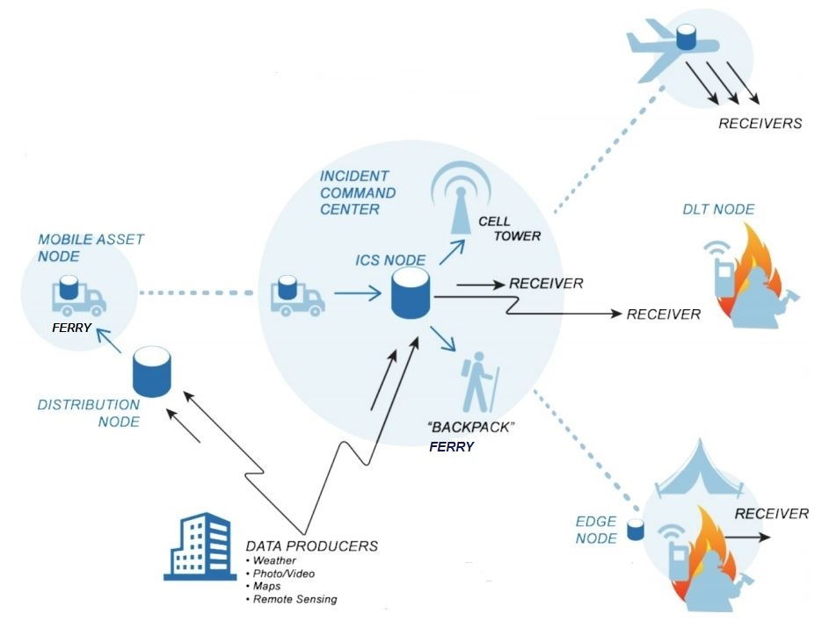
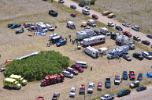
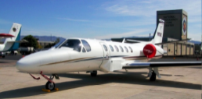


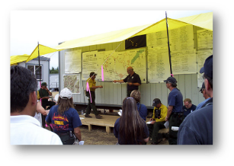
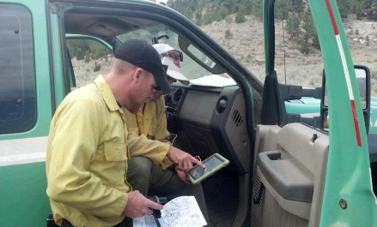
System Overview
The Wildland-fire Data Logistics Network
Solution: Develop hardware/software tools for data logistics
→ Data Ferry

Slide 5


Prototyping Scenarios
State of Colorado Center of Excellence for Advanced Technology Aerial Firefighting (CoE):
Development of ATAK-based data access
Develop an intelligent data ferrying system
National Interagency Fire Center (NIFC):
Identify relevant data needed for ICT/FBAN/LTAN/IMET, etc.
Improve current methods of moving large data to IC on-site systems
Deploy and test prototype hardware-software system with fire operations personnel that integrates the new data sharing system with existing capabilities and relevant data.

Slide 6
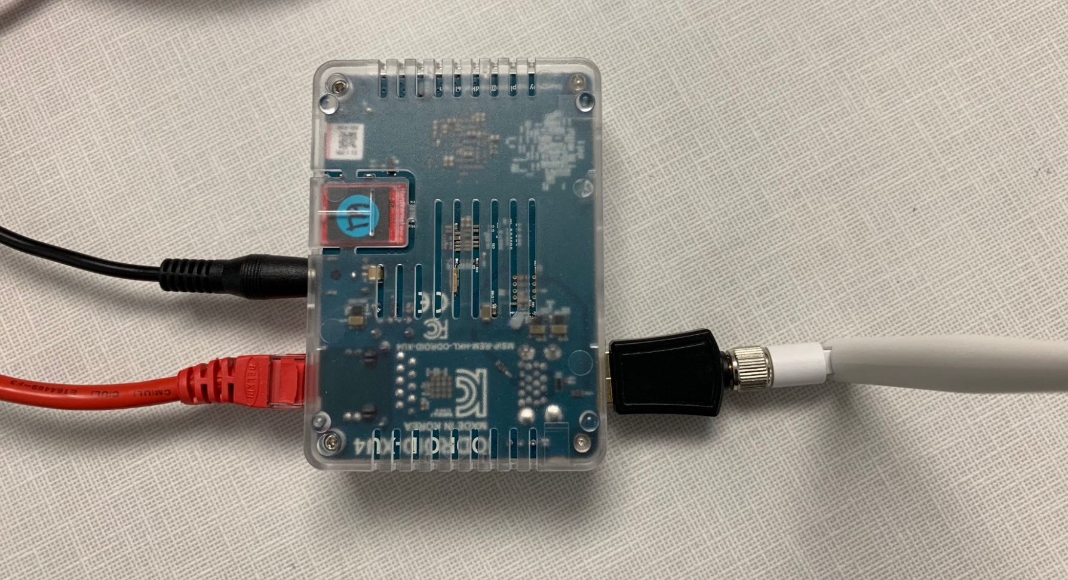
Base Station Hardware
ODROID XU4 embedded system with WIFI/LORA/GPS
Support expandable external storage
Connects to ICS LAN or local laptop for local data staging and distribution

Slide 7
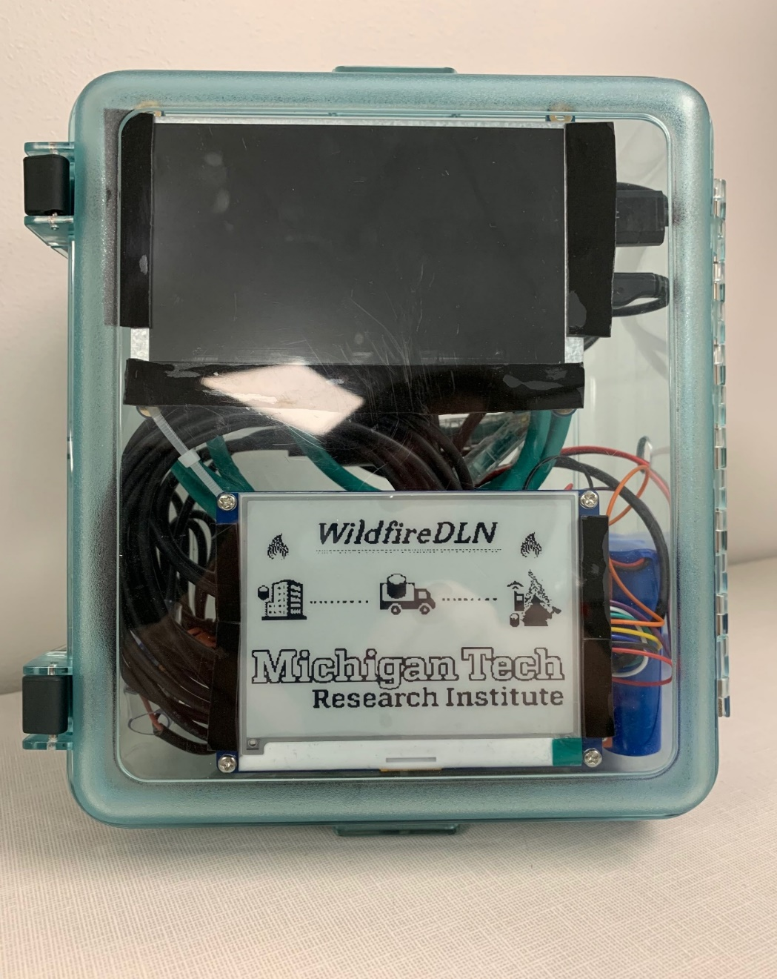
Data Ferry – Field Prototype
Intel x86 UP board with fast SSD
Numerous WIFI/LORA/GPS radios
E-ink display for low-power system status
HDMI display for logging and debugging
Battery-driven with solar connection
Light weather-proofing in initial design

Slide 8
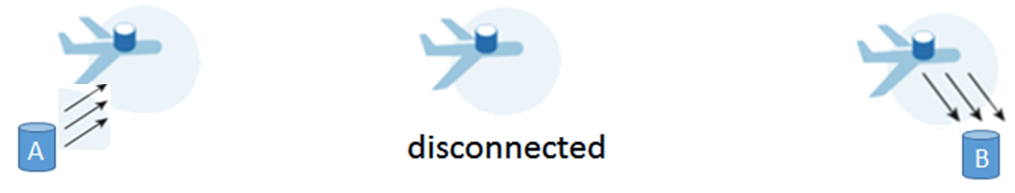



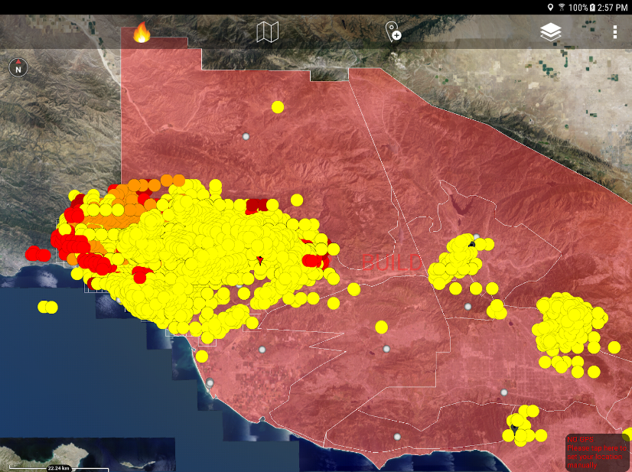

Data Ferrying & User Experience
Improving user experience is a fundamental project goal
High-performance wireless
  Low-power signaling
  To turn on the high-speed wireless when needed
  (for power conservation)
Automated/integrated connectivity
  “Always there with delay”
Fully automated transfer of data
  Detection of corruption
  Re-transmission
  View-consistency
ATAK interface
  Fully developed
  User-tested
  Flexible for development
  (but not the only solution)
Data Source
WDLN Ferry
Data Destination
Duplex communication
Potential for two-way data sharing
SUCCESS is:
Data is delivered without user anxiety
Users don’t know how they got data

Slide 9
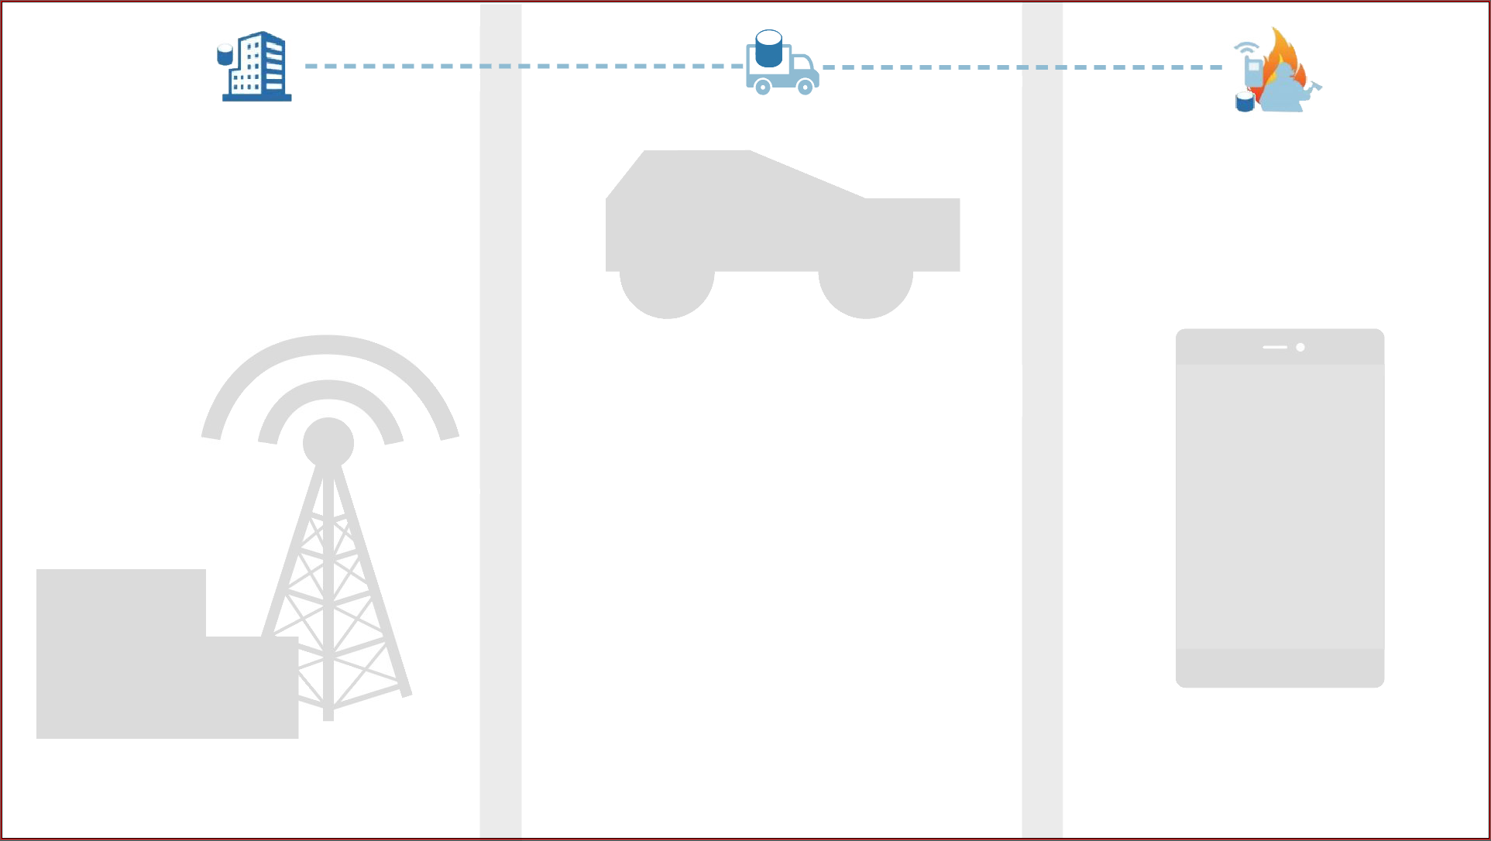

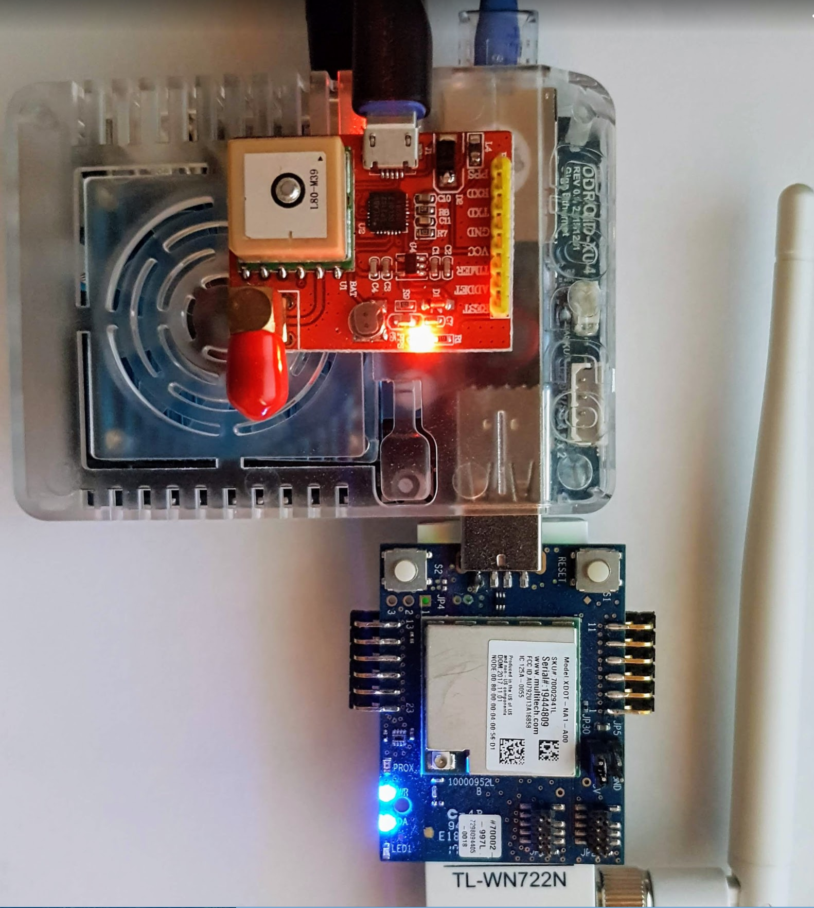




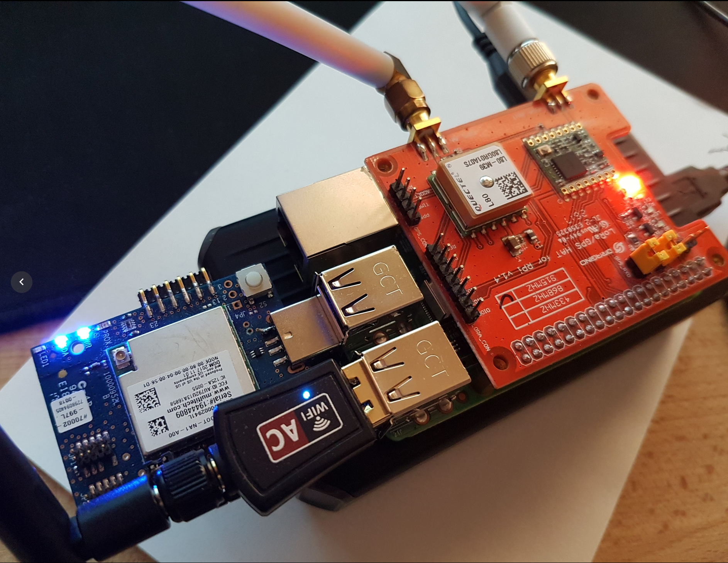



System Architecture – Hardware
Base station
Access to resources/data
User-facing web site
DLT software
Ferry platform
Ferry software resources
Communications hardware
Front-end system
Customized Android-based app (ATAK)
Mobile integration with
Android frontend
ARM-based, multi-core base station with fast storage
4G LTE
802.11 WiFi
Low-power radio
4G LTE, 802.11 WiFi
Low-power, embedded ferry platforms (RPI3)

Slide 10
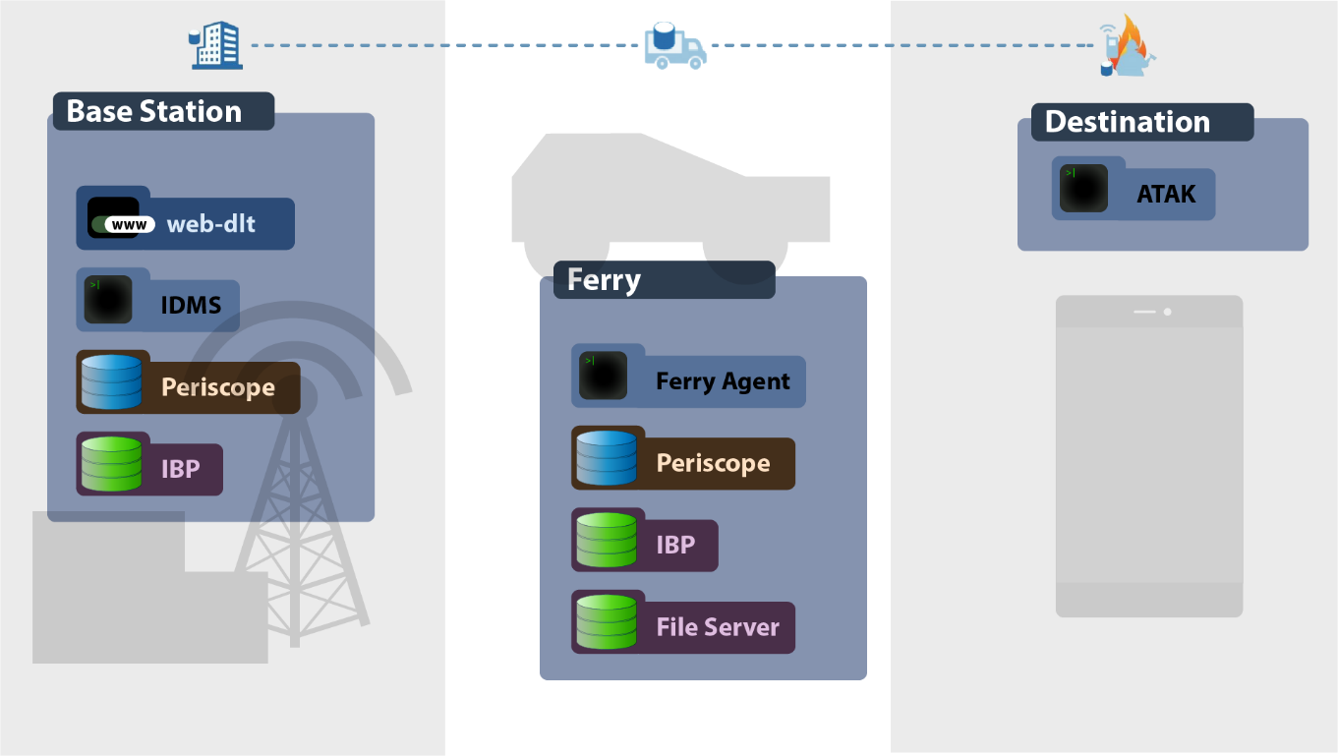
System Architecture – Software
Web-DLT
User facing web portal
IDMS
Data distribution manager
Periscope
Metadata storage database
IBP Depot
Block data storage
File Server
Web Mapping Service (WMS)
DLT and HTTP
ATAK
Mobile data client

Slide 11
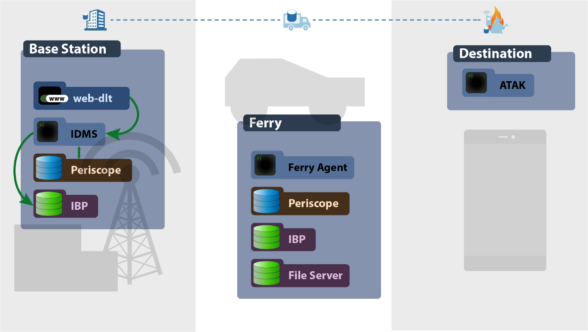
Data Request
Coordinator selects file to be sent to specified locations using the web-dlt portal
IDMS prepares the data for distribution:
Records the request for bookkeeping
Uploads the data to IBP, possibly from distant networked sources

Slide 12
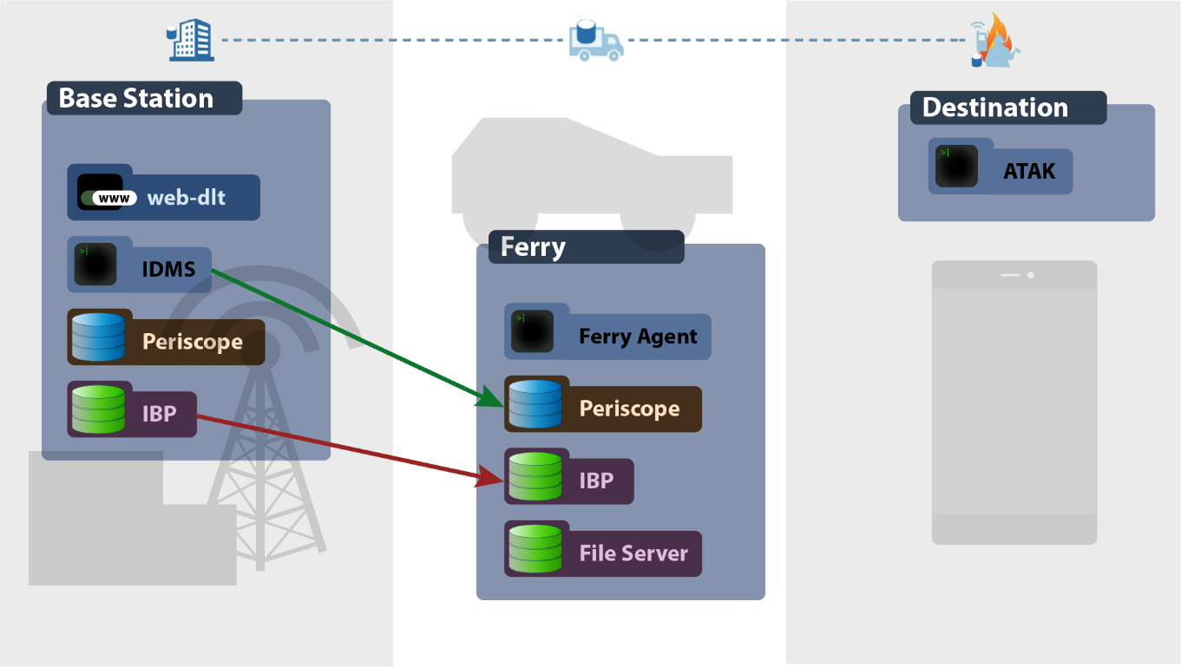
Data Transfer
After IDMS detects a ferry bound toward the destination:
IDMS records the transaction onto the ferry
IBP transfers the data onto the ferry

Slide 13
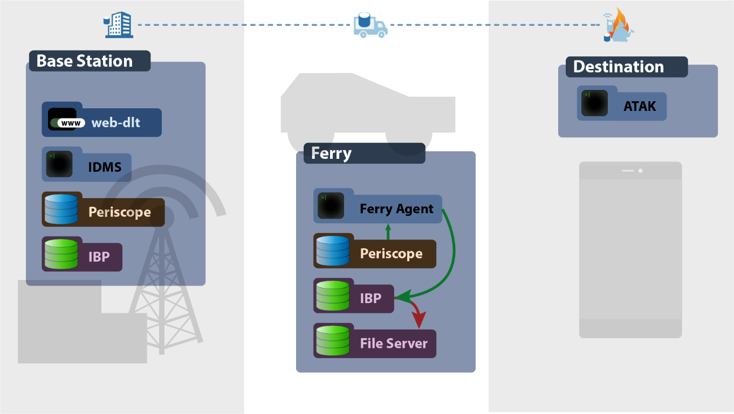
Ferry Enroute
While the ferry travels:
The ferry agent downloads all data placed into IBP into a local file server
File server is available for external downloads

Slide 14

ATAK Download
When the destination detects the ferry’s local WiFi:
ATAK automatically downloads all new files available on the ferry’s file server
Ferry locations are visible as a map overlay

Slide 15
Base Station Admin Portal
The Admin Portal presents a familiar drag-and-drop interface for managing files on the WildfireDLN system
When the Base Station is connected to a computer, the Admin Portal can be found at:
  http://wdln-base:9000/manage
Files and Folders are added to the system by dragging files onto the web page
Users can define policies to dictate how files are dispatched to WildfireDLN Ferries.

Slide 16
ATAK Development
WildfireDLN Plugin seamlessly integrates DLN Ferry services into ATAK to provide an easy access method of downloading/uploading files to mobile devices
Automatically connects to available ferries
- Connected ferries display as pins on the ATAK map
Lists remote and local files
- Allows you to view images/video files without leaving ATAK
- Images with geospatial information can be viewed as an overlay on the ATAK map
++ Future development: placing pins that allow you to view videos tagged with geospatial information on the map

Slide 17
ATAK Development
Allows download of remote files to the device
- Auto-download feature will download any file from a ferry the mobile device doesn’t already have
Allows users to upload files from mobile device to connected ferries so they can be easily shared with other users
Most of the WDLN plug-in code is portable to other android applications and other platforms.

Slide 18

Demonstration
WildfireDLN

Slide 19
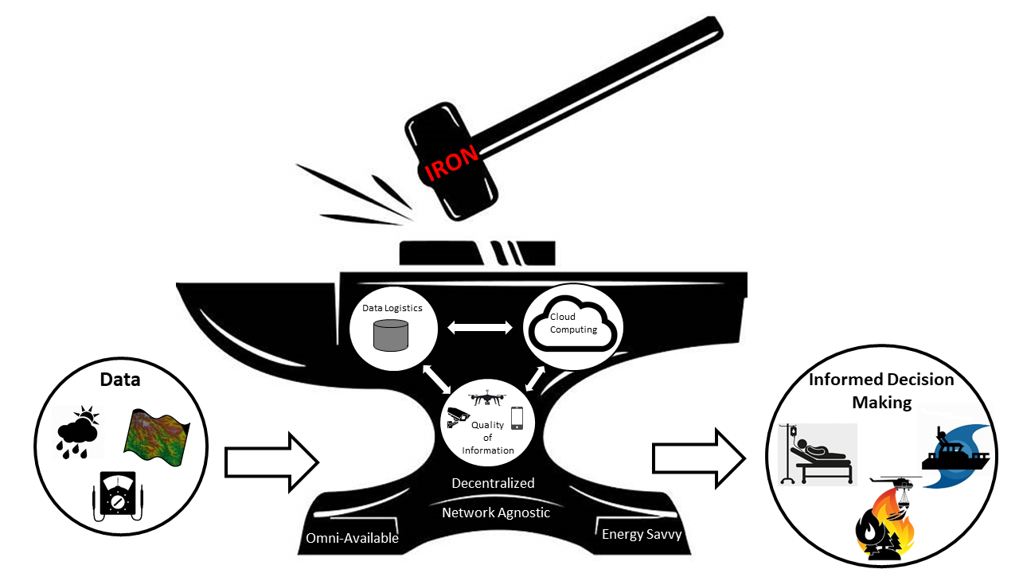



Bigger Picture
IRON: The Framework for Emergency Responders
Foundation Layer: Establishing Communication Channels
Operation Layer:
Security and Quality of Information Protocols
Computation Layer: Advanced Analytics for Decision Support
IRON is our vision of a platform for future emergency response services. It is a secure, on-demand, adaptive, efficient, and opportunistic networked information system built on situational intelligence for use in disaster-disconnected environments. It requires new models of storage, computation, networking, and system management tolerant of network disruption and heterogeneous system resources. It provides reliable computation, communication, and storage in disaster environments when infrastructure may be destroyed and communication disrupted. IRON advances the state of the art by optimizing transformation of data into information in communication-limited situations, commonplace during a disaster

