Slide 1

WE RISE TOGETHER
MINDEROO’S FIRE AND FLOOD RESILIENCE INITIATIVE

Slide 2
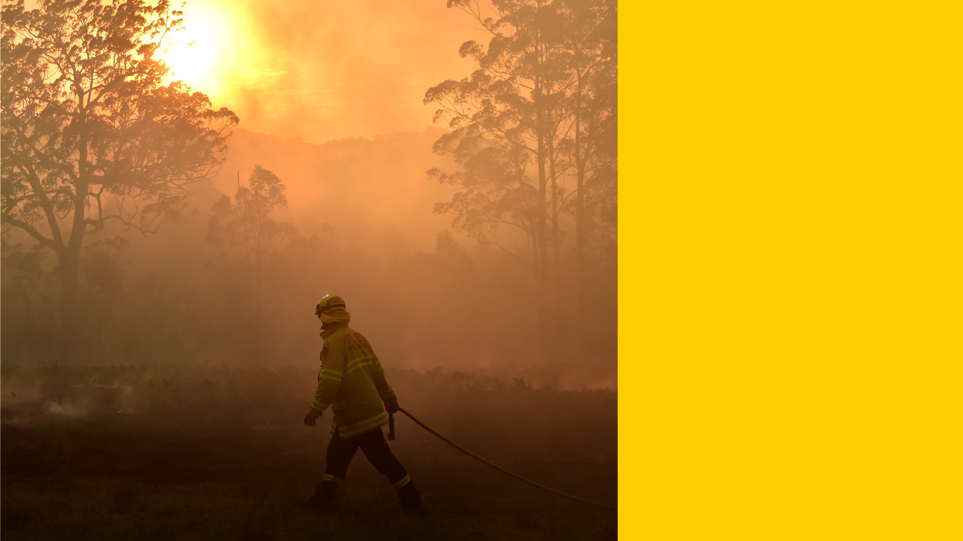





MISSIONS
FIRE
SHIELD
TO REDUCE THE HARM CAUSED BY FIRE AND FLOODS BY 2025
RESILIENT
COMMUNITIES
HEALTHY
LANDSCAPES
UNDERPINNED BY
RESILIENCE DATA COLLECTIVE
FIRE AND FLOOD RESILIENCE
Notes:
Our role
enabler, convenor
We are not the end users, we are not the technical delivery experts but we fill a vital role in bringing parties together and focusing solely on the goal of reducing impact that wildfires and floods have on communities and landscape

Slide 3
Notes:
In establishing the Resilient Communities Mission we have identified four areas of focus
Leadership
Knowledge
Resources
Investment
In the next three months we will undertake the following initiatives in these areas

Slide 4






FIRE SHIELD
Reduce the scale and impact of bushfires by being able to extinguish DANGEROUS fires within an HOUR, by 2025.
PREDICT | SHARE
DETECT
1) FUEL LOAD MAPPING
2) FIRE BEHAVIOUR MODELLING
1) SPACE-BASED DETECTION
2) GROUND DETECTION
3) ENHANCED DECISIONS & WARNING
3) HIGH RISK LIGHTNING
Notes:
Strategy for fire shield
Big open questions or big open challenges that we need to solve for to land on FY24 plan and business cases
Exit session with decision – next steps we have to take to land that
Plan for 2025 and key things to address for FY24 plan

Slide 5
FIRE SHIELD NATIONALLY SIGNIFICANT PROGRAMS
1. Early Fire Detection
2. Fuel Load Intelligence
4. Situational Awareness
3. Fire Prediction
Global capability to detect and monitor fires from space in near real time
National map of fuel load for evidence-based mitigation and improved understanding of fire behaviour
Nationally
integrated fire
spread simulator
to provide intelligence
for response and early community warnings
Efficient
response through integrated intelligence to prioritise potentially dangerous fires

Slide 6
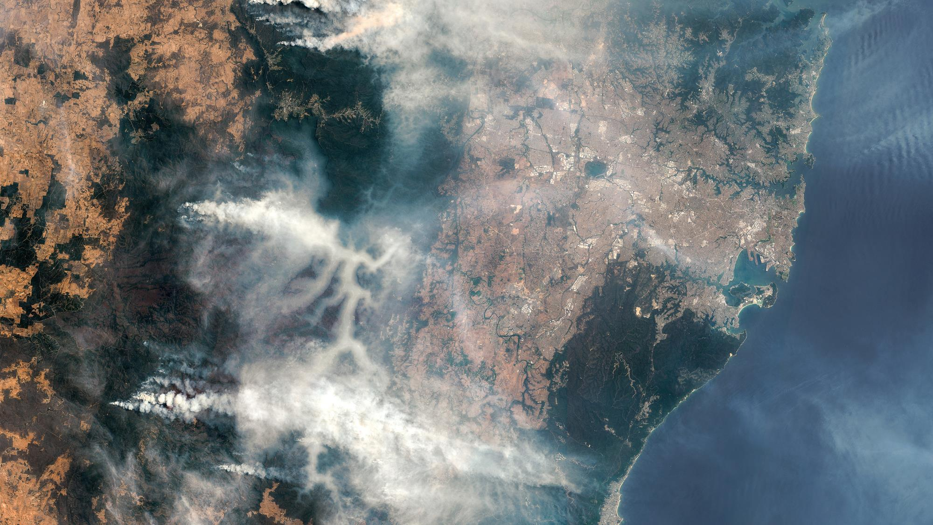

WILDFIRE IS A GLOBAL PROBLEM …
LET’S DELIVER A GLOBAL SOLUTION

