Slide 1
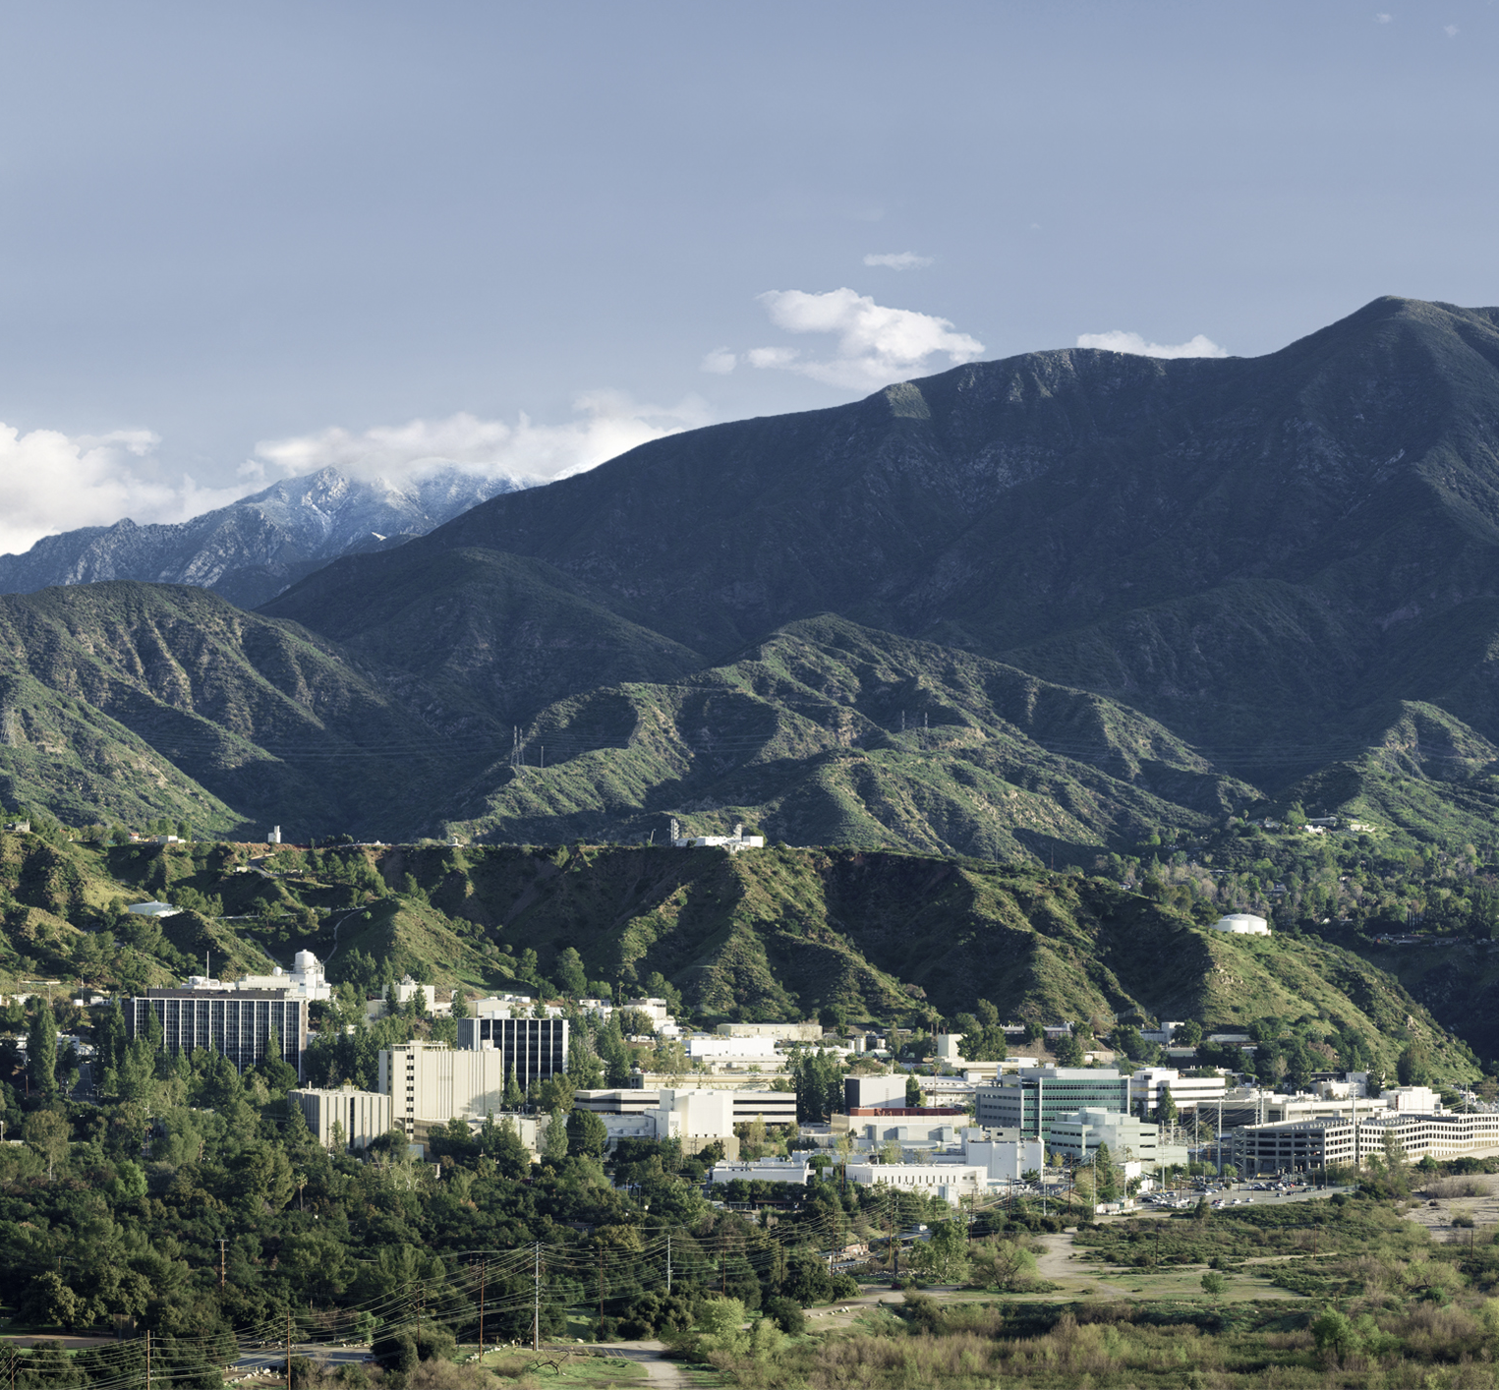
The compact Fire Infrared Radiance Spectral Tracker (c-FIRST): Addressing a Critical Need in the Remote Sensing of Fires from Space
Michael J. Garay &
Olga V. Kalashnikova
April 19, 2023

Slide 2
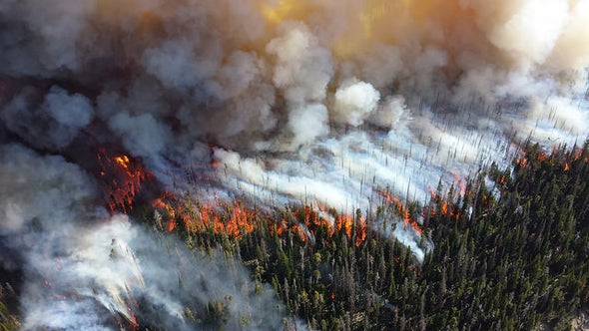
Wildfires in the Earth System

Slide 3
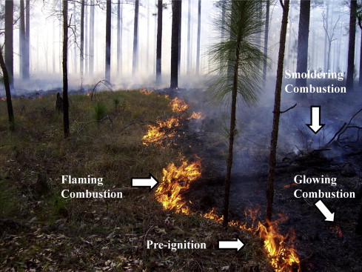
Wildfires in the Earth System
Ottmar, 2014

Slide 4
Unique Need
Oxygen and temperature determine combustion efficiency, which determines CO₂, CO, other trace gases, organic compound, and aerosol emissions
  Flaming combustion: > 800 K
  Glowing combustion (high oxygen): 500-800 K
  Smoldering combustion (low oxygen): 500-800 K
Emitted radiance increases with temperature and shifts to shorter wavelengths

Slide 5
Unique Need
Oxygen and temperature determine combustion efficiency, which determines CO₂, CO, other trace gases, organic compound, and aerosol emissions
  Flaming combustion: > 800 K
  Glowing combustion (high oxygen): 500-800 K
  Smoldering combustion (low oxygen): 500-800 K
SWIR
MWIR
TIR
Emitted radiance increases with temperature and shifts to shorter wavelengths

Slide 6
Unique Need
Currently, no instrument is able to span the entire dynamic range of fires that are present in the Earth system.
A 2018 study concluded, “most fires and most fire area in Florida are not detected, mapped, or otherwise accounted for by current satellites” (Nowell et al., GRL, 2018).
Limitations of current satellite instrument convey a critical need for a MWIR instrument with:
  Fine spatial resolution (~50 m)
  The ability to monitor fires without saturating for temperatures ranging from 400 K (peat fires) to 1600 K (flares)

Slide 7
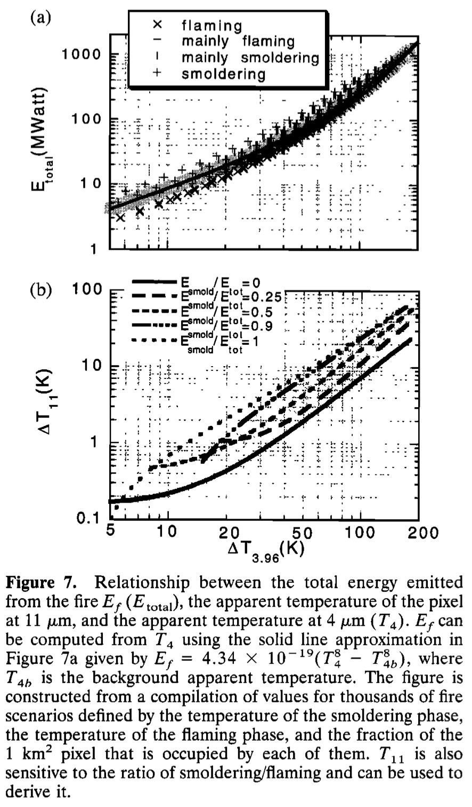
Fire Radiative Power (FRP)

Slide 8
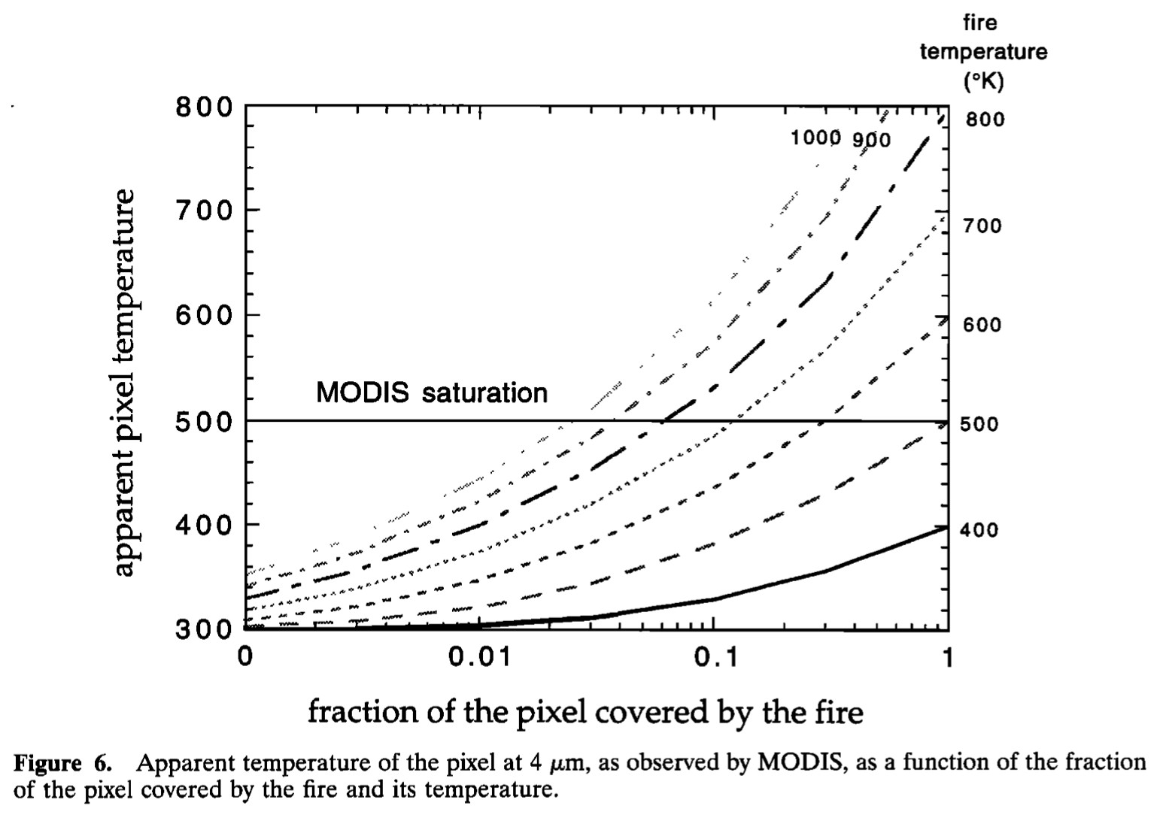
Fire Radiative Power (FRP)

Slide 9
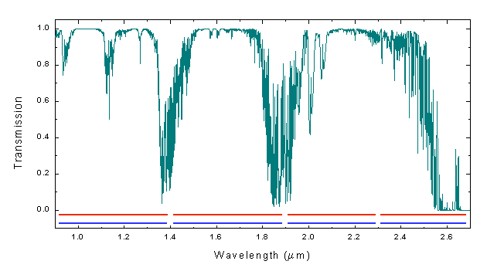
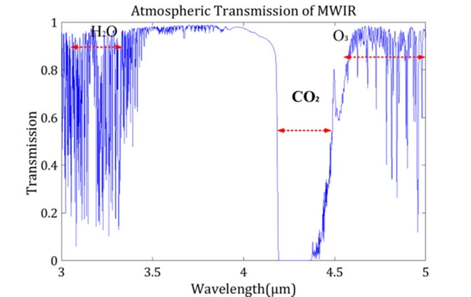
Current Satellite Approaches to Derive FRP
Polar orbiting satellites – 375 m to 1 km resolution: only provide four daily observations under ideal conditions but less when optically thick clouds are present, which may not be enough to fully characterize how fire activity varies over the course of the day.
Geostationary satellites - 1 to 4 km resolution: do not provide global data and have coarser pixel sizes than polar orbiting instruments. Have a higher minimum FRP detection limit (typically > 40 MW) than polar orbiters (~8 MW). They therefore do not observe the lowest FRP component of the fire regime.
Saturation: Although fire produces a strong MWIR signal this can result in a large scene dynamic range that poses challenges for fire detection. The difference in intensity between the image of a fire that fills one or more pixels and the background is very large and will exceed the dynamic range of most current MWIR sensors.

Slide 10
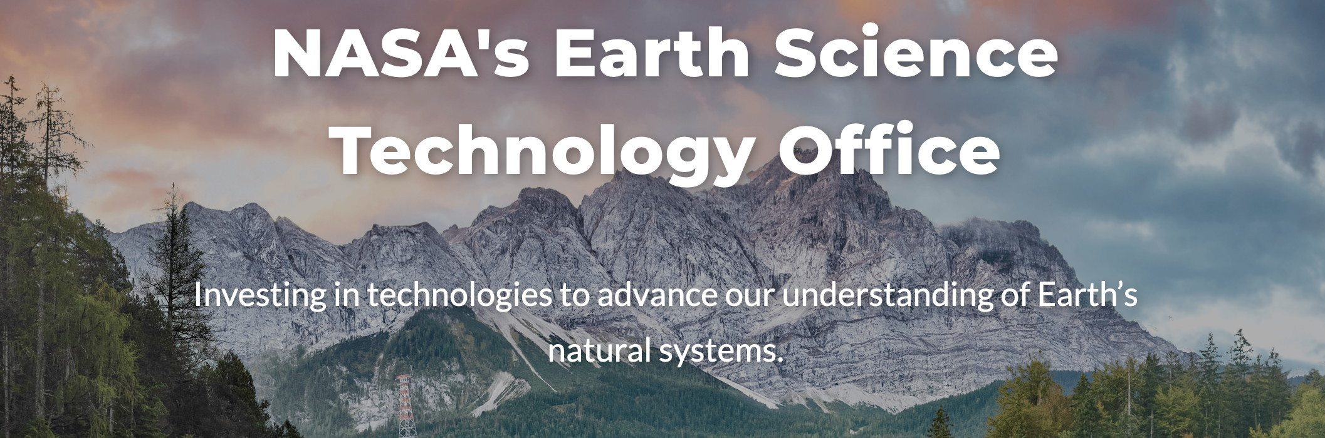
NASA Technology Investment
Instrument Incubator Program (IIP)
  Funds novel instruments offering new or improved ways to observe Earth
  Takes new ideas and helps develop them into validated demonstrations
  https://esto.nasa.gov/iip/
The Compact Fire Infrared Radiance Spectral Tracker (c-FIRST) was selected from the 2021 solicitation

Slide 11
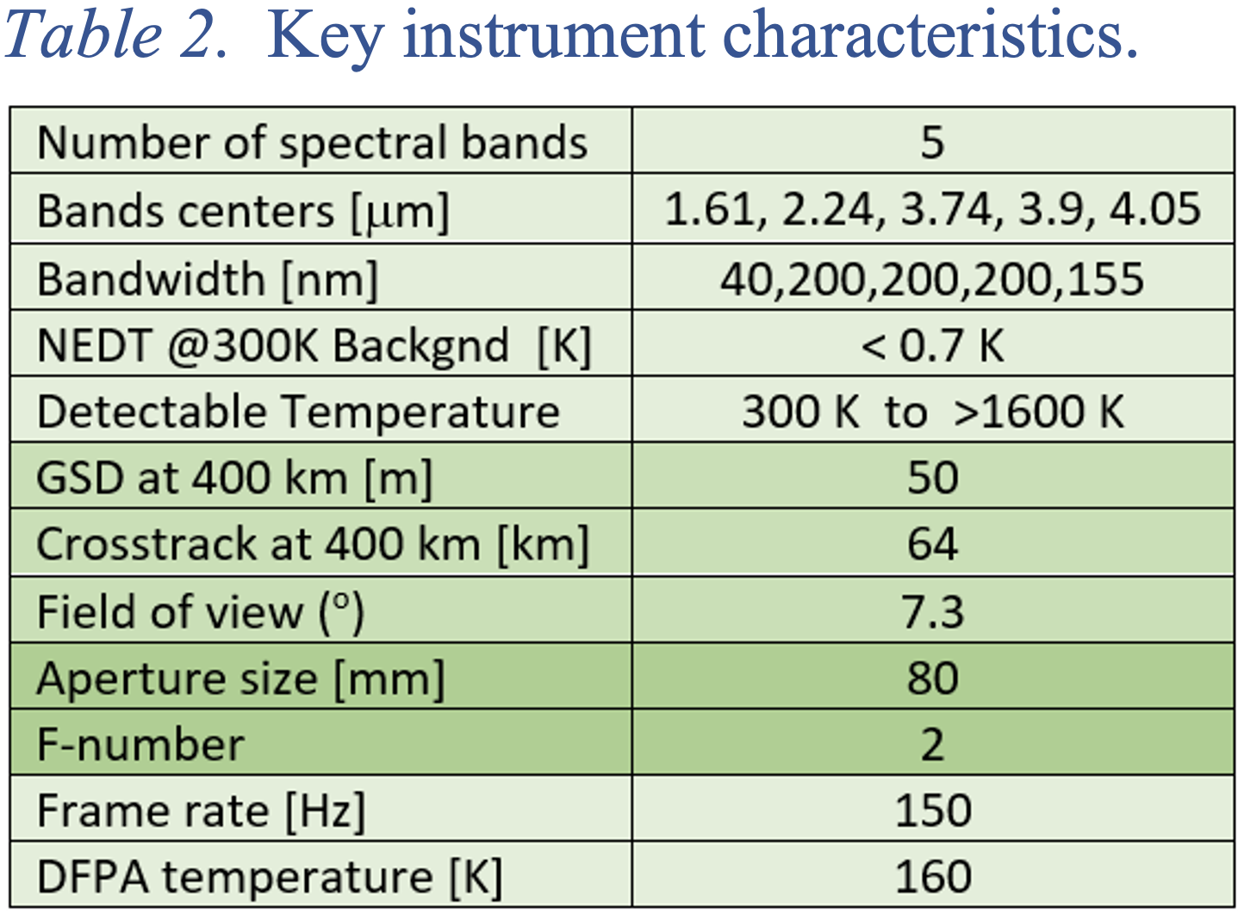
Key Instrument Characteristics

Slide 12
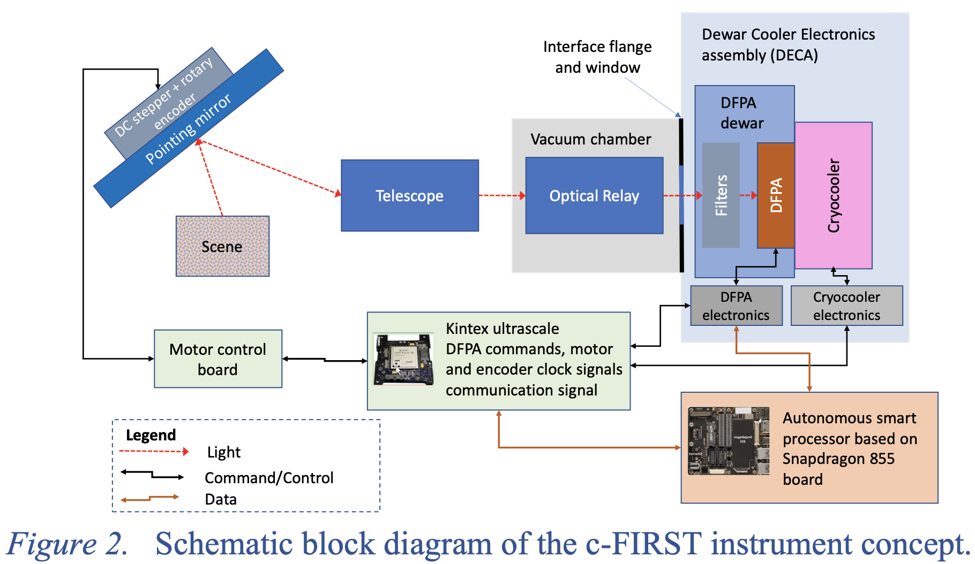
Block Diagram

Slide 13
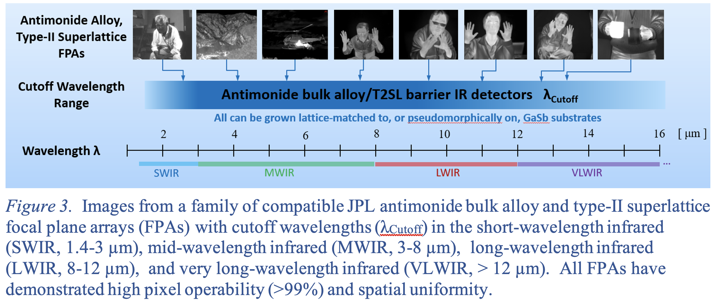
Barrier Infrared (BIRD) Detectors

Slide 14
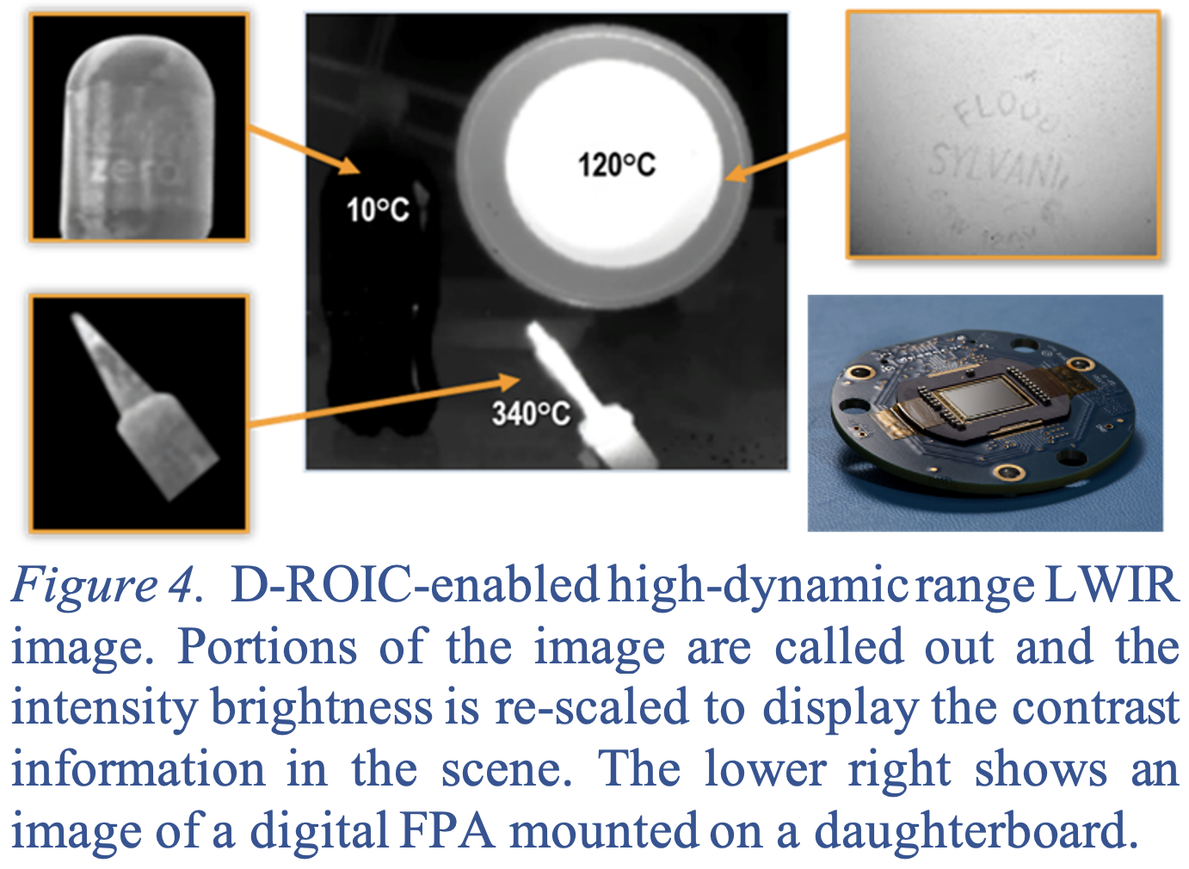
Digital Read-Out Integrated Circuit (D-ROIC)

Slide 15
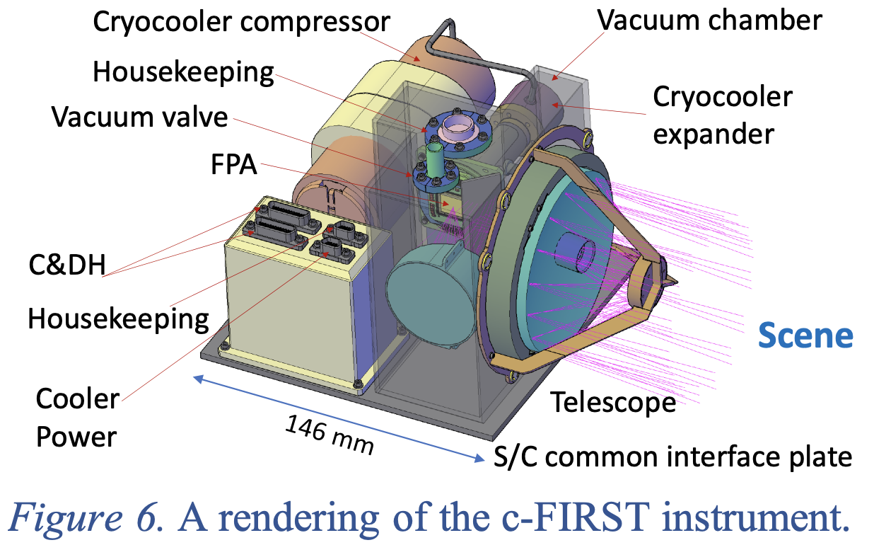
Instrument Configuration

Slide 16
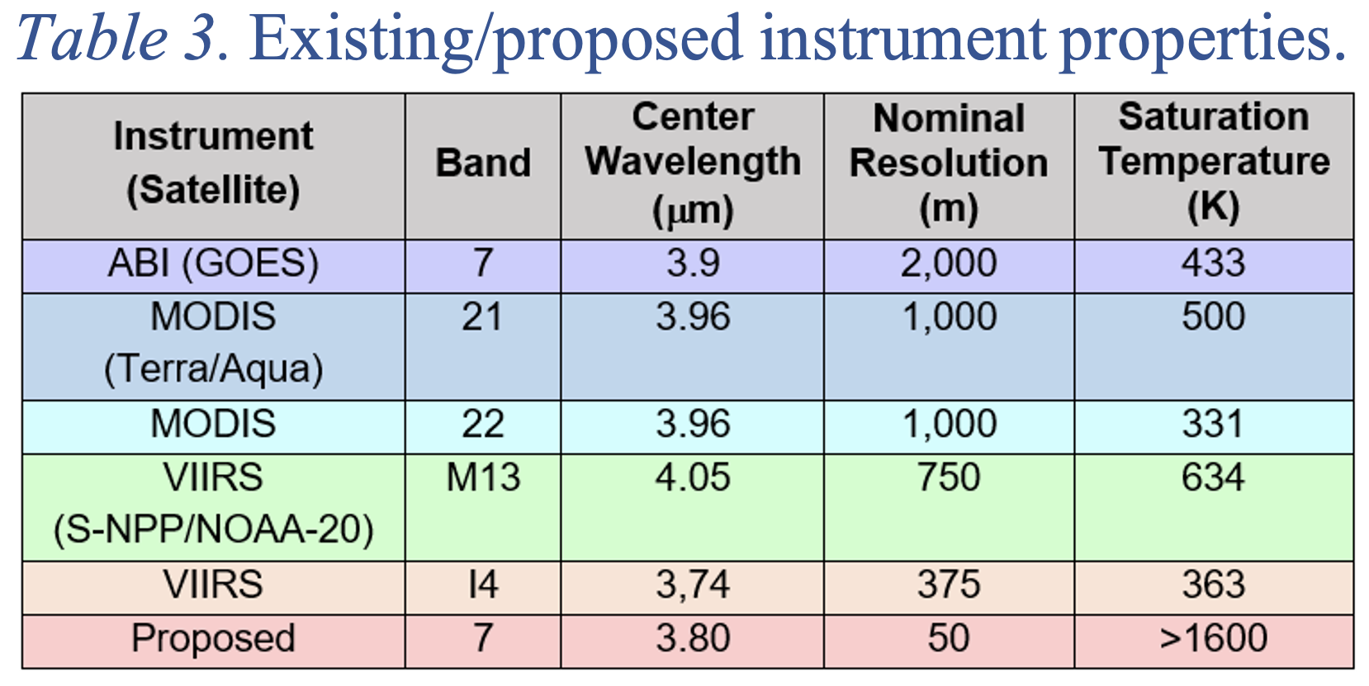
Instrument Comparison

Slide 17
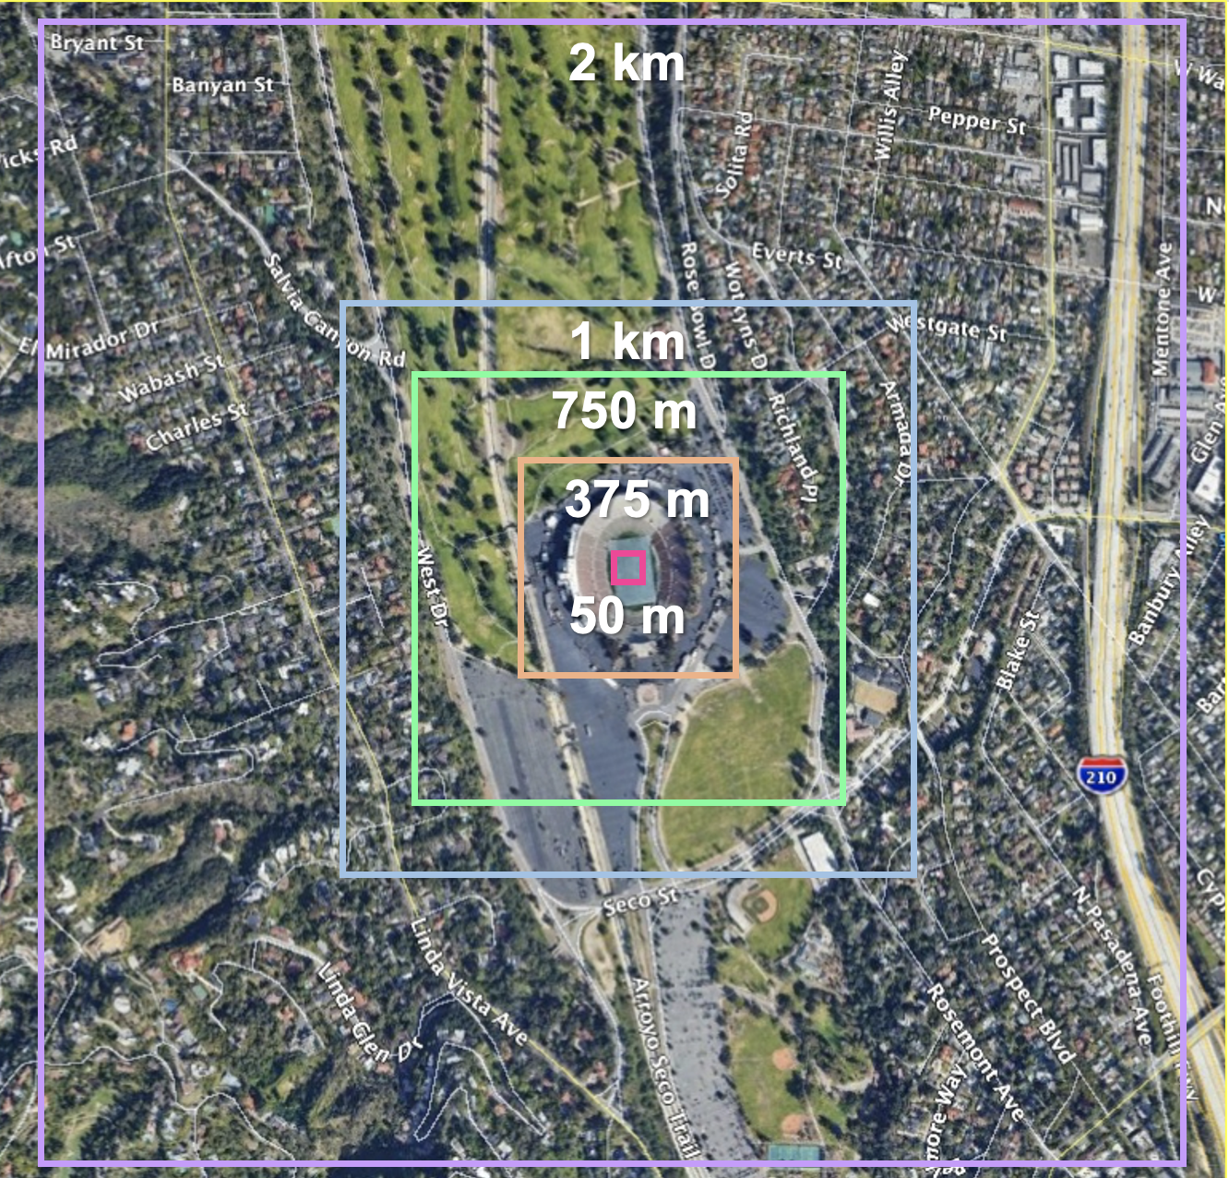
Instrument Comparison

Slide 18
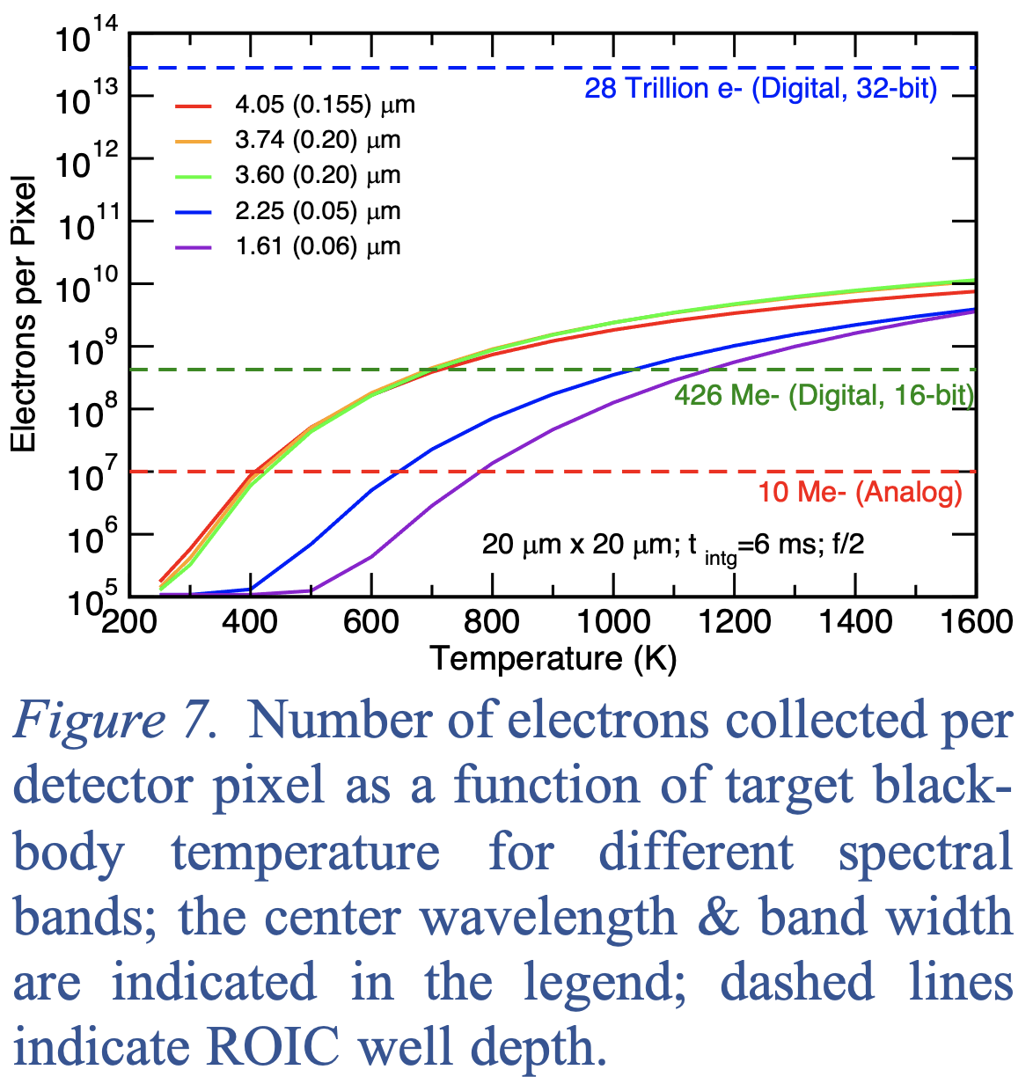
Instrument Performance

Slide 19
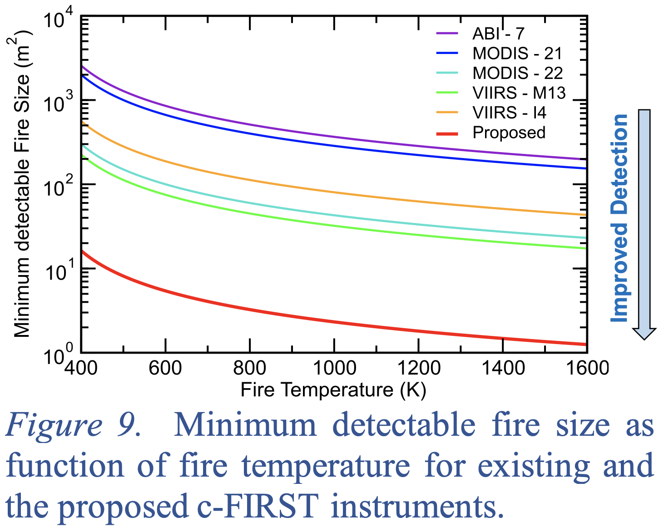
Instrument Performance

Slide 20
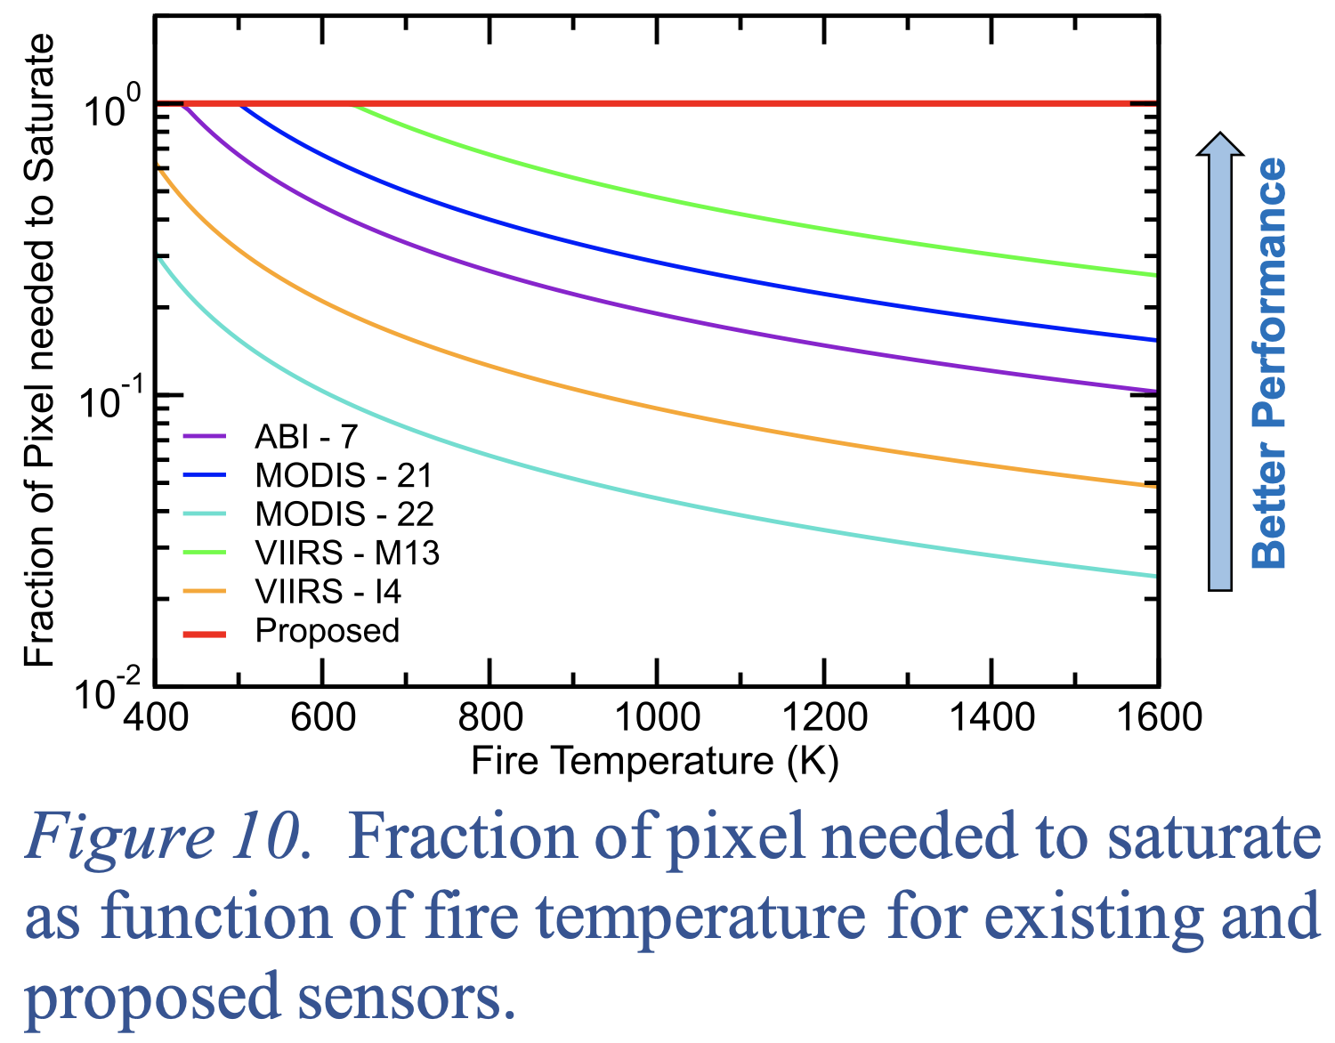
Instrument Performance

Slide 21
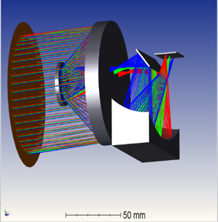
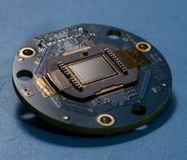
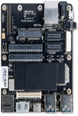
JPL airborne assets: Data Collection (C-FIRST, in development)
Compact Fire Infrared Radiance Spectral Tracker (c-FIRST), selected IIP 2021
Instrument
P.I.: Sarath Gunapala
12U modular unsaturable high dynamic range multispectral imager based on breakthrough high operating temperature barrier infrared detector digital focal plane array technology
To remotely monitor fire and volcano impacts on ecology, the carbon cycle, and atmospheric composition
3D Simulation of c-First
12U Instrument
Purpose
Off-Axis All Metal Korsch Optical Design
Science and Societal benefits
Quantify the flow of carbon in terrestrial ecosystems.
Discover cascading perturbations in ecosystems related to carbon storage.
Understand ecosystem response to fire events.
Understand how the threat of wildfires is changing with time and how exposure to emissions from wildfires can affect human health.
High Dynamic Range Digital FPA
Qualcomm Snapdragon 855 board

Slide 22
Michael.J.Garay@jpl.nasa.gov
Olga.V.Kalashnikova@jpl.nasa.gov

