Slide 2
About Us
2
Team of engineers with combined 40 + years of UAV and remote sensing experience.
University of Illinois at Chicago – Image and video processing.
National Science Foundation SBIR + I-Corps program participants.

Slide 3
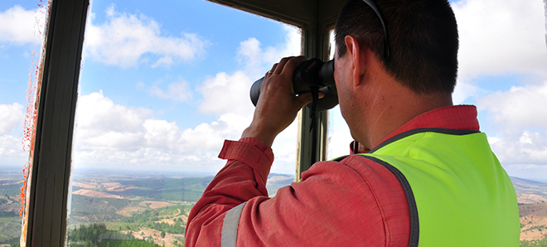
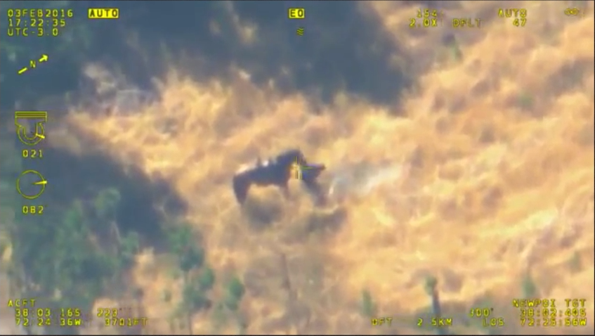
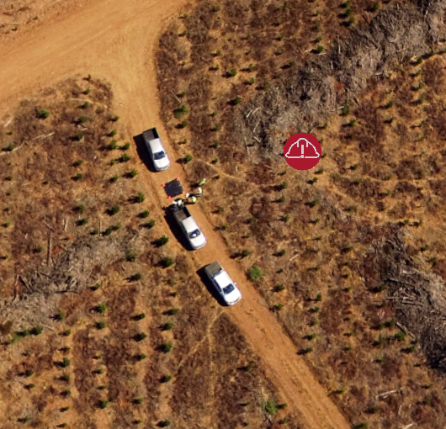
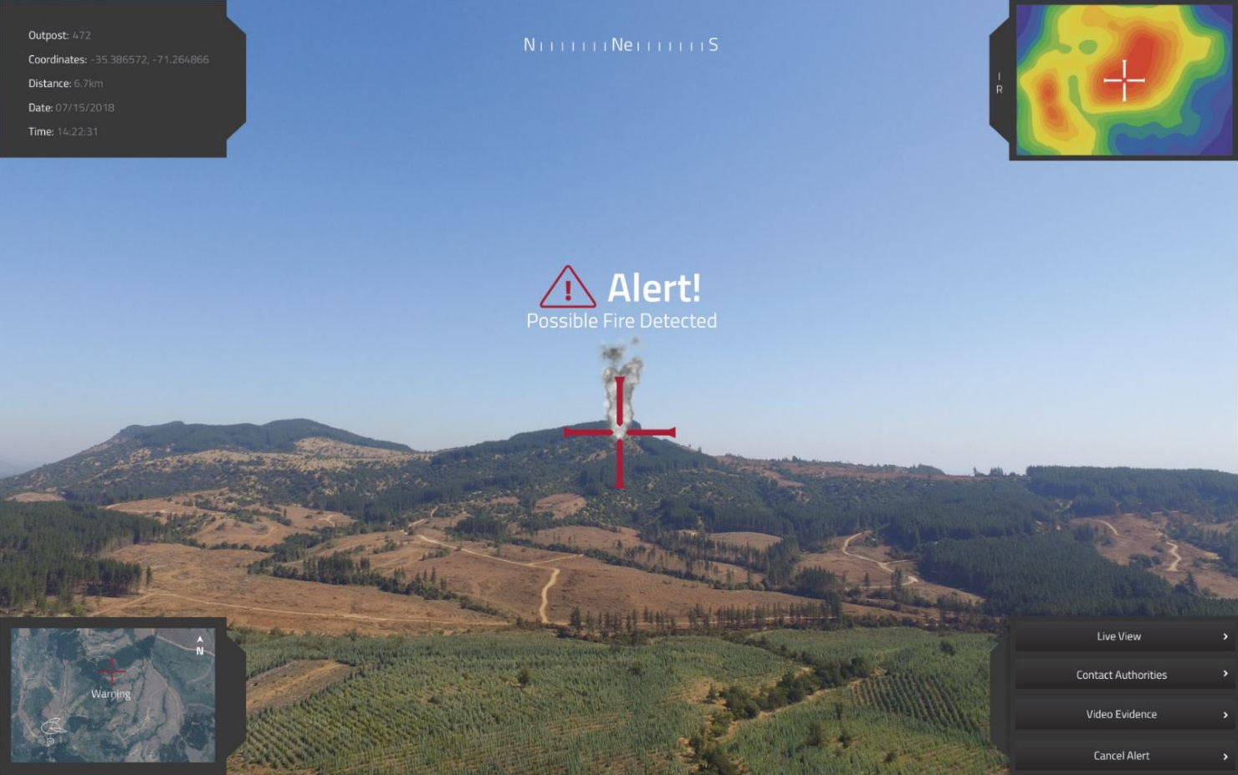
Operations
3
2
Early Fire Detection & Georeferencing
24/7 AI Monitoring
Geo-Referencing Fires
Alerts to Any Device
Live Video Feeds
Camera Control
Video Footage Prior to Detection Saved as Evidence
Integration with Existing Systems (i.e. ATAK, ArcGIS)

Slide 4
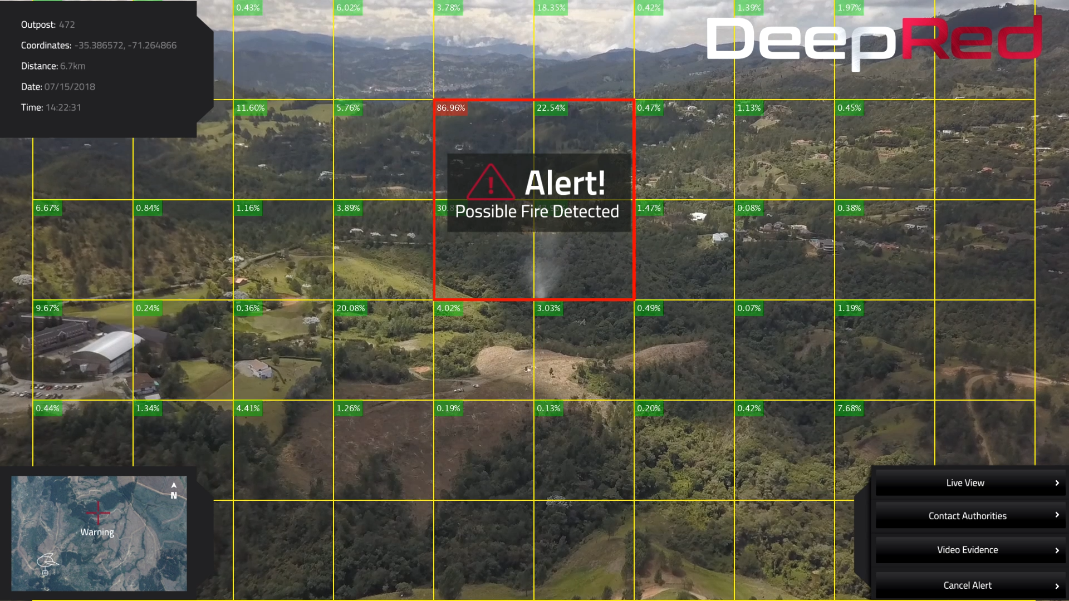
Fire and Plume of Smoke Detection
4
2
AI Video Detection
Reduced false alarms
Improves situational and spatial awareness
Neural network trained with novel dataset methodologies
Day and night operation. (RGB, NIR and IR)
Functions with Moving Platforms, (i.e. UAVs, aircraft, satellite)
Reduces latency in fire detection
Notes:
Situation
The construction and agriculture industries are always looking for more affordable and more effective ways of executing key tasks, such as:
Tracking excavation and construction projects
Safety monitoring & support
Managing logistics and production planning
Inventory control
Surveillance
Crop Analysis
Alternatives
Many companies have bought their own drones and trained/licensed their own pilots.
Many companies pay drone service companies to plan, fly and process the data.
Proofpoints
Average cost savings with drones up to 80% vs. traditional methods
Agriculture drones save $30-$40 per acre, per year. Fortune.com
All drones crash, with a 50% chance of not being able to recover from each.
Pilot licenses take 5 to 7 months to be issued. A remote pilot license is required.
Average Testing Intervals:24 months (vs. 24/7)
Insurance to 3rd party damages is mandatory

Slide 5
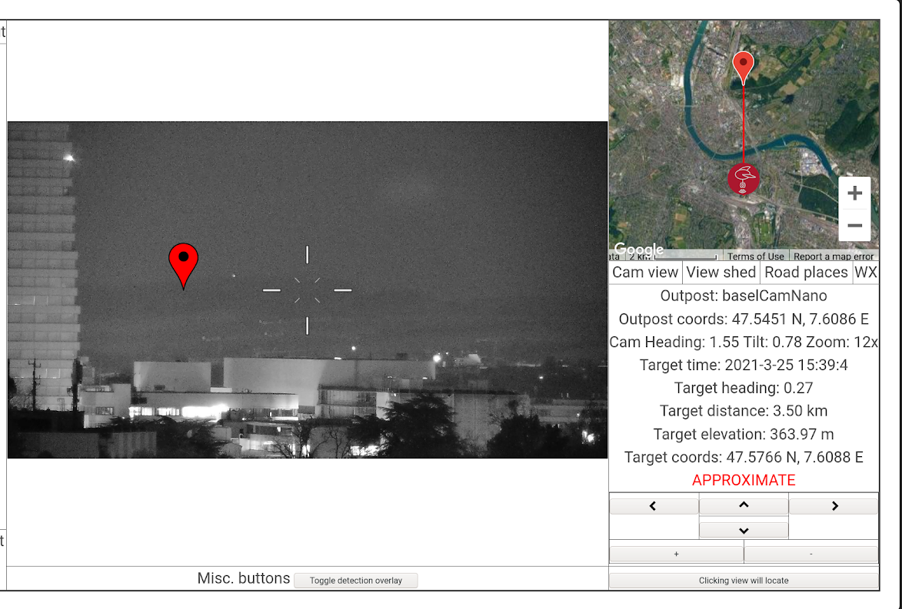
Operation
5
2
User Interface – In development to integrate with existing systems
Notes:
Situation
The construction and agriculture industries are always looking for more affordable and more effective ways of executing key tasks, such as:
Tracking excavation and construction projects
Safety monitoring & support
Managing logistics and production planning
Inventory control
Surveillance
Crop Analysis
Alternatives
Many companies have bought their own drones and trained/licensed their own pilots.
Many companies pay drone service companies to plan, fly and process the data.
Proofpoints
Average cost savings with drones up to 80% vs. traditional methods
Agriculture drones save $30-$40 per acre, per year. Fortune.com
All drones crash, with a 50% chance of not being able to recover from each.
Pilot licenses take 5 to 7 months to be issued. A remote pilot license is required.
Average Testing Intervals:24 months (vs. 24/7)
Insurance to 3rd party damages is mandatory

Slide 6
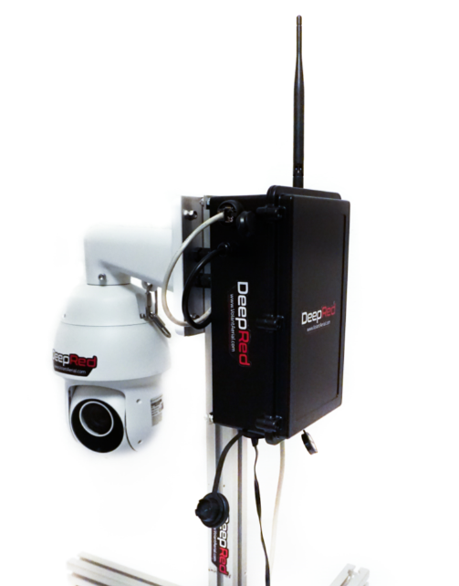
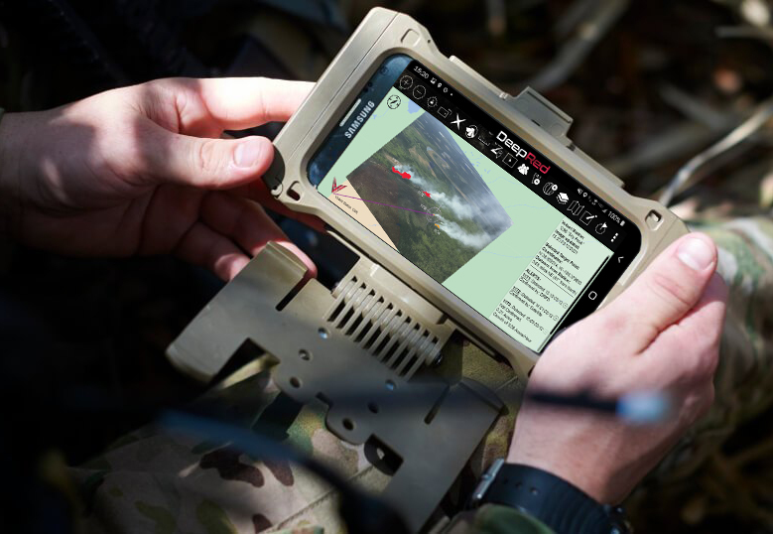
Compatability with Existing Systems
6
2
AI software integrates with camera and data networks
Integrates with existing infrastructure, to create smart camera networks:
Ground camera networks
Aerial platforms
Satellite imagery
Integrates with existing data systems:
ATAK
ArcGIS
Interra
InciWeb

