Slide 1
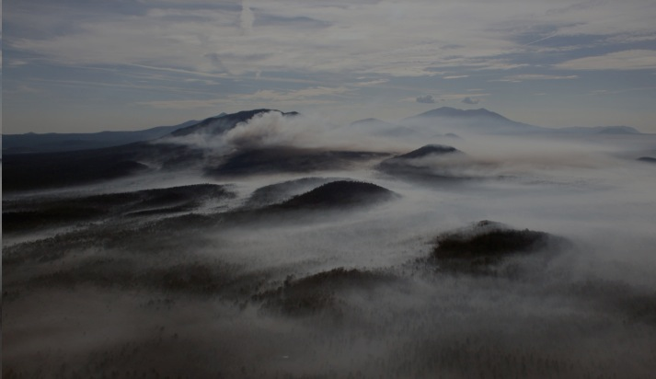
FireFlight system overview Tactical Fire remote sensing Advisory Committee 24th May 2016

Slide 2
Overview
Who am I? Who is Spatial Scientific?
What is the FireFlight system?
How does FireFlight operate? (Real time vs. near real time)
Acquisition and accuracy
Modes of operation: single system vs. fleet operations
Does the system work?

Slide 3
Overview
Who am I? Who is Spatial Scientific? Why am I here?
What is the FireFlight system?
How does FireFlight operate? (Real time vs. near real time)
Acquisition and accuracy
Modes of operation: single system vs. fleet operations
Does the system work?

Slide 4
Who is Paul Dare?
BA / MA in Physics from University of Oxford
PhD in Remote Sensing from University College London
7 years in academia
11 years in commercial sector ( CEO of Spatial Scientific Ltd. )
Commercial pilot
Aerial photographer
(Ex) volunteer fire fighter ( 6 years fire fighting experience )
Hon. Assoc. Prof. at University College London

Slide 5
Who is Spatial Scientific?
Australian “micro” company ( < 5 full time staff ) established 2005
Develop, manufacture and sell airborne flight management and camera control systems
Undertake aerial survey operations
Fully commercial: we sell real products to real end users
Privately funded. No government grants.
Own 100% of our IP

Slide 6
What about fire mapping?
We build systems for mapping fires from both manned and unmanned aircraft
We deploy those systems to fire danger regions worldwide
We offer two services to our clients:
Real time (5-10 minutes) fire hotspot intelligence
Near real time (6-12 hours) orthorectified fire maps
Our systems are flown by ourselves or third party aircraft providers
All fire intelligence data is managed through our servers in Australia

Slide 7
What is the FireFlight system?
A nadir-looking airborne fire spotting and fire mapping system
Deployed on either small manned aircraft or UAVs (coming soon)
Developed to be a small, lightweight and cost-effective
Able to locate fire hotspots in real time (5-10 minutes)
Able to create fire maps in near real time (6-12 hours)
A result of incremental development over many years
→ Robust, proven technology

Slide 8
The FireFlight System
System components:
Thermal camera(s) mounted on an aircraft or UAV
On-board computer to detect hotspots in thermal image data
Airborne (client side) software for uploading data
Telecommunications system (cell phone network)
Ground-based (server side) software for receiving incoming data
Web-based graphical user interface

Slide 9
The FireFlight System
Ground based
computer (server)
Airborne laptop
GPS / IMU
Cell phone
GROUND
AIRCRAFT
FLIR
End users

Slide 10
FireFlight operation – real time
Aircraft flies over area of potential fires
Thermal camera continuously acquires data
Detected fires converted to geographical points (lat / lon)
Points downloaded from aircraft to ground-based server
Server pushes fire hotspot locations to the end users
5 to 10
minutes

Slide 11
FireFlight operation – real time

Slide 12
FireFlight operation – near real time
Aircraft flies planned route over region of interest
Images captured at pre-determined locations and stored
On landing, images are uploaded to cloud-based software
12 hours later, ortho-mosaic is downloaded to server
Server pushes fire map ortho-mosaic to the end users
6 to 12
hours

Slide 13
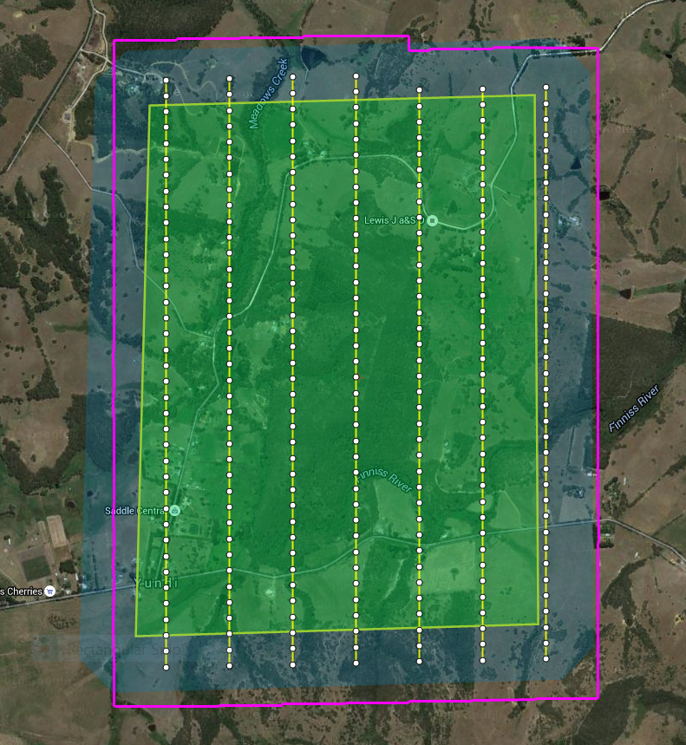
Near real time fire mapping
Flight plan is created in advance
Flight lines and camera trigger points are determined based on required overlap, resolution etc.
Optimum number of frames are captured to cover the area

Slide 14
Near real time fire mapping
Frames are mosaicked to create an orthomosaic
Fire hotspots can be highlighted in a different colour
Data uploaded to a web server with live streaming maps background
www.fire.aero/Examples/Kyeema-1

Slide 15
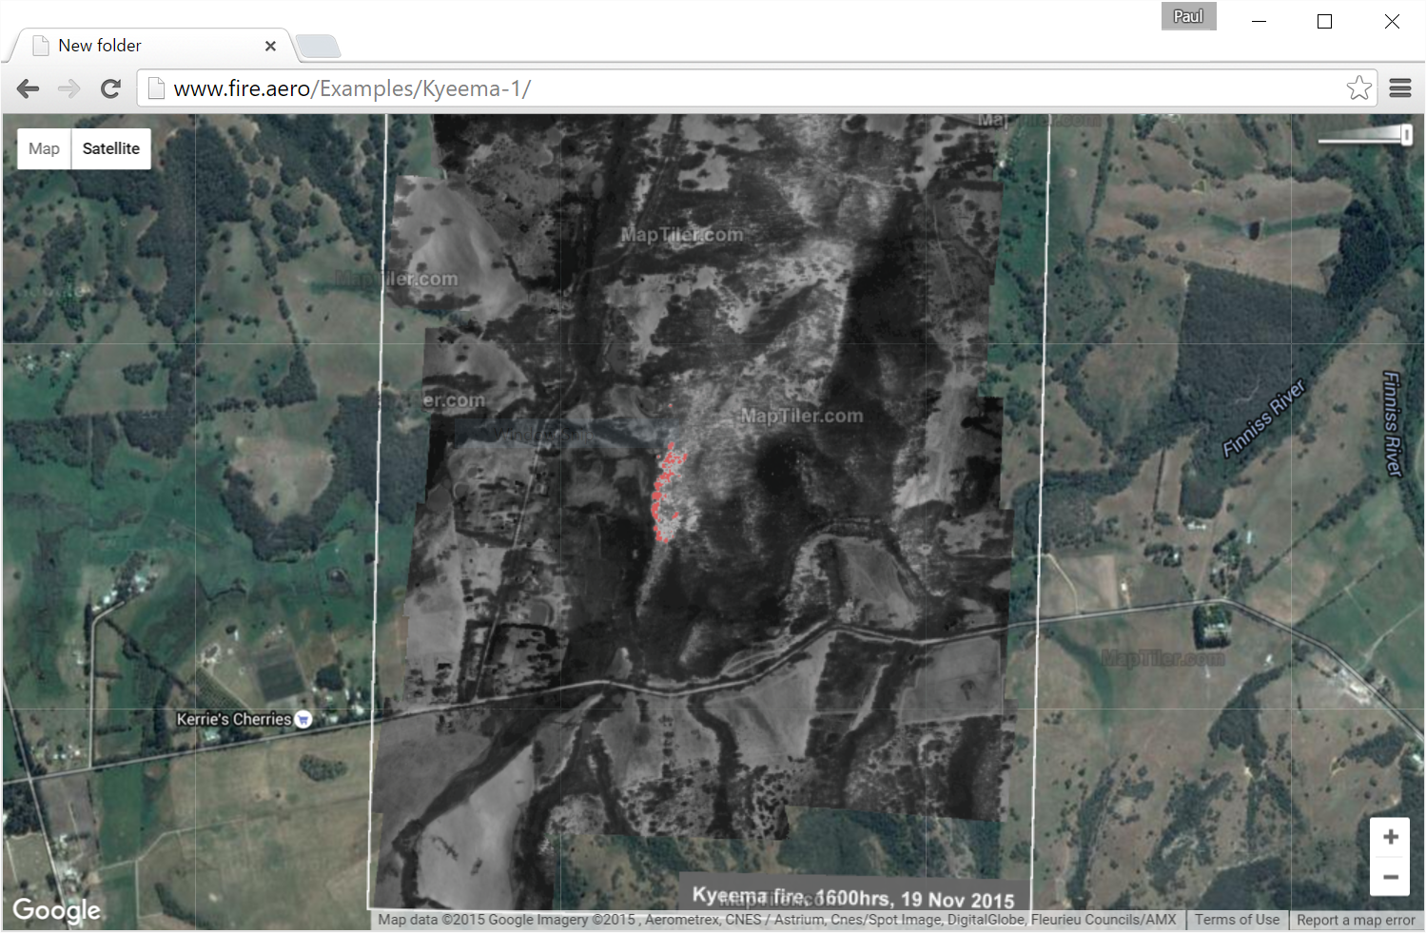

Slide 16
Acquisition and accuracy
Flying heights | Ground sample distance (m) / Swath (m)
Lens FOV | 1m / 640m | 2m / 1280m | 3m / 1920m
Narrow (25 deg.) | 4750 feet | 9500 feet | 14,250 feet
Standard (45 deg.) | 2500 feet | 5000 feet | 7500 feet
Wide (90 deg.) | 1250 feet | 2500 feet | 3750 feet

Slide 17
Acquisition and accuracy
Real time hot spot detection, accuracy is a function of height:
Planimetric accuracy is approx. 0.1 x flying height (AGL)
For example, flying at 3500 feet, planimetric accuracy is approx. 100m
Real time hot spot detection with an IMU, accuracy is 5-10 times better:
For example, flying at 3500 feet, planimetric accuracy is approx. 10m to 20m (with IMU)
Near real time fire maps are accurate to approx. 2 to 5 pixels

Slide 18
Single system operation: asset protection
Aircraft flies pre-planned flight path
Aircraft
diverts
to fire if
necessary
Aircraft
operations base
Flight path can be changed en route

Slide 19
Single system operation: call on demand
Aircraft
operations base
Aircraft fly to fires when required

Slide 20
Multiple system operation: fleet operations
Mixed operations:
Asset protection
Call on demand
Mixed platforms:
Manned aircraft
Unmanned aircraft

Slide 21
Fleet operations
Inexpensive to deploy
Redundancy of multiple systems
Wide area of coverage
Easy to reposition systems
All data managed through the same single server
Single point of contact for the end user

Slide 22
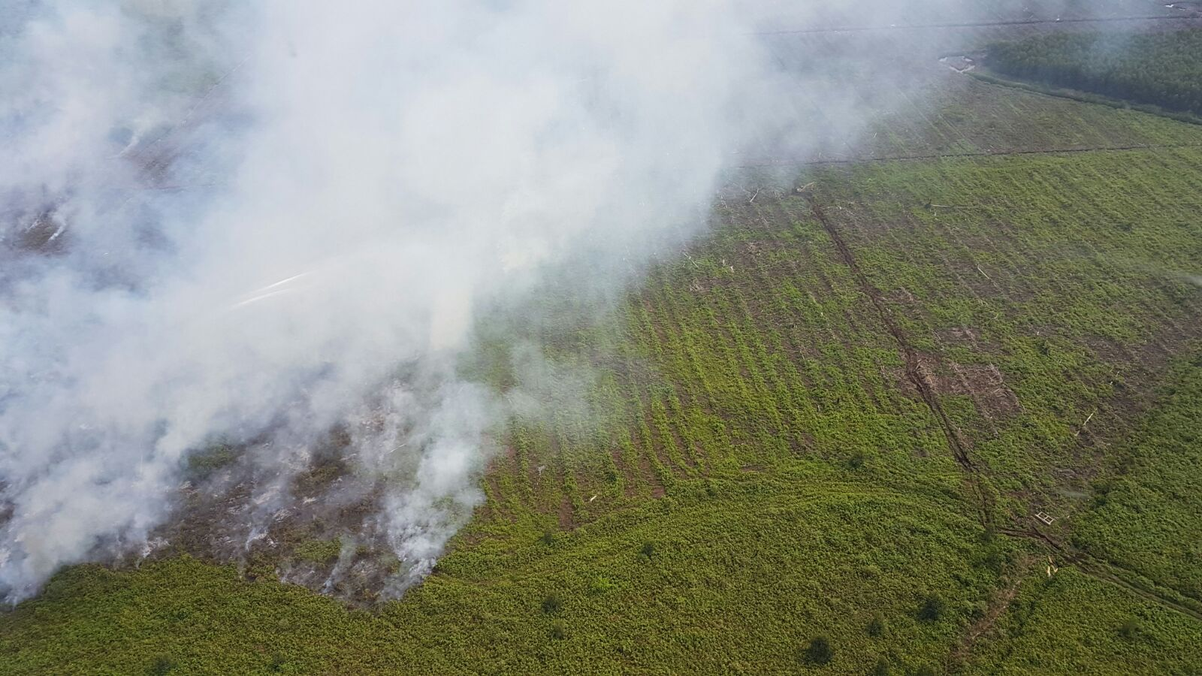
Does it work?
Real time fire spotting system currently deployed in Indonesia
“This is a pic sent by Super Puma pilot on site working Basilam fire also you can see an excavator scratching in a guard. Good job by all early detection and rapid response should hopefully result in quick containment and control.”

Slide 23
Contact
Phone: +61 405 141 647 (Australia)
+1-858-344-5161 (North America)
Email: info@fire.aero
Web: www.fire.aero
Facebook: @FireFlightOZ
Twitter: @FireFlightOZ
LinkedIn: www.linkedin.com/FireFlight

