Slide 1
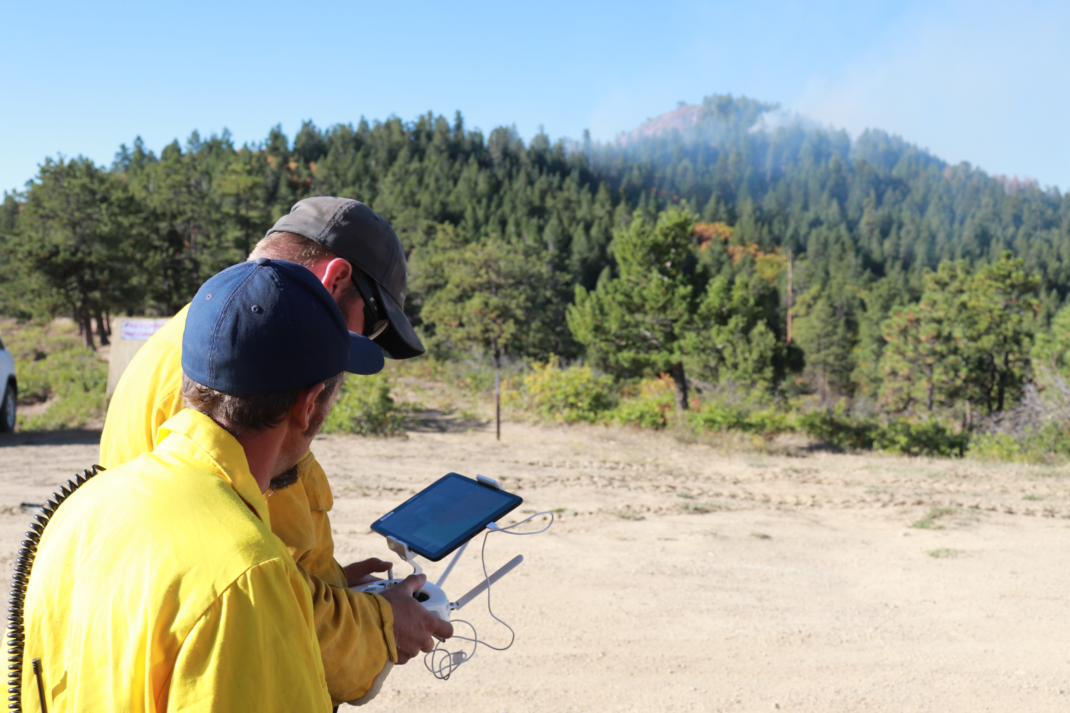

Implementing Distributed ISR with sUAS and the Team Awareness Kit UAS Tool

Slide 2
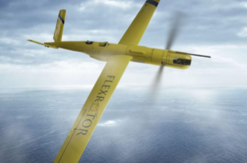
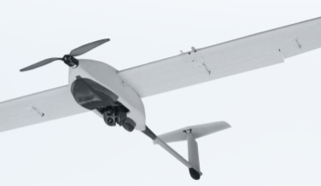
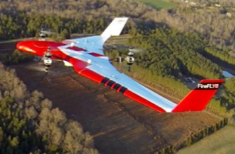
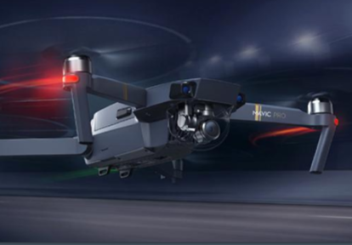
UAS Situational Awareness Missions
Broadly speaking UAS can improve situational awareness of wildland firefighters by:
        Mapping a fire perimeter
        Providing tactical support in real-time (gridding for spot fires, monitoring firing operations, watching fire progression)
The methods of these missions varies based on UAS capability, with Type I UAS the most capable and type IV the least

Slide 3
UAS for Fireline Mapping
UAS, especially smaller platforms, often conduct mapping missions by collecting still images of the fire, then using photogrammetry software to stitch the images into an orthophoto, which documents the fire’s perimeter.
Current workflows require several hours to capture the images, process the orthophoto, and create map products for dissemination to firefighters.

Slide 4
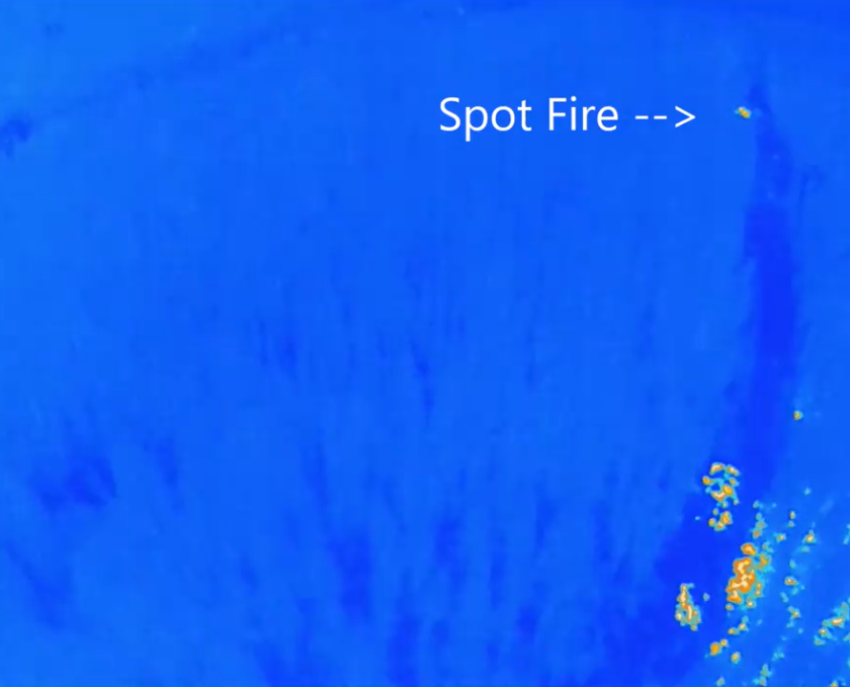
UAS for Tactical Support
Type I and II UAS often have long-distance data links that can stream video to command posts.
Type III and IV UAS are often operated at or near the fireline, but only provide video to the pilot.
In either case UAS crews interface with firefighters either face-to-face or over voice radio.

Slide 5
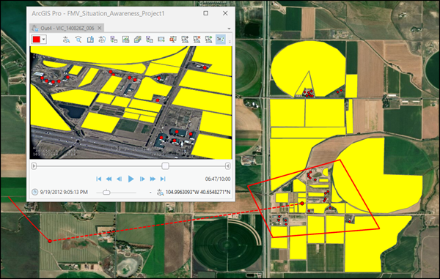
Full Motion Video
The technology of full motion video has potential to improve operations for both mapping and tactical support missions.
Full motion video (FMV) refers to a variety of different methods of adding spatial metadata to a video stream or file.
Once a video is georeferenced it becomes possible to view spatial data overlaid on the video, or digitize new spatial data using the video.

Slide 6
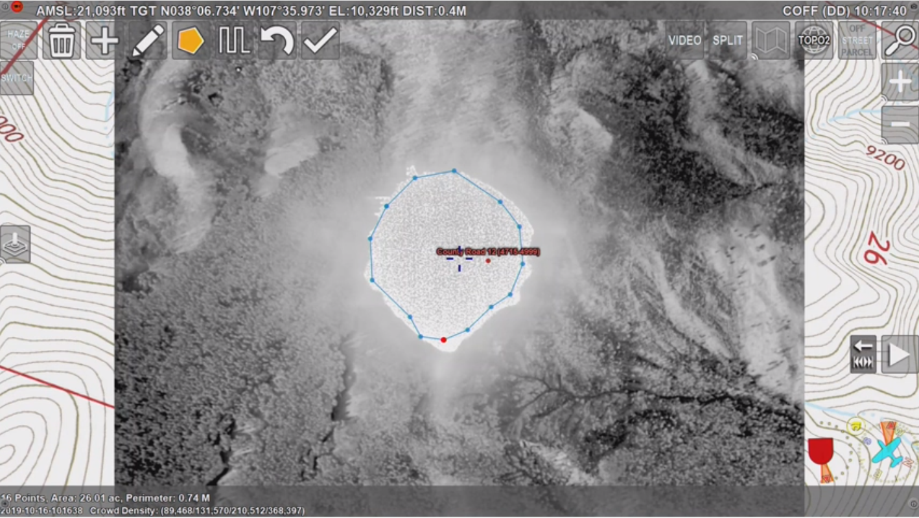
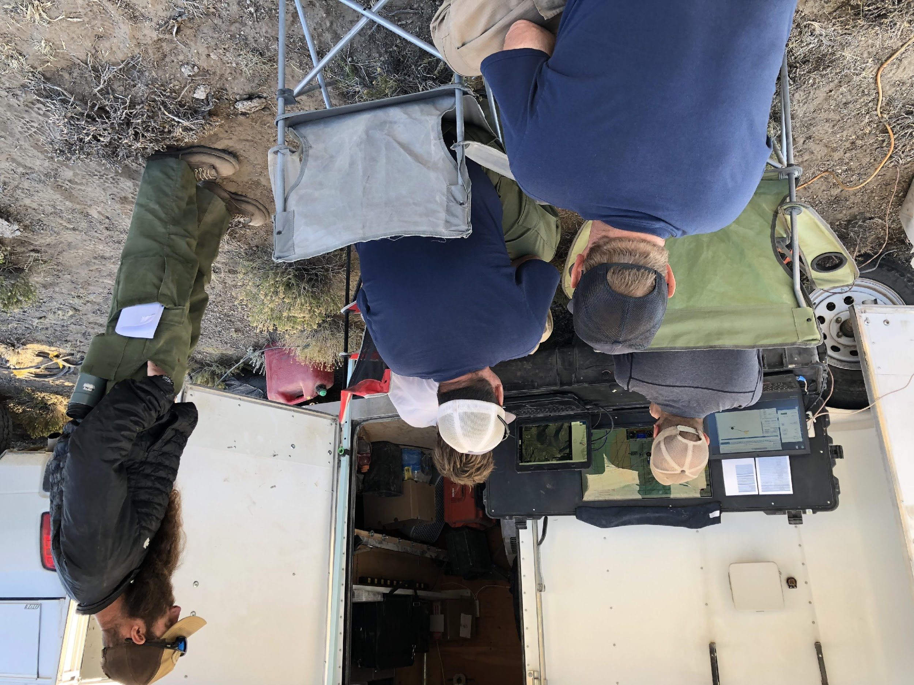
FMV Use Today
Type I and II UAS, and manned ISR aircraft, are typically capable of producing FMV, and teams can use it to map fire perimeters, and get tactical information in real-time.
However type III and IV UAS rarely produce FMV, and firefighters on the line are rarely able to view live FMV.

Slide 7
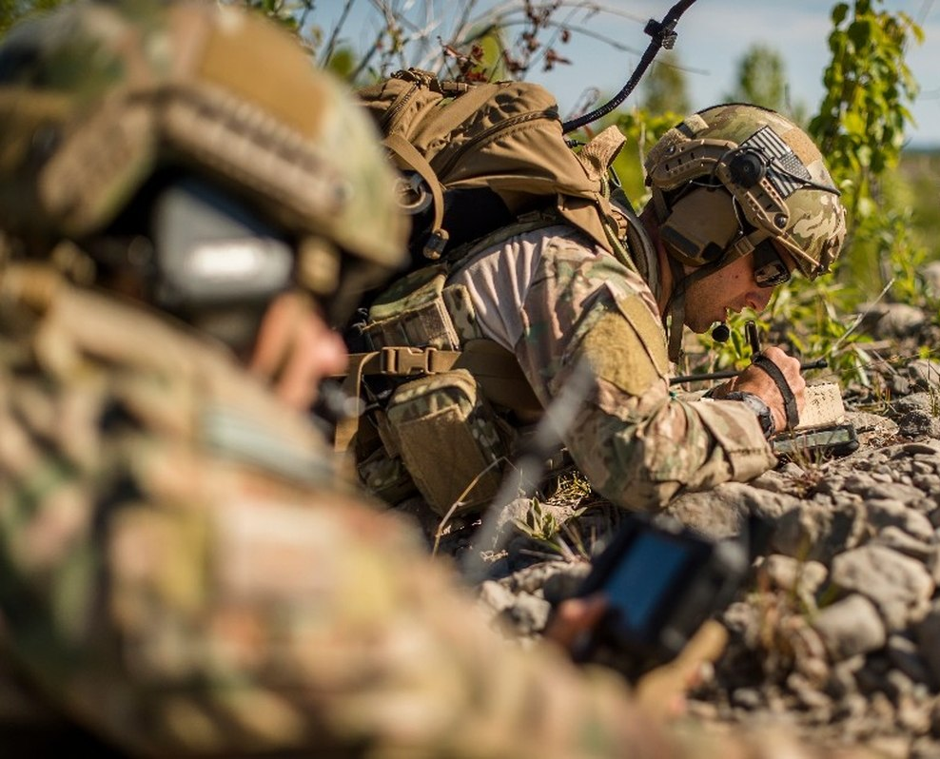
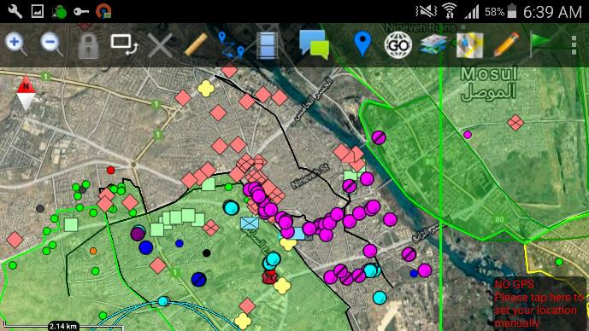
Team Awareness Kit
Since 2010 the US Air Force Research Laboratory and others have been developing the Team Awareness Kit (TAK) apps to provide a common operating picture to DoD forces and others using off-the-shelf smartphones, tablets, and computers.

Slide 8
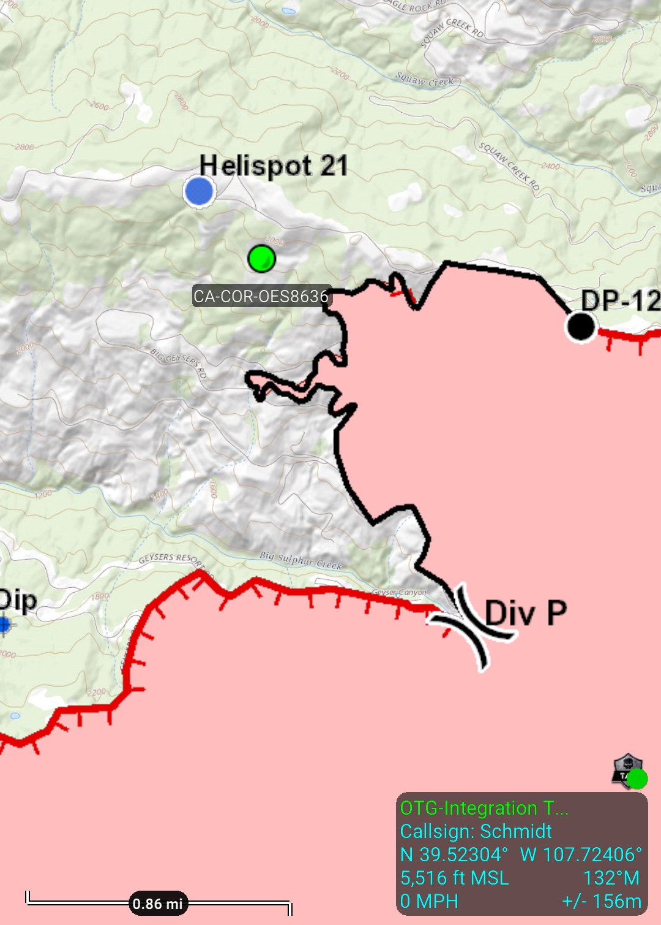
Fireline Uses for TAK
The CoE and others have demonstrated the TAK app on wildland fires as a means to:
      Track the locations of firefighters and aircraft
      View spatial data from EGP and other ArcGIS servers
      Measure distances, calculate elevation profiles, and estimate viewsheds
      Trigger emergency notifications through an SOS mode

Slide 9
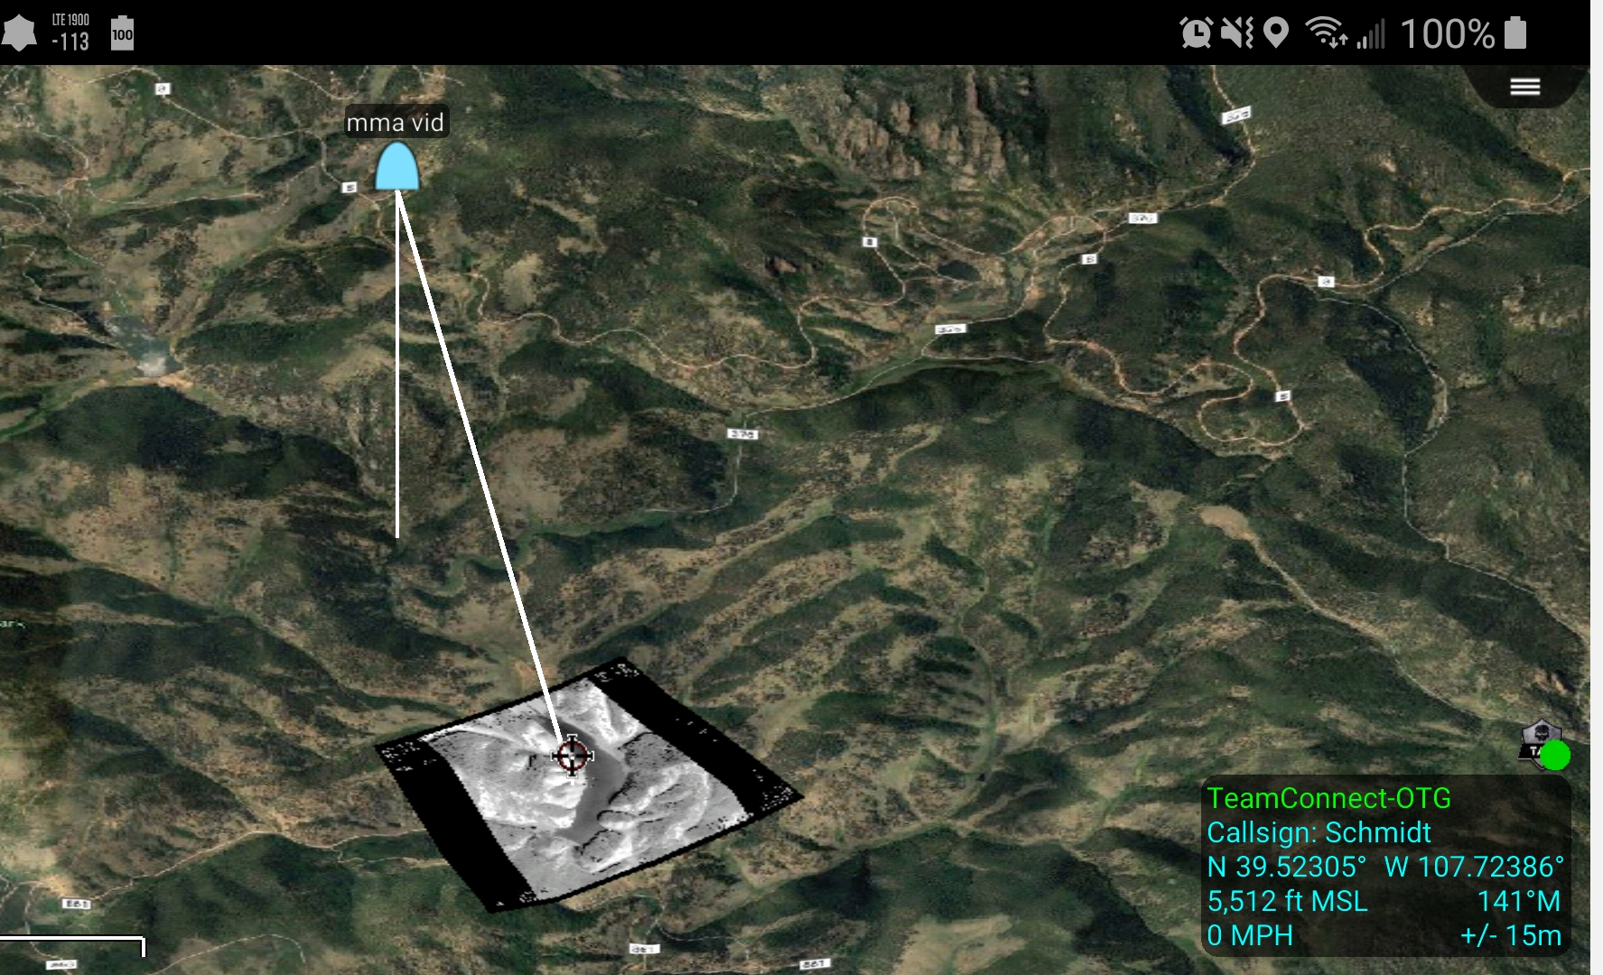
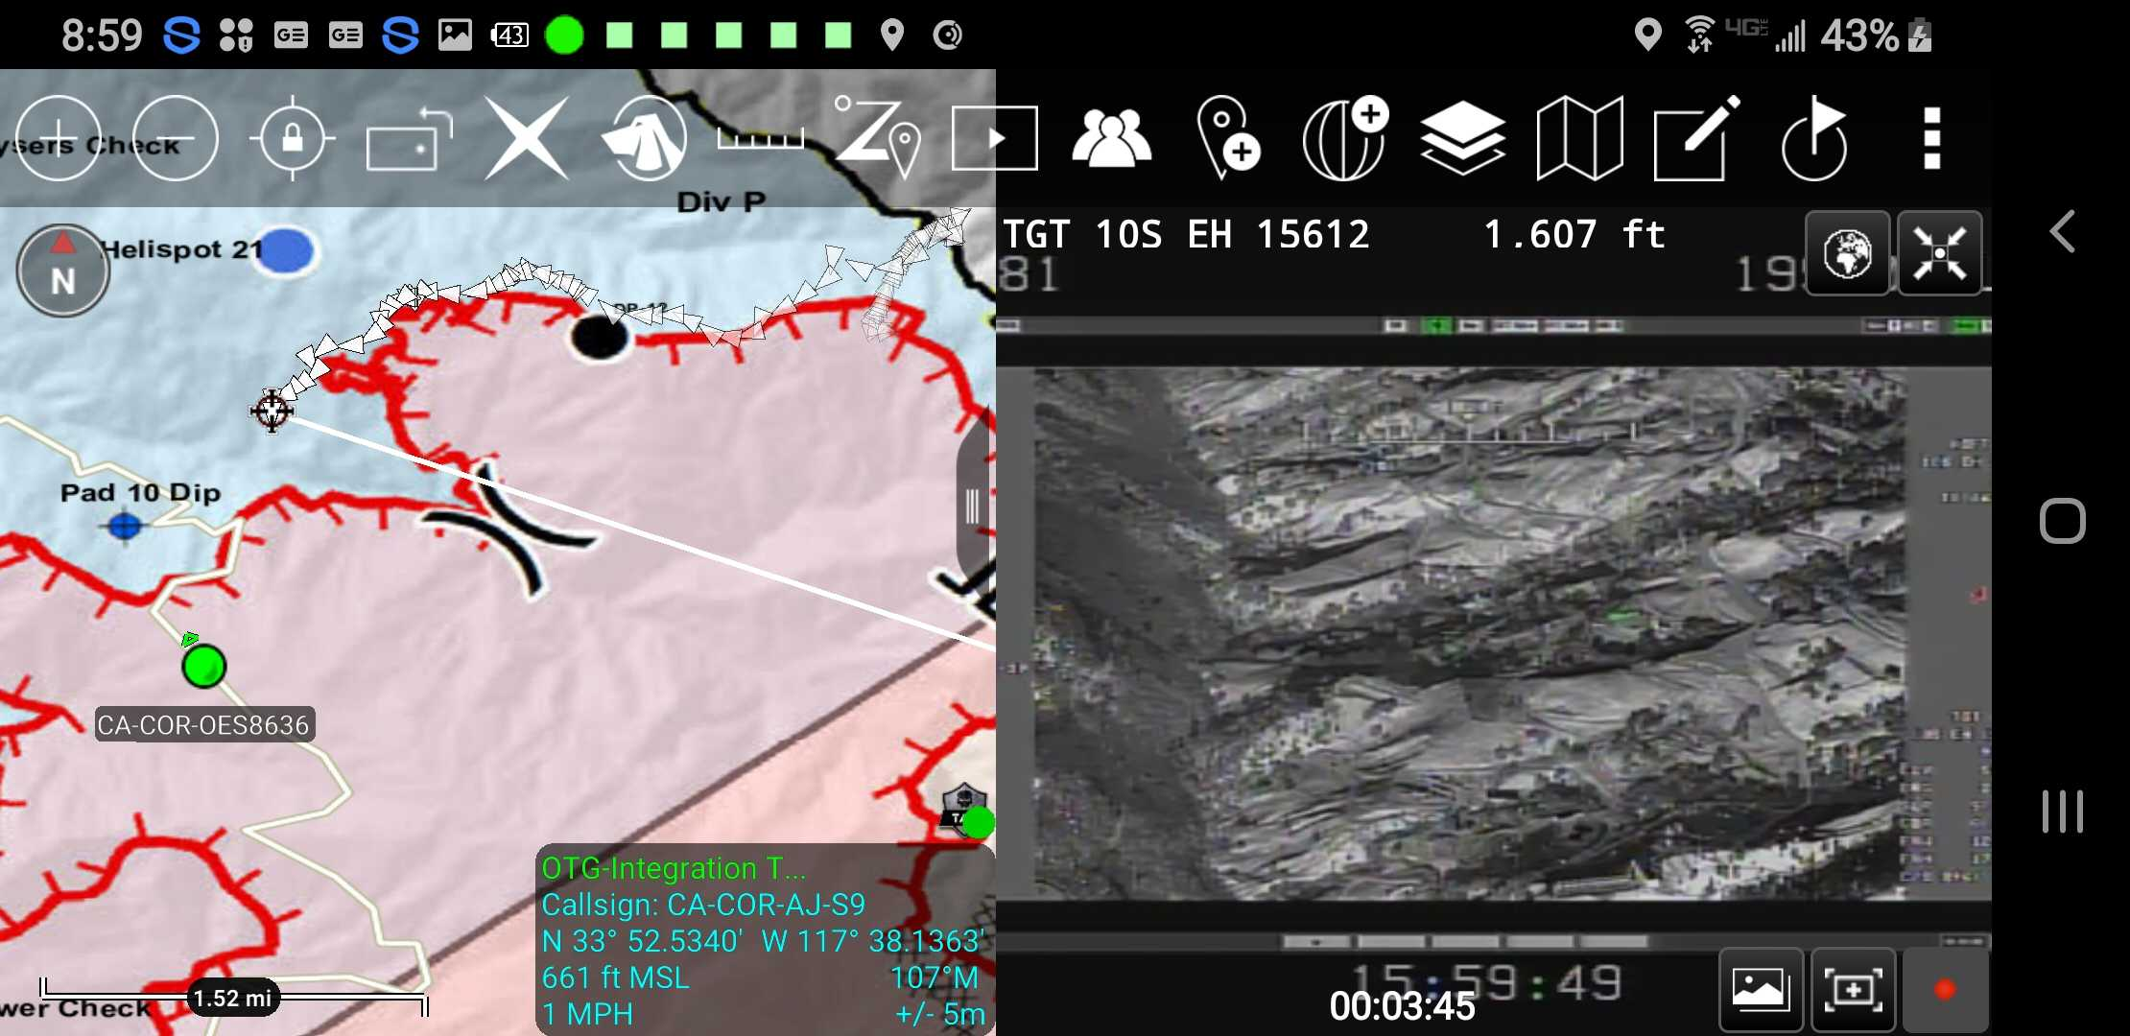
Distributed ISR in TAK
TAK can display and georeference FMV, as well as displaying standard video streams from pole cams.
With the appropriate MISB tags TAK can warp video directly onto the basemap.
Live video streams can be accessed over the internet or a local data link.

Slide 10
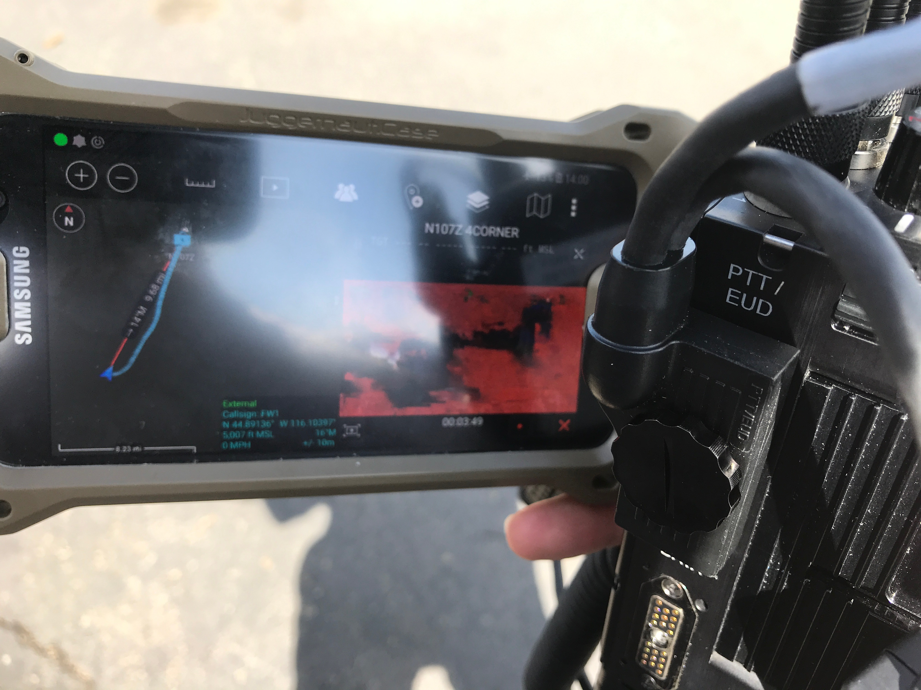
Local Data Links - Pros
A local data link allows firefighters on the ground to directly connect to an aircraft using a special radio, enabling FMV as well as the transmission of large files and audio if desired.
A local data link works as long as the aircraft is in line-of-sight to the firefighter. No internet connection is needed!
These radios are able to mesh network, and if one party had an internet connection they could extend that connection to their peers using these tactical radios.

Slide 11
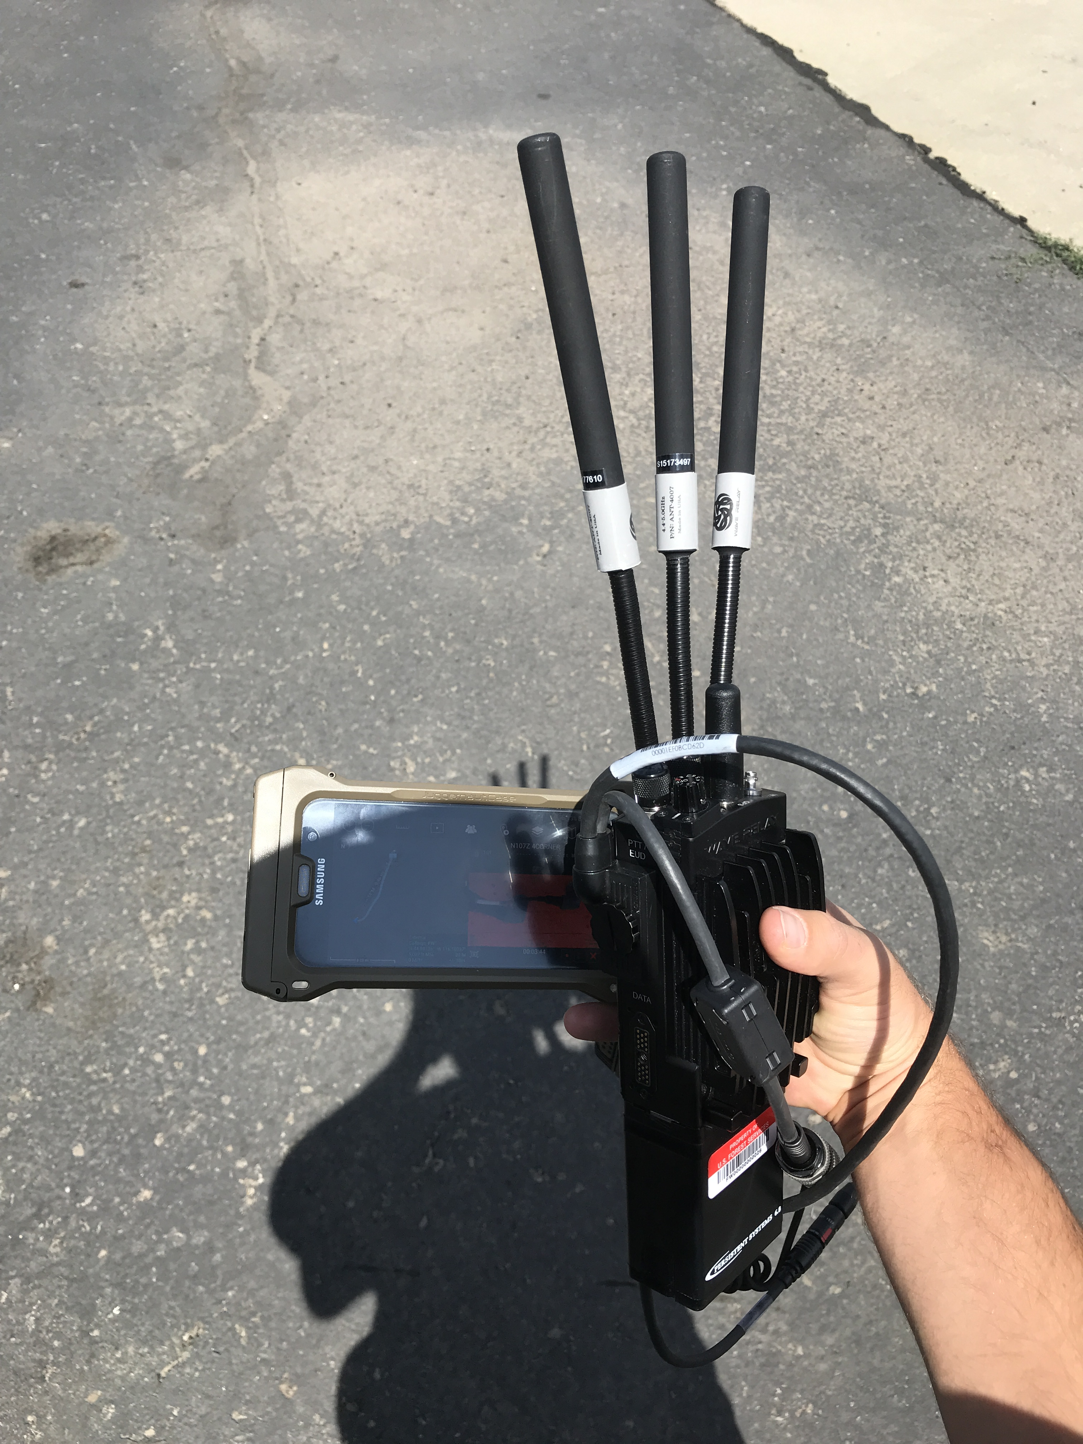
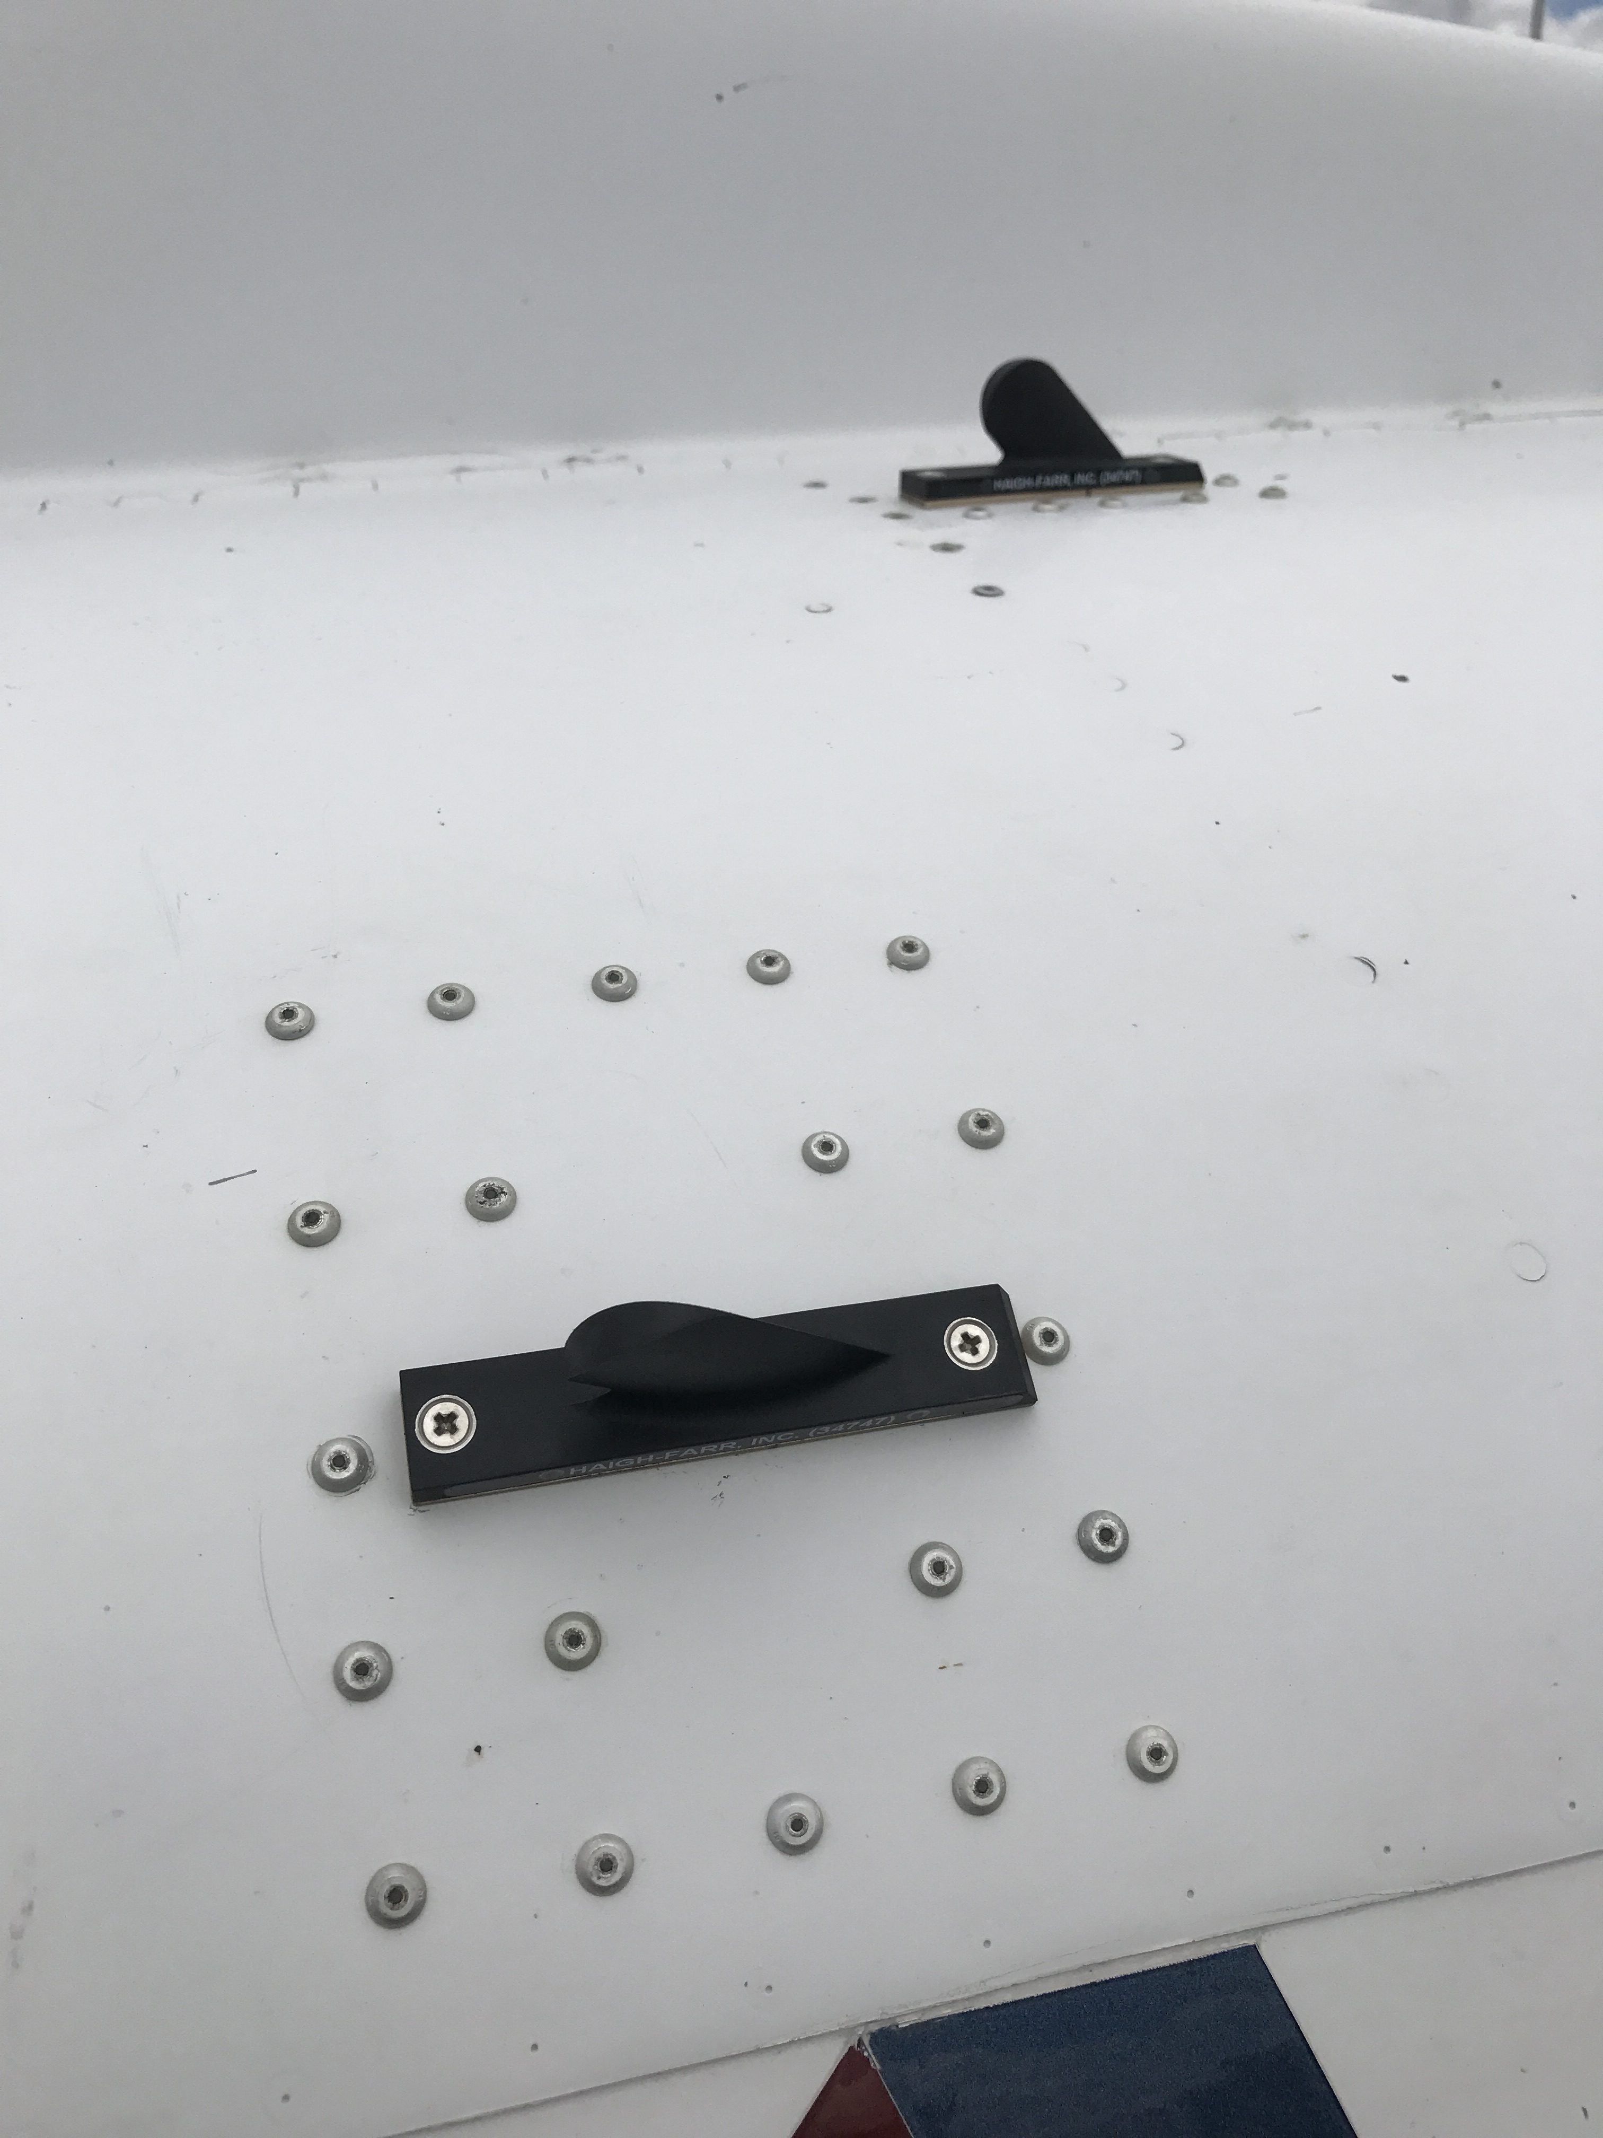
Local Data Links - Cons
This method requires every firefighter participating in the data link to carry a special radio with them. These radios cost about $10,000 each, and take up a significant amount of size and weight.
An aircraft hosting a local data link would require installation of multiple antennas. These devices actually contain two or three radios which work in tandem to improve reception.
There is no common standard for tactical data links, and in the civilian market Persistent Systems, Silvus, and Trellisware all make radios that mesh network and can stream video, but are not interoperable with each other.

Slide 12
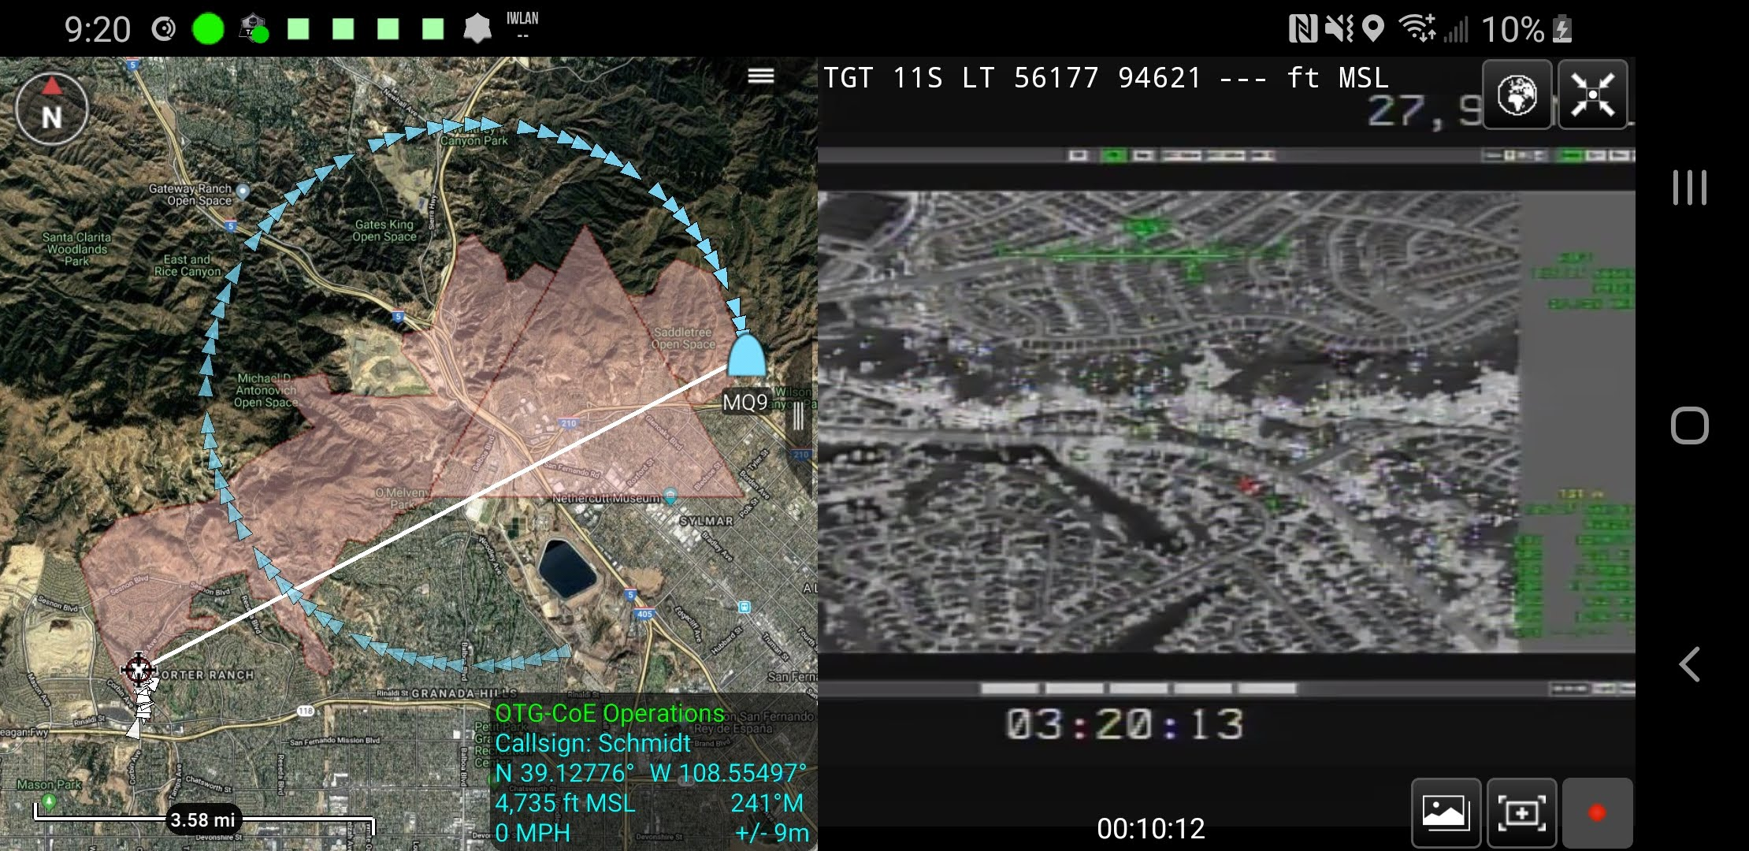
Internet Data Links
Alternatively a Internet data link focuses on linking an aircraft video feed to the Internet and a cloud-based video server. Any number of firefighters and managers can connect to the video server to view the full motion video.
This method provides end users with a free method of viewing the video, but requires a fairly robust internet connection on the fireline.
The aircraft is able to avoid installing a tactical data link, but must allocate 400-3000 kbps of bandwidth to serve the stream.

Slide 13

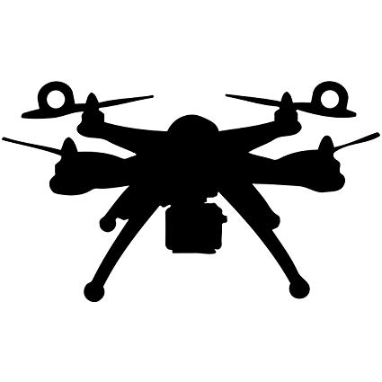
UAS Tool Plugin
Not only can TAK play FMV generated by others, it can also be used to generate FMV from small UAS!
The UAS tool plugin communicates with the pilot app, and adds the drone’s location and field of view into the TAK common operating picture, as well as full motion video from the UAS.
UAS Tool works with: DJI and AeroVironment (most types), FLIR Black Hornet III, Lockheed Martin Indago, and all MISB-compliant sensors.
FMV to video server
Pilot App
TAK
Telemetry on UAS location and status
UAS Tool

Slide 14
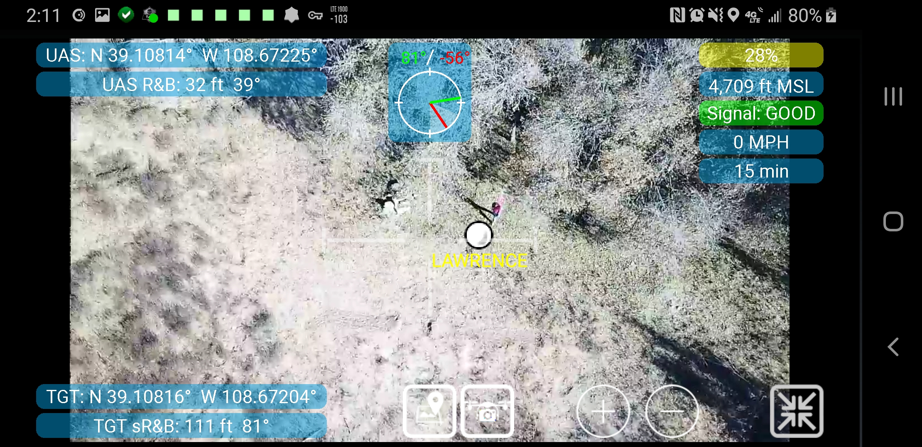
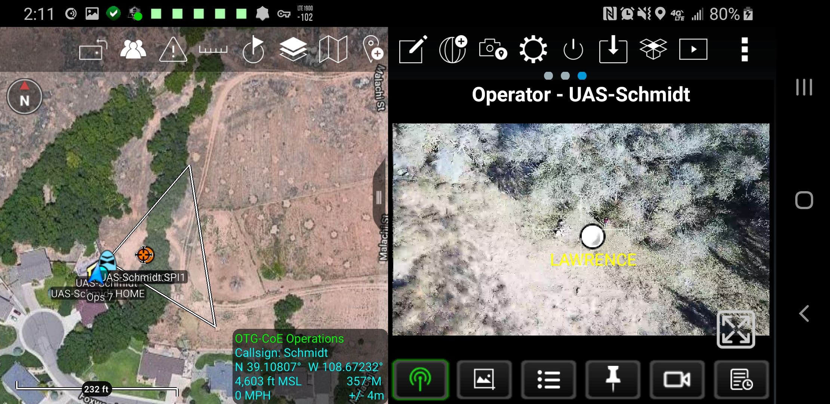
UAS Tool Experience for Pilots
For DJI aircraft pilots fly the drone using the TAK app and UAS plugin. A pilot can see either a split screen map/video view, or a video-only view that includes metadata on UAS location and status.
Augmented reality dots can be placed in the video feed where points have been dropped or where TAK app users currently are located.

Slide 15
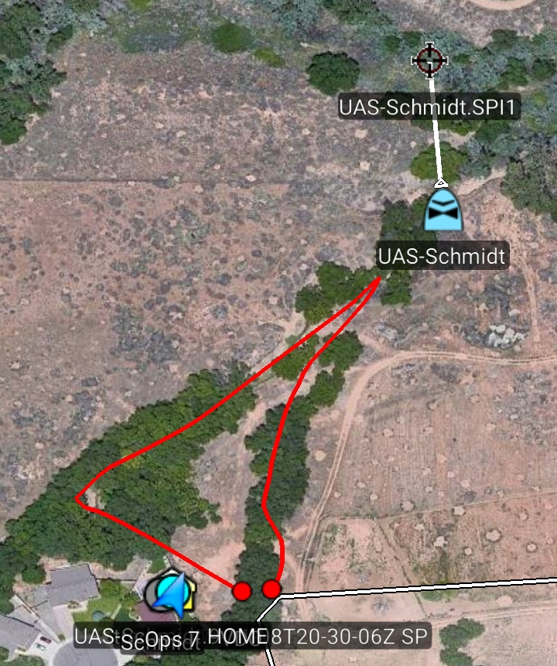
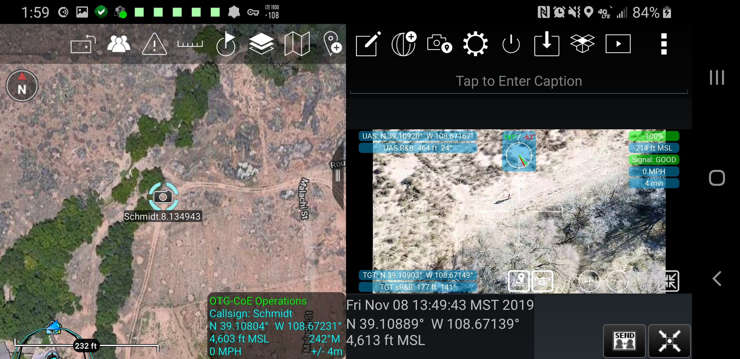
Data Collection Options
The UAS pilot, or firefighters who are not part of the flight crew, can use the UAS tool to collect data in the following ways:
The flight path, or sensor point of interest of the UAS can be captured as a line
Points can be dropped on the video and georeferenced in real time
      A MapShot can be taken, which takes a photo with the UAS metadata, aka a photo from the pilot’s perspective
      A Droneshot can be taken, which engages the UAS’s camera to take a photo, imports it into TAK, and sends it to other TAK users

Slide 16
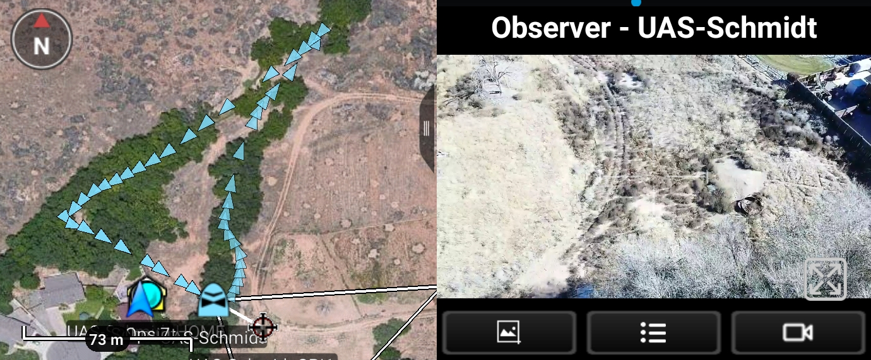
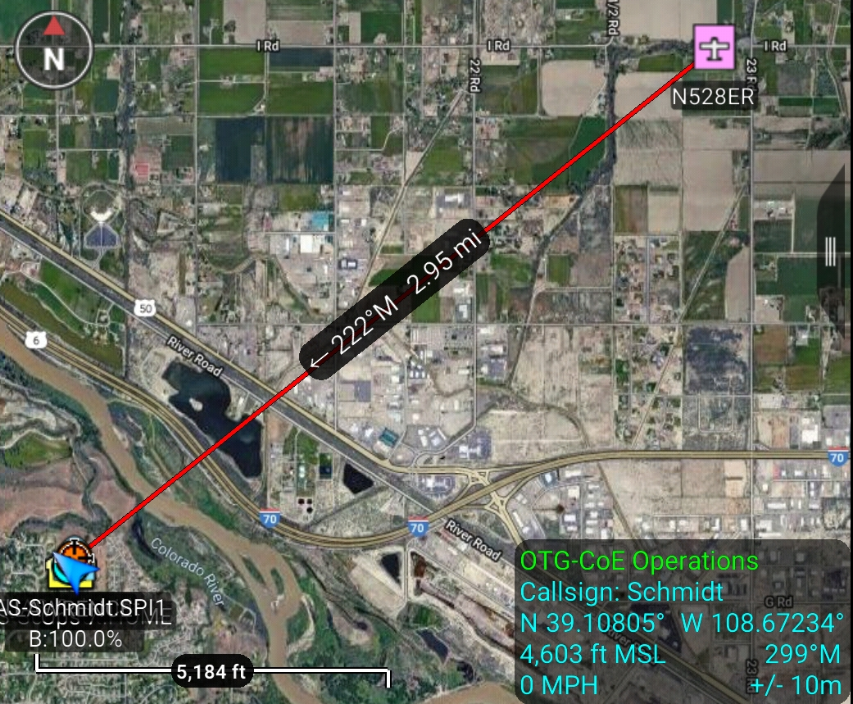
UAS Tool Experience for Firefighters
Firefighters with a robust internet connection can view live FMV from sUAS, and see up to the second telemetry with the location of the UAS and its field of view.
The ability to track incident UAS and verify the identify of a drone seen by firefighters could ease adoption of UAS on wildland fires.
Firefighters operating in areas with no internet access can utilize low-bandwidth radios such as the goTenna Pro or Beartooth to see points of interest captured by the UAS and transmitted to them by the pilot.

Slide 17
UAS Tasking
Firefighters who are using the TAK app, but are not part of the flight crew, can submit a request to the UAS pilot to task the aircraft to a point.
The pilot can accept or reject the task, then set parameters for the altitude of the UAS and how it should orbit the point when it arrives.

Slide 18
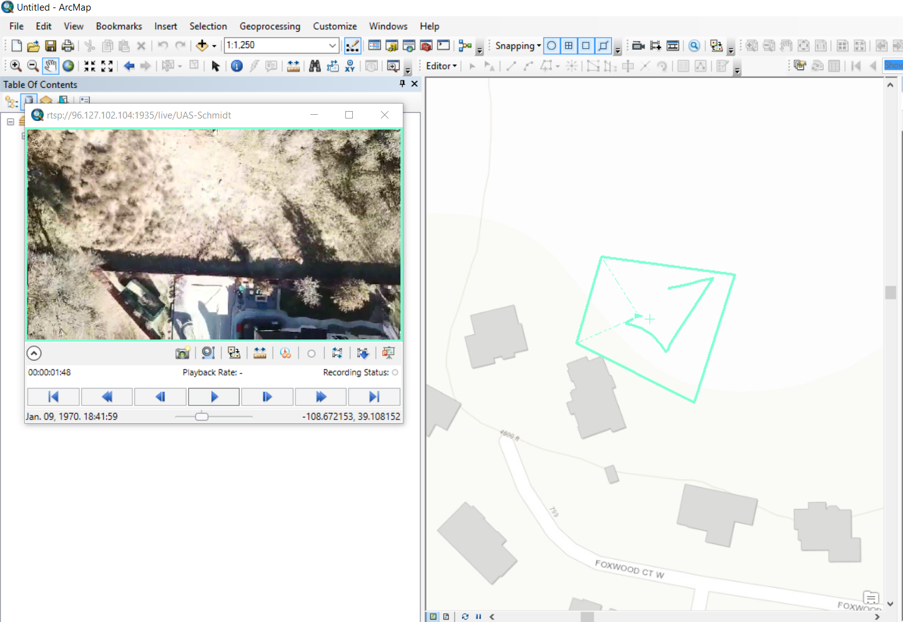
FMV Quality for Analysts
Assuming the UAS pilot has Internet connectivity, a FMV stream can be pushed by the pilot to a video server, and onto the Internet. Analysts can connect to the stream using ArcGIS or other FMV viewers.
The FMV meets MISB standards and can be used to digitize spatial data or observe fire behavior in relation to mapping data.

Slide 19





Comparison to Commercial Products
A wide variety of products from UAS manufacturers and third parties enable live streaming of UAS video.
Some commercial products are capable of augmenting UAS video with first responder locations and other spatial data.
Some products provide video to individual users only, or provide livestreams to the public via YouTube and Facebook.
However, only the UAS Tool on TAK provides live MISB Full Motion Video from sUAS, along with an augmented reality display and ability for field personnel to task the aircraft, all free of charge.

Slide 20
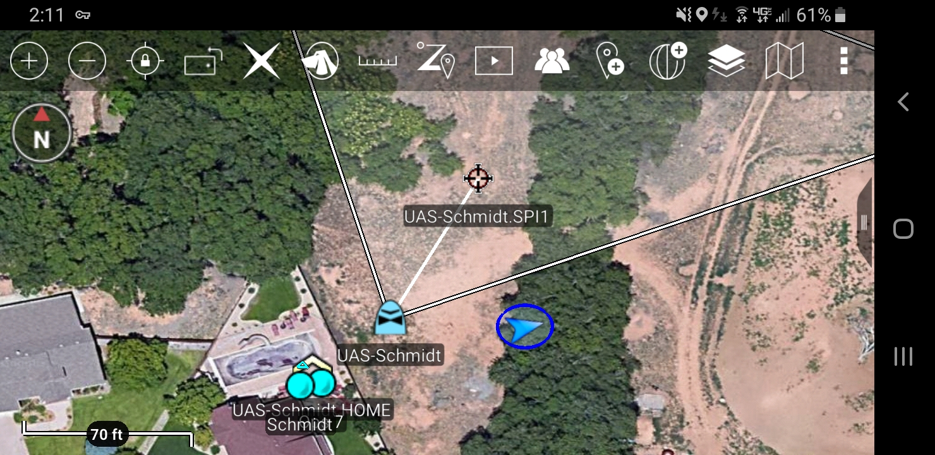
Summary
The UAS Tool and Team Awareness Kit can create a type I experience for a type IV UAS.
Additionally the UAS Tool provides a mechanism for firefighters in the field to directly view data on where UAS are, and what they are seeing.
If implemented this capability could improve airspace integration for UAS, and increase their usefulness to firefighters.

Slide 21
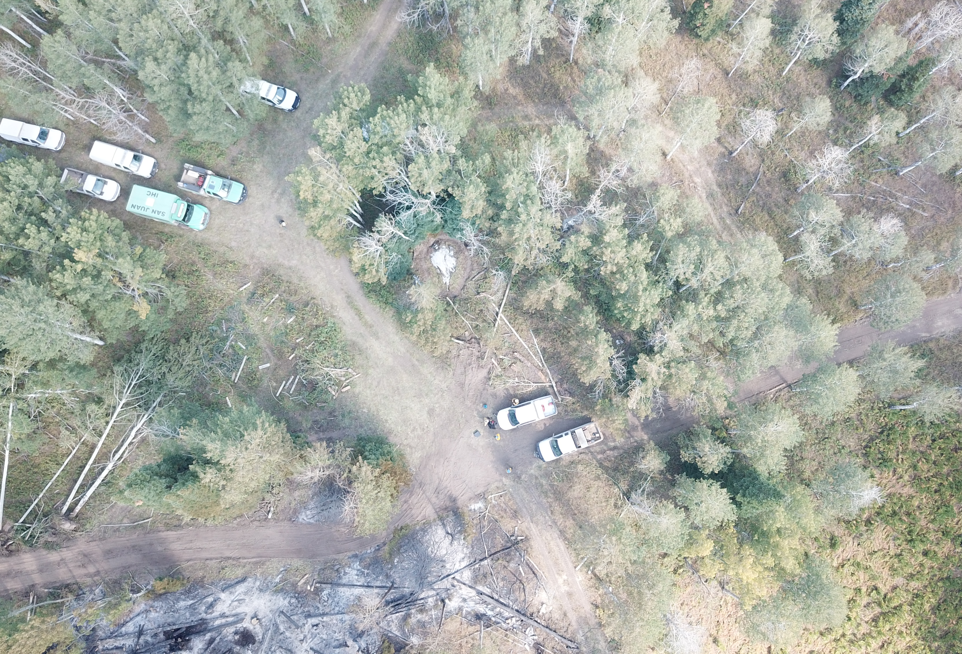
Questions?
Brad Schmidt
brad.schmidt@state.co.us
970-665-0038
cofiretech.org

