Slide 1
This document has been reviewed and determined not to contain export controlled technical data.
Application of SAR Products for Wildfire Response and Monitoring
KAREN AN, YUNLING LOU, & CATHLEEN JONES
NASA JET PROPULSION LABORATORY,
CALIFORNIA INSTITUTE OF TECHNOLOGY
© 2022 California Institute of Technology. Government sponsorship acknowledged.
Photo credit: Frederic J. Brown/AFP via Getty Images

Slide 2
Pre-Fire
UAVSAR
Active Fire
Uninhabited Aerial Vehicle Synthetic Aperture Radar
Post-Fire
https://uavsar.jpl.nasa.gov/
VEGETATION PENETRATION
SPATIAL RESOLUTION
L-band (23.8 cm, 9 in) frequency allows further penetration through veg, with more direct returns from surface.
High resolution (~6 m, 20 ft) products allow for detection of detailed features. Image swath is 22 km (13 mi) wide.
DATA COLLECTION
DISASTER RESPONSE
UAVSAR has been flying since 2008, with repeat acquisitions over many study areas.
Can potentially be deployed within hours of disaster event. In contrast to optical, radar can see through smoke, haze, and clouds. Can image surface day or night.

Slide 3
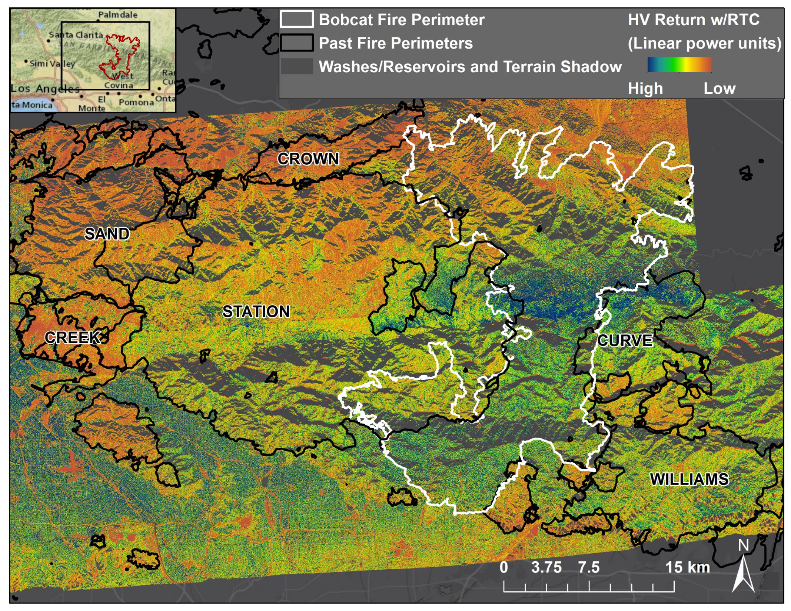
Pre-Fire Fuel Availability
Grey areas lie in radar terrain shadow
Orange/red areas show low vegetation burned in past fires
Green/blue areas show more vegetation
Pre-Fire
Vegetation
Post-Fire
February (north) and October 2018 (south)

Slide 4
Active Fire Burned Area
Light green shows relatively unchanged areas
Orange/red areas show areas burning during fire
Active Fire
October 2018 Minus September 2020
Ranch2 Fire
August 2020
Ranch2 Fire
August 2020

Slide 5
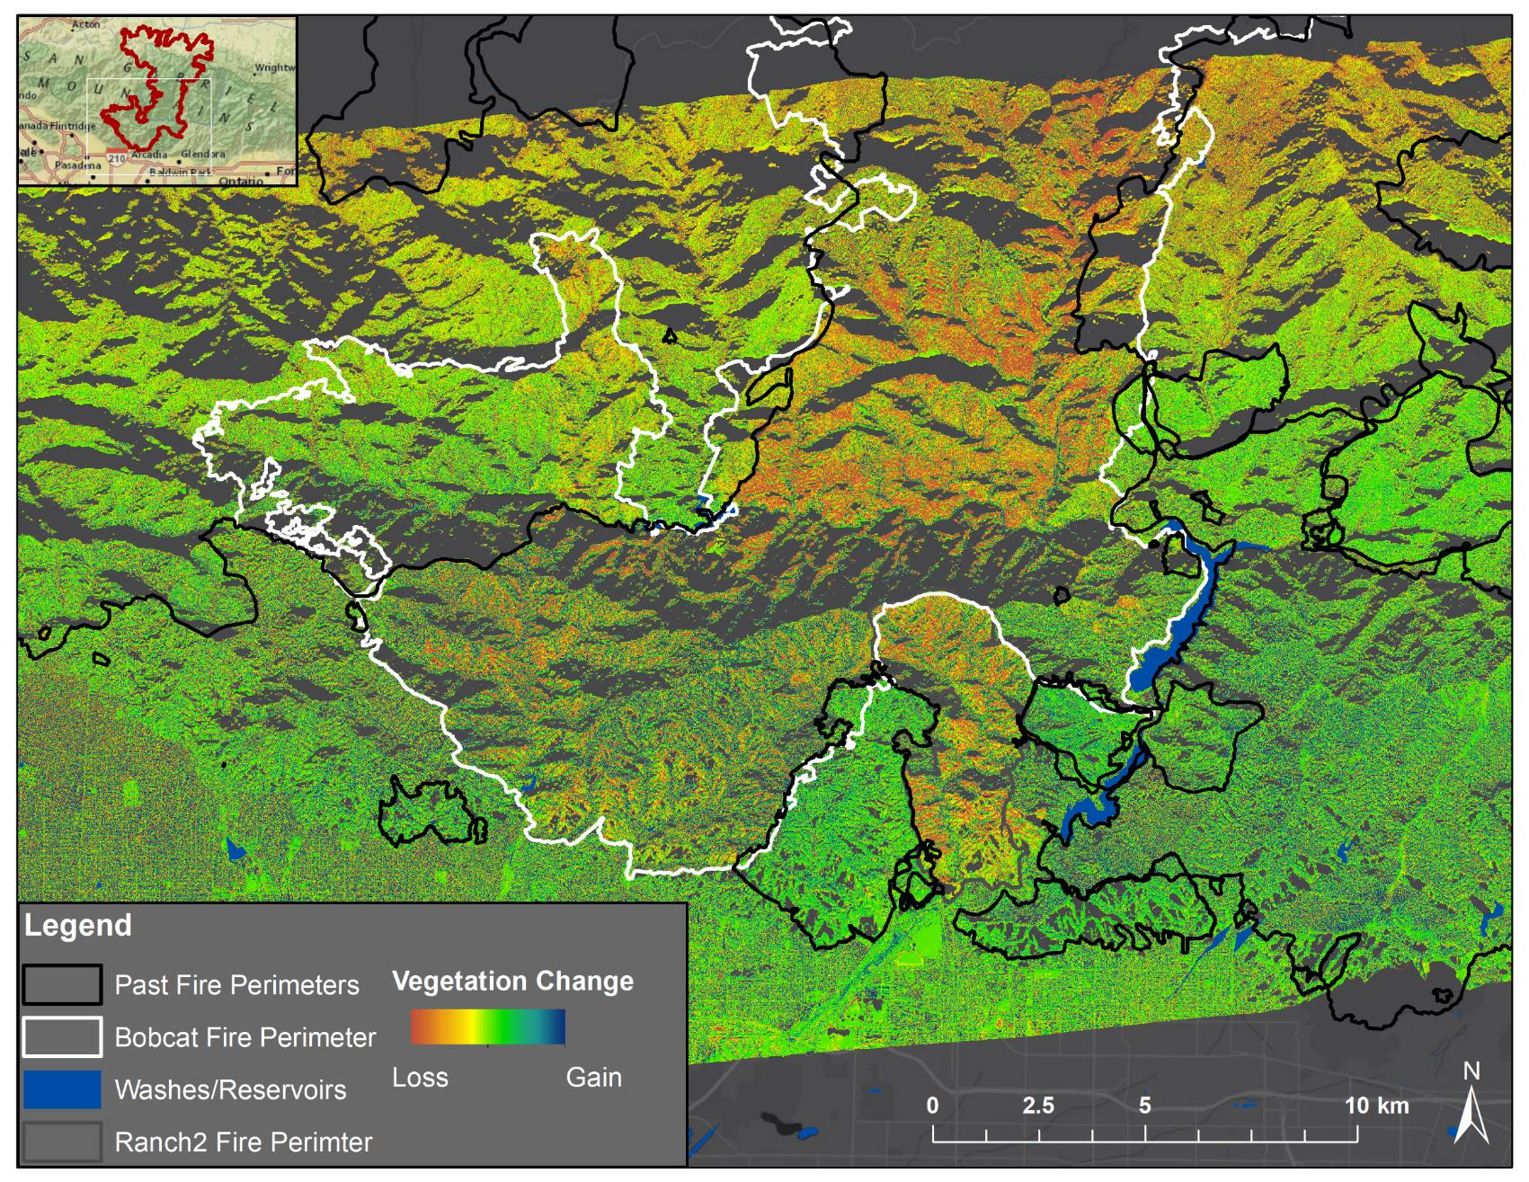
Active Fire Burned Area
Orange/red areas show areas burning during fire
Active Fire
Burn Severity (Optical Imagery)
October 2018 Minus September 2020

Slide 6
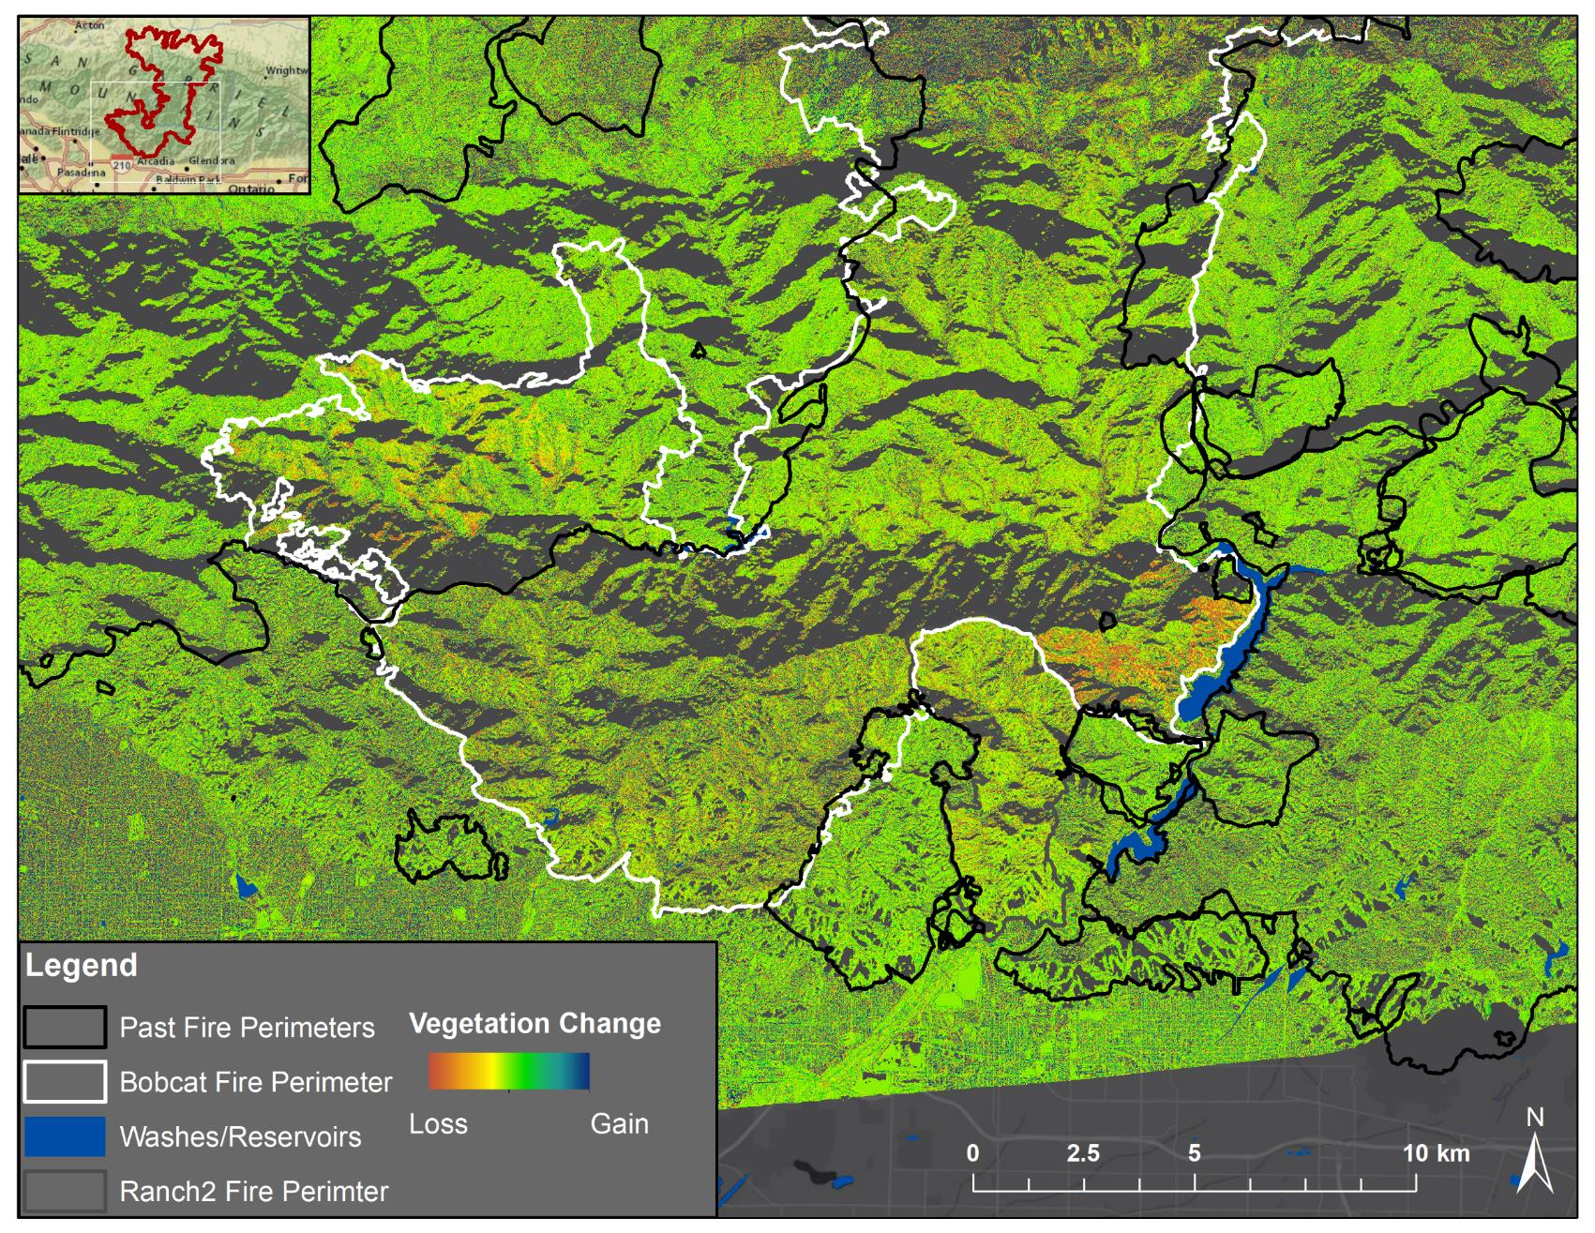
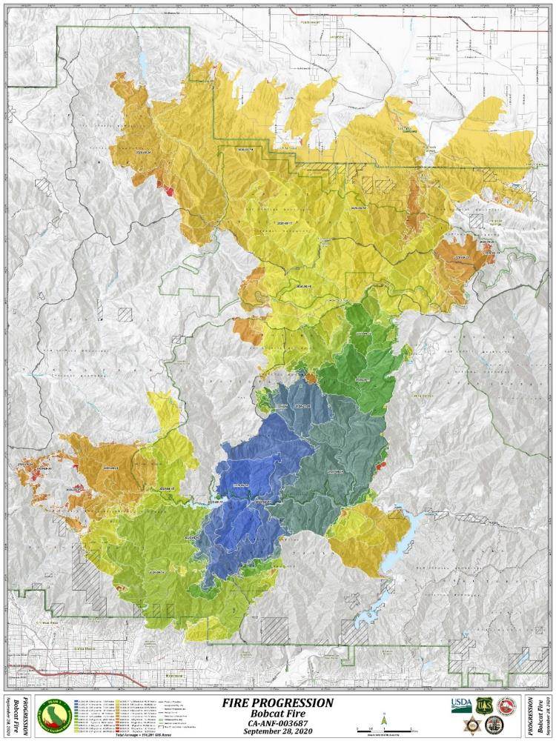
Active Fire Burned Area
Orange/red areas show burned areas between Sept-Oct during Bobcat Fire
Active Fire
Orange areas in HV difference (09/18-10/15) burned around same time as orange polygons (09/19-09/21)
September 2020 Minus October 2020

Slide 7
Final Vegetation Map from SAR
Light green shows relatively unchanged areas
Orange/red areas show areas burned during Bobcat Fire
Pre-Fire
Post-Fire
October 2018 Minus May 2021

Slide 8
Relationship between Burn Severity and Biomass
Pre-Fire
Post-Fire
Optical
UAVSAR
Within each burn polygon, what is the average HV value?
Areas that burned at high severity in 2020 had more vegetation in 2018
HV, an indicator of healthy biomass, can show available fuels for future fires
Vegetation

Slide 9
Relationship between Burn Progression and Biomass
Post-Fire
Within each progression polygon, what is the average HV value?
Areas that burned first in 2020 had more vegetation in 2018
Site of ignition, local slope, vegetation, wind, etc. can dictate fire progression

Slide 10
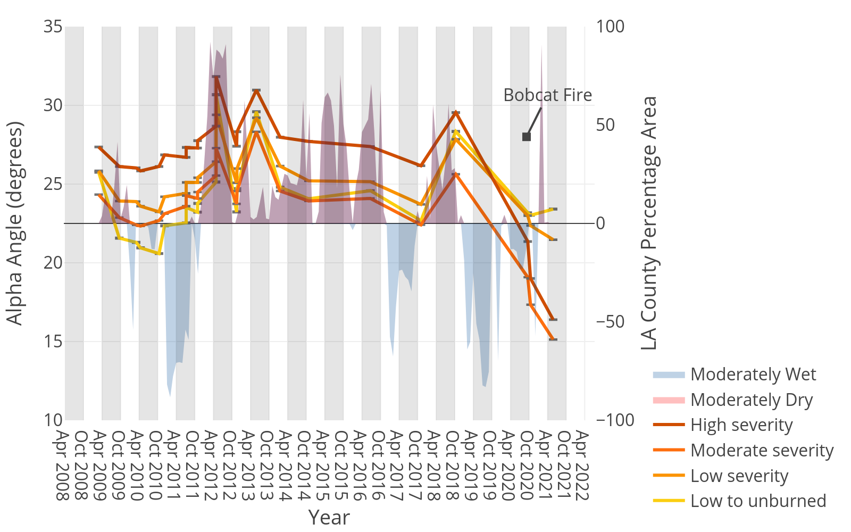
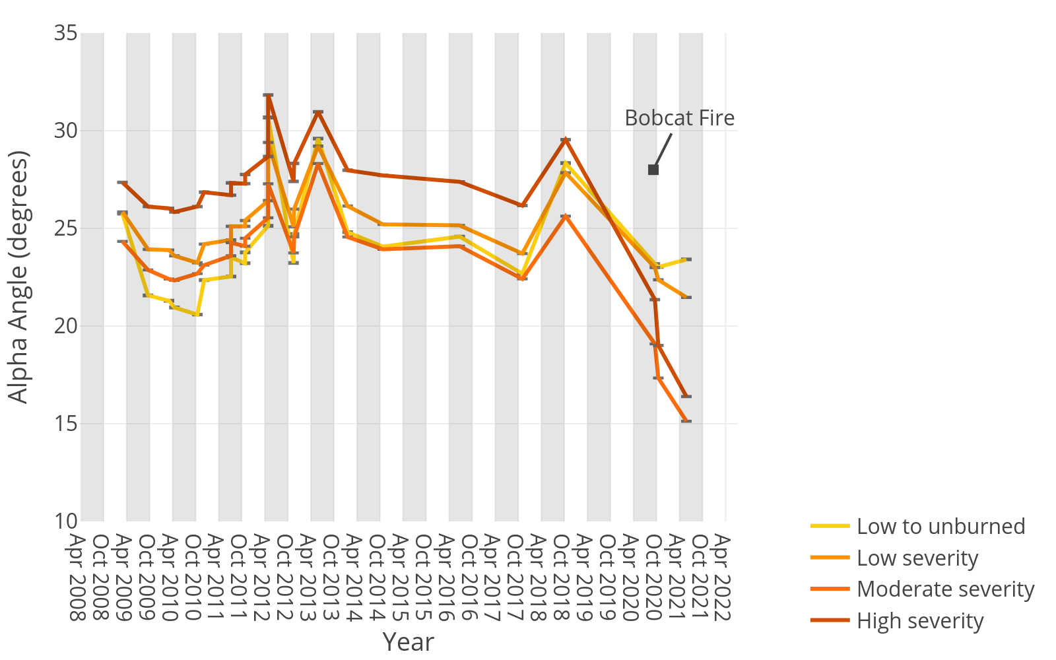
Pre-Fire
Post-Fire
More Vegetation
High severity areas had more vegetation before the fire
Less Vegetation

Slide 11
Caldor Fire (2021) – Detection of Fire Progression with Data Acquired 1.75 Hours Apart
Active Fire
UAVSAR Data (8/25/2021)
Burn Severity (Optical)

Slide 12
Woolsey Fire (2018) – InSAR Coherence
Active Fire
Post-Fire
Coherence is a measure of how similar two SAR images are
High coherence (blue) means little change occurred between images
Low coherence (orange) means a large amount of change occurred

Slide 13
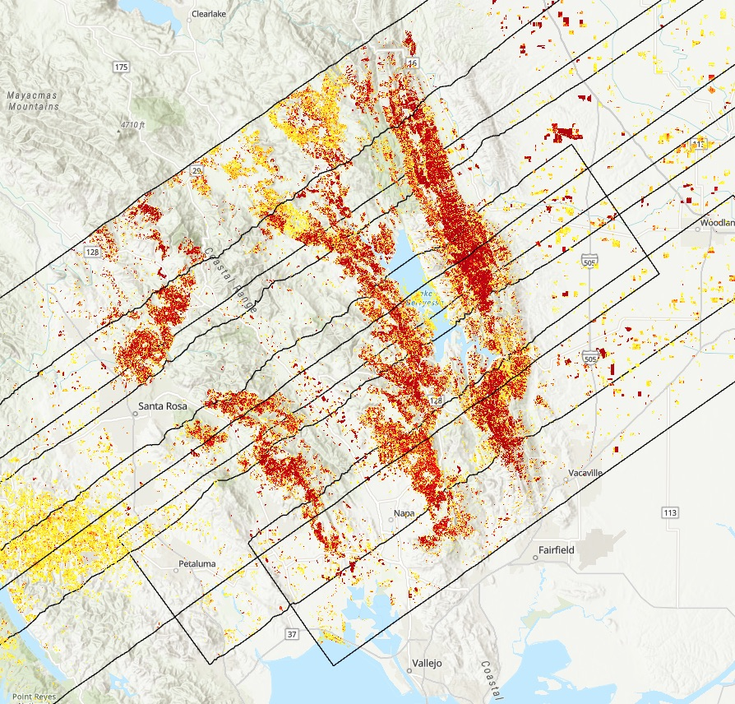
LNU Lightning Complex Fire (2020) - ARIA Damage Proxy Map
Active Fire
Post-Fire
Rocky Fire (2015)
Valley Fire (2015)
LNU Complex Fire (2020)
Map is derived from stack of UAVSAR images (in HV polarization)
Pre-event images taken in 10/2018 or earlier and post-event image was acquired during the LNU Complex (2020)
Map contains changes from previous fires or post-fire vegetation growth
Yellow to red indicates increasingly more significant ground surface change
Tubbs Fire (2017)
Nuns Fire (2017)
Atlas Fire (2017)

Slide 14
Summary of SAR for Fire Science and Response
PolSAR
InSAR
Tracks fuel availability and vegetation changes over fire cycle. Difference images highlight burned areas.
Pre- and Post-fire InSAR correlation shows detailed changes to the landscape, and with PolSAR, is used to generate damage proxy maps.
GIS
Fire
Response
NISAR
All datasets are GIS-compatible and can be modified to be ingested into existing platforms used by fire agencies.
UAVSAR can provide disaster response with current snapshots of burned areas, and aid fire management between events.
UAVSAR is the prototype for NISAR, the upcoming NASA-ISRO space satellite. Wildfires can be monitored in similar ways globally.

Slide 15
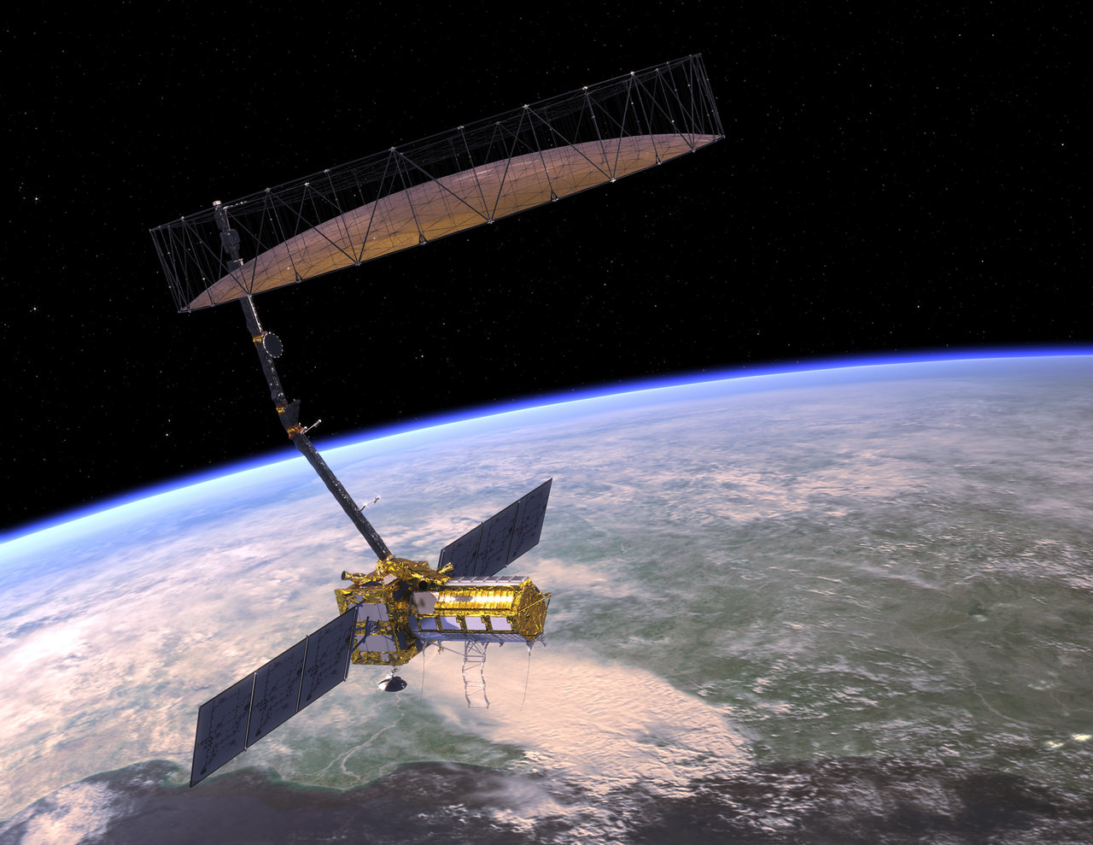
NISAR Early Adopters Program
Who are NISAR early adopters?
Individuals and organizations who
have a clearly defined need for NISAR data
have an existing application that can benefit from NISAR
are capable of applying their own resources to demonstrate the utility of NISAR data for their application.
Early Adopters provide important feedback to the NISAR team regarding which NISAR data products meet the needs of their applications.
https://nisar.jpl.nasa.gov/engagement/early-adopters/

Slide 16
Thank you!
Karen An (she/her/hers)
NASA Postdoctoral Scholar
karen.an@jpl.nasa.gov
https://nisar.jpl.nasa.gov/engagement/early-adopters/

