Slide 1

Welcome to TFRSAC – Day 2
Please be mindful to mute your connection unless you are speaking.
Thank you!!

Slide 2
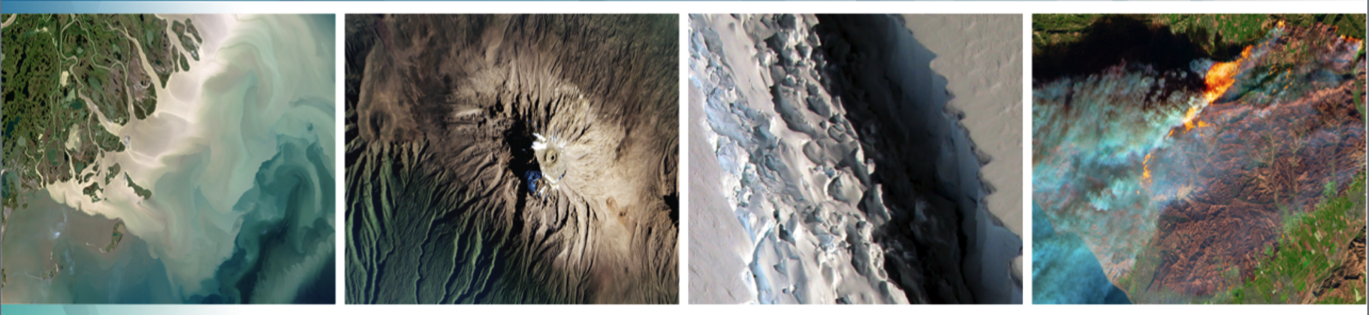
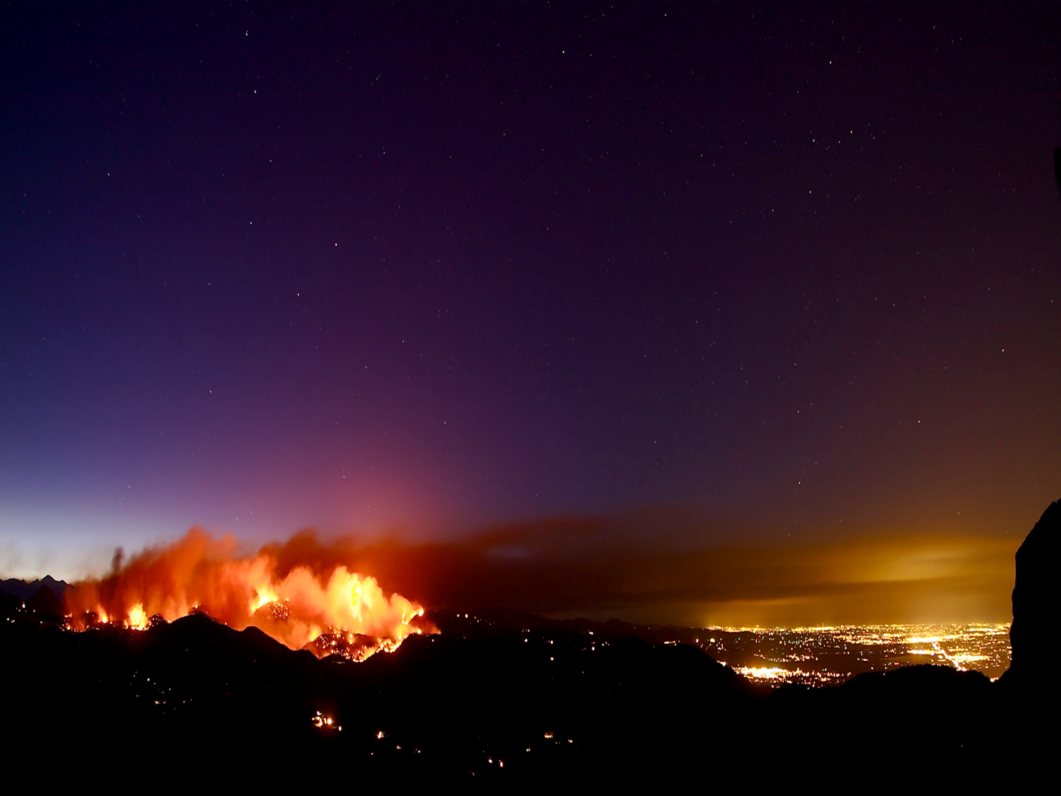

Welcome to Day 2
35th Tactical Fire Remote Sensing
Advisory Committee (TFRSAC) Meeting
Hosted By:
USDA-Forest Service: Everett Hinkley
NASA Applied Science Program: Vince Ambrosia
1-2 December 2021
11:00 AM – 5:00 PM ET

Slide 3
Tactical Fire Remote Sensing Advisory Committee (TFRSAC)
TFRSAC: A “Community of Practice” (CoP) which focuses on sharing best practices and creating new knowledge to advance the wildland management domain of professional practice. TFRSAC meets twice yearly (Spring and Fall) to discuss the developments and results of ongoing investigations for new and evolving capabilities that support improved fire observation.
TFRSAC OBJECTIVES: Demonstrate evolved and evolving technologies for increasing the information content and timeliness of EO data collected for wildfires.
Build and mature new relationships / partnerships amongst the community.
Notes:
The bi-annual meeting agendas and presentations are open-access and shared with the greater community
Technology Focus Areas:
Development and demonstration of improved and emerging airborne platform capabilities (manned and UAS).
Demonstrate new sensor capabilities for enhanced fire discrimination.
Demonstrate new data communication capabilities / automated processing for real-time data distribution from sensors (airborne sensor data to end-user communities on ground).
Develop and demonstrate Collaborative Decision Environment (CDE) capabilities to effect improvements to tactical fire decision support systems.

Slide 4
TFRSAC General Agenda Overview
Thursday Sessions 4 & 5:
  AI / ML in Support of Wildland Fire
Thursday Session 6:
  Wildfire Decision Support Tools
  Demonstrations
  Fire Fuel Detections
  Research Community Updates
  OPEN DISCUSSION / WRAP-UP

Slide 5
Miscellaneous
We will provide all contacts for the attendees (email addresses) post-meeting (for those that want to contact attendees or presenters directly. DO NOT USE the email addresses for solicitations!!!
The presentations will be shared with the community within a 1-2 weeks post-event. For those who do not want their presentations shared openly, please notify both Everett Hinkley and Vince Ambrosia in an email.
We will copy and share the Chat content for each day at the same link as the presentations….so be cautious on the contents of your chat!

Slide 6
Speaker Guidance
Please be mindful of the length of you speaking slot. Most are 15 minutes, so brevity and hitting the high notes are appreciated. We will be fairly strict about moving to the next speaking slot.

