Slide 1
SMC / RSXE
USFS Collaboration Efforts
October 2018
UNCLASSIFIED
Lt Col Charles Matt Loyer, SMC/RSXE
UNCLASSIFIED

Slide 2
Agenda
UNCLASSIFIED
Tool Applications and Processing (TAP) Lab Overview
Broad Area Announcement (BAA) contracts
Current USFS related projects
The US Air Force is actively pursuing research and development projects to contribute to wildland forest fire detection, monitoring, tracking/spread, reporting and post mission forensics.
UNCLASSIFIED

Slide 3



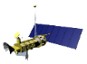





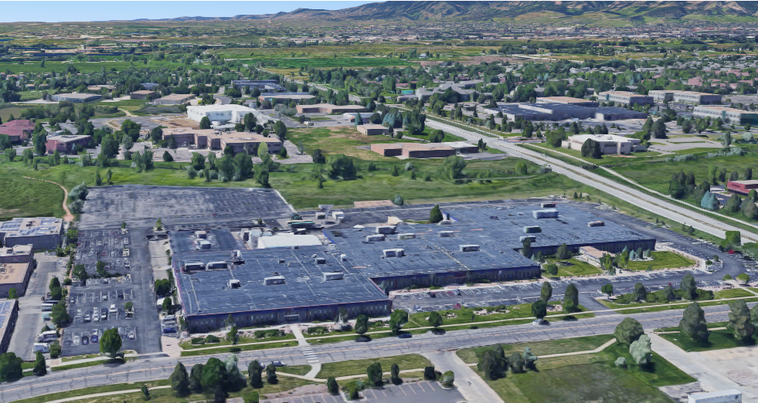
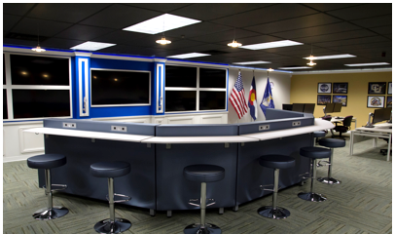
TAP Lab Purpose & Goals
UNCLASSIFIED
TAP Lab: data exploitation environment to provide an unrestricted innovation for furthering warfighting capabilities and discovery of civil and commercial uses of remote sensing data
Government-controlled Research, Development, Test and Evaluation (RDT&E) environment
Attract government (Defense & Civil), academia, industry partners (Small- & Large-business)
Provide easy access to all Remote Sensing data with multi-level enclaves (Unclassified, SECRET and TS/SCI)
Enable 3rd-party application/algorithm development via common API, SDK and open data standards
Provide a framework to host new applications with minimal system modifications
Facilitate capability transition to Operational Centers
Access to Data
Access to Contracts
Collaborative Development
UNCLASSIFIED

Slide 4
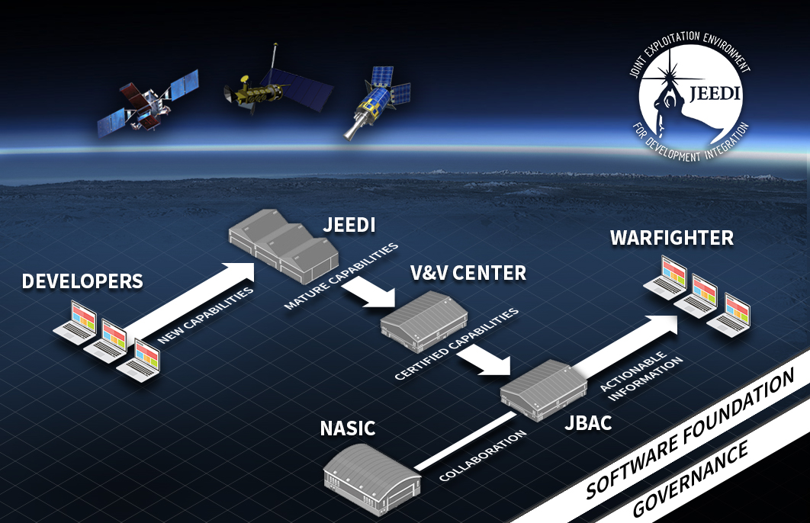


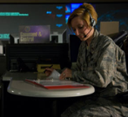

Exploitation Innovation Process
UNCLASSIFIED
RSX Data Exploitation Concept
Utilize all available RS data
Maximize innovation
Access for developers and warfighters
Close coordination with OBAC
Government controlled
FEEDBACK
Community Collaboration
(NASIC, ISPO, DoD, Civil)
BOULDER LAB
Developers/ Academia
New Capabilities
Boulder
Lab
Mature
Capabilities
OBAC /
SBIRS MCS
Actionable
Information
Warfighter /
Civil Users
FALCON SHIELD
User Feedback
Provide the environment, access to data and contracting for the development and rapid deployment of remote sensing data exploitation capabilities
UNCLASSIFIED

Slide 5
Concepts to Ops Capability
UNCLASSIFIED
Topic Focus Areas
White Paper Submissions
Evaluations
F1, F2 > F3
Multiple Evals
Project Execution
Fail Fast
OR
Validate /Demonstrate Concepts
Test & Evaluation
Transition to Ops
Composite Score
Mission-Specific and/or Customer Specific
F1. Contribution to Focus Area
As-A-Service Automation
Prioritization
F2. Technical Approach Qualifications
Data Display & User Experience
Decision Authority
F3. Cost
Data Display & Trending
Request for Proposal to Selected Papers
Data Ingest, Archive & Discovery
Technical Evaluation
USFS
Contract Award
Leverage Existing Data, Innovate Applications, Develop Utility, Transition to Ops
UNCLASSIFIED

Slide 6
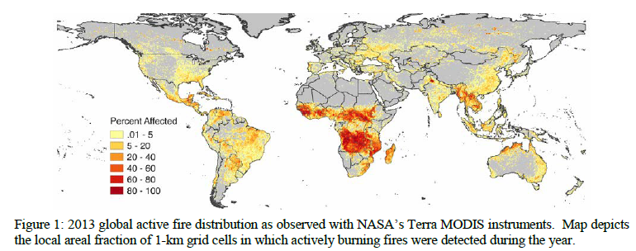


Global Cropland Fire Sensing and Characterization using SBIRS Data
UNCLASSIFIED
Who | Michigan Technological University (MTU) / University of Maryland (UMD)
What | Adapting fire detection and characterization algorithms for use with TAP lab data and tools for global cropland burning. Producing combusted cropland-residue biomass and cropland-residue black carbon/trace gas emissions data sets.
When | Project Start Date: 9 July 2018 | Project End Date: 9 May 2020
Where | Research performed by MTU and delivered to and demonstrated at the TAP Lab Potential end users include: USDA Forest Service smoke planning and management; US EPA Air Quality and GHG reporting, US Navy (NRL) aerosol mapping program; UNFCCC (greenhouse gas reporting), Arctic Council
Why | An important subset of worldwide fire activity are cropland fires associated with the burning of agricultural residue. Currently, it is not possible to reliably quantify the occurrence of cropland burning with conventional remote sensing data (due to small size and comparatively short lifetime) SBIRS provides this advantage when performing this research
UNCLASSIFIED

Slide 7


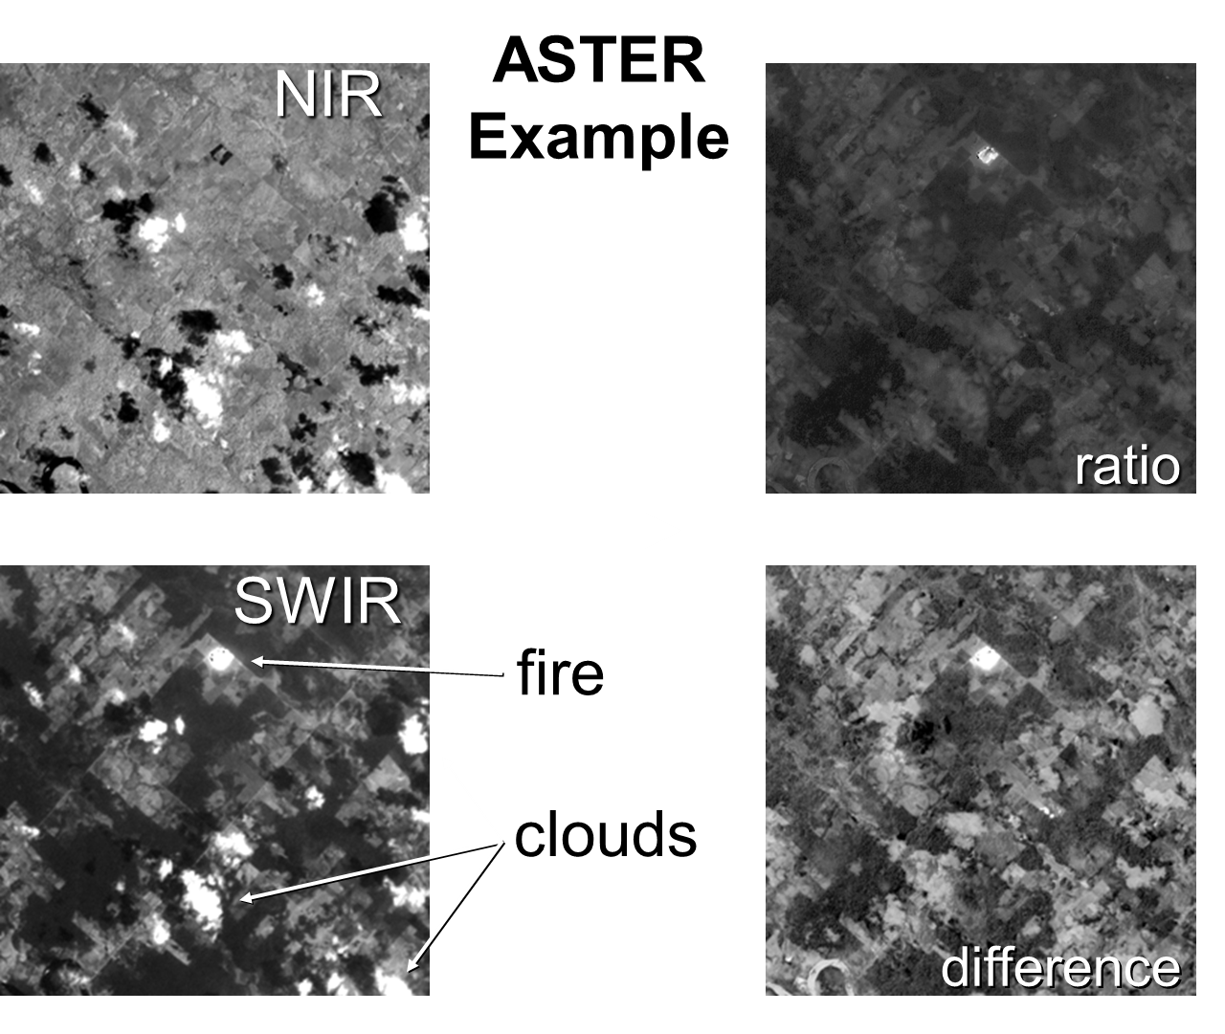
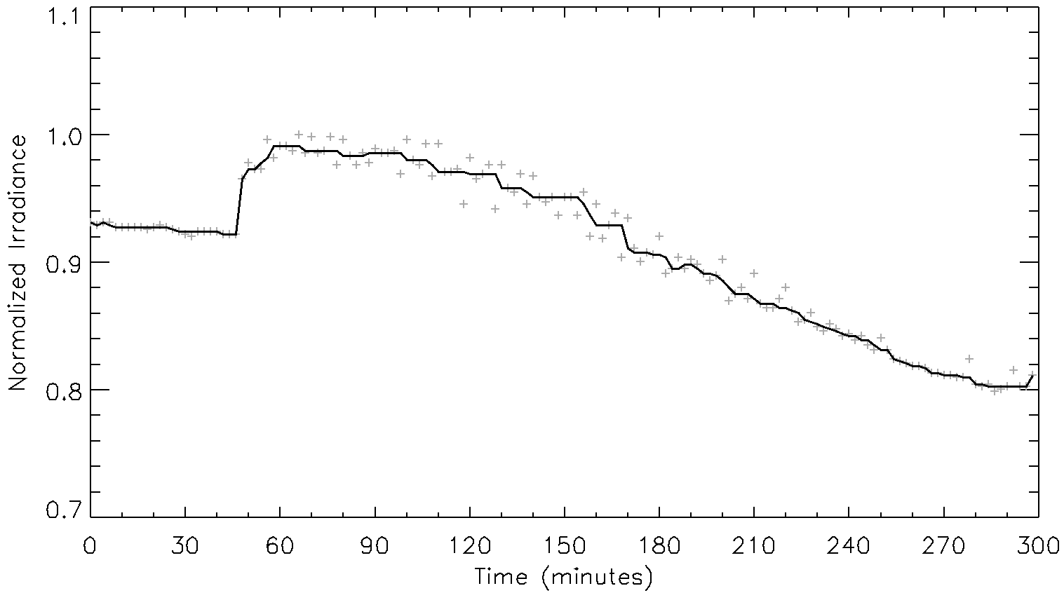
Global Cropland Fire Sensing - Tasks
Cropland fire detection algorithm
Fire emissions accounting approach: Inventory-based
Detection Example
ASSET simulated normalized irradiance time series of a ~500-m resampled grid cell containing a small fire. Fire was ignited ~48 minutes into the five-hour simulated data stream.
Notes:
1. Cropland fire detection 2. Inventory estimate of what is burning/burned to determine biomass products, emissions, and estimate of how much has burned, sizes, necessary for EPA reporting on international reporting goes into Greenhouse Reporting committee, Navy group that analyzes atmospheric aerosols for weather prediction, NRL, MRY. Department of State: treaty compliance for open burning overlap with Artic Council (biomass burning) i.e. non structures. IPCC cares with respect to Climate change. Open burning concerns globally

Slide 8
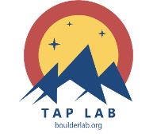
Global Cropland Fire Algorithm Development
Develop fire algorithms in unclassified setting for application to classified data.
Define cropland fire characteristics for location
Identify areas of known fire locations
Create ASSET simulated products
Make TAP data products
compare
Develop algorithm from existing civilian approaches (e.g. GOES, VIIRS, MODIS)
Adapt & apply unclassified algorithm
SBIRS fire products
Simulated fire products
compare
Notes:
UNCLASS Data (simulated available) via ASSET (OPIR Data simulator) currently validation simulated scenes vs. recorded event data

Slide 9
Intersect Exploit
UNCLASSIFIED
Who | Raytheon
What | Combining a previously-developed Visible Infrared Imaging Radiometer Suite (VIIRS) tool suite with SBIRS plugins to provide a user with a consolidated VIIR / SBIRS data view on a singular console
When | Project Start Date: 1 March 2017 | Project End Date: 31 March 2019
Where | Research being performed at the TAP Lab Potential end users are the OPIR Battlespace Awareness Center (OBAC) (Buckley AFB) and 557th Weather Wing (Offutt AFB)
Why | The Intersect Exploit application provides a data-fusion visualization technology for us by any TAP lab developer or intelligence analysts (such as those at the OBAC).
UNCLASSIFIED

