Slide 1
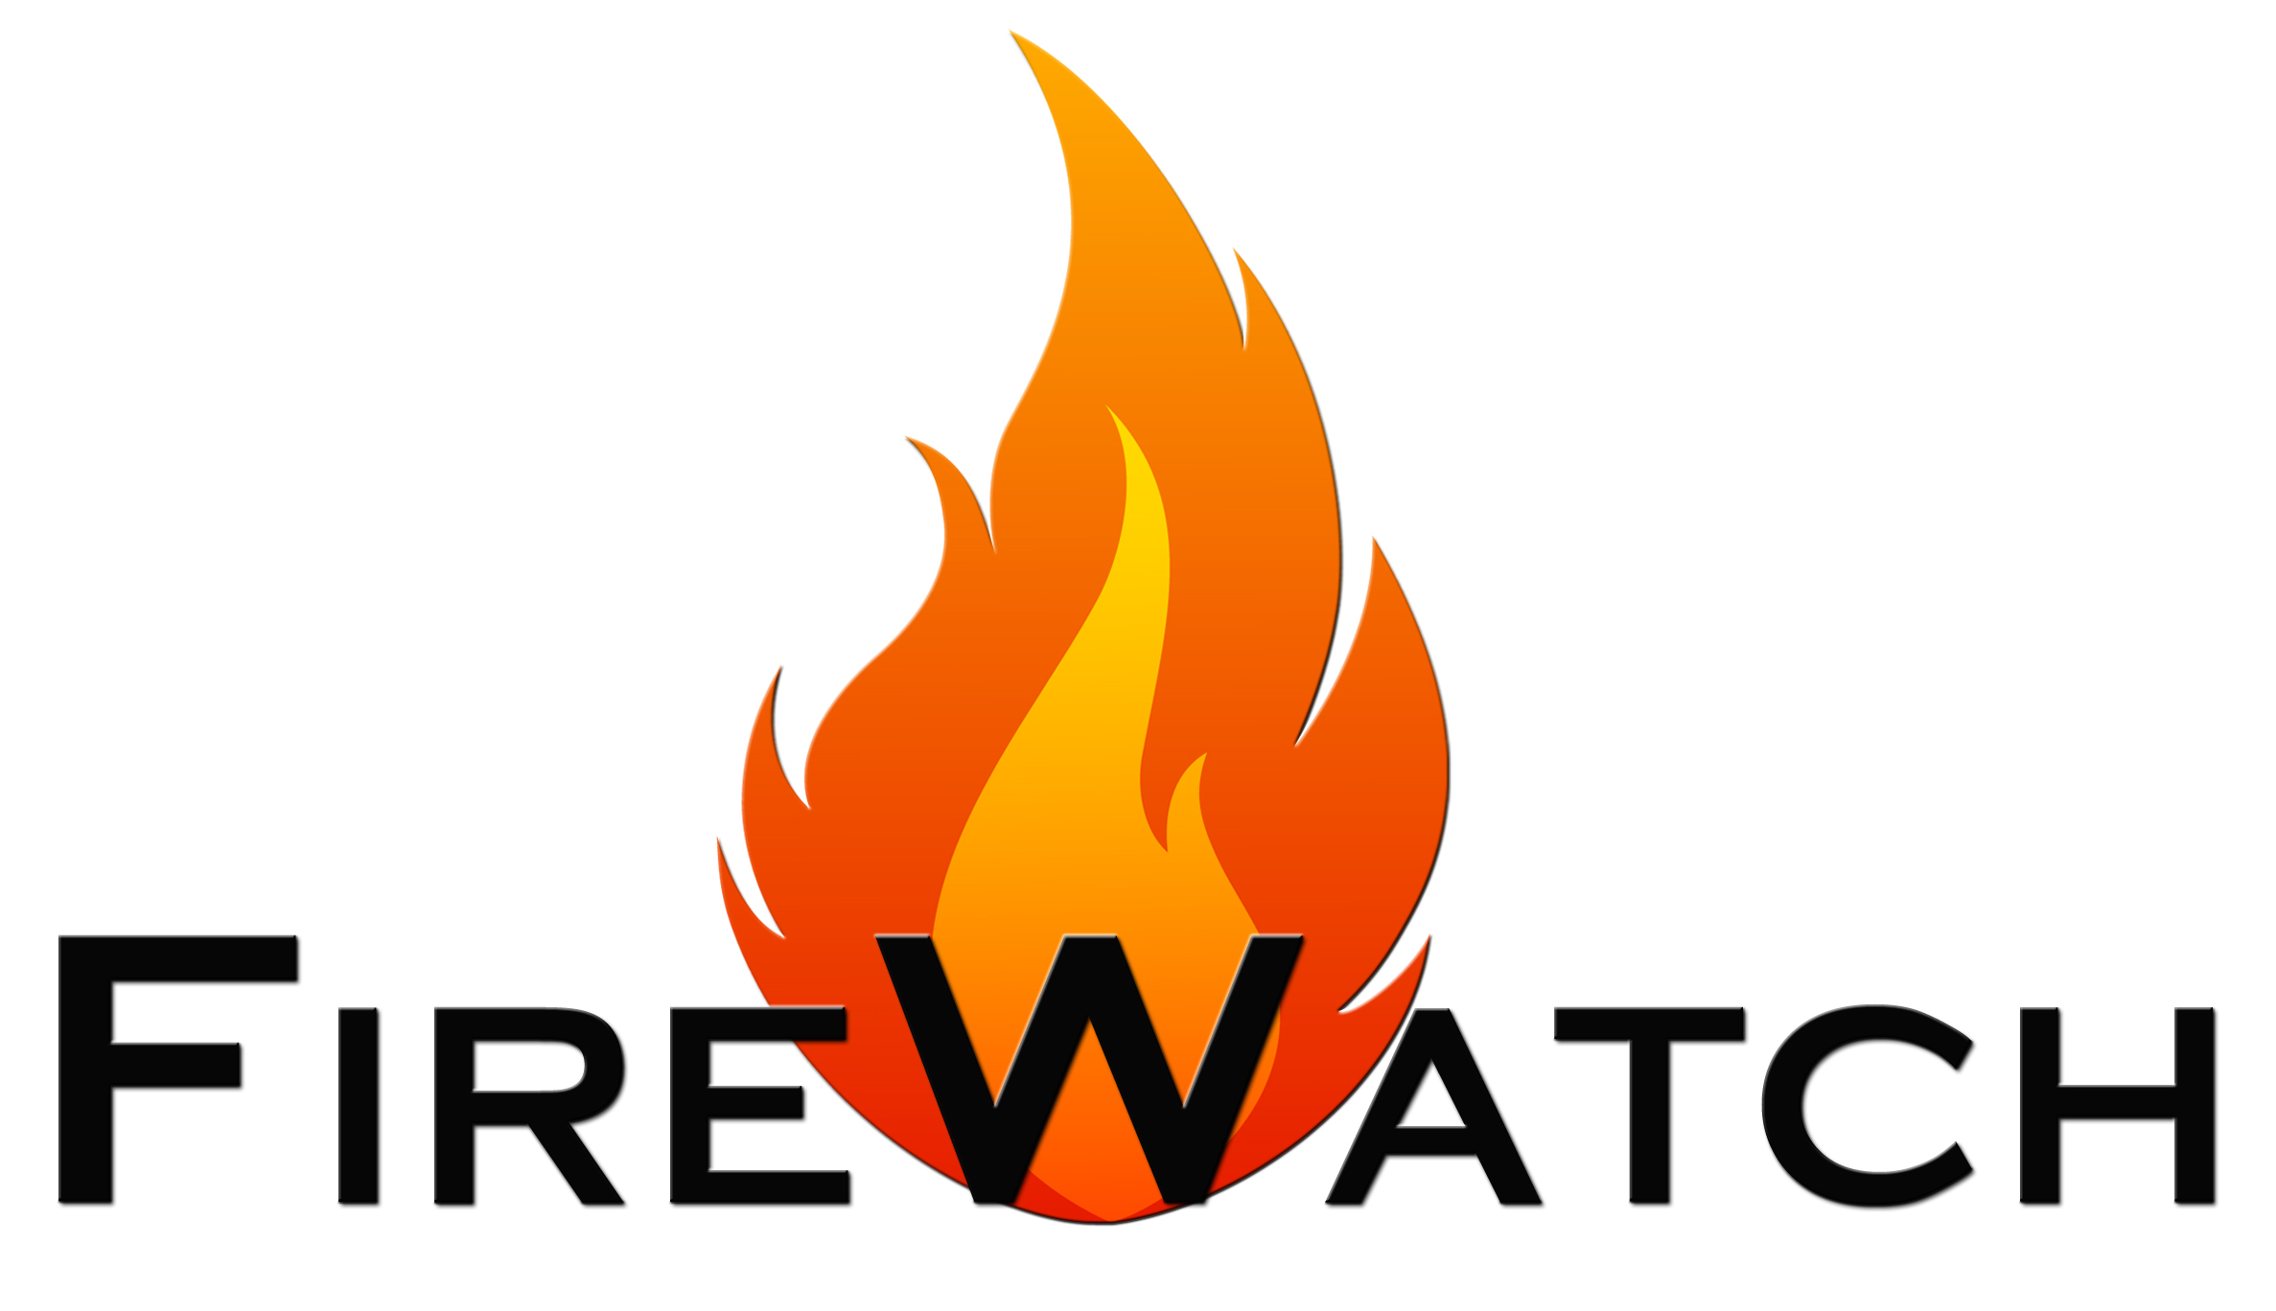
Breaking the Cycle of
Community Wildfire Destruction
Presented by
Richard McCreight
&
Gus Calderon
NASA/USFS Spring 2022 Tactical Fire Remote Sensing Advisory Committee (TFRSAC) meeting

Slide 2
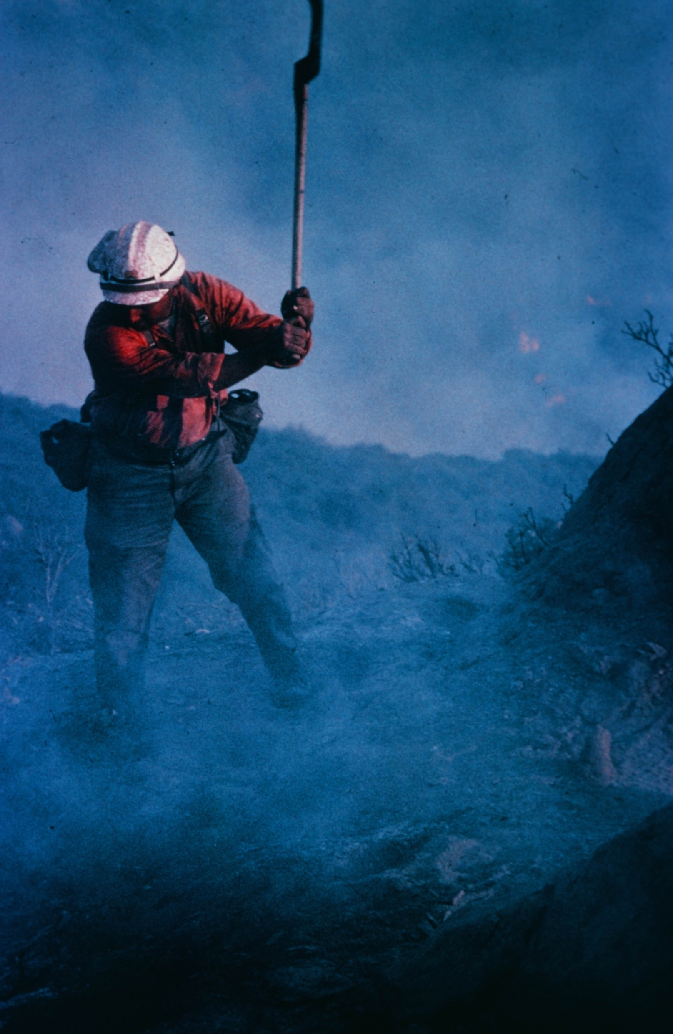
Richard McCreight
Hotshot and Helitack at the U.S. Forest Service
Researcher at the Forest Fire Lab in Riverside, CA
Pioneered environmental remote sensing from ultra-light aircraft at NASA
Mapped natural disasters and wildfire damage for over 20 years

Slide 3
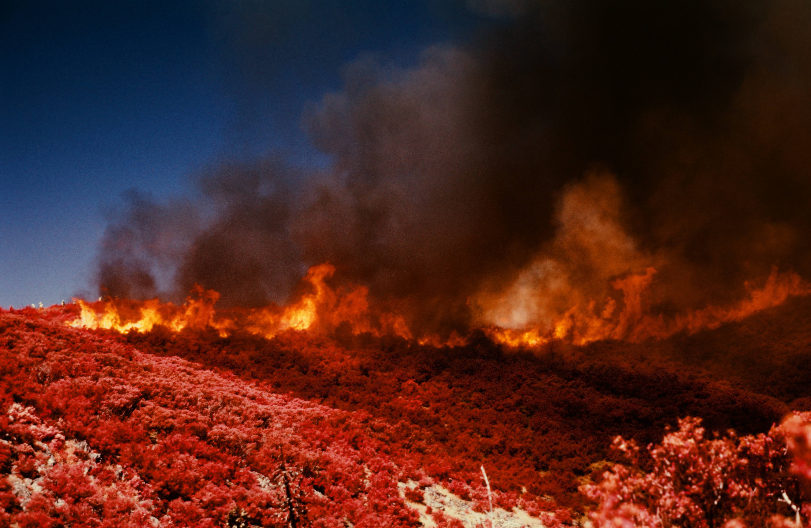
California Firestorms

Slide 4
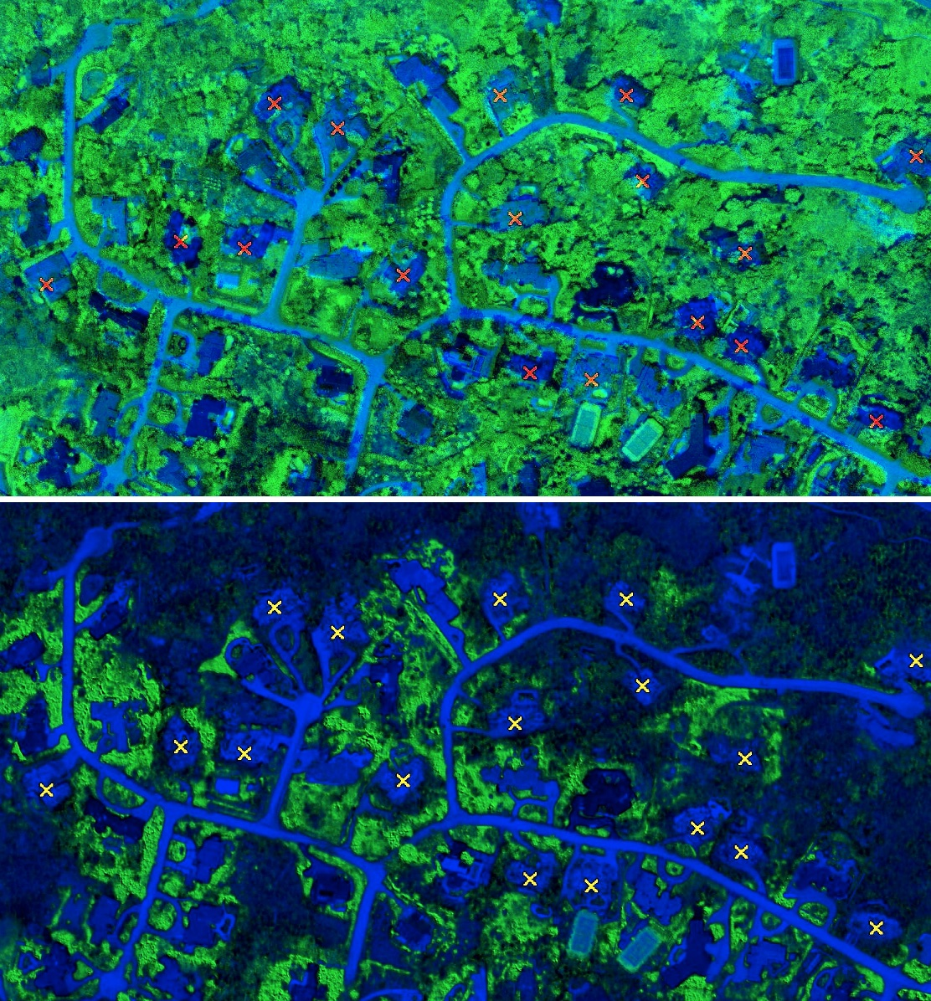
Normalized Green Vegetation
Pre-Witch Creek Fire 2005
Post-Witch Creek Fire 2007​
X = Destroyed Homes

Slide 5
Rancho Bernardo Trails Community
“The single greatest predictor of wildfire destruction is the proximity of vegetative fuels to structures”

Slide 6
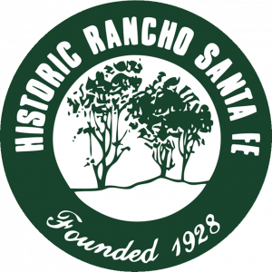
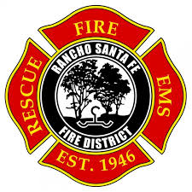
High Resolution
Wildfire Hazard Mapping
In 2019, FireWatch partnered with the community of Rancho Santa Fe and the
Rancho Santa Fe Fire Protection District for their wildfire prevention efforts.
FireWatch creates three categories of wildfire hazard maps to
help the community break the cycle of wildfire destruction:
Strategic maps for community planning
Defensible space maps for landscape-level planning
Change detection maps to monitor wildfire hazards over time

Slide 7
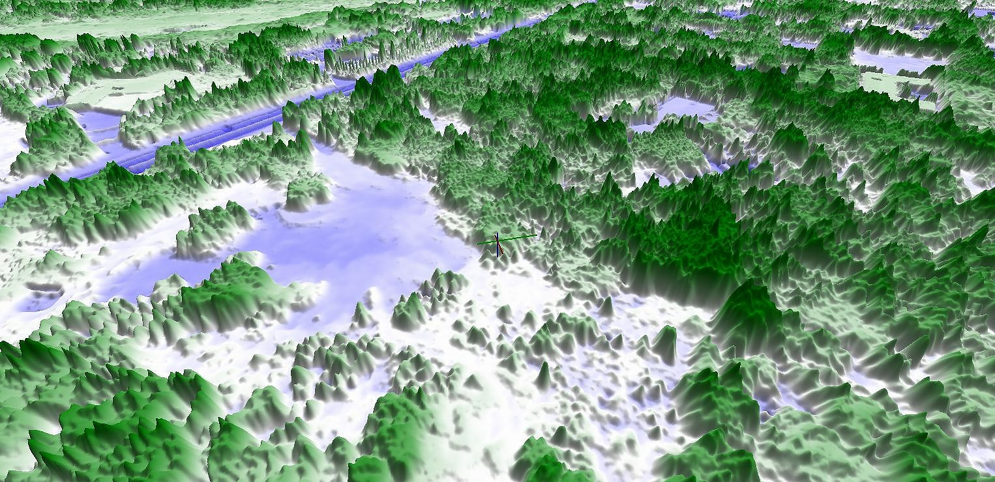
Spectral Vegetation Analysis

Slide 8
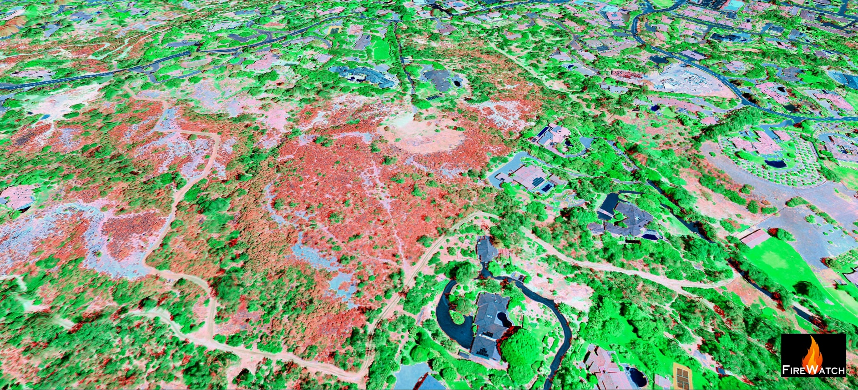
Vegetative Fuel Map

Slide 9
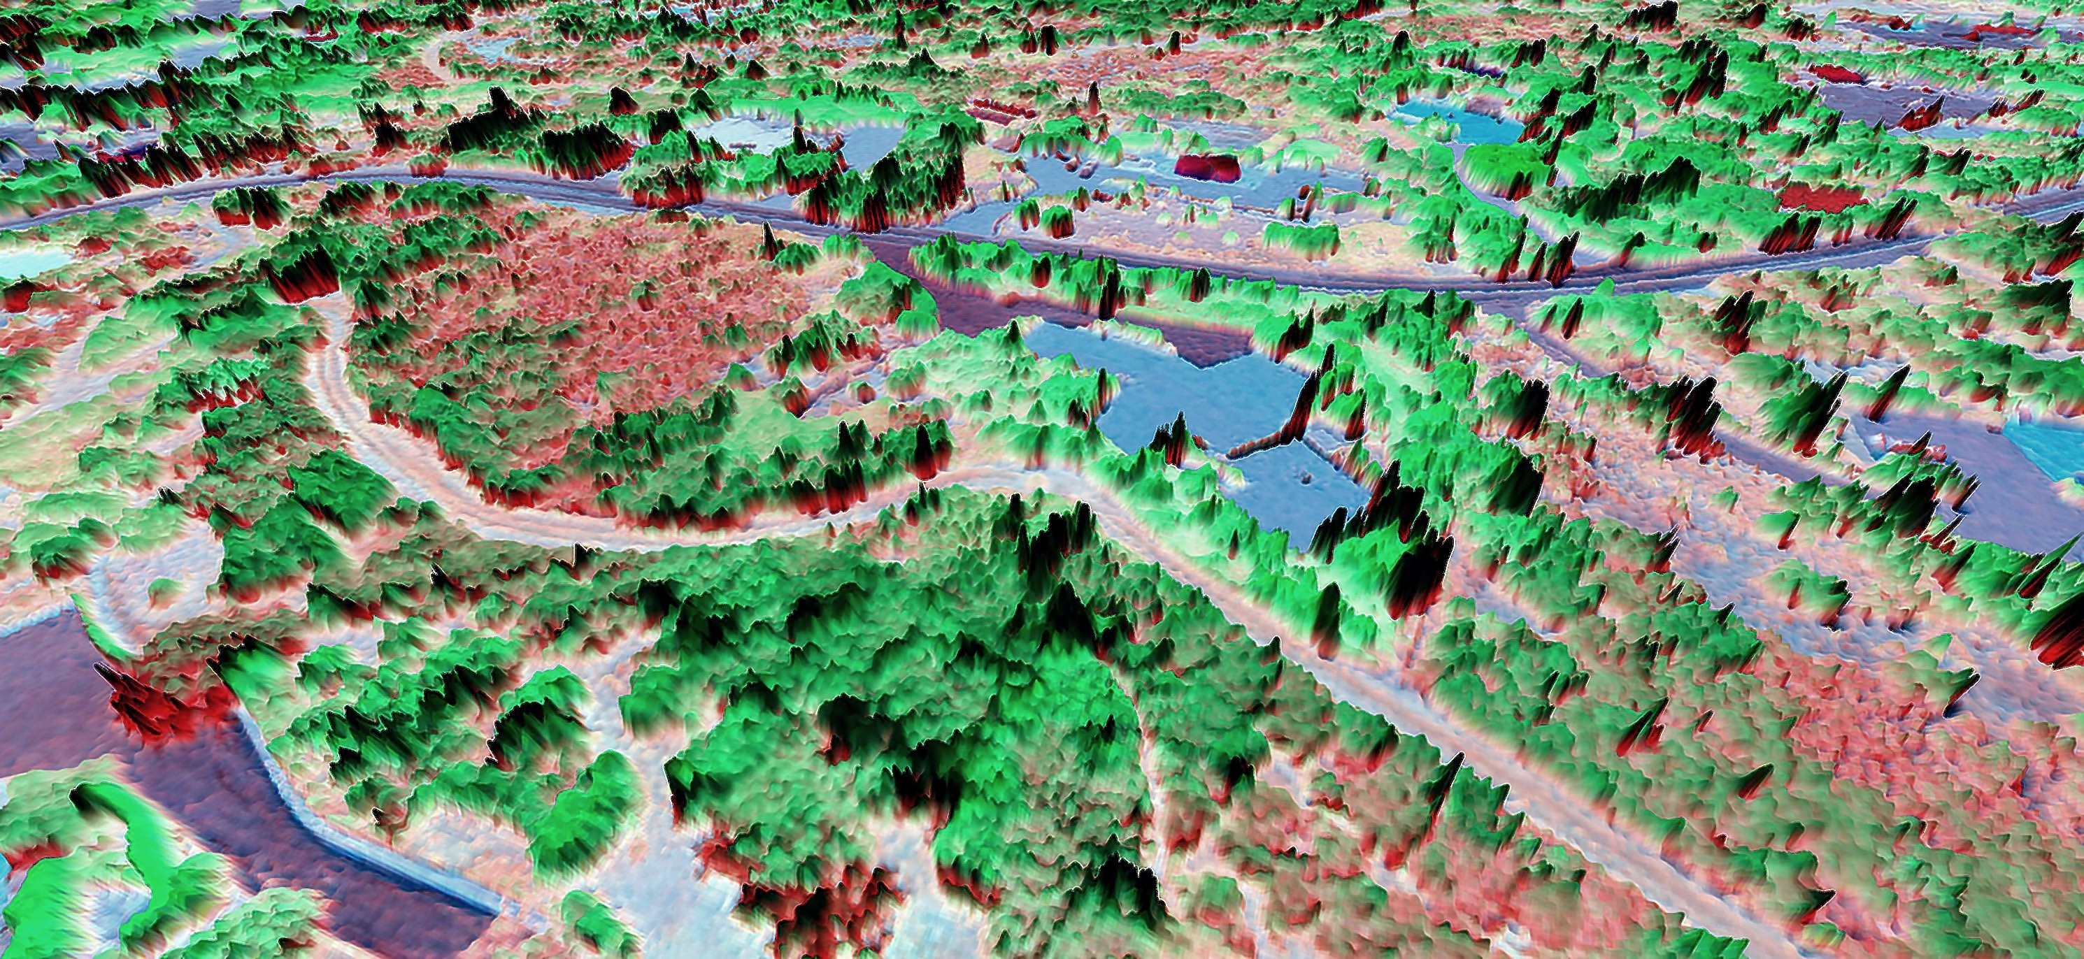
Vegetative Fuel Modeling

Slide 10
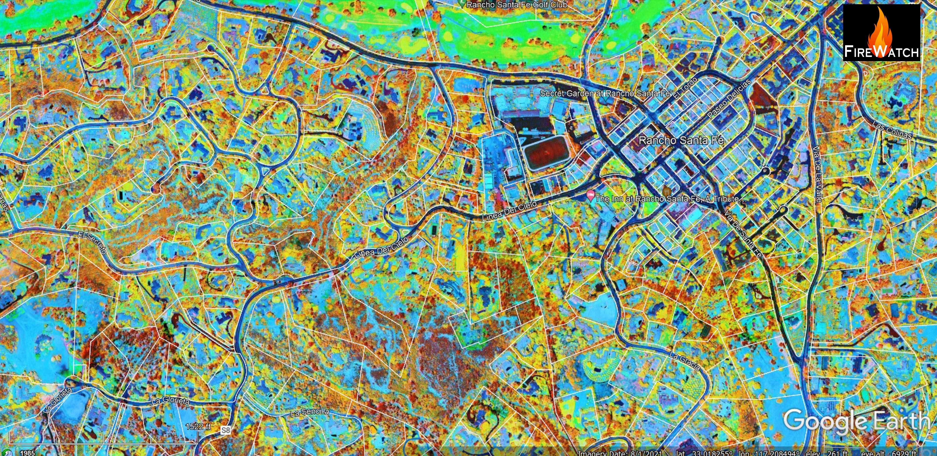
Wildfire Hazard Map

Slide 11
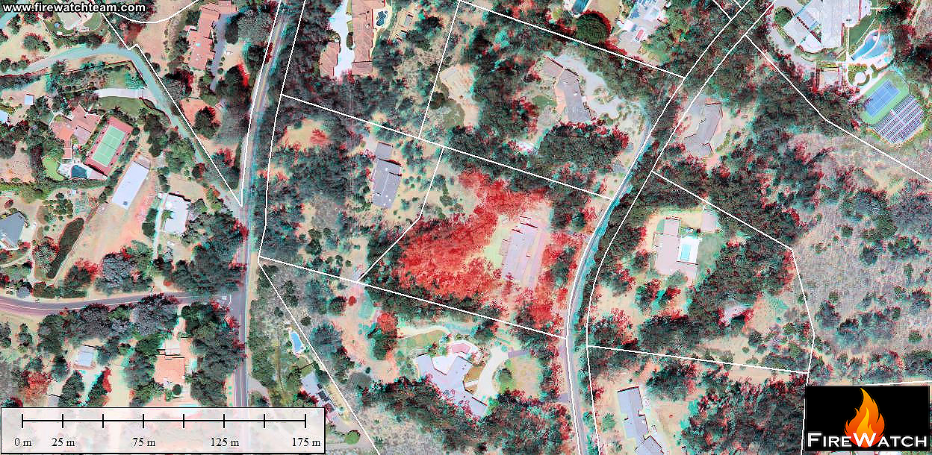
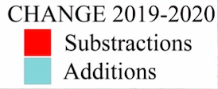
Change Detection Map

Slide 12
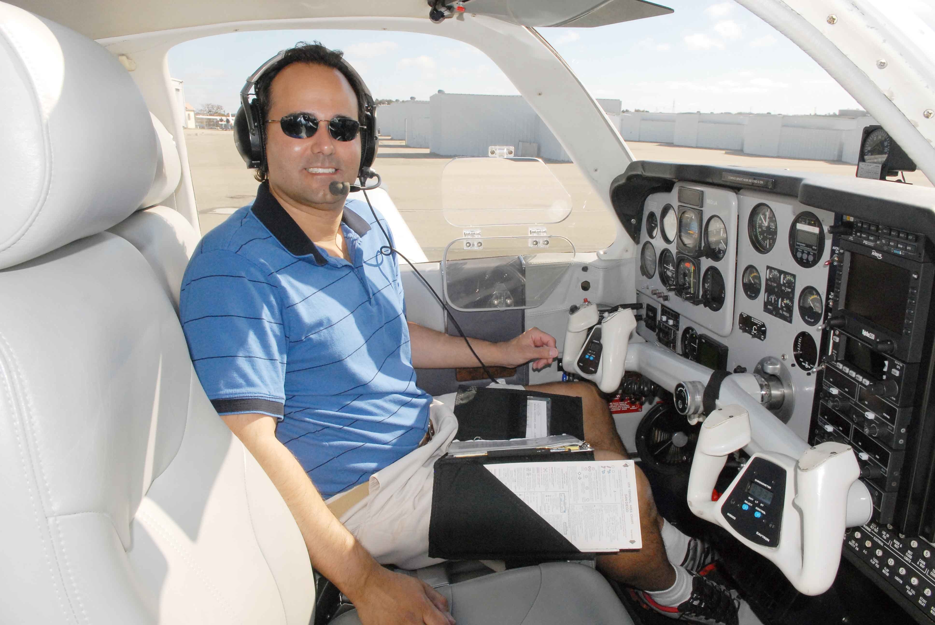
Gus Calderon
Commercial pilot for over 25 years
Owns an aircraft for aerial imaging
Background in earth science
Experience in community management
Video production and editing

Slide 13
Lessons Learned From
Three Years of Community Engagement
with
Rancho Santa Fe, CA
Remote sensing data must be scaled for the community.
The spectrum of homeowners for defensible space compliance.
Engaging the community for wildfire preparedness.

Slide 14
Remote Sensing Data at the Community Scale
High resolution (5” GSD) aerial imagery from manned aircraft is ideal.
Manned aircraft imagery provides height data for 3D models.
The resolution of satellite imagery is too low for parcel maps at the landscape level.
Drones are not welcome in the community for aerial mapping.
Drones are helpful for ground truthing in unpopulated areas.

Slide 15
The Homeowner Spectrum
Homeowners range from compliant to defiant!
Some homeowners were compliant before we began our mapping.
Others wanted to comply after they learned about our annual flyovers.
Some homeowners were interested in complying but did not know how.
Others were concerned about their privacy and who was going to see the aerial data.
Some loved their trees and were not going to let anyone tell them what to do.

Slide 16
Working with the Community
Find a liaison who is dedicated to wildfire preparedness.
Host and attend community outreach meetings.
Customize parcel maps and reports for the community.
Address privacy concerns.
Make maps and reports self-explanatory.
Create a team of experts in multiple disciplines.

Slide 17
Getting Homeowners Engaged in Wildfire Preparation
Produce community-specific videos.
Create parcel maps and reports for all homeowners.
Encourage neighbor-to-neighbor communication.
Use social media and web content as a tool for community engagement.
Creating content for community newsletters, etc.

Slide 18
Summary after 3 years of working with Rancho Santa Fe
High resolution imaging is essential for the community scale.
A team of experts in multiple disciplines is mandatory.
Communicating in simple terms can be quite the challenge.
Community feedback, whether positive or negative, is invaluable.
Breaking the cycle of wildfire destruction, one community at a time, is our mission.

Slide 19
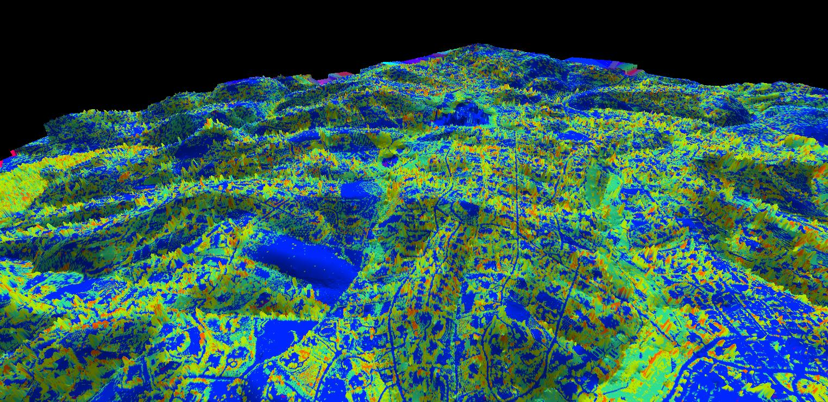
Questions?
www.firewatchteam.com
All Images Copyright FireWatch 2018-2022

