Slide 1
STEReO
Scalable Traffic Management for Emergency Response Operations

Slide 2
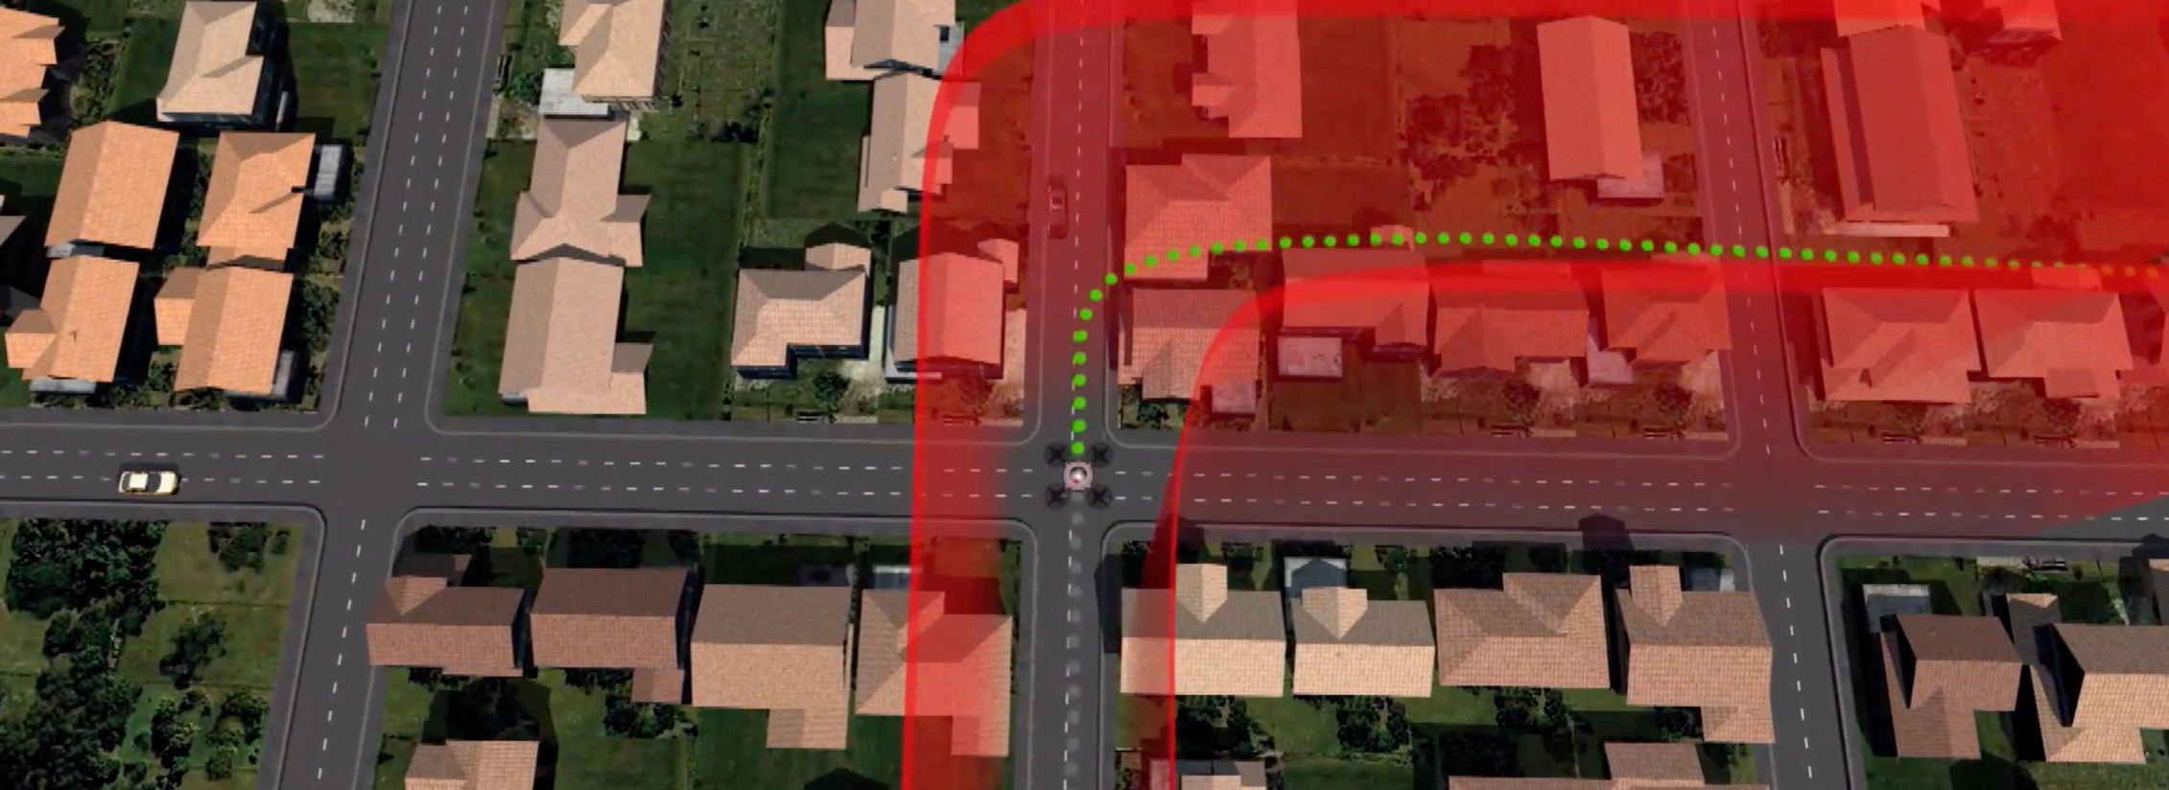
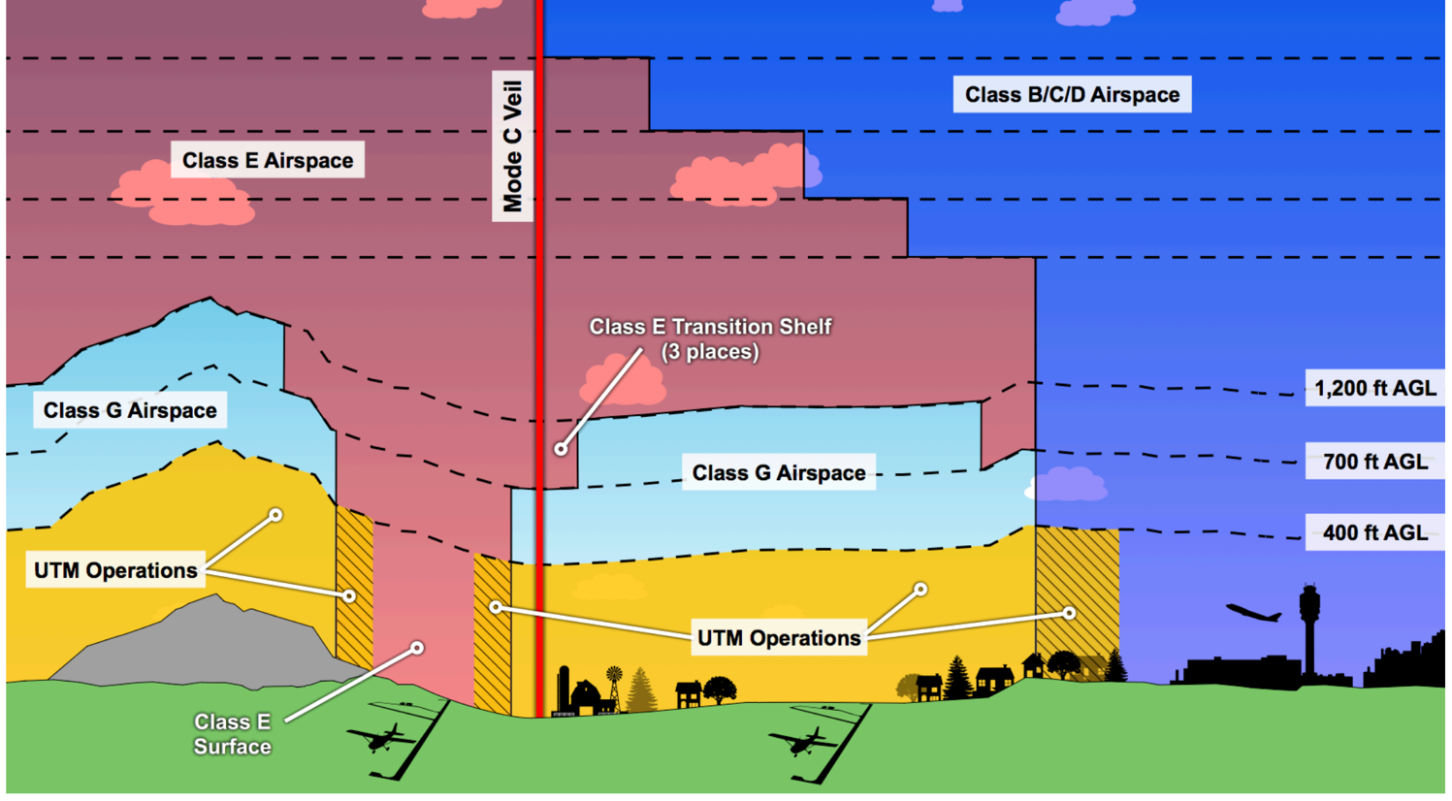
STEReO Scalable Traffic Management
NASA’s UAS Traffic Management (UTM) System
Standardized platform for sharing operation information & data
Operator intention, contingency plans, equipage
Airspace constraints, manned operations, terrain, weather
Enables coordination between operators & other stakeholders across multiple platforms
Goal: safe and efficient use of airspace
Safe separation, performance requirements, highly-automated authorization
Shared awareness

Slide 3
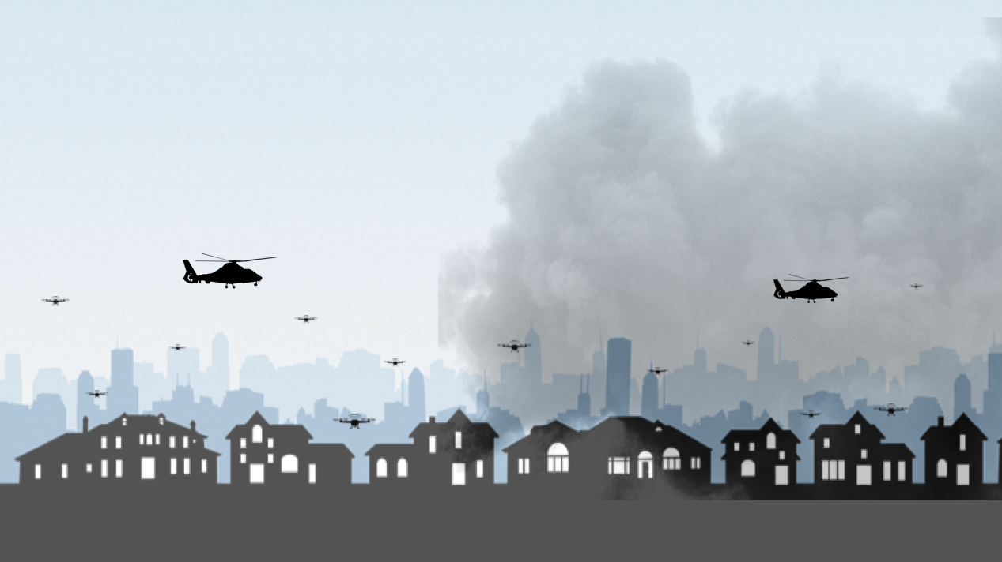
STEReO Emergency Response Operations
In disaster events UAS could…
Reduce danger, enhance effectiveness, and make relief operations more expeditious
Provide highly deployable and cost-efficient remote sensing with capabilities not possible with manned aircraft
Support a wide range of missions (e.g. search & rescue, logistics support, mapping, etc.)

Slide 4
STEReO Emergency Response Operations
Existing challenges include…
Limited communication and infrastructure
A high degree of collaboration and manual coordination to deconflict airspace
Remote sensing data can’t be received in a timely manner

Slide 5
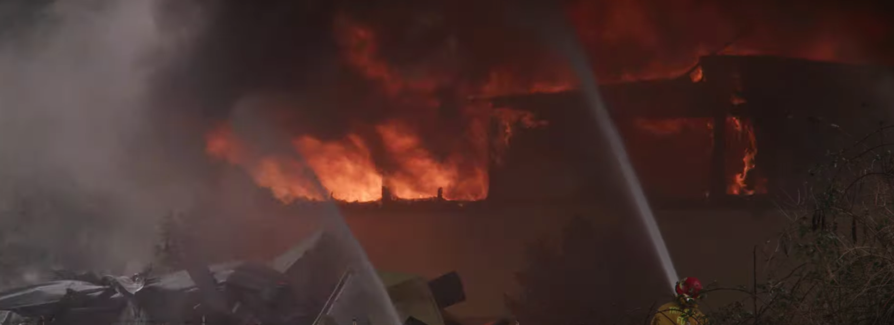
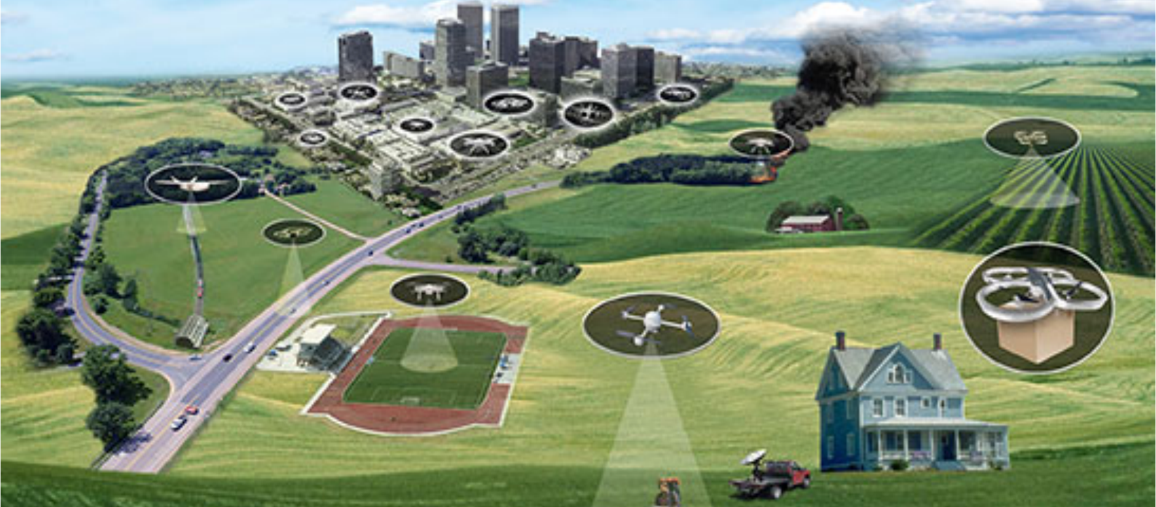
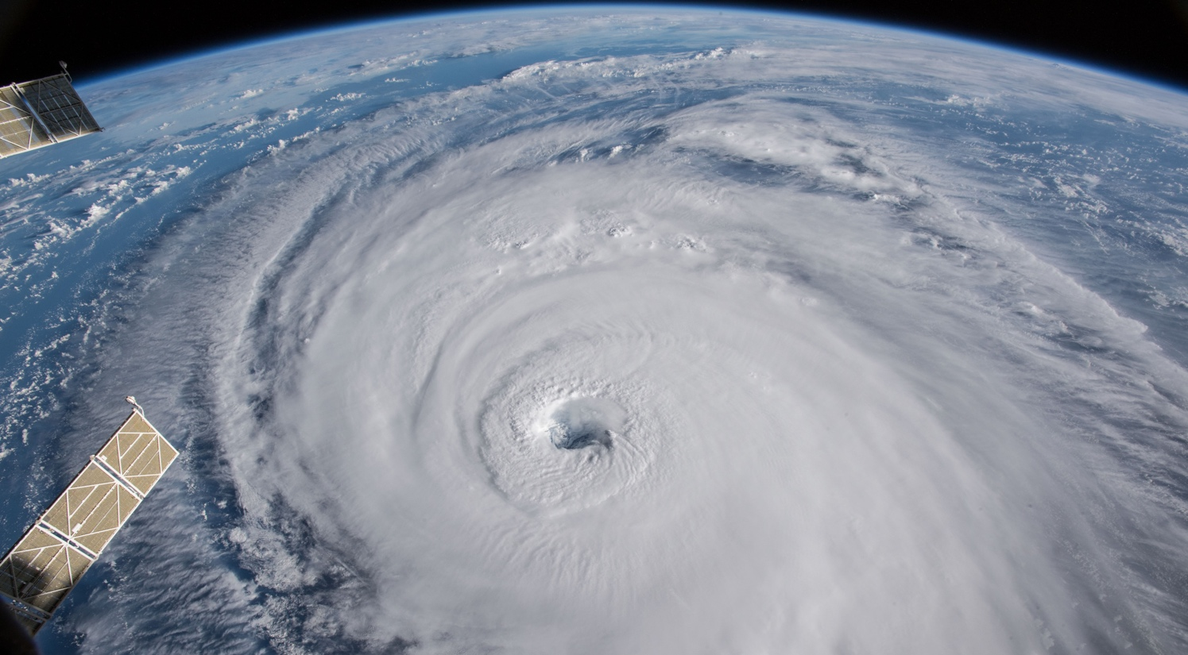
To what extent can a UTM ecosystem…
Reduce response times?
Enable large-scale aircraft operations?
Provide operational resiliency to dynamic changes during a disaster event?

Slide 6
Reduce response times
A public safety USS can be used to communicate the essential information needed to make a timely response
Increase interoperability of UAS operations and data flows, regardless of platform
Collaborative tools to ingest remote sensing information and distribute a common mission operating picture for all stakeholders for strategic planning and decision-making
Notes:
What, where, what direction, what altitude, and how fast?
Pilots typically want to know the answer right away so that they may respond

Slide 7
Enable large-scale aircraft operations
Allow for more efficient and effective coordination between manned and unmanned operations without compromising safety through shared awareness of airspace, mission objectives, assets
Leverage vehicle-autonomy technologies
Detect and avoid, safe2ditch
payload-directed guidance, onboard decision-making
UTM is a scalable, flexible, yet structured system
Risk based approach where geographical needs and use cases will dictate the performance requirements for airspace operations
Increased interoperability allows for more cooperation/collaboration
Notes:
The two ”UTM mantras”

Slide 8
Provide operational resiliency to dynamic changes during a disaster event
Increased situation awareness and common operating picture allow for earlier detection and decision making
Standardized, cross-platform communication of changes
Environment, operations, mission objectives
Scalable to size and complexity of operations
Utilize advanced communication/connectivity technologies for data exchanges and information sharing
Vehicle to vehicle communication, and onboard autonomy to ensure the safety and resilience of the operations under a UTM system

Slide 9
Five Domains
Vehicle to vehicle
Network
UTM Services
Autonomy
Domain Expertise and Tools
Human Factors
Communications
payload-directed flight
sense and avoid
crash management
Common operating picture
Tactical IAA
Fleet management
UAS services
Data services
NASA research results
Subject-matter experts
STEReO

Slide 10
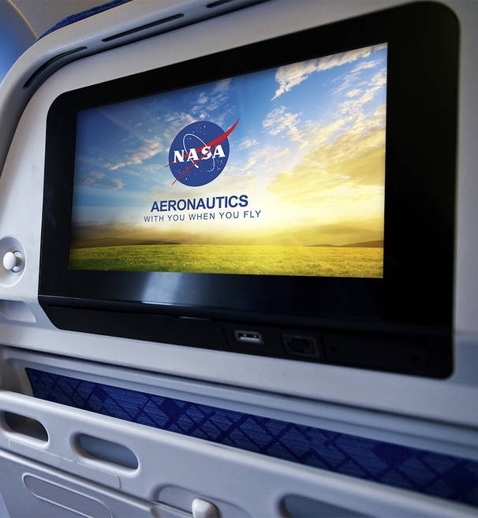
Why NASA?
Extensive background in aeronautics, communications, and autonomy research
R&D partnership with the FAA
Impartial/objective research
Safety is paramount
Coordinate with government and industry
Pioneers in UTM research
STEReO as a ‘disruptive’ technology

Slide 11
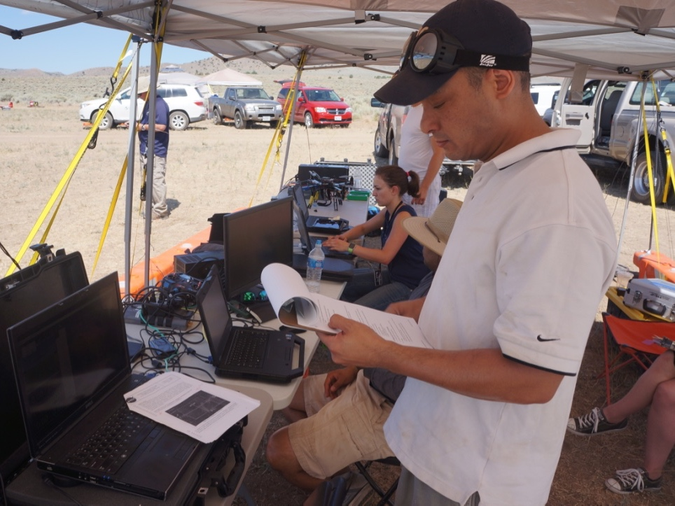
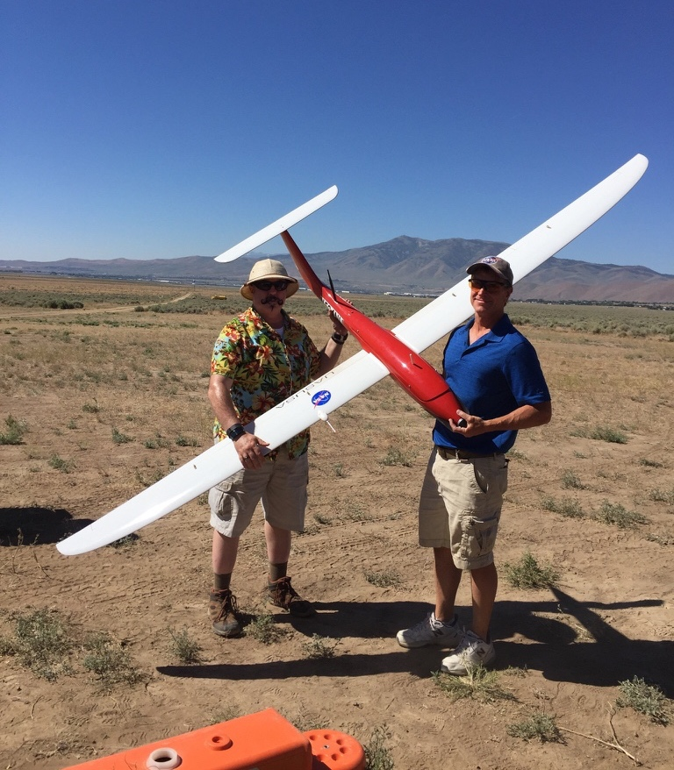
Why UTM?
First of its kind UAS traffic management system
Research effort that will inform policy
Collaborative effort between government, universities, and industry
Field tested system
Notes:
- STEReO will be the first of its kind for public safety USS
Research effort that will inform policy and they have an opportunity to be a part of that
Collaborative effort with strengths from each entity
UTM is a field tested system with at least four years of flight tests exercised

Slide 12
How you can help
Our goal is to use NASA technologies to improve emergency response operations
Provide subject-matter expertise
Participation in research goals
Joint work areas
Use-case and conops development
Simulation evaluation
Flight test partner

Slide 13
Target Milestones
California(?) Wildfire Flight Test
Florida(?) Hurricane Simulation

Slide 14
Questions
joey.mercer@nasa.gov

Slide 15
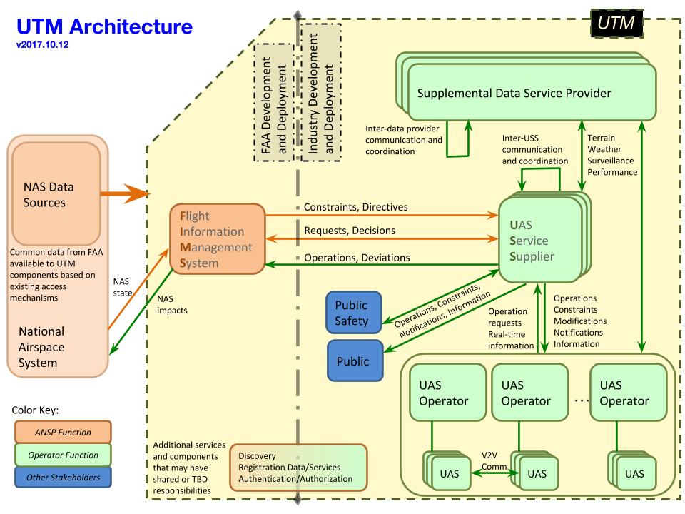

Slide 16
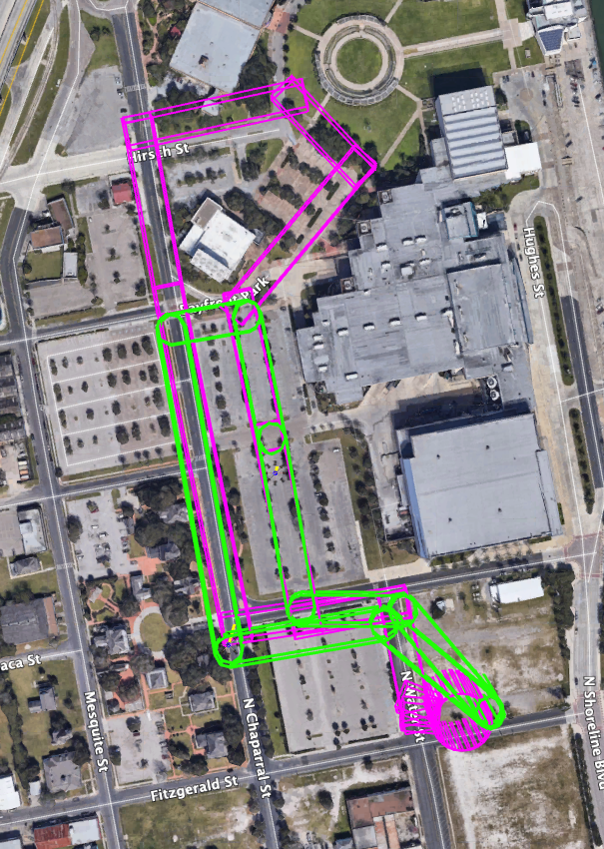
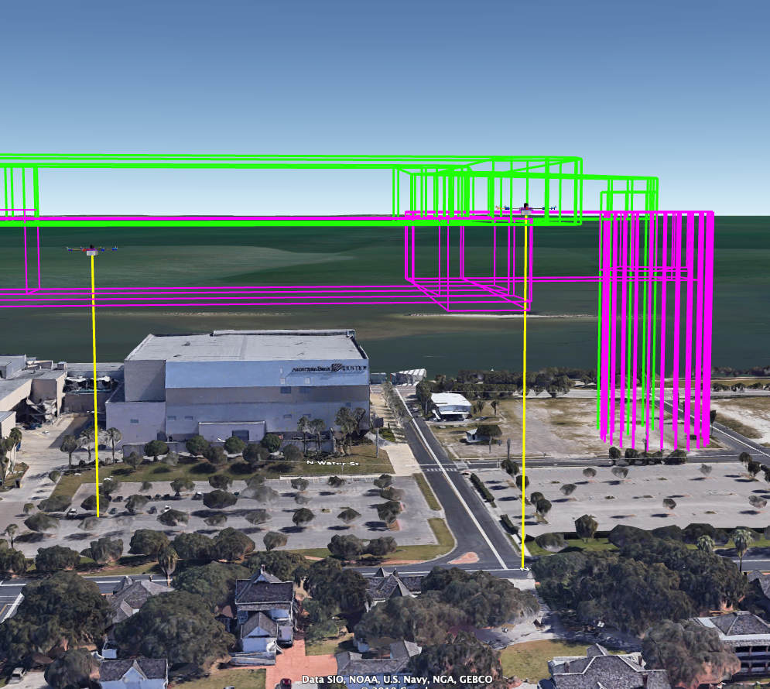

Slide 17
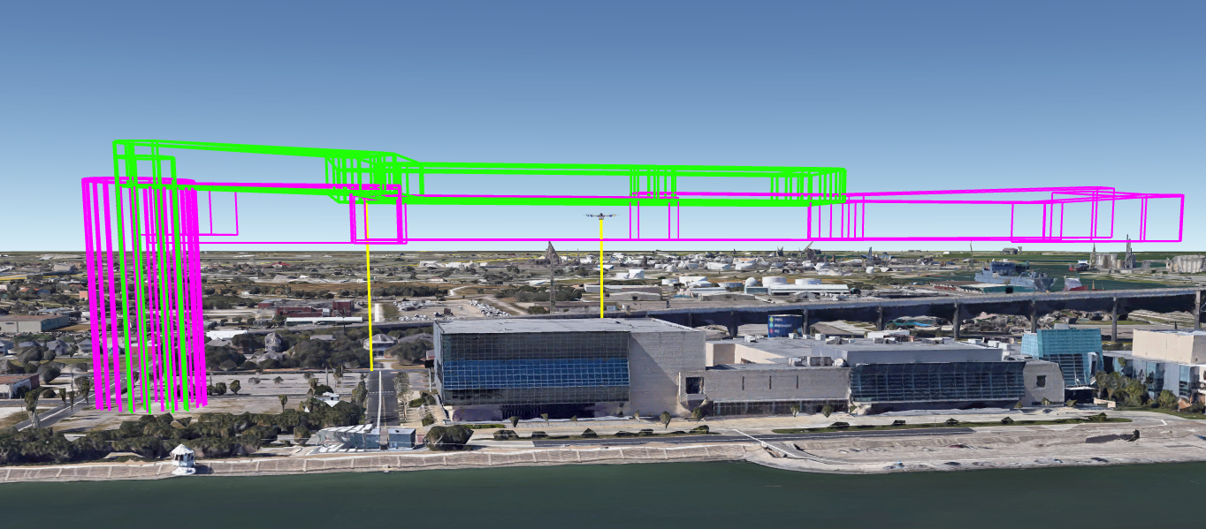

Slide 18
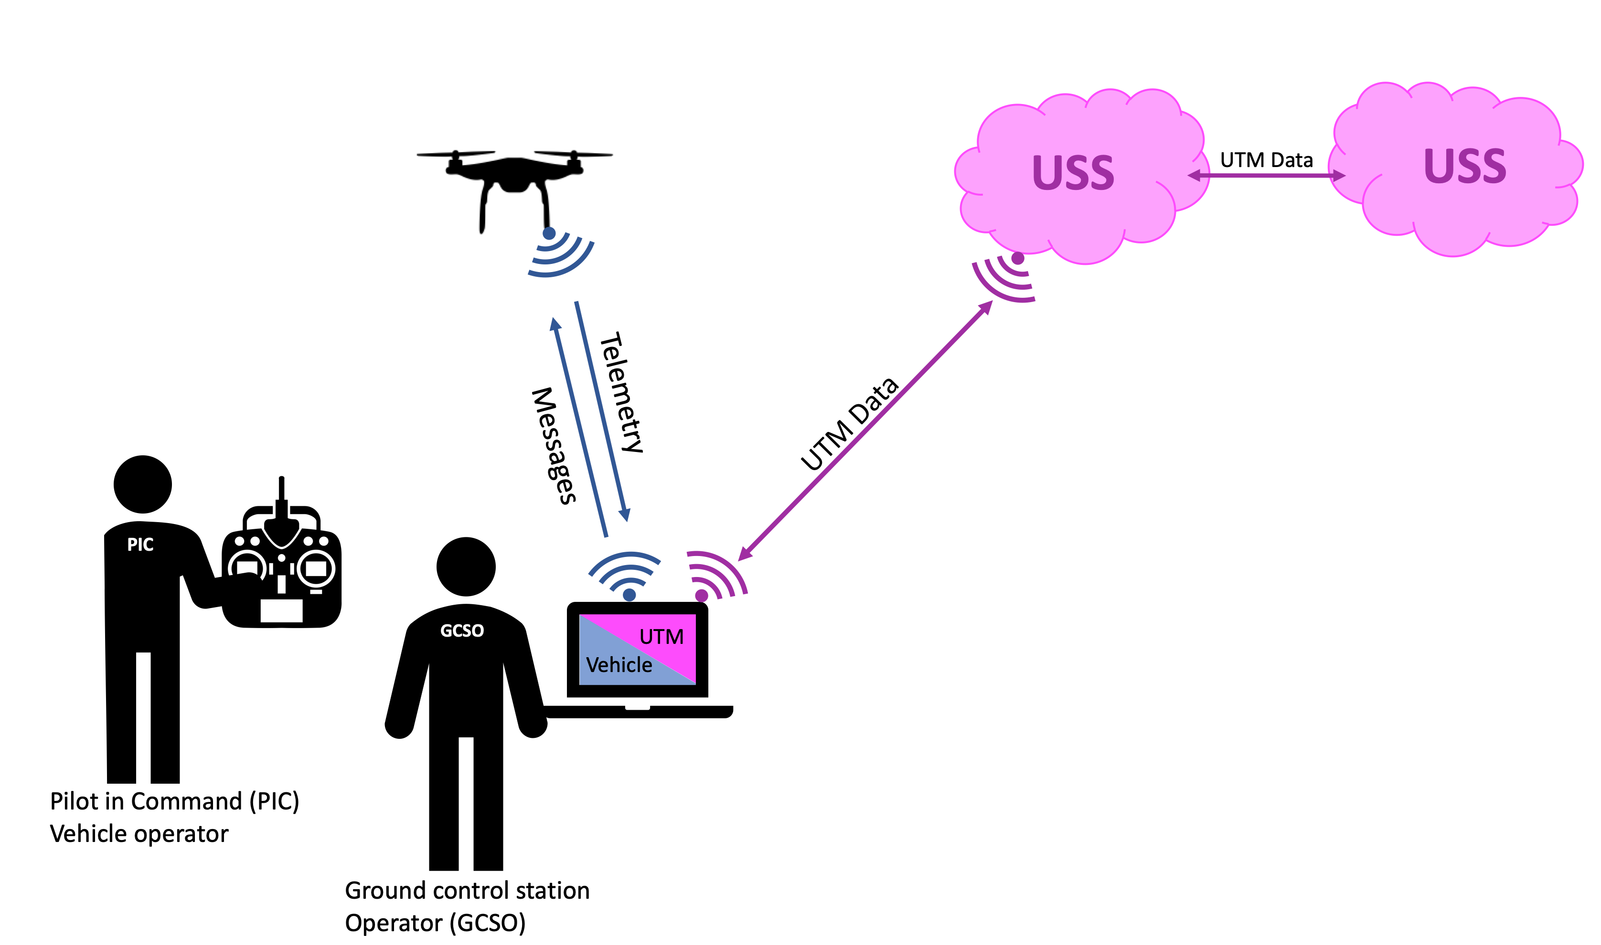

Slide 19
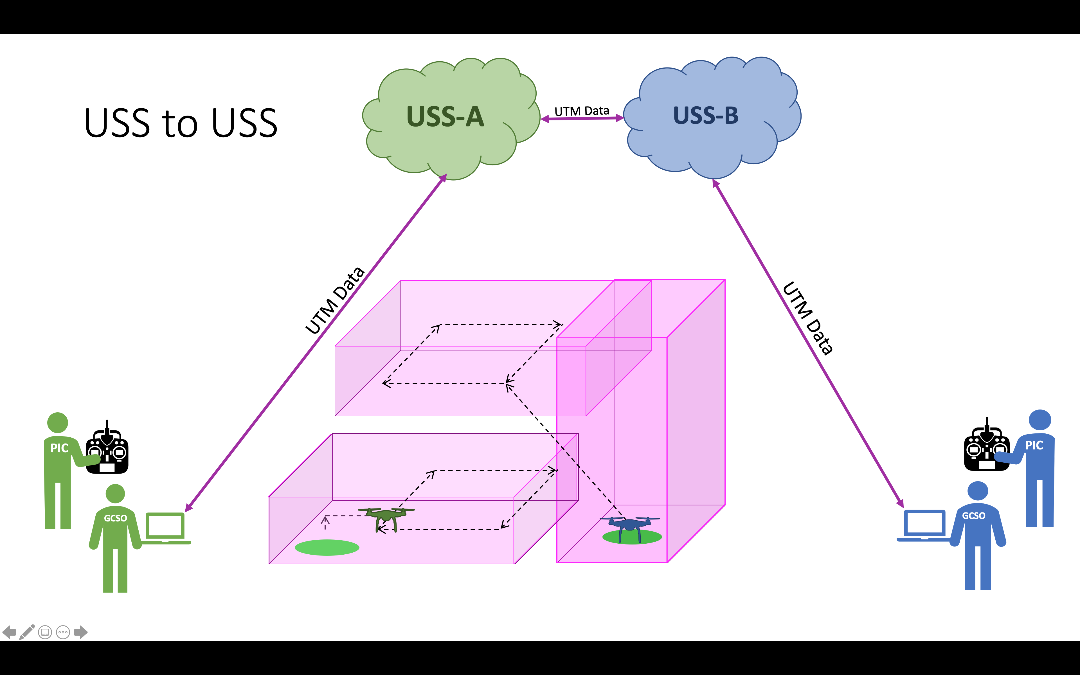

Slide 20
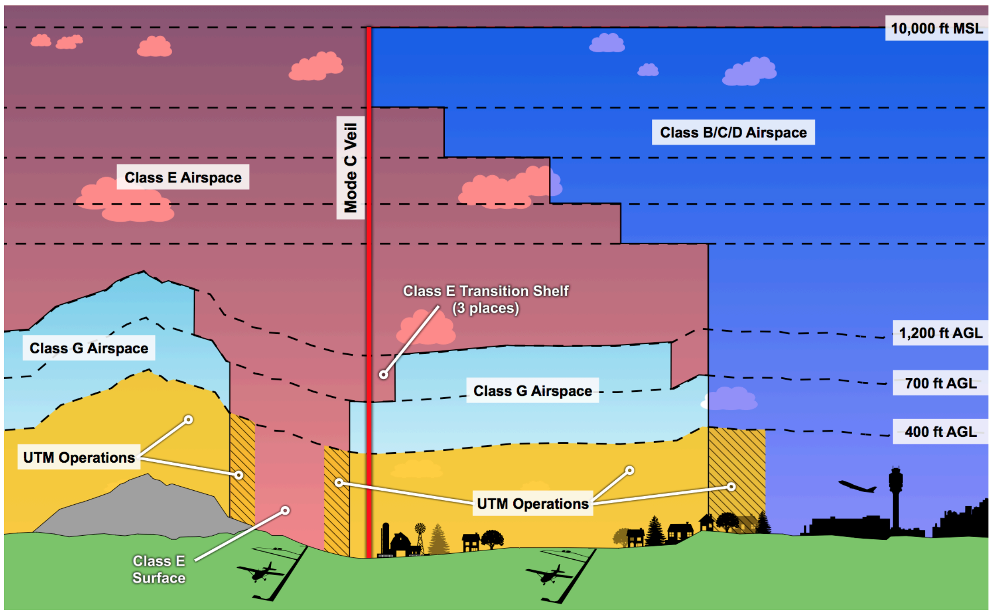

Slide 21
