Slide 1
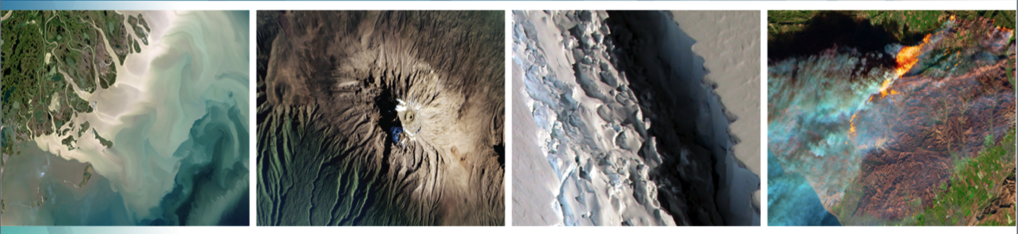
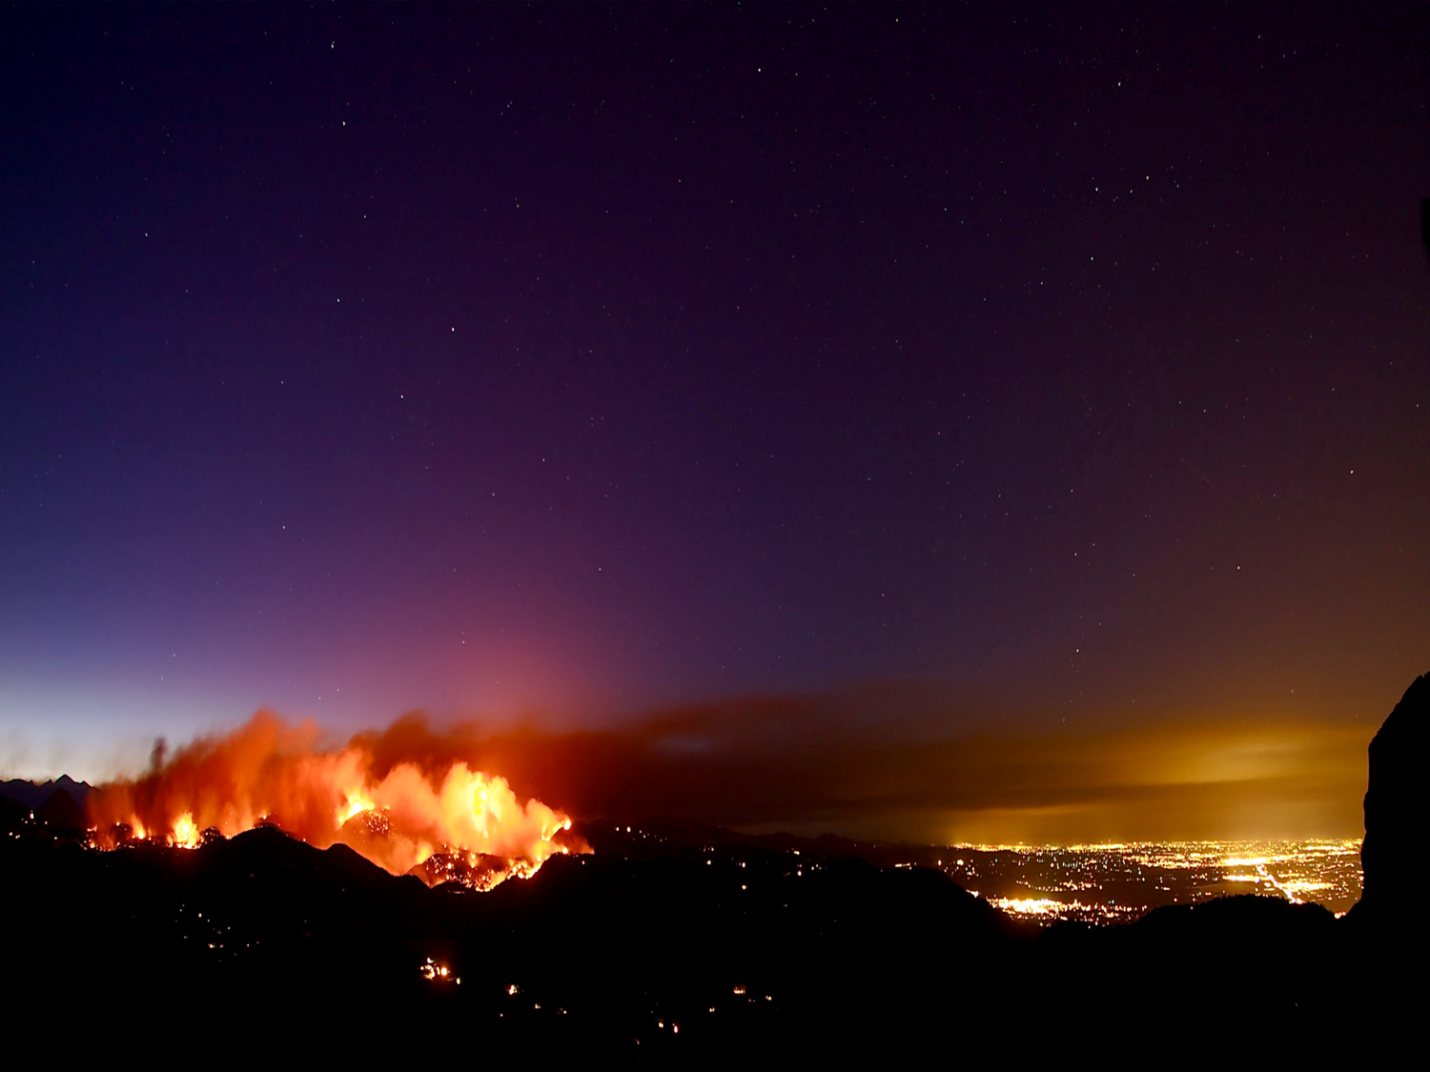


Welcome to Day 2:
Thirty-Fourth Tactical Fire Remote Sensing
Advisory Committee (TFRSAC) Meeting
Hosted By:
USDA-Forest Service: Everett Hinkley
NASA Applied Science Program: Vince Ambrosia
11-12 May 2021
8:00AM – 2:00PM PT / 11:00AM – 5:00PM ET
(times are the same for both days)

Slide 2
Observations From Day 1
From a technology standpoint, we stand on the threshold of tremendous advances in sensor technology (both airborne and spaceborne), computing power (including AI/ML), and ever-growing data streams. How do we harness this technology when facing the headwinds noted below?
Institutional inertia and declining budgets are a negative influence counterbalancing the “art of the possible”. Undermining currents include.
  Lack of funding
  Comfort with existing technology and ways of doing business
  Challenging contracting and acquisitions processes and rules
  A lack of understanding of the “art of the possible”
  Distrust built up from years of “being burned” by sales pitches on silver bullet solutions

Slide 3
Failure is not an option!
Remote Sensing support to wildland fire
Technical Issues
Institutional Issues
Funding Issues
Bridging the gap between research and operations
Making connections between end users and those with capabilities
  Sharing needs (gaps) and the “art of the possible”
  (hint: Communities of Practice!)

Slide 4
Failure is not an option!
Artificial Intelligence / Machine Learning
  Finding new fire starts from multiple sensors
    Recognizing Smoke (with low false alarm rate)
  Drawing points, lines and polygons on active fires (early and extended attack)
  Fire behavior modelling/prediction
  Other activities

Slide 5
As is – current condition
Little or no
Connective
Tissue
Incubators
Distill
Accelerators
Topic Specific
Communities of Practice
Topic Specific
Communities of Practice
Needs
& Gaps
Topic Specific
Communities of Practice
Industry Clusters
Operationalize ??
Prize Competitions
Participants
Federal Civil Agencies
State Agencies
Professional Organizations
Academic Institutions
Vendor Community
RFIs / SBIRs / STTRs
Agency Innovation Offices
Notes:
Our Intention
> Evaluate existing Communities of Practice which are in place. Advocate for new CoPs where none exist.
Follow-on
> The USGEO Subcommittee can leverage the information gathered by CoPs as a collective body to present issues and advice to the Administration.
> Distilled needs & gaps can be passed from the CoPs to other mechanisms to advance, refine and operationalize new capabilities.
> Individual USGEO members can use the information (needs and gaps) distilled from CoPs for particular programs or mechanisms they want to apply to their particular mandates

Slide 6
With
Connective
Tissue
Desired condition
Advance/Refine Ideas
Incubators
Clearinghouse??
Accelerators
Distill
Topic Specific
Communities of Practice
Topic Specific
Communities of Practice
Needs
& Gaps
Topic Specific
Communities of Practice
Innovation Activity
Industry Clusters
Operationalize
Prize Competitions
Participants
Federal Civil Agencies
State Agencies
Professional Organizations
Academic Institutions
Vendor Community
RFIs / SBIRs / STTRs
Agency Innovation Offices
Notes:
Not clear where the clearinghouse fits in, but this seems like the best spot. Innovation activity shown more clearly on the next slide. Here it is simply a black box.

Slide 7
“On Deck” Presentations
Presentation | Author
UAS for Wildland Firefighting (7_1) | Carl Recine (NASA Ames / Cal Poly)
Fire Autonomous Detection and Dissemination System | Matt Von Bargen (USFS)
FireMAP update | Dale Hamilton / Kamden Brothers (NNU)

Slide 8
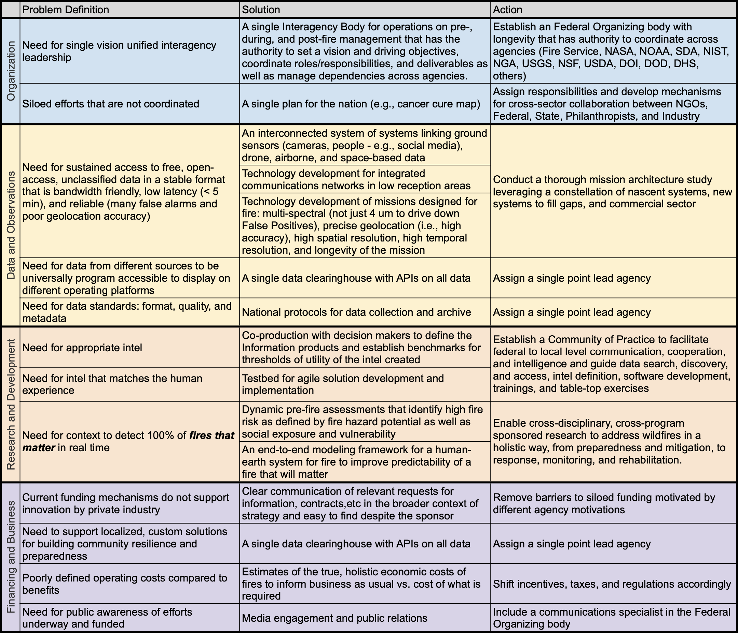
Recommendations and next steps:
Reached consensus despite each organization's self-interests and embodied co-production, a practice of working together across organizations to identify public services of value
Focus was on pre/post fire to contextualize the fires that matter for tactical fire management, which centers the problem around current authority systems
Follow-on workshops needed to do deep dive studies to scope the megafire problem more holistically thinking about the pre-/post- resilience planning in the context of our modern world
  Collaborate with diverse perspectives that build on millennia of traditional ecological knowledge from the Tribal Nations

Slide 9
Video Collaboration Platform
Platform: YouTube Live Stream
  Go to https://nari.arc.nasa.gov/tfrsac-wildfire for the link
    It will be available under the “TFRSAC Bi-Annual Meeting Details” section of the webpage
  For Closed Captions, select the CC icon (bottom right side of the YouTube menu bar)
    Subtitles can be moved if blocking important content. Just click, hold, and drag them to a better section of the video screen
  To change the video quality, select the Gear Icon (bottom right side of the YouTube menu bar) to adjust the settings
  Please ensure your YouTube Live button is on
    Hover over the bottom left of the menu and make sure the “LIVE” wording is RED
      If it is not red, click on the "LIVE" wording to turn it on

Slide 10
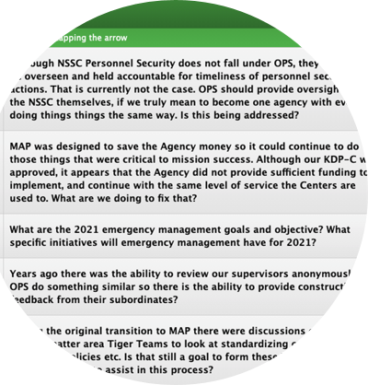
Q&A Platform
    Throughout the event, please enter your questions/comments in the conferences.io platform
    The questions/comments will be addressed (as time permits) during the Open Discussion sections at the end of each day
    To access conferences.io, enter https://arc.cnf.io/sessions/qr34/#!/dashboard into your browser

Slide 11
Connectivity Issues
Slow, delayed, poor connection or video feed:
Move closer to your WiFi router
Disconnect any devices you are not actively using from the WiFi
Close any applications or internet browsers that you are not actively using on the device
Disconnect from your organization’s VPN
Connect your device directly to the router using a Cat-5 ethernet cable
No Internet Connection:
Restart your modem and router (i.e., disconnect and reconnect to the power source)
NOTE: If there is a service outage in your area or region, you will need to contact your internet service provider directly.

Slide 12
Need Help?
If you need logistical or technological assistance throughout the meeting, you can reach out to the NARI hosts through the following platforms:
  Enter your comment or question in the conferences.io platform
  Email your comment or question to arc-cal-nari@mail.nasa.gov

Slide 13
Miscellaneous
We will provide all contacts for the attendees (email addresses) post-meeting
The meeting will be recorded, and we will be sharing the presentation materials and recording with the community at the following URL: https://nari.arc.nasa.gov/tfrsac-wildfire (within a week or so of the event)
The TFRSAC agenda can be found at the NARI website (shown in the bullet above)

Slide 14
Tactical Fire Remote Sensing Advisory Committee (TFRSAC)
TFRSAC: A “Community of Practice” (CoP) which focuses on sharing best practices and creating new knowledge to advance the wildland management domain of professional practice. TFRSAC meets twice yearly (Spring and Fall) to discuss the developments and results of ongoing investigations for new and evolving capabilities that support improved fire observation.
TFRSAC OBJECTIVES: Demonstrate evolved and evolving technologies for increasing the information content and timeliness of EO data collected for wildfires
https://nari.arc.nasa.gov/tfrsac-wildfire
Notes:
The bi-annual meeting agendas and presentations are open-access and shared with the greater community
Technology Focus Areas:
Development and demonstration of improved and emerging airborne platform capabilities (manned and UAS).
Demonstrate new sensor capabilities for enhanced fire discrimination.
Demonstrate new data communication capabilities / automated processing for real-time data distribution from sensors (airborne sensor data to end-user communities on ground).
Develop and demonstrate Collaborative Decision Environment (CDE) capabilities to effect improvements to tactical fire decision support systems.

Slide 15
TFRSAC General Agenda Overview
Tuesday & Wednesday:
  Agency briefings (USFS, NIFC-NIROPS,NASA, USGS, CALFIRE, DOI, Canada, TWG)
  Workshop and Mission Report-outs (Keck/JPL & FIREX-AQ)
  UAS Developments (inc. LTA)
  SBIR Developments (Sensors, etc.)
  Fire Management / EO Developments (inc. AI/ML)
  NASA ARMD Wildfire Gap Analysis / Support Strategies
  Orbital assets supporting Wildfire Ops., (inc. CubeSat / SmallSat)
Thursday:
  NASA ARMD Wildfire Management Workshop

