Slide 1
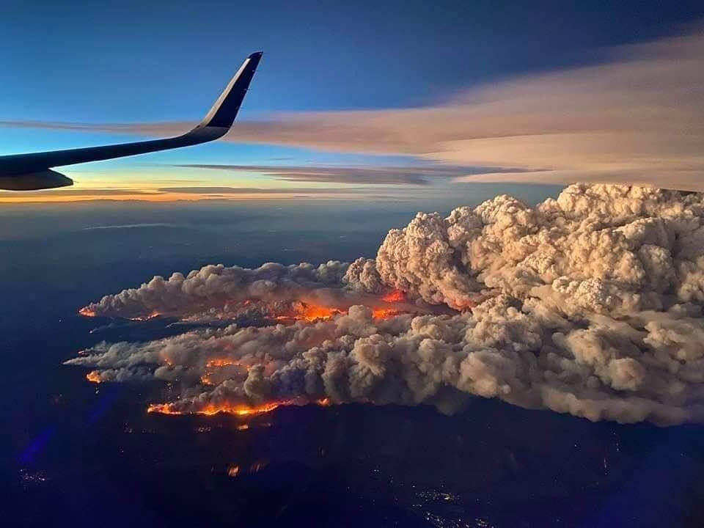
FUEGO GROUP
UC Berkeley & Fireball
Results from a Real-Time, AI-Based Wildfire Intelligence System
Carlton Pennypacker – UCB / LBNL
Chris Schmidt – Univ. of Wisconsin
Tim Ball – Fireball

Slide 2
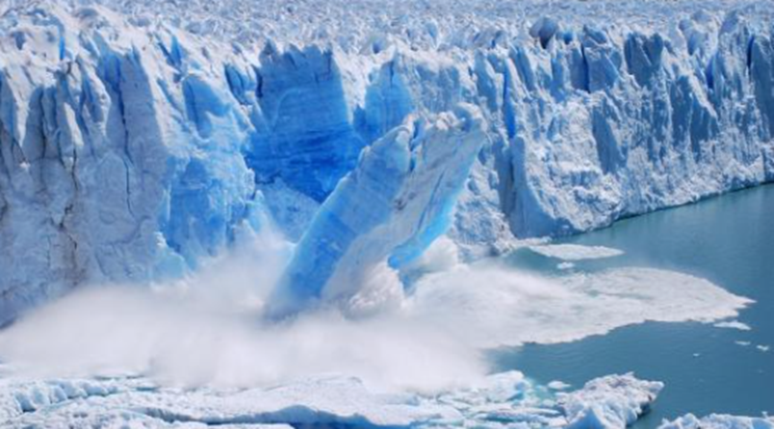
PROBLEM
WILDFIRE BEHAVIOUR IS OFF THE CHARTS ALREADY EXCEEDING THE SEVERITY PREDICTED FOR 2080
It’s Focused In The Wildland-urban Interface (WUI); Home To Many Low- And Fixed-income Folks.
There Is Positive Feedback Between Fires And Global Warming Via Both CO₂ And Soot
COVID & SMOKE INTERACTION*
16% greater impact on low-income people of color
“The Harvard Study found that low-income workers of color were more vulnerable to smoke, Covid and their combination.
So it's an environmental justice issue that our society should be dealing with.”
John Balmes Pulmonologist UCSF, & CARB
Fires were the source of more than 25% of the net CO₂ emission from California in 2020. Roughly 15% in 2021.
*Smoke increased Covid Case and Death Counts in Western US summer 2020. (F. Dominici, 2021, Harvard School of Public Health, in Press)

Slide 3
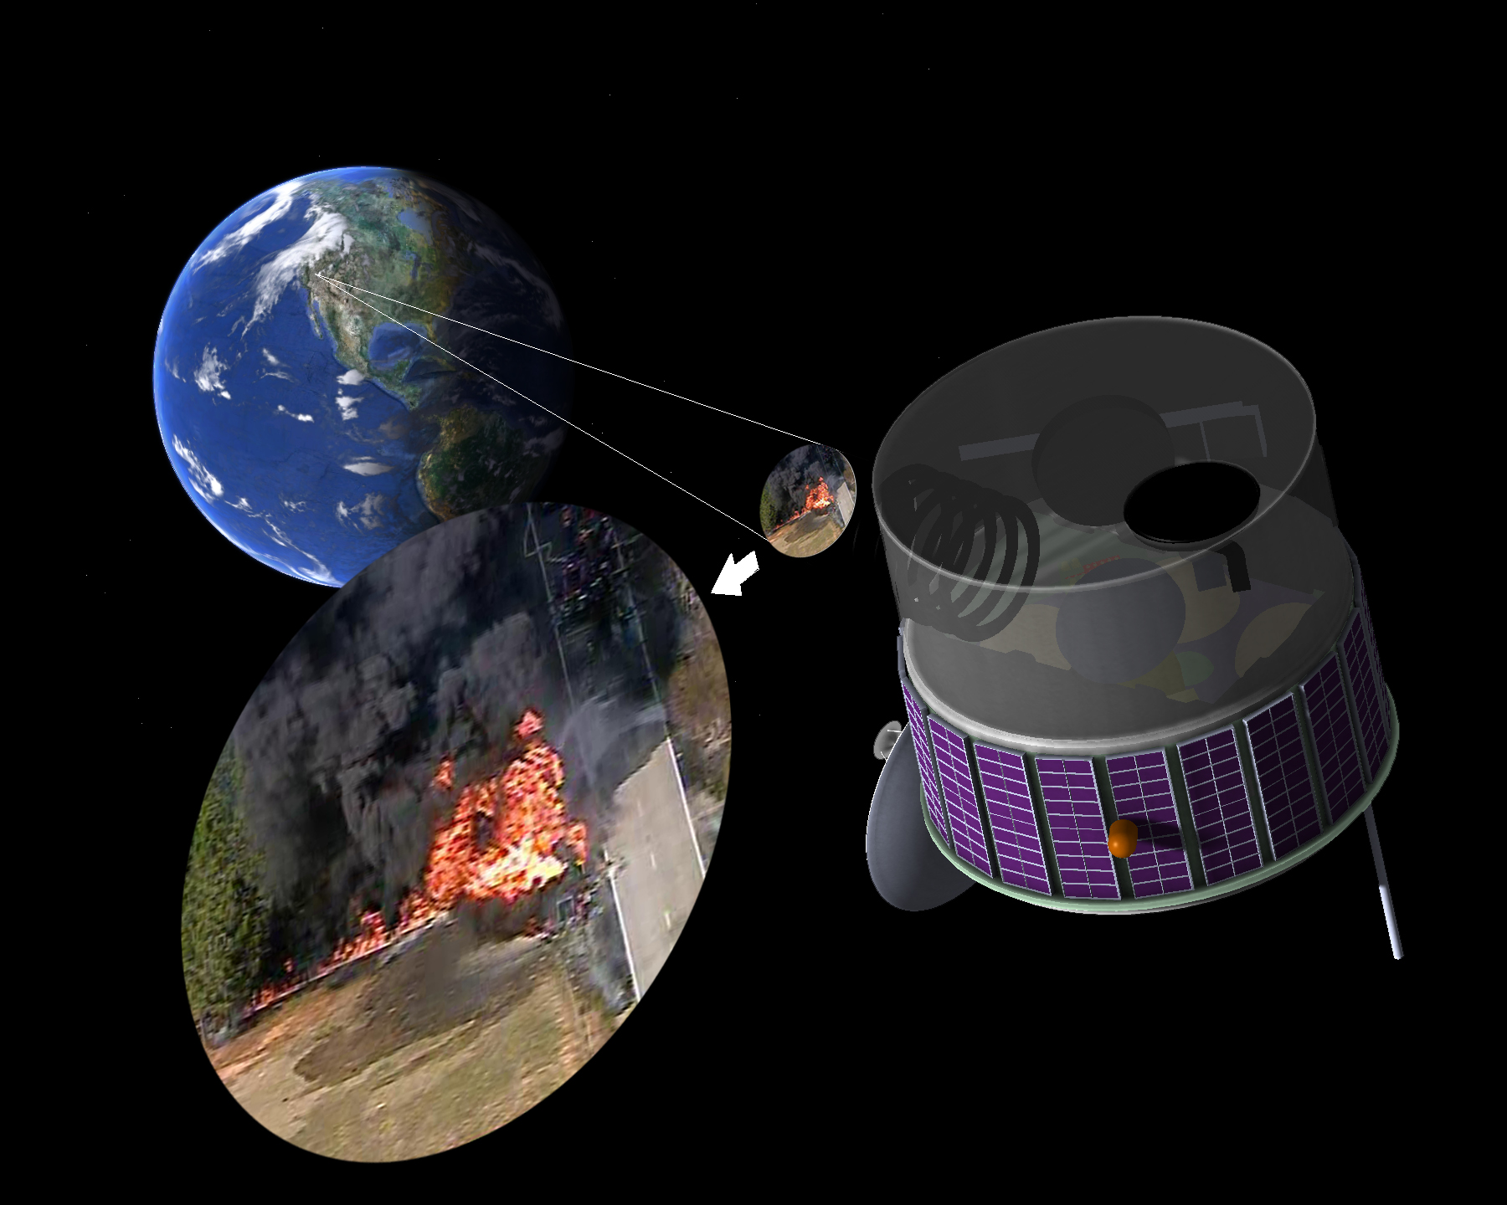
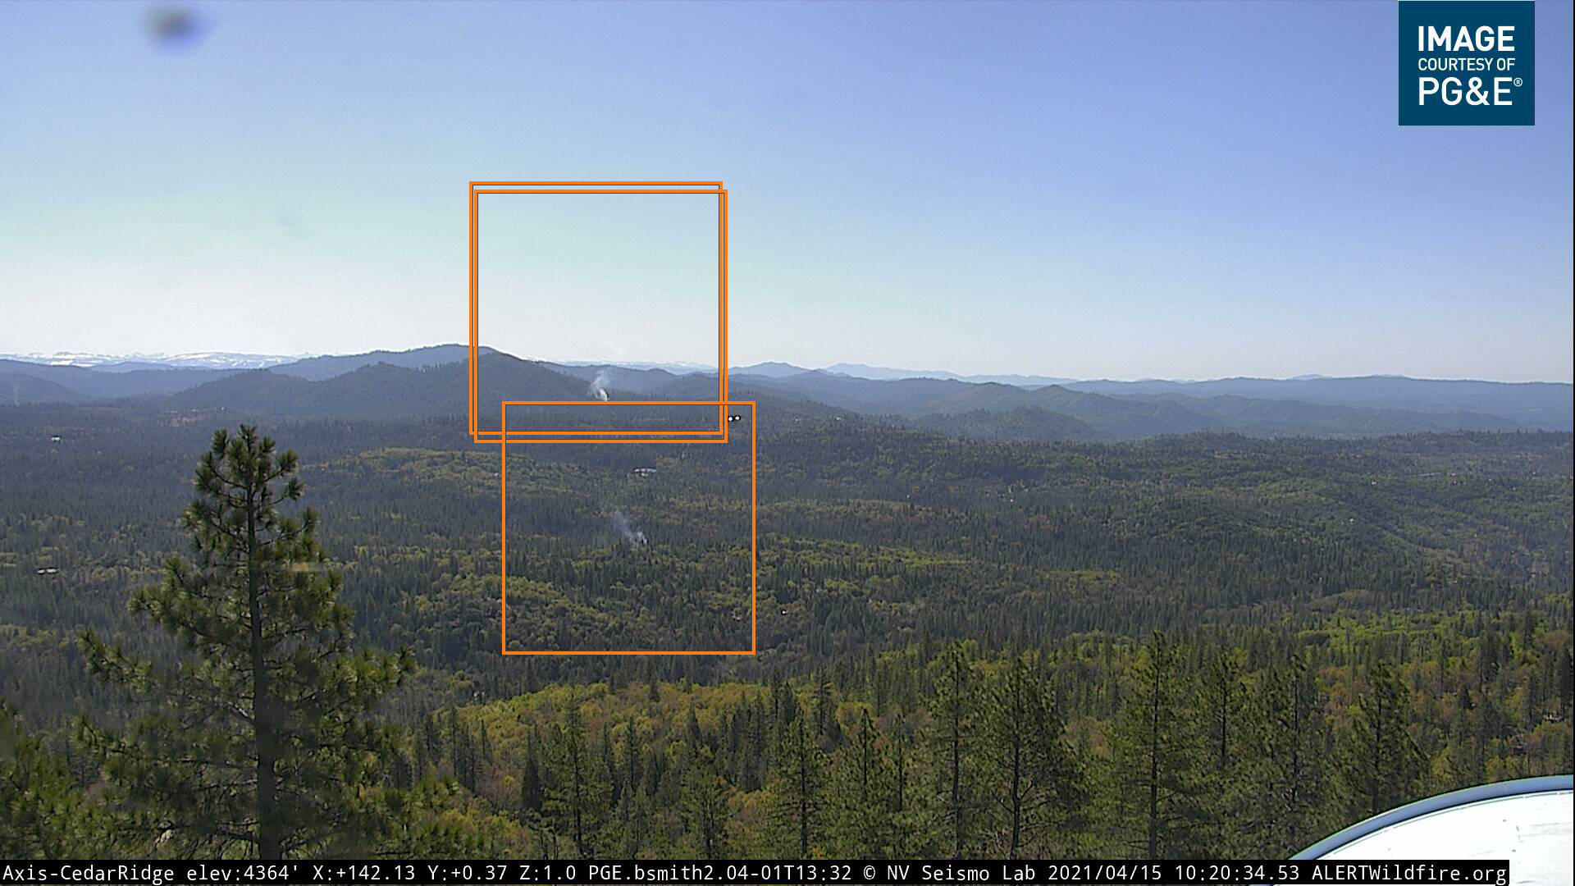
RAPID DETECTION: THE COST-EFFECTIVE KEY
Constant Stare of Geo-stationary Satellites
AI-based change detection
Large Terrestrial Camera Networks
Machine Learning

Slide 4
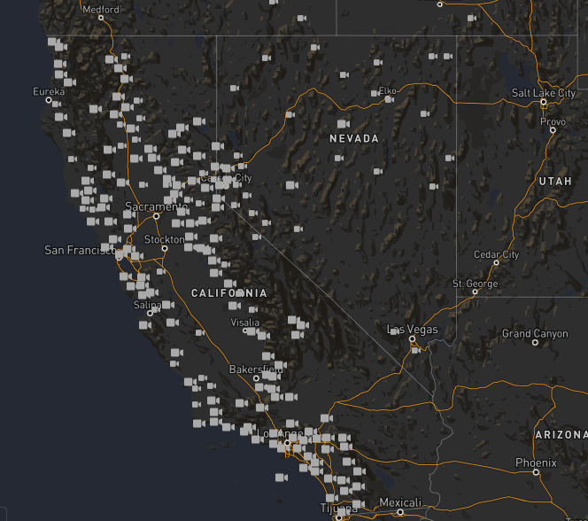
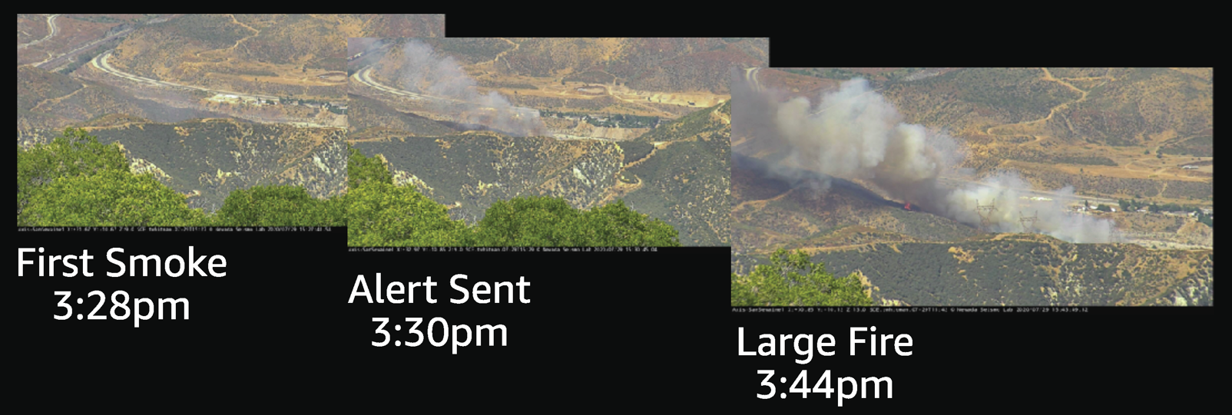
FUEGO CAM
Machine Learning Smoke Detection
Cloud and Edge Computing
Large Camera Networks
Verizon FrontLine™

Slide 5
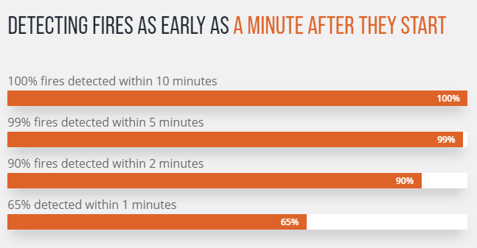
FUEGO CAM by the numbers
Low rate of Omission Errors due to:
Good detection algorithm,
Ability to set detection in aggressive posture without fear of false positives.
Low rate of Commission Error due to:
- Training ML to affirmatively detect sources of false signals.
Fusion of ancillary data
In Intelligence, context is everything
Cameras in Networks | 900+ |  | per minute | Images/minute | Images/Day
Waiting PTZs | 60% | 540 | 2 | 1080
Rotating Cameras | 40% | 360 | 4 | 1440
Total |  |  |  | 2520 | 3,628,800
Full System Error Rates
Commission (False Positive) |  | Hovers around 1 per Million images
Omission (False Negative) |  | Error: less than Ten Mile range Hovers around 1 per 4 Million images
 |  | Error: greater than Ten Mile range Hovers around 1.5 per 1 Million images
 |  | Omission defined as taking longer than 10 minute after first smoke.
Notification of agencies occurs between 25 and 45 seconds after an image is acquired at the camera.

Slide 6
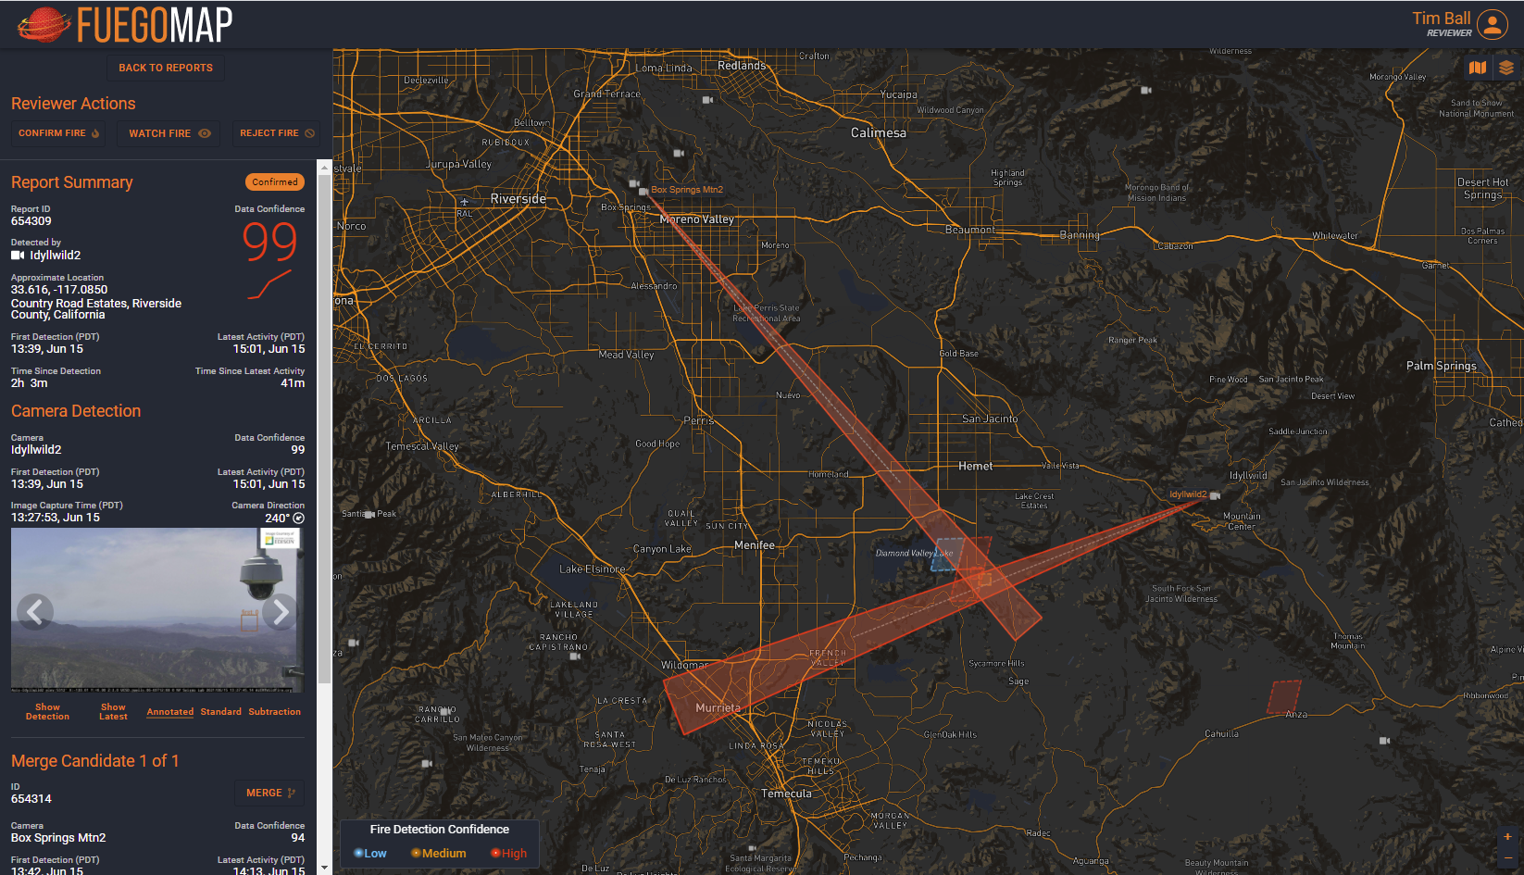
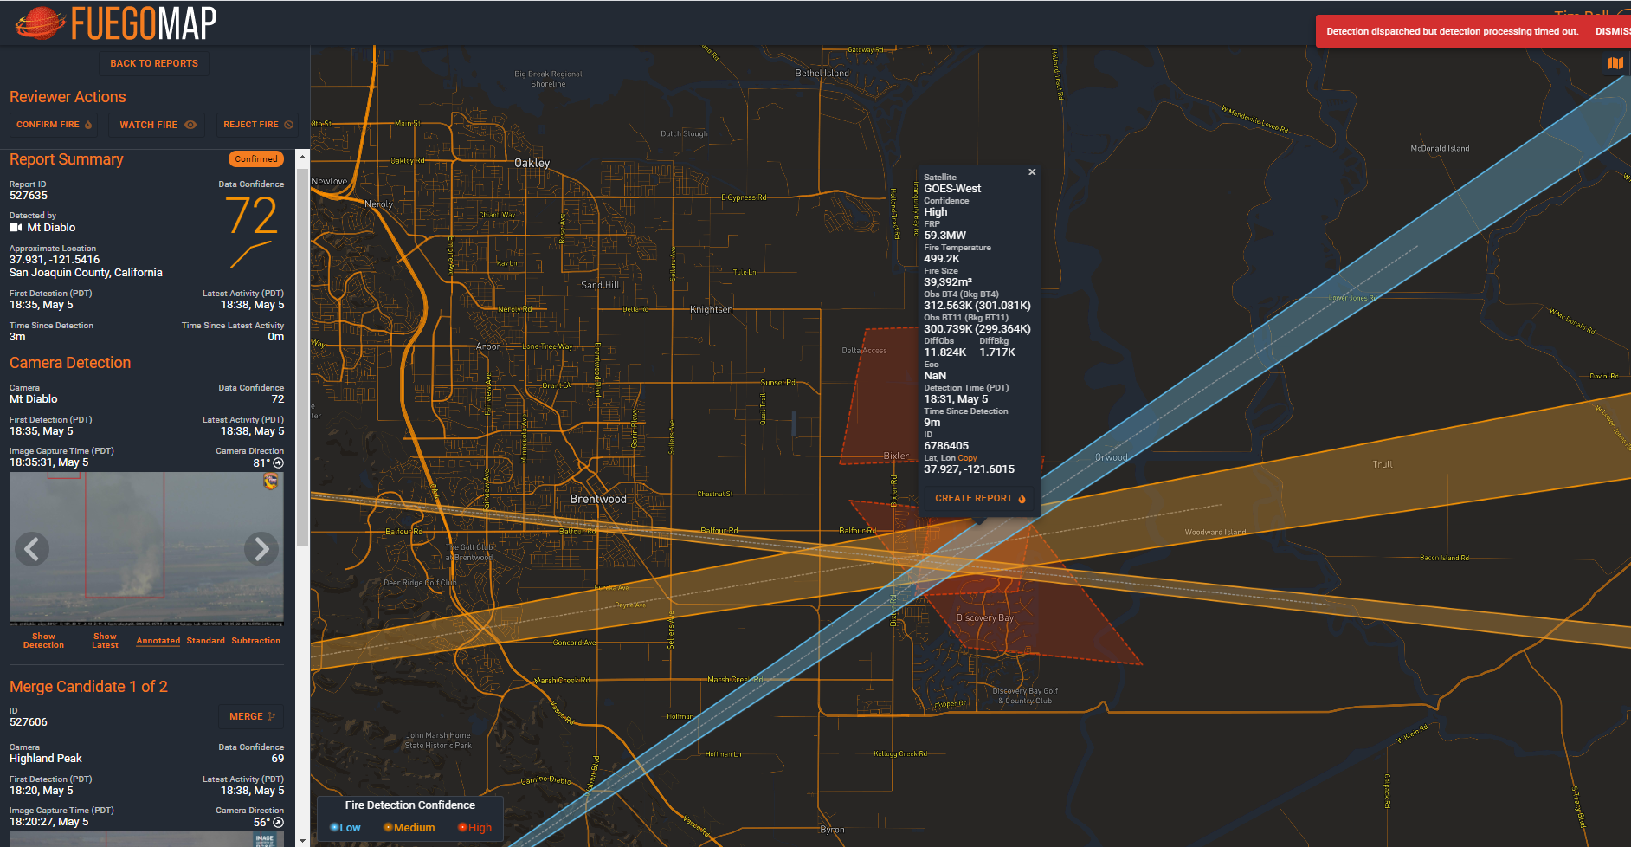
Satellite and Camera Data Fusion
Camera vectors provide triangulation, Images provide assessment. Satellite provides coordinates and record of intensity estimates
Important improvements in the GOES Fire Detection algorithm are possible. Including more bands, temporal pattern recognition, Ancillary data yields affirmative false positive recognition / rejection.

Slide 7
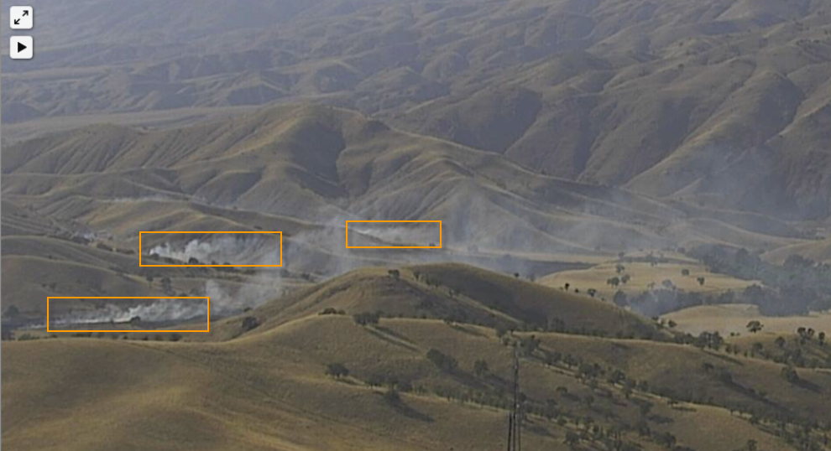
WHAT WE’RE HEARING
Fireball’s Fuego pinpoints the origin of fires and gives us the earliest ability to assess the threat.
FUEGO’s detections are delivered to the field , in the format we require, 24 /7/365 …for us Fireball and its FUEGO technology is a game changer.
Zach Wells, Deputy Chief – Kern County Fire
3 Wind-Driven Railroad Fires

Slide 8
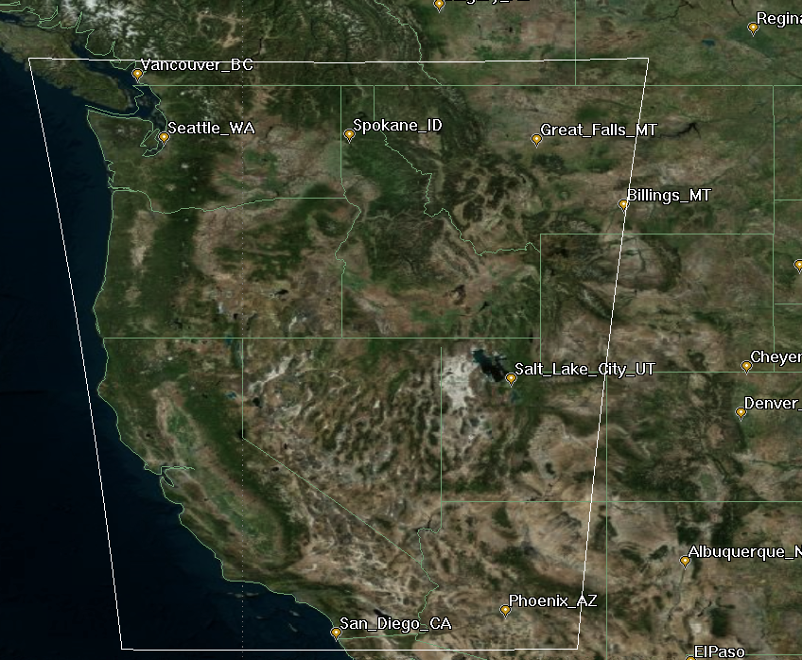
FUEGO – GEOSTATIONARY RATIONAL
Time from ignition to attack is crucial
Prioritization between fires is essential
Continuous automated monitoring from constant stare is indispensable (for both New & Existing)
Detection: >8s for 30 m² of flame >1000°K (800 °C)
200 x smaller fire than GOES-R
Ground Sample Distance < 300 meters
10 Second Cadence 30 times faster than GOES CONUS
Cost Effective
ROM = $220 M for 5 year operation, all-up
> 220 Million Hectares
$0.02 per thousand hectare/hour -- continuous
For Comparison
Inexpensive Jet $2000/hr. @ 35,000 ft. AGL with 120 ° FOV
Maps 2 Million Hectares per hour Cost = $1.00 per thousand hectares

Slide 9
FUEGO – GEOSTATIONARY SPECS
Detection: >8s for 30 m² at 1000°K
Geo-stationary Free-Flyer Over Western US
> 220 Million hectare field of regard
Pointing Mirror: Field of Regard can be re-positioned
Bands: RGB, 3.9µm, 10.2µm
4K x 4K MCT Array, 10 micron pitch
Focal Length: 1000 mm (2.35 degree FOV)
Optics: f/4
Effective GSD: < 300 meters (dithered for BPR)
Array readable @ 100 Hz; planned read 0.5 Hz
Simple image processing & compression on-board
Transmit cadence: Every 10 Seconds -- 40 Mb/S or less
All-up ROM for 5 year operation: $220M
10 msec read every 10 seconds, ΔT=3.7K; 6 images co-added: SNR = 87
GOES ~0.6K ΔT from 2 ms read, SNR~8.5

Slide 10
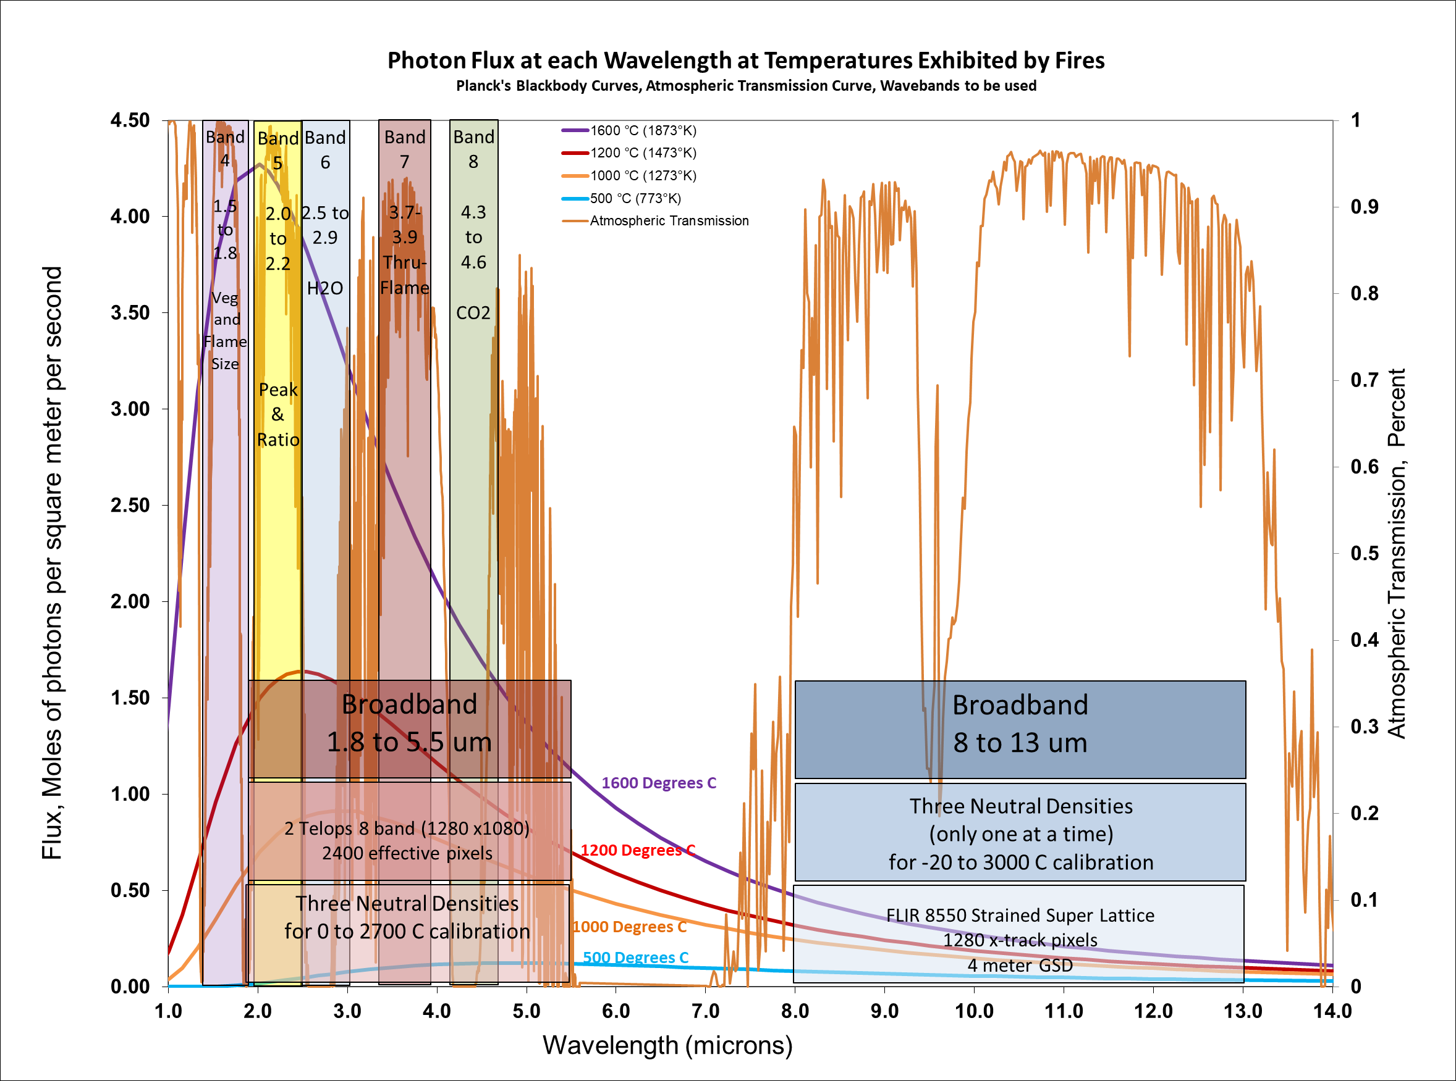
AIRBORNE FIRE CHARACTERIZATION & MAPPING SYSTEM
Improve SCIENTIFIC & OPERATIONAL understanding of fire behavior
8 Mid-Wave Bands
2400 Cross-track Pixels
1 Longwave Band
1280 Cross-track Pixels
Helicopter-borne follows fire front for science missions
Fixed Wing for Operational Mapping

Slide 11
The FUEGO Group
Ed Wishnow (UCB – Space Sciences Lab)
Harald Frey (UCB – Space Sciences Lab)
Greg Dalton (UCB – Space Sciences Lab)
Kodi Rider (UCB – Space Sciences Lab)
Cathy Chou (UCB – Space Sciences Lab)
Mike Lampton (UCB – Space Sciences Lab)
Chris Schmidt (Univ. of Wisconsin – SSEC & GOES)
Chaincy Kuo (Fireball)
Rob Gordon (Fireball)
Janis Lesinskis (Fireball)
Marek Jakubowski (Fireball)
Kent Richards (Fireball)
Itsi Weinstock (Fireball)
Morgan Welch (LBL Affiliate)
Kinshuk Govil (LBL Affiliate)
Michael Chan (LBL Affiliate)

