Slide 1
Fire Monitoring and Assessment Platform (FireMAP)
A More Responsive, Affordable and Safe Method for Mapping Wildland Fires.
Dale Hamilton
Northwest Nazarene University
Assistant Professor of Computer Science

Slide 2
FireMAP
What do we mean by Wildland Fire Severity?
How are we working to map fire severity in a more timely, affordable and safe manner

Slide 3
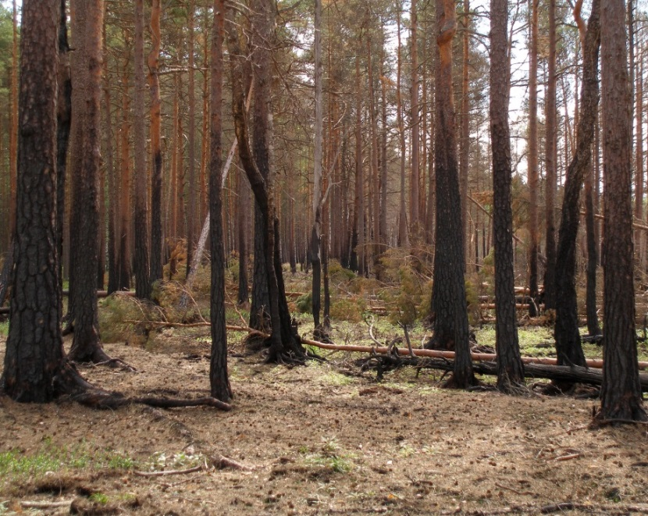
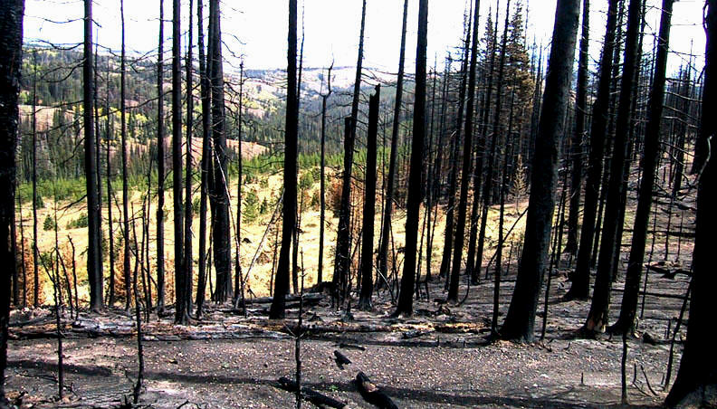
What is Wildland Fire Severity?
How much fuel (vegetation) did the fire consume?
Burn Severity (Fire Effects – First Order)
The effects that concern the direct or immediate consequences of fire, such as biomass consumption and crown scorch. (nwcg.gov)

Slide 4
FireMAP Research Objective
Enable the acquisition, analysis and management of hyper-resolution imagery to map burn severity in a more responsive, affordable and safe manner than is possible with current methods.
Utilize Unmanned Aircraft Systems (UAS)
Hyper (excess) resolution
Spatial
Spectral
Temporal
Radiometric
Notes:
Hyper (excess) resolution
Spatial
The pixel size is smaller than the object being observed
Spectral
Spectral bands are smaller than the RGB bands needed for humans to be able to observe an object
Radiometric
Humans can only observe 64 levels (6 bits) of intensity
Temporal
Can the date and time of imagery be determined by ecological need instead of when the sensor is available over the burn?
Radiometric
8 bit images allow 256 levels of intensity
Micro-MCA and BaySpec OCI-F can capture 8 or 10 bits. OCI-F – 60 bands
JPG format compresses to retain 6 bits of information.

Slide 5
How will FireMAP map wildland fire more responsively, affordably and safely?
Workflow developing in reverse – NASA funded
Ecoinformatics
Acquisition, analysis and management of complex ecological data to provide actionable knowledge for ecosystem management
Platform
Action
Sensor
Knowledge
Imagery
Geoanalytics
Notes:
Ecoinfomatics – acquisition, analysis and management of complex ecological data in order to provide actionable knowledge for ecosystem management.

Slide 6
What actions do managers need to take?
Write post-fire recovery plans
Update vegetation layers
Update fire history atlases
Suppress vs manage future fires
Notes:
Post fire recovery plans - Burned Area Emergency Response (BAER) Teams
Actions that could/need to take place in order to:
Improve ecosystem response and productivity
Reduce future fire risk/hazard
Reduce erosion – adverse sedimentation into neighboring hydrologic features
Update vegetation (fuels) layers to reflect impact of this fire.
Fuels Specialists
Model effect this burn will have on future fire behavior and effects
Update Fire History Atlases (Hamilton, 2014)
Fire Ecologists
Most land management units have spatial fire history going back decades (or more)
Spatial and severity accuracy is suspect the older the data is
Spatial extent of fires under reported on small fires (Morgan, 2014)
Small fires are the most spatially and ecologically diverse acreage (Hamilton, 2014)
Used to calculate Fire Frequency and Fire Regime Departure. (frcc.gov, 2014)
Suppress vs manage a fire: Let future fires burn or actively suppress?
Incident Command Teams
Ecosystems (flora and fauna) are fire adapted
Do we need more fire (let it burn) or have we had too much (suppress it)

Slide 7
What do we need to know?
Knowledge – awareness gained from information and experience
Where has a fire burned and how severe was it?
Can fuel consumption be determined by amount and type of char and ash?
Black ash – mostly consumed Hot
White ash – more complete combustion Hotter
Change in live vegetation?
Change in Chlorophyll can be measured by reflectance
Scorched vegetation?
Reduction in upper layer canopy cover (frcc.gov)
Classify on life form to differentiate tree canopy from grass/shrub
Notes:
Knowledge – Classes needed to identify burn severity
Black ash (Charred organic matter)
White ash
(complete combustion) most important. – can we infer soil heating?
Scorched (unburned) vegetation
dying - expected mortality increases severity
Unburned live vegetation (herbaceous, brush, canopy)
need current canopy cover to determine reduction or veg change
need lifeform to get at canopy cover (conifer/deciduous = canopy, herb/shrub = no canopy)
if conifer/deciduous island -> surface fire
Unburned dead organic matter
slash?
Mineral soil / Rock

Slide 8
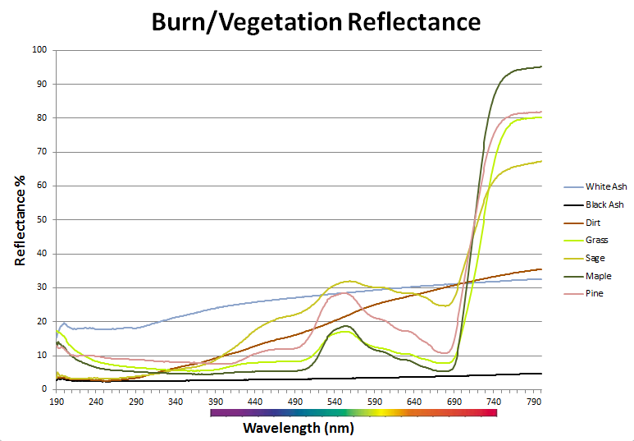
Geoanalytics - Discovery of Patterns -> Knowledge
Look for patterns in the spectral response
Ultra-violet
Blue
Green
Red
NearIR
Notes:
Bands are Landsat 7

Slide 9
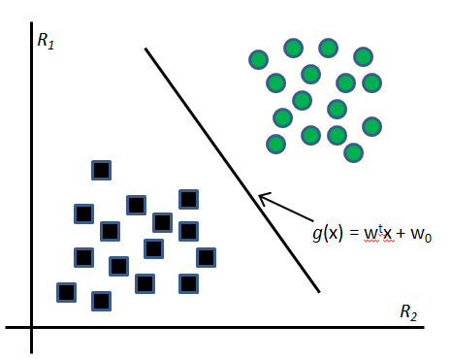
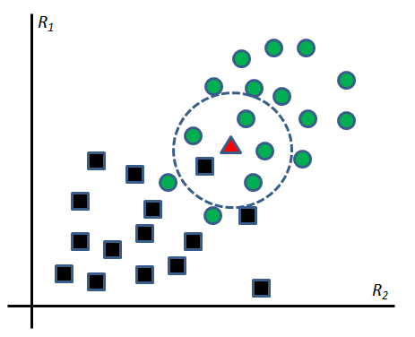
Geoanalytics - Discovery of Patterns -> Knowledge
Potential tools for measuring burn severity
Machine Learning – learn by example
Support Vector Machine (SVM)
K-Nearest Neighbor (KNN)
Notes:
Information and experience
we’ve seen something like this before -> can

Slide 10
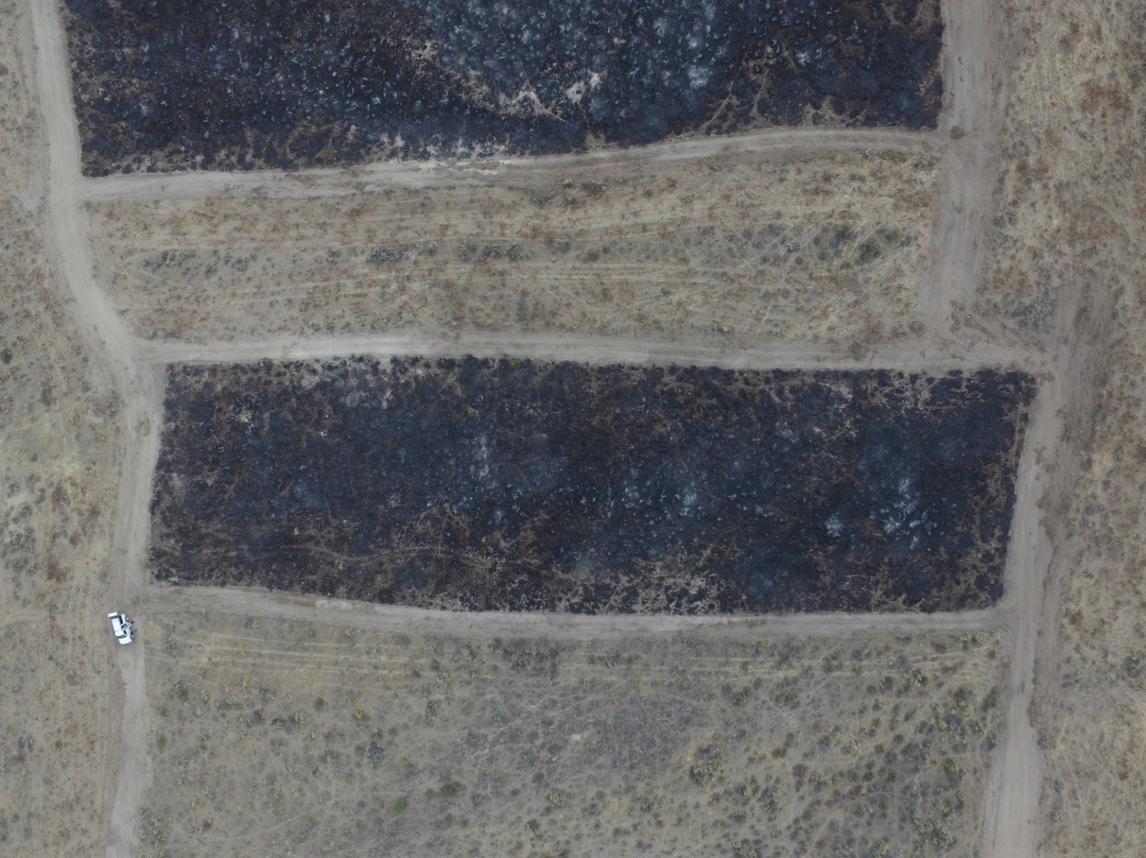
Geoanalytics - Discovery of Patterns -> Knowledge
Look for spatial patterns
Notes:
Reynolds Creek prescribed burn – 4000x3000 image taken at 400ft AGL

Slide 11
Geoanalytics - Discovery of Patterns -> Knowledge
Can we leverage hyper-resolution imagery to quickly and inexpensively map burn severity?
How high of resolution is necessary (adds info)?
Spatial
Spectral
Temporal
Notes:
Hyper = excessive
Spatial
Higher accuracy with hyper-spatial resolution. (Rango, 2009)
Function of altitude and sensor
Pixels small enough that they won’t contain more than a one kind of material.
Just conifer or just black ash
Spectral
Intensity (energy reflectance)
Bands (center and range)
Temporal
Optimal image acquisition delay span (how long after containment to take imagery)
Time of day & weather (lighting and degrade info)
Radiometric (ignore)
Are there more that 8 bits of useful information per spectral band, per pixel?
If not, is it because the analog image isn’t mapped properly to the digital image? E.g., is the burn are indistinguishable from the shadow area because of lack of resolution, or poor camera settings prior to digitization?
Micro-MCA and BaySpec OCI-F can capture 8 or 10 bits.
Can see 6bits, but can move where that 6 bits is over wide range

Slide 12
Geoanalytics - Discovery of Patterns -> Knowledge
Pre-processing to better enable classification
Software filters
Resample imagery to optimal resolution
Normalization
Transformation
Object detection
Structure
Post-processing to clarify classification.
Noise Reduction (Salt and pepper effect)
Object enhancement
Output spatial resolution
Islands
Unburned vegetation type
Notes:
Filters
Resample spatially to optimal spatial resolution
Other resolutions?
resampled 120m burn image -> 240m = burn extent worked fine
what about burn severity/white ash?
Can dumb down resolution, but can’t increase. There is no cure for stupid
Mitigate the “Curse of Dimensionality” – if we only have 3 dimensions (rgb, not an issue) – higher w/ object classification
Transformation
Principal Component Analysis
normalization is a process that changes the range of pixel intensity values
Dimensionality reduction
Transformation
Hue Saturation Value – drop value, separable without it
Principal Component Analysis
Structure
Identify burn/unburn before white ash and veg type
If this is a morning image and there’s a tree to the east, this might be a shadow.
Post processing
Object enhancement
Morphology to Bring out white ash
Salt and pepper effect
Morphology – dialate, erode, open, close, connected components
Blurring (Median Blur Filter)
Majority Filter (arc) or Area opening(matlab/OpenCV) - removes from a binary image all connected components (objects) that have fewer than P pixels
Output Spatial Resolution
Depends on what we’re looking at
Islands – if it’s just tree, is it island or low intensity burn (with live canopy)
Look for grass vs just conifer/disciduous

Slide 13
Imagery – How much data is enough?
Spectral Resolution
Multi-spectral vs Hyper-spectral
Extent & Resolution
Spatial resolution
Pixel size smaller than object we’re looking at
Temporal
UAS - on demand but have to be there
Manned or Satellite – expensive and non-responsive
Notes:
Spectral Resolution
Multi-spectral - consumer grade cameras
Color (Red, Green and Blue)
Near Infrared
Hyper-spectral
Extent
wider range of the electromagnetic (EM) spectrum
Including Shortwave Infrared?
Get data we can’t get with multi-spectral
NIR, swir, thermal
Are there unevaluated bands that we can’t get with satillite?
Resolution
Narrower bands record smaller part of the EM spectrum
Spatial resolution
Altitude (AGL) of 60 meters (200 ft)
Spatial resolution < 5 cm/pixel
Pixel size smaller than object we’re looking at
At what resolution do we stop getting an increase in information
Improve on what’s available
satellite = 2.5m – 30m
Aerial = .25 – 1m
Georeference
Where exactly is the burnt log I’m looking at in the image?
Needed for multi-temporal sampling and mosaicing
Need latitude, longitude, elevation and heading
Pix4D
Can use ArcGIS to georeference and mosaic
Imagery - temporal resolution
UAS - on demand but have to be there
Manned
Availability
Cost (10x UAS)
Satellite
Flyover frequency
Cloud/smoke cover

Slide 14
Geoanalytics – Spatial Resolution
Reynolds Creek Prescribed burn – 120m AGL – 6.4 cm/px
Notes:
Reynolds Creek prescribed burn – 4000x3000 image taken at 400ft AGL
6.4 cm/px => tan(47) * 120m/2000px

Slide 15
Geoanalytics - Spatial Resolution
Previous image resampled to 30 meter (Landsat) resolution
Notes:
Reynolds Cr burn resampled to 30 meter Landsat (8x6) resolution.

Slide 16
Sensor – Data Acquisition
Inexpensive color cameras
Show Red, Green & Blue bands
Mod to capture Near Infrared (NIR) band
Hyperspectral Camera - capture visible and NIR bands
Capture more, narrower bands.
Can it capture beyond Near Infrared
Shortwave Infrared (SWIR) @ 2.09-2.35 μm
Notes:
Sensor
Inexpensive color cameras
Show Red, Green & Blue bands
Blue .45-.51 μm
Green .52-.60 μm
Red .63-.69 μm
Capture Near Infrared (NIR) band
Change filter to capture NIR instead/in addition to Red
Near Infrared = .77-.90 μm
Hyperspectral Camera - capture visible and NIR bands
Capture more, narrower bands.
Can it capture beyond Near Infrared
Shortwave Infrared (SWIR) @ 2.09-2.35 μm
Reflectance spectrum obscured by atmospheric obstruction
Radiometric resolution
10 bit sensors - Micro-MCA and BaySpec OCI-F
NIR – Pi NIR camera
RGB, NIR, SWIR used because that’s what atmosphere does not block for Landsat
are there other bands that would be helpful that are outside atmospheric window.
Micro-MCA and BaySpec OCI-F are 60 bands, 10 bit sensors.

Slide 17
UAS – Just get the sensor up there!
Why Unmanned Aircraft Systems (UAS)?
Low altitude = High spatial resolution
Increased Availability - fly under clouds and smoke
Affordability
Fire fighter safety
Notes:
Why Unmanned Aircraft Systems (UAS)?
High spatial resolution
FAA ceiling 120 meters (400 ft) AGL
Hyper-spatial resolution @ 30 meters (100 ft) AGL < 2.5 cm
Increase the precision of estimates of key rangeland indicators (Rango, 2009)
Increase Availability - fly under clouds and smoke
Temporal resolution determined by local unit
Let ecological needs drive timing of image acquisition
Get knowledge to managers when they need it
Affordability
1/10 cost of Manned (USGS, 2015)
Fire fighter safety
Won’t put personnel at risk
First priority of every fire management activity (WFLC, 2014)
Contrast satellite and manned aircraft –
manned fly at 5000 ft
fixed wind airspeed preclude hyper-spatial
Manned Helicopter - $5k/day
UAS contract for much less
Phantom 3 - $1000
Performance
transmit imagery in flight. Process onboard or at ground station.
Safety – don’t put man in air or in burn.
Purchase limit on government cards is $2,500

Slide 18
FireMAP Proof of Concept Results
Image taken by a DJI Phantom 3 at 120 meters (400 ft) AGL

Slide 19
FireMAP Proof of Concept Results
Burn/unburned classification with SVM

Slide 20
FireMAP Proof of Concept Results
Addition of high severity (consumption) from white ash classification with SVM

Slide 21
Acknowlegements
FireMAP funding through NASA EPSCoR via the Idaho Space Grant Consortium
Northwest Nazarene University
Barry Myers – Computer Science
University of Idaho
Greg Donohoe – Computer Science
Eva Strand – Forest, Rangeland & Fire Science

Slide 22
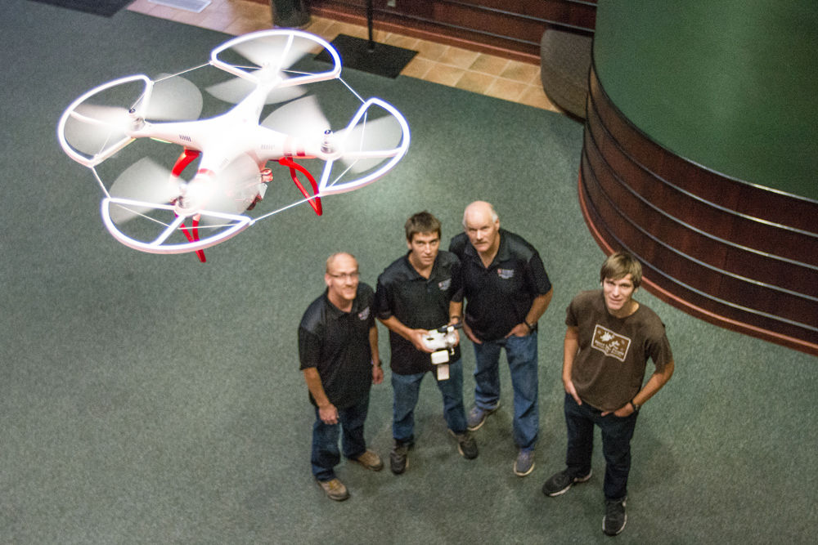
Questions?

