Slide 1
Characterization of Fire Geometry and Energy Release in Relation to Fuels Geometry and Consumption Measured on the Ground, from the Air and from Space.
Tim Ball Fireball
Andy Hudak - USFS Rocky Mtn Experiment Station, Moscow, Idaho PI of SERDP Objects Project
Nancy French - Michigan Tech University, Co-PI of SERDP Objects Project
Matt Dickinson - USFS Eastern Experiment Station Co-PI of SERDP Objects Project
Chaincy Kuo - Fireball Carl Pennypacker & Ed Wishnow UC Berkeley Space Sciences Lab
Bob Kremens - RIT Craig Clements - Fire Interdisciplinary Research Center, San Jose State
Supporting Entities
SERDP: DOD, DOE, EPA USFS
Gordon & Betty Moore Foundation
Ball Aerospace
Space Dynamics Lab -- Utah State University
UC San Diego

Slide 2
Objectives
1. Fuel Consumption and Energy Release (radiative & convective) are obviously linked but how?
Measured independently and then cross checked, testing the hypothesis there is a linear relationship between consumption and fire intensity. Does that relationship vary between fuel types.
What is the split between convective and radiative energy release and how does it vary?
Can these relationships be used predictively.
This feeds and validates: fire behavior models as well as smoke generation & dispersion models
There is operational need to understand and predict fire intensity and geometry in different fuel types.
  This is flame length and the validity of nomograms which remain an important tool for FBAN
Fire Severity Prediction test against Burn Severity Index

Slide 3
Consumption Estimation Methods:
Indirect Method, Modeled:
𝑀𝑐 = 𝐴 x 𝐵 x β
𝑀𝑐 = Consumption Mass (kg)
A = Burn Area (m²)
B = Fuel Biomass Density (kg m⁻²)
β = Burning Efficiency (%)
French and Hudak (In Review) Ch. 5: Fuel Consumption and Emissions from Biomass Burning, In: T. Loboda, N. French, R. Puett (Eds.), Fire, Smoke and Health: Tracking the Modeling Chain from Flames to Health and Wellbeing. AGU.
Notes:
Fuels are the independent variable that constrain fire behavior and smoke emissions.
Both fire behavior and smoke emissions are more directly related to fuel consumption than fuel loadings.

Slide 4
Consumption Estimation Methods:
Direct Method:
Indirect Method, Modeled:
𝑀𝑐 = FRE x C
𝑀𝑐 = 𝐴 x 𝐵 x β
𝑀𝑐 = Consumption Mass (kg)
𝑀𝑐 = Consumption Mass (kg)
FRE = Fire Radiative Energy (MJ)
A = Burn Area (m²)
C = Combustion Factor (kg / MJ)
B = Fuel Biomass Density (kg m⁻²)
β = Burning Efficiency (%)
French and Hudak (In Review) Ch. 5: Fuel Consumption and Emissions from Biomass Burning, In: T. Loboda, N. French, R. Puett (Eds.), Fire, Smoke and Health: Tracking the Modeling Chain from Flames to Health and Wellbeing. AGU.
Notes:
Consumption is a process, so the direct approach estimates from integrated measurements of radiative heat flux.
Otherwise, it can be estimated indirectly based on estimates of fuel loadings and how much of it burned.

Slide 5
Consumption Estimation Methods:
Direct Method:
Indirect Method, Modeled:
𝑀𝑐 = FRE x C
𝑀𝑐 = 𝐴 x 𝐵 x β
𝑀𝑐 = Consumption Mass (kg)
𝑀𝑐 = Consumption Mass (kg)
FRE = Fire Radiative Energy (MJ)
A = Burn Area (m²)
C = Combustion Factor (kg / MJ)
B = Fuel Biomass Density (kg m⁻²)
β = Burning Efficiency (%)
Wooster et al. (2005) JGR 110: D24311
Fire Radiative Power (kW / m²)
Fire Radiative Energy (MJ / m²)
Combustion Rate (kg / s)
Consumption (kg / m²)
French and Hudak (In Review) Ch. 5: Fuel Consumption and Emissions from Biomass Burning, In: T. Loboda, N. French, R. Puett (Eds.), Fire, Smoke and Health: Tracking the Modeling Chain from Flames to Health and Wellbeing. AGU.
Notes:
Seminal work by Wooster et al. (2005) based on small fire experiments showed:
Rate of combustion is linearly related to the rate heat is released (FRP)
Total consumption is linearly related to total heat released (FRE)

Slide 6
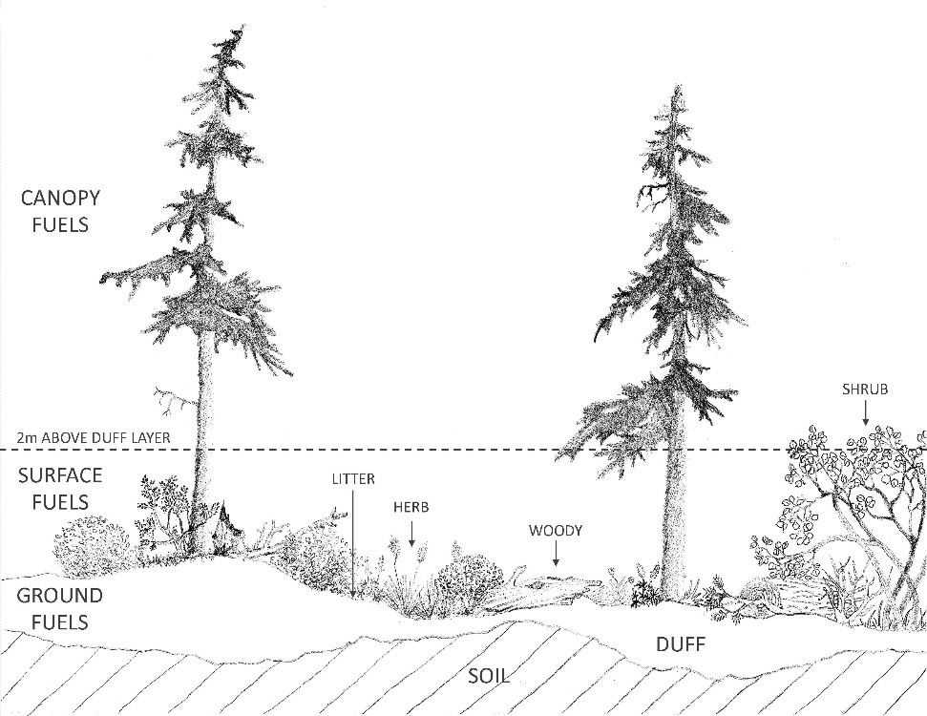
Do fuels matter?
Yes!
Vertical fuel strata in a wildland fuelbed (drawing by Ben Wilson from Keane [2015])
Ensemble steps to estimating emissions. Of these, fuel loading, consumption, and fire behavior (in that order) have the highest uncertainty and contribute to the greatest error.
Prichard et al. (In Press) Fuels and Consumption. In: US Forest Service National Smoke Assessment.
Notes:
Fuels are complex and heterogeneous!
The different fuel components that comprise natural fuelbeds have very different burning properties.

Slide 7
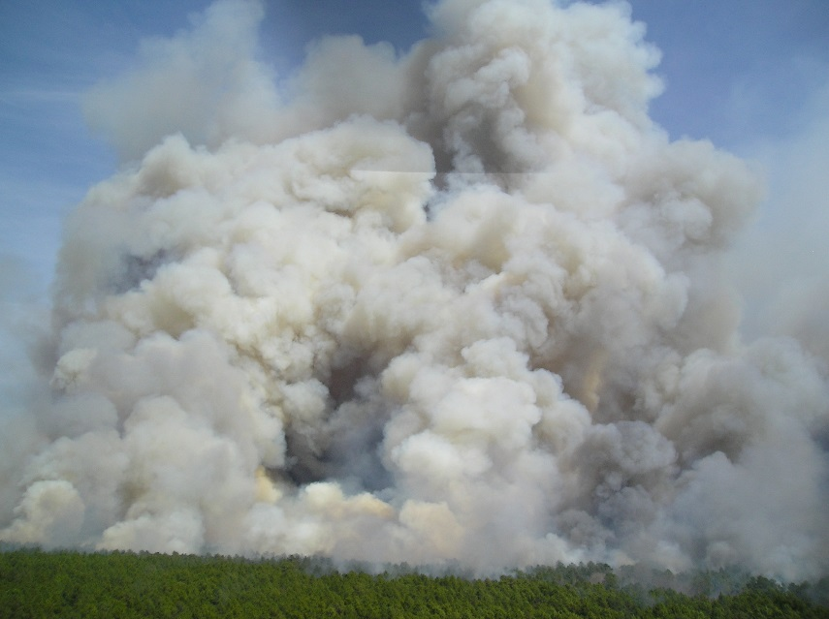
Consumption is a process
Indirect Approach
Direct Approach
French, N.F., and A.T. Hudak. (In Review) Ch. 5: Fuel Consumption and Emissions from Biomass Burning, In: T. Loboda, N. French, R. Puett (Eds.), Fire, Smoke and Health: Tracking the Modeling Chain from Flames to Health and Wellbeing. AGU.
$M_{x}=A×B× β× {EF}_{x}$
$M_{x}=FRE×C×{EF}_{x}$
Notes:
Two alternative approaches for estimating emissions from fuel consumption.
On left is fuel based, on right is active fire based.
Mx = mass of emissions (kg) for fuel type x; ${EF}_{x}$ = emissions factor for fuel type x
Fuel-based: A = area burned (ha); B = biomass burned (kg/ha); $β$ = burning efficiency (%)
Fire-based: FRE = Fire Radiative Energy (MJ); C = combustion factor (kg/MJ)

Slide 8
Objectives
2. Understand what satellites really see and why? Satellites are being used to understand and then predict fire behavior
Opportunities to calibrate satellite measurements are rare.
Best approached from measurements at a various altitudes/scales
3. Modelling behavior of our new FUEGO geo-stationary satellite
Convincing ourselves that we can detect the start of dangerous fires in the first minute or two.
Designing a High Dynamic Range capability allowing us to track fire growth & intensity as well has detecting significant spot fires.
All of these objectives require non-saturating measurements of both Temperature & In-band Radiance rapidly and at several spatial scales

Slide 9
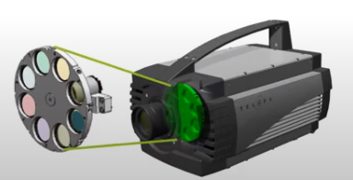
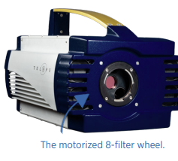
Telops Specially Doped InSb Extended Mid-wave (1.5-5.5µm) Camera’s Filter Wheel Details
Telops MS 100 HD Multispectral Camera
Allows eight neutral density and narrow band-pass filters to be combined. There will be two of these cameras in the system. Their function is to characterize conditions and fluxes round the hottest portions of the fire.
These cameras are quite fast, collecting up to 1000 frames per second, meaning 125 frames per minute through each filter.
This is fast enough so the cameras can be used in an moderately fast aircraft and at altitudes down to 1000 feet without smearing pixels. This yields high spatial resolution.

Slide 10
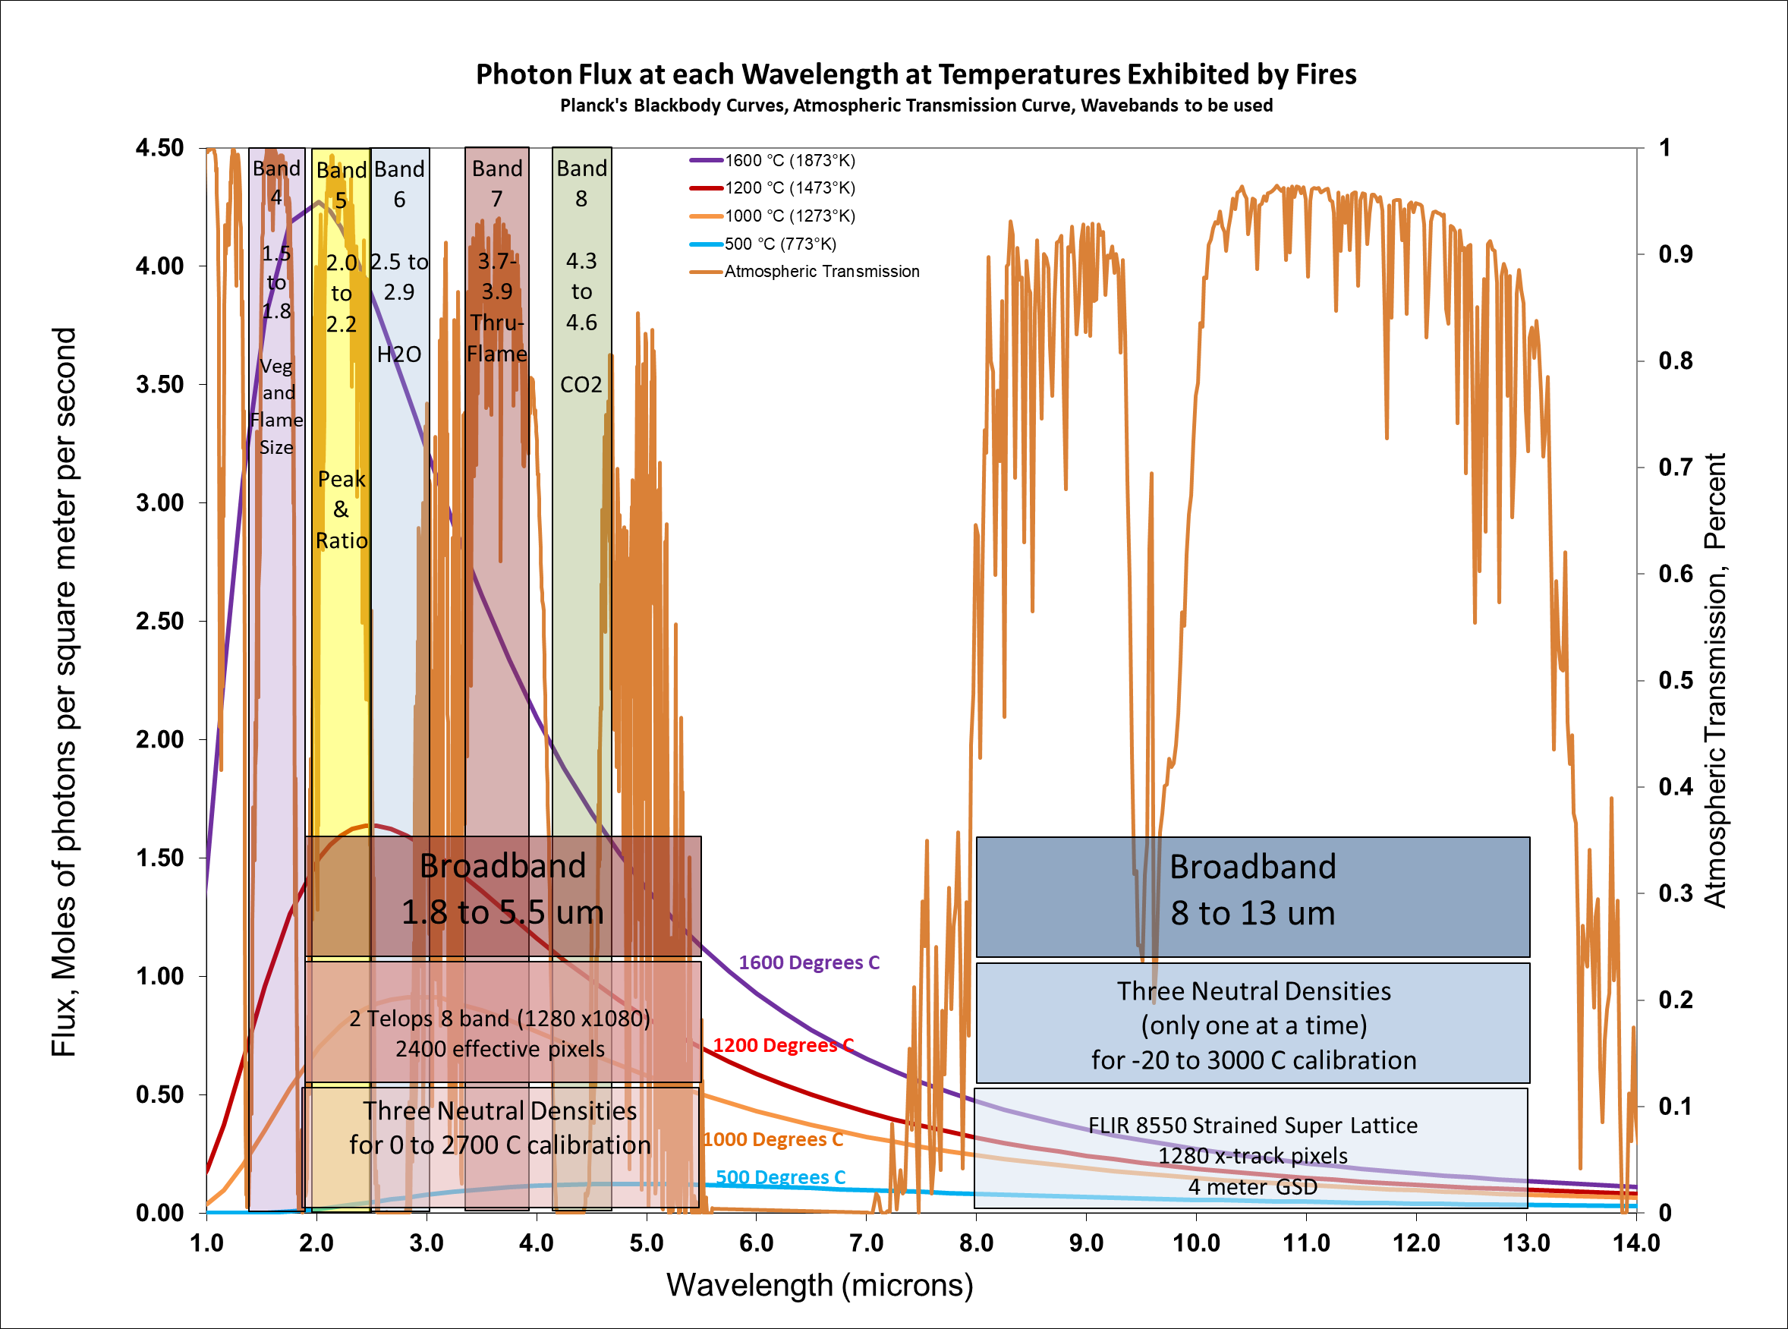
Four Tasks
Measure and understand the total radiation from fires and its components. Secondary radiation likely plays a significant part and the emissivity of components is not simple.
Measure temperatures of burning fuels to understand both energy release and fuel consumption.
Measure flame and fuel geometric relationships.
Measure perimeter and rates of spread.

Slide 11
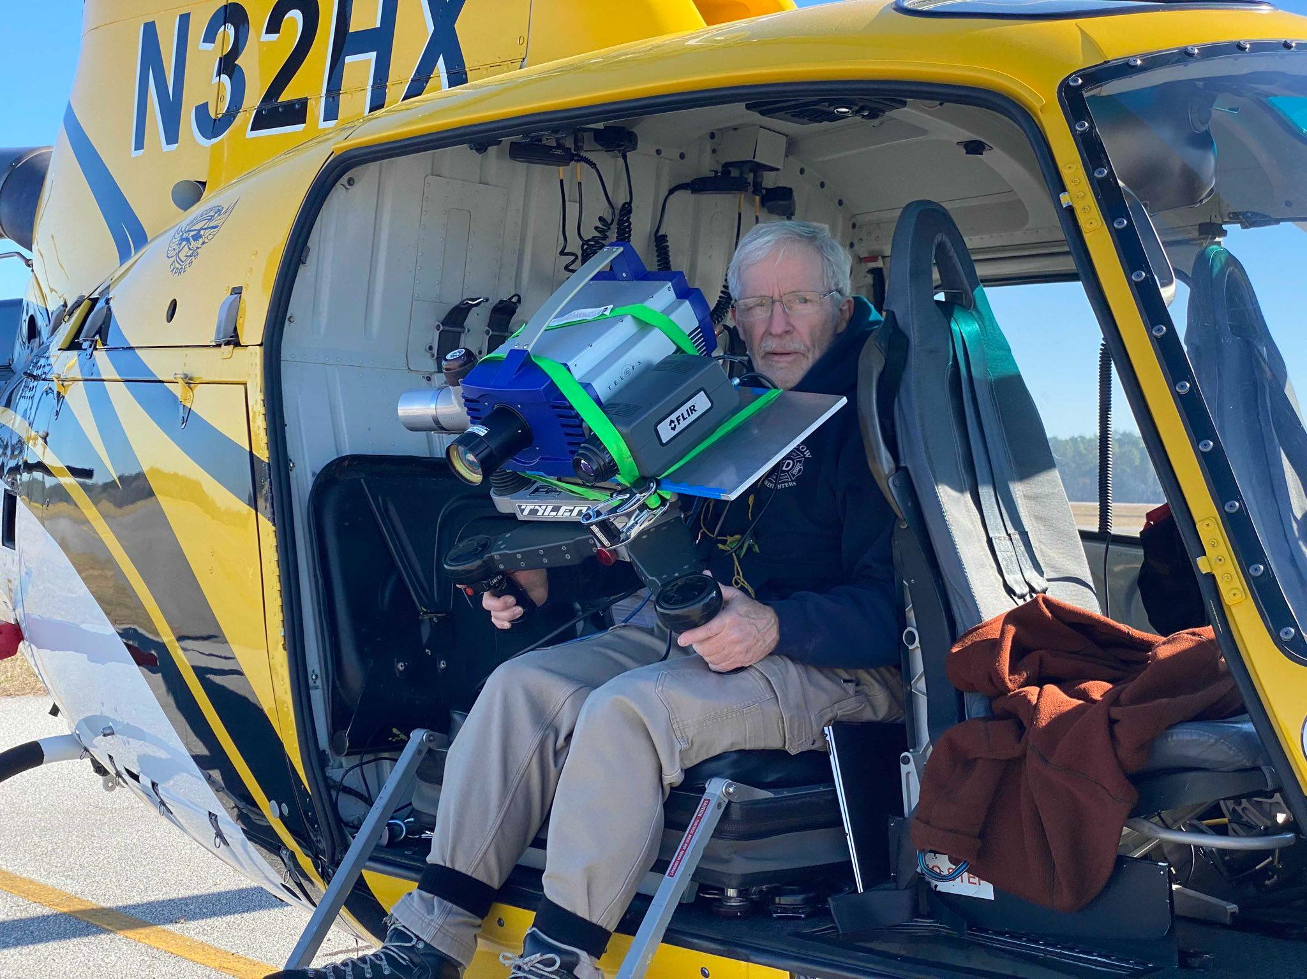

Slide 12
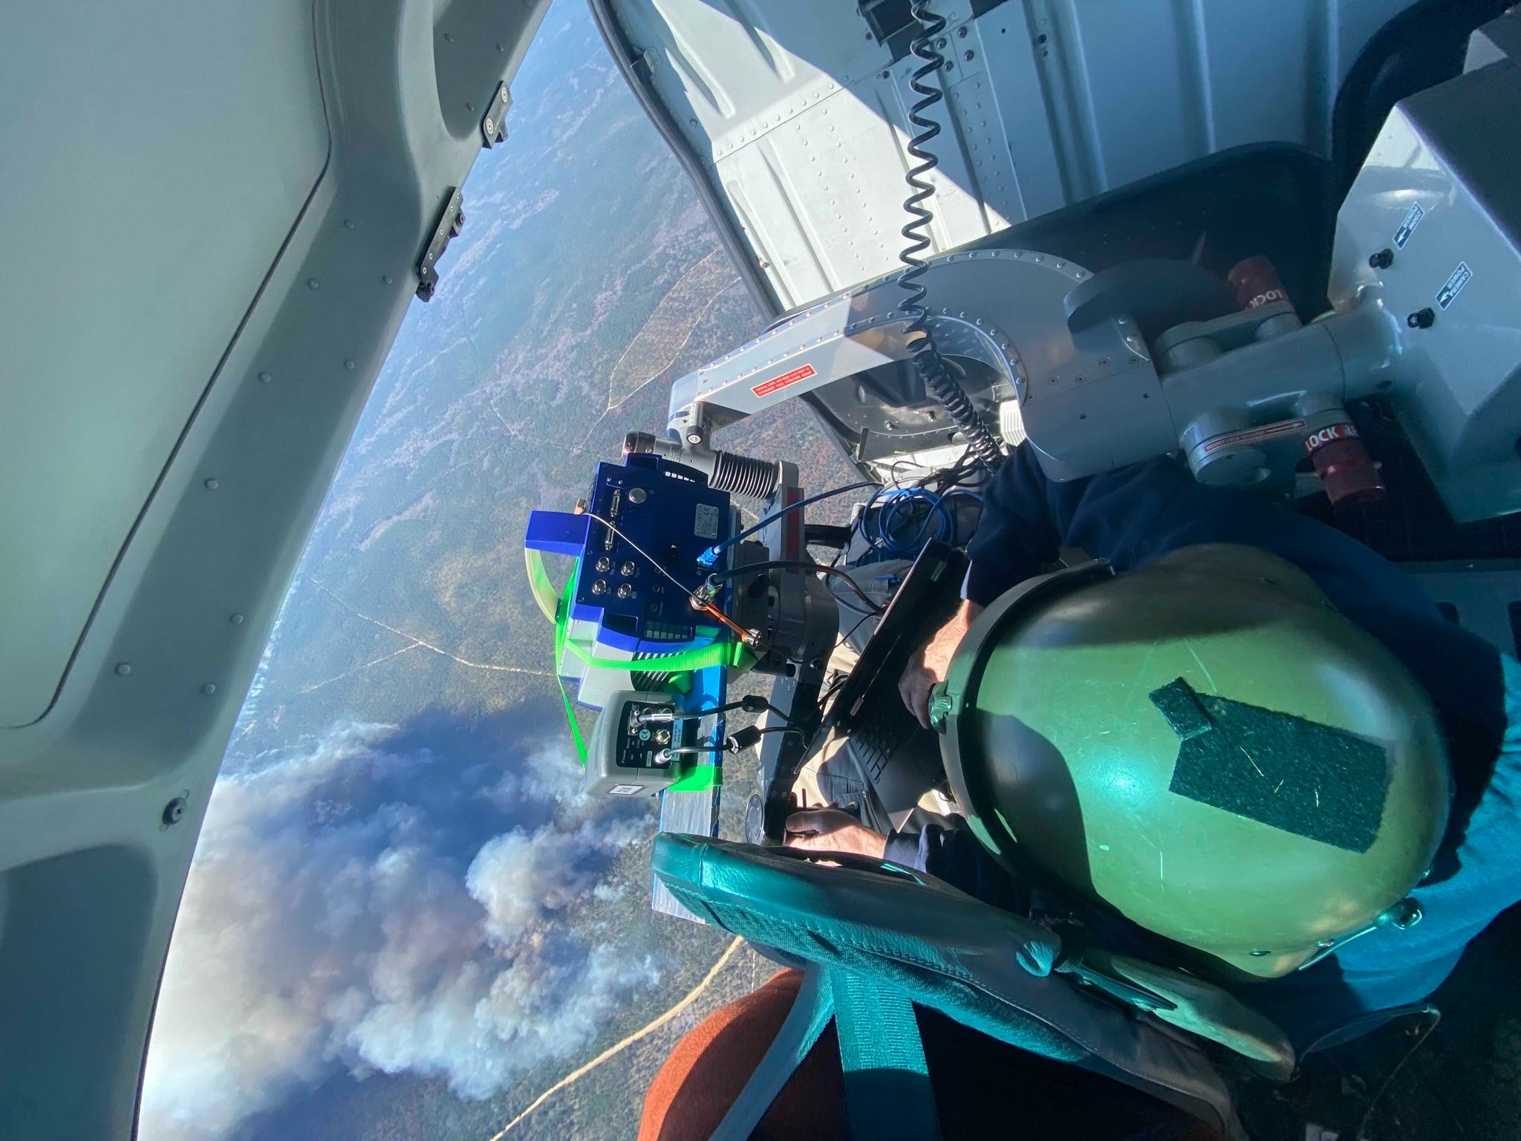

Slide 13
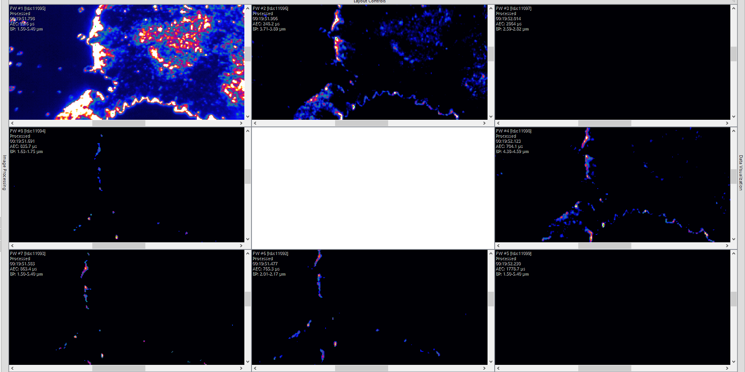
1.5 to 5.5um OD1 0-328 C
3.71 to 3.89um 189-919 C
2.59 to 2.82 um 277-875 C
1.63 to 1.75 um OD2
396 -1040 C
4.38 to 4.59 um
144-932 C
1.5 to 5.4 um OD2 293 -1501 C
2.0 to 2.17 um OD2 396 -1040 C
1.5 to 5.4 um OD3 575 -2500 C

Slide 14
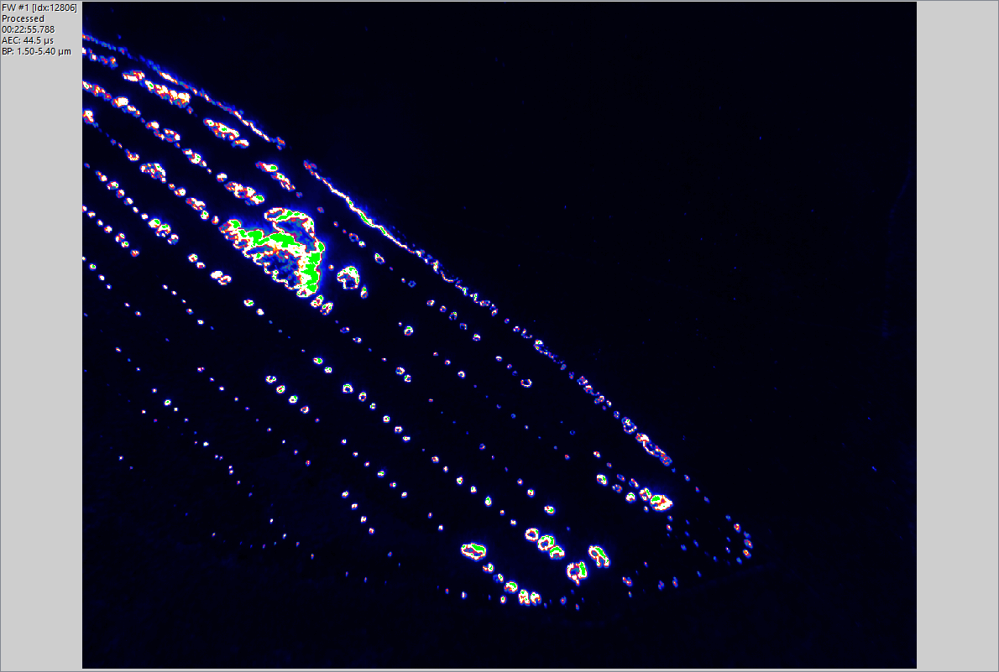

Slide 15
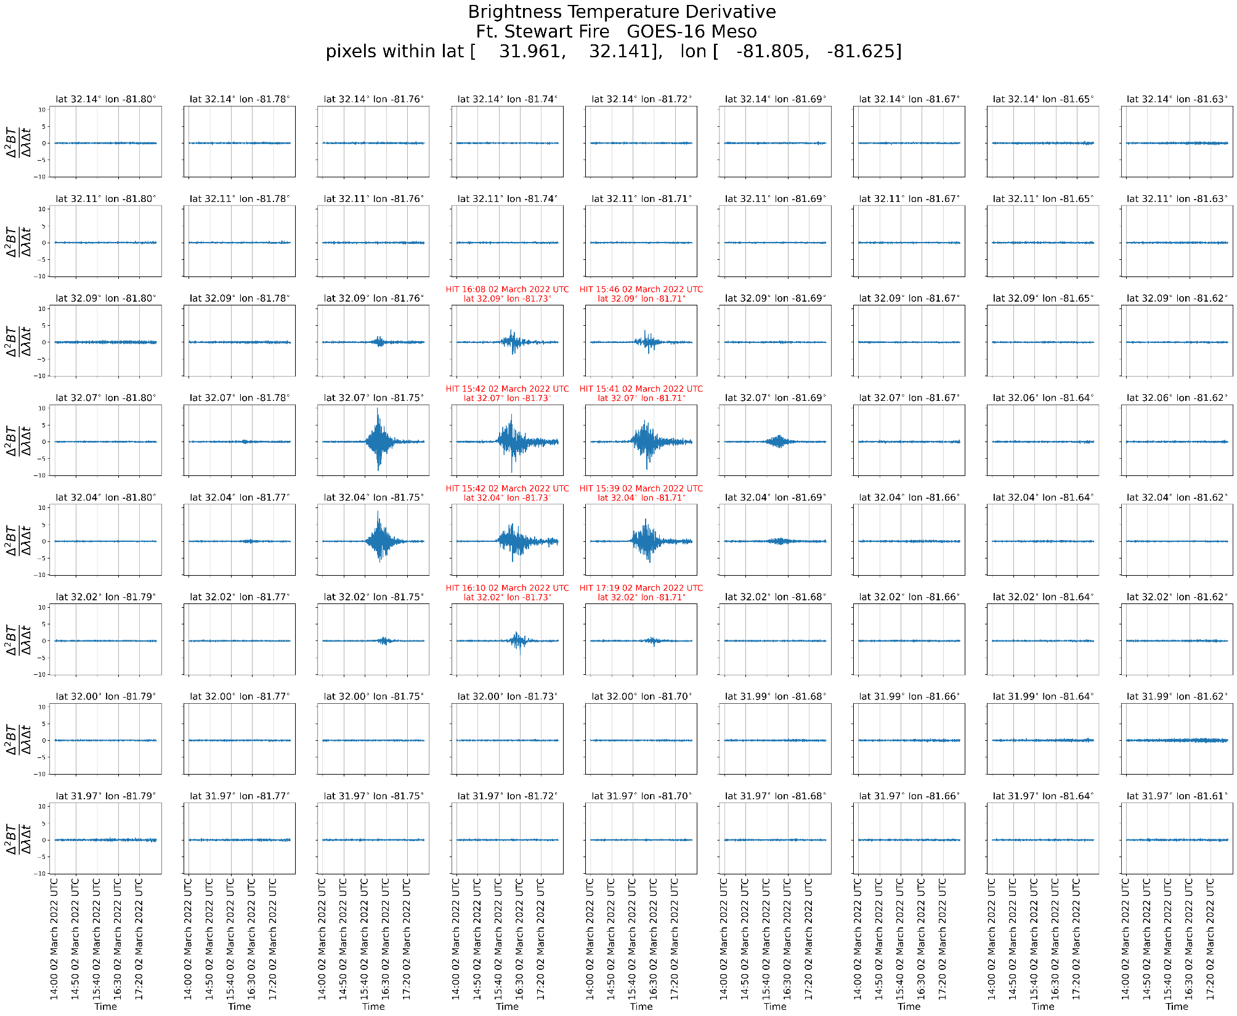

Slide 16
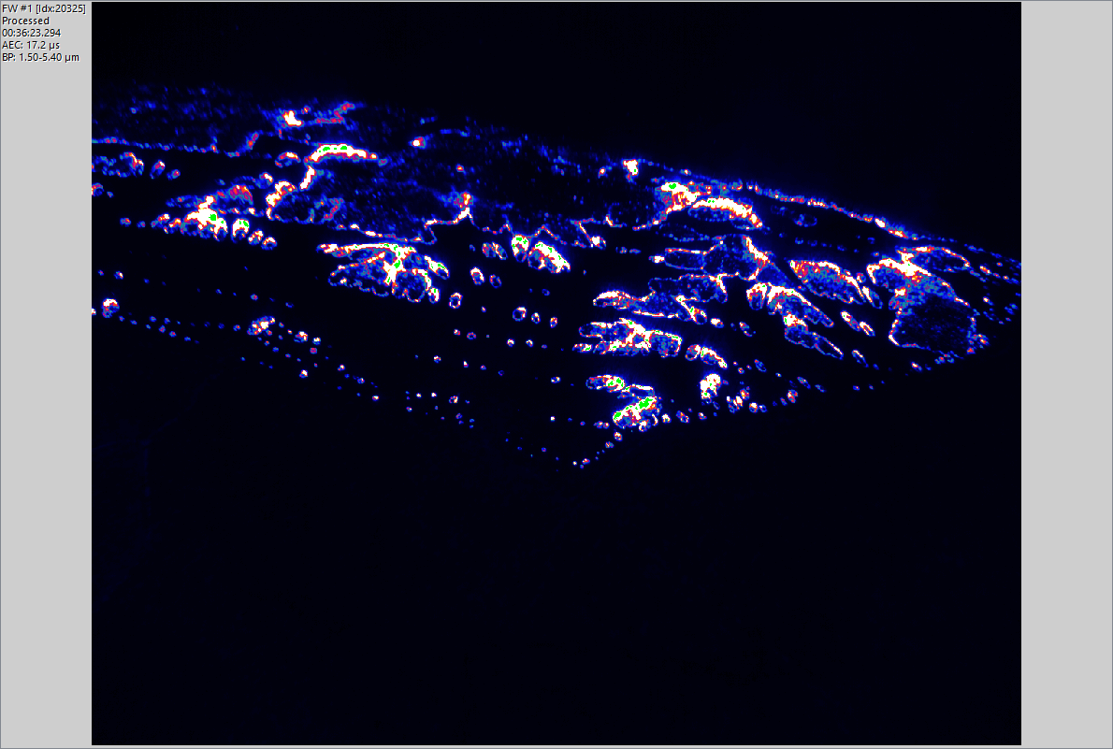

Slide 17
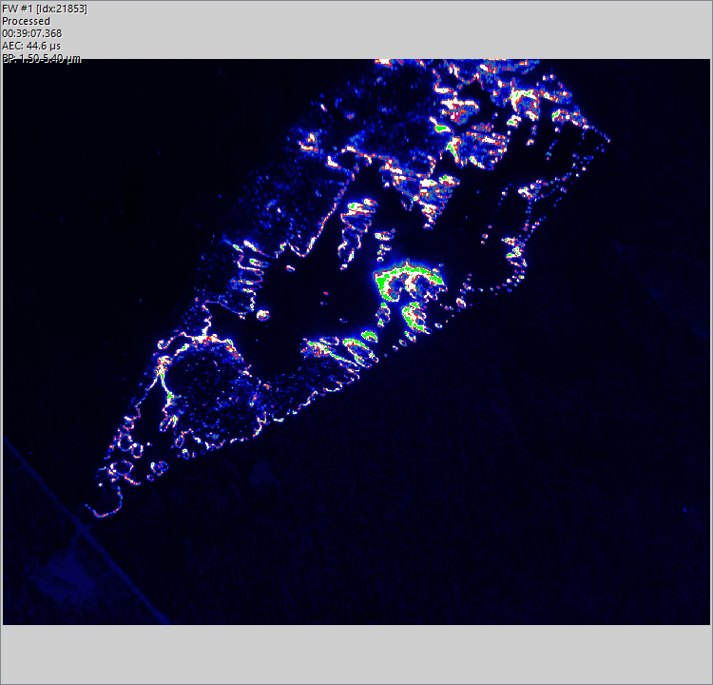

Slide 18
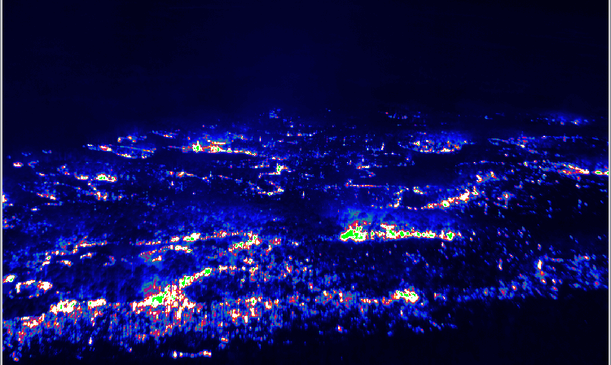

Slide 19
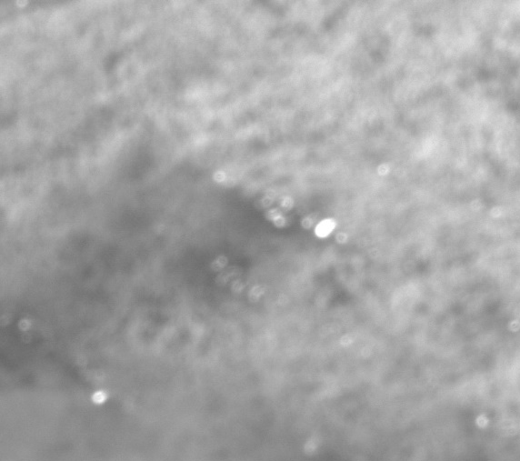
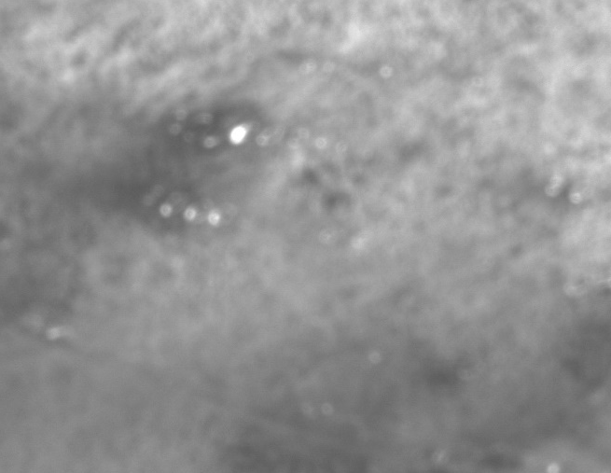
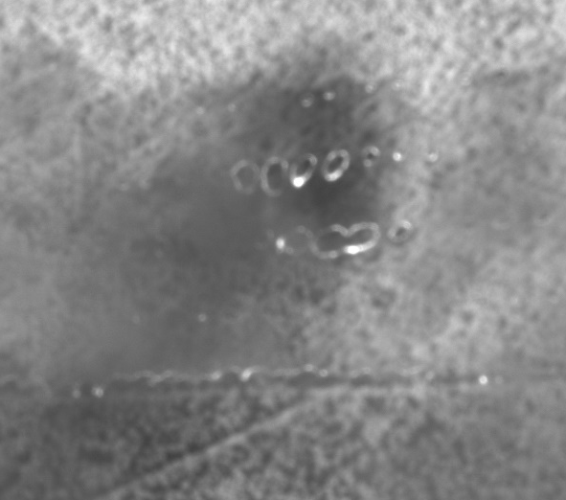
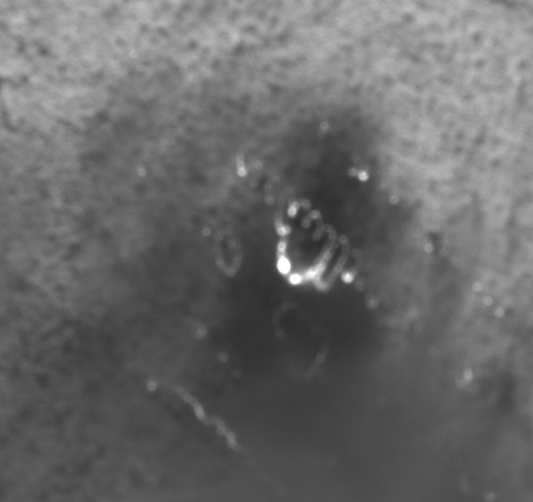
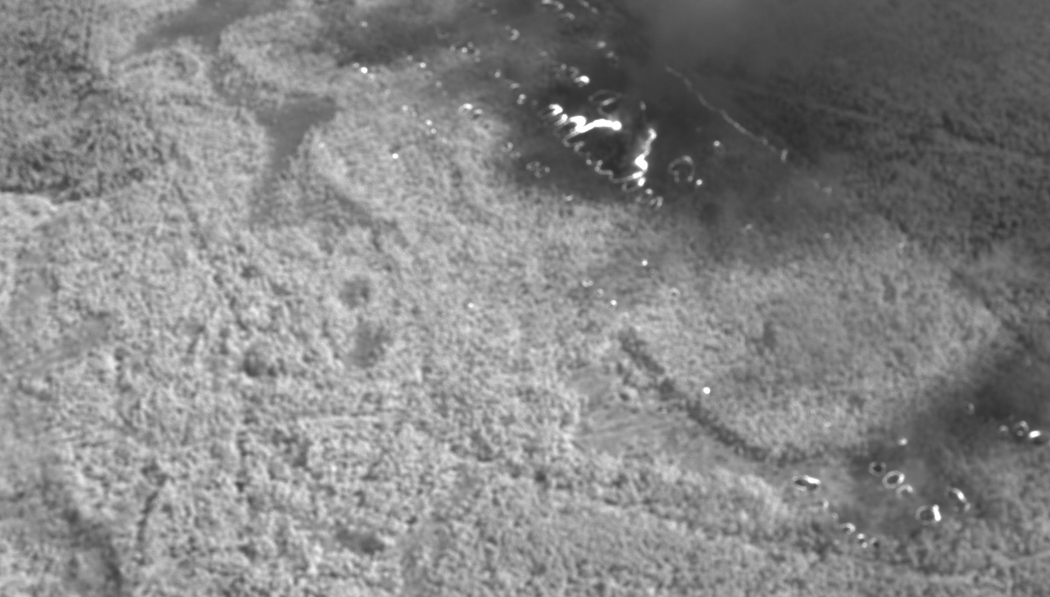
Samples from a sequence 6.5 minutes long of flame spread through light fuels NIR (830-1100nm)
These images are “chips” meaning little pieces of the same spot cut out of larger images.
The sequence was collected on a cadence of 1 image every 10 seconds.
The idea behind this camera is to document the geometry of the plasma that we call flame and the rate of spread.
These images are not yet geo-referenced so their scale is not the same.
1032_03 hr. LT
1032_24 hr. LT
1032_58 hr LT
1034_41 hr. LT
1038_34 hr. LT

Slide 20
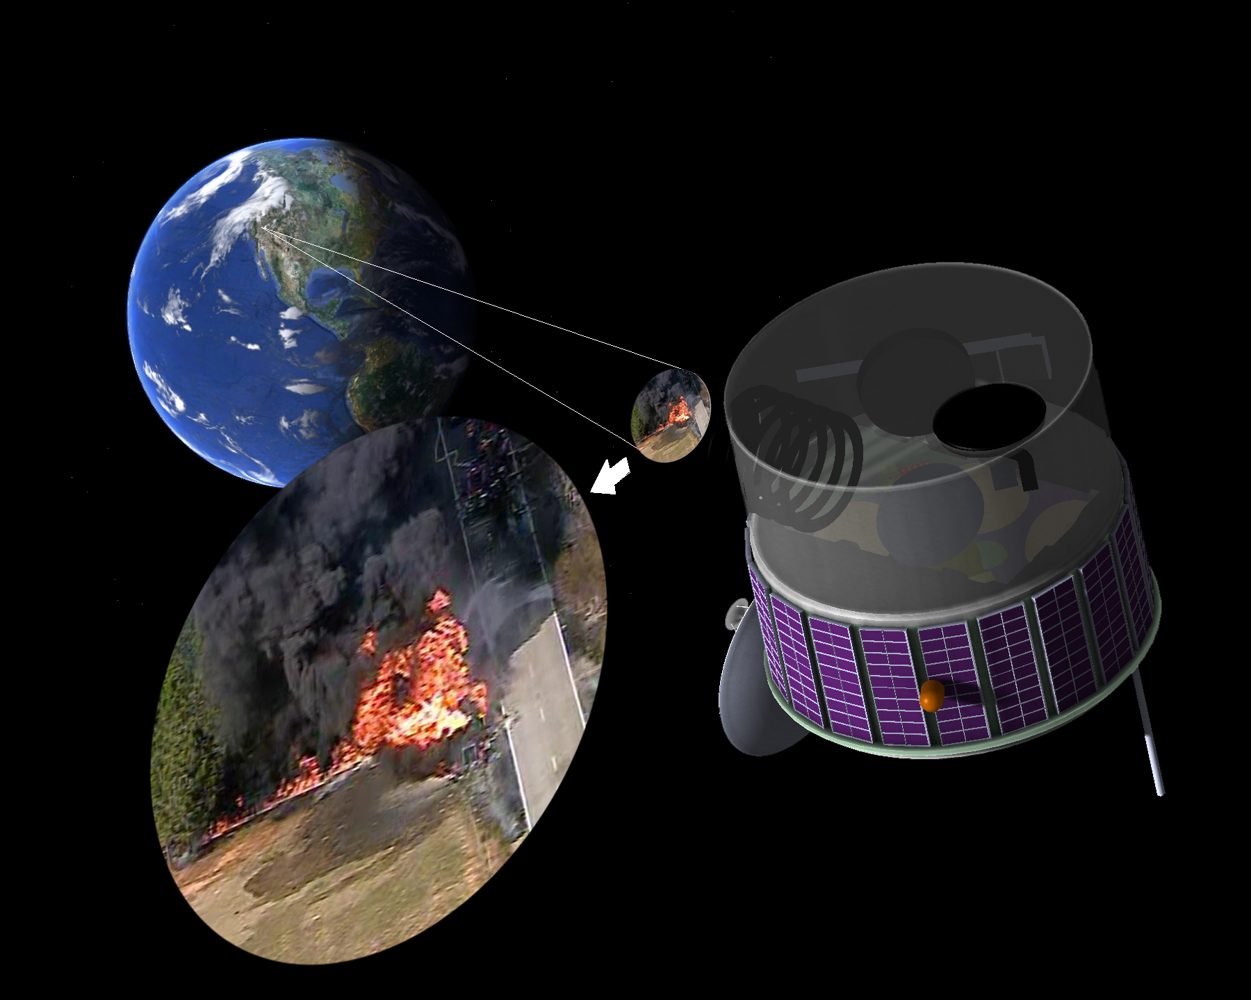
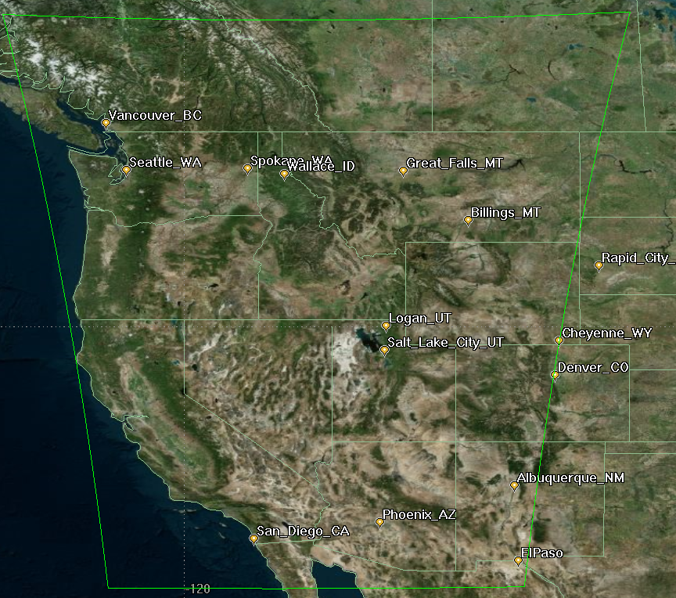
FUEGO – GEOSTATIONARY RATIONAL
Persistence is our business
Time from ignition to attack and evac. are crucial
Prioritization between fires is essential
Continuous automated monitoring from constant stare is indispensable (for both New & Existing)
Detection: ~1° K increase in (3.9 – 10.2 um) Brightness Temperature Difference over 296K background for 30 m² fire composed of 18 m² of flame at 1000°K & 12 m² 600K smoldering.
200 x smaller fire than GOES-R
Ground Sample Distance 550 meters
  Sub-pixel centroid location to approximately 100 meters
30 Second Cadence 10 times faster than GOES-R CONUS
3 integration times each capture => High Dynamic Range Image
Usable initial perimeter
Likely to see a spot fire half a mile ahead of the fire.
Cost Effective
    ROM = $250 M for 5 year operation, all-up
> 250 Million Hectares
$0.02 per thousand hectare/hour -- continuous

Slide 21
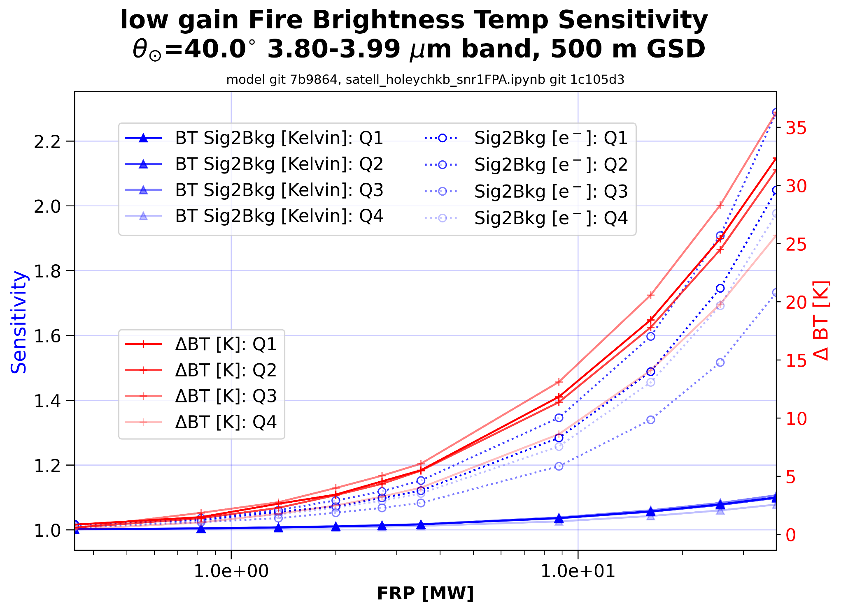

Slide 22
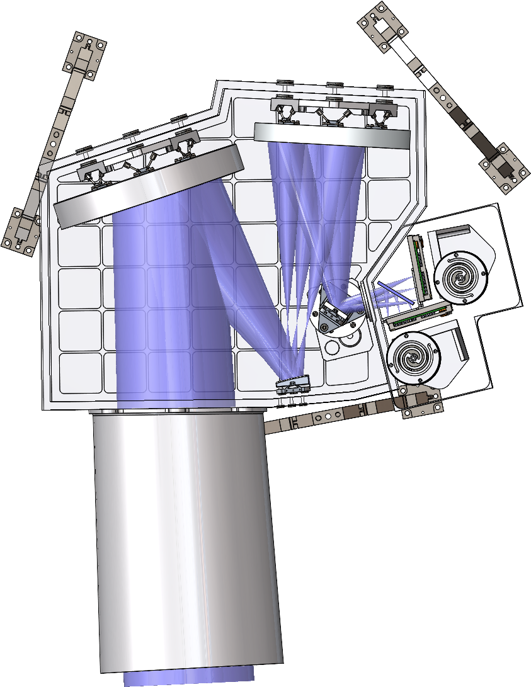
FUEGO – GEOSTATIONARY SPECS
Geo-stationary Free-Flyer Over Western US
> 220 Million hectare field of regard
Pointing Mirror: Field of Regard can be re-positioned
Bands: RGB, 3.9µm, 9.2µm
4K x 4K MCT Array, 10 micron pitch
Focal Length: 1000 mm (2.5 degree FOV)
Optics: f/4
Effective GSD: < 550 meters (dithered for BPR)
Array readable @ 100 Hz; planned read 0.5 Hz
Simple image processing & compression on-board
Transmit cadence: Every 30 Seconds -- 40 Mb/S or less
All-up ROM for 5 year operation: $250M
3 reads every 10 seconds: 10, 5, 2.5 millisecond integrations

