Slide 1
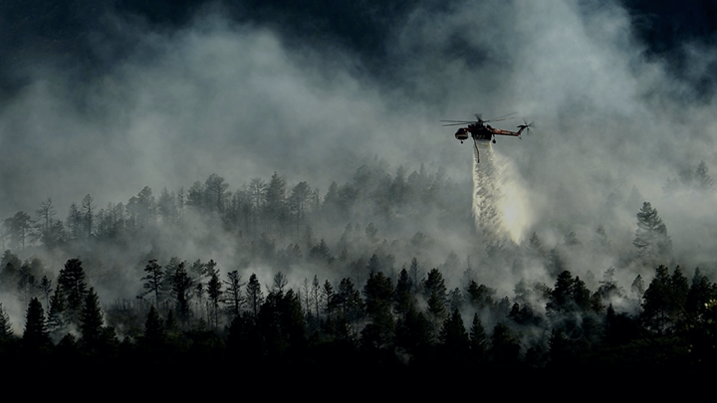
Beacon: A machine learning system for real-time wildfire planning at scale
December 2, 2021
Contact: anshu@hangar.is
PROPRIETARY & CONFIDENTIAL - CORNEA

Slide 2
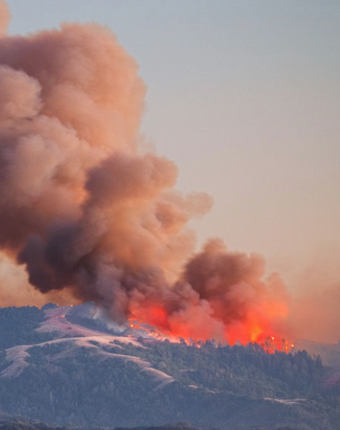
Beacon expands on previous scientific research to provide and improve on machine learning models for wildfire spread and control at scale.
PROPRIETARY & CONFIDENTIAL - CORNEA

Slide 3
Overview of the academic research for SDIs and PCLs
Suppression Difficulty Index (SDI) weighs simulated fire behavior against possible suppression activities
Introduced in Silva et al. 2014
Composite index based on expert-informed translations of land/geo details to measures for risk and suppression
Fire Risk determined by energy behavior models
Suppression activities determined by accessibility, fireline production rate, etc.
Validated on large fires in Spain, Chile, Israel and the US
Potential Control Lines (PCLs) predict likely fire control lines as determined by supervised models
Introduced in O’Connor et al. 2017
Model: Boosted regression tree
Predictors: Geo/Topography primary data (elevation, slope, aspect, fuel, vegetation, etc.) plus several composite indexes (fireline construction difficulty, travel cost, rate of fire spread, SDI)
Evaluation Data:
34,000 km2 region in the Rocky’s covering 238 historical large fires from the Monitoring Trends in Burn Severity Database
1.5M points samples from this are of which 200K were control lines
Validation Results: 69% AUC via 10-fold cross validation
PROPRIETARY & CONFIDENTIAL - CORNEA

Slide 4
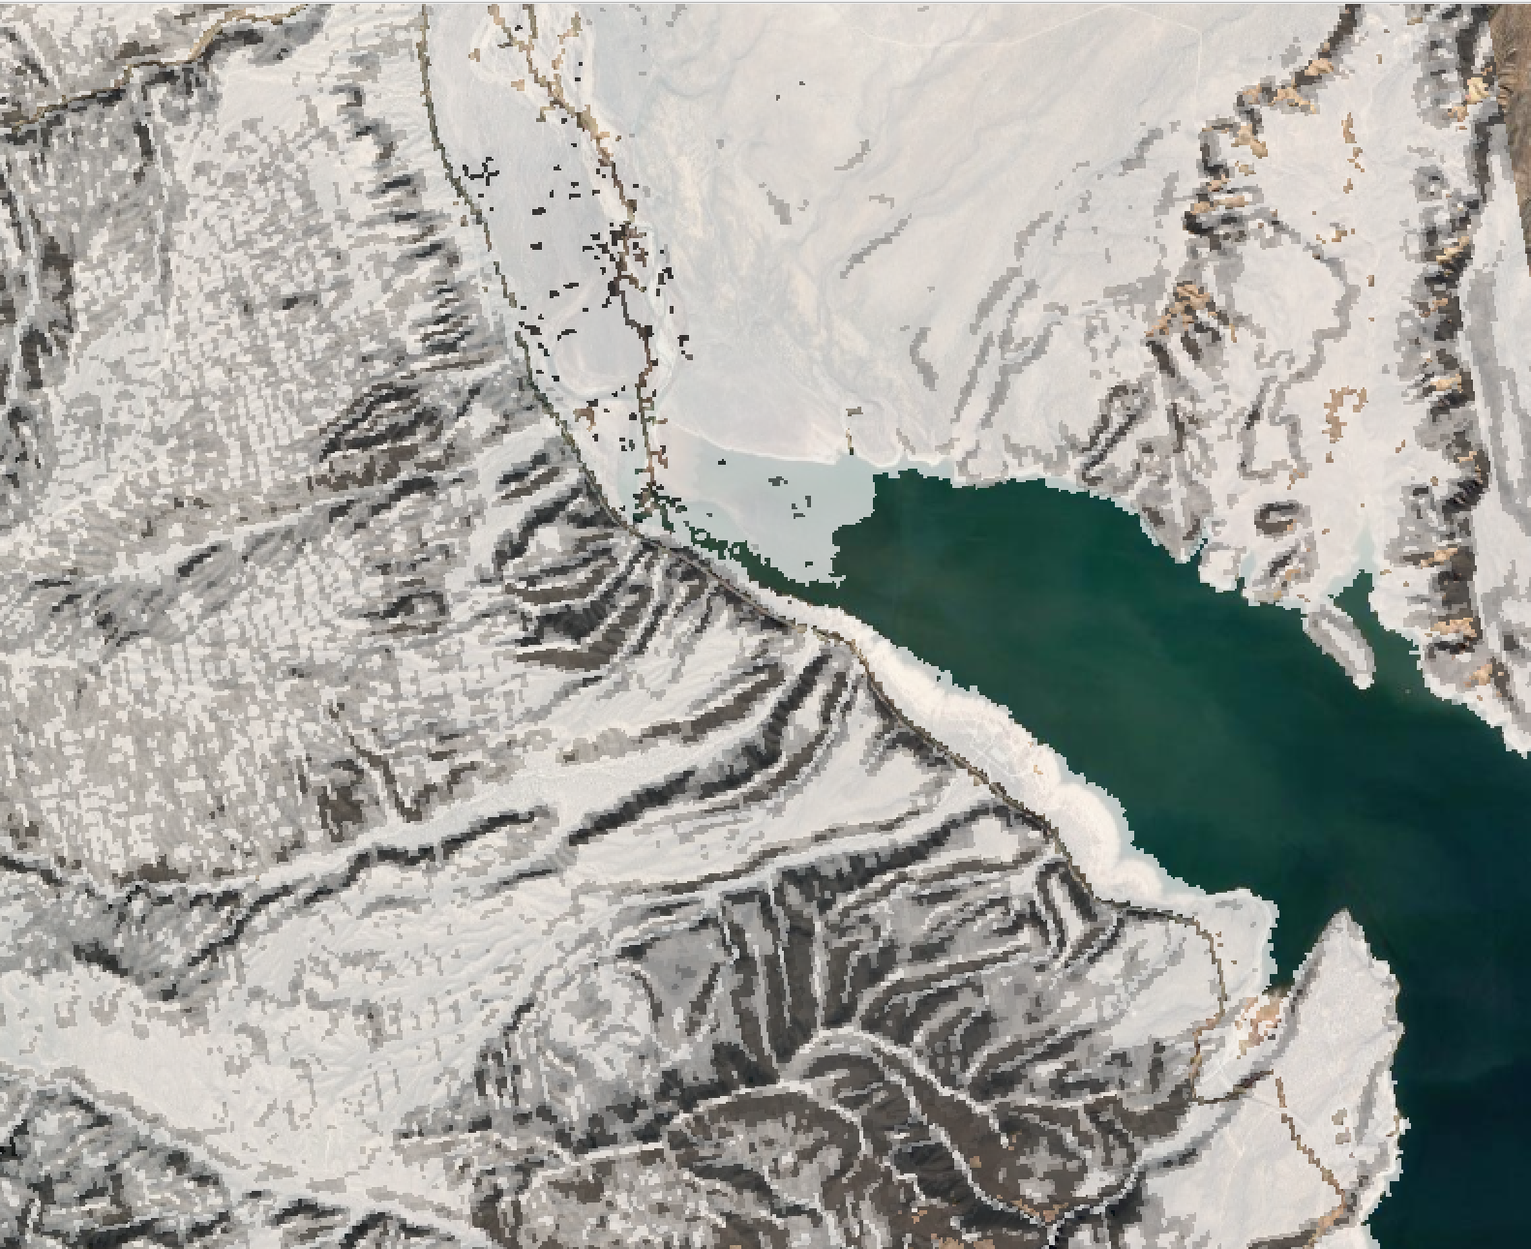
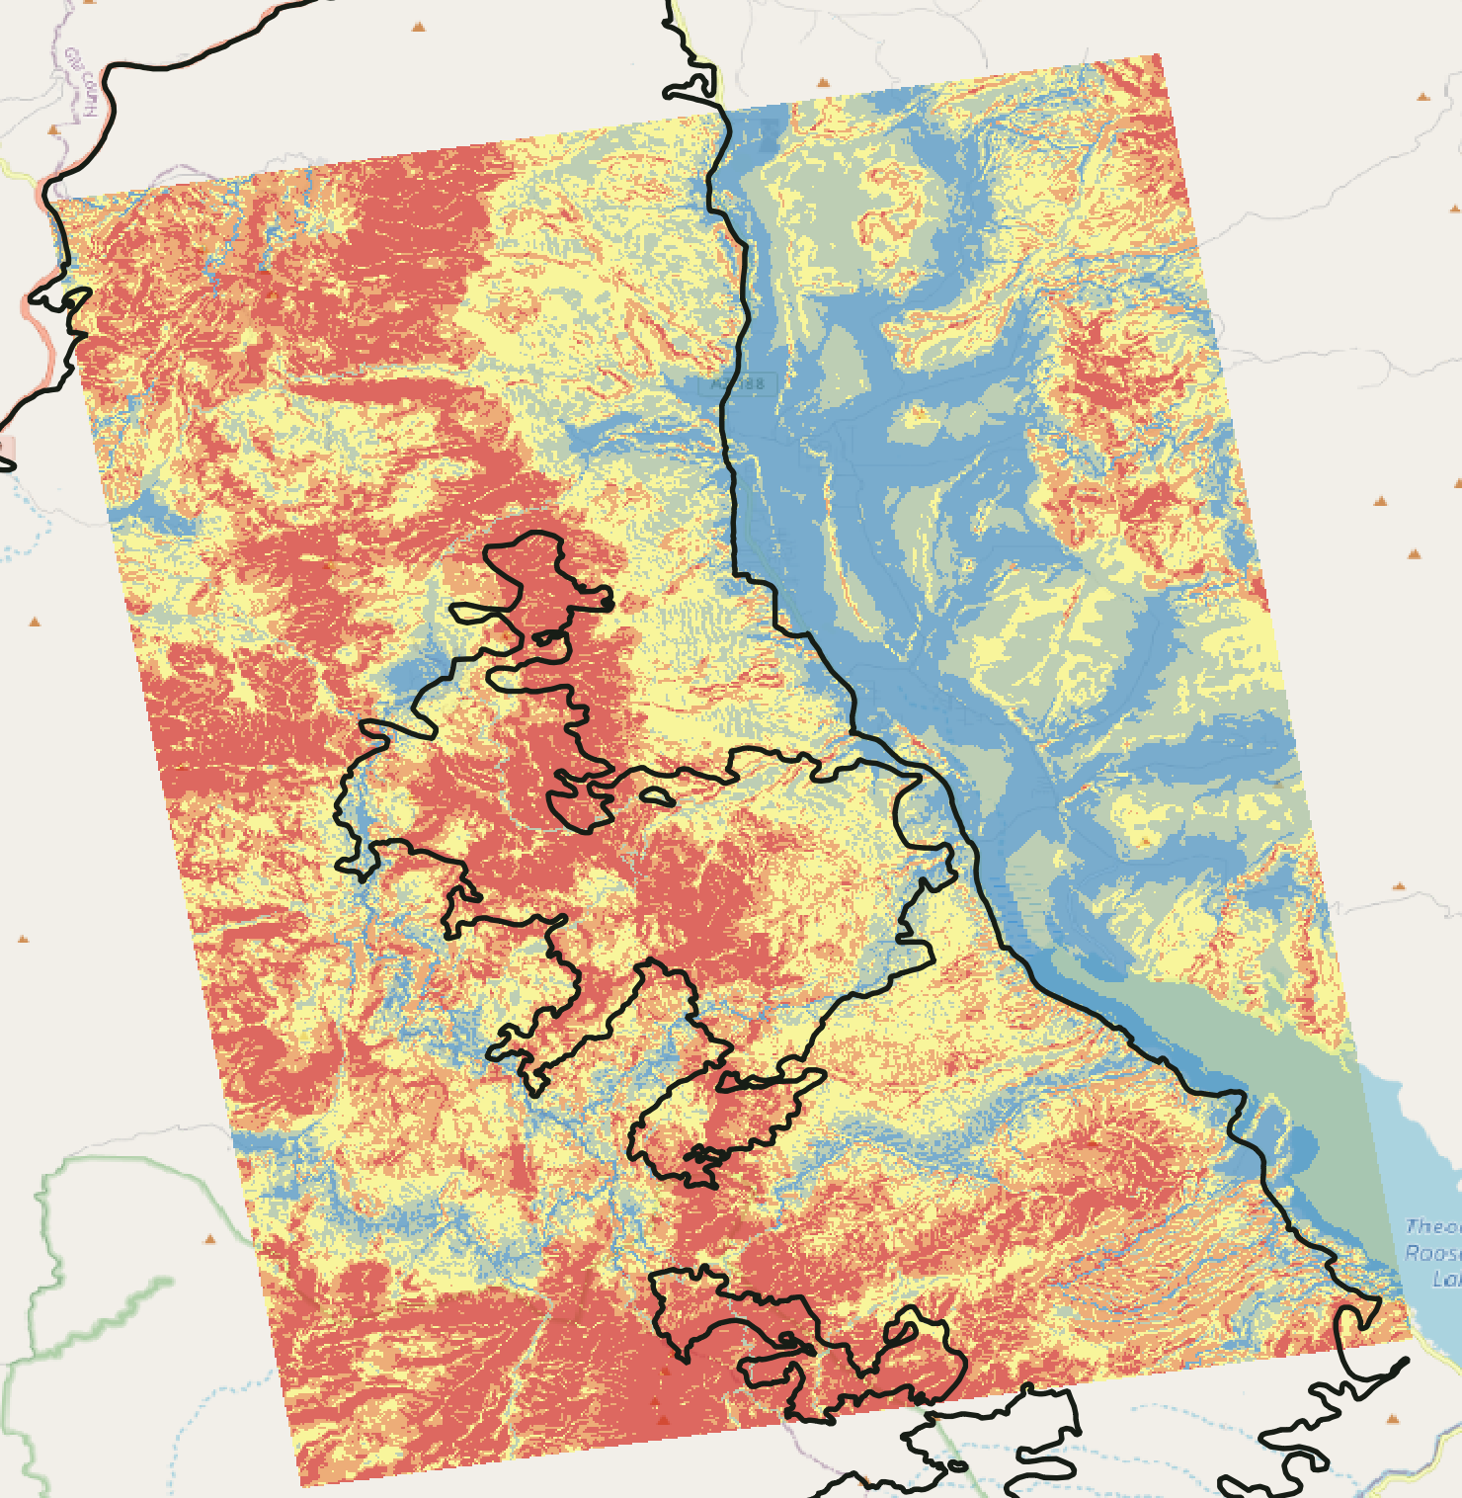
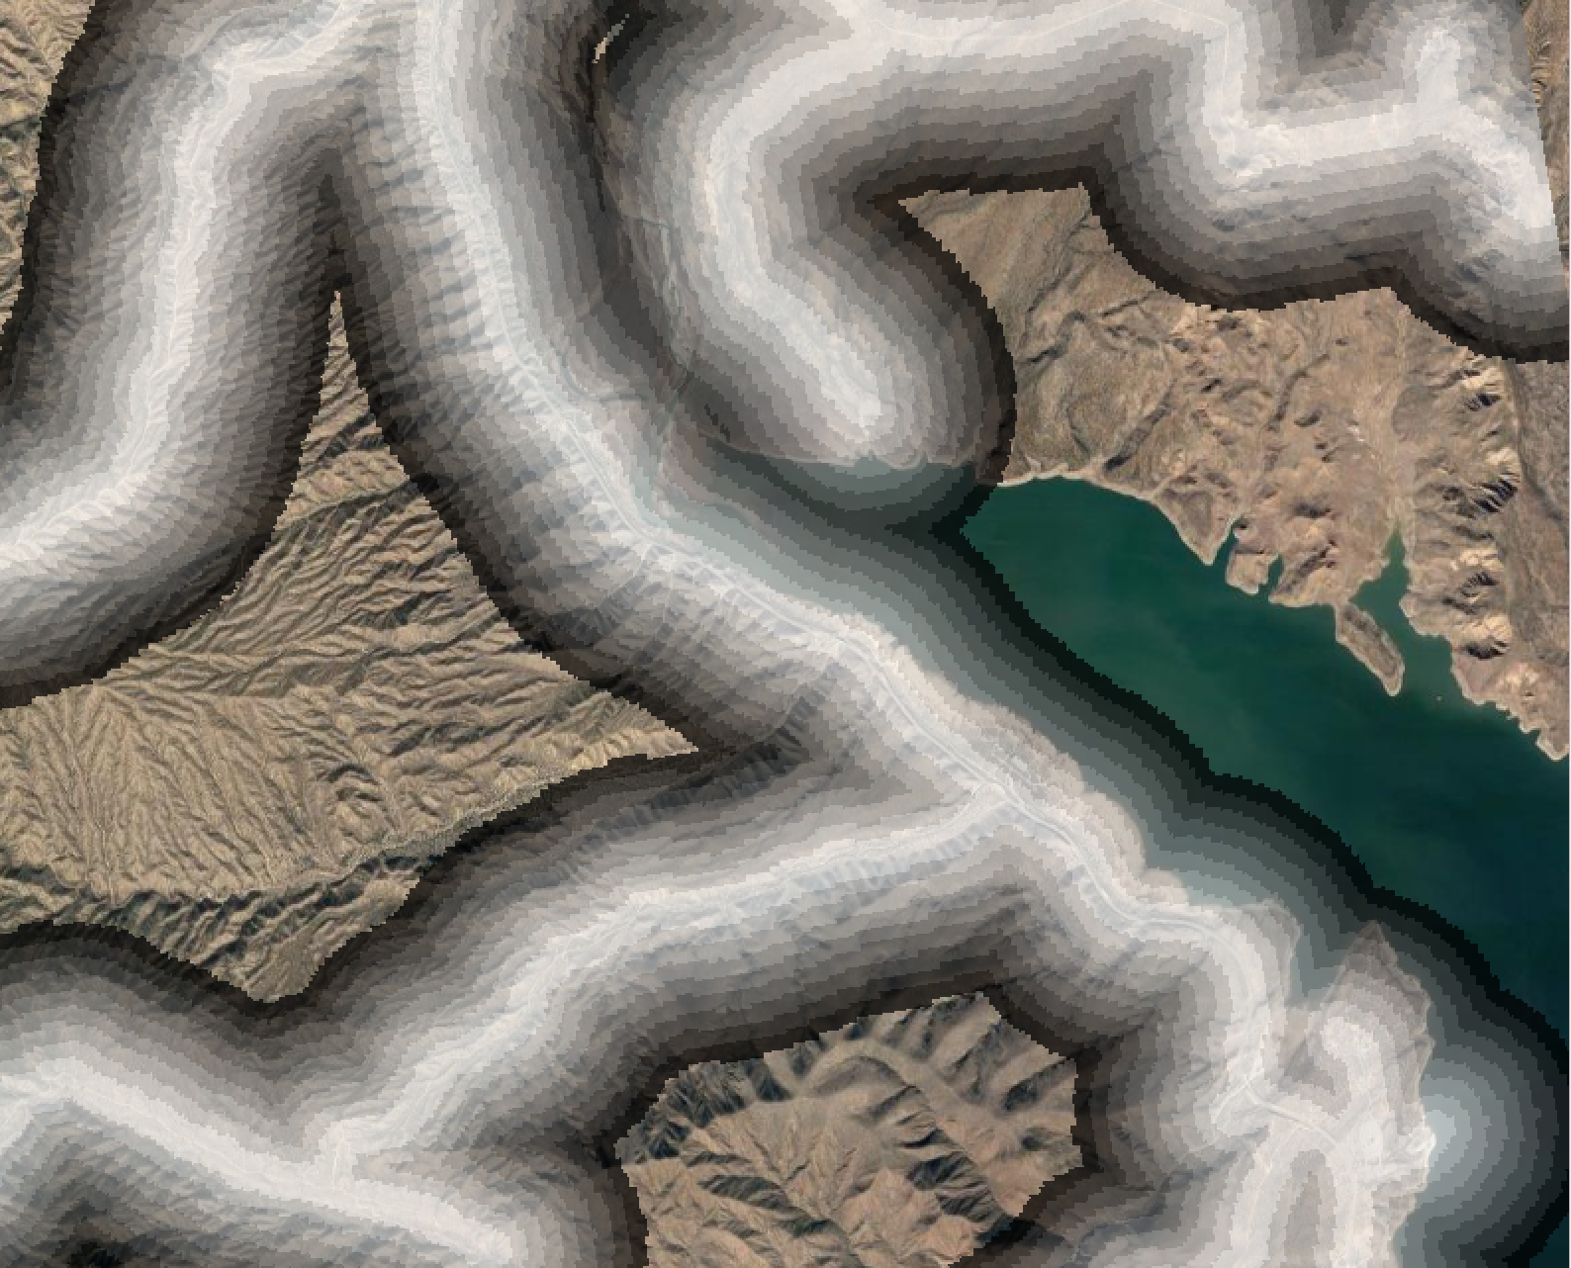
SDIs and PCLs for enhanced operational planning
Cornea model outputs and overlaid Bush Firelines
Real-time operational fire management
Onboarding, especially for non-local IMTs
Strategy confirmation to deploy fuel treatments, firelines, etc.
Pre fire season planning
Effective positioning of resources to dampen time pressures and expand options
Identification of locations with high risk to firefighter safety
Potential usage for fuels treatment projects
Fireline Opening
Accessibility
PROPRIETARY & CONFIDENTIAL - CORNEA

Slide 5
Understanding the need for a scalable platform
Data Storage: Gigabytes of data are needed for each SDI/PCL generation process, which often must be customized to individual fires.
Throughput & Latency: Generating outputs real-time was a slow process that, prior to now, made its use impractical in the field, especially at scale with a given fire and considering the need for parallelization.
Reproducibility: There is still a need within the community for better and more standard tools to capture audit trail and versioning info.
Algorithm Tuning & Iteration: Addressing all of the above will allow quicker iteration and improvement on these algorithms.
PROPRIETARY & CONFIDENTIAL - CORNEA

Slide 6
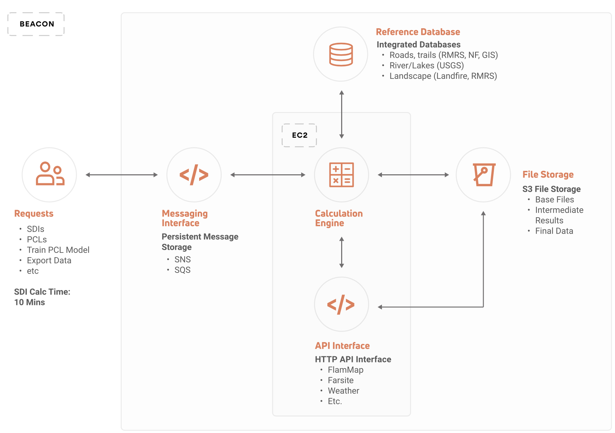
Scalable Machine Learning Architecture
SNS/SQS for logging & fault tolerance
Reference DB for data and transactions
S3 file storage for terabytes of data
EC2-based calculation engine for real-time CPU scaling
API interface for real-time data
PROPRIETARY & CONFIDENTIAL - CORNEA

Slide 7
Generalizable Machine Learning Pipeline
Cornea aggregates data, customizes for a need, and then deploys for collaboration and planning
Terabytes of
Data Aggregation
- Roads, Trails (RMRS)
- Rivers, Lakes (USGS)
- Weather (NOAA)
- Landscape (Landfire, RMRS)
- Fuels
- Fire Activity / History
- Satellite, Sensor data & more!
Customizable & Modular
Feature Engineering
- Energy Behavior
- Rate of Spread
- Accessibility
- Penetrability
- Travel Cost
- And more!
Generalizable ML Model Development & Deployment
- Standard ML models (Regression, RF, XGBoost, Deep Learning, etc.)
- Hyperparameter tuning
- Evaluation data framework
- Champion-challenger
- Real-time results at scale
PROPRIETARY & CONFIDENTIAL - CORNEA

Slide 8
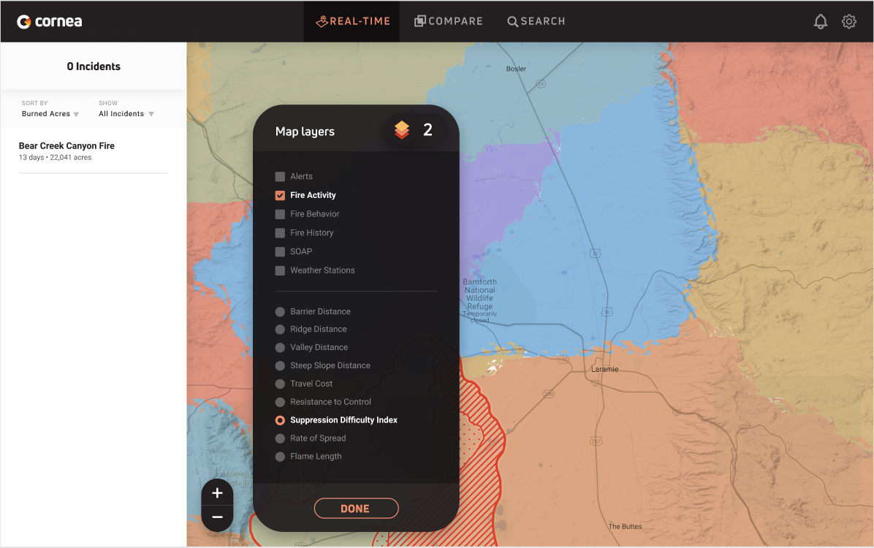
Advanced tooling includes customizable data for detailed situational awareness.
PROPRIETARY & CONFIDENTIAL - CORNEA

Slide 9
What’s next for Beacon...
Iterate on algorithm accuracy via improved input data for real-time data for weather, topography, fuels, etc. - we’re looking for relevant remote sensing and satellite data!
Enhance algorithm generalizability through expanded evaluation data.
Develop capability to run simulation studies via the Beacon platform.
Create a turnkey ETL pipeline for a centralized data source and real-time ingest.
Enable public and private sector users to make informed decisions based on customizable outputs from Beacon
Reinforce the value of scientific data to the general public, Congress, and agencies
PROPRIETARY & CONFIDENTIAL - CORNEA
Notes:
Value add to NASA + using NASA data in Beacon + any additional use cases for NASA to be interested and invest in Cornea

Slide 10
The Team
Margot Preuss
CEO
Jennifer Miller
Strategy
Anshu Sinha
Data Science
Madiha Shaikh
Product Manager
Chris Martin
Engineering
Amar Yashlaha
Engineering
Jeremy Hirschhorn
Operations
Scott Cameron
Strategy
PROPRIETARY & CONFIDENTIAL - CORNEA

Slide 11
Thank You!
PROPRIETARY & CONFIDENTIAL - CORNEA

