Slide 1
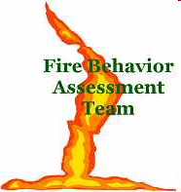

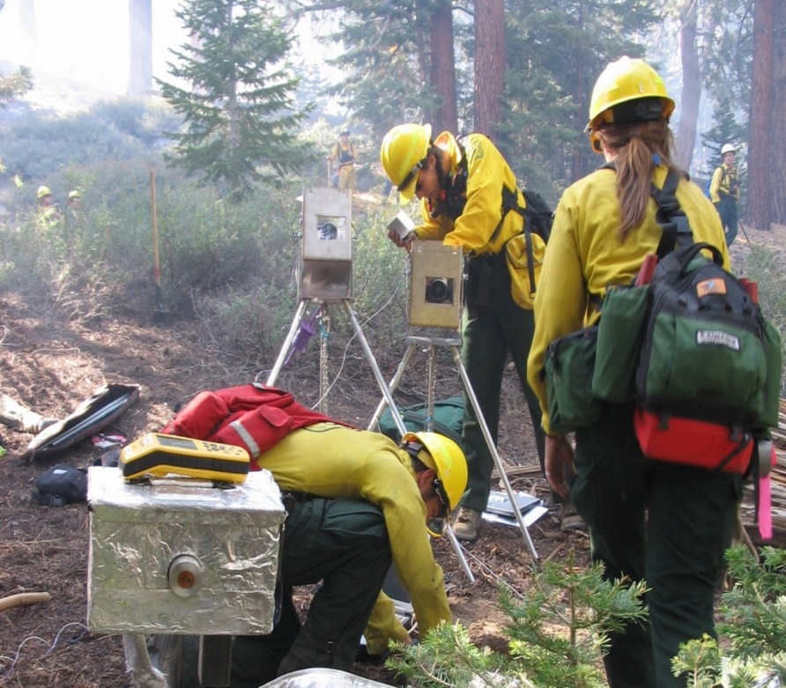
Fire Behavior Assessment Team ‐ ground measurements on wildfires and opportunities for remote sensing
Matthew Dickinson
FBAT Program Manager & Research Ecologist
USFS Northern Research Station
Shout out to:
Joseph Cooper – Post-Doc, Michigan State Univ.
Carol Ewell – FBAT Asst. Lead & Fire Planner, Stanislaus National Forest
Scott Dailey – Ecologist, USFS Enterprise Program
Ali Reiner – Fire Ecologist & past FBAT Lead, USFS Enterprise Program
Many other On-Call FBAT members & collaborators

Slide 2
Background

Slide 3
FBAT mission
Work with fire and land managers and other stakeholders to:
Improve knowledge about relationships among fuels, fire behavior, and fire effects
Support application of that knowledge to fire and land management
Promote firefighter safety and public understanding
…for current and future generations.
Notes:
FBAT is a unique module that measures pre- and post-fire fuels and vegetation, active fire behavior (with in-fire sensors), and fire effects on active wildland fires.
FBAT mission: To support wildland fire operations and land management through applied science measurements and information delivery
Goals and objectives can apply to IMT, local unit, regional or national goals.
Past objectives:
Directly measuring fuel treatment effectiveness
Measuring fire behavior and effects and their relationship to pre-fire fuels, fire history and treatments
Build a dataset useful for calibration of consumption, smoke/emissions production and fire behavior models
Supply data and video useful for improving firefighter safety & public outreach
On-call member system, not IMT or module
Ordered in ROSS as name requests
Bonus = don’t need funding for a module
Drawback = people get busy and take other assignments, hard on leaders/core memters to continually train new members

Slide 4
Value proposition
Work within the incident command system to collect coordinated pre-, active-, and post-fire measurements of fuels, fire behavior, and fire effects on wildfires
…to achieve the mission
Pre-fire Active-fire Post-fire
Notes:
FBAT is a unique module that measures pre- and post-fire fuels and vegetation, active fire behavior (with in-fire sensors), and fire effects on active wildland fires.
FBAT value proposition:To support wildland fire operations and land management through applied science measurements and information delivery

Slide 5
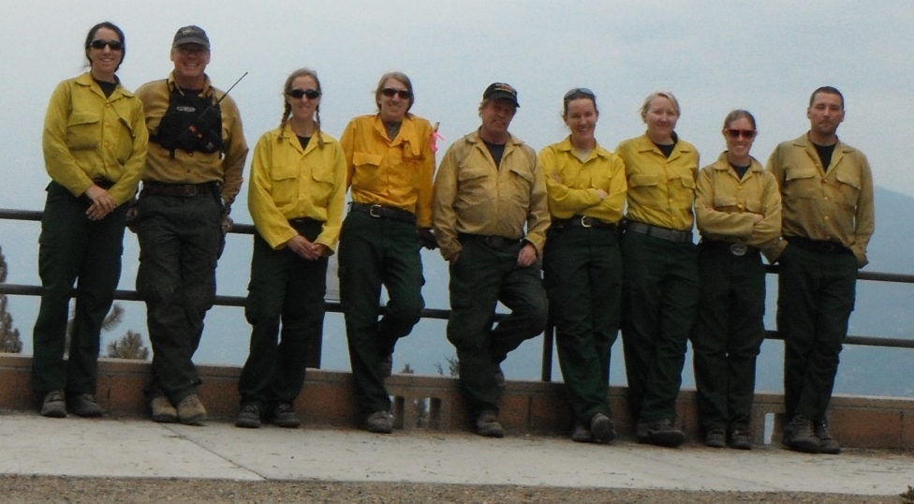
What is FBAT?
A unique module:
On-call module of experienced land management, fire operations, and research staff who are dedicated to the FBAT mission
Ordered in the Incient Resource Ordering Capability (IROC) as name requests
FBAT is collateral duty
Notes:
FBAT is a unique module that measures pre- and post-fire fuels and vegetation, active fire behavior (with in-fire sensors), and fire effects on active wildland fires.
FBAT mission: To support wildland fire operations and land management through applied science measurements and information delivery
Goals and objectives can apply to IMT, local unit, regional or national goals.
Past objectives:
Directly measuring fuel treatment effectiveness
Measuring fire behavior and effects and their relationship to pre-fire fuels, fire history and treatments
Build a dataset useful for calibration of consumption, smoke/emissions production and fire behavior models
Supply data and video useful for improving firefighter safety & public outreach
On-call member system, not IMT or module
Ordered in ROSS as name requests
Bonus = don’t need funding for a module
Drawback = people get busy and take other assignments, hard on leaders/core memters to continually train new members

Slide 6
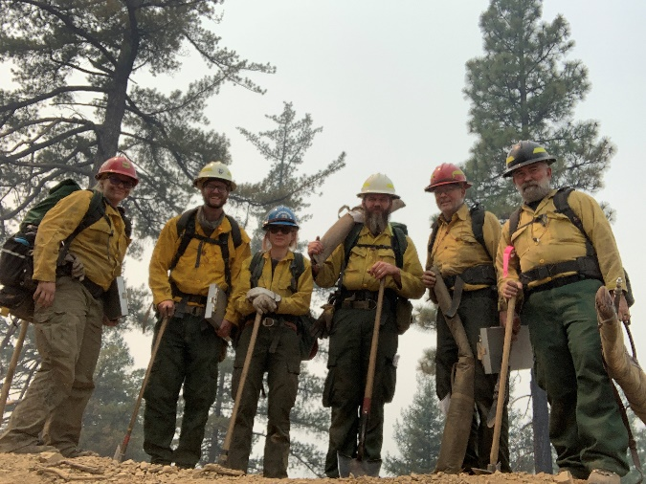


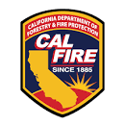


FBAT history & support
Established by AMSET (Enterprise Program) staff ~ 2002
On assignment - incidents support travel and time
Between assignments
  Grants: JFSP, CAL FIRE, USDA
  Internal funding: AMSET, NFS and FAM (esp. Region 5), NRS
  Staff time: On-Callers, Research Data Archive, Enterprise Program
  Stanislaus NF hosts gear and vehicle
  University collaboration (MSU, UNR)

Slide 7
Operations & methods

Slide 8
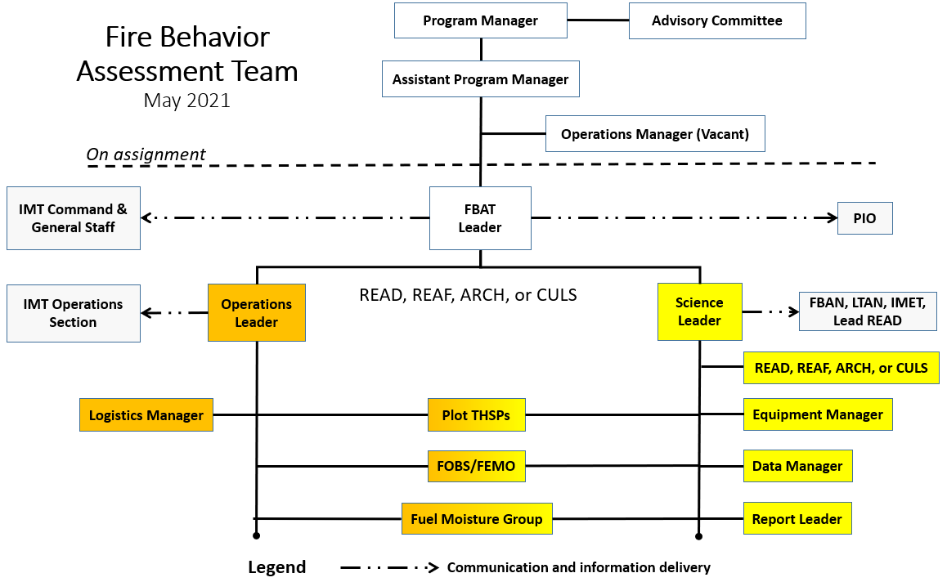
Team organization
Notes:
FBAT is a unique module that measures pre- and post-fire fuels and vegetation, active fire behavior (with in-fire sensors), and fire effects on active wildland fires.
FBAT mission: To support wildland fire operations and land management through applied science measurements and information delivery
Goals and objectives can apply to IMT, local unit, regional or national goals.
Past objectives:
Directly measuring fuel treatment effectiveness
Measuring fire behavior and effects and their relationship to pre-fire fuels, fire history and treatments
Build a dataset useful for calibration of consumption, smoke/emissions production and fire behavior models
Supply data and video useful for improving firefighter safety & public outreach
On-call member system, not IMT or module
Ordered in ROSS as name requests
Bonus = don’t need funding for a module
Drawback = people get busy and take other assignments, hard on leaders/core memters to continually train new members

Slide 9
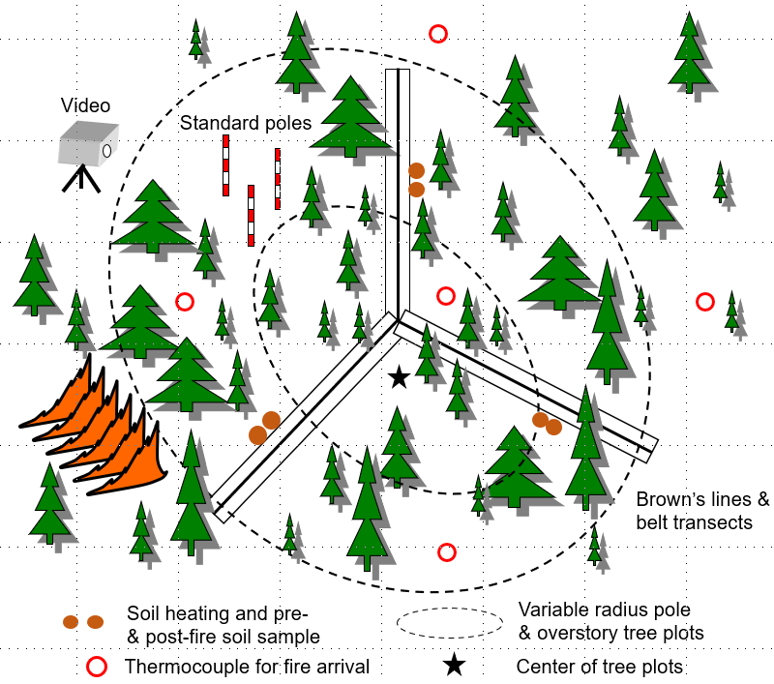
Core methods
Adding:
3D fuels and vegetation mapping from TLS, GoPro, and UAS
Severity measurements from UAS
Notes:
FBAT is a unique module that measures pre- and post-fire fuels and vegetation, active fire behavior (with in-fire sensors), and fire effects on active wildland fires.
FBAT mission: To support wildland fire operations and land management through applied science measurements and information delivery
Goals and objectives can apply to IMT, local unit, regional or national goals.
Past objectives:
Directly measuring fuel treatment effectiveness
Measuring fire behavior and effects and their relationship to pre-fire fuels, fire history and treatments
Build a dataset useful for calibration of consumption, smoke/emissions production and fire behavior models
Supply data and video useful for improving firefighter safety & public outreach
On-call member system, not IMT or module
Ordered in ROSS as name requests
Bonus = don’t need funding for a module
Drawback = people get busy and take other assignments, hard on leaders/core memters to continually train new members

Slide 10
Deep experience
237 plots sampled on 28 fires plus special projects
Arizona
Warm Fire 2006
California
Crag Fire 2005
Bar Complex 2006
Orleans Complex 2006
Ralston Fire 2006
Antelope Complex 2007
Clover Fire 2008
Lion Fire 2011
Aspen Fire 2013
Rim Fire 2013
Beaver Fire 2014
French Fire 2014
King Fire 2014
Rough Fire 2015
Willow Fire 2015
Cedar Fire 2016
California, continued
Cedar Fire 2016
Slate Fire 2016
Pier Fire 2017
Ferguson Fire 2018
Walker Fire 2019
Red Salmon Complex 2020
River Complex 2021
Florida/Georgia
Georgia Bay Complex 2007
Idaho
Blackerby Fire 2005
Montana
Black Mountain II Fire 2003
Robert Fire 2003
Wyoming
Tatanka Complex 2016
Notes:
FBAT is a unique module that measures pre- and post-fire fuels and vegetation, active fire behavior (with in-fire sensors), and fire effects on active wildland fires.
FBAT mission: To support wildland fire operations and land management through applied science measurements and information delivery
Goals and objectives can apply to IMT, local unit, regional or national goals.
Past objectives:
Directly measuring fuel treatment effectiveness
Measuring fire behavior and effects and their relationship to pre-fire fuels, fire history and treatments
Build a dataset useful for calibration of consumption, smoke/emissions production and fire behavior models
Supply data and video useful for improving firefighter safety & public outreach
On-call member system, not IMT or module
Ordered in ROSS as name requests
Bonus = don’t need funding for a module
Drawback = people get busy and take other assignments, hard on leaders/core memters to continually train new members

Slide 11
Program delivery

Slide 12
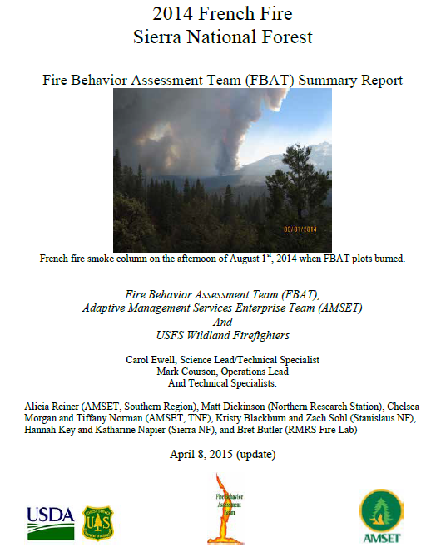
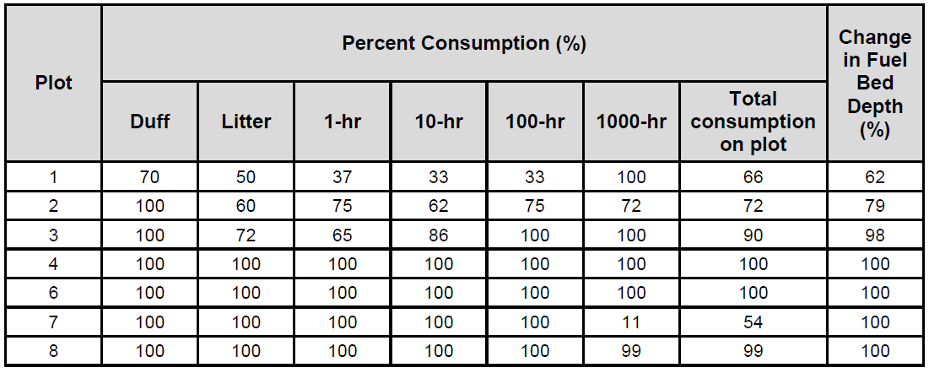
Incident & unit support
Delivers information:
Situational awareness for FBANs, LTANs, IMETs, ARAs (always looking for how to improve)
Summary report delivered to units after each assignment

Slide 13
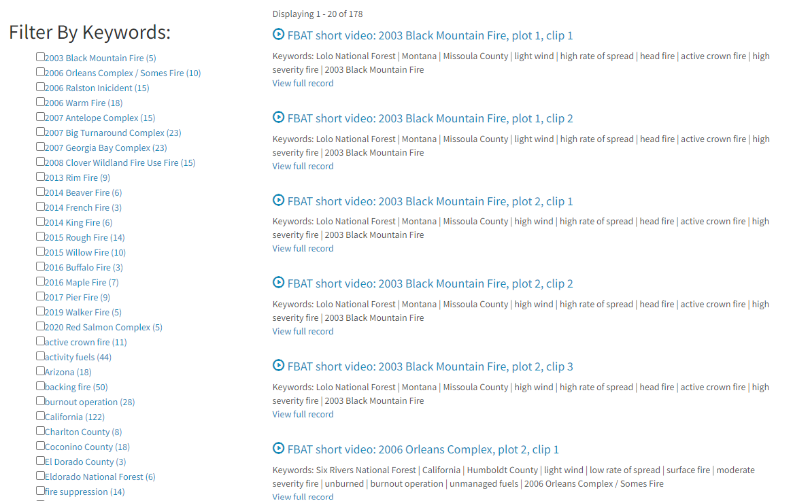
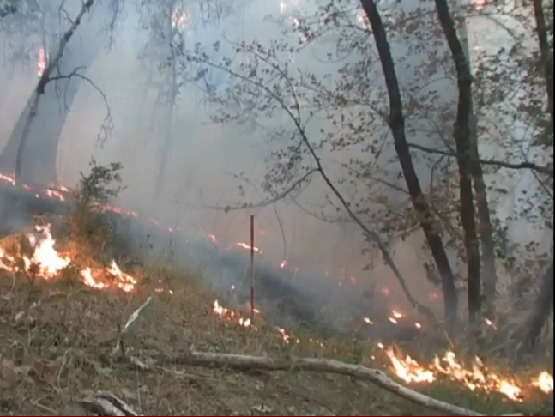
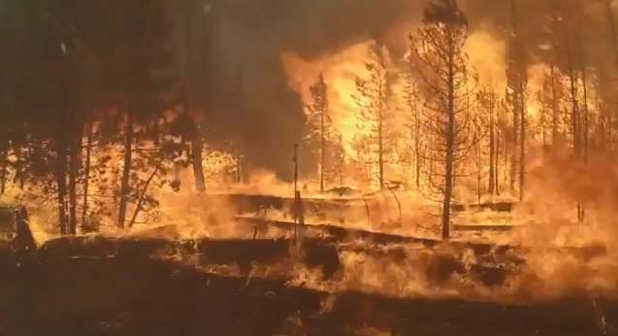
Information delivery for training and outreach
Videos and other information for firefighter training & public outreach (Scott Dailey)
https://www.frames.gov/fbat/fire-videos
Notes:
New archive of videos that you can search on by category
Used in lectures at Universities, used in fire training
We hope this will get a lot of use now that its fully available publicly in a searchable way
Scott Dailey shout out

Slide 14
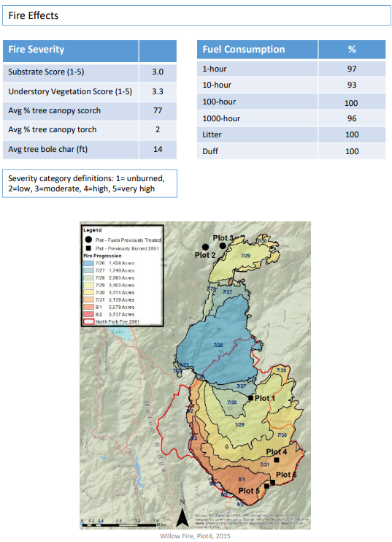
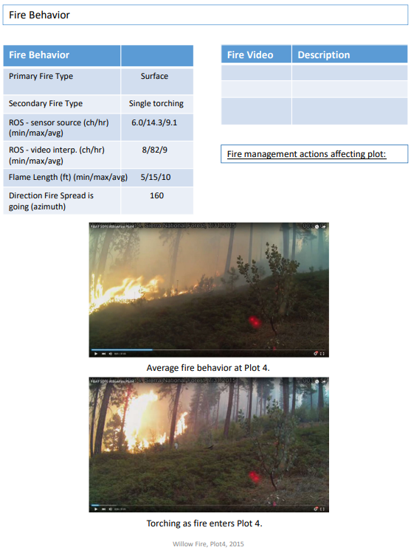
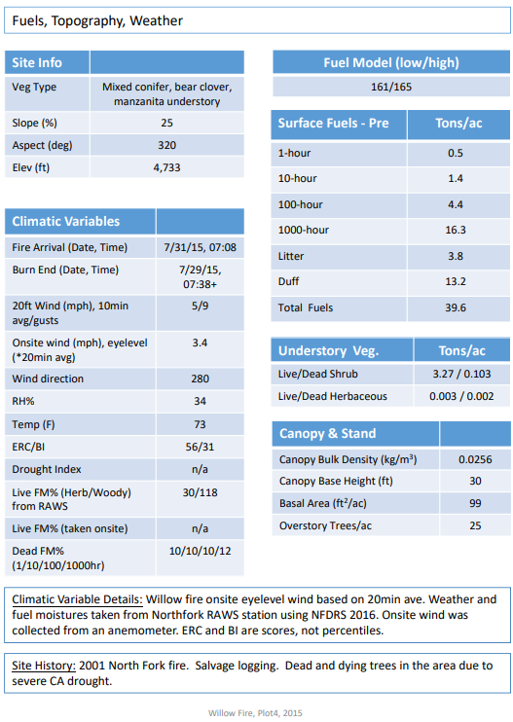
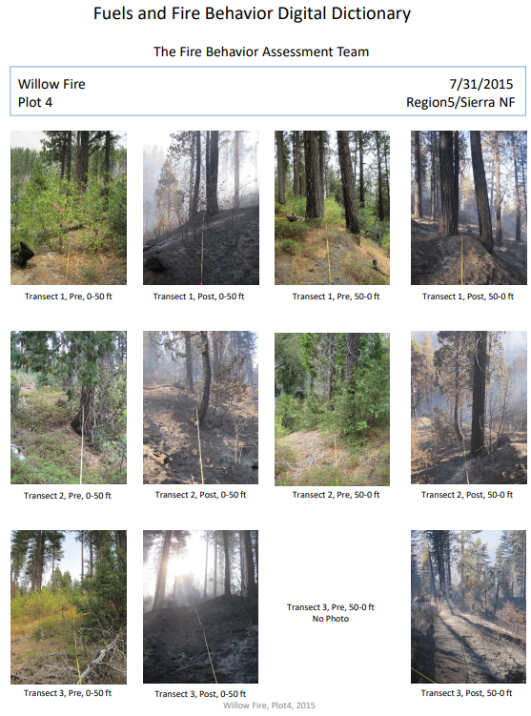
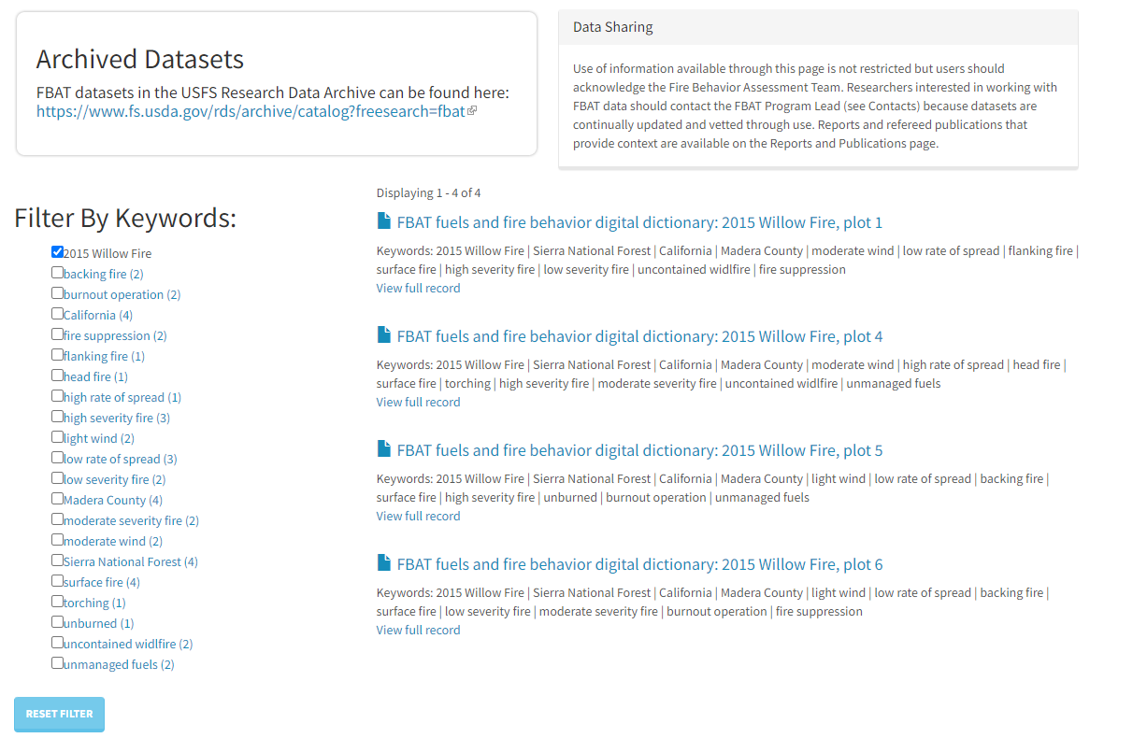
Information for training and outreach
Digital Fire Dictionary entries for plots with complete data (Ali Reiner & Scott Dailey)
https://www.frames.gov/fbat/datasets-and-summaries
Notes:
Special project, looking to get this onto EGP

Slide 15
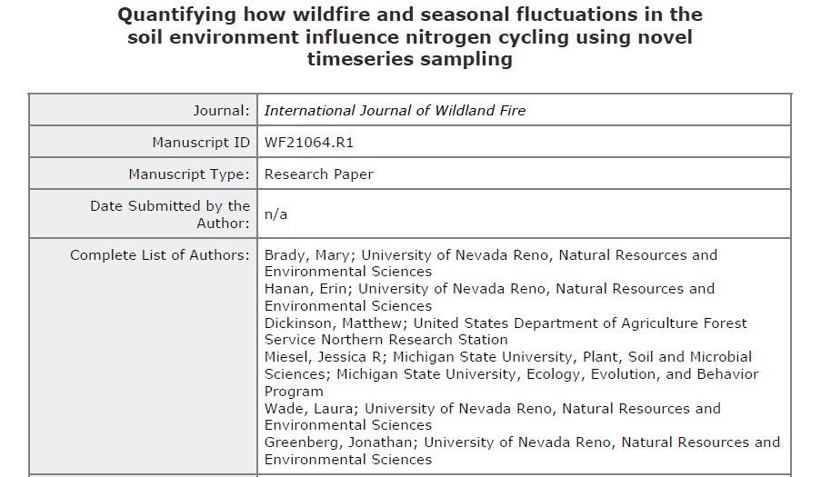
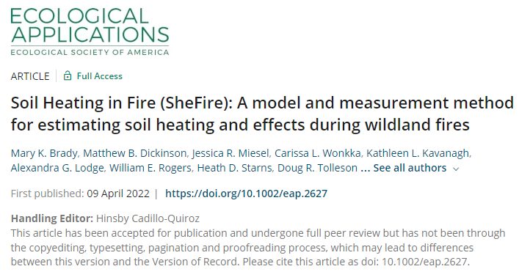
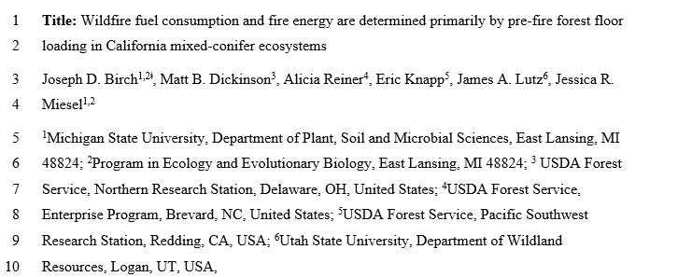
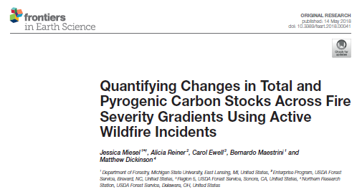
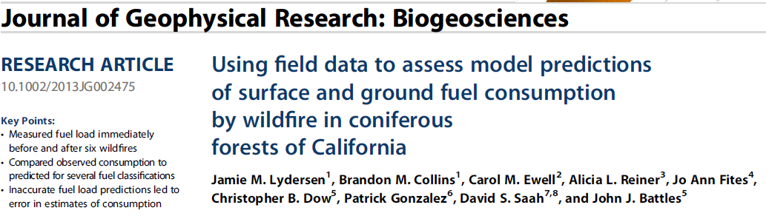
Full cycle of research
Supports applied and basic science:
Database development (USFS RDA)
Support publication of refereed papers uniquely focused on wildfires
Notes:
Others in the works by Joseph Cooper, postdoc at MSU

Slide 16
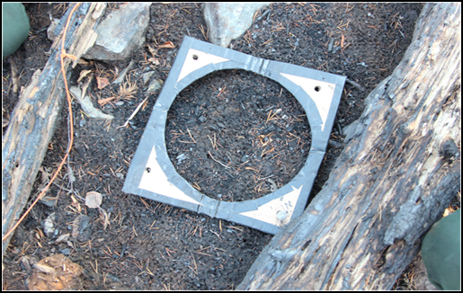
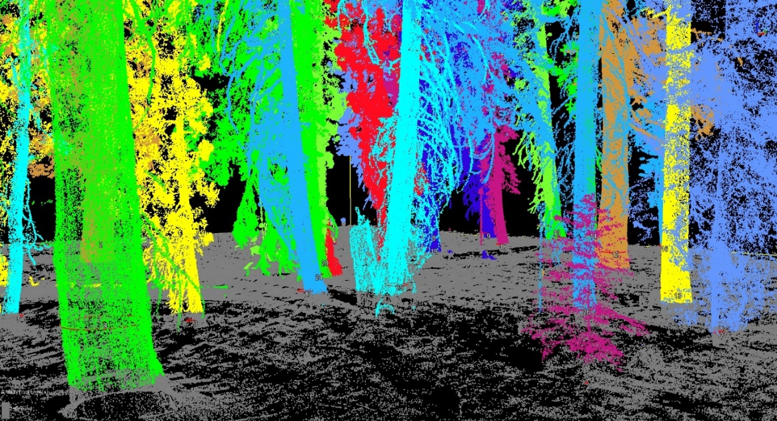
Add-on support for research
Supports researchers whose measurements add value to FBATs core dataset
Jessica Miesel (Michigan State University) & Erin Hanan (University of Nevada, Reno) - black carbon dynamics, microbial community impacts, soil health
Jonathan Greenberg (University of Nevada, Reno) – 3-D fuels and forest structure and fuel consumption
Notes:
FBAT is a unique module that measures pre- and post-fire fuels and vegetation, active fire behavior (with in-fire sensors), and fire effects on active wildland fires.
FBAT mission: To support wildland fire operations and land management through applied science measurements and information delivery
Goals and objectives can apply to IMT, local unit, regional or national goals.
Past objectives:
Directly measuring fuel treatment effectiveness
Measuring fire behavior and effects and their relationship to pre-fire fuels, fire history and treatments
Build a dataset useful for calibration of consumption, smoke/emissions production and fire behavior models
Supply data and video useful for improving firefighter safety & public outreach
On-call member system, not IMT or module
Ordered in ROSS as name requests
Bonus = don’t need funding for a module
Drawback = people get busy and take other assignments, hard on leaders/core memters to continually train new members

Slide 17
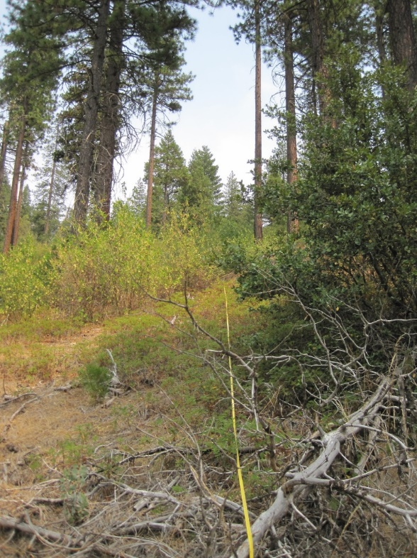
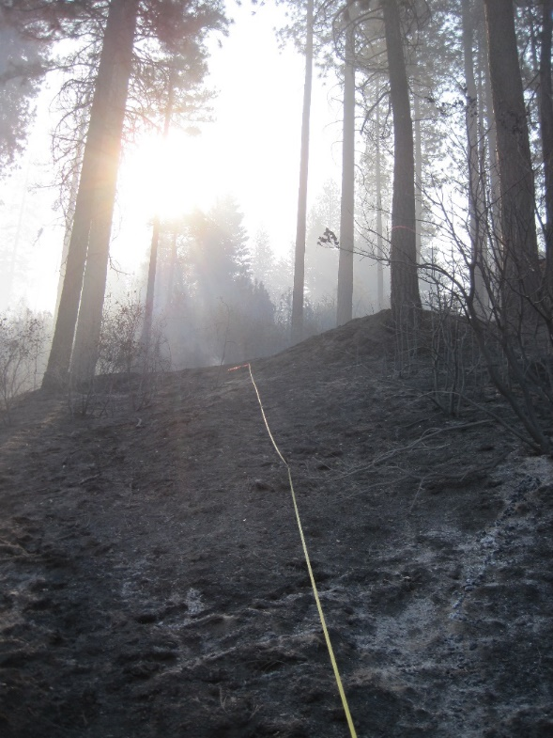
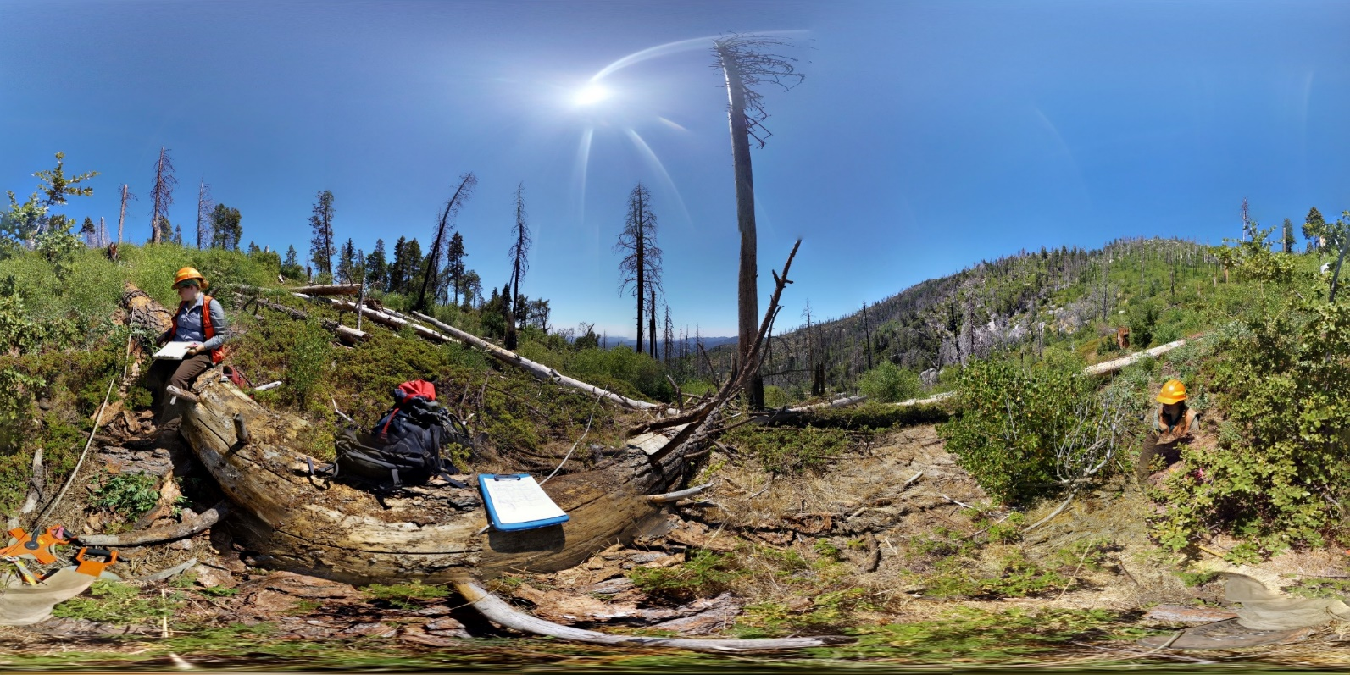
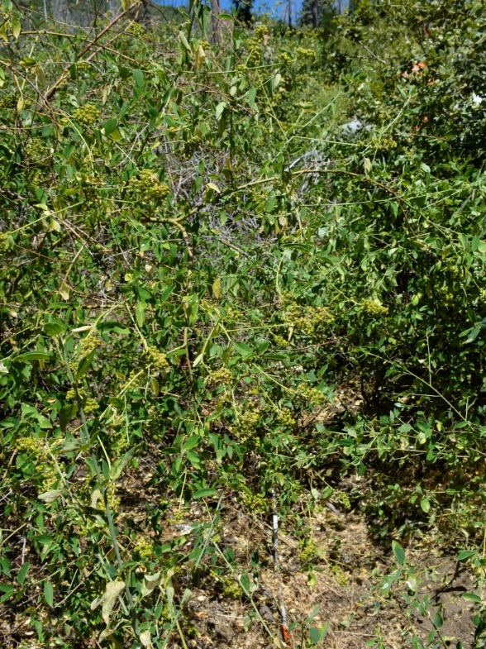
Pictures – Willow 4 (Moderate severity) – burned 2015
Plot re-measurement project (CAL FIRE)
Pre-fire
Post-fire
2021
FBAT data help explain what happened and why
Notes:
Plot that showed moderate severity in FBAT measurements but severe effects had developed after 6 years

Slide 18
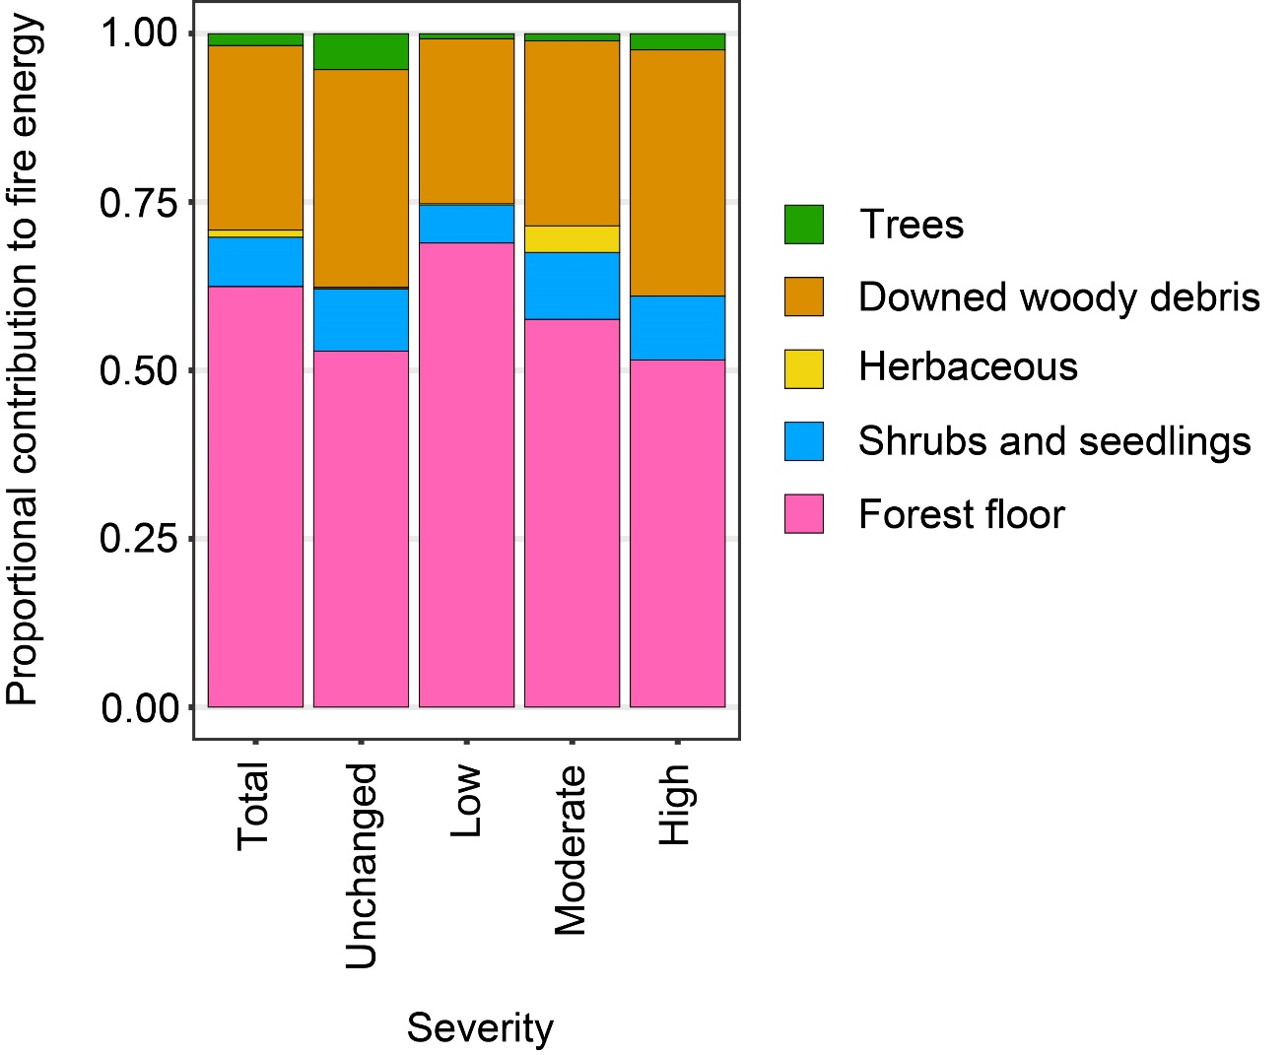
Contributors to fire energy
(proportional to consumption & emissions)
Consumption overall is driven by pre-fire:
Litter & duff
1000-hr + wood

Slide 19
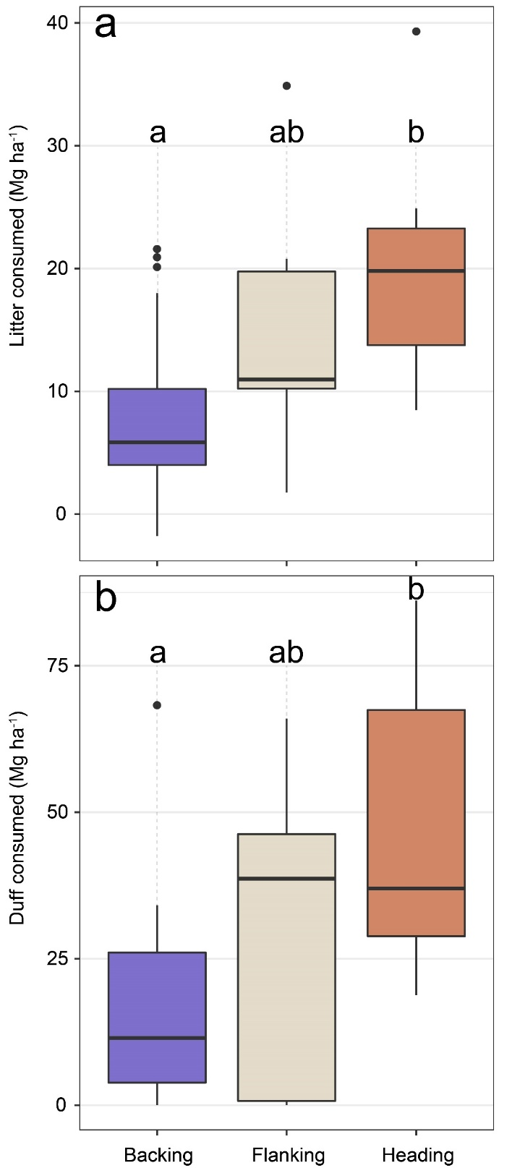

Heading fires consume more litter and duff than backing fires
Litter
Duff
Notes:
Not related to pre-fire loading, fuel moisture, or RH

Slide 20
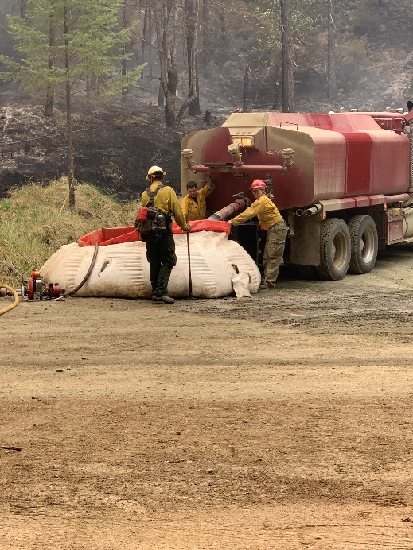
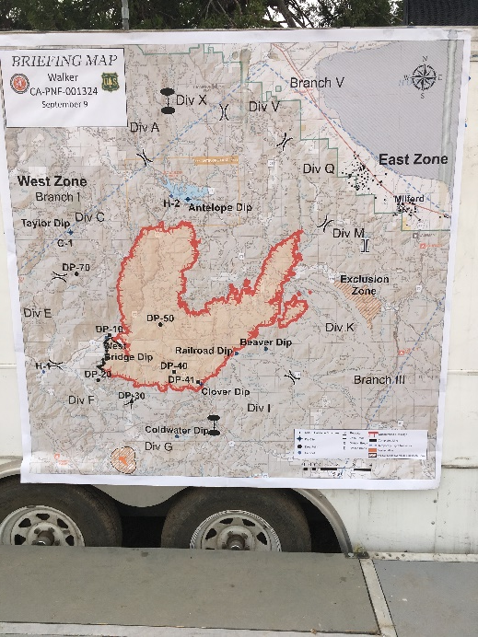
Remote sensing connections
Improving fire severity mapping and calibrated products (e.g., biomass loss, soil effects)
Ground calibration/evaluation data for fire-scale remote sensing
  Fire dynamics
  Suppression effectiveness
  Fuel treatment effectiveness
Support gathering of relevant tactical information on incidents that is otherwise lost to posterity
Questions?

