Slide 1
California Wind Dashboard & Decision Support
Kristen Allison – USFS Southern California Interagency Coordination Center – Predictive Services

Slide 2
Climate change, drought, and other environmental factors are exacerbating the wildfire risk in California and other western states.
In 2020, California had the second-highest number of wildfires of any state (10,488) and the highest number of acres burned (4,257,863).
Over the past decade (2011-2020), California had the highest number of wildfires of any state (84,025) and the second-highest number of acres burned (8,802,086), after Alaska.
Wildfire suppression costs in California have also been on the rise. In 2020, the total cost of wildfire suppression in California was over $1.6 billion, according to National Interagency Fire Center (NIFC) data.
Population continues to increase with continued development in the Wildland Urban Interface (WUI)
Notes:
Recent Stats

Slide 3
Dixie Fire (2021): The Dixie Fire started on July 13, 2021, and burned over 960,000 acres in Northern California. The fire grew rapidly in its early stages, fueled by strong winds and dry conditions. The National Weather Service issued a Red Flag Warning for the area on the day the fire started due to gusty winds and low humidity.
Camp Fire (2018): The Camp Fire started on November 8, 2018, in Butte County and burned over 153,000 acres, destroyed over 18,000 structures, and caused 85 deaths. The fire was fueled by strong winds, low humidity, and dry conditions. The National Weather Service had issued a Red Flag Warning for the area on the day the fire started due to gusty winds and low humidity.
Woolsey Fire (2018): The Woolsey Fire started on November 8, 2018, in Ventura County and burned over 96,000 acres. The fire was fueled by strong Santa Ana winds, which caused the fire to spread quickly and made it difficult for firefighters to contain the blaze. The winds also caused power outages and made it difficult for residents to evacuate.
Tubbs Fire (2017): The Tubbs Fire started on October 8, 2017, in Napa County and burned over 36,000 acres. The fire was fueled by strong, dry winds known as Diablo winds, which caused the fire to spread rapidly and unpredictably. The winds also caused power lines to fall, which sparked additional fires.
Thomas Fire (2017): The Thomas Fire started on December 4, 2017, in Ventura County and burned over 280,000 acres. The fire was driven by strong Santa Ana winds, which caused the fire to spread rapidly and unpredictably. The winds also made it difficult for firefighters to contain the blaze.
Notes:
Why this is all important

Slide 4
Why A Wind Threat Dashboard?
Customizable risk assessment: A dangerous wind dashboard can be tailored to different types of winds that are unique to California, such as the Santa Ana, Sundowner, and North winds. This can provide more accurate and specific information on the risks posed by each wind type, allowing emergency responders to make more informed decisions about how to respond to potential threats.
Improved coordination: By providing a centralized platform for monitoring and sharing information on dangerous winds, a dashboard can improve coordination between different agencies involved in wildfire response efforts. This can help to ensure that resources are allocated more effectively and that emergency responders are able to work together more efficiently.
Public awareness: A dangerous wind dashboard can also help to raise public awareness of the risks posed by wildland fires and dangerous winds. By providing accessible and easy-to-understand information, it can encourage people to take necessary precautions and evacuate when necessary.
Increased preparedness: Finally, a dangerous wind dashboard can help to increase preparedness for wildfire events. By providing real-time data and analysis, it can help communities to anticipate potential threats and take action to mitigate risks before a fire starts or spreads.
Notes:
Early warning system: A dangerous wind dashboard can serve as an early warning system for communities at risk of wildland fires. By providing real-time data on wind speeds and directions, it can help emergency responders to quickly identify areas where fires are likely to start or spread.
Customizable risk assessment: A dangerous wind dashboard can be tailored to different types of winds that are unique to California, such as the Santa Ana, Sundowner, and North winds. This can provide more accurate and specific information on the risks posed by each wind type, allowing emergency responders to make more informed decisions about how to respond to potential threats.
Improved coordination: By providing a centralized platform for monitoring and sharing information on dangerous winds, a dashboard can improve coordination between different agencies involved in wildfire response efforts. This can help to ensure that resources are allocated more effectively and that emergency responders are able to work together more efficiently.
Public awareness: A dangerous wind dashboard can also help to raise public awareness of the risks posed by wildland fires and dangerous winds. By providing accessible and easy-to-understand information, it can encourage people to take necessary precautions and evacuate when necessary.
Increased preparedness: Finally, a dangerous wind dashboard can help to increase preparedness for wildfire events. By providing real-time data and analysis, it can help communities to anticipate potential threats and take action to mitigate risks before a fire starts or spreads.
A dangerous wind dashboard is crucial for California to better prepare and respond to wildland fires, especially considering the prevalence of dangerous winds like Santa Ana, Sundowner, and North winds. It can serve as an early warning system, customizable risk assessment tool, improve coordination, increase public awareness and preparedness, all of which can help save lives and property during wildfire events.
Our Partners continue to build – for examples one of the utility companies are working on intensities within the Santa Ana Wind Threat Index (SAWTi) to better characterize strength and intensities

Slide 5
Warnings can work
Wildfires in Australia (2019-2020): In 2019-2020, Australia experienced some of the worst wildfires in its history, causing widespread destruction and loss of life. However, early warning systems allowed for evacuations and other measures to be taken to protect residents. The Bureau of Meteorology issued fire weather warnings for the region several days before the wildfires started, which allowed for preparations to be made and for residents to be warned of the potential dangers.
Heatwaves in Europe (2019): In the summer of 2019, a heatwave swept across Europe, causing record-breaking temperatures and putting vulnerable populations at risk. However, early warning systems allowed for measures to be taken to protect residents. The European Centre for Medium-Range Weather Forecasts (ECMWF) issued a heatwave warning for the region several days before the heatwave hit, which allowed for preparations to be made, such as the opening of cooling centers for vulnerable populations.
Superstorm Sandy (2012): In 2012, Superstorm Sandy caused widespread damage and power outages along the East Coast of the United States. However, early warning systems allowed for extensive preparations to be made before the storm hit. The National Weather Service issued a high wind warning for the region two days before landfall, which allowed for preparations to be made, such as the deployment of additional utility crews to assist with power restoration.
Tornado Outbreak in Alabama (2011): In 2011, a series of tornadoes swept through Alabama, causing widespread destruction and loss of life. However, early warning systems allowed many residents to take shelter before the storms hit. The National Weather Service issued a tornado watch for the area six hours before the first tornado touched down, which gave residents ample time to prepare and seek shelter.
Hurricane Katrina (2005): In 2005, Hurricane Katrina struck the Gulf Coast of the United States, causing widespread devastation and loss of life. However, thanks to advanced warning systems, many residents were able to evacuate before the storm hit. The National Hurricane Center (NHC) issued a hurricane warning for the region two days before landfall, which allowed for sufficient time for emergency responders and residents to prepare.

Slide 6
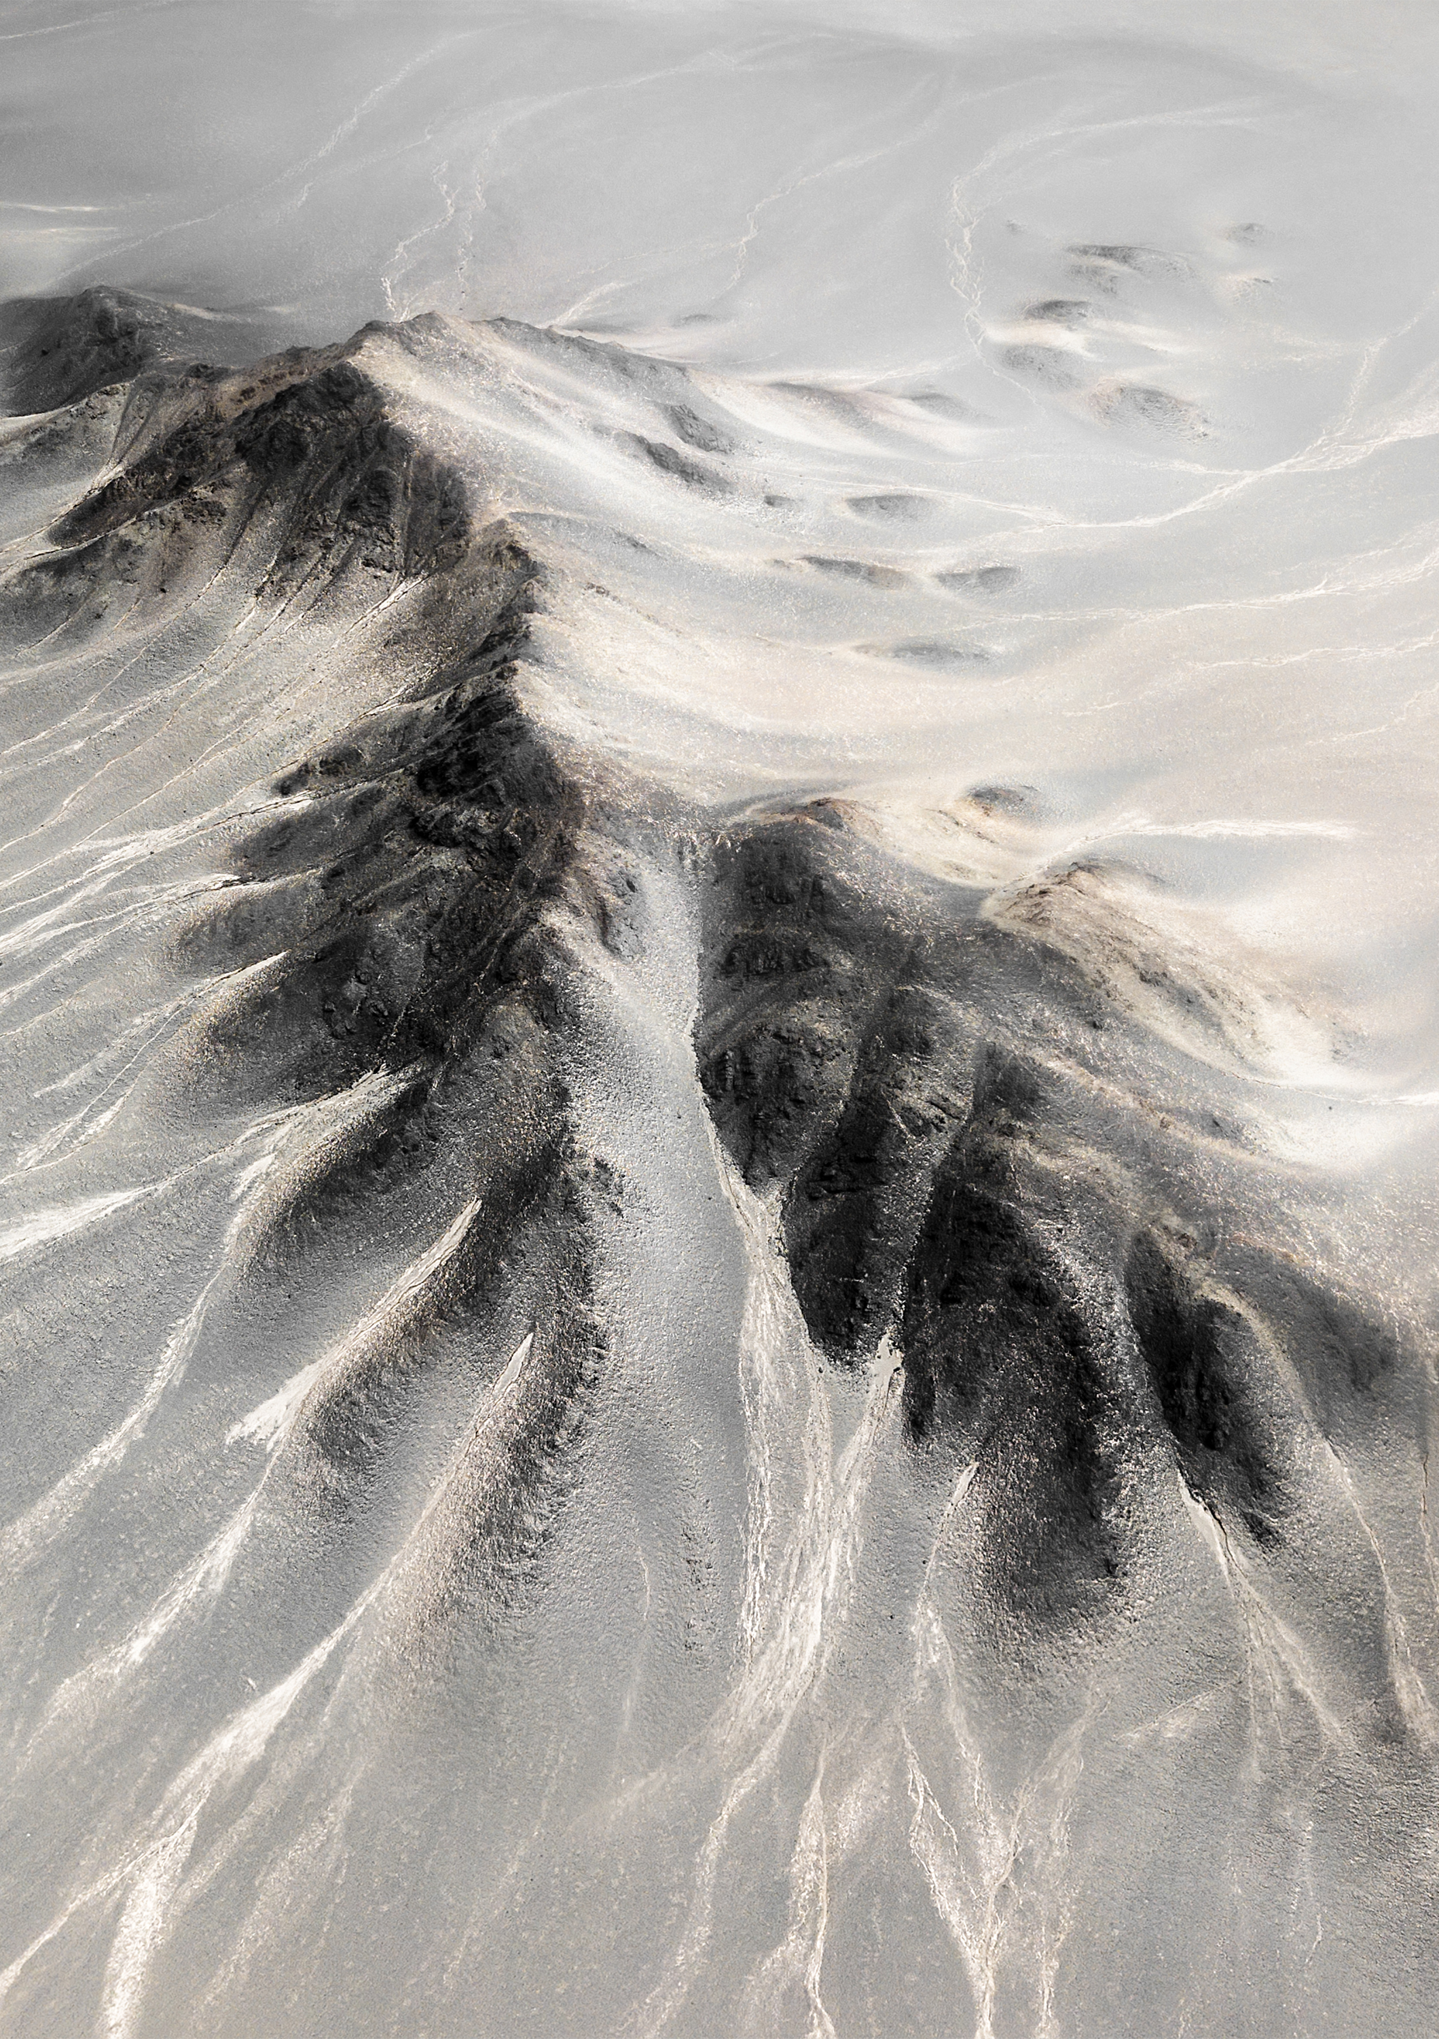
Some of the dangerous winds that are commonly associated with wildfires in California include
Santa Ana winds: These are strong, dry winds that originate from the Great Basin area and blow towards the coast of Southern California. They typically occur from October to April.
Diablo winds: These are strong, dry winds that blow from the northeast towards the coast of Northern California. They typically occur in the fall.
Sundowner winds: These are warm, dry winds that occur in the Santa Barbara area of Southern California. They typically occur in the evening.
North winds: These are cool, dry winds that blow both from the northeast towards the coast of Northern CA and down the Sacramento Valley. They typically occur in the fall and winter.
Mono winds: downslope winds that occur from the San Joaquin river to the Toulouse River, west slope mostly fall and winter and rare.
There are also other types of winds that can contribute to wildfires in California, such as the Washoe Zephyr (east slope daily) Santa Lucia winds central coast fall to spring, and the El Dorado winds, which occur in the Sierra Nevada foothills.
Notes:
"The Diablo Winds of Northern California: Climatology and Synoptic Evolution" by C. Orr et al., published in the Journal of Applied Meteorology and Climatology in 2017.
Recent Articles on CA Winds and Wildfires
"Climate change is driving stronger and more frequent Santa Ana winds, exacerbating California wildfires" by E&E News, published in Scientific American in 2021.
"Why Sundowner winds may be the most dangerous kind of wildfire weather you've never heard of" by R. St. John, published in The Los Angeles Times in 2020.
"Diablo winds hit Bay Area: What you need to know" by A. Graff, published in SFGATE in 2020.
"As California Burns, Scientists Search the Smoke for Answers" by J. Gorman, published in The New York Times in 2018.
"Wildfires ravage Northern California's wine country, killing at least 10 and destroying 1,500 structures" by J. Bacon et al., published in The Washington Post in 2017.
"The destructive potential of the Santa Ana winds is becoming clearer" by A. Wigglesworth, published in The Los Angeles Times in 2021.
"California's deadliest wildfires were decades in the making. 'We have forgotten what we need to do to prevent it'" by J. Myers, published in The Los Angeles Times in 2018.
"A New Risk Index for California Wildfires" by M. Davis, published in Eos in 2019.
"Wildfires and Climate Change: California's Unending Crisis" by H. Fountain, published in The New York Times in 2021.
"Santa Ana winds, soaring temperatures expected to increase fire danger in Southern California" by H. Abdollah and A. Smith, published in The Washington Post in 2019.

Slide 7
How Neural Networks, AI, and ML Can Assist
Predictive modeling
Real-time data analysis
Pattern recognition
Decision-making support
Automated reporting
Notes:
Predictive modeling: By analyzing historical weather and fire data, AI and ML algorithms can build predictive models that can forecast where and when wildfires are likely to occur. This can help emergency responders to pre-position resources and prepare for the potential impacts of wildfires before they happen.
Real-time data analysis: AI and ML algorithms can process real-time data from sensors and other sources to quickly identify changes in wind patterns, temperatures, humidity levels, and other environmental factors that can affect the behavior of wildfires. This can help to alert emergency responders to potential threats and allow them to respond more quickly and effectively.
Pattern recognition: AI and ML algorithms can identify patterns and anomalies in data that may be difficult or impossible for humans to discern. For example, they can detect changes in wind patterns that may be indicative of an impending wildfire, even if the changes are subtle and difficult to detect with the naked eye.
Decision-making support: AI and ML algorithms can provide decision-making support for emergency responders, allowing them to make more informed decisions in real-time. For example, they can suggest evacuation routes, predict how a fire may spread, and recommend which resources to deploy based on the latest data.
Automated reporting: AI and ML algorithms can automate the generation of reports and alerts, which can be disseminated to emergency responders, government officials, and the public. This can help to ensure that critical information is communicated quickly and effectively, reducing the risk of confusion or misinformation during wildfire events.
The integration of neural networks, AI, and ML technologies can greatly enhance the capabilities of a dangerous wind dashboard, providing more accurate and timely information to emergency responders and the public, allowing for faster and more effective response to wildfire events.

Slide 8
Recent Scientific Research
Sinha, A., et al. (2021). "Machine Learning for Early Warning of Wildland Fires in California." Journal of Environmental Management, 296, 113229.
Lin, W.-H.; Wang, P.; Chao, K.-M.; Lin, H.-C.; Yang, Z.-Y.; Lai, Y.-H. Wind Power Forecasting with Deep Learning Networks: Time-Series Forecasting. Appl. Sci. 2021, 11, 10335. https://doi.org/10.3390/app112110335
Kim, H., et al. (2022). "Real-Time Prediction of Fire Spread Using a Neural Network." Natural Hazards, 113(2), 1115-1132.
Ghosh, A., et al. (2020). "A Decision Support System for Wildfire Management Using AI and ML." Journal of Intelligent & Fuzzy Systems, 38(1), 1059-1073.
Zhang, Y., et al. (2021). "A Wildfire Early Warning System Based on Deep Learning and Multi-Source Data Fusion." Remote Sensing, 13(11), 2157.
Cheng, L., et al. (2022). "Design of a Fire Danger Index Based on Machine Learning for Wildfire Risk Assessment." Environmental Research, 206, 112549.
Boukabara, S.-A.,Krasnopolsky, V.,Stewart, J. Q.,Penny, S. G.,Hoffman, R. N., and Maddy, E. (2019), Artificial Intelligence may be key to better weather forecasts, Eos, 100, https://doi.org/10.1029/2019EO129967. Published on 01 August 2019.

