Slide 1
Xiomas Technologies, L.L.C.
Briefing
for
Spring 2021 TFRSAC
Three Band IR Detector (TBIRD) for Cubesats and UAS
Xiomas Technologies, L.L.C.
John Green
johngreen@xiomas.com
734-646-6535

Slide 2
Brief Outline
Background and History of The TBIRD
MODIS/ASTER Airborne Simulator MAS/MASTER
Wide Area Imager (WAI)
Thermal Mapping Airborne Simulator (TMAS)
TBIRD
TBIRD Concept
Phase II Prototype – TRL Airborne Prototype
Phase IIE Prototype – CubeSat ready including Sub-Orbital or High Altitude Flight Tests.
Depending on Funding the Phase IIE may put one TBIRD in LEO
Phase III – 24 TBIRDS in LEO providing hourly global coverage

Slide 3
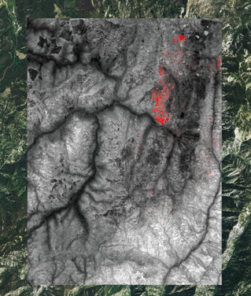
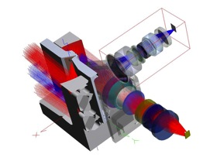
About Xiomas --
R&D for high performance airborne imaging systems
Development of physics based models for remote sensing
Software and computer engineering
Data acquisition, detection, identification, geo-location, and dissemination
Optical Engineering
Hyperspectral imagers, thermal infrared imaging systems, multispectral imaging systems, and scanning imagers
Xiomas Hyperspectral Imager developed under
U.S. Navy SBIR
Xiomas Thermal Image
with Fire Detection overlaid
on color photo

Slide 4
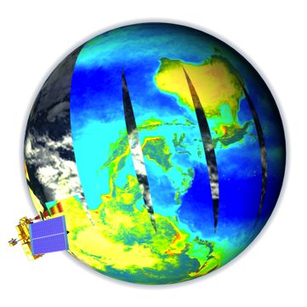
Background
TBIRD
The high performance step stare scanning system combined with current state of the art detectors results in wide area coverage similar to MODIS and with the spatial resolution of ASTER
MODIS
is a multispectral cross-track scanning radiometer that operates in the visible through the thermal infrared. MODIS operates in 36 spectral bands: 21 within 0.4-3.0 µm and 15 within 3-14.5 µm. Two of the bands have 250-m resolution, five have 500-m resolution, and twenty-nine bands, including the thermal infrared bands, have 1-km resolution. MODIS has a total field of view of 110 degrees resulting in a large swath width of 2300 km, giving it the capability to cover the entire globe every 1-2 days.
ASTER
The Advanced Spaceborne Thermal Emission and Reflection Radiometer (ASTER) has a smaller field of view, viewing a swath width of 60km. To scan any point on earth, tiltable telescopes are employed for ASTER. The ASTER thermal infrared subsystem has a spatial resolution of 90m and five spectral bands in the 8 to 12 um range.
The ASTER instrument operates for a limited time during the day and night portions of an orbit.
The full configuration (all bands plus stereo) collects data for an average of 8 minutes per orbit.

Slide 5
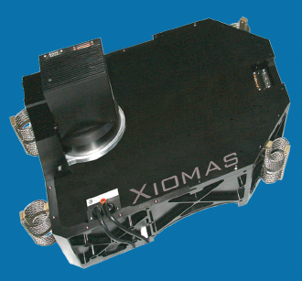
Wide Area Imager for Wildfire Mapping
NASA Funded Small Business Innovative Research Project
Multi-Band System – 2 to 5 Bands
2 Band QWIP for Mid-Wave and Long Wave Infrared
3 Band Color Infrared Sensor (Green Red NIR)
“Step – Stare” Optical System Combines High Resolution -- 300 uRadian and Wide Field of View -- 90 Degrees
Data System Generates Fire Layer and Terrain Layer
Real Time Orthorectification Processing Unit (OPU) generates GIS compatible Files
Image Classification and Compression
Data Transmission via Ethernet -- Air to Ground or Satellite –
Sensor Head Weight – approximately 80 pounds

Slide 6
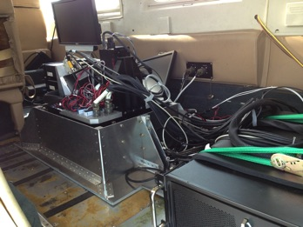
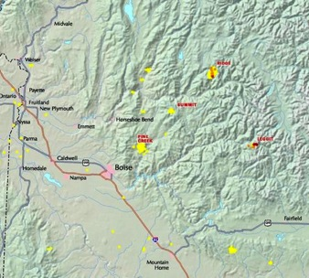
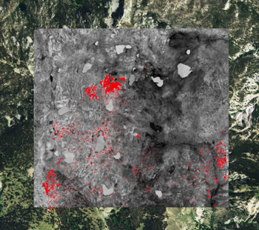
Wide Area Imager Fire Mapping Evaluation/Demonstration Mission --
Multi-day mission conducted July 23-26, 2013 over active fires near Boise Idaho
In total, the WAI has flown about 30 flights, including a number of engineering tests, calibration flights, several flights for two commercial imaging projects,
and the fire mapping flights

Slide 7
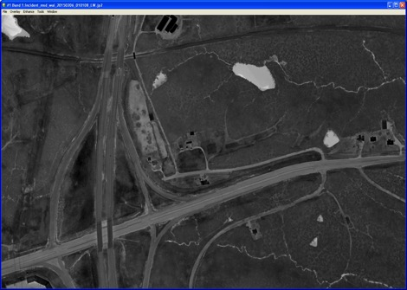
Xiomas WAI 2015
Thermal Imaging project over Jefferson County KY for Quantum Spatial Inc.
Following the success of the 2013 mission, Jefferson County hired us again to fly the
WAI over Louisville Kentucky in January and February 2015.
Following is some sample imagery from this mission.

Slide 8
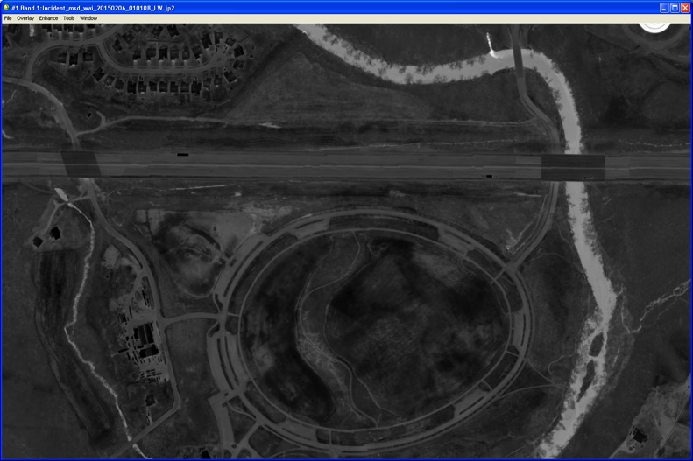
Xiomas WAI 2015
Thermal Imaging project over Jefferson County KY for Quantum Spatial Inc.

Slide 9
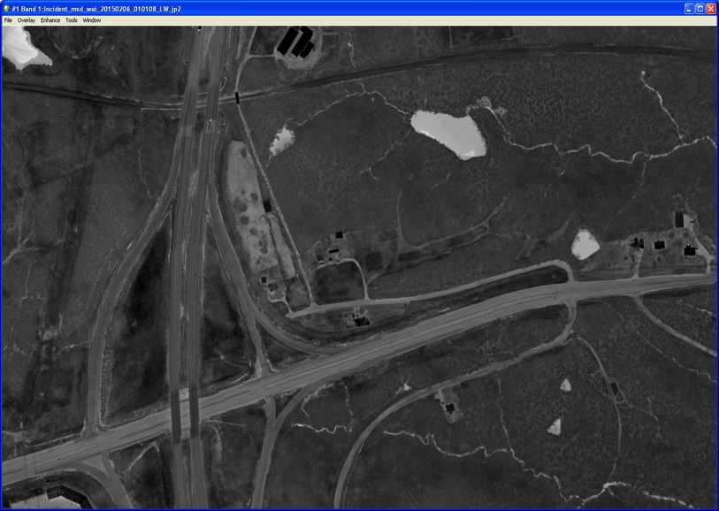
Xiomas WAI 2015
Thermal Imaging project over Jefferson County KY for Quantum Spatial Inc.

Slide 10
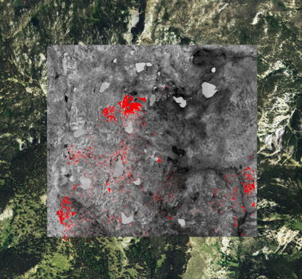
TMAS
Operating at the same altitude and velocity as MODIS the TMAS will have the same capability to map the globe every one to two days
110 degree field of view (same as MODIS)
94 meter spatial resolution (similar to ASTER)
3 Spectral Bands (more can be added in Phase III)
133 uRadian IFOV
Sensor Head Weight Approximately 80 pounds

Slide 11
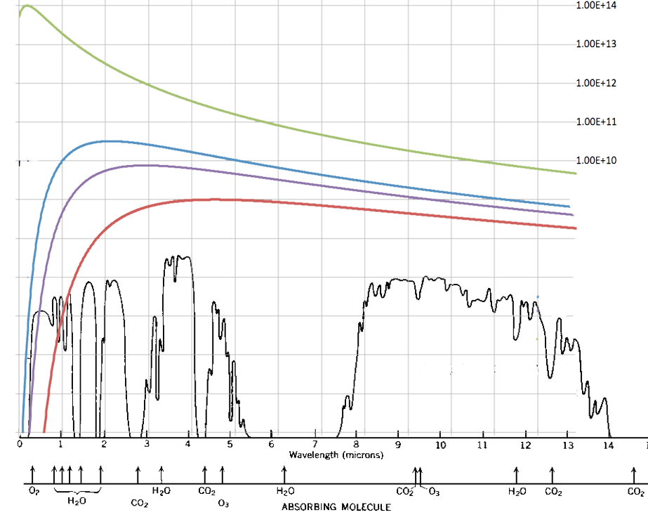
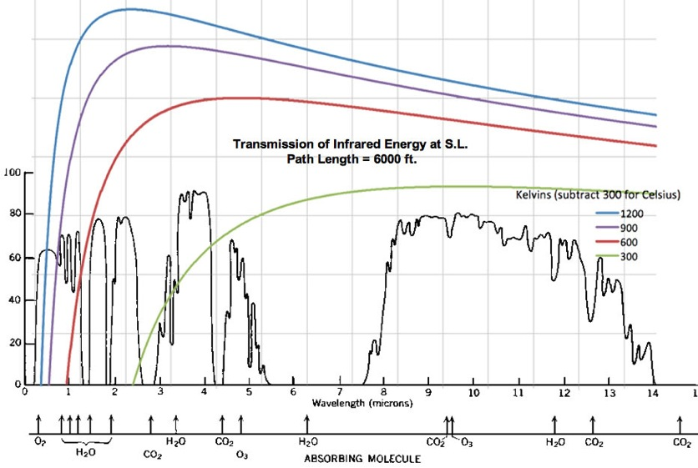
TMAS INSB 1.5 – 1.7 um
TMAS QWIP 4.3 – 5.2 um
TMAS QWIP 8.2 – 9.0 um
6000 K (Sun)
1200 K (High Intensity Fire)
600 K (Low Intensity Fire)
TMAS Spectral Bands and Black Body Curves

Slide 12
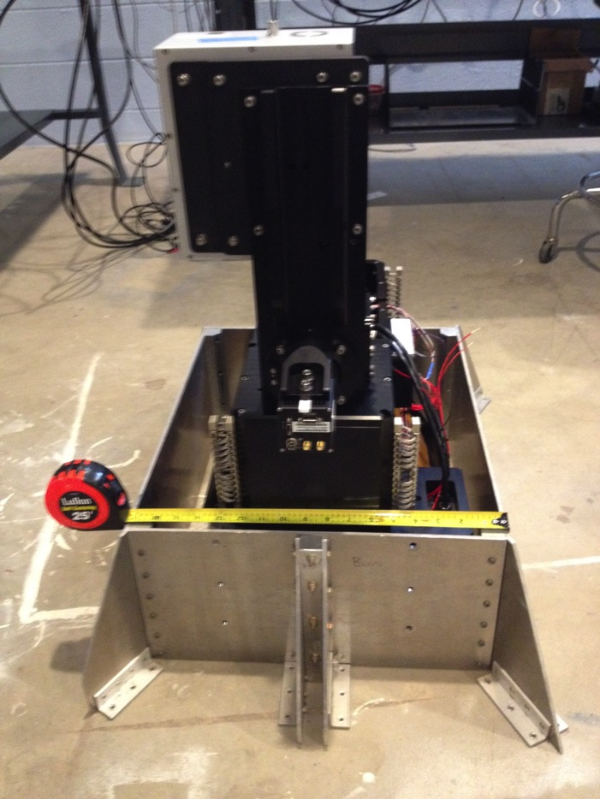
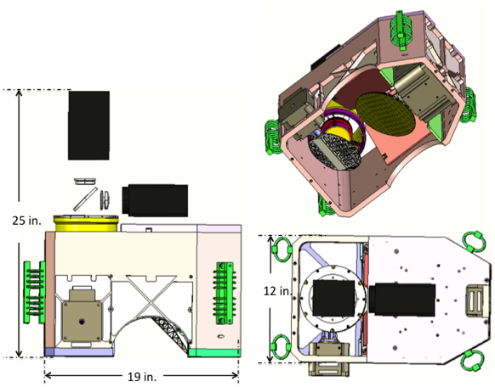
TMAS Sensor Head

Slide 13
TBIRD Three Band Thermal Infrared Detector for CubeSats and UAS Contracting Officer Representative: Matt Fladeland
Xiomas Technologies, L.L.C.
Phase II SBIR Contract Number: 80NSSC19C0168
Principle Investigator: John Green
johngreen@xiomas.com
734-646-6535
SBIR RIGHTS NOTICE (DEC 2007)
These SBIR data are furnished with SBIR rights under Contract No._____ (and subcontract _____, if appropriate). For a period of 4 years, unless extended in accordance with FAR 27.409(h), after acceptance of all items to be delivered under this contract, the Government will use these data for Government purposes only, and they shall not be disclosed outside the Government (including disclosure for procurement purposes) during such period without permission of the Contractor, except that, subject to the foregoing use and disclosure prohibitions, these data may be disclosed for use by support Contractors. After the protection period, the Government has a paid-up license to use, and to authorize others to use on its behalf, these data for Government purposes, but is relieved of all disclosure prohibitions and assumes no liability for unauthorized use of these data by third parties. This notice shall be affixed to any reproductions of these data, in whole or in part.
(END OF NOTICE)

Slide 14
TBIRD Overview
Identification and Significance of the Proposed Innovation
The overall objective of the SBIR is to develop a high performance, inexpensive, three-band thermal infrared camera system, suitable for deployment in Unmanned Airborne Systems and CubeSats.
This imaging system will be capable of mapping thermal features on the surface of the earth with a high revisit rate and high spatial resolution.
Xiomas believes the Three Band Infrared Detector (TBIRD) System will see significant demand as a small multiband thermal sensor onboard small to medium sized unmanned airborne vehicles (UAV) and space-based cubesat applications, in both the commercial and military markets.
In Phase II we propose to develop a flight ready TRL 7 prototype, with the final six months of Phase II dedicated to instrument calibration and characterization, environmental tests (shock, vibration, temperature, etc.), and flight tests in manned or unmanned small aircraft.

Slide 15
TBIRD Overview
TBIRD incorporates a step stare optical design which provides fundamental advantages over current imaging systems including:
The combination of a step stare scanning mirror with a focal plane array offers fundamental improvements in spatial resolution
The high performance of the step stare scanning system combined with current state of the art detectors results in wide area coverage similar to MODIS and with the spatial resolution of ASTER
The proposed step stare system will easily accommodate higher scan rates. As a result the TBIRD will be suitable for a wide range of applications and operational concepts, both space based and airborne.
We’ve developed a Forward Motion Compensation mechanism, which is incorporated in the TBIRD lens. This feature eliminates image smear due to platform motion, greatly enhancing image quality over existing high resolution thermal imagers.
Super resolution feature, which has the potential to improve spatial resolution and subpixel target detection by a factor of 2 or more.

Slide 16
TBIRD Overview
NASA Funded Small Business Innovative Research Project
3 Bands -- Mid-Wave and Long Wave Infrared
“Step – Stare” Optical System Combines High Resolution -- 213 uRadian and Wide Field of View -- 110 Degrees
Data System Generates Fire Layer and Terrain Layer
Real Time Orthorectification Processing Unit (OPU) generates GIS compatible Files
Image Classification and Compression
Data Transmission via Ethernet -- Air to Ground or Satellite –
TBIRD Sensor Head Weight Approximately 12 pounds

Slide 17
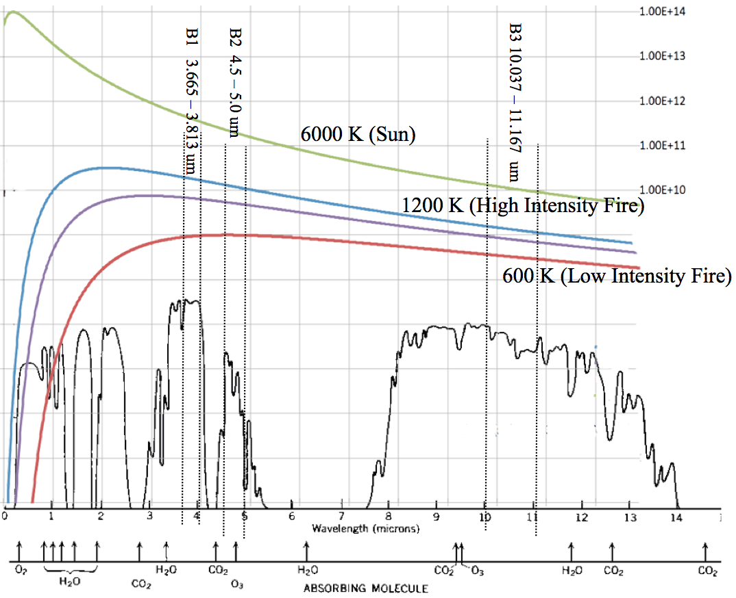
TBIRD Overview
During the Phase I we analyzed the choice of spectral bands on a couple of applications and have come up with a couple of options that work well, specifically we believe we have chosen a
MWIR/MWIR/LWIR combination which will be excellent for fire detection and glint rejection, and a
LWIR/LWIR/LWIR combination which will be excellent for detecting and mapping disturbed earth.
We have shown that the TBIRD optical system produces excellent imagery for any combination of three bands across the wide range of 3um to 12um.
We believe will be desired for fire mapping and general purpose thermal mapping is:
MWIR/MWIR/LWIR with bands at:
TBIRD Band 1 = 3.665 – 3.813 um
TBIRD Band 2 = 4.5 - 5.0 um
TBIRD Band 3 = 10.037 - 11.167 um
This band selection takes advantage of the atmospheric windows and the fact that the solar curve rises rapidly in the MWIR facilitating glint rejection (see the curves at right).

Slide 18
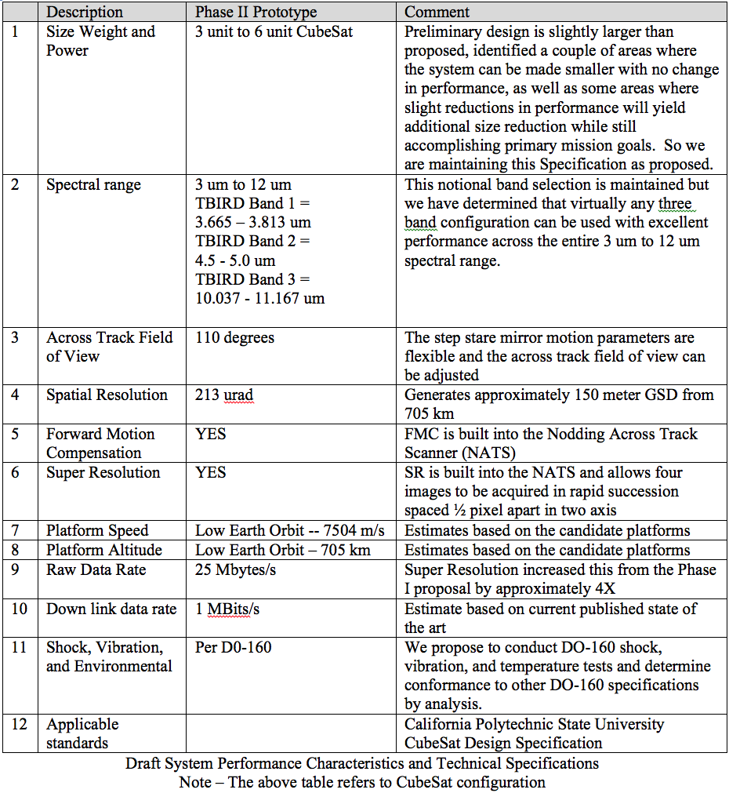

Slide 19
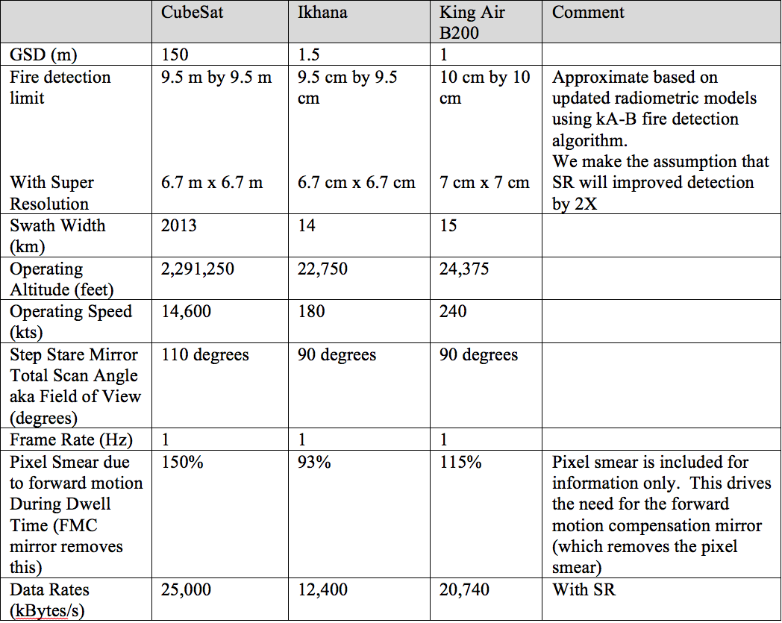
The System Technical Requirements shown above have been extended to analyze performance in a typical aircraft (King Air) and a notional UAV (Ikhana) (table below).
In short this analysis demonstrates that the design is suitable for a wide variety of platforms.

Slide 20
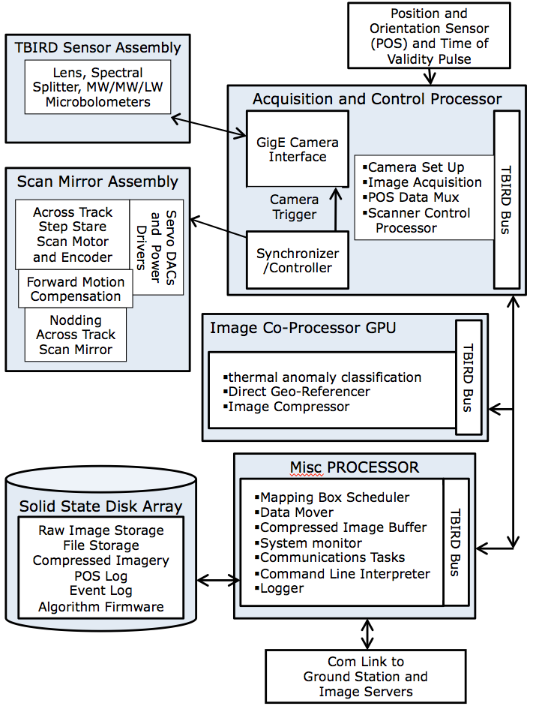
The proposed design is composed of eight major modules:
Acquisition and Control Unit (ACU) – This is relatively low risk and is based on technology previously developed by Xiomas.
Image Processing Unit (IPU) -- Real time IPU based on the ITTVis Rigorous Orthorectification Module. Runs on a Graphics Processing Unit (GPU). The IPU performs image orthorectification and generates GIS compatible image files.
Misc. Processor – SW module running on the ACU hardware using technology previously developed by Xiomas.
Solid State Disk Array – Standard state of the art hardware
Optical system and sensor array including the broad spectral range lens with integral forward motion compensation, three band thermal IR sensor with prism block, on board thermal reference source. – The Three Band IR Detector (TBIRD) assembly is the main innovation in this proposal and involves a moderate risk.
Across track scanning mirror – This is a low risk area and involves currently available state of the art hardware including technology previously developed by Xiomas which will be adapted to the TBIRD.
Position Orientation System – COTS Novatel Span provided by Xiomas
Data communications system – Low risk item, using currently available state of the art components.
TBIRD Block Diagram

Slide 21
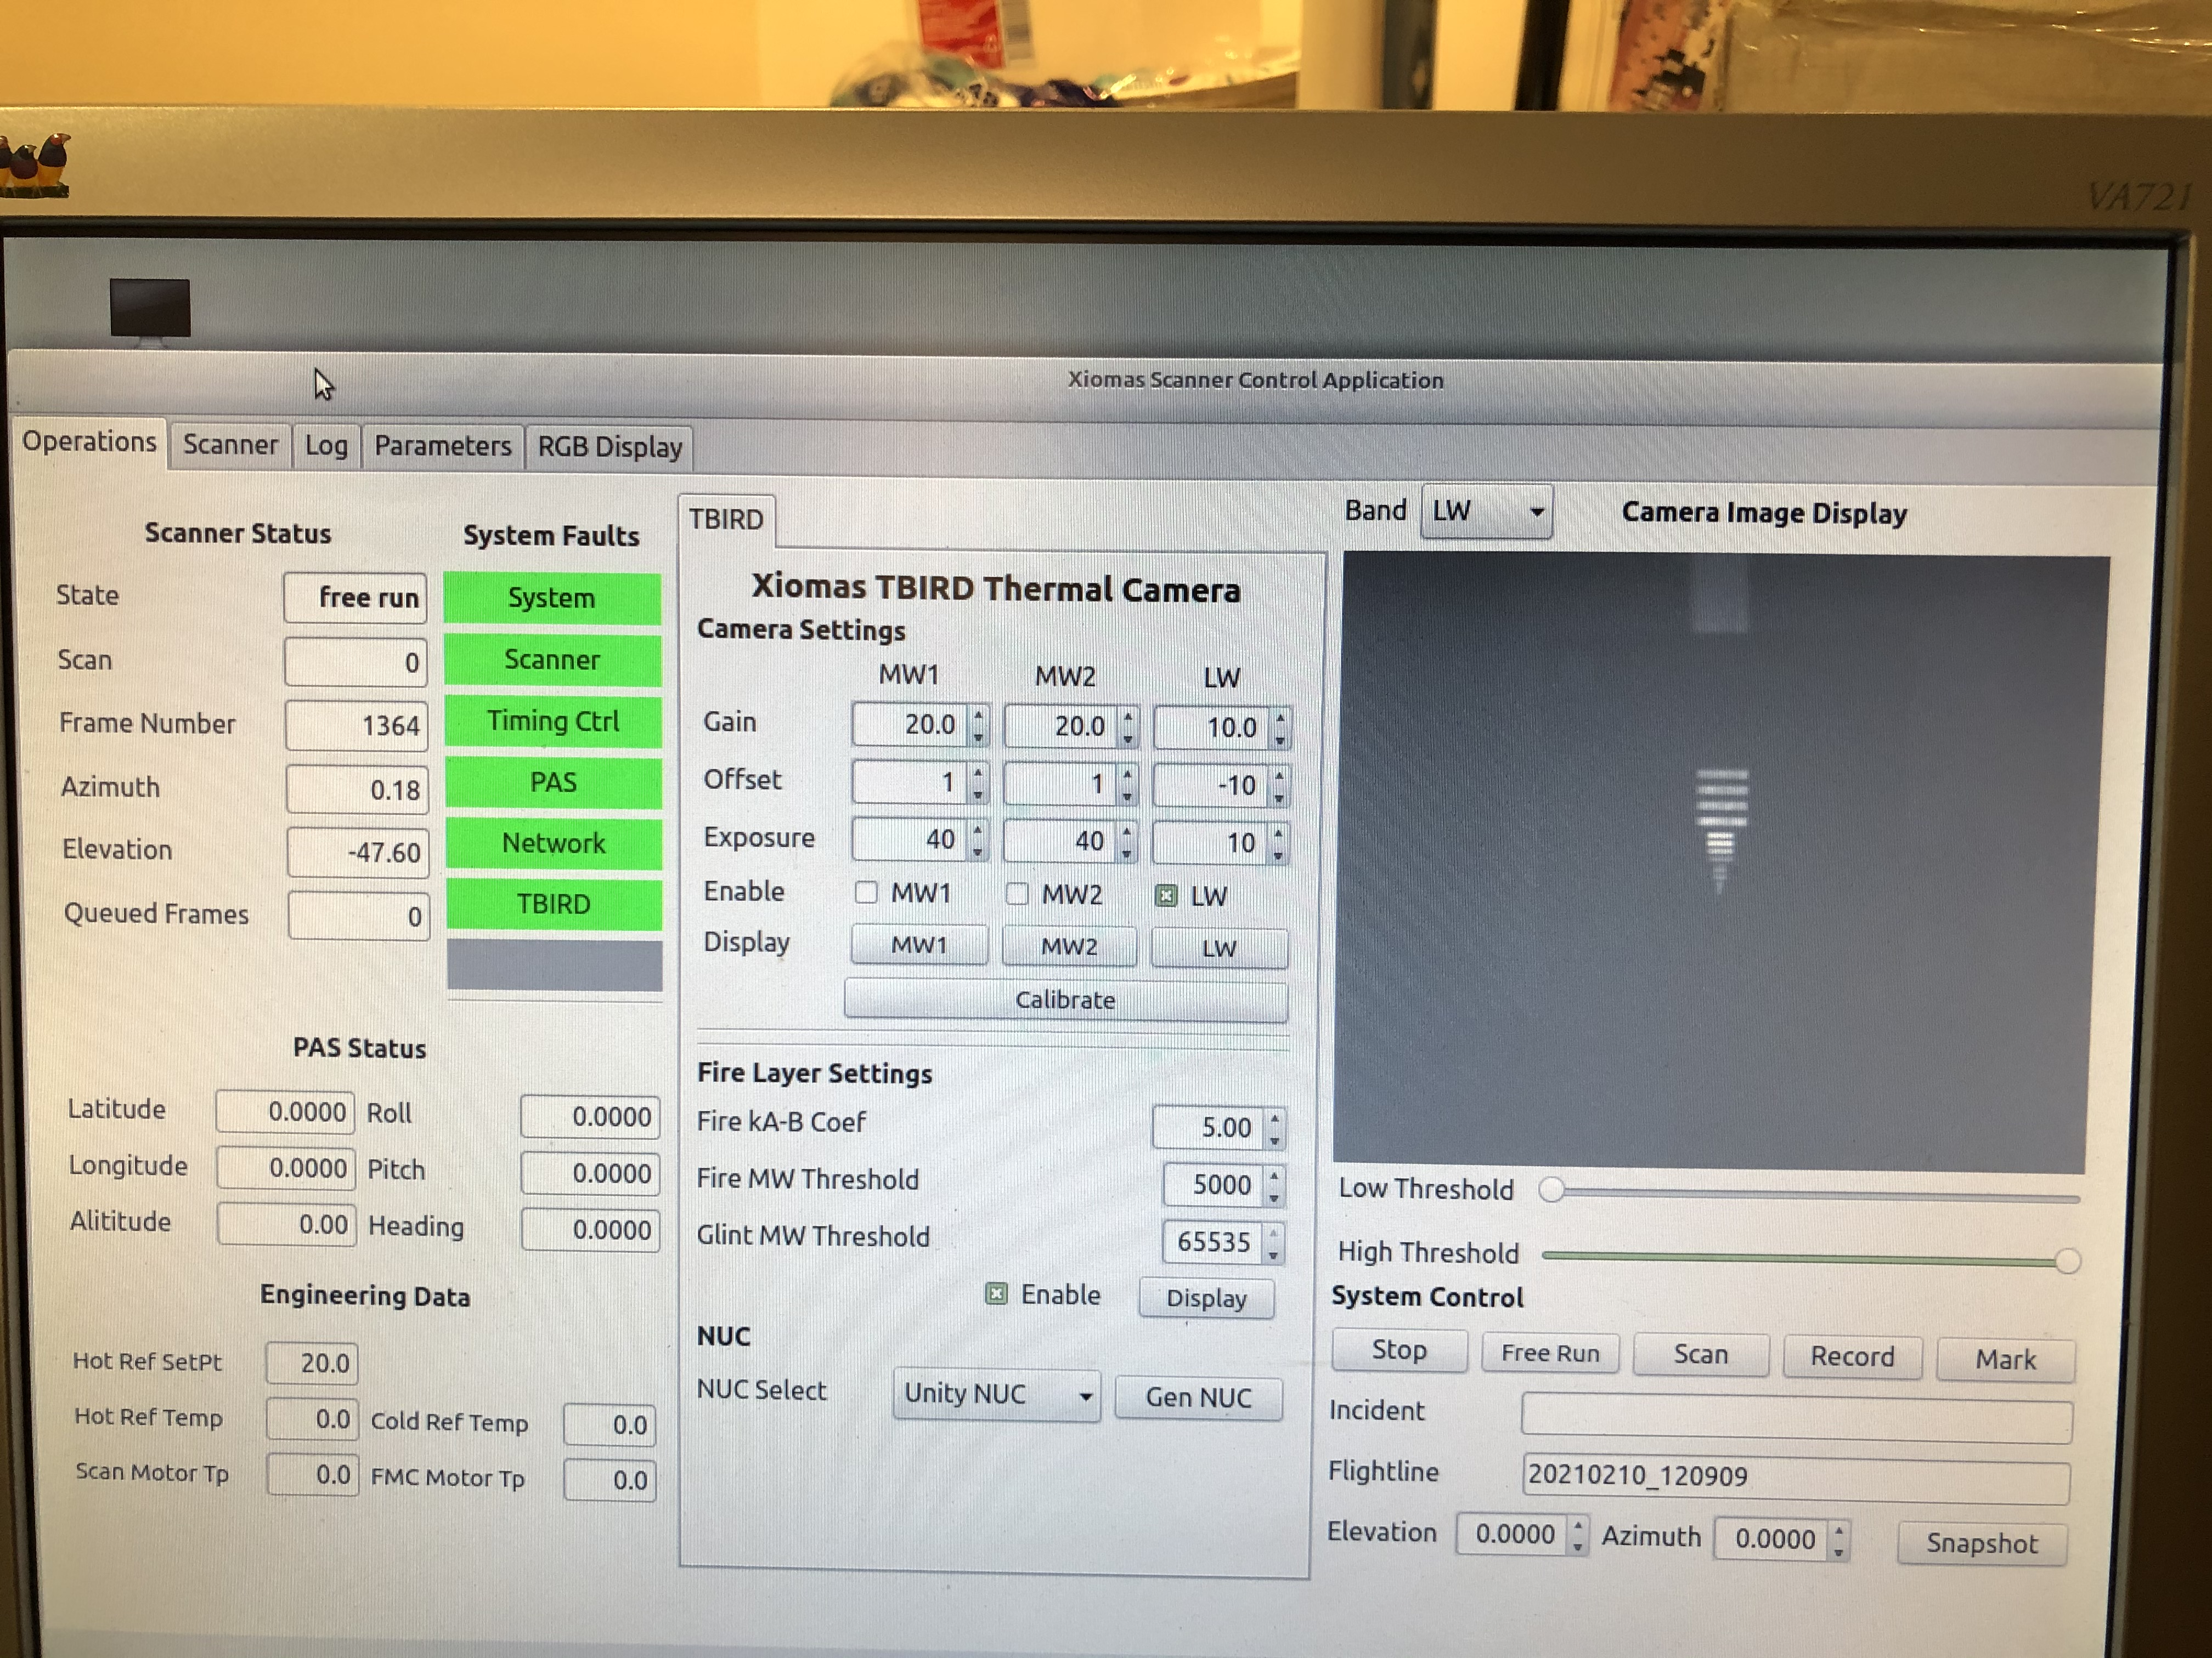
TBIRD Lab Prototype
TBIRD User Interface with Image of Resolution Target

Slide 22
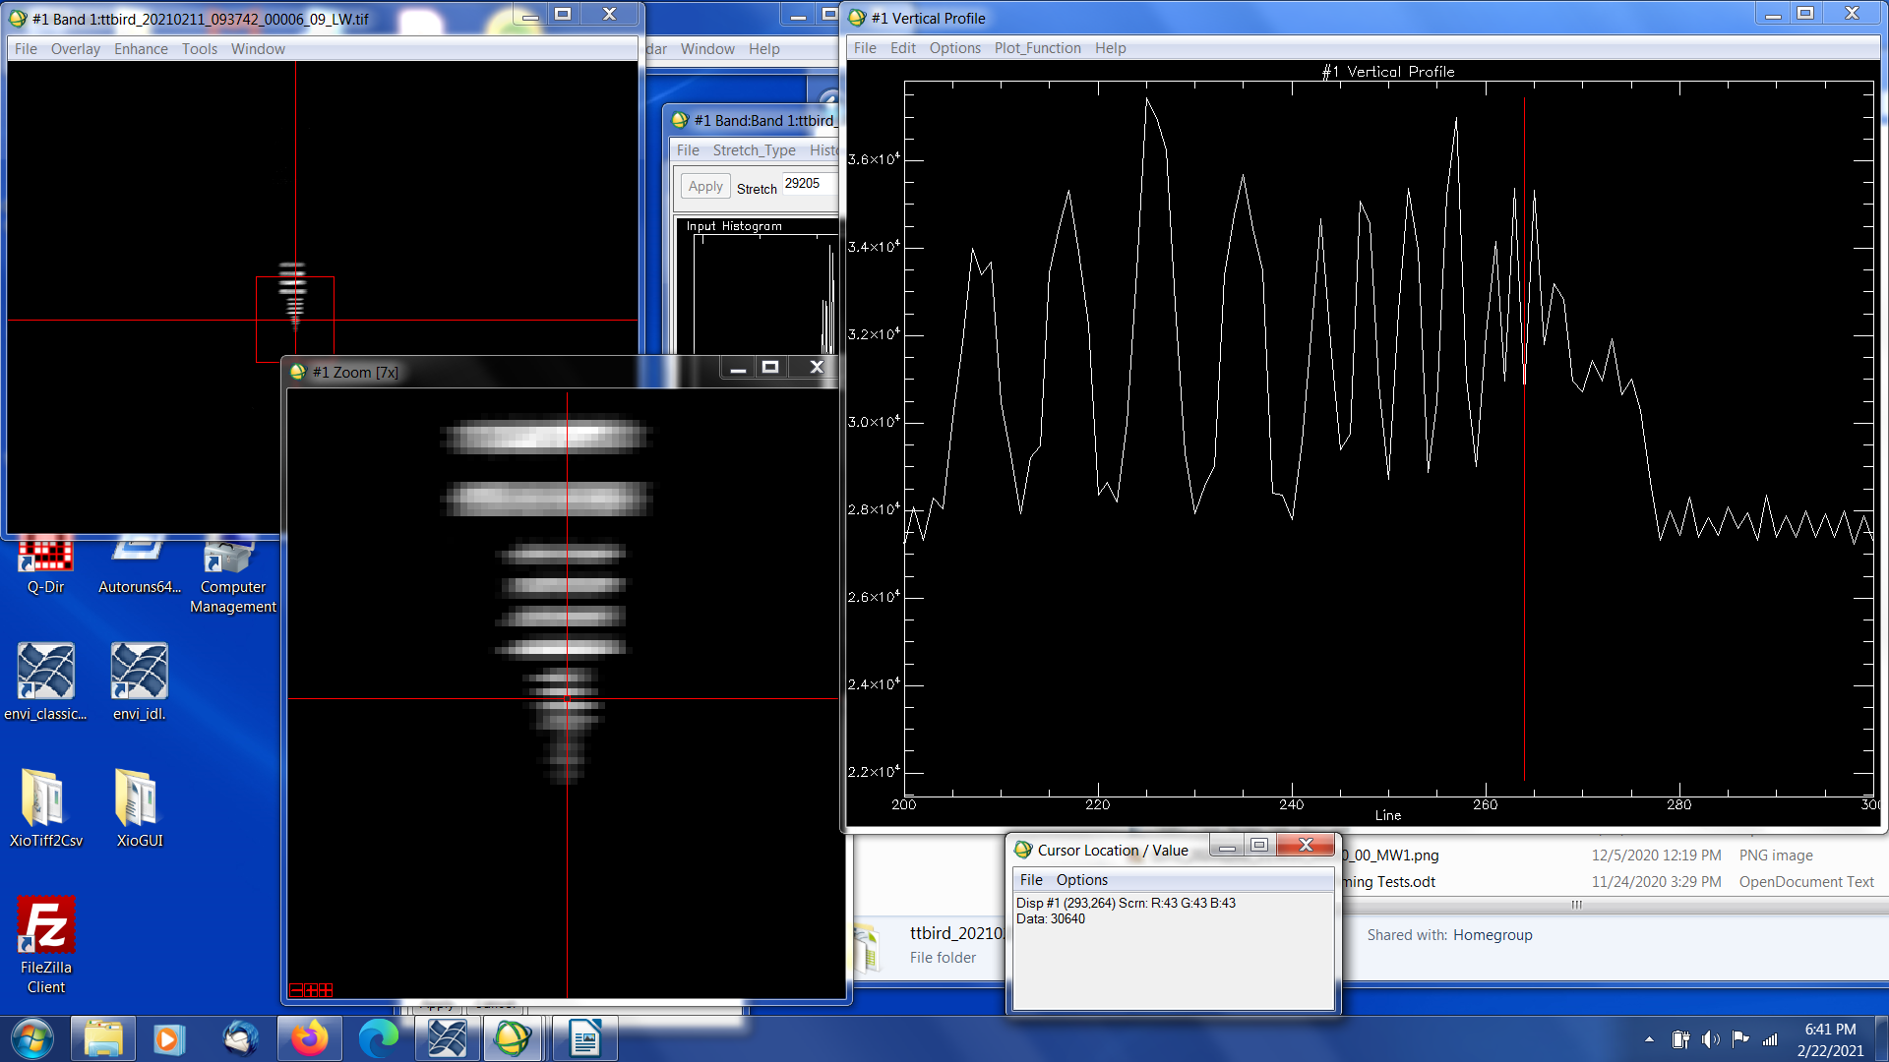
TBIRD Lab Prototype
Preliminary results of spatial resolution tests:
Resolution Target is Electro Optical Industries Part 101-117-026 with four sets of bar targets:
0.05”/1mrad; 0.025”/0.5mrad; 0.0125”/0.25mrad; 0.0063”/0.126mrad;
For reference TBIRD is 0.213 mrad
In brief, the tests below are of the LWIR port and show that the 0.25 mrad target is resolved
and the 0.126 mrad target is not (as expected).

Slide 23
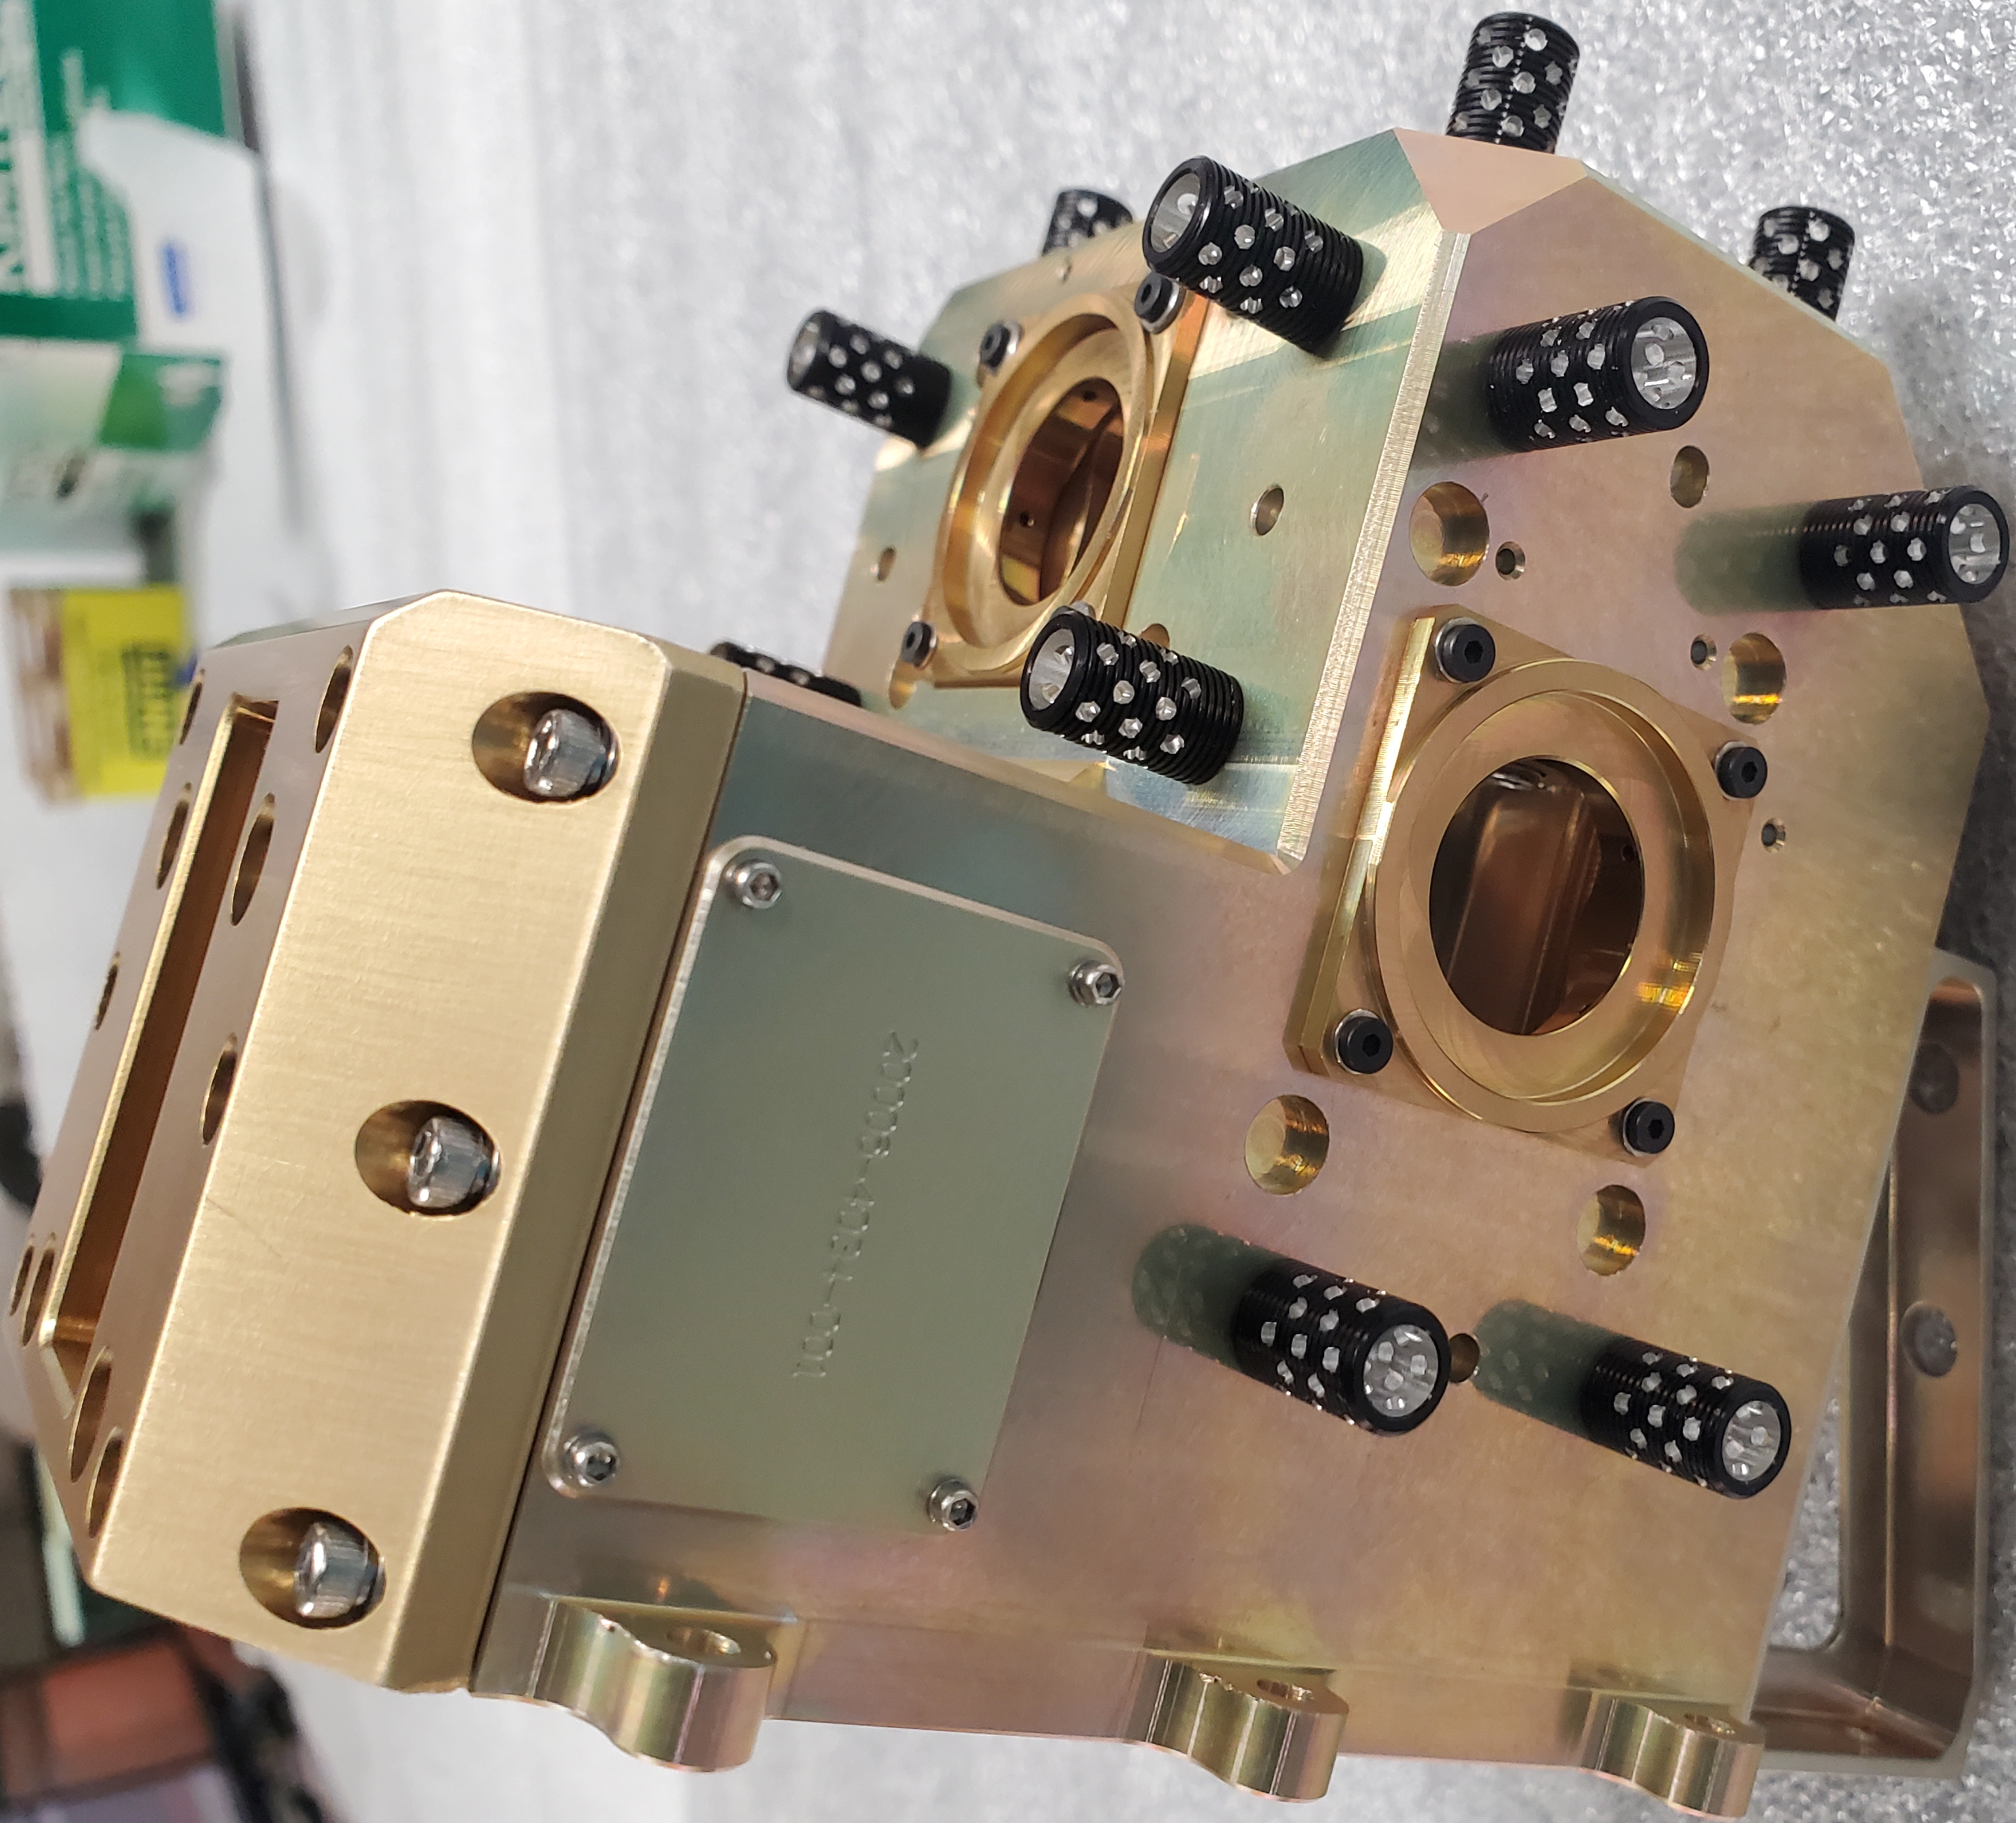
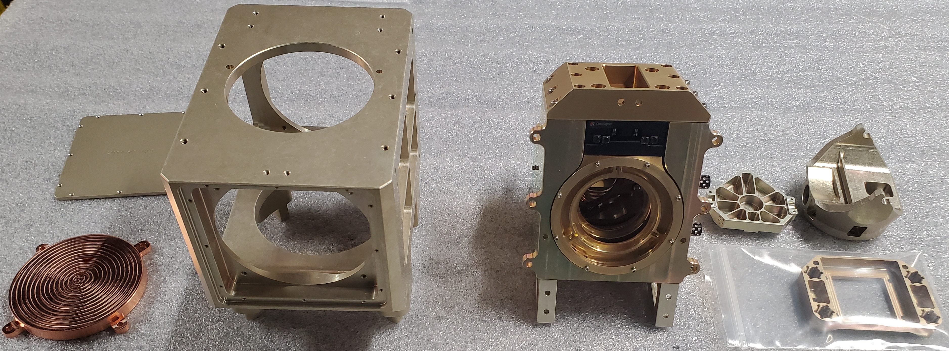
TBIRD Phase II Prototype currently in finale fabrication and assembly
TBIRD Sensor Head in Fabrication and Assembly

Slide 24
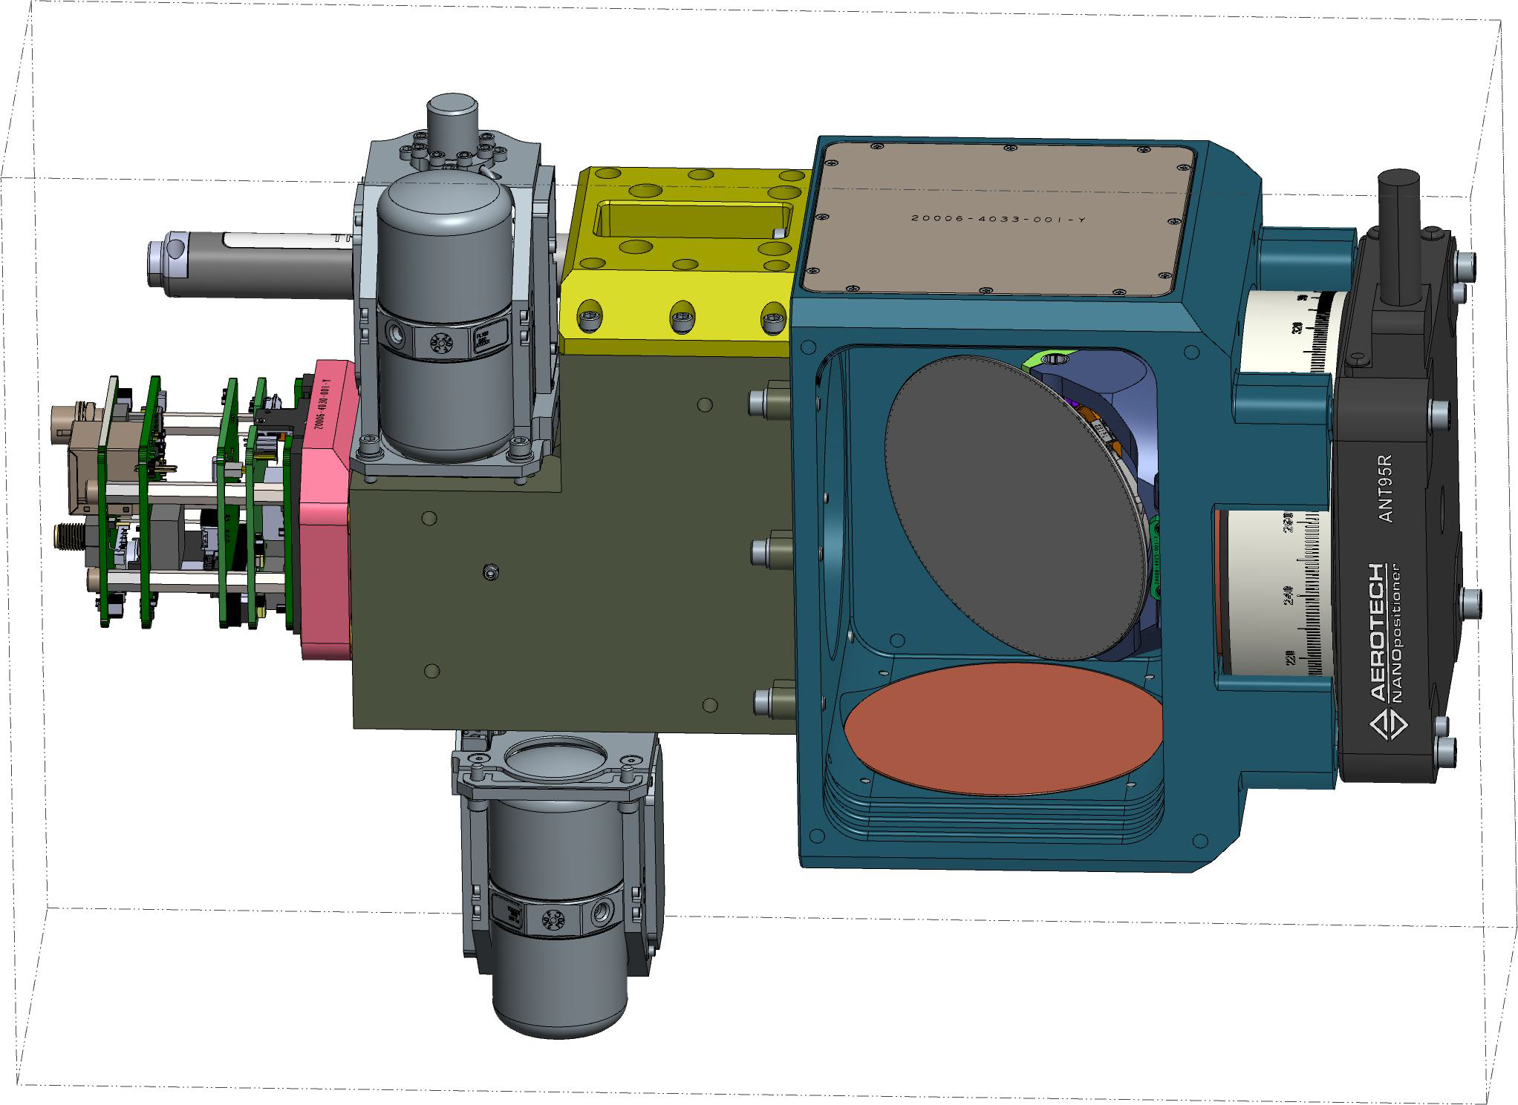
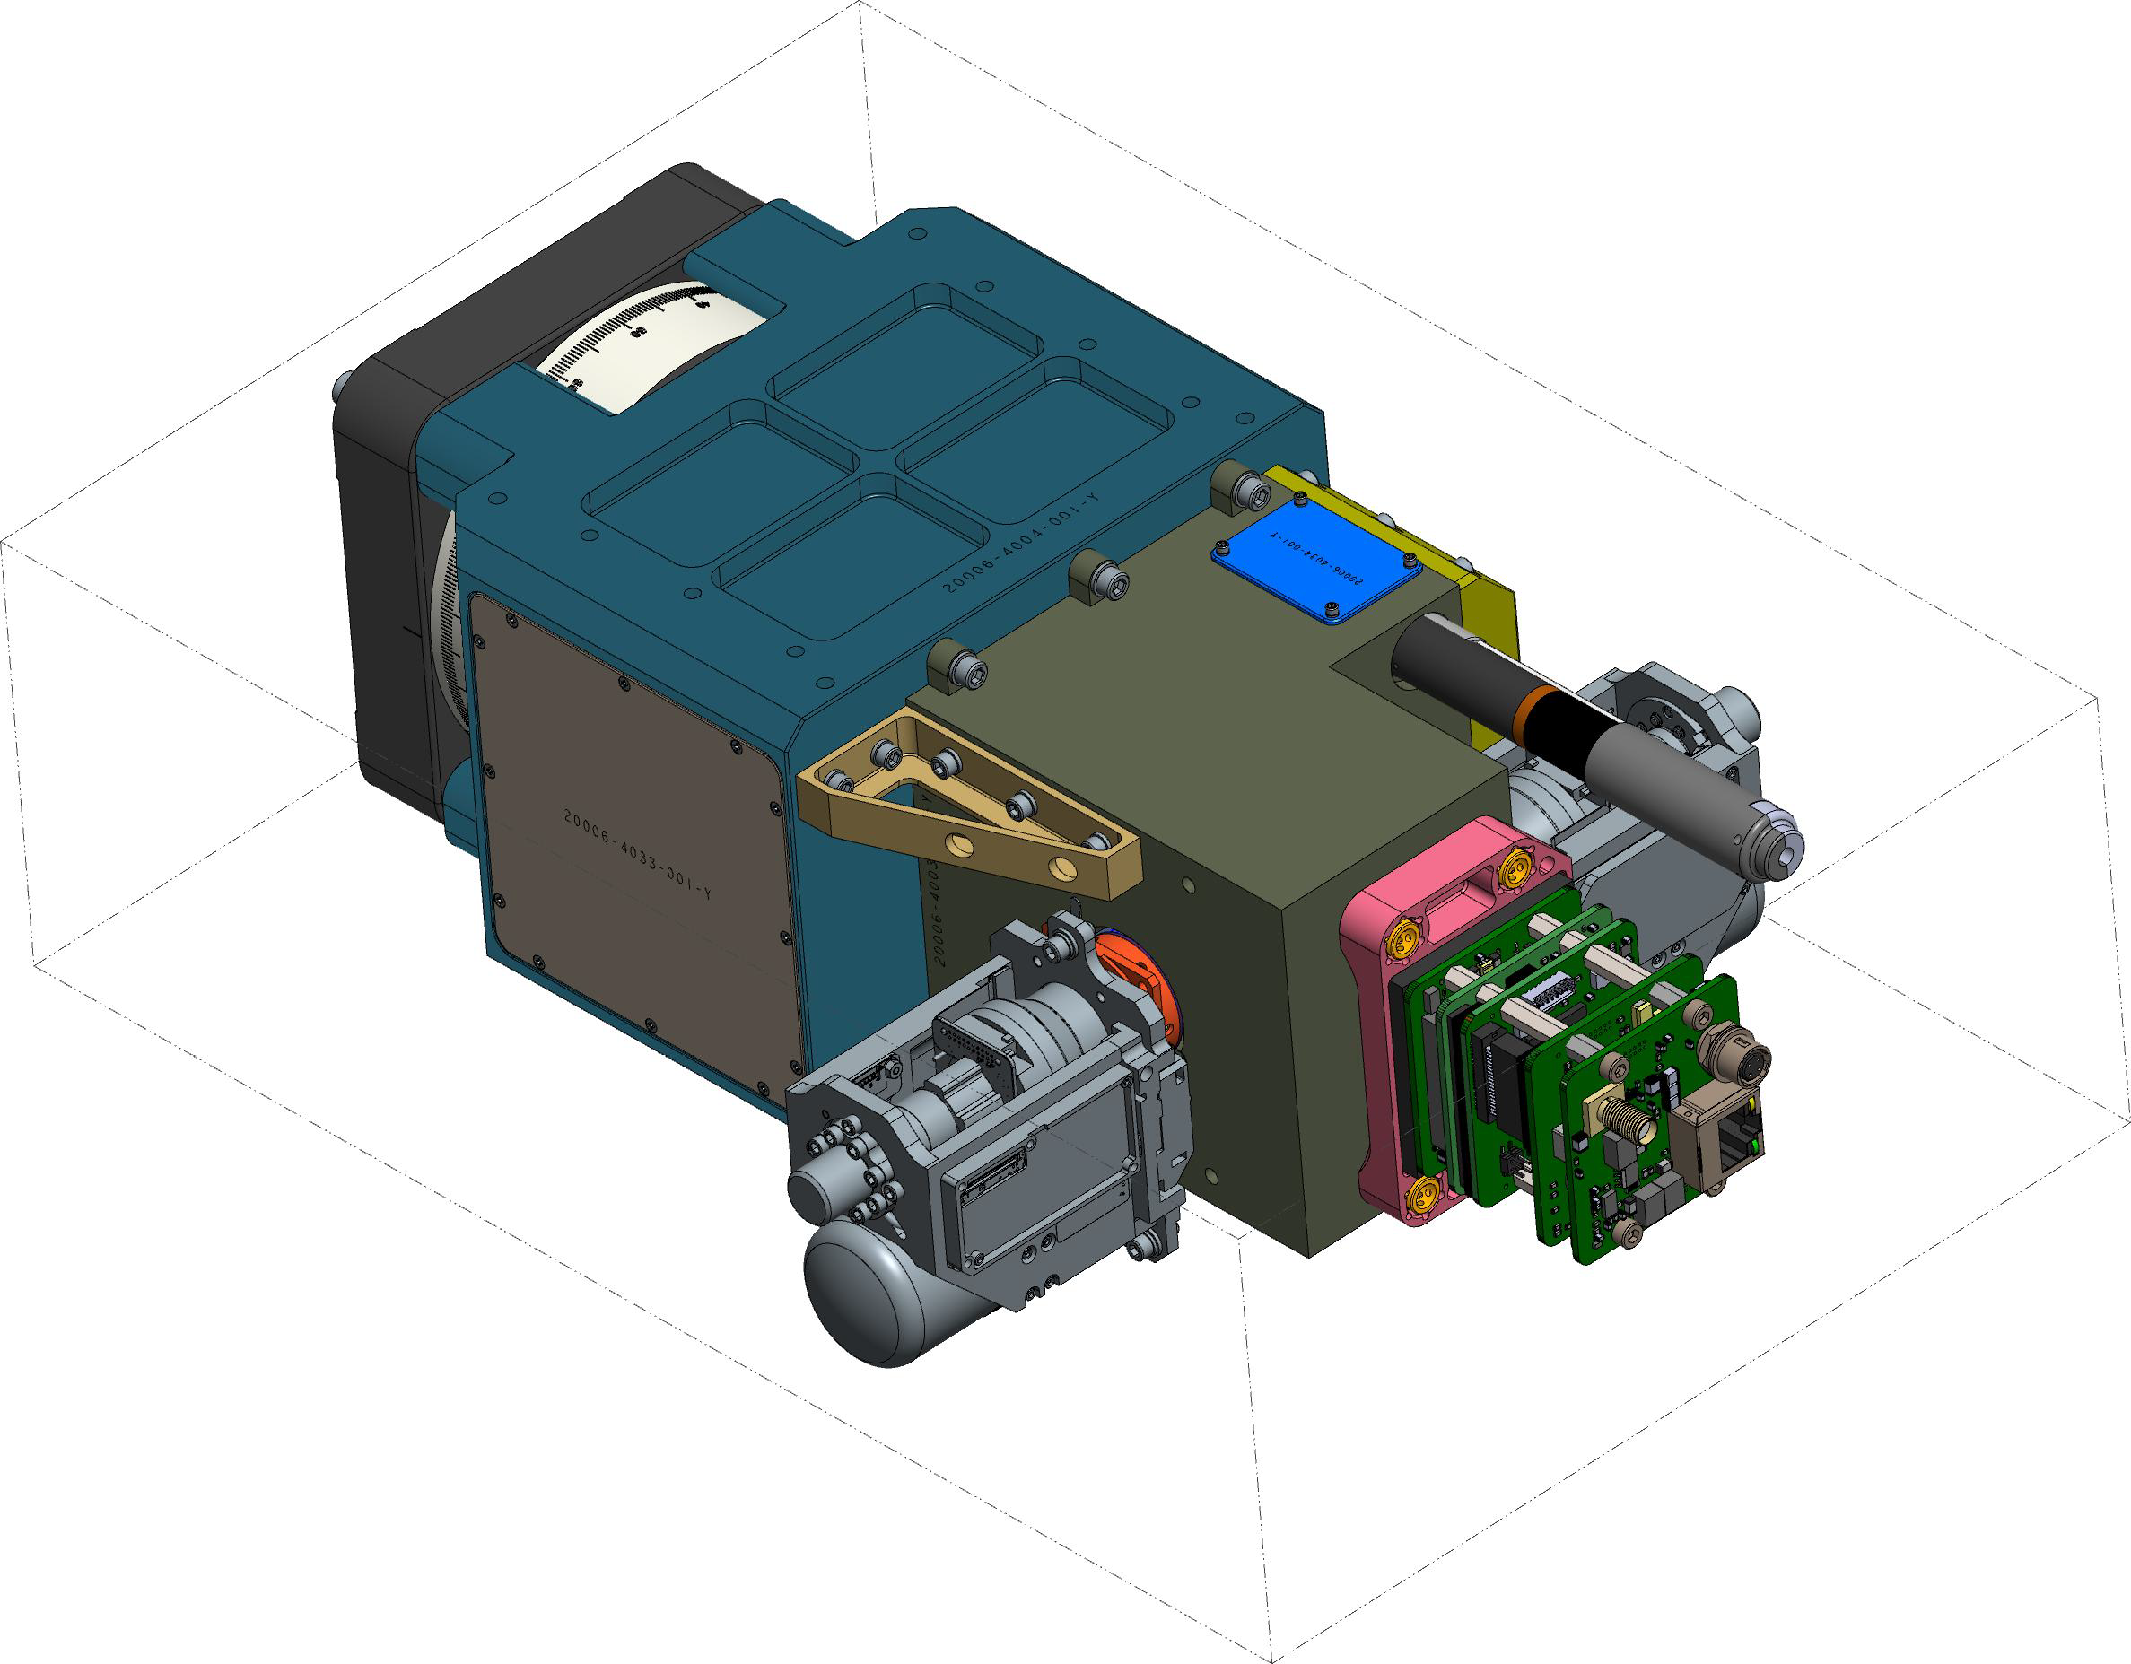
TBIRD Sensor Head
Nodding Across Track Scanner
MWIR
LWIR
MWIR
226.3 mm
Thermal Reference Source
100
6U CubeSat Mechanical Envelope
366 mm
TBIRD Sensor Head in 6U CubeSat

Slide 25
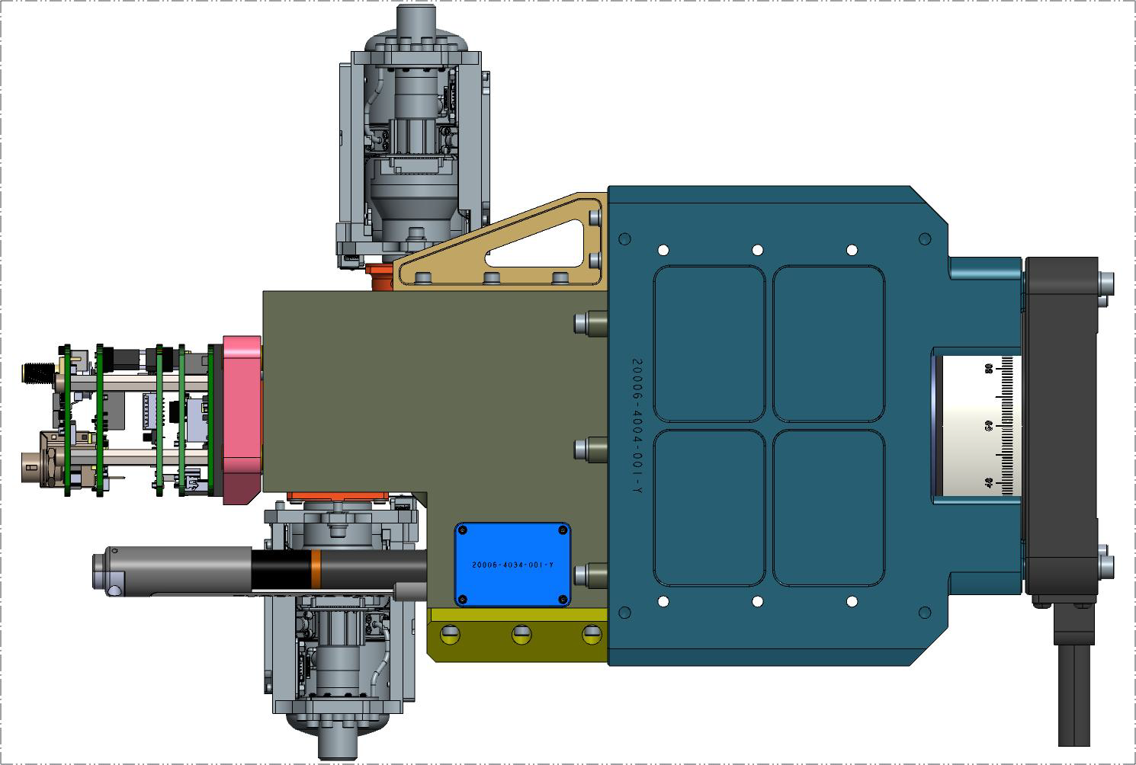
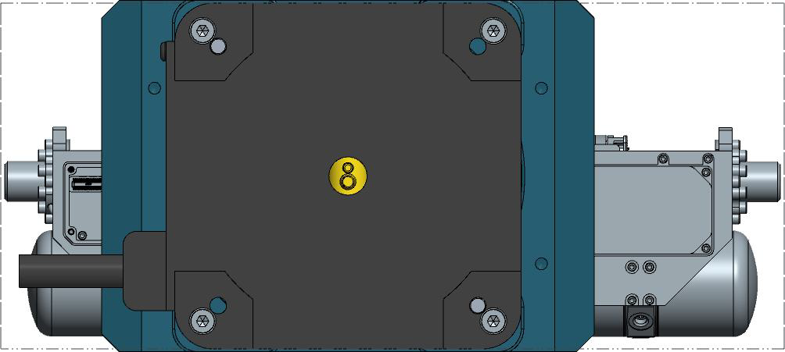
TBIRD Sensor Head
366 mm
226.3 mm
100
TBIRD Sensor Head in 6U CubeSat

Slide 26
TBIRD Program Structure
How are the Small Business Innovative Research programs structured?
“The structure of the SBIR and STTR programs reflects the Congressional understanding that the innovation process and bringing new products and services to the market takes time and has a high degree of technical and business risk.”
The programs have three phases:
Phase 1 – Preliminary Design and Feasibility -- the opportunity to establish the scientific, technical and commercial merit and feasibility of the proposed innovation in fulfillment of NASA needs.
NASA SBIR Phase 1 contracts last up to 6 months with a maximum funding of $125,000
TBIRD Phase I Completed January 2019
Phase 2 – is focused on the development, demonstration and delivery of the proposed innovation. It continues the most promising Phase 1 projects through a competitive selection based on scientific and technical merit, expected value to NASA, and commercial potential. Phase 2 contracts require reporting on the work and results accomplished, and whenever possible, the delivery of a prototype unit, or a more complete product or service, for NASA testing and utilization. SBIR Phase 2 contracts are usually for a period of 24 months with a maximum funding of $750,000. TBIRD Phase II PoP August 2019 to August 2021
Result is a TRL 7 Airborne Prototype
Phase II-E Option to Extend which offers up to $375K in matching funds. TBIRD Phase IIE PoP August 2021 to August 2022
Result is a TRL 7 CubeSat Ready Prototype including Sub-Orbital or High Altitude Flight Tests.
Depending on Funding the Phase IIE may put one TBIRD in LEO
Phase 3 – commercialization of innovative technologies, products and services resulting from Phase 2, including their further development for transition into NASA programs, other Government agencies, or the private sector. Phase 3 contracts are funded from sources other than the SBIR program and may be awarded without further competition.
TBIRD Phase III – Result is 24 TBIRD CubeSats in LEO providing approximately hourly global coverage

