Slide 1
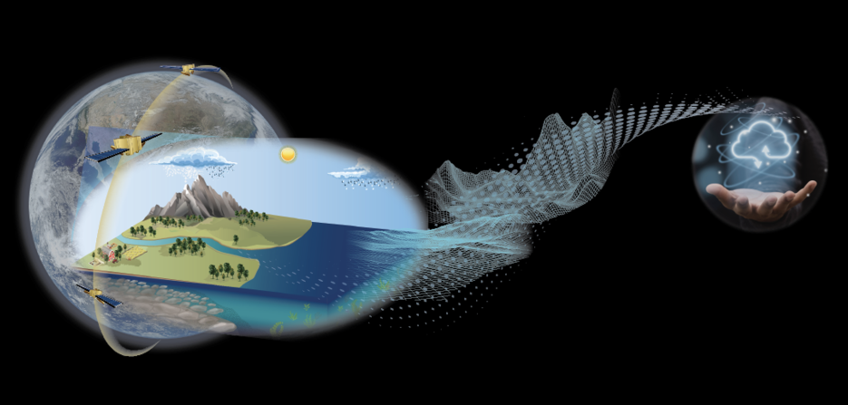
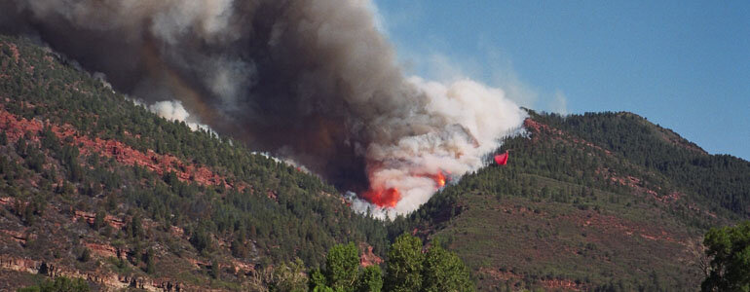
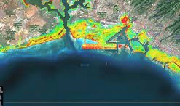
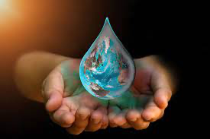
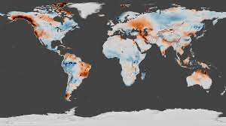
EIS - Freshwater
Sujay Kumar, Thomas Holmes (representing the EIS team)
https://freshwater.eis.smce.nasa.gov
Probe the water cycle by integrating remote sensing data with advanced earth system models and data fusion tools.
Showcase a global capability to quantify water cycle components and provide an open science environment for addressing water security challenges facing the society.
Provide actionable information about freshwater availability, quality, variability, and extremes.
Transition mature modeling, analysis, and dissemination capabilities to routine and operational environments by working with relevant stakeholders.
Fire-hydrology interactions
Inland and coastal flooding
Water security
Changes to the water cycle
Science translation with AI

Slide 2
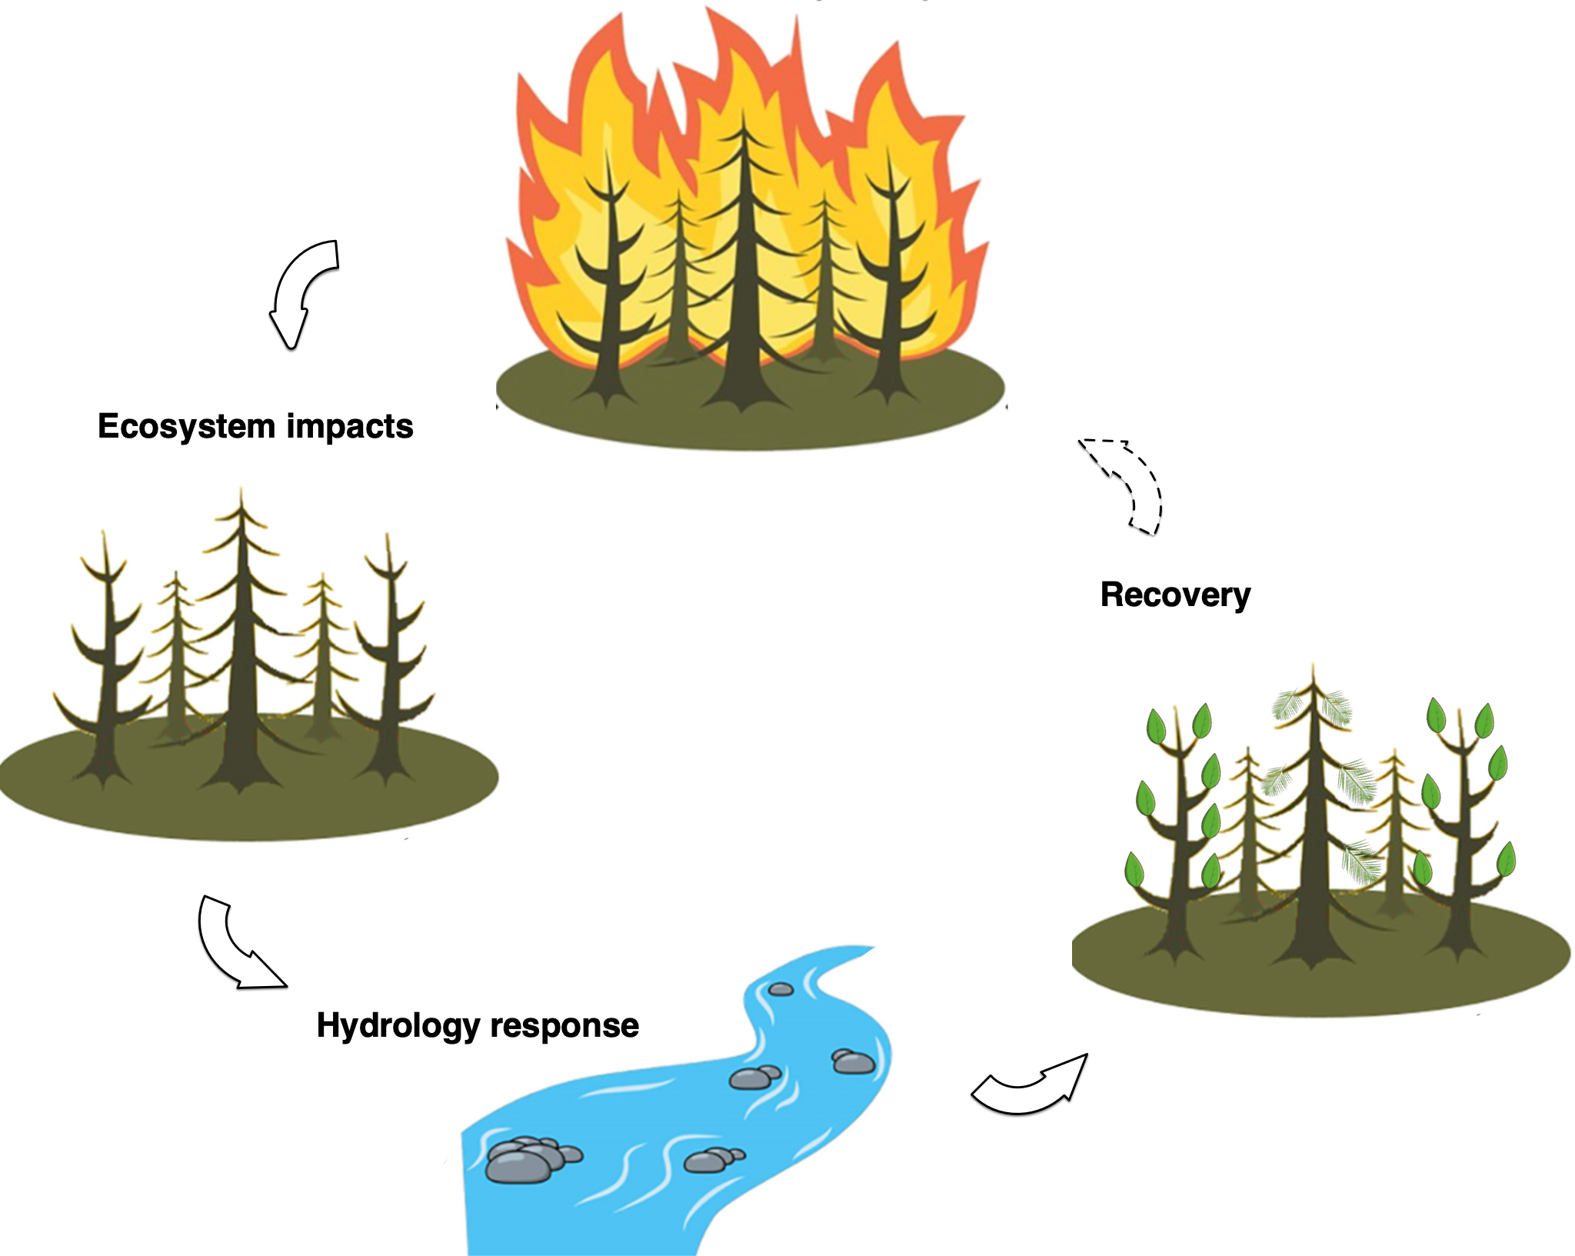
Fire-hydrology case studies
Disturbance
Objectives
Quantify the hydrological causes and impacts of fires and how these relationships have evolved. Evaluate the linkages between antecedent land surface conditions and fire development.
Quantify the local hydrological response (changes in ET, runoff) and recovery post-fire; How quickly do different types of land cover recover their pre-fire evaporation rates after fire events and what is aggregate impact on the runoff?
Examine possible feedback loops (drier/warmer conditions promoting fires → more open land cover with changes to ET/runoff, → enhanced fire risk, sustained land degradation, ..)
Drought
Recovery

Slide 3
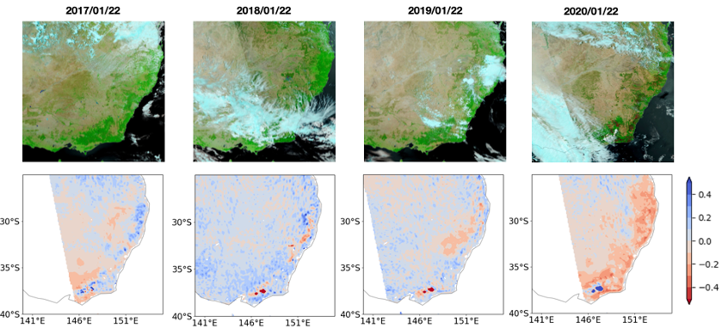
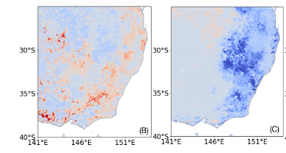
Example 1: Australia 2019-2020 fires
% change in ET post fire
% change in runoff post fire

Slide 4
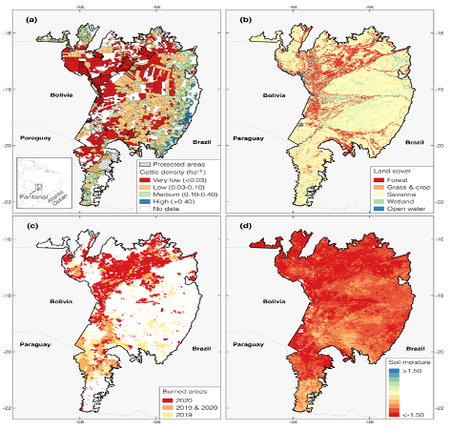
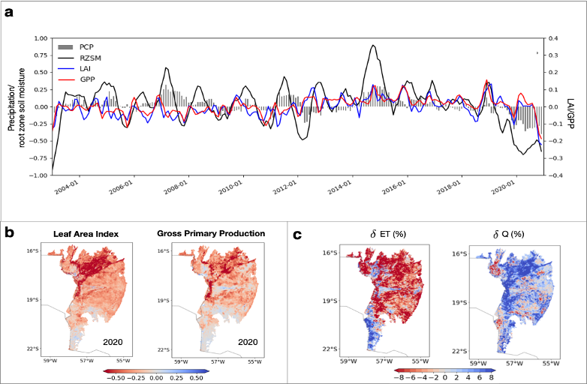
Example 2: Pantanal 2020 fires

Slide 5
Fire-hydrology case studies
Workplan
Feb-March 2022: Scoping period
Identify areas with historical associations between hydrological conditions and fire development and post-fire response based on remote sensing datasets (e.g. OpenET, Burn area - MTBS, TWS – GRACE, Vegetation - LAI)
Evaluate open loop runs (10 km), and look for agreement with RS products.
Develop external connections, plan for webinar.
April-May 2022: Model set-up
Model configuration, RS data preparation, with 1-km runs with LAI, Snow DA
Mini-run to test capturing fire impacts over small time period (e.g. 6-month centered on Fire event).
June-July 2022: Model Implementation
Develop high resolution simulations over hotspots
August-September, 2022: Analysis
Enable connections with hazard models and link them with local scale assessments (Feb 23)
Create interactive storymaps and Jupyter notebooks (Feb 23)
Collaborators/Science groups/End users
USDA-ARS: Yun Yang
Amazon Environmental Research Institute (IPAM)
Federal University of Rio de Janeiro
Matt Hansen and UMD GLAD (advisors)
and EIS-Fires, Applied Wildfires, NASA Ames, ET
USFS (Missoula Fire Sciences Lab, Tactical Fire Remote Sensing Advisory Committee, other researchers) (?)
NASA Mission relevance
NISAR (deformation, disturbance),
SBG (fire risk/recovery, carbon),
SWOT (surface water)

Slide 6
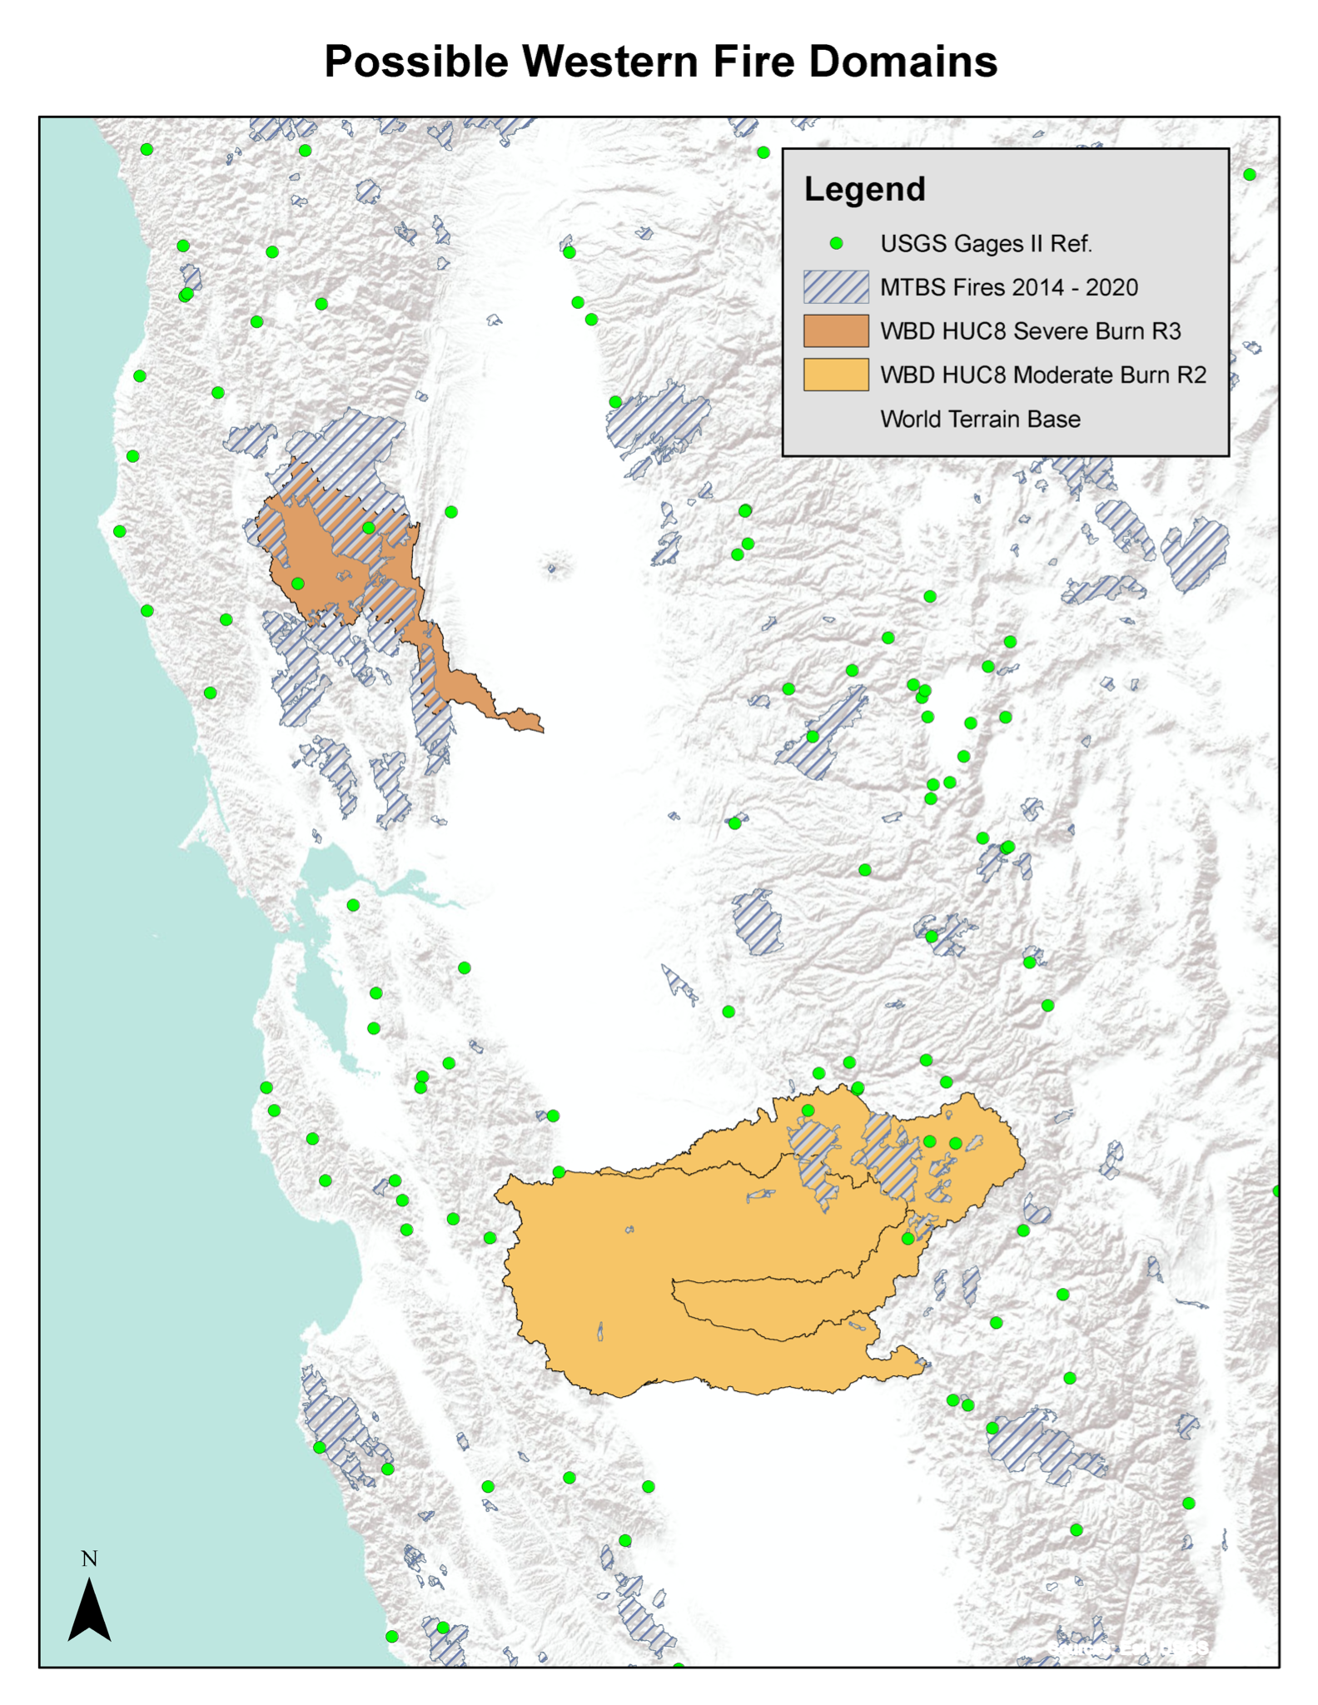
Regional LIS Model Domain Selection
Domain Configuration Details
1-km Grid Resolution (we can go lower e.g. 2 - 2.5 km to cut computational time)
LDT to downscale 10-km simulation for initial conditions (less spin-up)
2002 - Present Analysis Period
LIS-HyMAP
Moderate Fire R2 Domain
Encompasses several USGS HUC-8 basins
Upper Merced (North East) is most valuable with most of the fire domains and several USGS reference basins. Gages outside the fire area are nearby, which could be useful as a control
Downstream areas in central valley have limited reference basins (too many diversions)
Severe Fire R3 Domain
Includes single HUC-8 (Upper Cache)
Single USGS Gage is in the fire area, but other options are limited

Slide 7
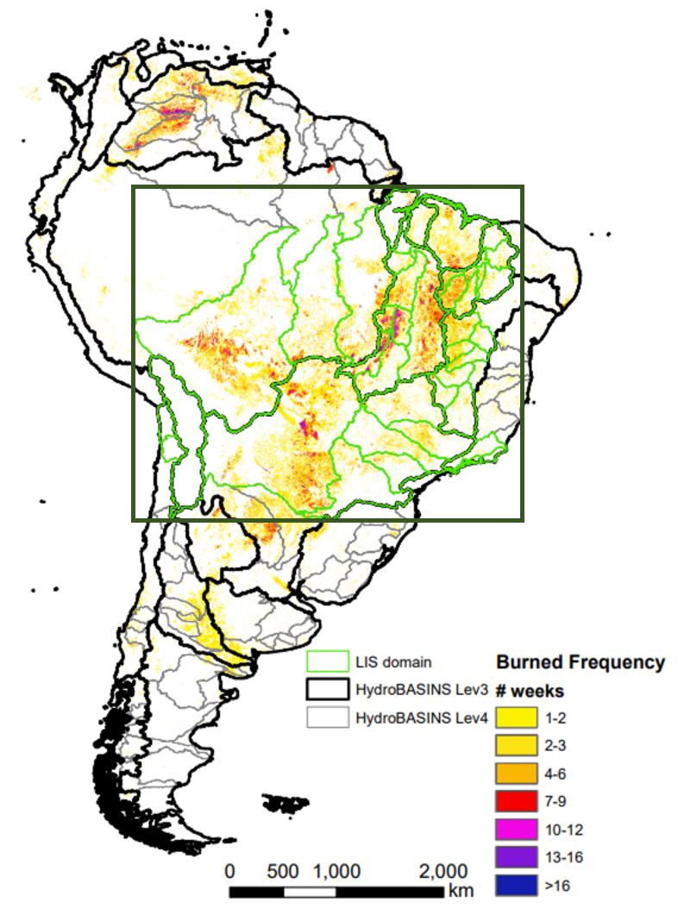
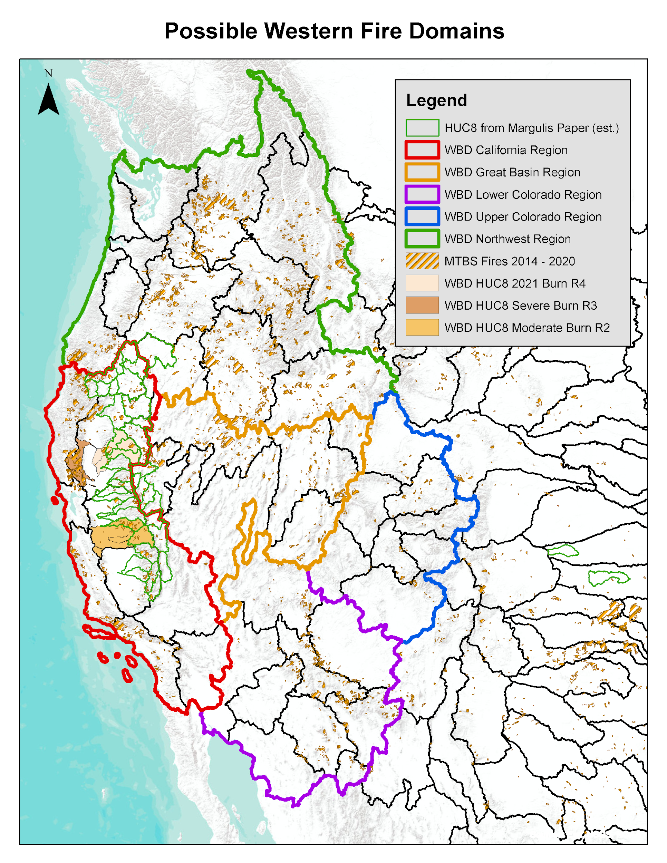
Fire-hydrology case studies
Two domains with recent fire activity are selected to investigate Fire/Hydrology connections:
Western US: West coast to Rockies.
South America: Amazon and Parana river basins.
Other options (for later stages): Boreal Russia (with permafrost), Mediterranean, Australia.
Western US: California and Columbia River watershed, Sacramento/San Joaquin watershed
Repeated fire events in the past several years with post-fire effect on ET and recovery (Yang et al.)
Within OpenET domain (high-res, multi-model ET data available)
Fire dependent grasslands.
Partner: Yun Yang/ARS (Applied Sciences project)
Amazon and Parana river basins, Brasil:
Pantanal wetlands/Cerrado savannah
Evidence of human activity in fire development (Kumar et al. 2022), ecological and hydrological regime changes post-fire.
Fire sensitive wetland (Pantanal), and Fire dependent forest/pasture (Cerrado ??)
Partner: IPAM: Fire science field experiment in Mato Grosso to test Savannisation since 2014

Slide 8
Connection between EIS Freshwater and EIS Fire
EIS FIRE represents the main effort focused on wildfire from a near real-time angle, including risk prediction, fire behavior monitoring and tracking of post-fire debris flows.
EIS Freshwater Task 1 (Fire/Hydrology) connects to the following elements of EIS FIRE:
EIS FIRE Task 1: Pre-fire risk, lead: Robert Field/NASA GISS Goal: to better understand the role of specific fire weather conditions for periods of rapid fire spread (focusing on fire behavior, rather than fire ignition risk) and investigate how well we can forecast those specific driver variables (FWI, hot-dry-windy, or related metrics like VPD) for different regions on 1-5 day lead times.
Advise FW-Fire/Hydro on implementation of FWI based on LIS and interpretation of existing products.
Research Question: Do high-res (1km) LIS/WRF surface state variables (soil moisture, VPD) improve the precision of FWI? Explorative work for topics in future EIS years.
EIS FIRE Task 3: Fire spread/behavior monitoring.
Advise FW-Fire/Hydro on Fire Products from VIIRS, Robert Wolfe/619
Question: besides Fire intensity, is there an early assessment of post-fire vegetation condition to inform landcover settings for LSM?
EIS FIRE Task 5: , Post-fire debris flows, lead: Dalia Kirschbaum, team: Elijah Orland/617
Can LIS-WRF-Hydro model impact of fires on overland flow?
Research Question: Soil moisture conditions after fire, more saturated?
Fire Spread and behavior
ET
Pre-fire risk
drought information
Overland flow impactv
Post-Fire
land cover
Post-Fire debris-flow

Slide 9
Fire-hydrology case studies
MATERIALS
Observational products (Remote Sensing, unless noted otherwise)
Water inflows: Precipitation (IMERG)
Water state: Vapor Pressure Deficit (tbd, e.g. as in PT-JPL), Soil Moisture (SMAP 1km product), TWS (GRACE), Vegetation water content (proxy: LAI, AMSR-E VOD)
Water outflows: Evapotranspiration (OpenET for California, ALEXI, PT-JPL, or GLEAM global), overland flow (USGS river gauges)
Vegetation state: LAI (MODIS ), land cover (MODIS), Burn area (MTBS global, Amazon local alternative?)
MODEL FRAMEWORK
LIS 1 km spatial resolution, 2003-2021
HyMAP for river routing. only executed for smaller sub-regions based on science questions.
Driving data
MERRA-2 Meteorology
Data assimilation
Snow
Soil Moisture
Leaf area index (LAI) / Vegetation Optical Depth (VOD)
Special adaptation
Startup based on Global spin-up
Ability to switch land use in response to disturbance, annually

Slide 10
Case Study 1: Western US
EIS Freshwater Task 1: Fire/Hydrology

Slide 11
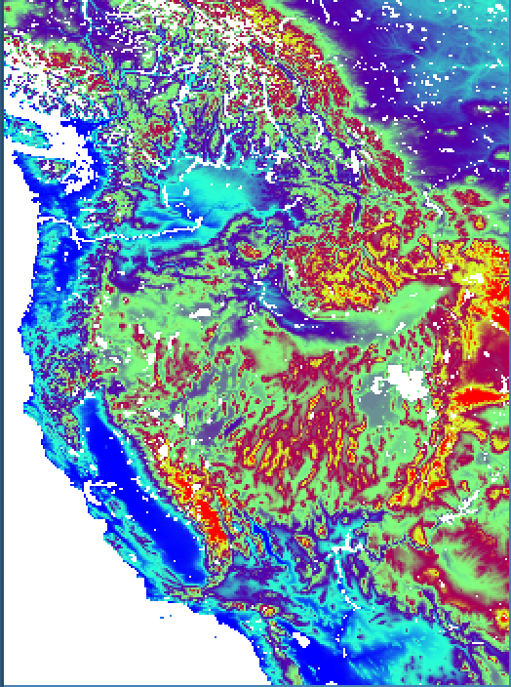
Columbia River and California Configuration
Domain Details
Domain size: 1560 (x) x 2110 (y) km (updated)
LIS-Only: Simulation Complete to 1-Jan-2021
LVT Postprocessing: In progress, to be completed later this week (slower than model)
Model Configuration
24-hr LSM Output: Faster post-processing, less storage required
Updated Variable Lists: Selected based on needs of fire project and science questions
HyMAP: Will be executed for smaller sub-regions based on science questions.

Slide 12
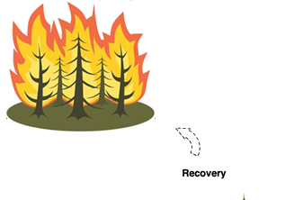
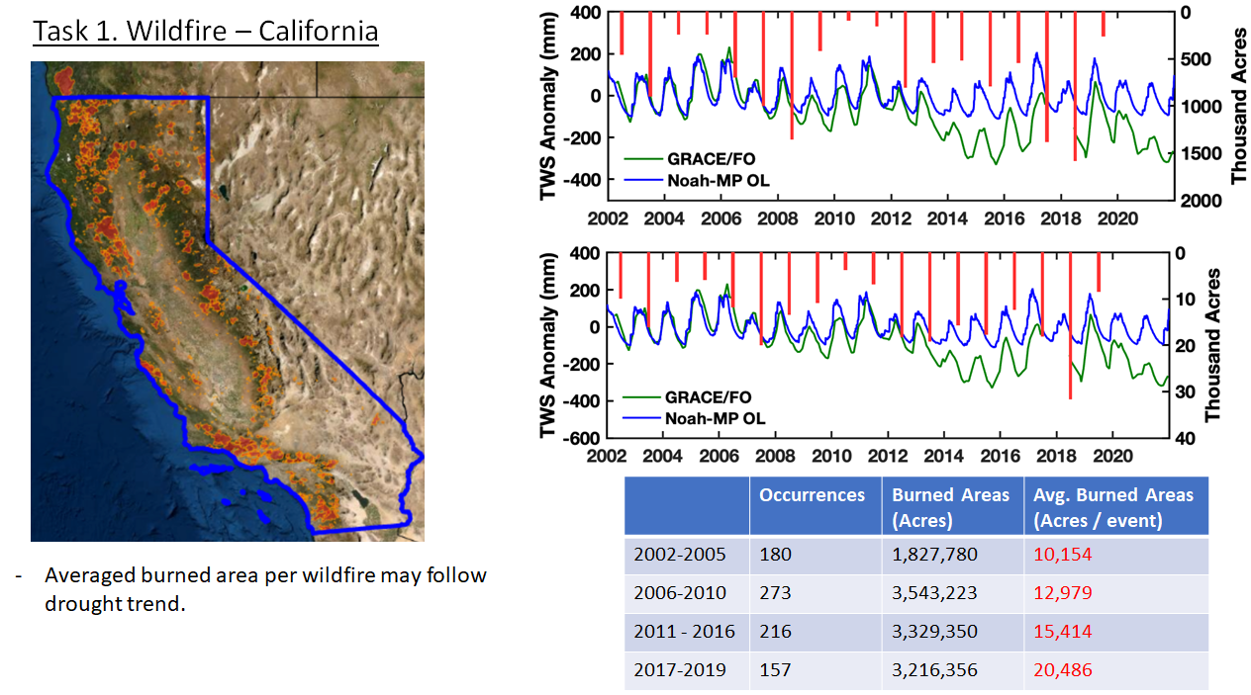
Large scale drought provides conditions for increased fire activity.
California, Western US: Sacramento/San Joaquin watershed
GRACE/FO shows large anomalies in terrestrial water storage (TWS)
Heatwave/ Drought

Slide 13
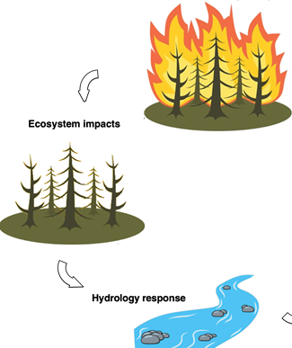
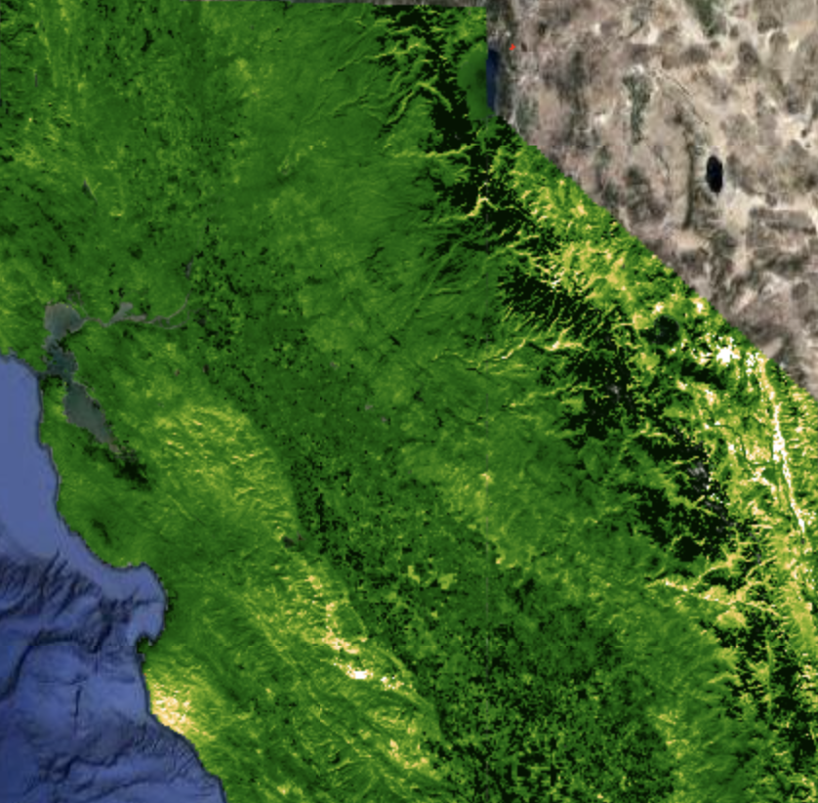
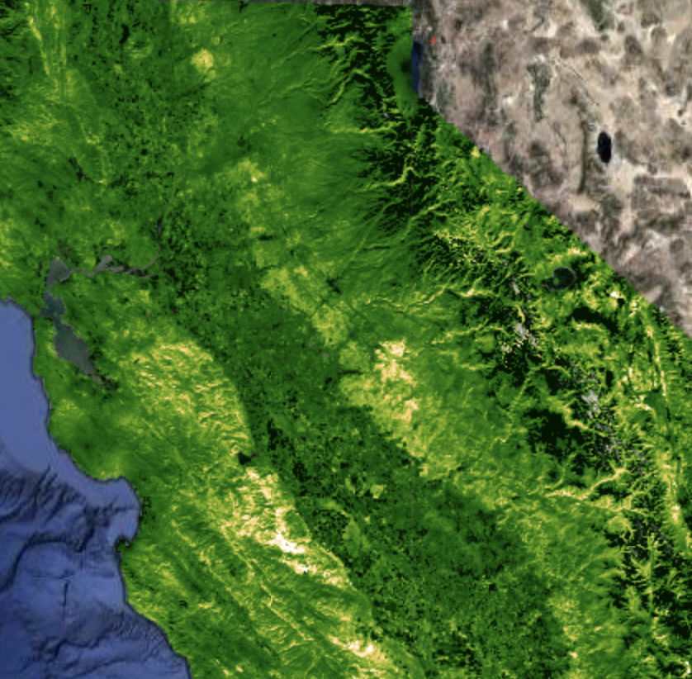
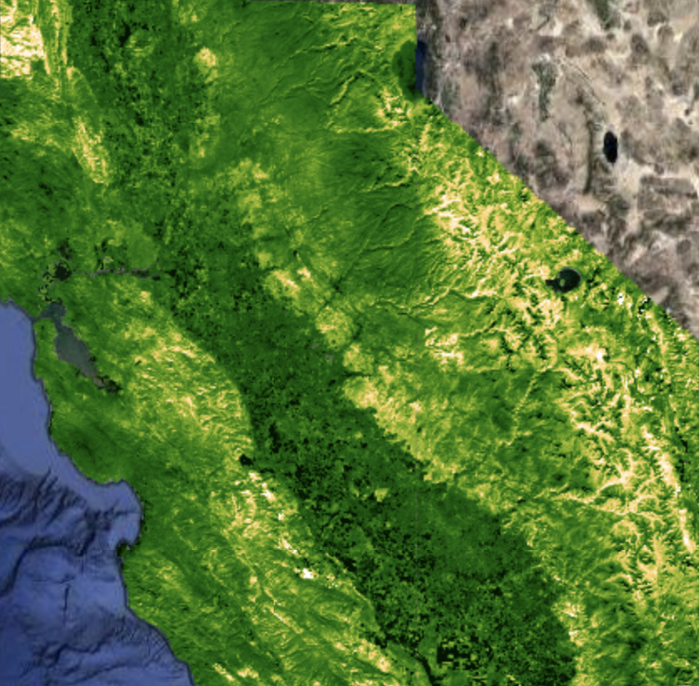
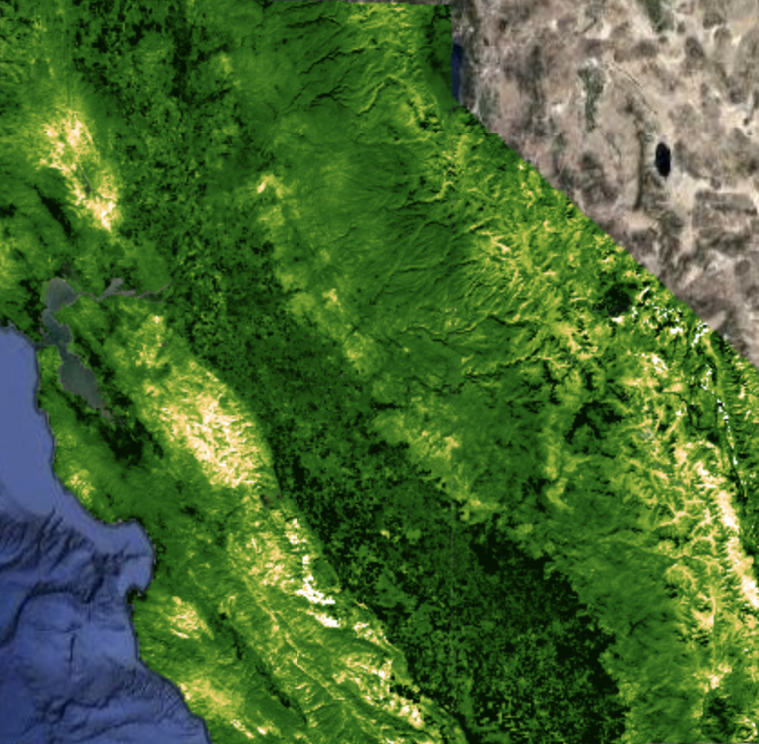
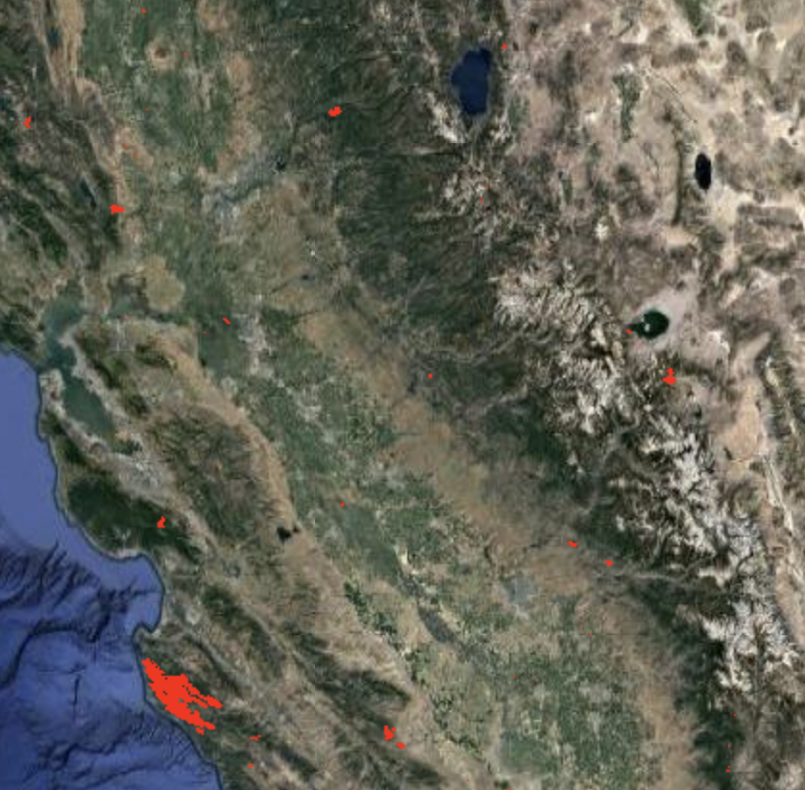
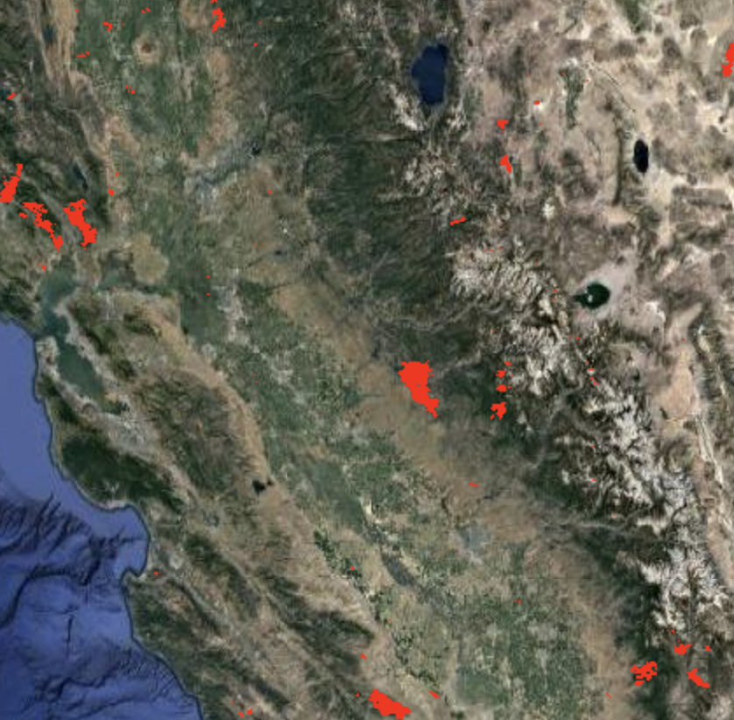
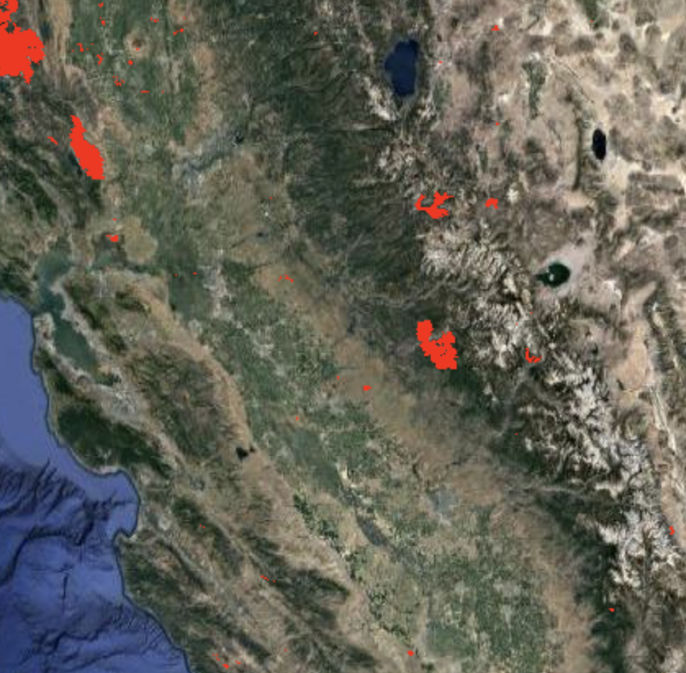
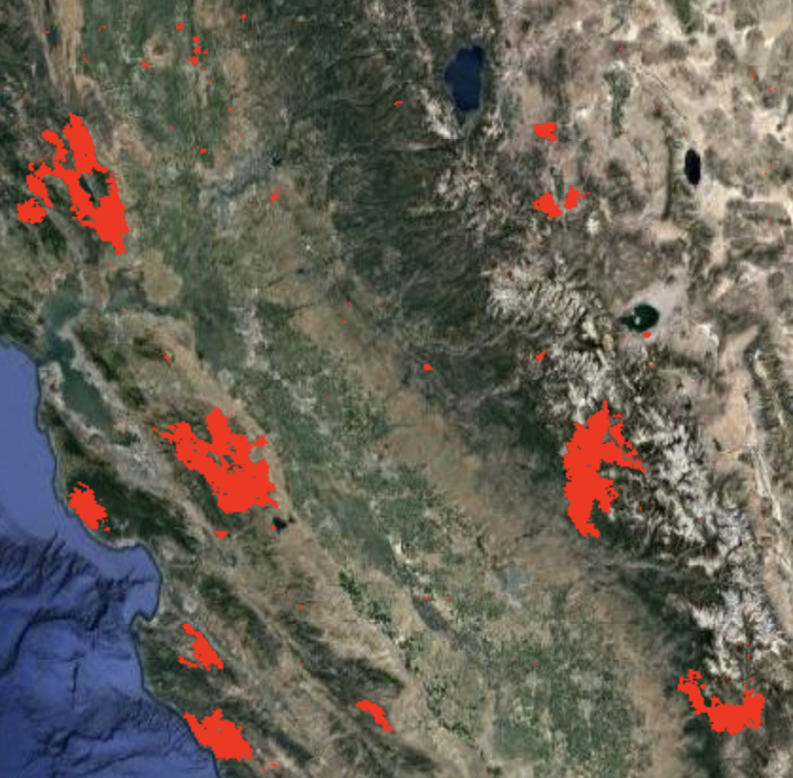
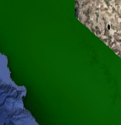
MODIS Burned area corresponds well with reduced relative ET rates.
Reference ET (lower-right) shows no such spatial pattern, confirming a land surface source.
While wider scale drought provides conditions for fire, vegetation impacts affect ET recovery.
2016
2017
2018
2020
0
0.2
DISALEXI-based ET residuals
F (reference ET)
2017
MCD64A1 Burned areas
0
0.25

Slide 14
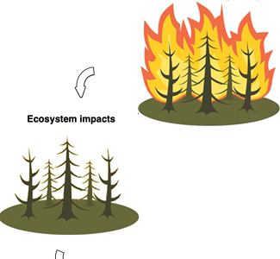
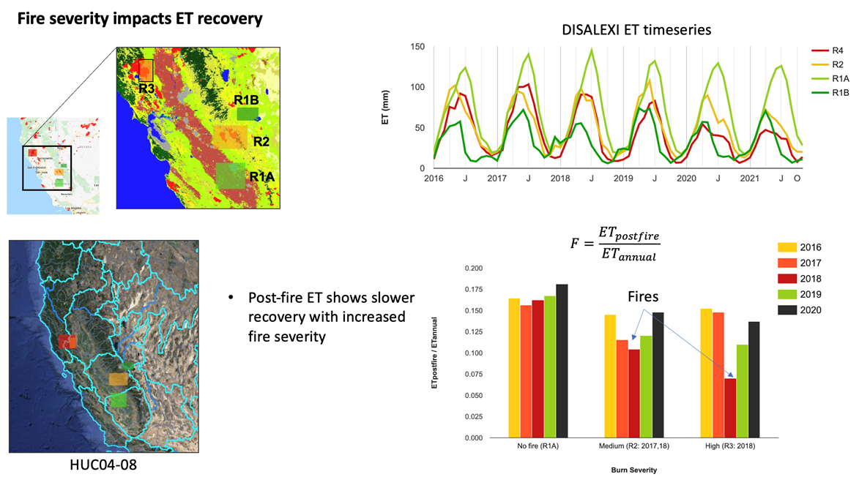
Fire severity impacts ET recovery

Slide 15
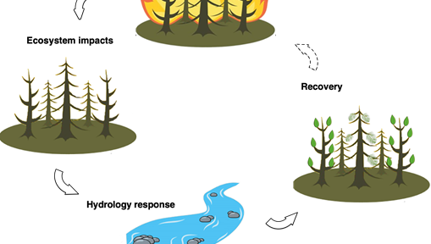
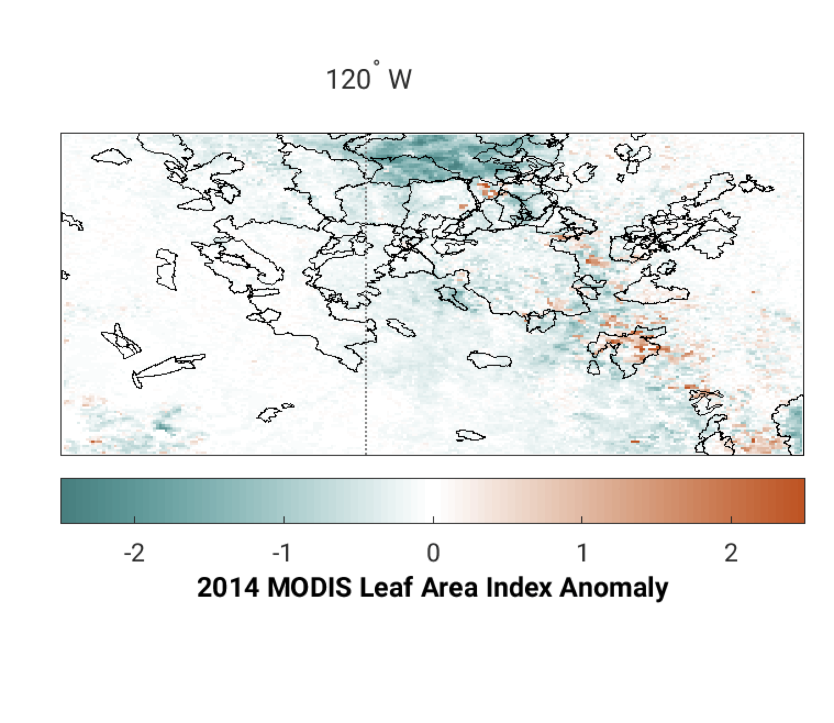
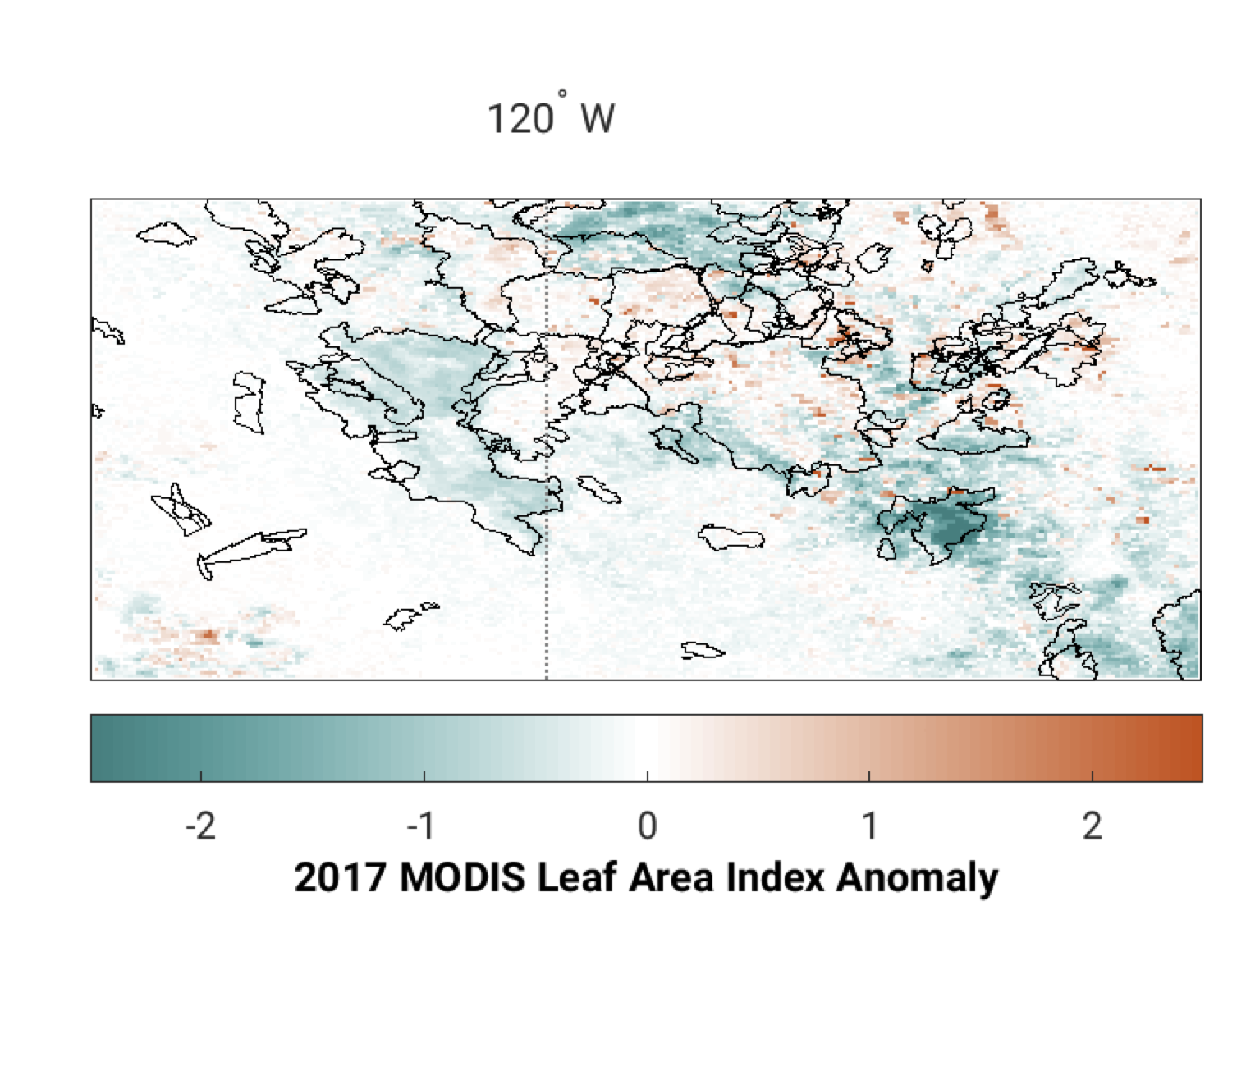
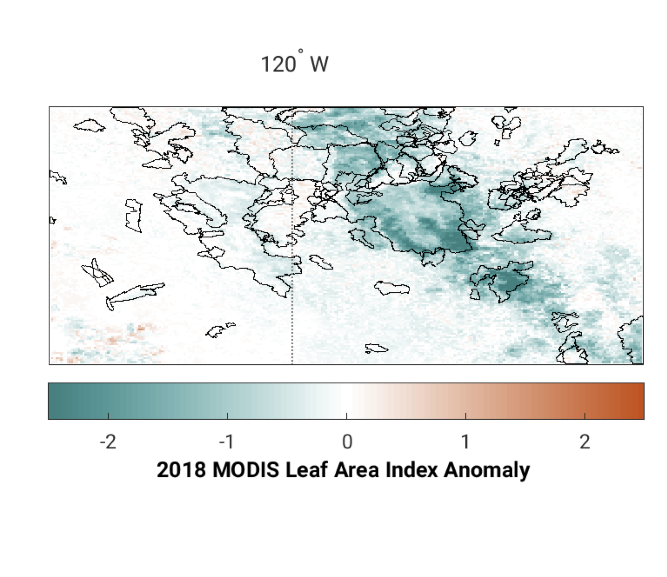
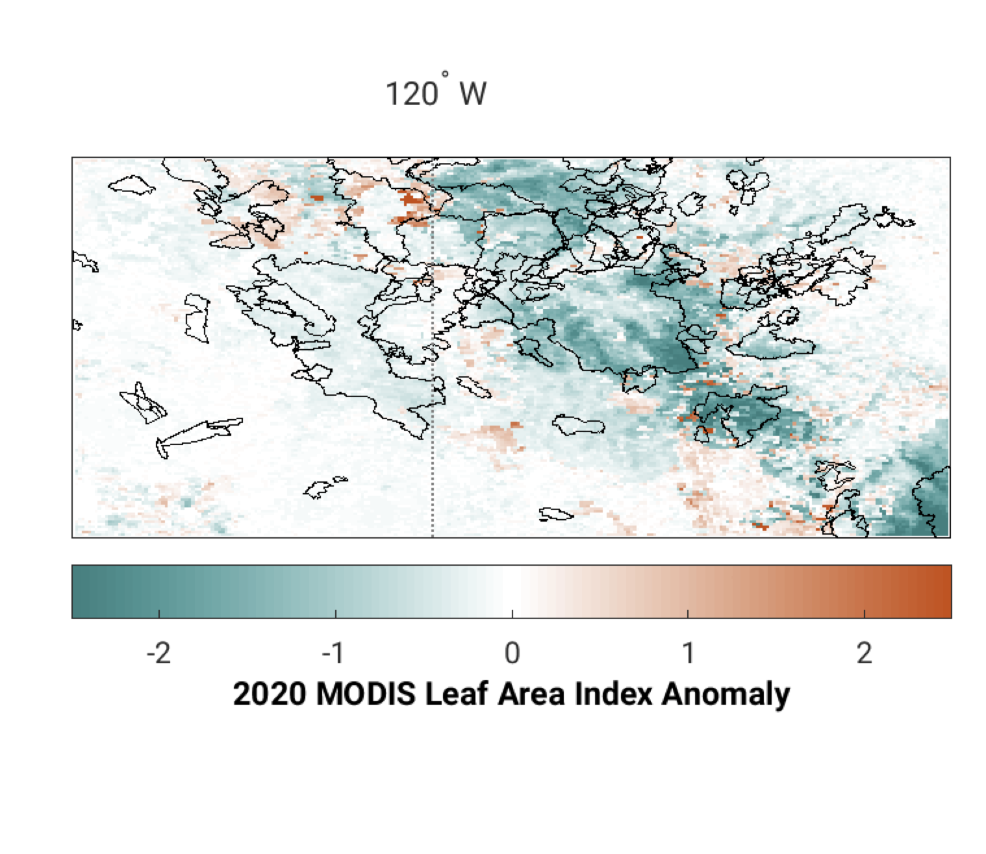
MODIS LAI Anomalies show sustained impact on vegetation
Fire Years R2 Domain (6 September)
MODIS LAI Anomalies follow burn areas, especially following fires.
Impacts to LAI vary. For example, 2018 fires appear to be the most severe, while 2019 fires barely impact LAI. LAI anomalies persist past fire years (2020)
Fire impacts are less than LAI reductions due to drought (compare to 2014).
2018 Fires
2017 Fires
2017 Fires
2018 Fires

Slide 16
Case Study 2: South America
EIS Freshwater Task 1: Fire/Hydrology

Slide 17
Amazon LIS Configuration
Final LIS domain
Domain size: (2779, 3239) km
OL model runs in process based on updated output list
~2 hours/month with 24-hr outputs

Slide 18
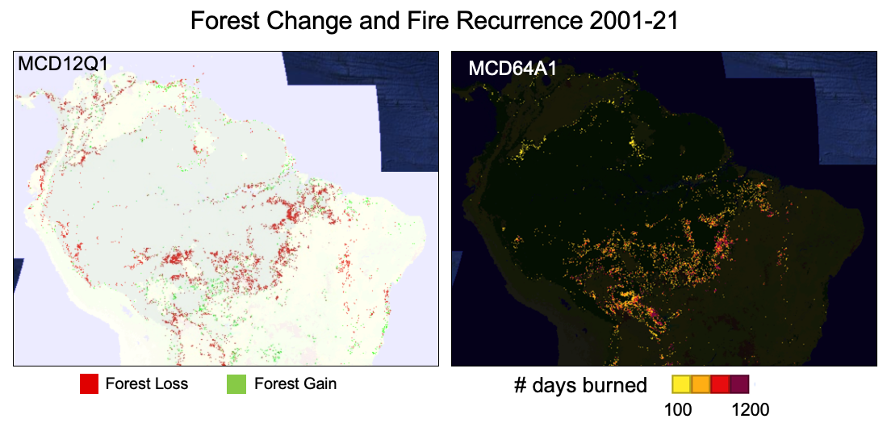
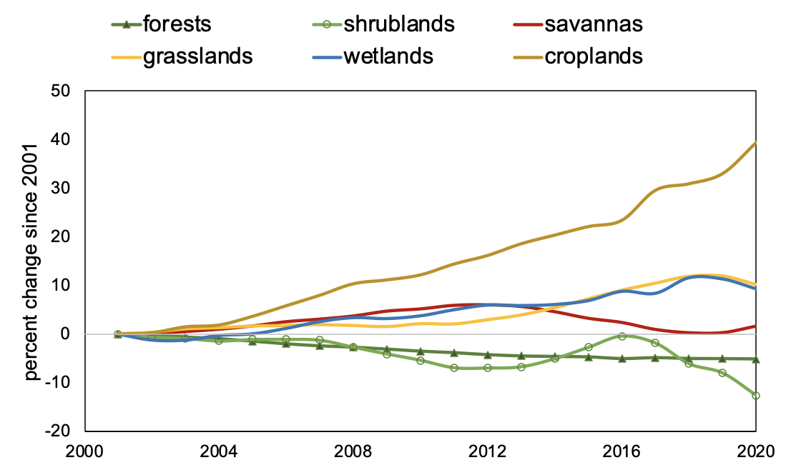
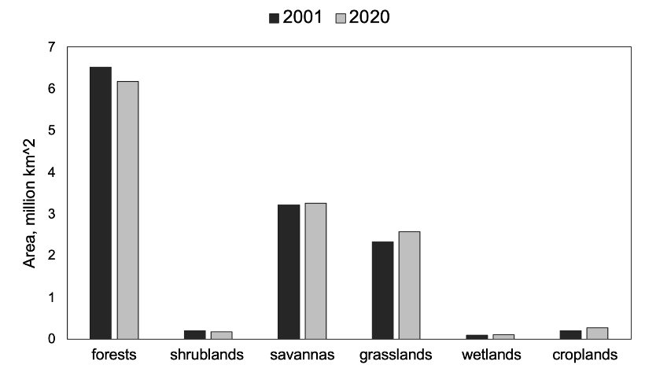
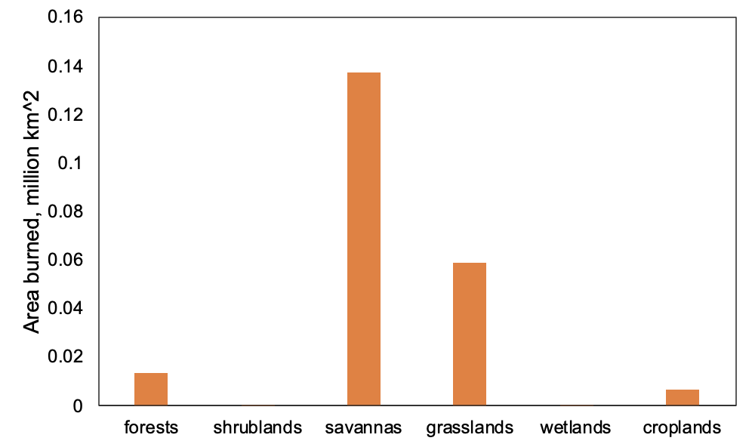
Amazon: Land cover and fire recurrence trends
Total area by land cover
Area burned by land cover
Decline in forests potentially corresponds with increase in grasslands
Higher fire recurrence causes rapid change in land cover

Slide 19
Summary
EIS –freshwater is focused on quantifying the fire-hydrology connections as it relates to both pre-fire and post-fire conditions.
Looking for science collaborators to co-develop and advise on these case studies and explore possibilities for routine use.

