Slide 1
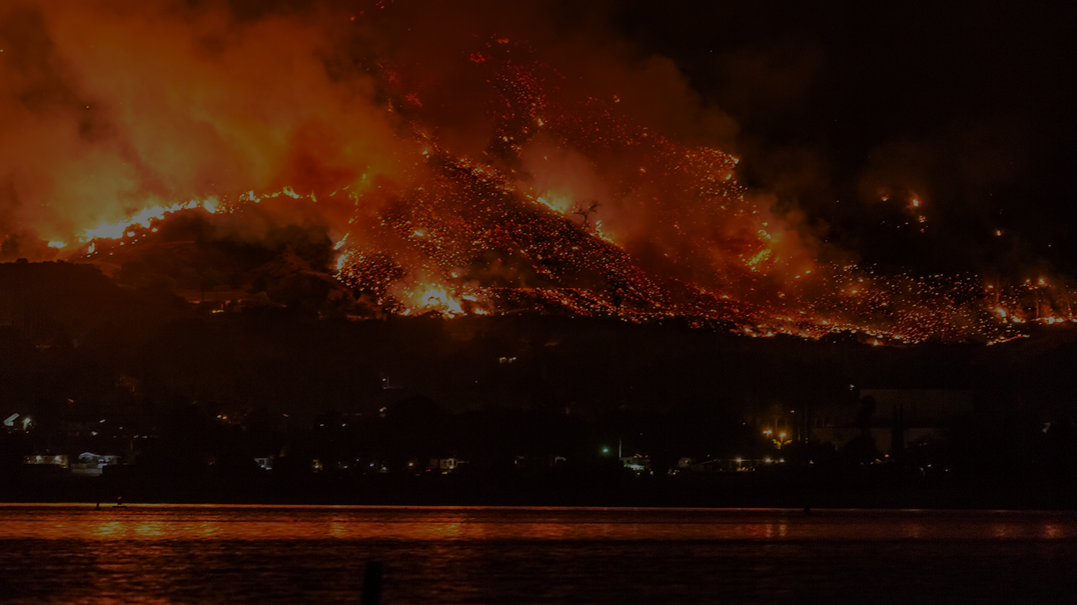
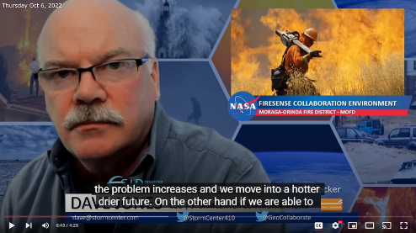
TFRSAC April 19-20, 2023
StormCenter Communications
Engaging the Wildfire Community with Improved Trusted Data Integration and Interoperability
Wildland Fire Program
JPSS Fire & Smoke Initiative
Prime Contractor
SBIR Phase III Technology Implementation
Dave Jones, CEO
StormCenter Communications, Inc.
Tactical Fire Remote Sensing Advisory Committee
April 19-20, 2023 Hybrid Meeting
INFORMATION SOURCES
Presentation: Block 5 5_5 April 20, 2023

Slide 2
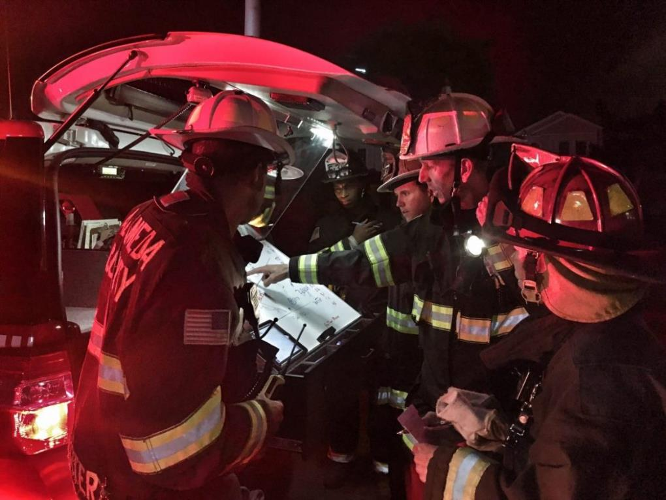
Fire Chief Dave Winnacker
Moraga-Orinda Fire District, California
ESIP Disaster Lifecycle Cluster Monthly Meeting
“If we can get Fireline intensity, by acre as a fire is burning, and an understanding of where those pathways occurred, not just a perimeter but the intensity of the fire within that perimeter and ranking it by doing what is needed to restore those landscapes to balance, we will limit the impacts of bad fire while using the good fire help restore the ecosystem.”

Slide 3
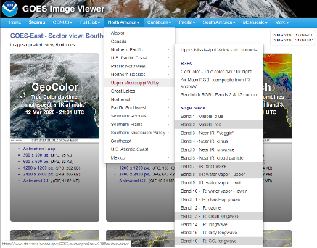
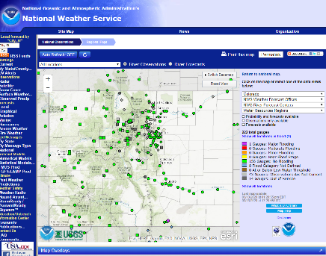
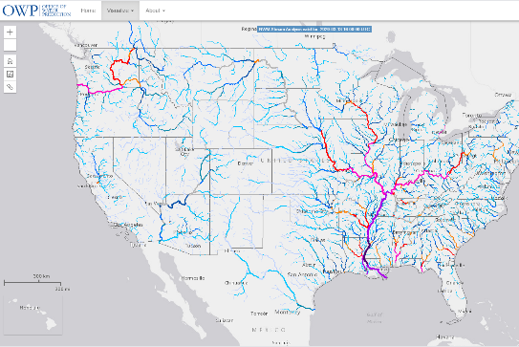
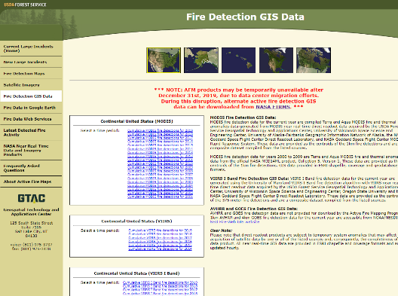
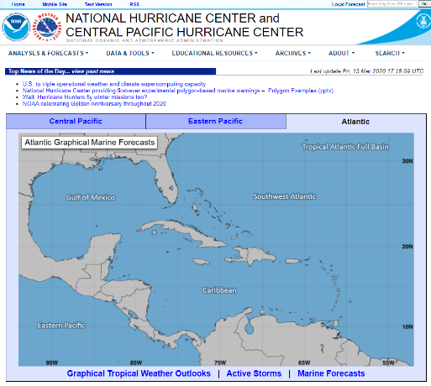
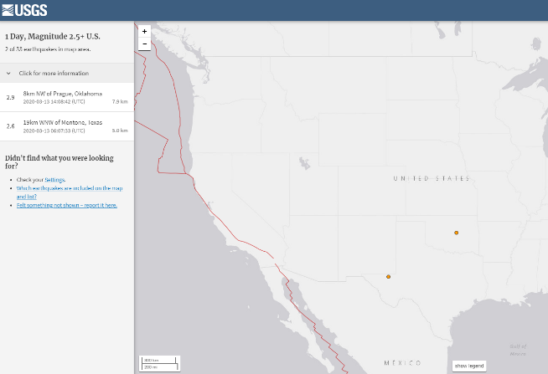
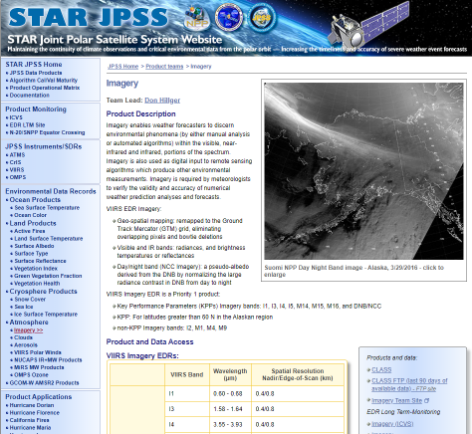
Many Websites & Data Portals Out There
Hubs, Portals & Data Sources
Earthquakes
Many browser windows
look like this
Hurricanes

Slide 4
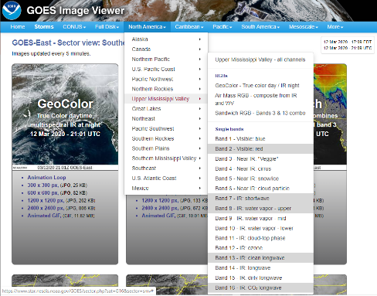
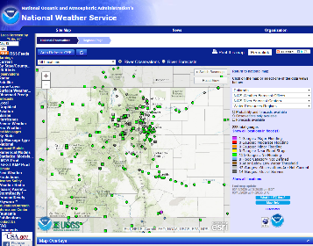
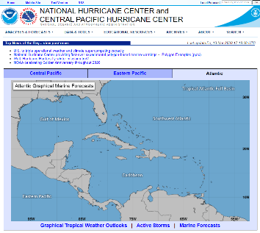
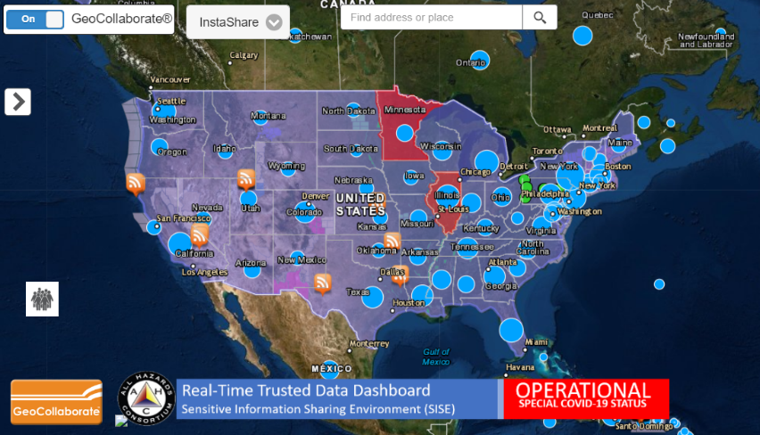
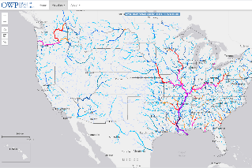
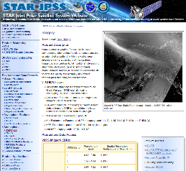
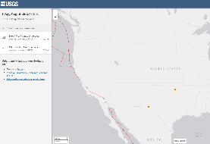
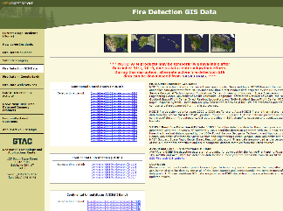
GeoCollaborate Unifies Disparate Trusted Sources
In a collaborative environment
Hydrology / River Gauges
National Water Center
Hurricanes
Earthquakes
Polar Satellite Imagery
Simple Display controlled by ON/OFF switch
So many websites offering pieces of information
Deliver Trusted Data from disparate sources, in real-time, onto any map

Slide 5
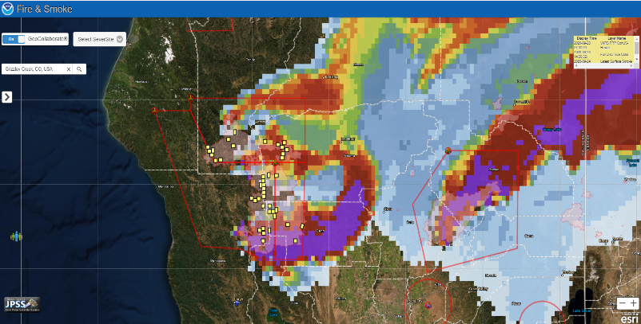
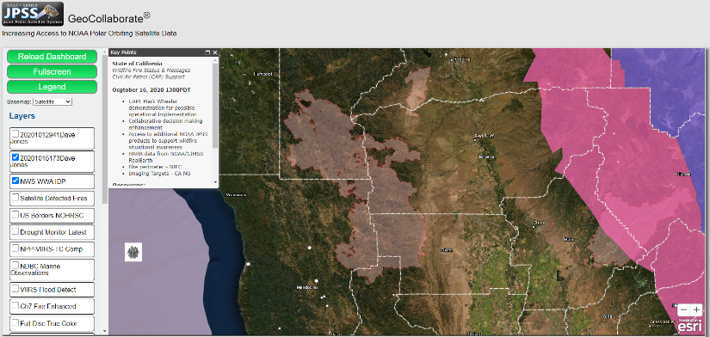
GeoCollaborate Unifies Disparate Trusted Sources
In a collaborative environment
LEADER
FOLLOWER
COLLABORATIVE
DASHBOARD
Geographic location (Area of Interest & Data Layers) can be selected by individual user
OGC compliant data formats for rapid interoperability
*Satellite, drones, models, observations, reports, pictures
Output from AI, ML – data driven decision making

Slide 6
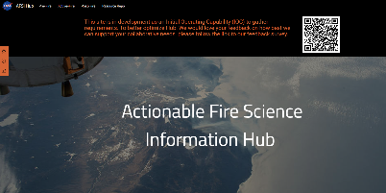
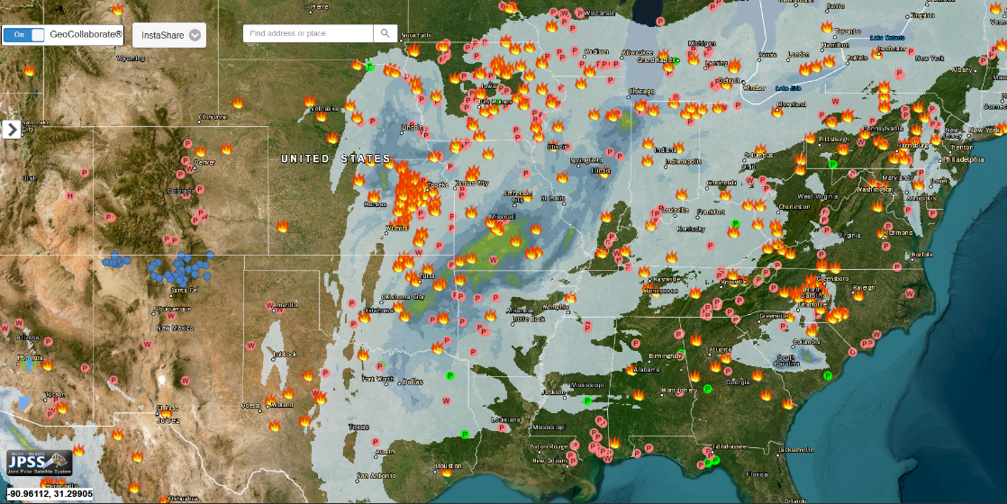
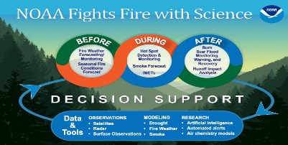
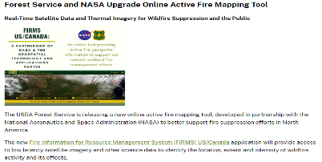
Wildland Fire Collaboration
StormCenter Communications
Unified trusted data via web services shared across platforms
INFORMATION SOURCES

Slide 7
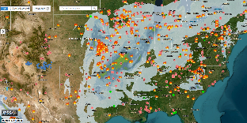
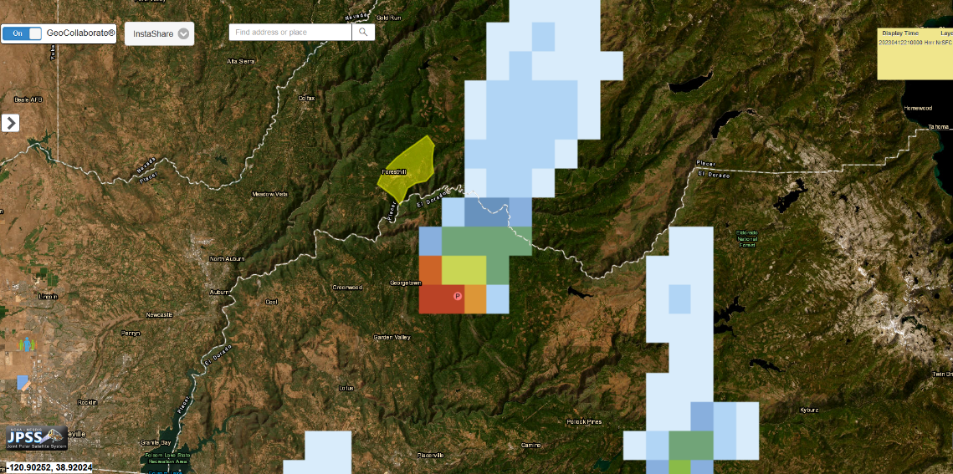
Wildland Fire Collaboration
StormCenter Communications
Tobacco Gulch Rx
Unified trusted data via web services shared across platforms
INFORMATION SOURCES

Slide 8
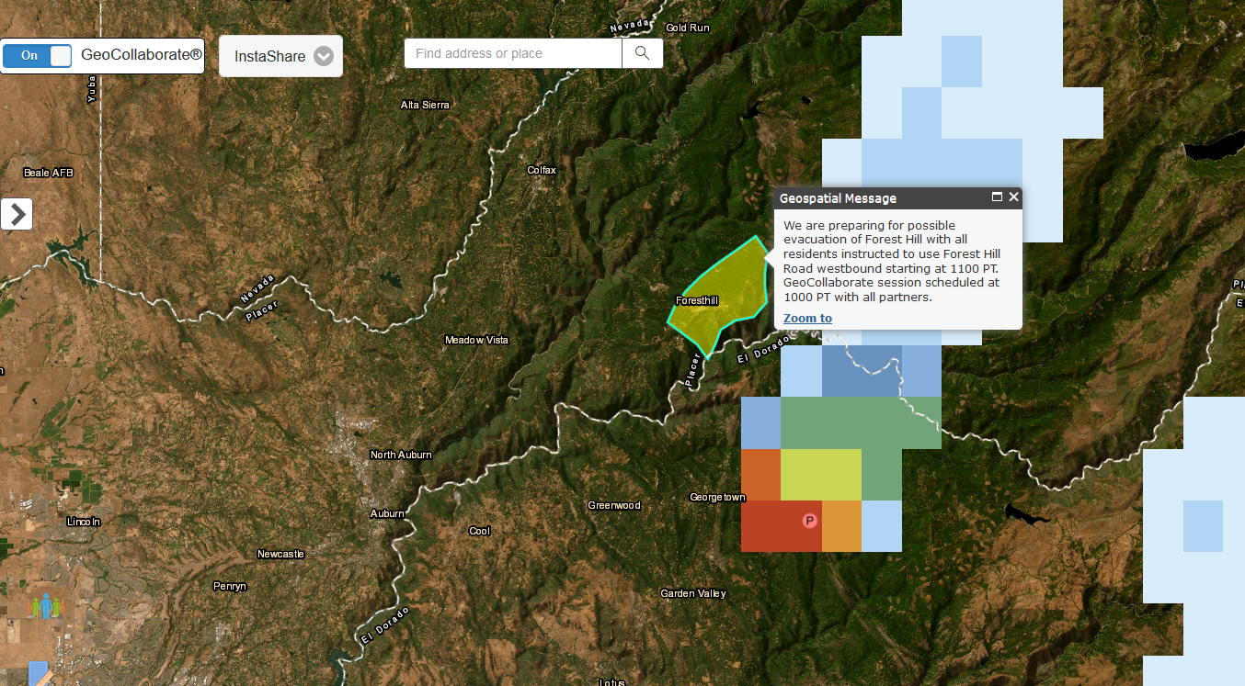
Wildland Fire Collaboration
StormCenter Communications
Tobacco Gulch Rx
Unified trusted data via web services shared across platforms
INFORMATION SOURCES

Slide 9
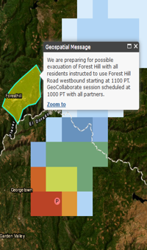
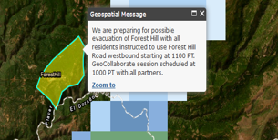
Wildland Fire Collaboration
StormCenter Communications
Mobile Devices
Laptops
Tobacco Gulch Rx
INFORMATION SOURCES
Unified trusted data via web services shared across platforms

Slide 10
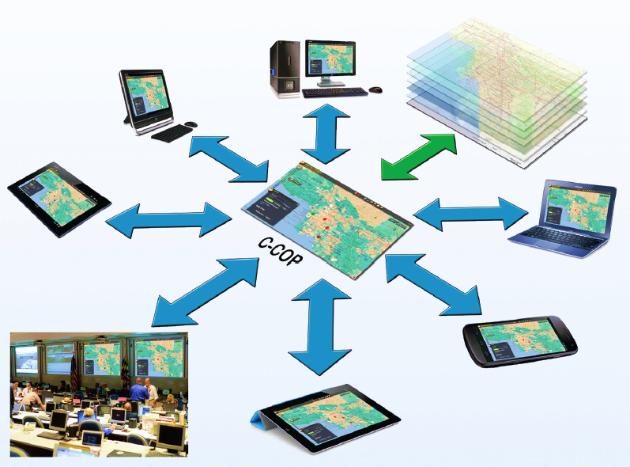
Wildland Fire Collaboration
StormCenter Communications
Mobile Devices
Laptops
INFORMATION SOURCES
Unified trusted data via web services shared across platforms

Slide 11
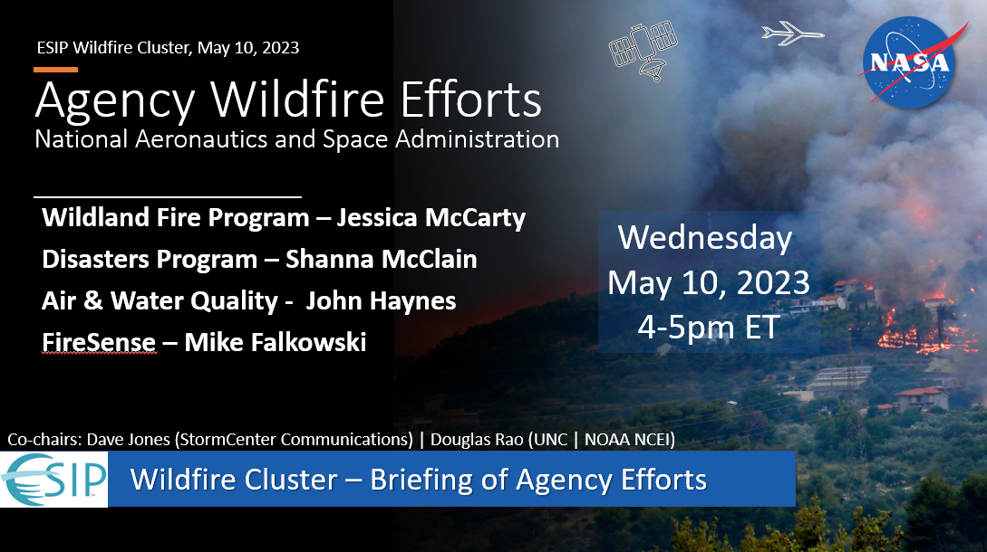
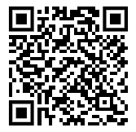
Wildfire Cluster
ESIP Wildfire Cluster
April 12: NOAA
May 10: NASA
June 14: USFS & USGS
July 18-21 ESIP Burlington, VT
“A bridge between practitioners and data geeks.”
Wildfire Mail List
ESIP Wildfire Cluster
INFORMATION SOURCES

Slide 12
Thank you!
Technical Contact:
Dave Jones
dave@stormcenter.com
410-271-4413 (m) / 410-203-1316 (o)
Chief Scientist
Ellen Prager, Ph.D
ellen@stormcenter.com
410-203-1316 (o)
Contracts Manager:
Nancy Campbell
nancy@stormcenter.com
410-203-1316 (o)
Tactical Fire Remote Sensing Advisory Committee Meeting

Slide 13
Thank you!
LIVE Brief Demonstration
of GeoCollaborate During the Break
Tactical Fire Remote Sensing Advisory Committee Meeting

