Slide 1
Artificial Intelligence Systems for Analysis of On-orbit Satellite Imagery
December 2, 2021

Slide 2
Overview
Large Area Fire Detection
Reduce Data Latency down to 30 Minutes
Reduce Cost of Data
FeatherEdge Platform
Using Machine Learning on the Ground
Next Steps
Questions?

Slide 3
Large Area Fire Detection
Current Aerial Solutions
 | Manned/unmanned Aircraft | NASA FIRMS (GSD 250m) | Commercial satellites (GSD <5m) | Satellite with AI (GSD <5m)
Coverage | Low coverage | High coverage | Moderate coverage | Moderate coverage
Revisit Rate | 1-2 times a day/night | 3-4 returns per 24 hr period | Multiple times a day/night (scales with # of satellites) | Multiple times a day/night (scales with # of satellites)
Data Latency | Real-time | ~3 hours | ~5 hours | ~30 minutes
Cost | High | Free | Moderate | Low

Slide 4
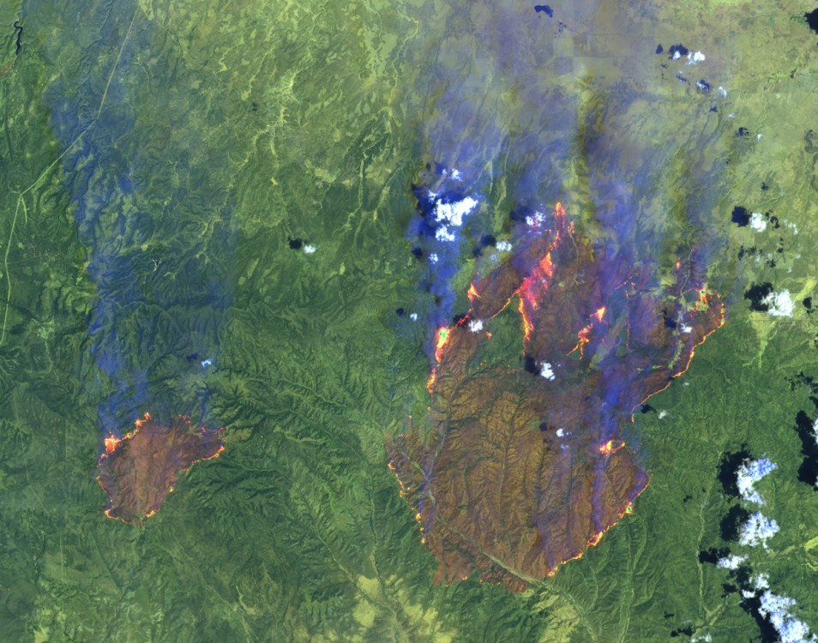
Reduce Data Latency down to 30 minutes
Machine learning model is trained to detect fires from satellite images
Images are processed in real-time on-orbit as they are being taken
Only need to downlink image with fires and their corresponding GPS coordinates
Data can be sent directly to the end users (ex: agency leadership fire managers, dispatchers, duty officer)
Fire
Fire
Photo from Landsat 7 Science Team, NASA GSFC

Slide 5
Reduce Cost of Data
Only need to pay for the relevant data rather than the raw images
Fire detection model replaces some of the work done my analyst
Same fire detection model can be used by multiple organizations in different regions, therefore reducing cost

Slide 6
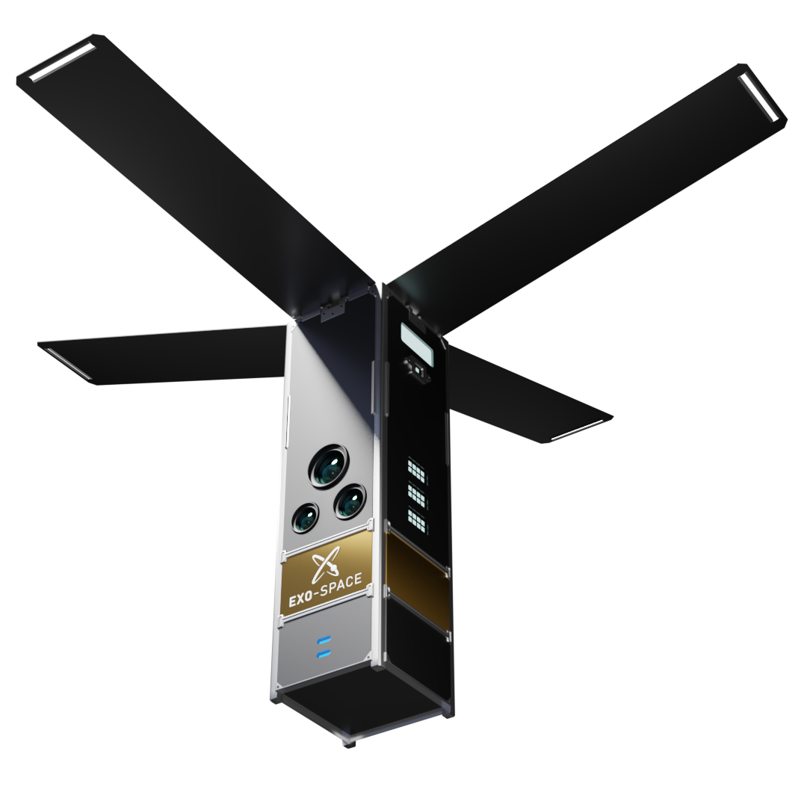
FeatherEdge Platform
Mission Specification
Satellite Imager | Visible and near infrared spectral range (GSD <5m)
Orbit | Low-Earth Orbit
Revisit Rate | Up to 4x per day per satellite (area dependent)
Number of Satellites | First satellite to launch in October 2022
Processing Capabilities
Processor | Quad Cortex-A53 CPU with integrated GPU
ML Accelerator | yes
RAM | 4 GB LPDDR4
Flash Memory | 128 GB
AI/ML Model Type | TensorFlow Lite

Slide 7
Using Machine Learning on the Ground
Combine satellite data with other sources on the ground to provide a more accurate fire map
Machine learning model can ingest weather and soil conditions, fuels, historical data, etc., to assess the risk and predict the spread of active wildfires

Slide 8
Next Steps
Work with an organization(s) to train a machine learning model to detect wildfires from satellite imagery
Upload wildfire detection model to FeatherEdge Platform
Help build out machine learning capabilities on the ground to predict the spread of active wildfires

Slide 9
Thank you! Any questions?

