Slide 1
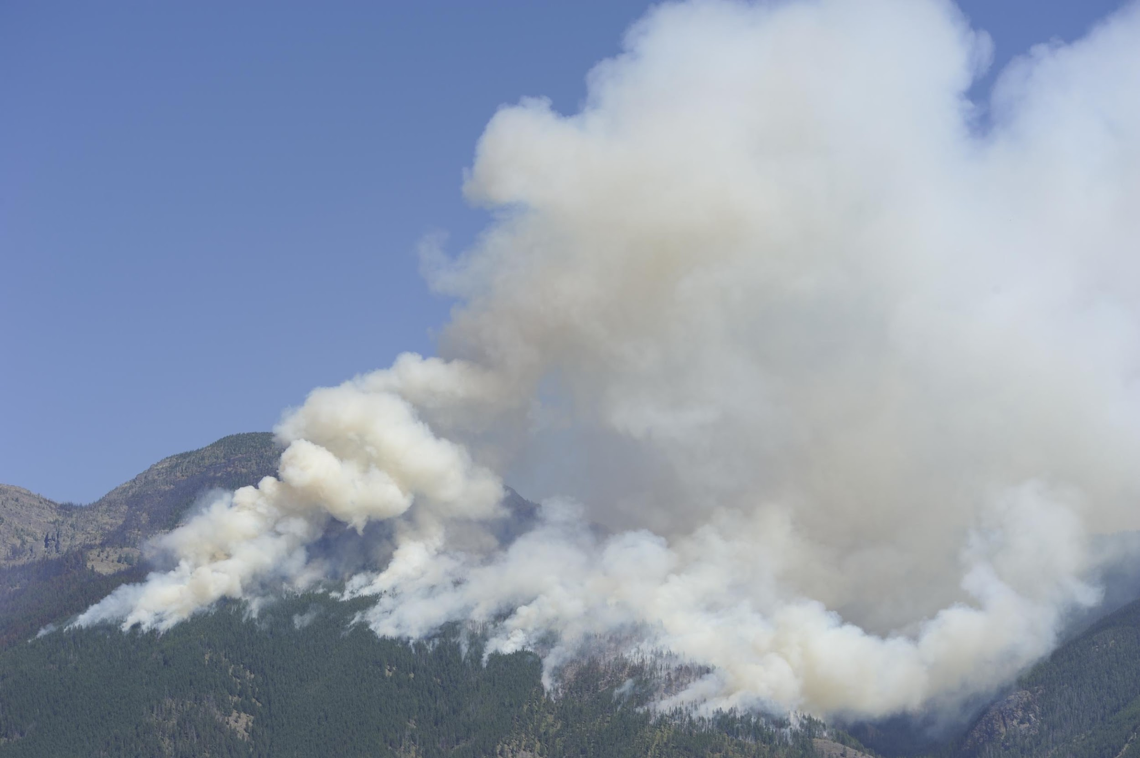
Fire Monitoring and Assessment Platform (FireMAP) Update
Wildland Fire Tree Mortality Mapping from Hyperspatial Imagery using Machine Learning
Dale Hamilton PhD, Kamden Brothers and Samuel Jones
Northwest Nazarene University
Department of Math and Computer Science
November 19, 2020 - Virtual Meeting
Background photo courtesy of the USDA Forest Service

Slide 2
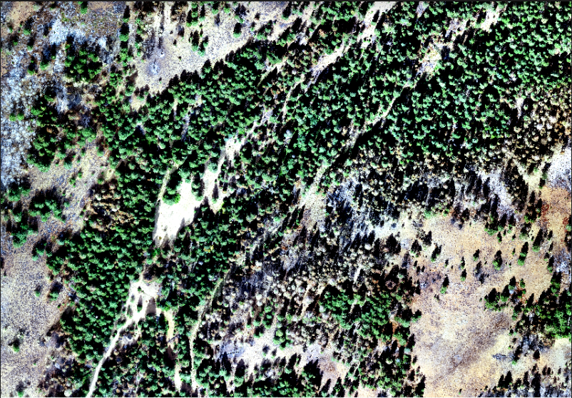
Wildland Fire Severity
Canopy Reduction → Tree Mortality
Non-regenerative (resprouting) species
Post-fire = acquire w/ sUAS (5cm)
Pre-fire = Landfire Canopy Cover products
Canopy Reduction = CC_{pre} - CC_{post}
Crown Fire Activity
if CR = 0 → Surface fire
elseif CC_{post} = 0 → Active crown
else Torching
Background photo courtesy of the USDA Forest Service

Slide 3
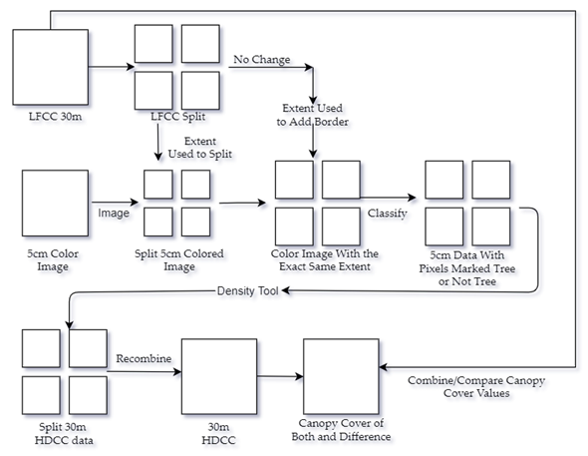
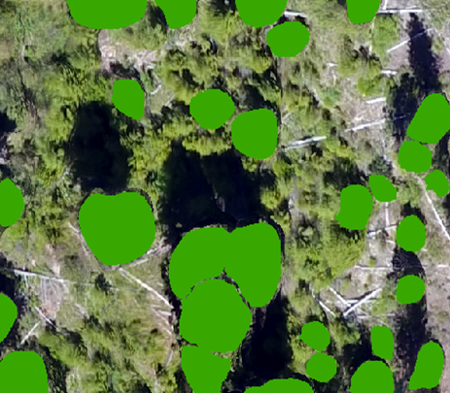
Methods
LandFire Data (30m resolution)
Clip the LandFire Canopy Cover (LFCC) to the extent of the sUAS image
Orthomosaics are split into segments less than or equal to 1GB in size for OpenCV’s file size limitations
sUAS Data (5cm resolution)
The split segments of the LandFire data is used to clip the hyperspatial data
Add a border of 5cm pixels to create a one-pixel edge
The split images are classified into tree and nontree pixels using a Mask R-CNN
The density tool sums the tree pixels within a 30-meter area and divides it by the total number of pixels in the image
Split images are then recombined
The result is Hyper Spatially Derived Canopy Cover (HDCC) a 30-meter orthomosaic that contains the percentage of canopy cover and has the same spatial reference as the LandFire data
The LFCC and HDCC Orthomosaics are then compared pixel to pixel. The difference between them determines whether a reduction in canopy cover occurred within the time frame of the pre-fire and post-fire observed dates
Background photo courtesy of the USDA Forest Service

Slide 4
Results
The first result of the project was the difference between the LFCC and HDCC. This was done on 10 different unburnt orthomosaics.
Mean shows the average difference between LFCC and HDCC
Overall average difference is 2.6 percentage points
Standard deviation of combined differences is 14.5 percentage points
If a difference greater than 26 percentage points was present canopy cover reduction occurred within 95% certainty
 | Belshazzar | Newstart | Grimes Creek | NW Placerville | 0530 Placerville
Mean | 17% | 4% | 6% | 1% | 10%
Standard Dev | 14% | 13% | 15% | 11% | 9%
 | Edna Creek | South Exp. For. | North Exp. For. | East Placerville | West Placerville
Mean | 4% | 3% | 7% | 7% | 2%
Standard Dev | 1% | 12% | 12% | 12% | 13%
Background photo courtesy of the USDA Forest Service

Slide 5
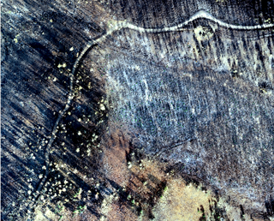
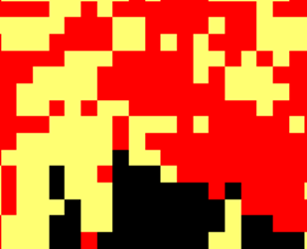
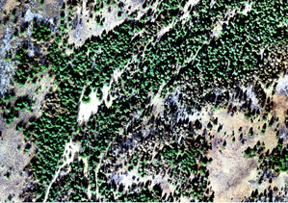
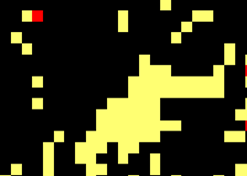
= passive crown/torching
= active crown
= no change detected
Background photo courtesy of the USDA Forest Service

Slide 6
Conclusion
Mapping from hyperspatial drone imagery enables a more accurate measure of canopy cover to be calculated
Higher accuracy in canopy cover measurements can be used to determine ecosystem departure from historic fire regimes
Pre-fire LFCC and post-fire HDCC comparison results in a highly accurate measure of canopy reduction and therefore an accurate measure of tree mortality within the study area
Future Work
Manuscript going through editorial review process for publication in Remote Sensing.
Identifying unburned trees surrounded by surface vegetation could improve wildland fire extent mapping
MR-CNN classification accuracy could be improved by refining training data based on observations of false negatives
Tree crown classification could be improved by using pixels' heights as additional input for the classifiers from the digital surface model produced during the orthomosaic creation process
Eliminating the need to split images would help prevent the loss of tree detection from split tree pixels and an extra 30m pixel from the clipping process
Background photo courtesy of the USDA Forest Service

Slide 7
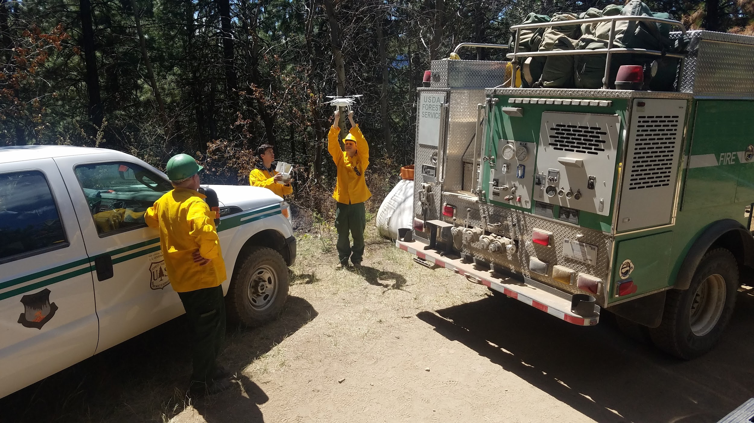
Questions?

