Slide 1

ENHANCEMENT OF WILDFIRE MODELS THROUGH INTEGRATION OF TACTICAL OBSERVATIONS
TFRSAC Fall 2022 Meeting
Nov 29th-30th, 2022
Rocio Frej Vitalle
Improving Aviation

Slide 2
Outline
Intro
Current Wildfire Modeling Limitations
Wildfire Project & Architecture
Current Efforts
Next Steps

Slide 3
Current Wildfire Modeling Limitations
Limited atmospheric observations
Meteorological observations are performed only a few times a day with one-point measurements
No night observations
Observations are only taken during day-time and form basis for the next day plan of attack
No reliable ember spread models
Existing ember spread models rely on weather forecast – does not include fire induced weather

Slide 4
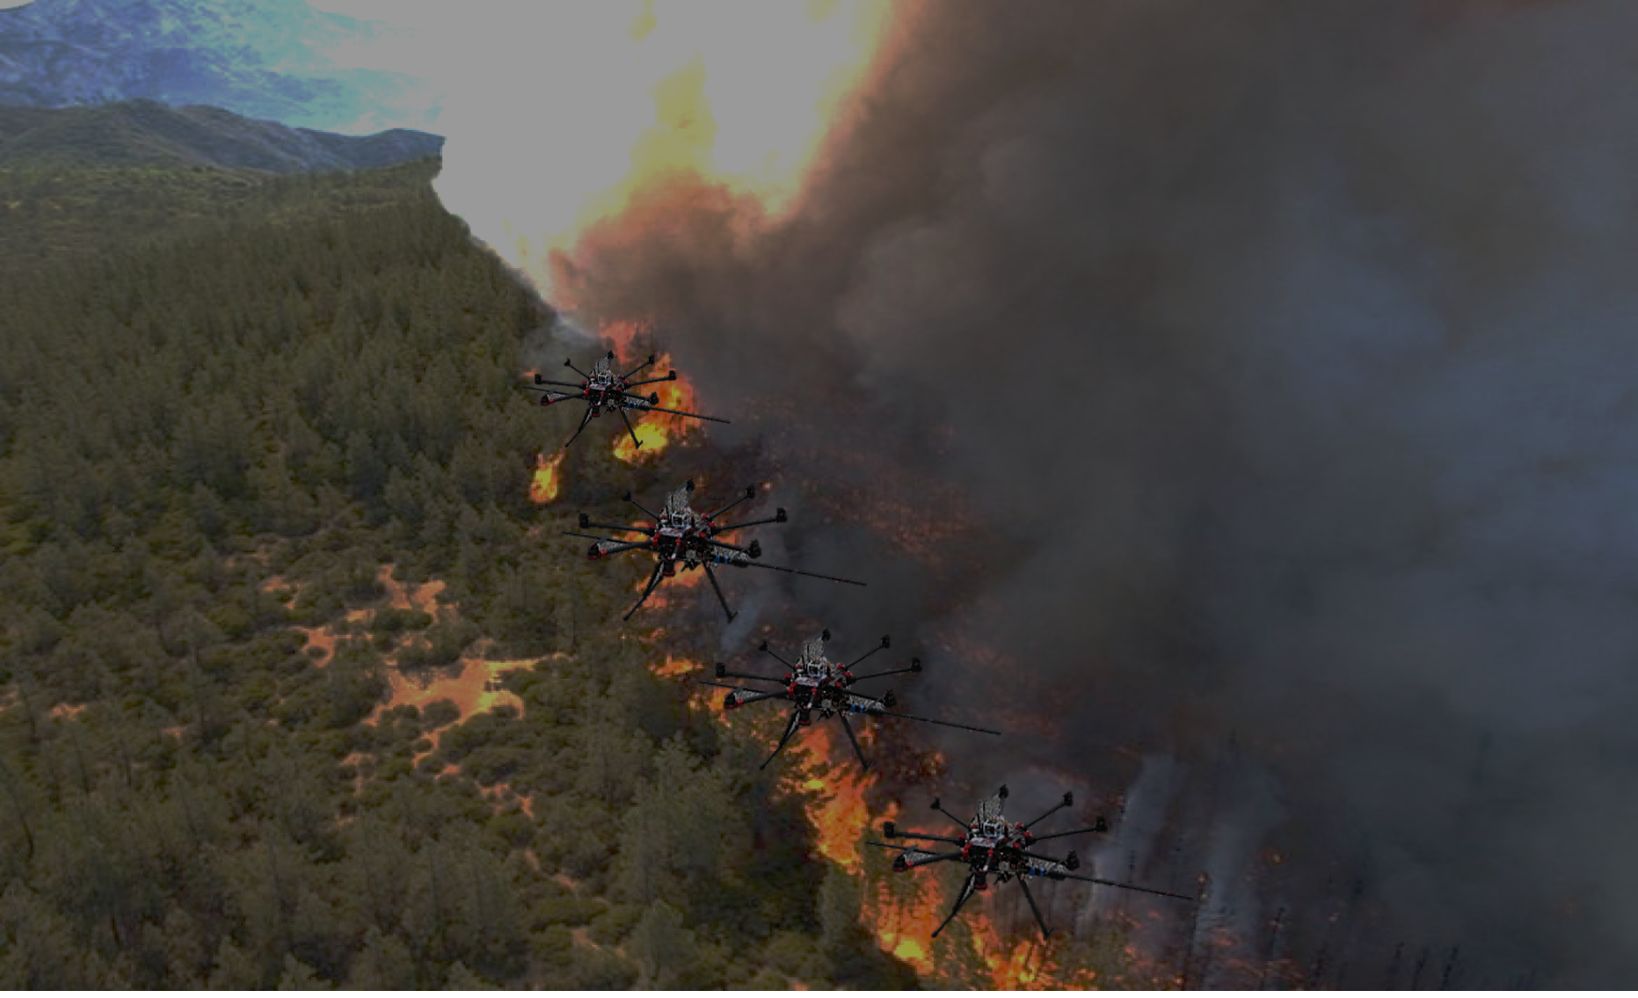
UAS:
THE DISRUTIVE NEWCOMERS

Slide 5
Current Goals & Objectives
Goals:
Two enhance wildfire response operations and current fire spread wildfire physics-based models with in-situ information
To create an ember spread module that is based on empirical observations and can be added to reanalysis and operational wildfire physics-based models
Objectives:
  Integrate local real-time atmospheric observations with weather station data and NWS predictions/forecasts into atmospheric and wildfire models.
    Collect real-time atmospheric observations utilizing UAS’.
    Integrate collected data from the UAS with data observed by local weather stations and NWS predictions/forecasts.
  Combine/streamline the process of collecting data and producing WindNinja/FlamMap results.
    Use the collected data from the UAS' and weather stations and model forecasts in producing WindNinja and FlamMap results.
    Streamline the process so that results are quickly produced from collected data.

Slide 6



An Integrated Platform for Model Enhancement
SKYTL
WINDTL
Real-Time Tactical Sensor Observations
Real-time data fusion
Integration with atmospheric and wildfire models
Enhanced prediction of wildfire movement and spread
Notes:
In sum, our WINDTELLECT API obtains real-time wind information from drones without the need for expensive wind sensors and pilots. It also automatically identifies fire fronts where these wind profiles are taken. This information is next synthesized and ready to be distributed in real time for customers, such as National Lab to improve wildfire spread predictions.

Slide 7
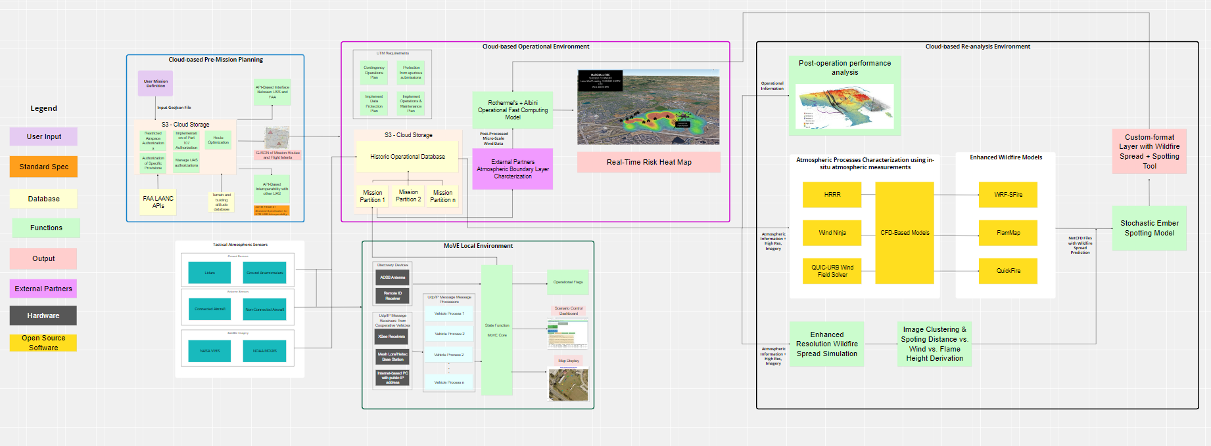
The Wildfire Project Cycle

Slide 8
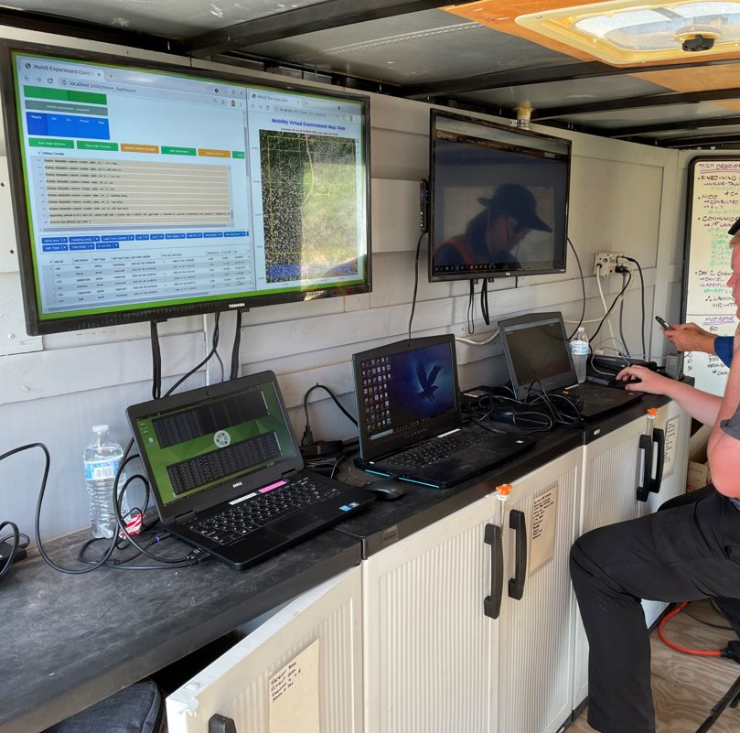
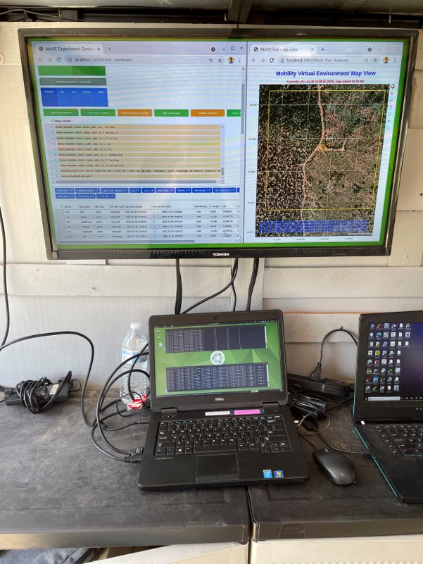
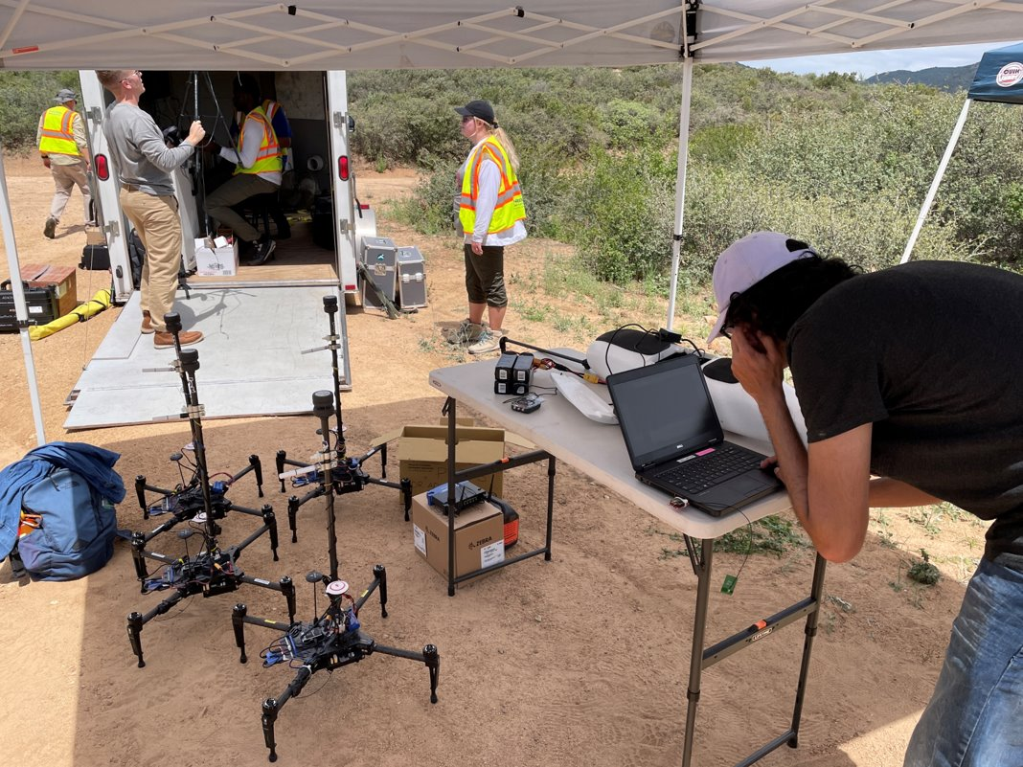
Data Collection and Surveillance Platform
SkyTL is a real-time in-situ data collection and distribution platform for use in emergency response operations.
SkyTL objectives are to determine the software and data link network limitations for the exchange of operational and atmospheric data across multi-modal vehicle operations, and the fusion of operational datasets in real-time that are based on consistent standards
Key Principles for SkyTL
Drone operations management
Connected to external cloud services
Collects real-time data from vehicles
Supports multi-modal vehicles beyond drones
Standalone, no-connection needed platform for local environment
Dedicated to emergency response operations
Notes:
Using machine learning methods, winds are estimated by combining aircraft state measurements with GPS observations. This eliminates the need for wind sensors that limit operational flexibility and reduce flight time

Slide 9
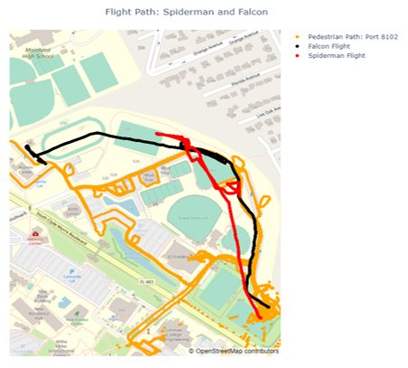
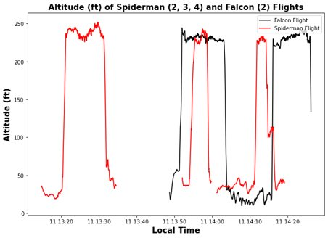
Flight Tests
Flight tests were conducted at Embry-Riddle Aeronautical University’s (ERAU) campus on October 11, 2022.
Several different flight tests conducted:
  Stationary tests utilizing discrete and continuous climbs to collect data.
    Only data collected during ascents of interest, as data collected during descent is contaminated due to the mixing of air with the downwash of the UAS propellers.
  Tested telemetry and range of data collection with base center of operations.
    Furthest range tested near 800 meters away from base center of operations.
  Flights were conducted near maximum ceiling height of 200 ft as provided by ERAU's certificate of authorization (COA).

Slide 10
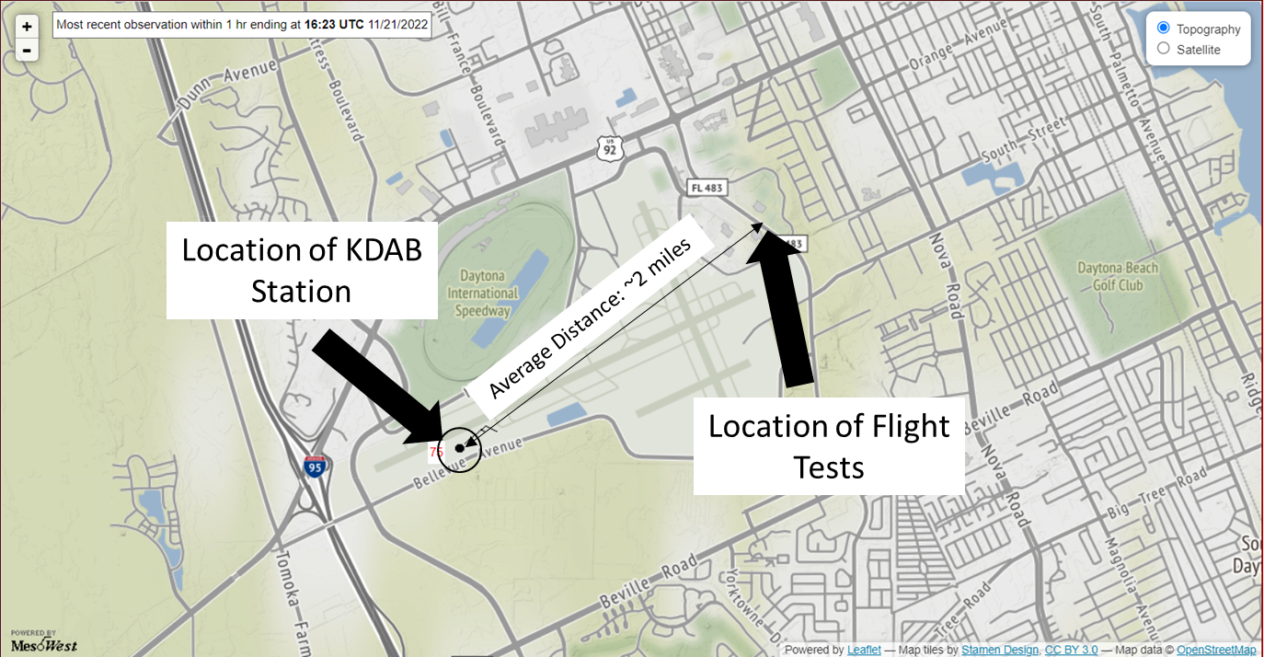
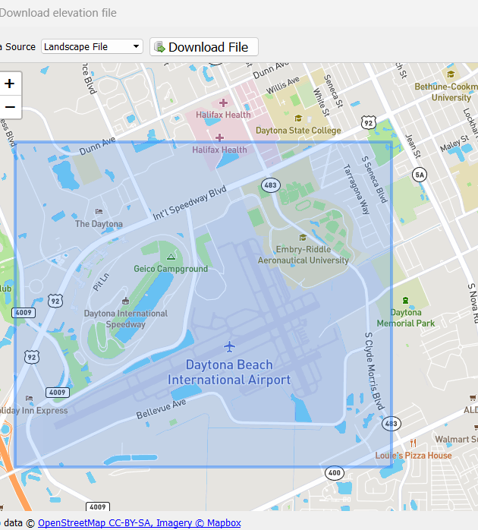
Data Assimilation with WindNinja
The domain used for the running of WindNinja is provided here.
It encompasses the university campus and Daytona Beach International Airport.
  The domain was made larger than the actual flight test area so as to obtain the KDAB weather station output data.

Slide 11
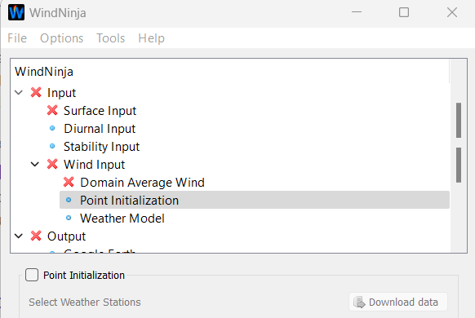
Data Assimilation with WindNinja
The data was further processed so that it could be utilized within the WindNinja program.
The data was fed into the WindNinja program and then resolved so as to obtain results that include the data collected.
  All UAS data was assimilated together regardless of test.
The data was fed into the “Point Initialization” section within the “Wind Input” solver of WindNinja.
The “Point Initialization” option allows for users to use recorded measurement data from weather stations in the area domain defined by the user.

Slide 12
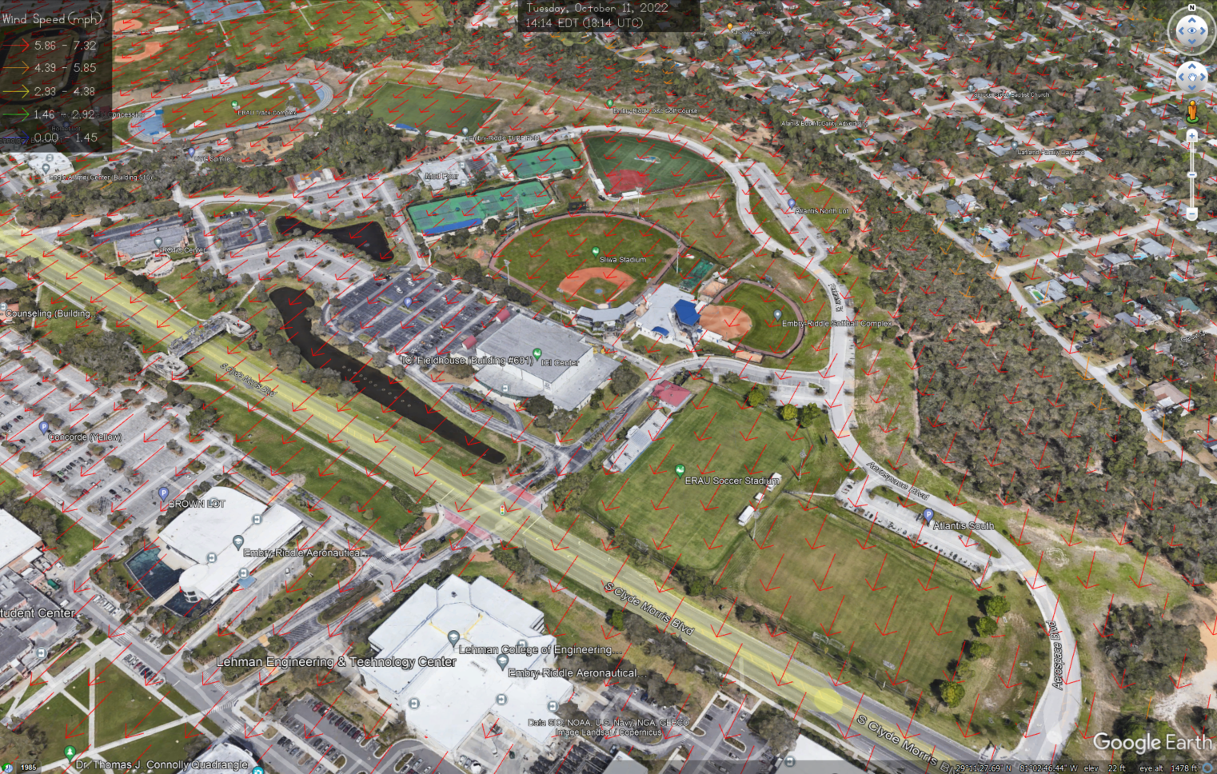
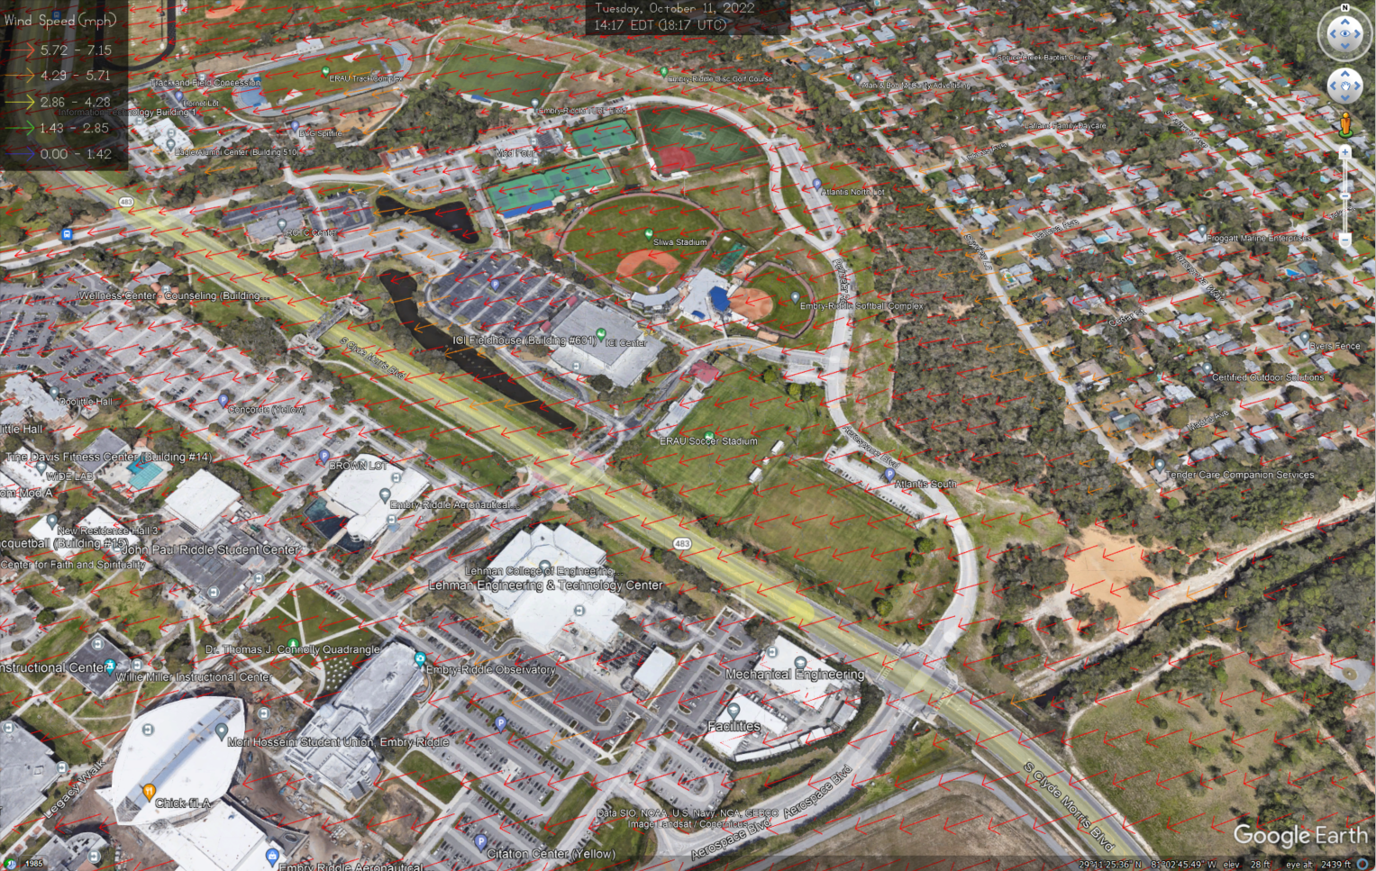
WindNinja Results
Flight Test Data
KDAB Data
Combined Data

Slide 13
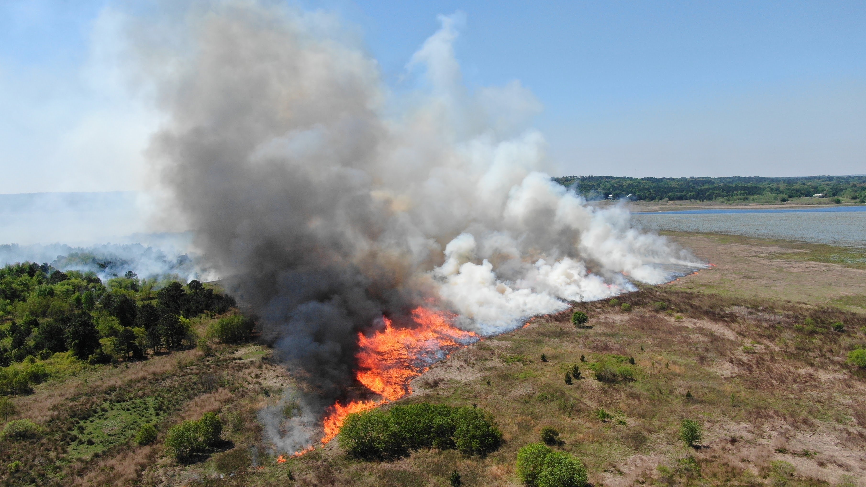
Next Steps
  Collect atmospheric data during prescribed fires at Tall Timbers (Dec 13/14th)
  Use the collected data from the UAS' and weather stations and model forecasts in producing WindNinja and FlamMap results.
  Combine/streamline the process of collecting data and producing WindNinja/FlamMap results.
    Streamline the process so that results are quickly produced from collected data.
    Implement downscaled wind into ember spread model
Notes:
Prescribed fire on Lake Jackson 2020

Slide 14
Development of Ember Spread Model
Using Albini et al. (2012) data, a linear regression equation has been developed that uses wind speed (m/s) and flame height (m) as variables.
The idea of the model is not to necessarily predict each exact individual location of the spotting embers, but rather to gain an understanding on an area of confidence for ember landing.
The associated fire perimeter is extracted from NASA VIIRS
A normal distribution is used to account for flame heights, wind speeds, and wind directions.
The equation is implemented to find a normal distribution of the landing distances of the embers.
The landing distances are projected from the fire perimeter, and a heatmap is used to show the 95% confidence interval of predicted ember spotting distances.
The model was tested using fire data used from Page et al. (2019).
  The paper focused on an analysis of spotting distances that were observed during fires in the Northern Rocky Mountains during 2017.
  The observed spotting distances were recorded at various times throughout the dataset – typically only once or twice a day.

Slide 15
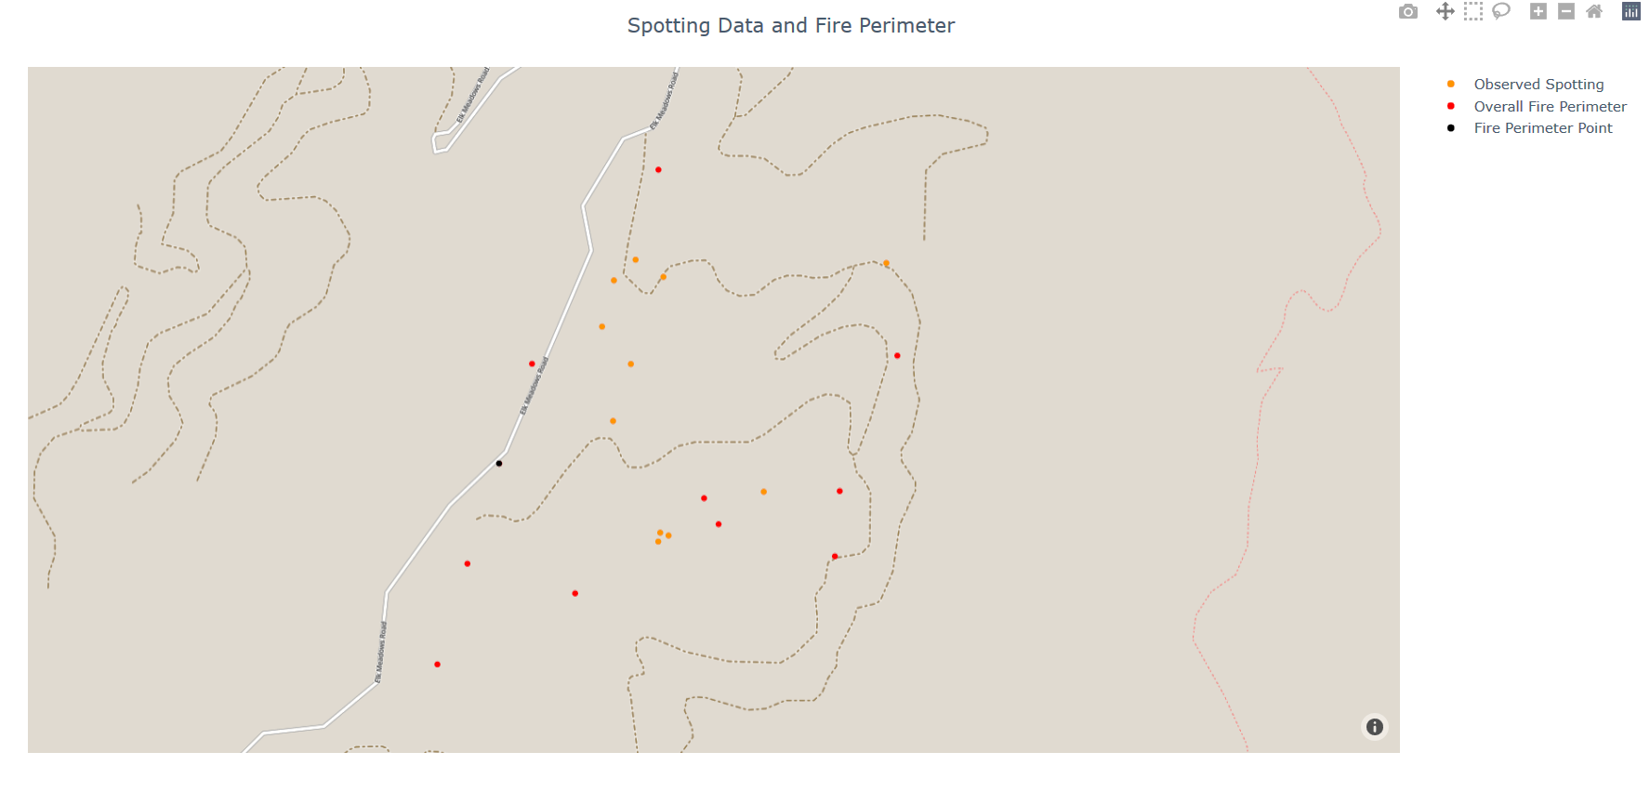
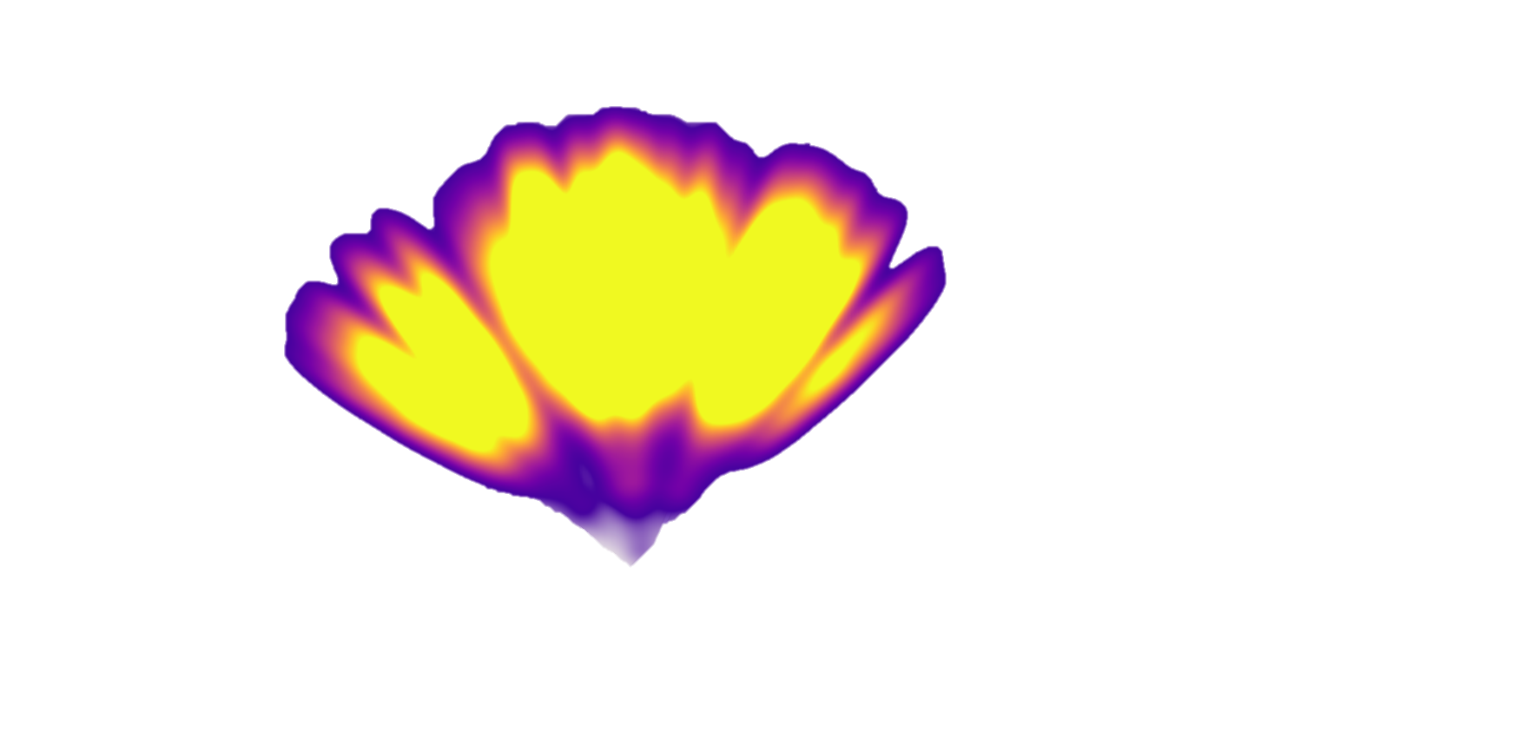
Testing of Ember Spread Model
The model was tested during each day that accompanied the observed spotting dataset.
Daily information was selected from the observed spotting distances data, fire perimeter data, and observed meteorological measurements data.
Observed wind speed and wind direction data was selected in times leading up to the observed spotting distance time and after, depending on data availability.
For example, if the observed spotting distance was recorded at 2114, then wind speed and wind direction data was obtained from 2015 to 2215.
This was done to give an array of wind speeds and wind directions that could be used in the model.
Since no data was available concerning flame heights, the range of flame height was derived from Albini observations

Slide 16
THANK YOU
Contact Info:
Rocio Frej Vitalle
rocio@improvingaviation.com
(386) 307-5437

