Slide 1
Ground Fuel Discovery
TFRSAC Spring 2022
Jack Gihl
Cristian Washburn
Ram Prabu
Haofei Tian
Notes:
Jack

Slide 2
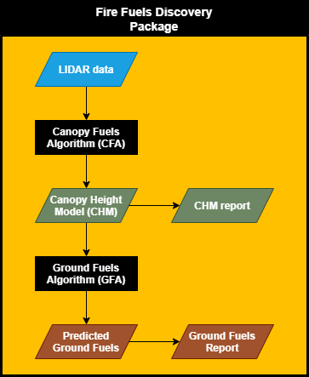
Fire Fuels Discovery Package Use Overview
Image adapted courtesy: https://www.newport.com/n/lidar
Notes:
handout

Slide 3
Technical Results
ML Algorithm | Category | Specifications
Canopy Fuel Algorithm | Training | -Number of Samples in data set > 1000:700 -Training error optimized to prevent underfit (high bias) and overfit (high variance)
 | Testing/Validation | -Regression Accuracy: 85%: ~70% -Classification Accuracy: 95%: ~75%
 | Timing | -Maximum calculation time = 9 sec : ~60 sec (with minimum hardware requirements)
Ground Fuel Algorithm | Training | -Number of Samples in data set > 1000: 760 -Training error optimized to prevent underfit (high bias) and overfit (high variance)
 | Testing/Validation | -Regression Accuracy: 80%: >88%
 | Timing | -Maximum calculation time = 10 sec: 120 sec (with minimum hardware requirements)
Goal: Achieved

Slide 4
Fire Fuels Discovery Package: How we are training overview
Lidar Data
DBH, CrHt, CrRad, Canopy Density
Train CFA
Canopy Plot Data
Ground Plot Data
Duff, Litter, Ground Fuels (time)
Train GFA
Image adapted courtesy: https://www.newport.com/n/lidar
Notes:
handout

Slide 5
Prototype Software
Selecting input LIDAR file
Selecting Canopy fuel parameters
Selecting 3D or heat map
Output for CFA (Heat map or 3D view)
Selecting Ground fuel parameters
3D view of LIDAR
Output for GFA (Heat map)

Slide 6
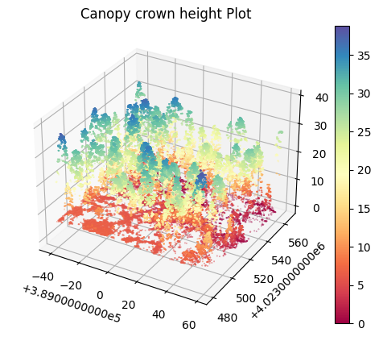
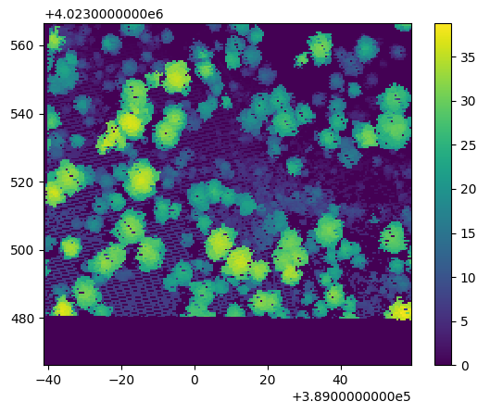
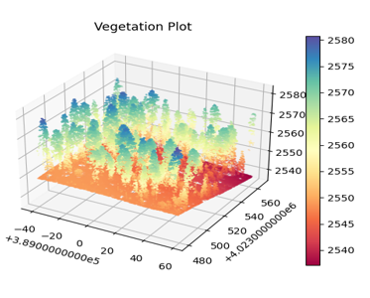
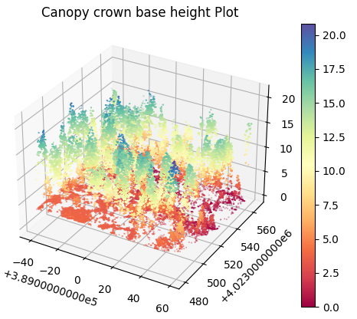
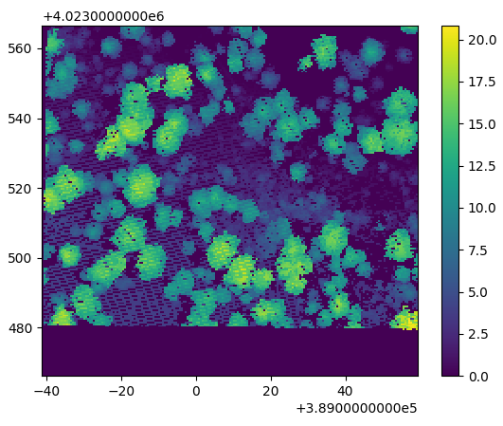
Prototype - Canopy Fuel Parameters
Fire Fuel Detector Prototype Software
Canopy Height
Canopy Base
Height
Input LIDAR File

Slide 7
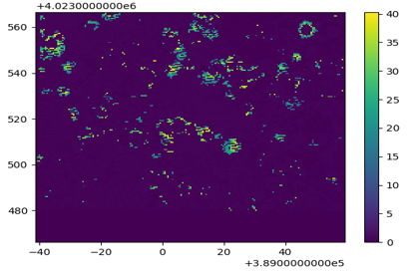
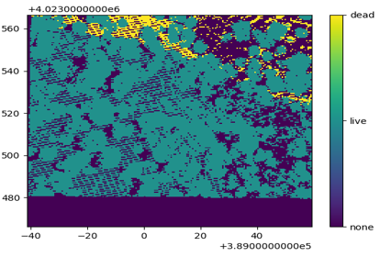
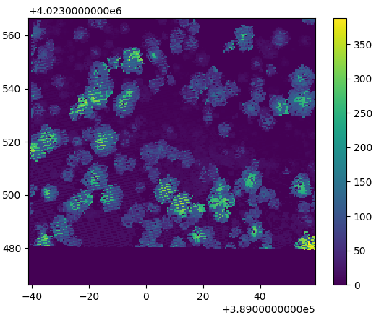
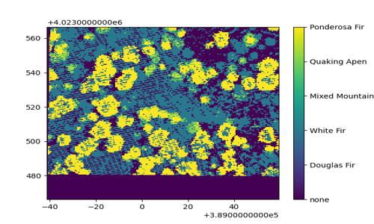
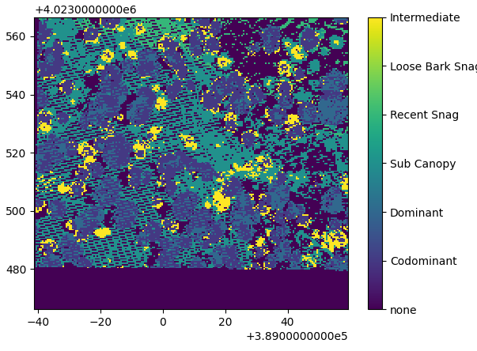
Prototype - Canopy Fuel Parameters
Small Branches
Fuel Weight
Dead/Live
Crown Type
Fire Fuel Predictor Prototype Software
Species
LIDAR input

Slide 8
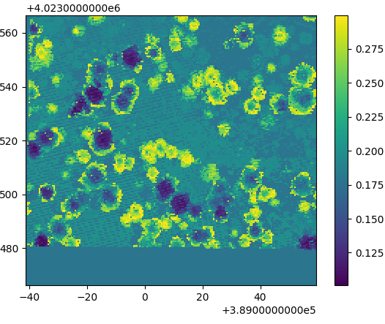
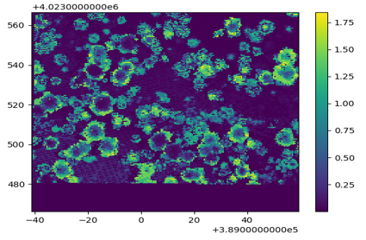
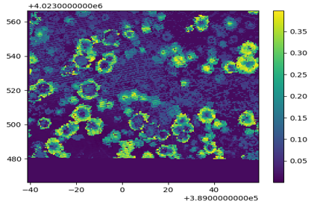
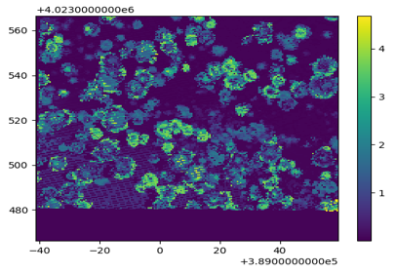
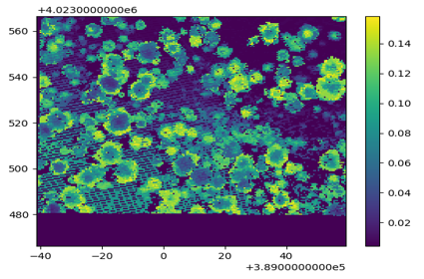
Prototype - Ground Fuel Parameters
f1h
f100h
f10h
Fire Fuel Predictor Prototype Software
duff
litter
LIDAR input

Slide 9
Future Plans
Continued work with Andy Hudak and Ben Bright (USFS)
In IP and copyright process for our software
Reach out to other forest services in other countries
Pursue SBIR grants to continue work
Move from Beta to full product
Leverage FIA data
Improve Accuracy
Broaden ecological scope for algorithms
Smoother interface
Compatibility for transfer learning

Slide 10
Demonstration
Video Link of the demo: Demo Video

Slide 11
Wrap Up
Thank you for your Participation
TPM, BOL – Jack Gihl: jgihl@purdue.edu
DC, GFA SME – Cristian Washburn: cwashbur@purdue.edu
Algorithm SME – Ram Prabu Ganesan: ganesan2@purdue.edu
GFA ML SME – Haofei Tian: tian213@purdue.edu

