Slide 1

Software to output fire behavior metrics for airborne imagery
Miguel Valero
Wildfire Interdisciplinary Research Center
Department of Meteorology and Climate Science
San José State University
Tactical Fire Remote Sensing Advisory Committee (TFRSAC)
Fall 2020

Slide 2
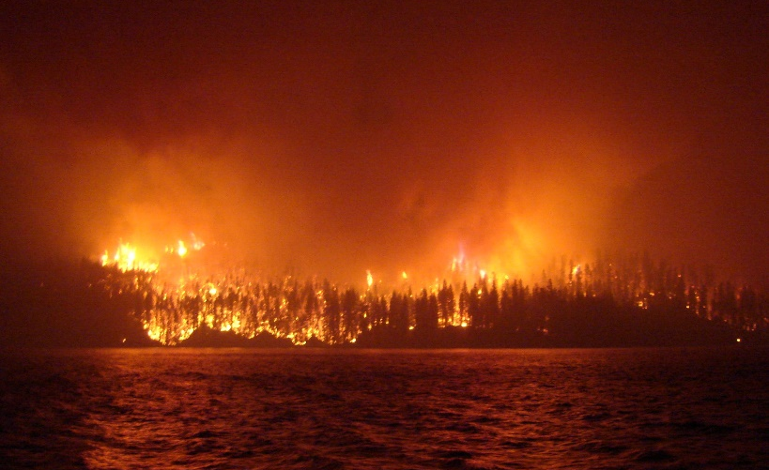
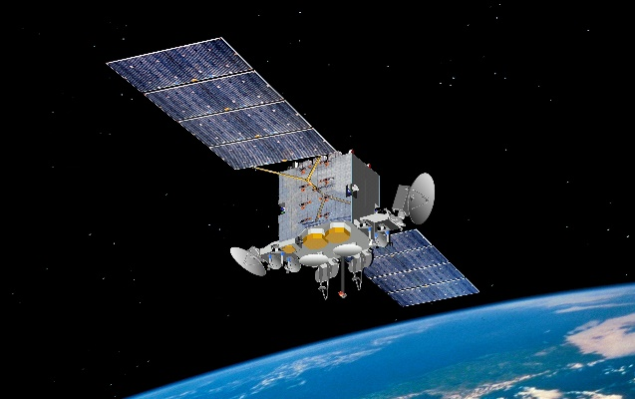
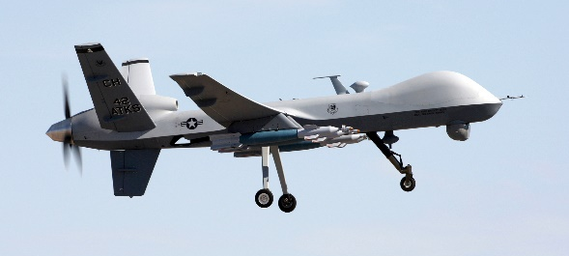
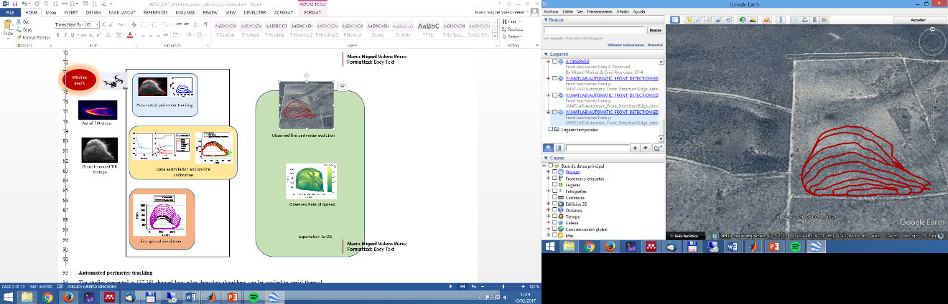
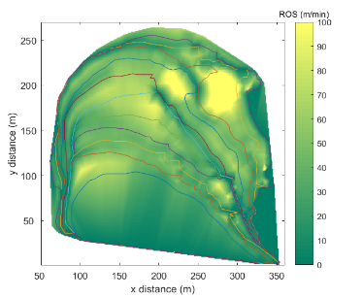
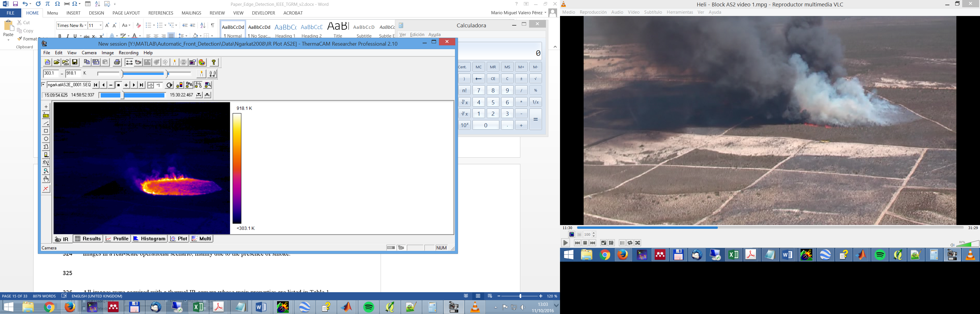
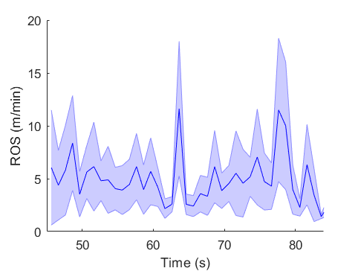
Wildland fire
Remote sensing platforms
Photo by: Paul Ridgeway, U.S. Air Force
Photo by: Space and Missile Systems Center, US DOD
Photo by: Shawn Cahill
Automated image analysis
Fire imagery

Slide 3
Contents
Image analysis software to study wildfire behavior
State of the art
Our current research and goals
Collaboration opportunities

Slide 4
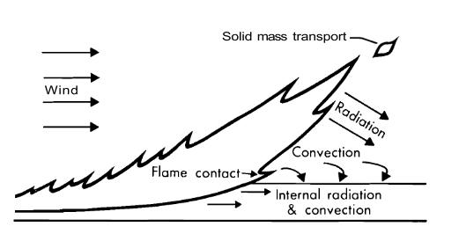
1. Introduction: state of the art
Wildfire behavior measurement: quantitative and replicable
Why?
Steps of the scientific method:
  Observe
  Hypothesize
  Model (predict)
  Verify prediction
Data
Source: Rothermel (1972)

Slide 5
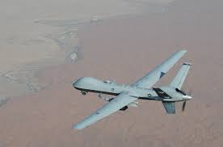
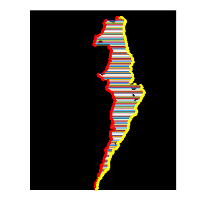
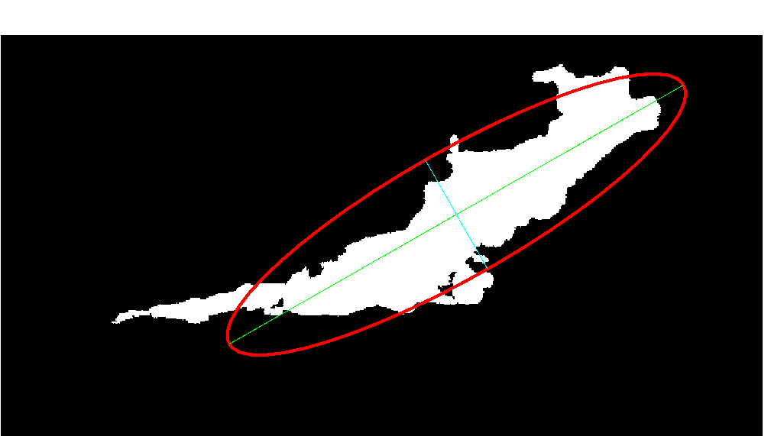
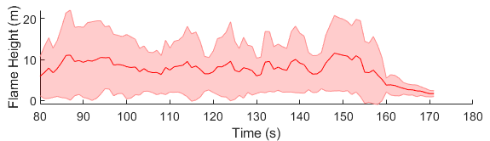
1. Introduction: state of the art
Wildfire behavior measurement: quantitative and replicable
What?
  Fuel load and structure
  Fire perimeter location
  Rate of Spread (ROS)
  Flame height and tilt angle
  Flame thickness
  Fire front width
  Fire Radiative Power (FRP)
  Fire line intensity
  Fuel consumption
Flame tilt angle
Flame thickness
ROS

Slide 6
1. Introduction: state of the art
Wildfire behavior measurement: quantitative and replicable
When?
Source: Zajkowski et al. (2016)
Source: O’Brien et al. (2016)
Source: Clements et al. (2016)
Source: Clements et al. (2019)

Slide 7
1. Introduction: state of the art
Wildfire behavior measurement: quantitative and replicable
How do we turn the available research-level software into tactical solutions?

Slide 8
2. Current research and goals
Automated video stabilization and image georeferencing
Perimeter tracking and measurement of fire behavior
Data-driven fire spread forecast
+ Artificial Intelligence applied to spaceborne imagery

Slide 9
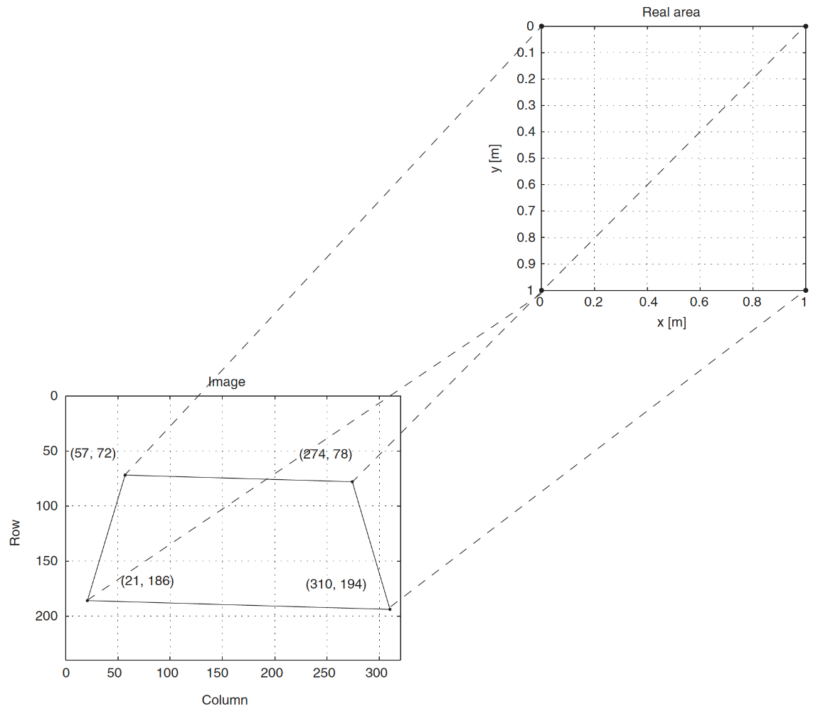
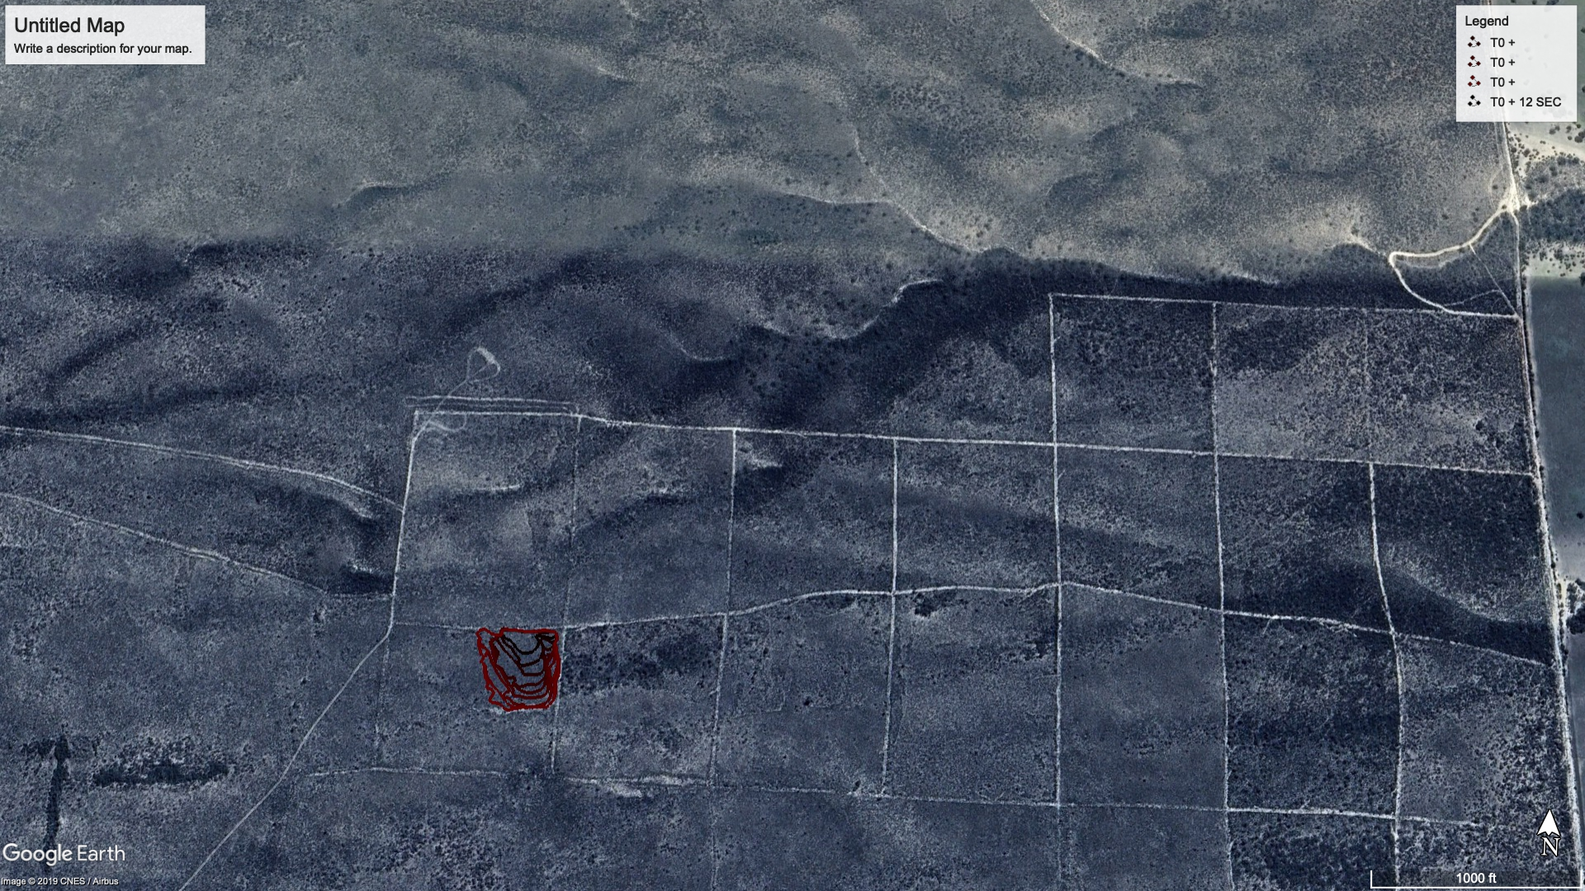
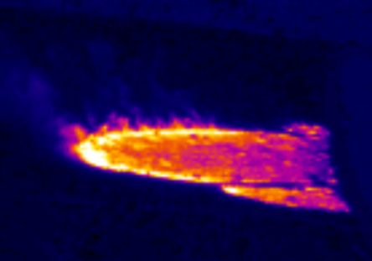
2. Current research and goals
Automated video stabilization and image georeferencing
Figure by Paugam et al. (2013)
Figure by Pastor et al. (2006)
200 m
Figure by Valero et al. (2018)
Image content
Ground coordinates

Slide 10
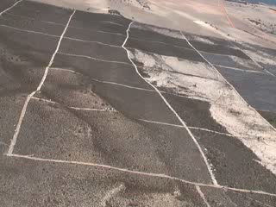
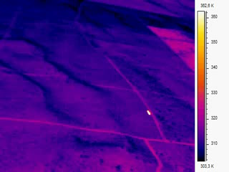
2. Current research and goals
Automated video stabilization and image georeferencing
Video acquired during large scale experimental fires conducted in Ngarkat Conservation Park, South Australia, 2008 (Cruz et al., 2010)

Slide 11

2. Current research and goals
Automated video stabilization and image georeferencing
Video acquired during large scale experimental fires conducted in Ngarkat Conservation Park, South Australia, 2008 (Cruz et al., 2010)

Slide 12
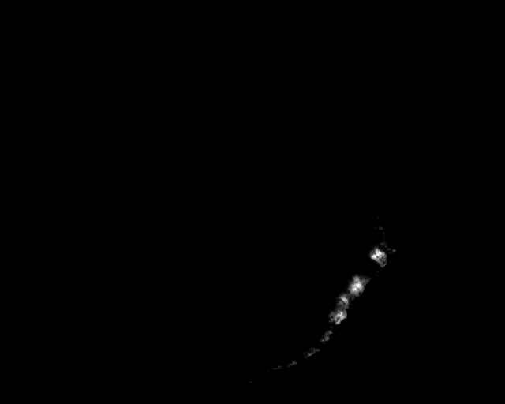

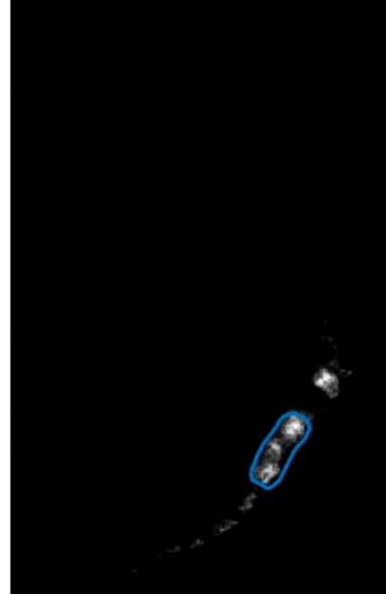
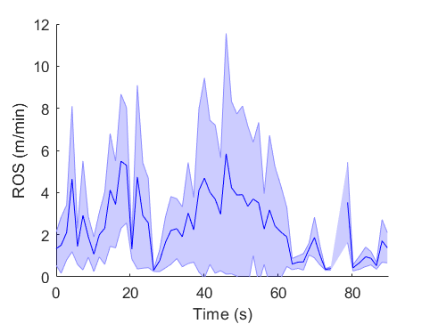
2. Current research and goals
Perimeter tracking and measurement of fire behavior
Original
Stabilized
Fire perimeter
Video acquired during small scale experimental fires conducted in the Nature Conservancy land next to Baxley, GA, USA, 2017

Slide 13
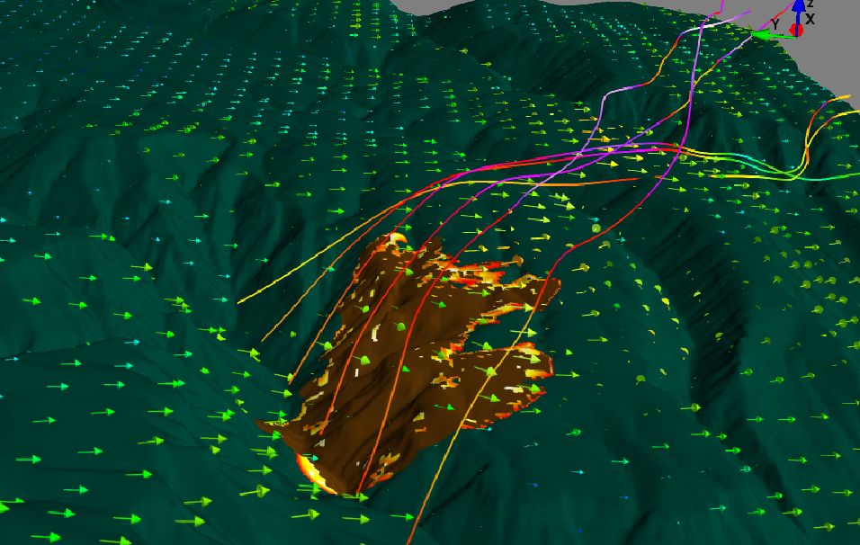
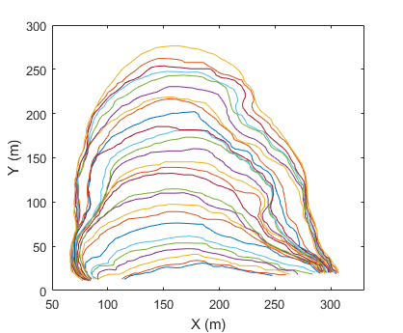
2. Current research and goals
Data-driven fire spread forecast
Fire behavior remote sensing
Data-driven fire spread forecast
Figure by Mandel et al. (2011)
Perimeter tracking
Rate of spread
Data assimilation and on-line calibration

Slide 14
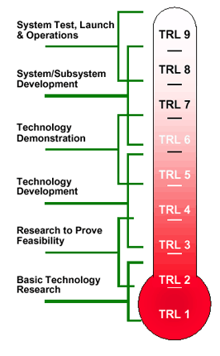
2. Current research and goals
TRL = Technology Readiness Levels
Current goals
Move up in the TRL scale:
  Adapt algorithms to more general scenarios
  Extensive prototype testing
Make system usable operationally:
  Consider end-user needs
Research applications
Challenges
Tactical applications
Scarce experimental data
Legal and safety issues in real fires
Missing hardware support:
  Airborne platforms
  Communication network

Slide 15
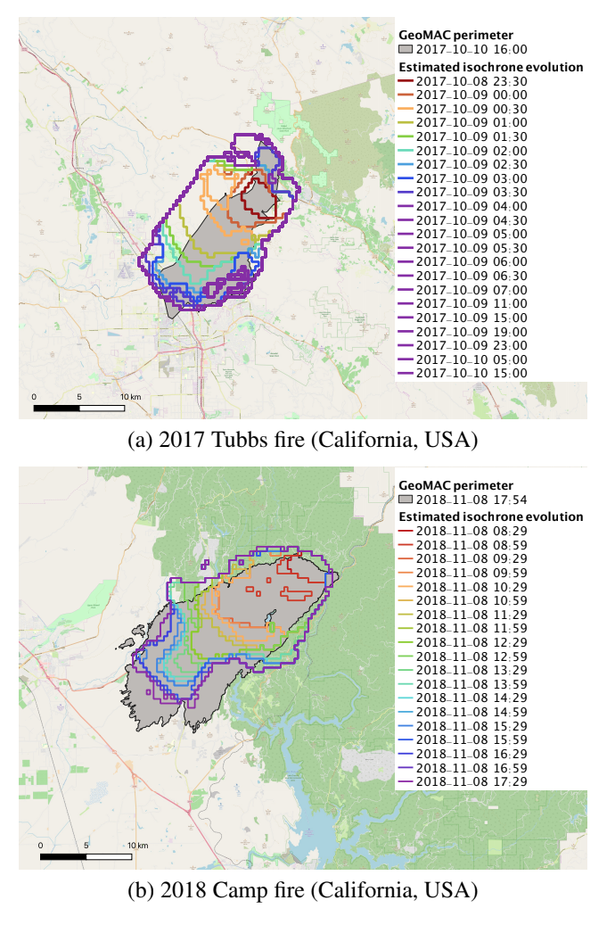
2. Current research and goals
Artificial Intelligence applied to spaceborne imagery

Slide 16
3. Collaboration opportunities
What we seek:
  From the research community:
    Discussion & ideas
    Application of our systems to a variety of scenarios and problems
    Experimental data
    Coupling with similar or complementary systems
  From the operational community:
    End-user needs:
        Which information is most useful to support emergency-response decisions?
        How should it be displayed?
        When is it necessary?
    Real fire data

Slide 17




Software to output fire behavior metrics for airborne imagery
Miguel Valero
mm.valero@sjsu.edu
https://www.sjsu.edu/wildfire/
Wildfire Interdisciplinary Research Center
Department of Meteorology and Climate Science
San José State University
Tactical Fire Remote Sensing Advisory Committee (TFRSAC)
Fall 2020

