Slide 1
Knowledge management for mitigation and response
TFRSAC Spring 2021
Brian Wee, Ph.D.
Massive Connections, LLC
Bill Teng, Ph.D.
NASA Goddard Earth Sciences (GES) Data and Information Services Center (DISC)

Slide 2
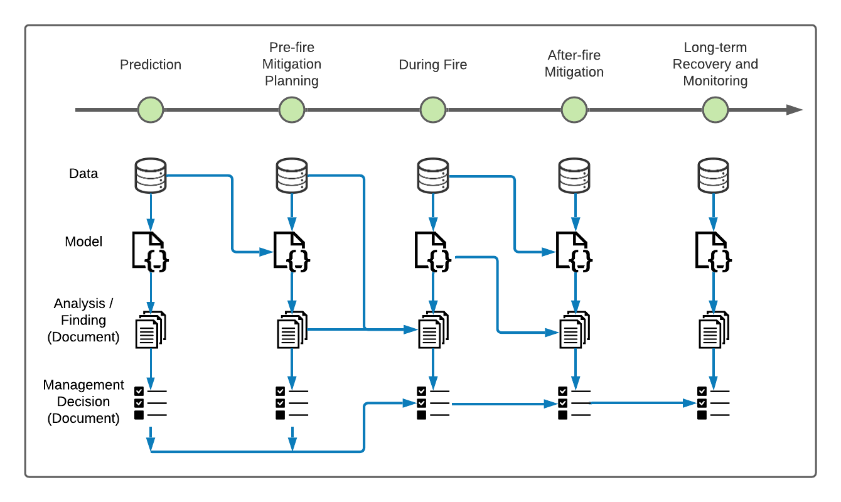
Punchline:
Reusing Data and Information Across the Fire Management Lifecycle

Slide 3
Punchline:
Reusing Data and Information Across the Fire Management Processes
Why?
Data-driven, science-based decisions.
Data and information visualization.

Slide 4
Punchline:
Reusing Data and Information Across the Fire Management Processes
This presentation:
Is not a software demo.
Is a long-term vision.
Assesses level of resonance.

Slide 5
Earth Science Information Partners (ESIP)
ESIP: a collaboration among across government, academia, NGOs, and the private sector.
Sponsored by NASA, NOAA, and USGS.
The Agriculture and Climate Cluster (ACC): a group within ESIP.
Other ESIP groups include:
Disaster Lifecycle Cluster
Semantics Harmonization Cluster
Discovery Cluster

Slide 6
Agriculture & Climate Cluster (ACC) Overarching Themes
Science AND technology related to agriculture and climate
Science: e.g.
wildfire mitigation and response
climate adaptation strategies
Technology: e.g.
natural language processing
linking data to decisions
Policy (USDA- and data-related EOs, statutes, specific regs)

Slide 7
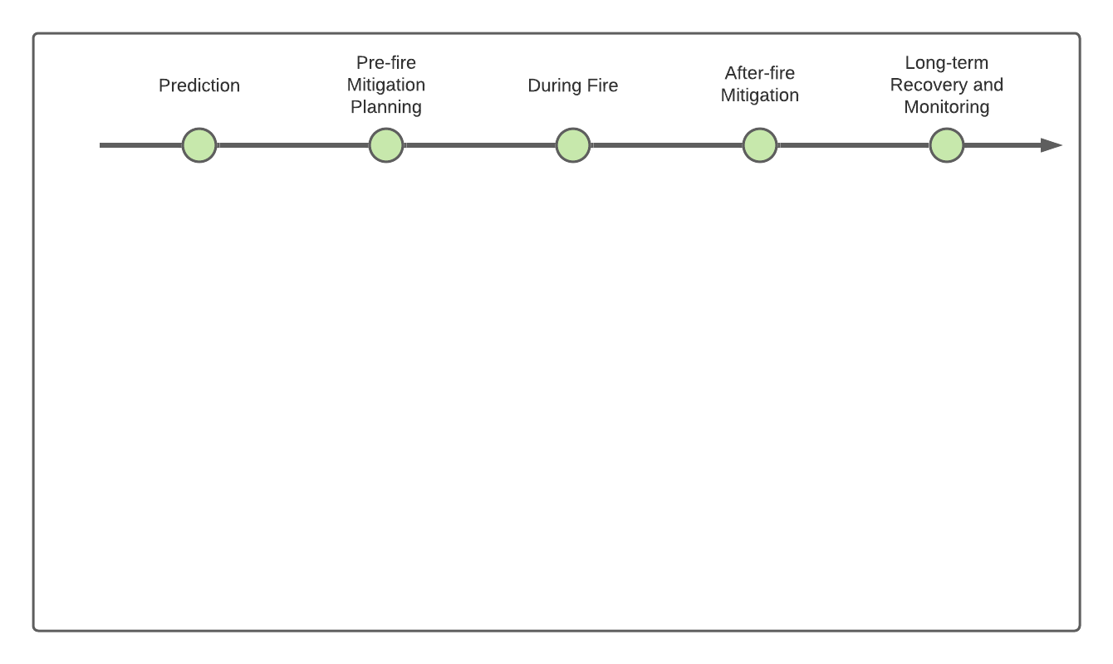
Fire Management Lifecycle
Informal representation of fire management lifecycle.
Mirrors NASA ARMD workshop’s (day 3) timeframe.
But this talk: focus is on the tactical timeframe.

Slide 8
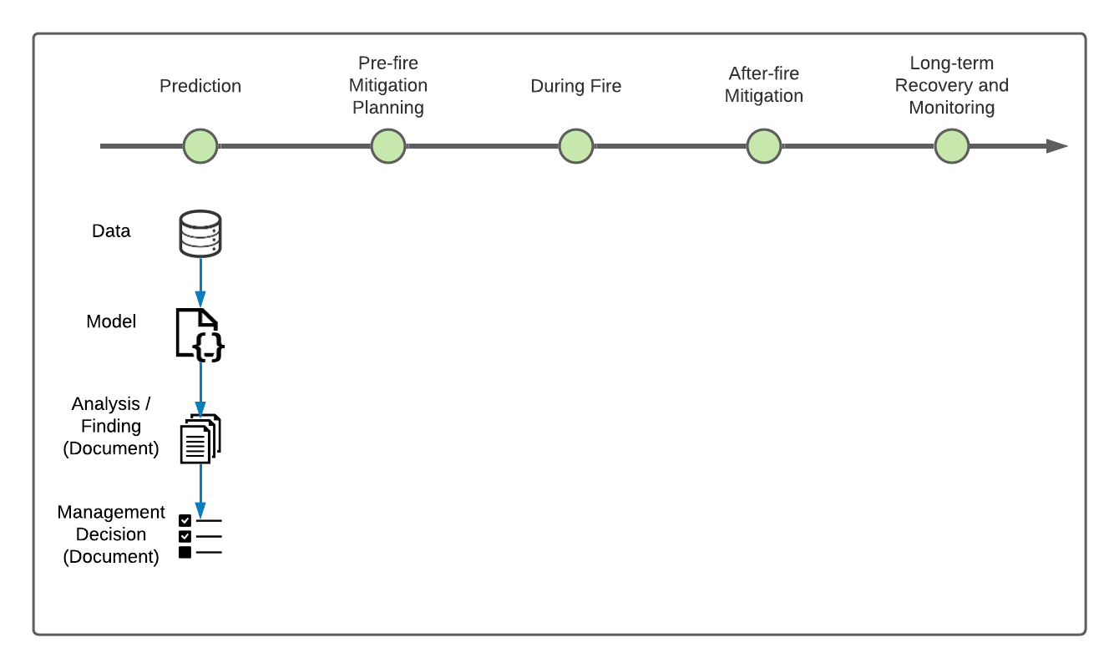
Linking data to decisions
Data.
Model (code).
Information (documents).

Slide 9
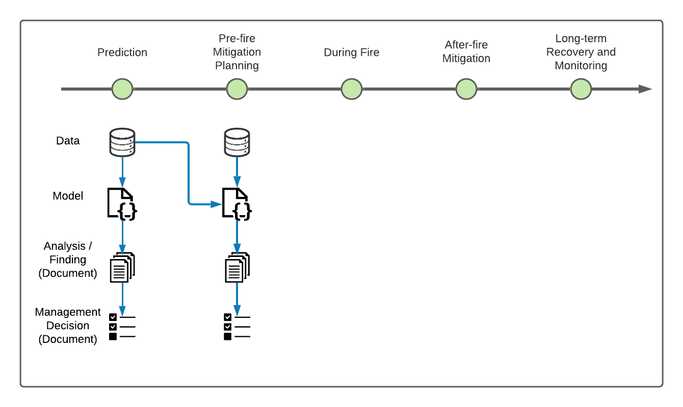
Reusing / repurposing data and information
Promotes consistent pattern of use of data and information.
E.g. same geospatial data viz. in GeoCollaborate used for other analyses.

Slide 10
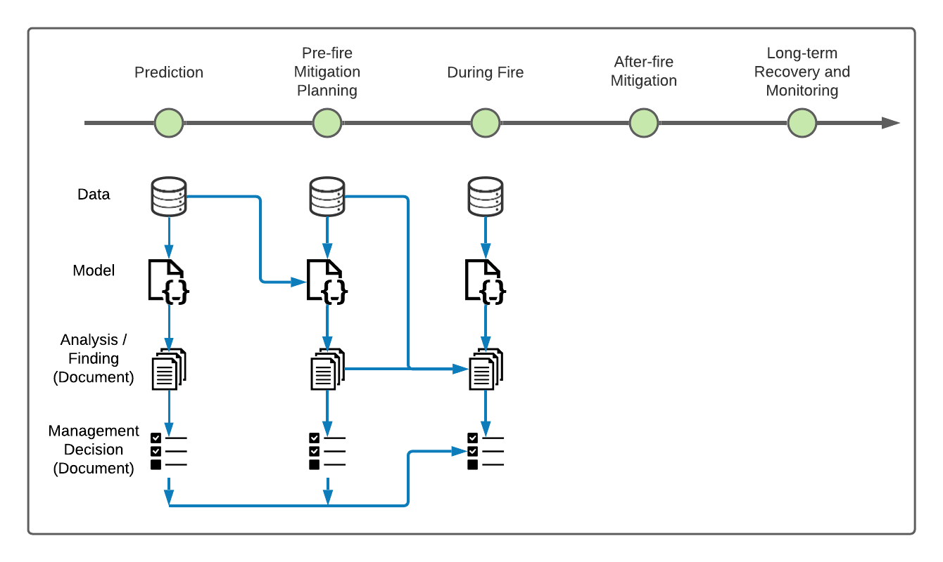
Spanning across barriers
Disciplines.
Organizations.
Time.

Slide 11
Completing the picture...

Slide 12
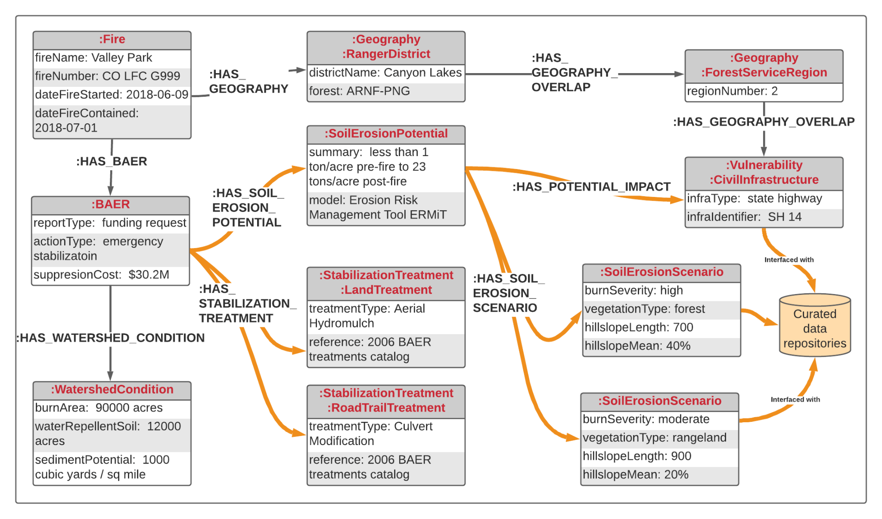
Graphs for knowledge management
Link data and information generated across the fire mgmt lifecycle.
Closely related to “knowledge graphs”.
Knowledge management for socio-environmental systems.

Slide 13
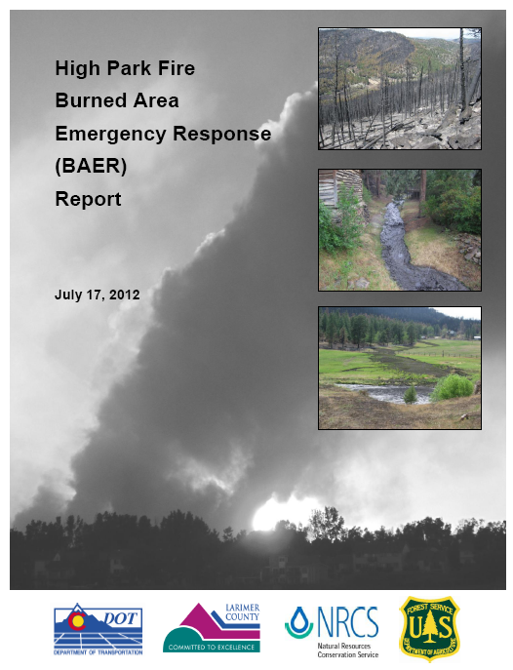
Example: BAER as a graph
Burned Area Emergency Response (BAER) report example based on 2012 High Park Fire and other Colorado BAERs.
Graph representation for illustrative purposes only: not vetted for factual and technical accuracy.

Slide 14
Wildfire

Slide 15
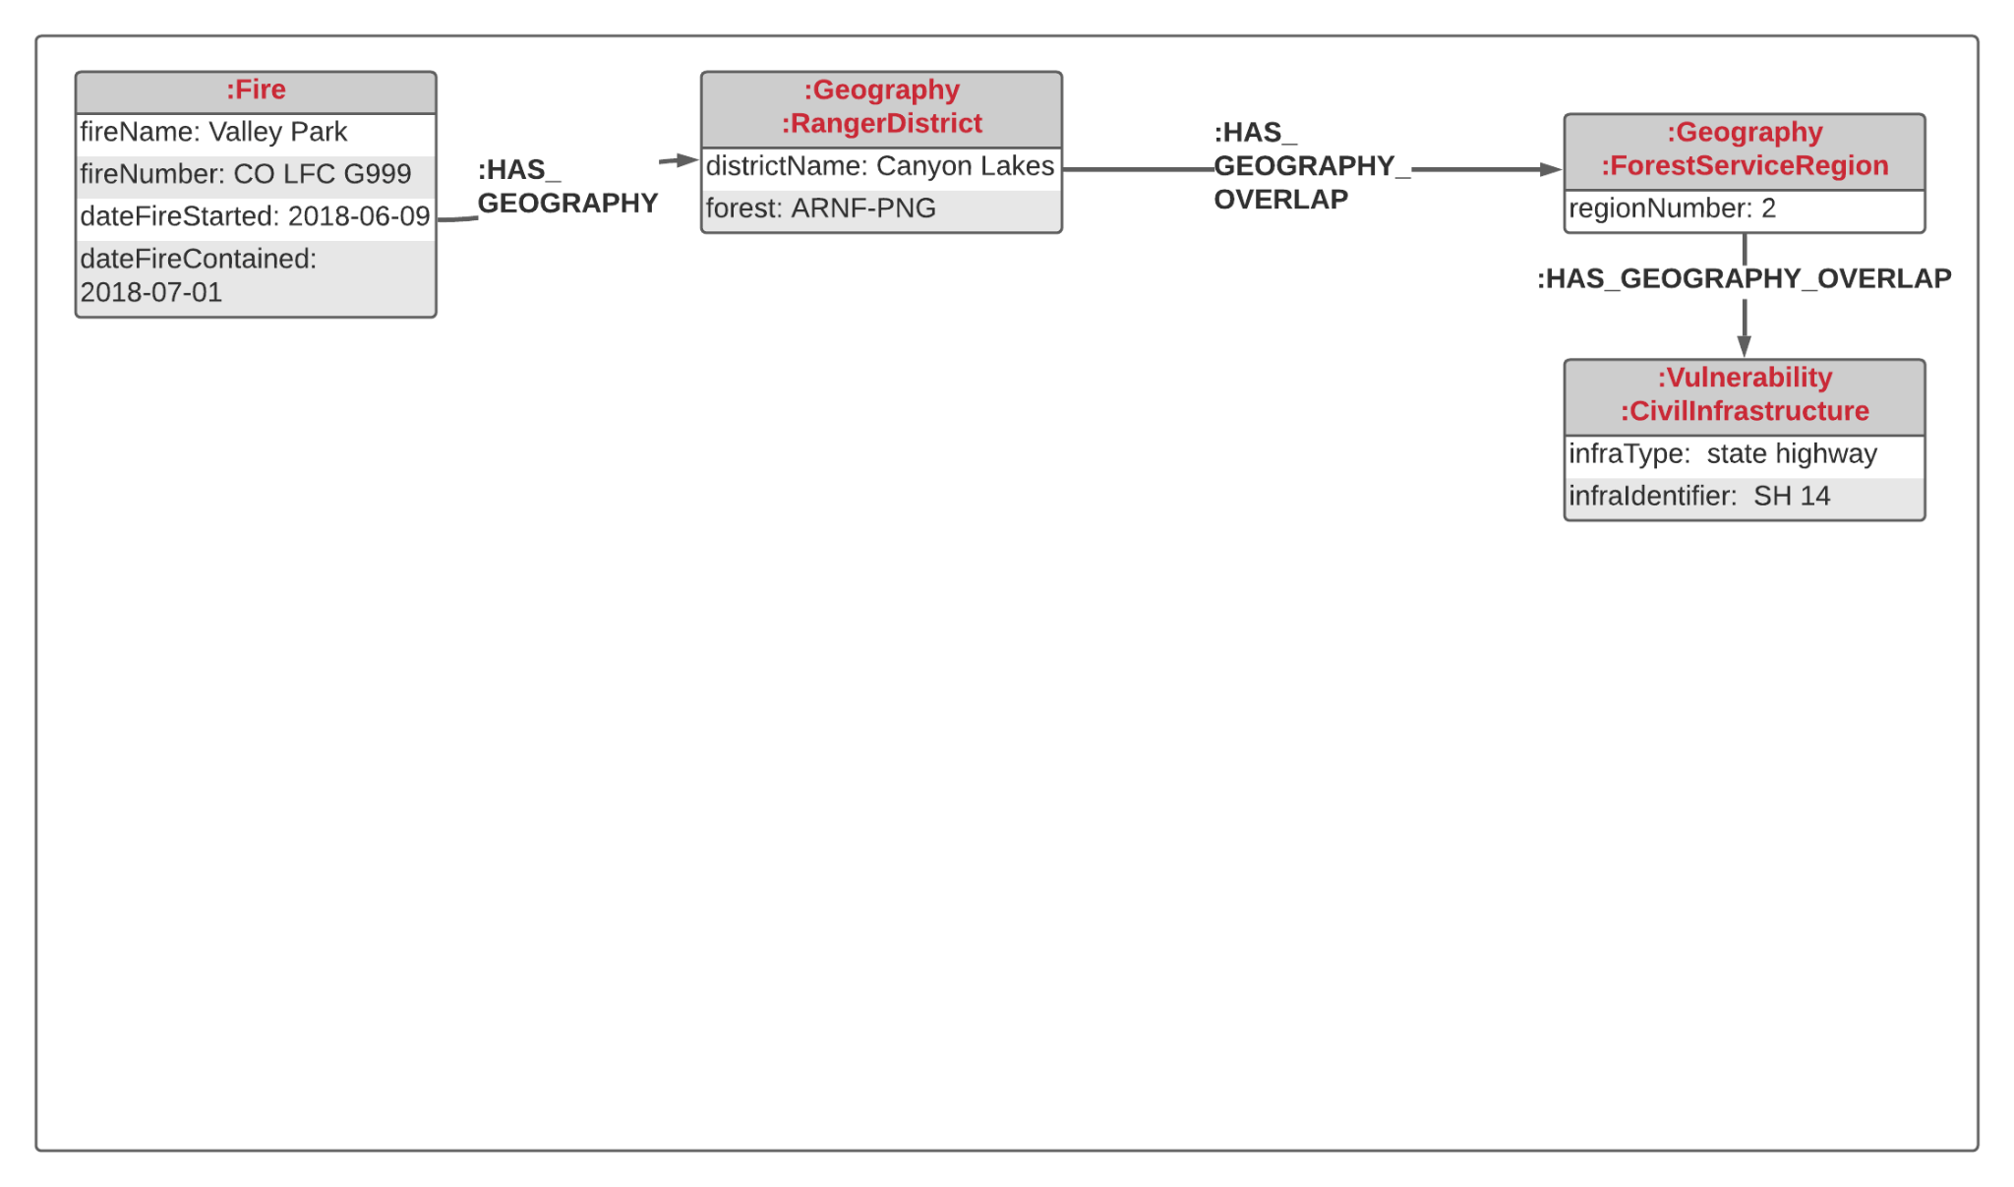
Wildfire - Geography

Slide 16
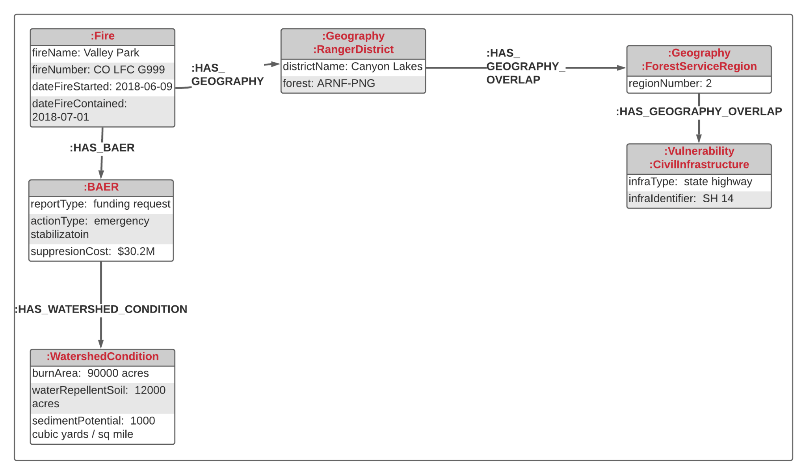
Wildfire - Geography - BAER

Slide 17
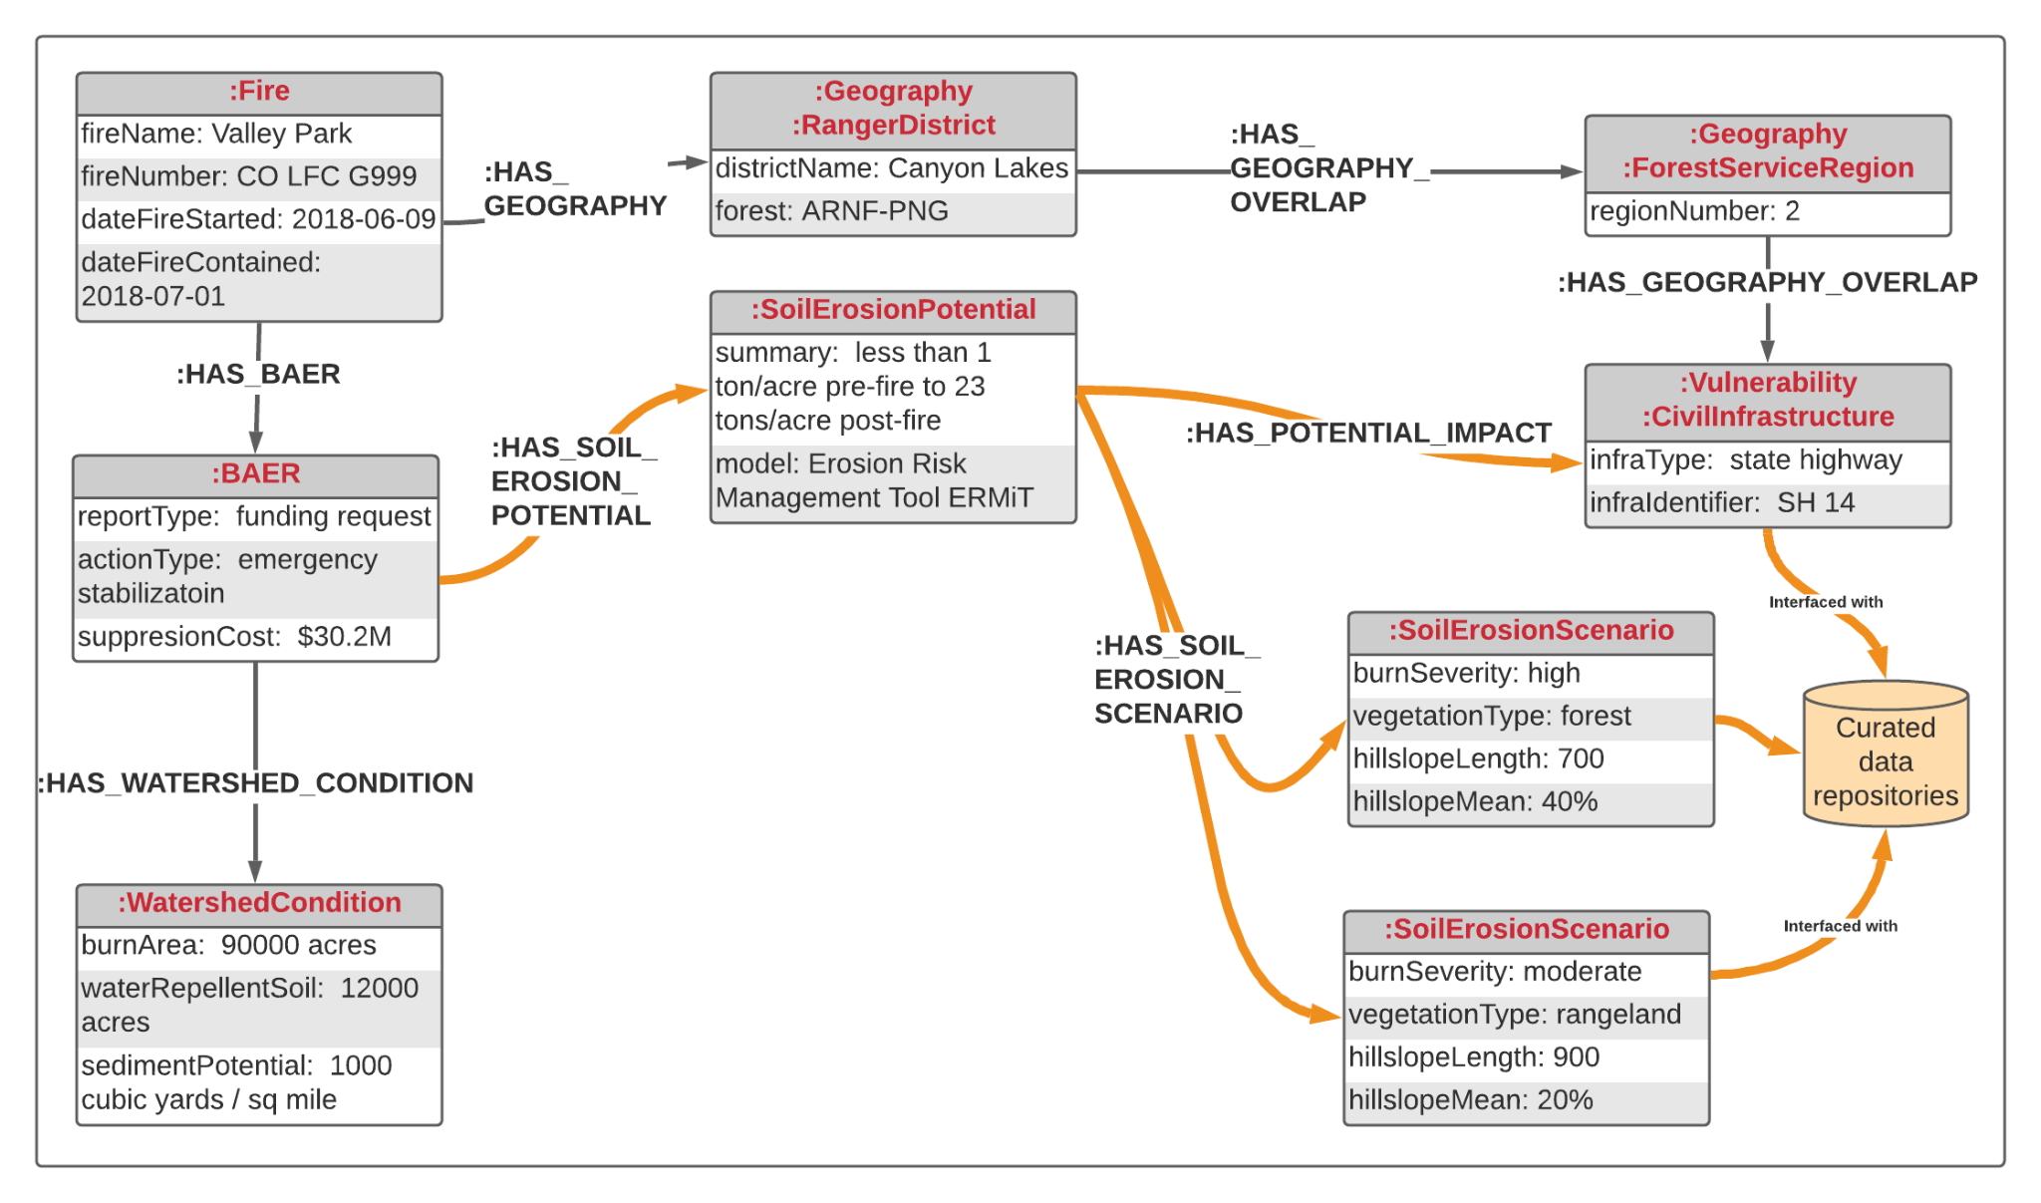
Wildfire - Geography - BAER - Soil

Slide 18
Wildfire - Geography - BAER - Soil - Emergency Stabilization

Slide 19
Reminder: equivalence

Slide 20
Facilitating knowledge mobility
Translating this...

Slide 21
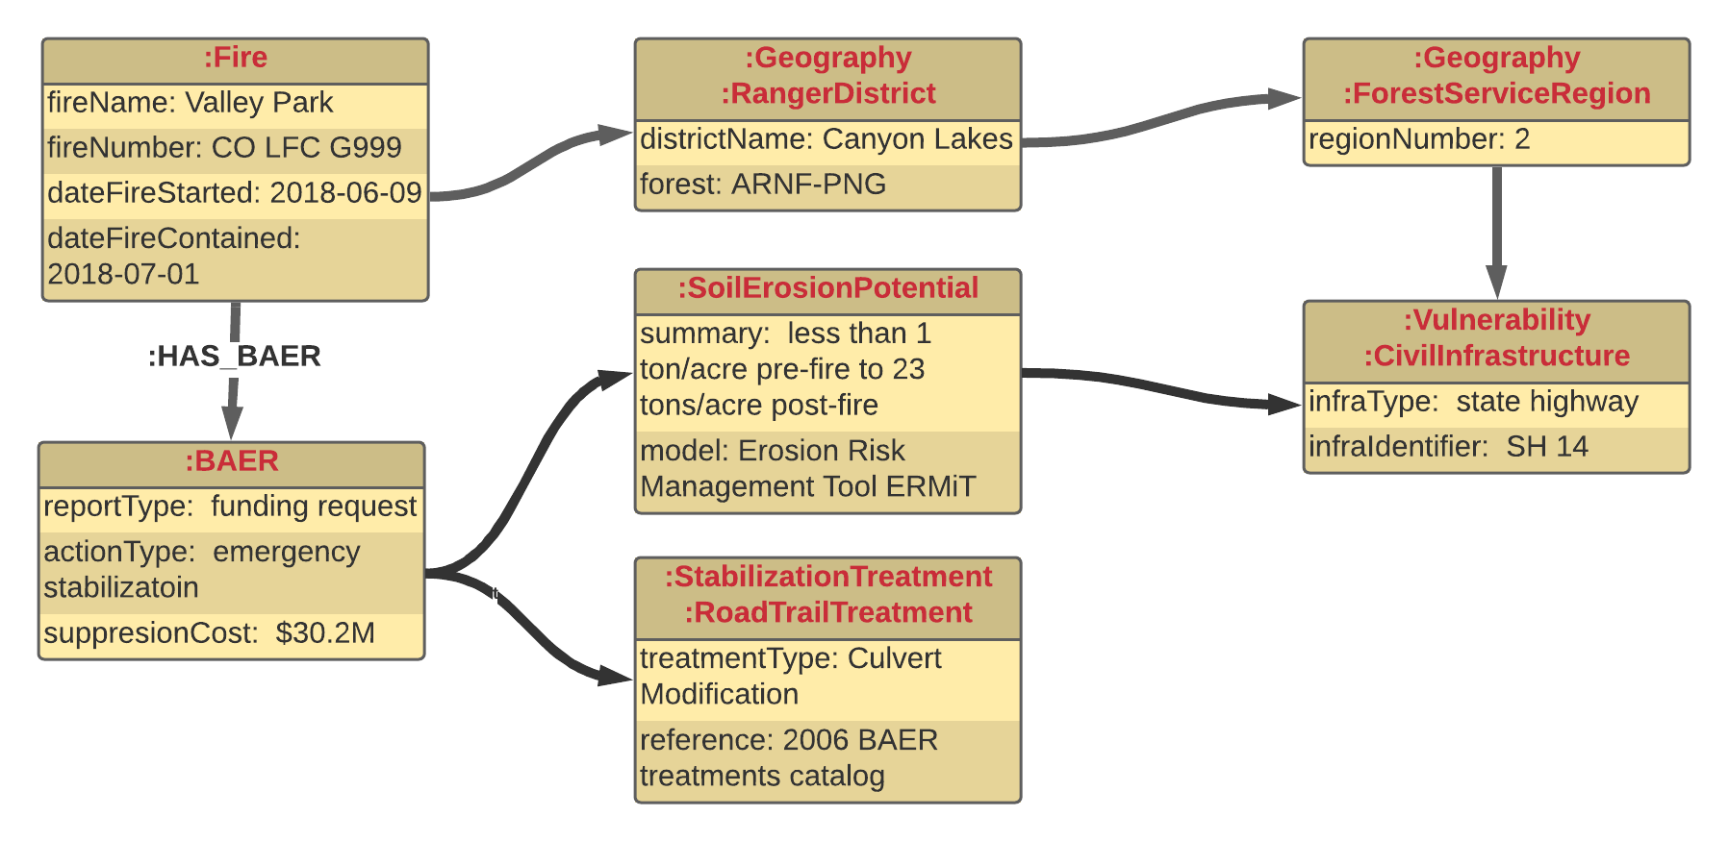
Facilitating knowledge mobility
Translating this...
...into graphs...
During Fire
Weather
Values at risk
Topography
After Fire

Slide 22
Facilitating knowledge mobility
Translating this...
...into graphs...
...to facilitate:
During Fire
Reusable and repurposable evidence-based decisions.
Data-to-decisions search engines.
Data-to-decisions visualizations for discovery.
Weather
Values at risk
Topography
After Fire

Slide 23
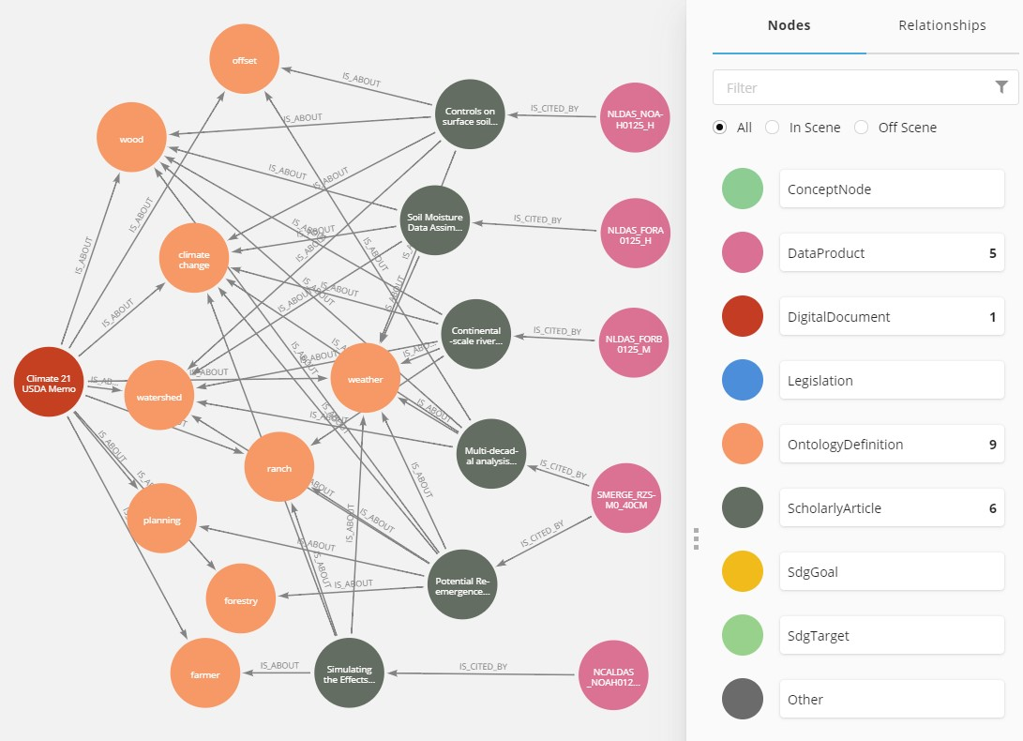
USDA carbon management per Climate 21 Memo

Slide 24
Next steps
Agriculture and Climate Cluster (ACC) monthly meetings.
Open to anybody, no prerequisites
Sign up for announcements
Possible online fall 2021 workshop (unconfirmed).
Theme: knowledge management across the wildfire management lifecycle
In discussion:
Focus on these phases?
BAER as a bridge between phases?
What outcomes will be useful to you?
Bill Teng (william.l.teng@nasa.gov), Brian Wee (bwee@massiveconnections.com) (Co-chairs of the ACC)

