Slide 1
Fire Fuel Discovery
Purdue University-ECE
Jack Gihl
Cristian Washburn
Ram Prabu
Haofei Tian
Notes:
Jack

Slide 2
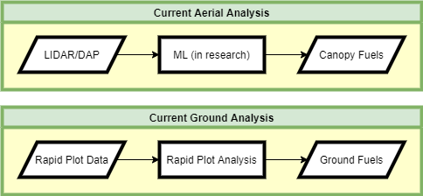
The Current Challenge
Aerial Data (LIDAR & DAP) collection
  Wide area coverage for low cost/time expense
  Determines Canopy Fuels
Ground Data (Rapid Plot) collection
  Small area for high time expense
  Determines Ground Fuels
Aerial data cannot penetrate beneath the canopy or directly give ground fuels
Notes:
Jack

Slide 3
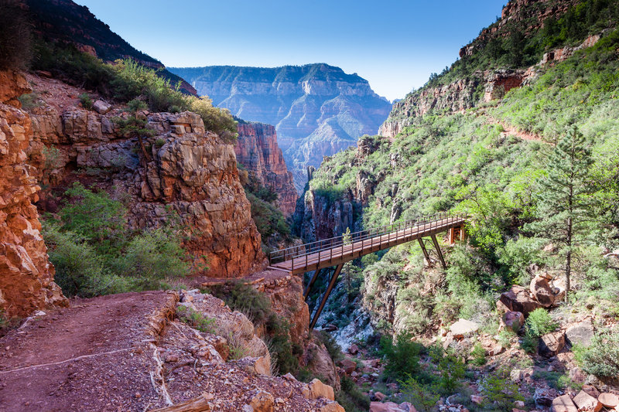
Communication with Everett Hinkley and Andy Hudak
Originally Post Disaster Image Recognition
  Realized Forest Fires are a bigger issue
  Machine Learning Applications
North Kaibab Region
  Pre- and Post-fire data
  DAP and LIDAR
Source: https://www.hikingproject.com/trail/7003260/azt-passage-38-north-kaibab
Notes:
Jack

Slide 4
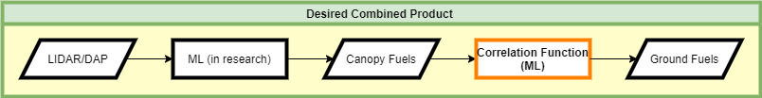
Our Proposed Solution – Developing the Correlation
Combine the two analysis methods
LIDAR/DAP can’t directly give ground fuels
Ground fuels can be treated as a function of canopy fuels
Correlation function – Machine Learning/regression based
Notes:
Cristian

Slide 5
Schedule Outlook
First contact with Everett Hinkley – Sept. 13, 2021
Team formed – late October 2021
First data received – November 20, 2021
TFRSAC Meeting – December 1, 2, 2021
Starting work - January 2022
Testing of first Aerial-to-Canopy Fuels ML algorithm – March 2022
Testing of Canopy Fuels-to-Ground Fuels correlation algorithm – April 2022
Working prototype – early May 2022
Notes:
Cristian

Slide 6
Primary Functional Requirements
The software shall accept LIDAR/DAP data as input
Utilizing the input and ML algorithm, it shall output the classifications (Table 1), densities and locations of the understory fire fuels
It shall have a User Interface (UI) that gives a good user experience
It shall output an informative report to internal and external storage, which is based on user's choice
It shall provide performance log
It shall have admin mode and operation mode
Type | Diameter
downed, dead, woody fuels | < 0.25 inches
downed, dead, woody fuels | 0.25 - 1.0 inches
downed, dead, woody fuels | 1 - 3 inches
downed, dead, woody fuels | 3+ inches
shrub: dead and live shrubby fuels | > 2 inches
herb: dead and live grass and forb fuels | NA
Table 1: Fire Fuels to Estimate
Notes:
Haofei

Slide 7
Primary Technical Requirements
Requirement Category | Requirement | Specifications
Hardware Requirements | Computer/Laptop Requirements | 32-bit architecture or higher 4 GB RAM or higher CPU performance > 100 examples/second
 | Storage/Memory Requirements | Maximum size of software: 500 MB Training or Test data size: greater than 500 GB
Performance Requirements | Training Requirements | Test data size: Train data size = 1:9 Initial Training rate: 14k examples/second
 | Validation Requirements on test data | Location Accuracy: 80% Classification Accuracy: 90%
The software shall be an independent, standalone software system.
Different releases of software shall be made for different operating systems.
Different Modes are password protected and the password is stored in MySQL tables.
Parameters of the trained ML model will need to be stored in a MySQL table.
User shall select the runtime type (CPU/GPU) based on need.
Table 2: Summary of the Technical Requirements
Notes:
Ram

Slide 8
Challenges
The main cores of the project are the two ML algorithms, so they are the primary challenges we could expect.
For the first ML algorithm, since it has been researched by many organizations, the challenges are to research their current methods and customize them for our specific applications
The second one would be the biggest difficulty, because there are plenty of ML algorithms for developing a correlation, and we need to find the most accurate one
Notes:
Haofei

Slide 9
Conclusion & Contact Info
Fire Fuels Discovery – Purdue University - School of Electrical & Computer Engineering
Current Challenge & Conversations
Proposed Solution & Schedule Outlook
Primary Functional & Technical Requirements & Challenges
Contacts
  Cristian Washburn – Engineering Integration, Regression Analysis - cwashbur@purdue.edu
  Jack Gihl – Remote Sensing, Ecology Research - jgihl@purdue.edu
  Ram Prabu – Machine Learning, Programming Implementation - ganesan2@purdue.edu
  Haofei Tian – Programming Implementation, Machine Learning, Customer Analysis - tian213@purdue.edu

