Slide 1
Fire Spyer: Fire Reporting Citizen Science App
NASA Academy 2021
Langley Research Center
Made by NASA Academy 2021
Presented by Patrick Wilson
12/02/2021

Slide 2
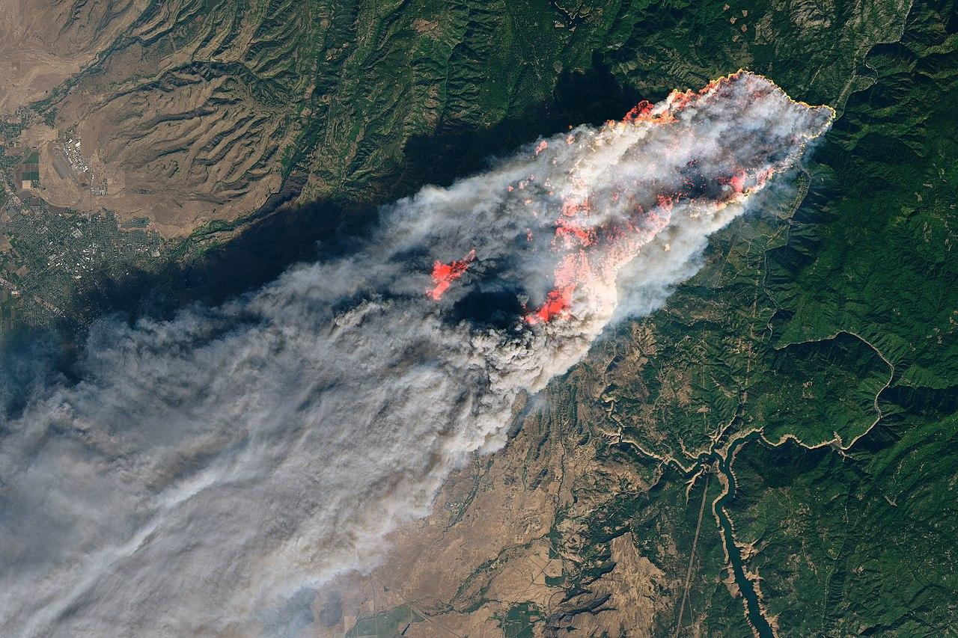
The Problem
911 only avenue to report fires
Chance for reports to be overlooked
Time delays to get to fire management
Camp Fire Incident shows devastating consequences of miscommunication and time delays
“It breaks my heart that I and anybody else that was answering the phone that day was not able to give them more information, better information, faster information”
- Carol Ladrini, Camp Fire 911 dispatcher
Wildfire Analysis,
Management, and Response
NASA Academy 2021
Langley Research Center
Notes:
https://earthobservatory.nasa.gov/images/144225/camp-fire-rages-in-california

Slide 3
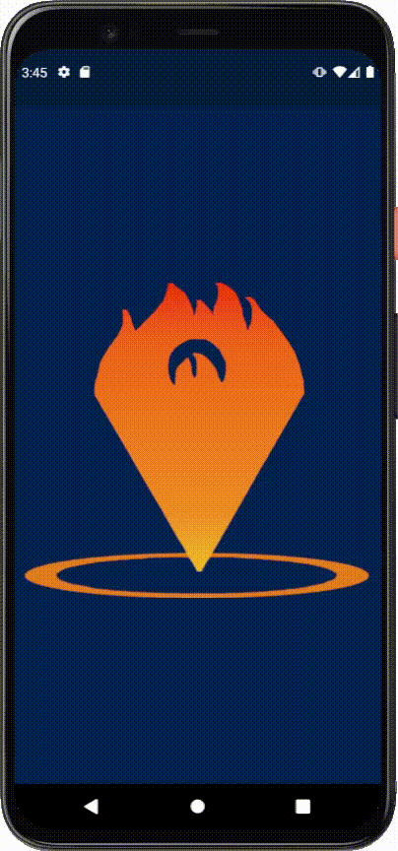
The Solution
Fire Spyer harnesses many observations in near real-time to assist in monitoring what is happening and where values are at immediate risk.
Fire Spyer = network of self-organizing, mobile, ad hoc fire towers
supplements existing methods of IAA (incident awareness and assessment)
collects information and informs citizens without overloading local dispatch
Wildfire Analysis,
Management, and Response
NASA Academy 2021
Langley Research Center

Slide 4
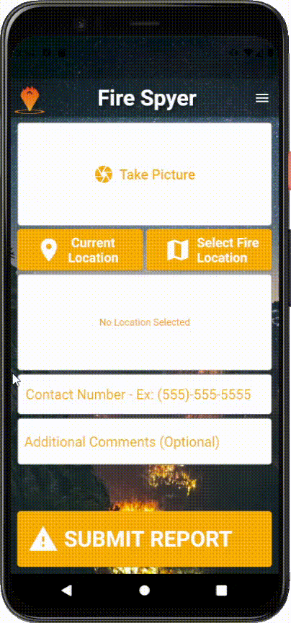
Main Features
Sleek and user-friendly home screen
Camera
Location
Contact info
Comments submission fields
Sidebar Menu with News and Admin Access
Admin access to pending reports and their data
Local weather data and user’s bearing
Data populates pull-able cloud database
Can be integrated into existing common operating pictures and data libraries
Wildfire Analysis,
Management, and Response
NASA Academy 2021
Langley Research Center

Slide 5
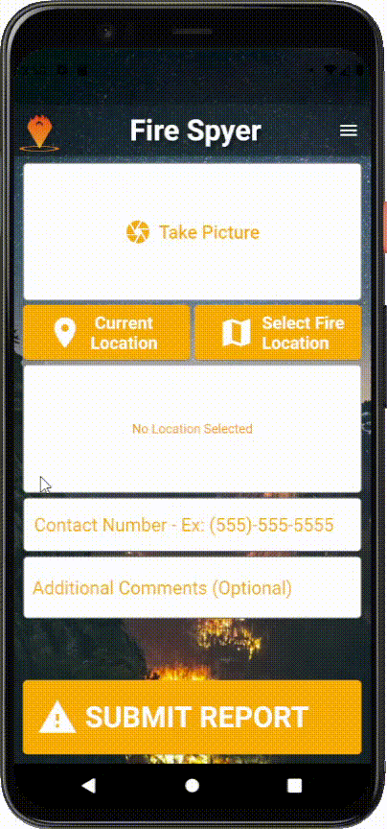
Distinctive Approach
This app fills a unique niche
No alternate national fire reporting methods exist
Clarifies where people and property are at risk
Expedites and expands citizen reporting
Serves as an extension of the fire watchtower cameras and other existing systems
Supplements awareness of new fires
Augments knowledge of existing fires
Wildfire Analysis,
Management, and Response
NASA Academy 2021
Langley Research Center

Slide 6
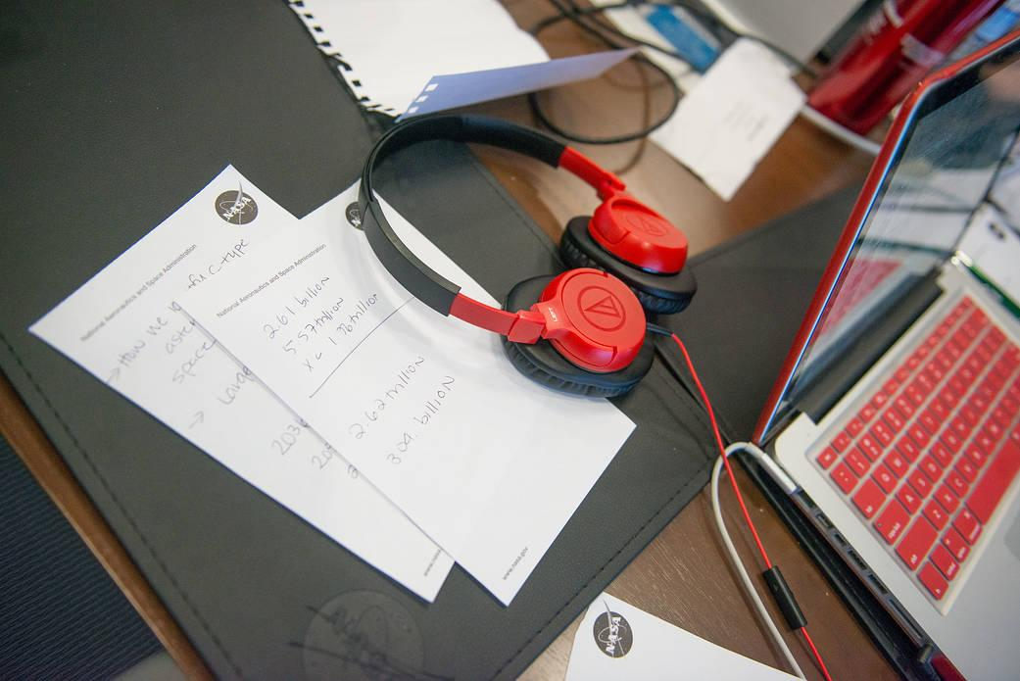
App Launch
We need assistance in a beta release to evaluate Fire Spyer’s performance.
Fire Spyer works for android and ios
Publishing will require long-term moderation of the app
Integration with existing fire data infrastructure
Wildfire Analysis,
Management, and Response
NASA Academy 2021
Langley Research Center

Slide 7
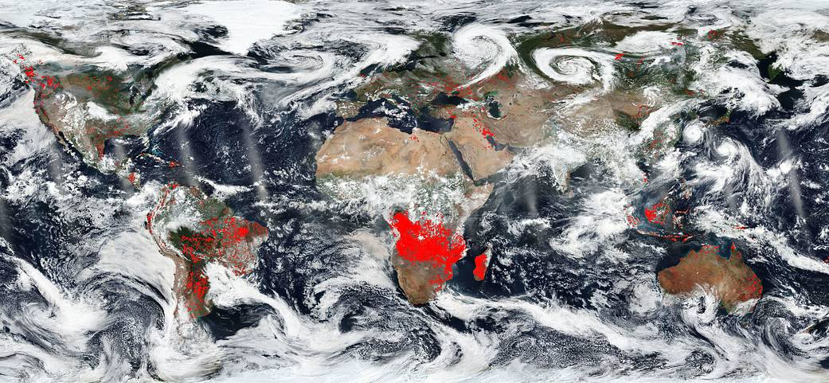
Conclusion
Adds civilian reports as a real-time data source
Improves incident awareness for wildfire management
Helps prevent another Camp Fire Incident
Fire Spyer harnesses many observations in near real-time to assist in monitoring what is happening and where values are at immediate risk.
Wildfire Analysis,
Management, and Response
NASA Academy 2021
Langley Research Center
Notes:
https://www.nasa.gov/image-feature/goddard/2018/a-world-on-fire

