Slide 1
RoGO DropBlock / SNC Ronin UAS
Extending Communications to Protect Resources
Rod Goossen (CEO/Founder, RoGO Communications)
Scott Petersen (Program Director, Sierra Nevada Corporation)

Slide 2
Agenda
RoGO DropBlock Description/Characteristics
Ronin / RoGO Concept of Operations (CONOP)
RoGO DropBlock / HAP and Ronin Operational Employment
Propose Way Ahead
Questions

Slide 3
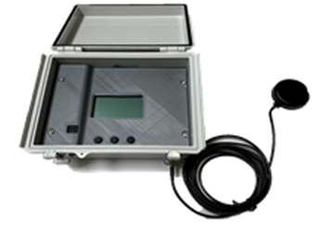
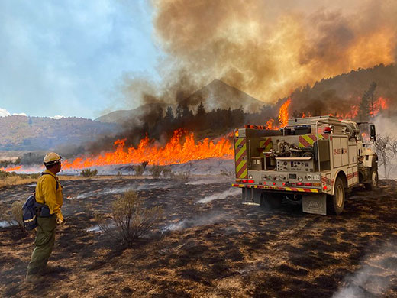
RoGO DropBlock
Features and Functions
Current Size, Weight, & Power
Size: 8.5” x 7” x 4”
Weight: < 2.2 lbs
Power: ≤ 18 watt hours p/day
Mark, track, & share real-time locations of First Responders, Firetrucks & Equipment so Incident Command sees everyone in real-time – and identifies who is in possible danger.
DropBlock transmits wind speed/wind direction data, crucial information for wildland firefighters
RoGO has Predictive Analysis software to show where/when/what the next threat is coming from…and when it will arrive.
Improves communication & asset coordination across tactical & organizational teams.
Allows faster & safer tactical decision-making – update new tactical decisions in seconds with remotely-located personnel.
Future Size, Weight, & Power
Size: 5.5” x 3.5” x 1.125”
Weight: < 16 oz.
Power: ≤ 18 watt hours p/day
* First Net (Band 14) Capable
- Instant deployment for Sensor Data
- Tracks Equipment GPS Location
- DropBlocks relay: Temperature, Barometric Pressure, and Relative Humidity
- Device powered from USB, AA Battery, Solar, or 120V AC power
Save lives, money, and time; reports data to anywhere, from anywhere

Slide 4
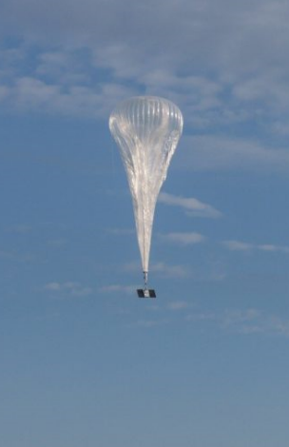
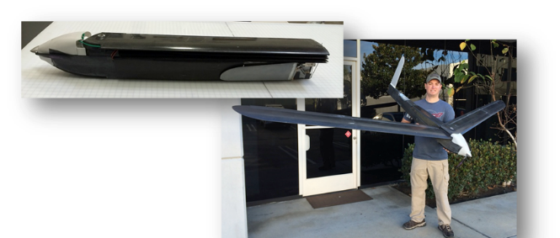
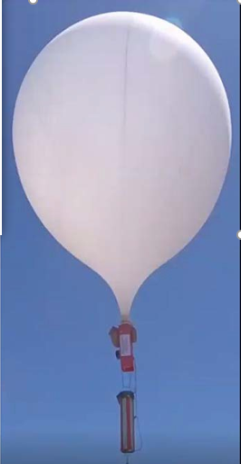
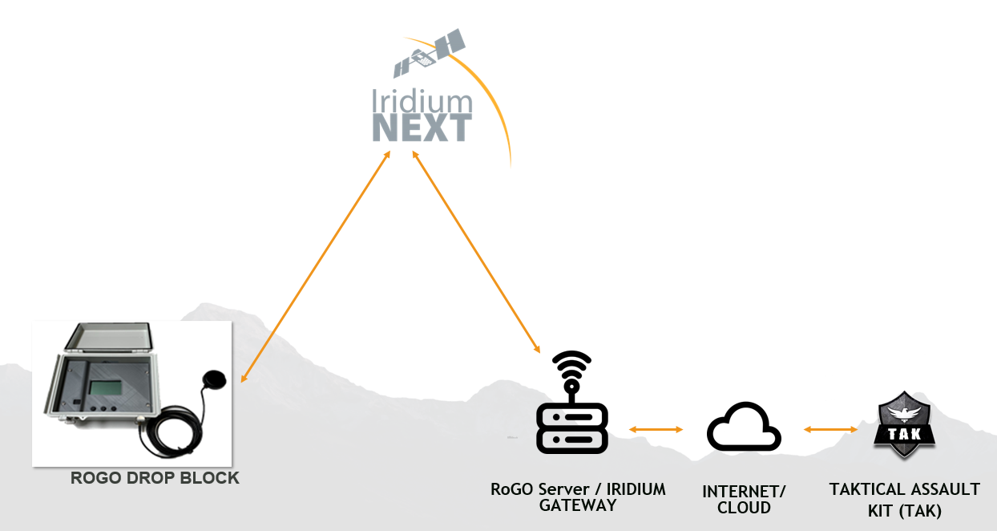
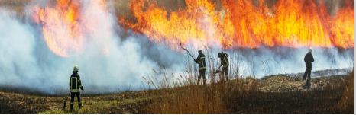
Ronin / RoGO / HAP CONOP
Situation:
The USFS, NPS, F&WS, BIA and BLM requires enhanced & responsive ground based / overhead communications with ISR capabilities to more effectively address a forest fire in resource-challenged areas or where extended communications are not available.
Mission:
Provide The USFS, NPS, F&WS, BIA and BLM with high altitude ISR & data processing via a sustained presence via High Altitude Platforms (HAPs). Leverage mesh networks, EO/IR capabilities, Air Launched Effects (ALE) UAS, 5G connectivity, BLOS communications over areas with forest fires.
Concept of the Operation:
Phase I: This phase begins with USFS/DOI defined requirements and forward staging logistics to support high altitude platform launches; RoGO deployed / employed via firefighters (vehicle) during initial attack.
Phase II: This phase begins when firefighters are on-site and a C2 location is established. Small balloons launched by firefighters; RoGO employed via small balloons / RONIN UAS, RoGO airdropped at designated locations to support firefighting efforts and overall C2.
Phase III: This phase begins with the launch of large balloons connected via mesh network and associated payloads to support long duration ISR and C2.
Phase IV: This phase begins when all assets (aircraft, balloons, UAS, vehicles, C2 Location) are connected via MESH network / RoGO

Slide 5

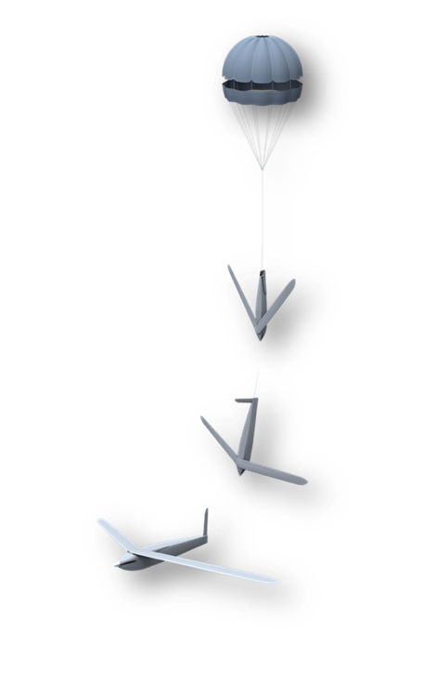


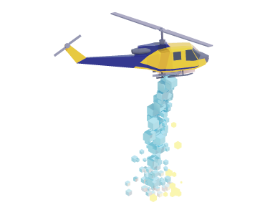




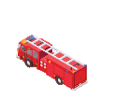

HAP Operational States and Ronin Employment
Pre-Flight State
Ascent State
Operable State
Descent State
Post-Flight State
70K’
Float Reached
~1 hour ascent
User Initiated Release
60K’
Ronin Delivery
MESH RF Network
DropBlock Delivery
Balloon launch
DropBlock Recovery
Ascent Zone
MSL

Slide 6
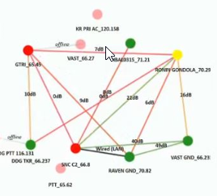
Way Ahead
Support a capabilities demonstration in vicinity of a prescribed fire or controlled burn
  Enable enhanced first responder situational awareness via RoGO emplacement / connectivity
  Employ a Ronin that provides first responders with RF, EO/IR, and RoGO capabilities
  Demonstrate a distributed communications architecture that links first responders and a C2 node
  Launch balloons with additional payload capabilities that increase the overall sensing architecture
MESH Network

Slide 7
Questions?

Slide 8
Contact Information
Scott Petersen
Program Director
scott.petersen@sncorp.com
910-307-3336
910-574-2536
sncorp.com
Rod Goossen
CEO/Founder
r.goossen@rogofire.com
719-800-7646 (RoGO)
RoGoFire.com
RoGoCom.com

Slide 9
Back Ups

Slide 10
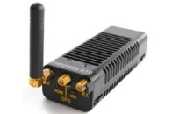
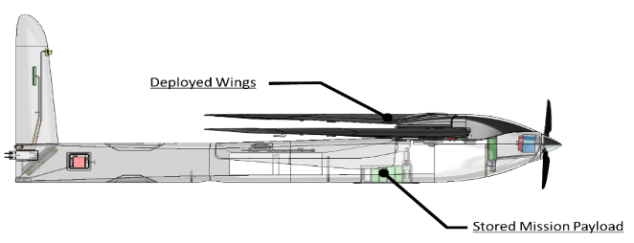
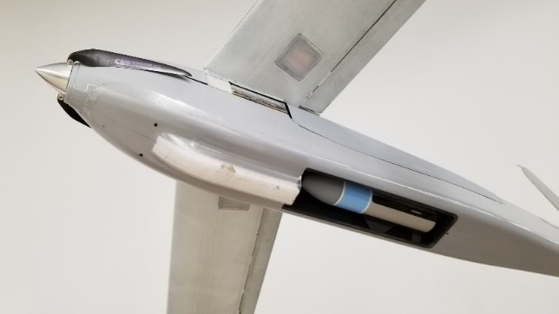
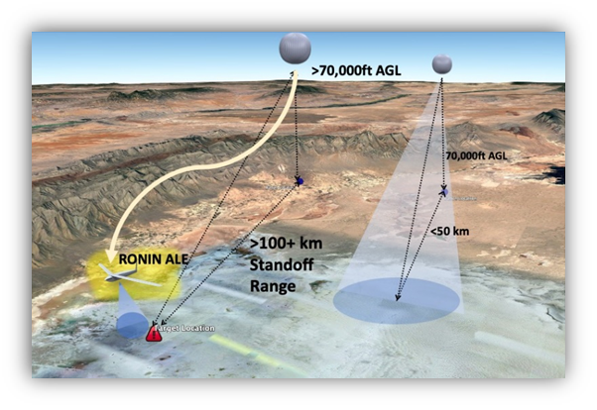
Rōnin ALE-UAS
  Tailless flying wing configuration
  Automated unfold and fly
  Army Level 3 AWR
  Endurance: up to 4 hrs
  Weight: ~17 lbs
  Wing Span: ~11.8 ft
  Cruise / Dash speed: 38 kts / 80kts (Sea Level)
  Super Quiet electric propulsion
  Low visual, acoustic, thermal, and RCS observables
  Optional AJ-GPS / GPS denied operations
  Secure RF digital data link to airborne “mothership”& GCS
    Radio-Link / frequency band flexibility
    FIPS 140-2, AES 256 Encryption, Optional Anti-Jam Radio
  Supplemental payload capacity (ROGO DropBlock Mini)
  Gimbaled 14 mp HD color camera – 640x512 IR camera
    Electronic Pan, Tilt, Zoom and stabilization
    Color camera: 1.6cm GSD at 150m (nadir) – 2.3cm GSD at 212m 45degree slant range
    Infrared camera: 9.1cm GSD at 150m (nadir) – 12.9cm GSD at 212m 45degree slant range

Slide 11
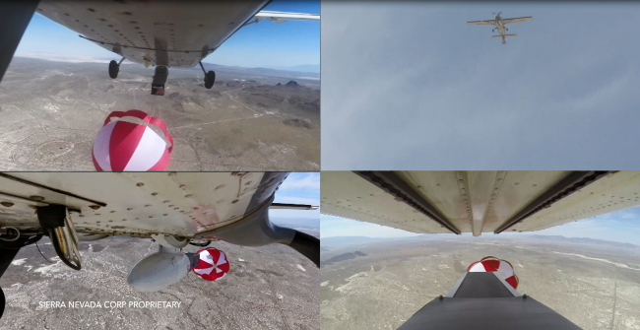

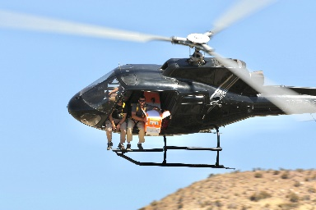
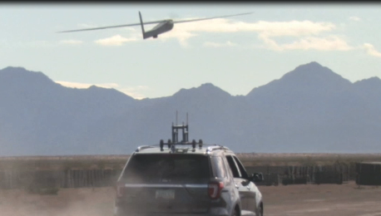
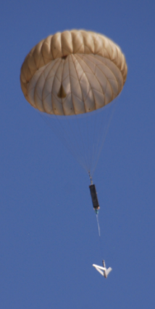
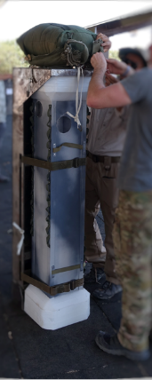
Rōnin Employment Options
Wing/Belly POD
Low Altitude Helo Toss
  Demonstrated
  Success
High TRL Proven Capability
> 200 Flights To Date
~85 Airdrop flights performed to date
Airdrop altitudes of up to 78,000 ft
Precision placement of sensors
Serves as a comms relay node
High Altitude Balloons
Ground Vehicle Launch
High Altitude FW Cargo Drop
Proven Deployment Options for Employing the Ronin UAS

