Slide 1


Advanced Forest Fire Planning introducing Quantitative Climate Intuition (QCI) Presented to the Tactical Fire Remote Sensing
Advisory Committee (TFRSAC) Meeting
Steve Ambrose & John Timler, SAIC
29 November 2022
Disclaimer statement:
“The material contained in this document is based upon work supported by a National Aeronautics and Space Administration (NASA) grant or cooperative agreement. Any opinions, findings, conclusions or recommendations expressed in this material are those of the author and do not necessarily reflect the views of NASA.”

Slide 2
NASA Grant 80NSSC22K1817 - Advanced Forest Fire Planning introducing Quantitative Climate Intuition (QCI) (Formerly called Complexity Management (QCM)/Artificial Intuition)
Goal: Through QCI, identify locations/areas of forest system sensitivity and stress that often leads to wildfires or wildland fires.
Project Details:
Duration: Nov 2022 – Dec 2024
Initial work to build out wildfire case studies to determine areas of forest system stress (ignition zones)
Investigate incorporating NASA remote sensing data sets in conjunction with other data sets
Demonstrate technique in operational setting to key stakeholders (i.e. California Department of Forestry and Fire Protection (CAL FIRE))
Project Team:
- Steve Ambrose – PI, SAIC Chief Climate Scientist
Dr. John Timler – Chief Scientist
Dr. David Morrison – Modeling and Analytics
Jeanne Lane – Data Acquisition
-NASA Program Manager: Dr. David Green, Wildland FireSense Management Team
-NASA Project Manager: Dr. Jessica McCarty, NASA Ames

Slide 3


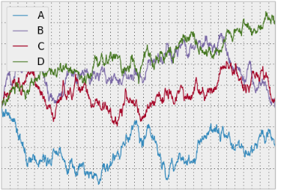
What is Complexity?
Complexity is a fundamental property of all systems, just like energy. It is a scalar function of structure and uncertainty. It quantifies the amount of structured information within a system.
Complexity is measured in cbits (complexity bits).
Structure
(Interdependency of players)
Uncertainty
(Noise content in information)

Slide 4
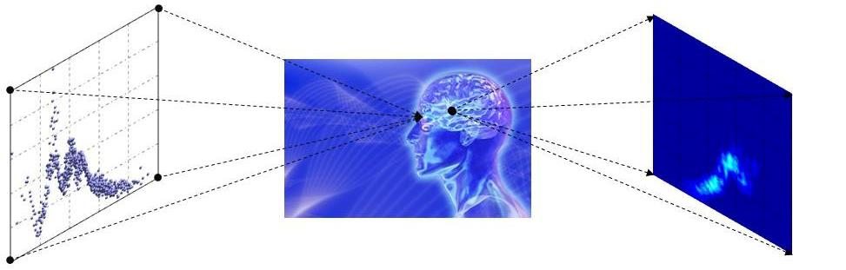
Quantitative Complexity Management (QCM):
Model-free Analysis of Data
The brain processes a scatter plot not as data, but as an image created in the cortex; it then identifies instantaneously a series of features, even if the image is blurred. This is done without any calculations, building equations, or model fitting. Adapted by nature, the brain can perform this task without resorting to mathematics and has done so long before the discovery of mathematics. The data analysis technology delivered by SAIC/Ontonix mimics the brain. No statistics, no regressions or cluster analysis, no model fitting, no fuzzy logic: just brand new, disruptive technology in its purest form.

Slide 5
Preliminary Exploration of Forestry Use Cases
Evaluation of Forest Ecosystem Robustness and Fragility from Satellite Optical Imagery
Correlations between complexity of drought maps and fire activity
Near term plans include incorporating additional data sets such as air quality and temperature maps.

Slide 6
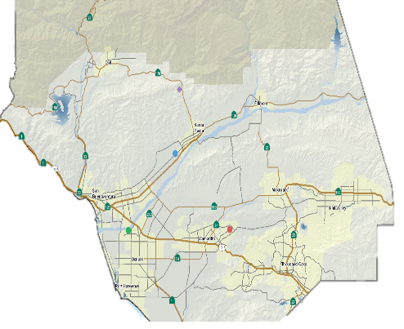
Ventura County – Thomas Fire Preliminary Case Study
Ignition
Contained
Thomas Fire
Ignition Point
Camarillo
Complexity
Santa Paula
Station
Analysis Window: 30 Days
Step Size: 1 Day
Data Taken Daily/Station:
Precipitation
Air Temp Max
Air Temp min
Soil temp Max
Soil temp Min
Solar Radiation
Camarillo
Station
Santa Paula
Complexity
Individually Neither Station Has a Complexity Response to the Fire
Combined Station Data Has Region of High Sustained Complexity Correlating to the Fire
Complexity in Fire Region is Driven by Max Soil Temperature at Camarillo
Next Step Introduce More Stations and Additional Types of Data Like Soil Moisture
Combined
Complexity
Combined
Complexity
Profile
11/11/2017
1/21/2018

Slide 7
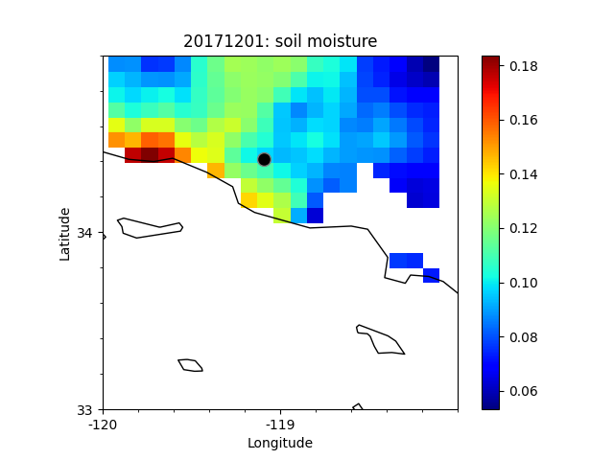
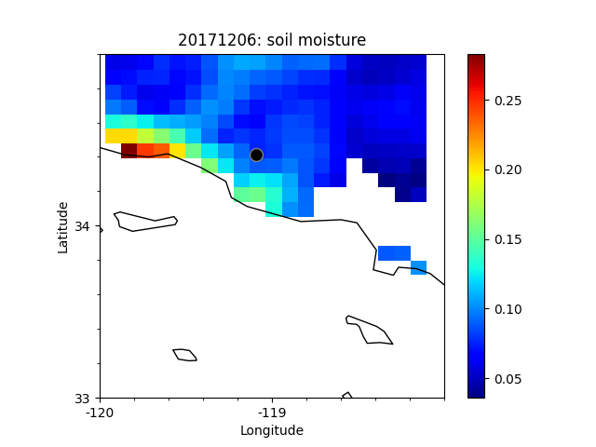
Soil Moisture Data from Thomas Fire Prepared for QCM Processing
Thomas
Fire
Thomas
Fire
Thomas Fire Start Date: December 4, 2017
Actively Looking for Collaboration Team Members for Pre-Processing

Slide 8
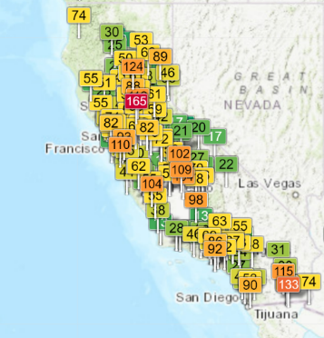
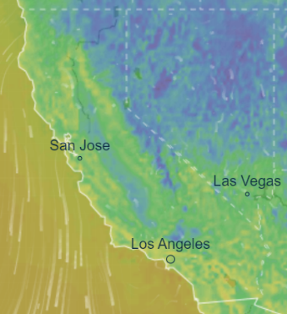
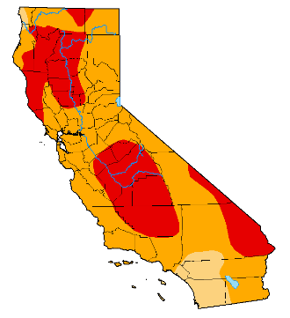
Path towards integrating diverse data sets
Each data stream (air quality, temperature, drought level) becomes a column with individual rows being distinct points in time for the entire system.
Air Quality
https://aqicn.org/map/california/
Temperature Models
https://www.ventusky.com/?p=36.7;-124.1;4&l=temperature-2m
Drought Maps
https://droughtmonitor.unl.edu/Maps/MapArchive.aspx

Slide 9
Artificial Intuition for Earthquake Early Warning (12 seconds)
Complexity
Significant Complexity Delta
Pre-tremors detected
Main Quake Detected
Window of 500 data time stamps corresponding
to initial increase in complexity
12 sec
Window = 500 points (5 seconds)
Step = 1 point (0.01 second)
Profile
Next Step: Integrate data
from multiple seismographs
for advanced early warning
Seismograph Data
https://www.kaggle.com/datasets/isevilla/stanford-earthquake-dataset-stead
Time (0.01 seconds)
109C.TA_20061114133221_EV

Slide 10
Collaboration Opportunities & Next Steps
Collaboration Opportunities:
  Data Archive Access
  Data Preprocessing (diverse formats => numerical tables)
  Results Visualization
Next Steps
  Integrate More Diverse Data Sets
  Show Historical Correlation Between Complexity and Forest Health
  Ultimate Goal is Employ QCI in a Predictive Capacity for Forest Protection

Slide 11
Stakeholder Outreach
California Department of Forestry and Fire Protection (CAL FIRE):
  Ongoing Discussions with R&D and Innovation Team to test QCI on historical and emerging fire events
  Proposed Use Cases:
    Provide analysis of wildfire risk to community infrastructure to analyze long term accumulation of vegetation around infrastructure.
    Using historical case studies, determine of deployment of operational assets, such as fire suppressant, fire crews, and other equipment makes the best use of resources and effectiveness in fighting the fires.
    Analyze drought conditions as a potential key indicator for fire risk on a statewide scale
    Investigate enhanced forecasts for seasonal/monthly planning that integrate climate-weather and fuels are necessary, while balancing Air Quality (AQ)
Seeking outreach to any state and local contacts to see if they are interested in participating in our projects and studies.

Slide 12
Contact Information and Link to Climate Enterprise Website
SAIC’s Climate Enterprise
Steve Ambrose, Chief Climate Scientist – stephen.d.ambrose@saic.com
Dr. John Timler, Lead Project Scientist – john.p.timler@saic.com
Climate Enterprise Website – https://www.saic.com/what-we-do/mission-support/climate-enterprise

Slide 13
Thank you!

Slide 14
Backup Slides

Slide 15
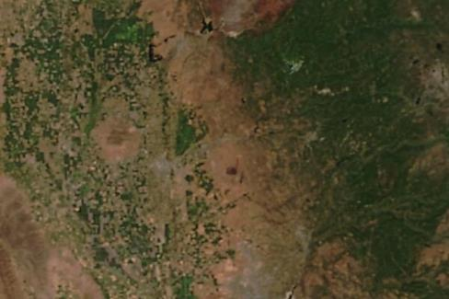
Quantitative Complexity Management (QCM) for Forest Criticality
QCM is a model free approach that quantifies the entropy and correlation of system interdependencies to identify system anomalies
QCM ‘Artificial Intuition’ can be used in a Stand Alone Capacity or in Conjunction with ML/AI
Changes in Grid Elements can be Tracked Overtime
Size of Grid and Size of Elements can be Scaled for Regional Comparisons
Temperature, Rainfall, Wind Speed and other Environmental Data Sets can be Integrated into Multi-Layered QCM Image Analysis
16
26
Divide Satellite Image into Grid and Apply QCM to Each Element

Slide 16
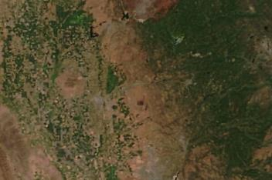
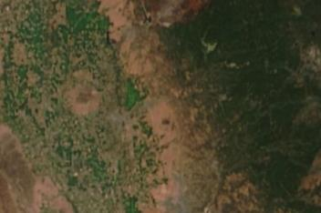
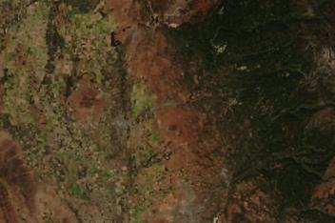
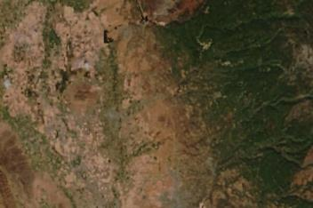
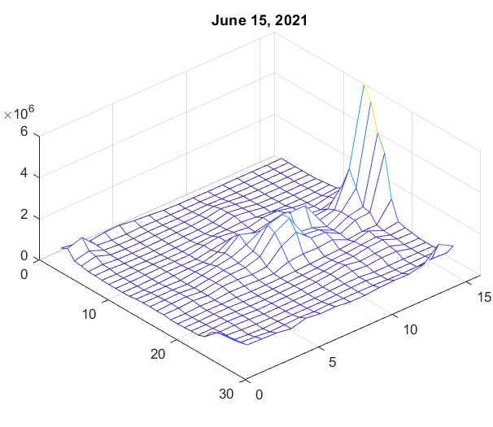
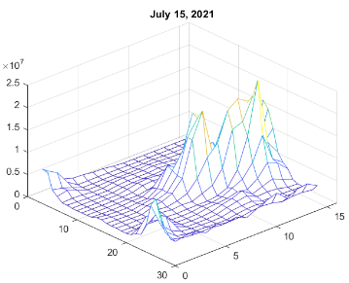
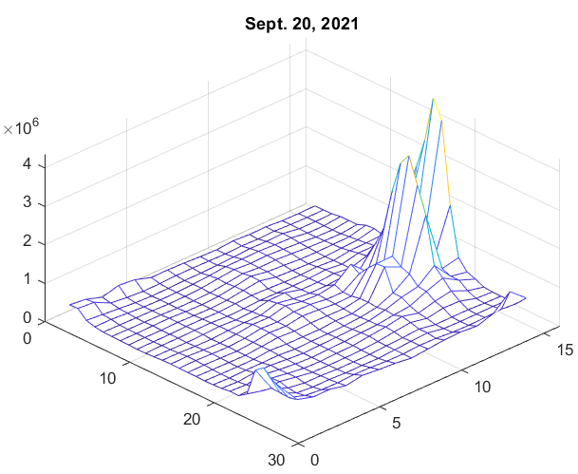
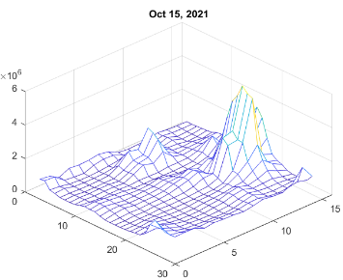
Complexity Analysis of Foliage in Southern California
16
Peak
0
26
Peak Complexity = 6.0x10⁶
Peak Complexity = 2.3x10⁷
Factor of 4 increase
Peak Complexity = 4.3x10⁶
Factor of 5 decrease
Peak Complexity = 5.0x10⁶
Local Complexity Increases and Diminishes in Conjunction with Growth Season. Densest Region of Foliage has Highest Complexity.

Slide 17
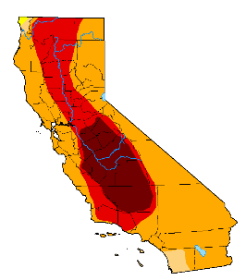
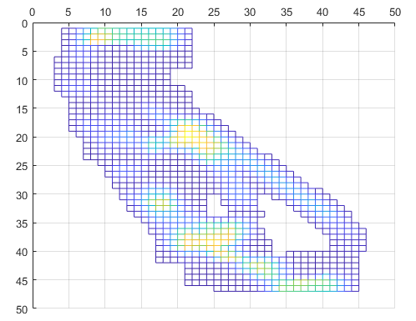

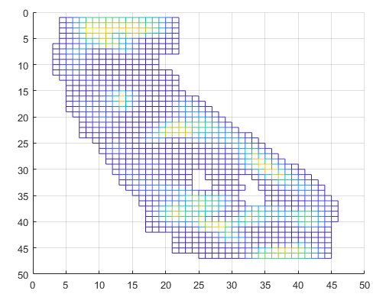
Drought Maps Converted to Complexity Maps with Artificial Intuition
Drought Map
9/13/2022
Complexity Map
9/12/2022
Drought Map
3/15/2022
Complexity Map
3/15/2022
https://droughtmonitor.unl.edu/Maps/MapArchive.aspx
c

Slide 18
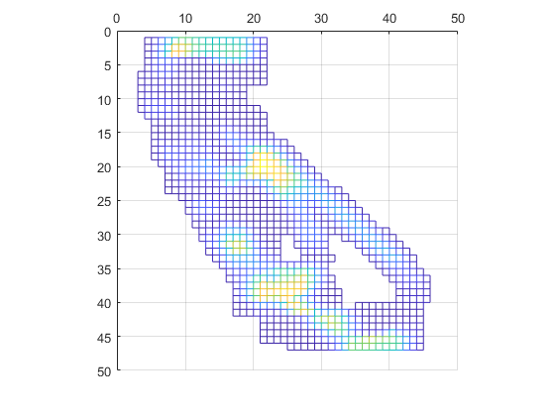
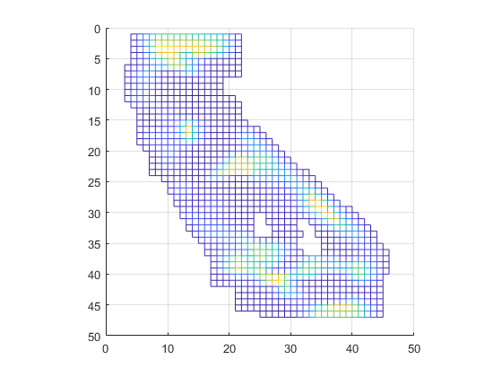
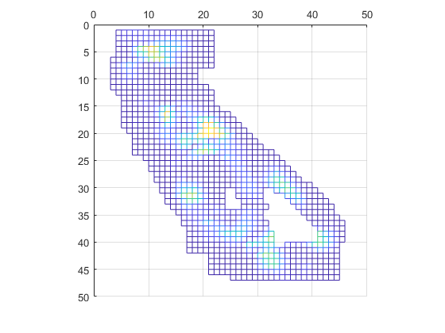
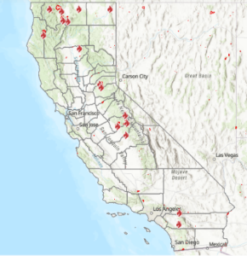
Correlation of Drought Dynamics to Potential Fire Activity
Complexity 9/12/2022
Complexity 3/15/2022
Complexity Delta
-
=
Largest Delta
Mosquito Fire Region
Mountain & Mill Fires
Not conclusive, but definitely interesting to see the relationship Current major fires correspond to complexity delta regions from drought maps.
Mosquito Fire Region
Fairview Fire

Slide 19
Examples of Forestry Criticality Analysis Enabled by QCI
Forest Historical State of Health Monitoring and Prognostics
Detection and Evaluation of Insect Infestation Events
Short and Long Term Impact of Drought
Logging Impact Assessment and Modeling
Quantitative Ranking of Forests Overall Resiliency
Real Time Prediction of Trends, Inflection Points and Catalyst Nexuses for Forest Fires
Individually or Collectively Assess Impact of Diverse Data Sets (Urban Growth, Terrain, Water Supply…) on Forest Resiliency

Slide 20
QCI Computation Parameters
16 vCore | 32 vCore | 200 vCore | 300 vCore | 640 vCore | Memory used | Number Elements
2.08 sec | 1.48 sec | 0.54 sec | 0.48 sec | 0.41 sec | 40 MB | 300,000
16.41 sec | 13.3 sec | 2.12 sec | 1.83 sec | 1.25 sec | 436 MB | 580,000
0:02:34 | 0:01:44 | 20.72 sec | 16.39 sec | 8.84 sec | 3.7 GB | 1,740,000
0:58:43 | 0:21:20 | 0:04:22 | 0:02:56 | 0:01:25 | 41.98 GB | 5,800,000
N/A | N/A | 0:28:05 | 0:18:42 | 0:08:49 | 260 GB | 14,500,000
N/A | N/A | N/A | 0:50:08 | 0:25:09 | 760 GB | 24,192,786
Approximately Linear Reduction in Computation Time with Additional Cores
Both Cloud and Dedicated Server Implementations Available

