Slide 1
Spire Weather
For an increasingly complex and fast-moving world

Slide 2
The largest
private constellation
in the world
We are the largest producer of radio occultation and space weather data
Our data provides a global view with coverage in remote regions like oceans and not observed by traditional systems. All data can be refreshed within a 15 minutes cycle
We are continuously launching improv poles ed sensors and upgrading them in-orbit.
We turn ideas into live feed from space in as little as 6 months
30+
100+
19.4M
Ground stations
Satellites
Messages in one day

Slide 3
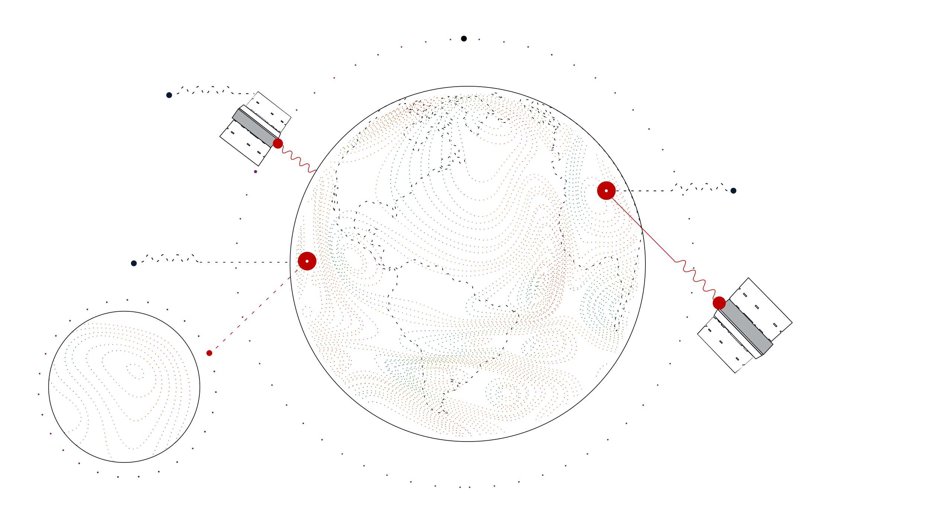
Spire RO Data Collection
Global 3D Weather Coverage
Proprietary
Radio Occultation
Technology
100+ Satellites measure
11,500 times per day
15 Minute
Data Refresh
Continuous
Forecast
Improvement
30 Ground Stations
Retrieve Data

Slide 4
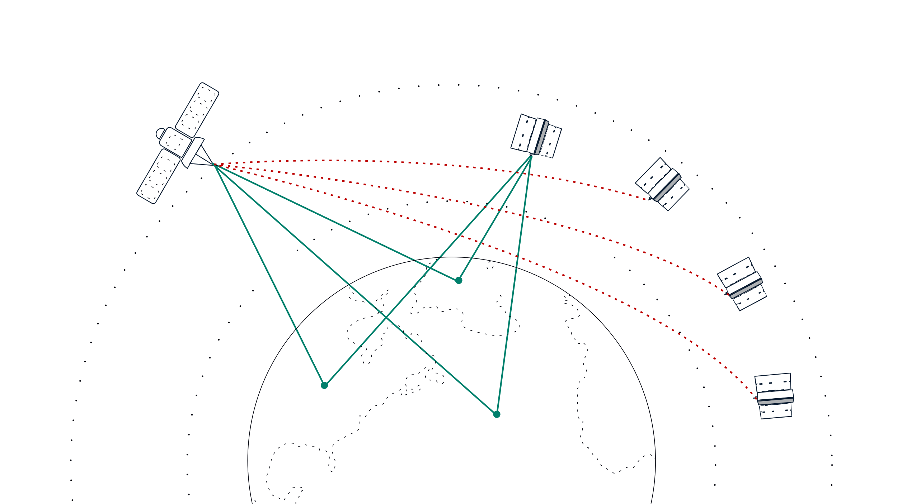
Additional Data Collected
GPS/GNSS satellites
Radio Occultation
Space
weather
GNSS-R
GNSS-RO
GNSS-Reflectometry
Sea ice
Atmospheric
profiles
Soil moisture
Ocean winds
Ionosphere
Atmosphere

Slide 5
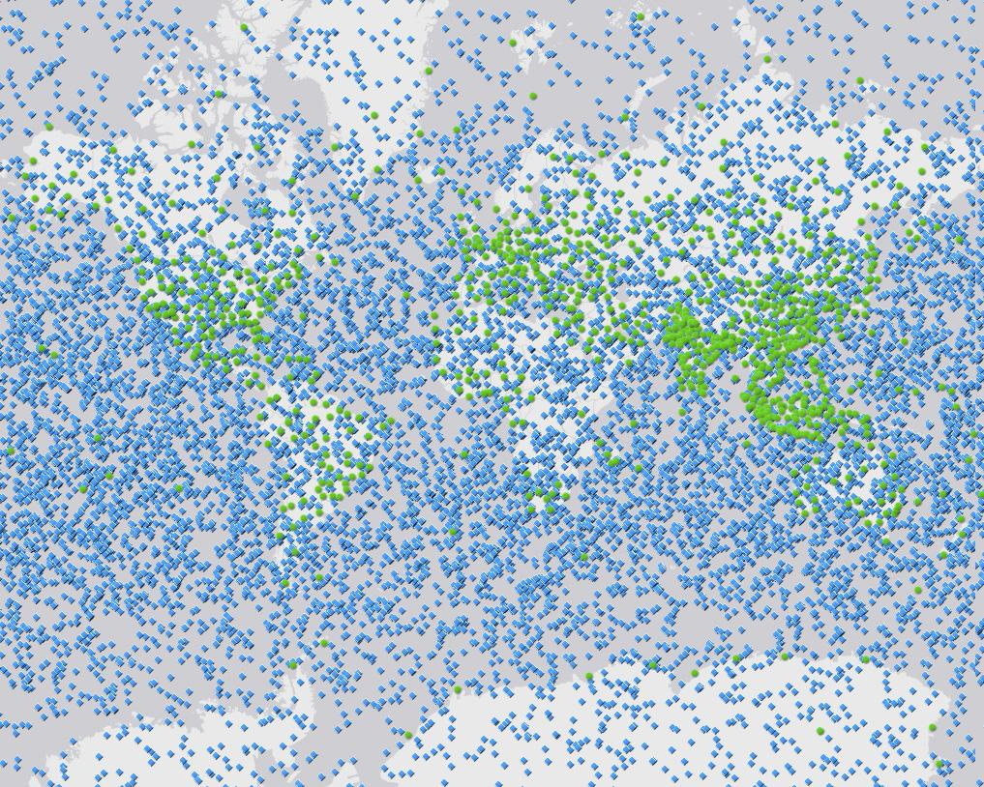
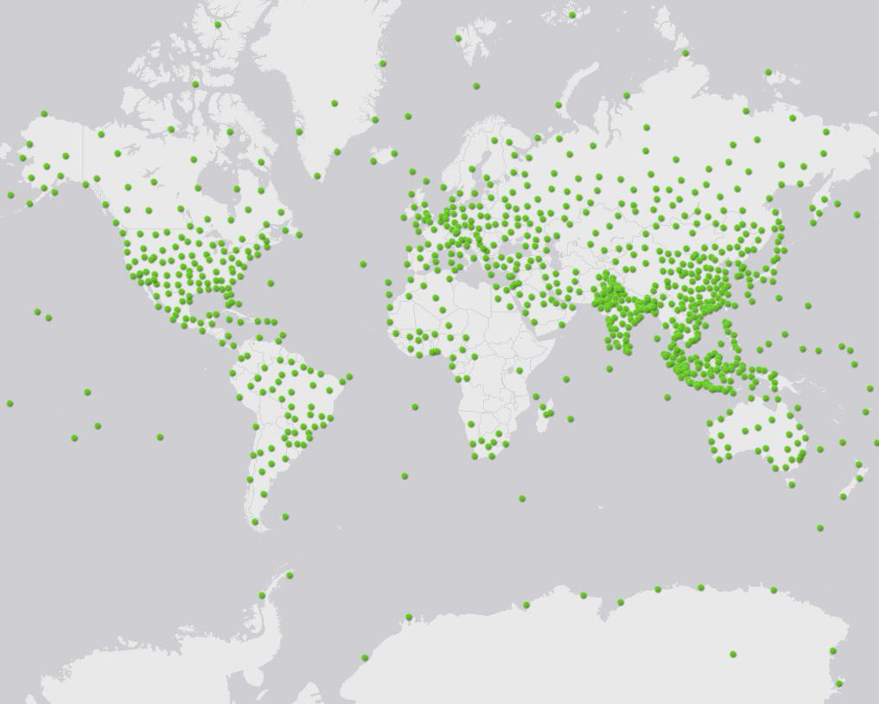
Spire RO Global Advantage
RO + Radiosondes
Radiosondes
24 hours of RO collection, November 2020, 11,500 profiles

Slide 6
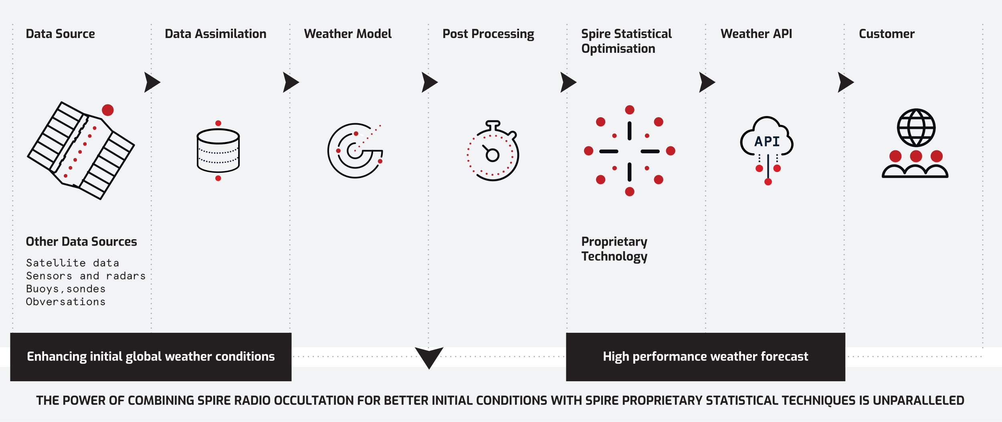
Spire weather forecast system

Slide 7
Spire weather forecast system
Spire’s Ensemble Forecast Technology uses multiple weather models to understand the uncertainties of the forecast
Using statistical and machine learning techniques, we analyze the historical accuracy of each model in different conditions and locations, and select the single most likely outcome
We analyze each possible weather path in each different local climate. Over 1M individual locations are optimized
1.
2.
3.
Comparing multiple models
Understanding each model strength for each location
More accurate weather forecast
MODEL A
MODEL C
GFS (NOAA)
The result of the technique is a forecast that shows unparalleled skill in predicting the local weather outcome
MODEL B
MODEL D
IFS (ECMWF)
Spire Model A
Spire Model B
Spire Model C
Spire Model D
GFS (NOAA)
IFS (ECMWF)

Slide 8
Driving value across multiple industries
Maritime
The greatest risk to safety and fuel emissions is extreme weather. Having access to reliable, easy-to-use weather forecasting is paramount to the wellbeing of all seafaring vessels.
Aviation
With a constant focus on safety and fuel efficiency, it is more important than ever to have access to global weather forecast data. Aviation forecasters must also consider clear air turbulence, icing and winds aloft data to support scheduled flight operation for safety and efficiency.
Agriculture
As each season shows an increasing amount of extreme weather events and each region faces unique weather-related difficulties, the decision-making process has become more and more complex for farmers. Weather is one of the most important factor impacting yield productivity.
Energy
The capacity of power line network is highly dependent on weather. Reliable and accurate weather information tailored to grid operator’s is paramount to efficient energy planning.

Slide 9
Spire weather data APIs
Historical weather data
Historical Weather data available anywhere on the planet for 10 years and historical forecast for 3 years
Single coordinate forecast
Weather forecast for a single coordinate in JSON format, anywhere on the planet
Global or Regional forecast
Download global or regional forecasts in industry-standard GRIB2 format, for offline use
Visualization
Integrate weather visual data into your GIS platform or application in minutes with the WMS feature

Slide 10
Customized solution for your point of interest
Forecast (A)
Forecast (B)
A hyper localized, optimized weather forecast for a specific point of interest anywhere. Complementary to the global forecast
An optimized forecast for one location
Gridded forecast
Sensor 1
Reads local or near-by sensors Learns from historical weather data vs forecasts from multiple sources
Creates an optimized forecast for one single point (taking into consideration natural or man-made obstructions surrounding the specific location)
Example: A point forecast using a gridded global model to predict weather for a specific point of interest
Forecast (D)
Forecast (C)

Slide 11
Wildfire Quiron Case Study

Slide 12
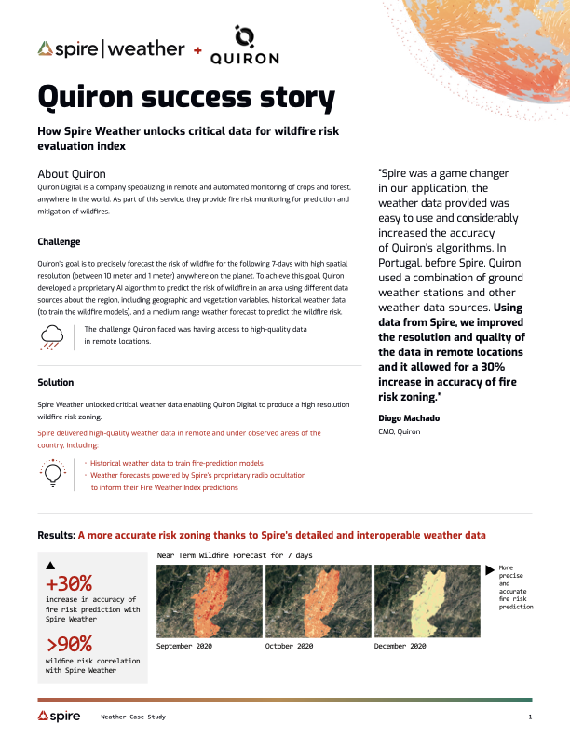
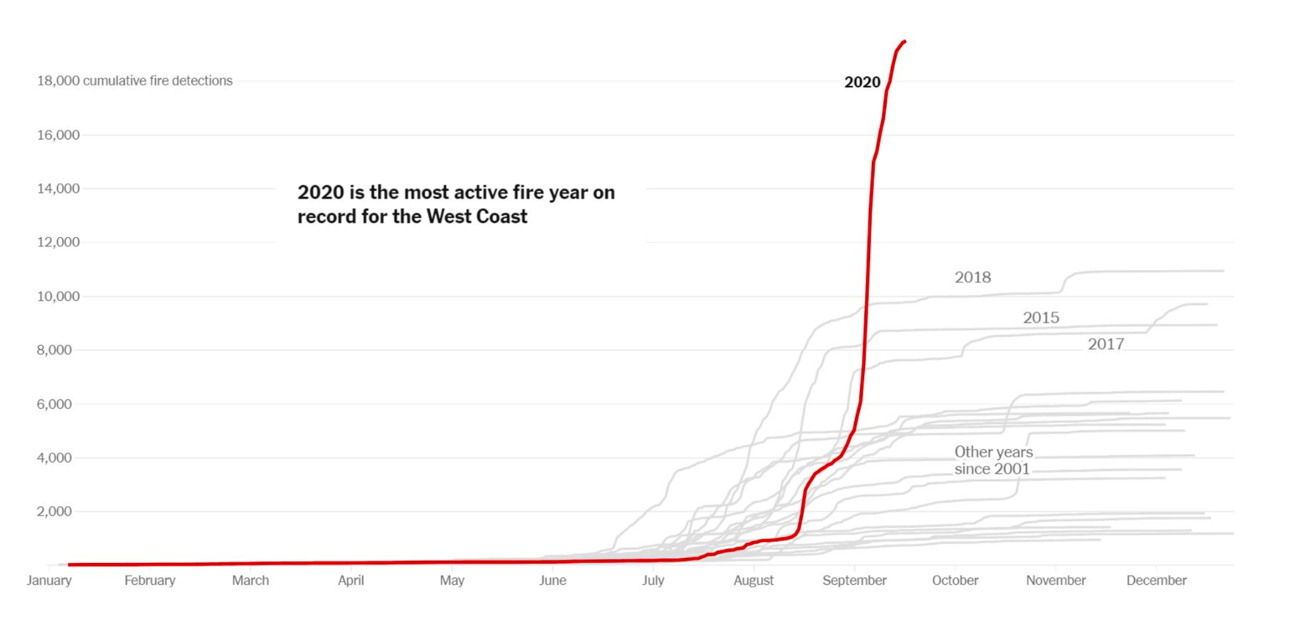

Slide 13
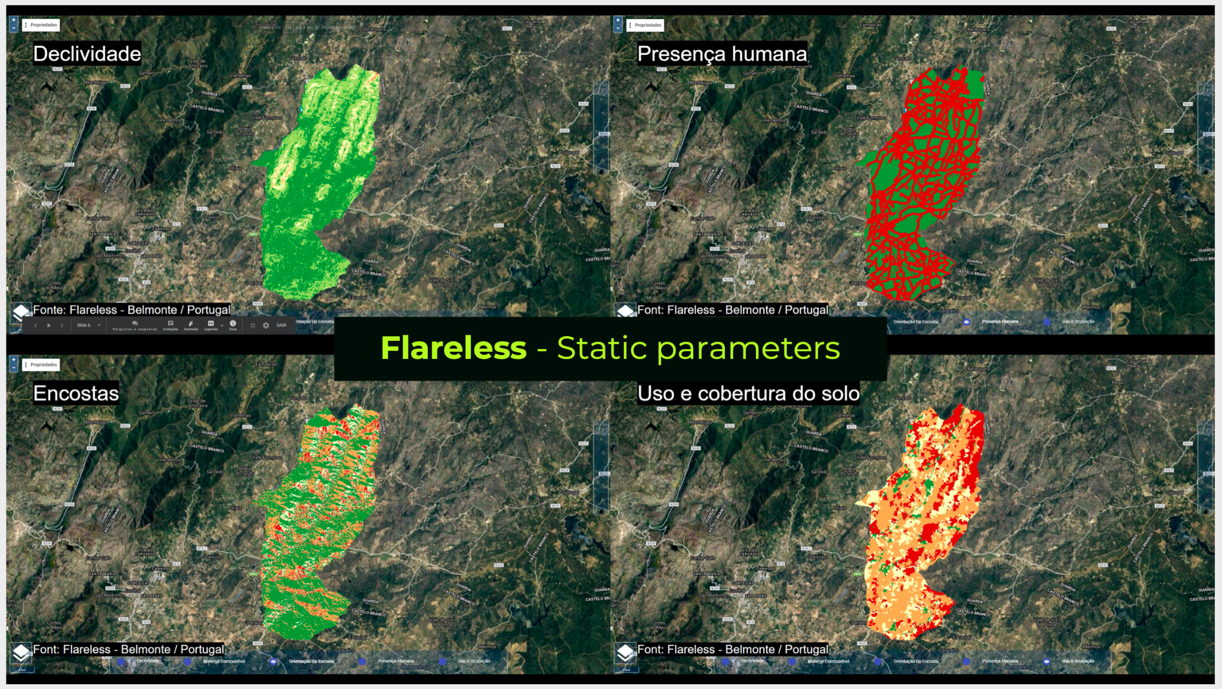

Slide 14
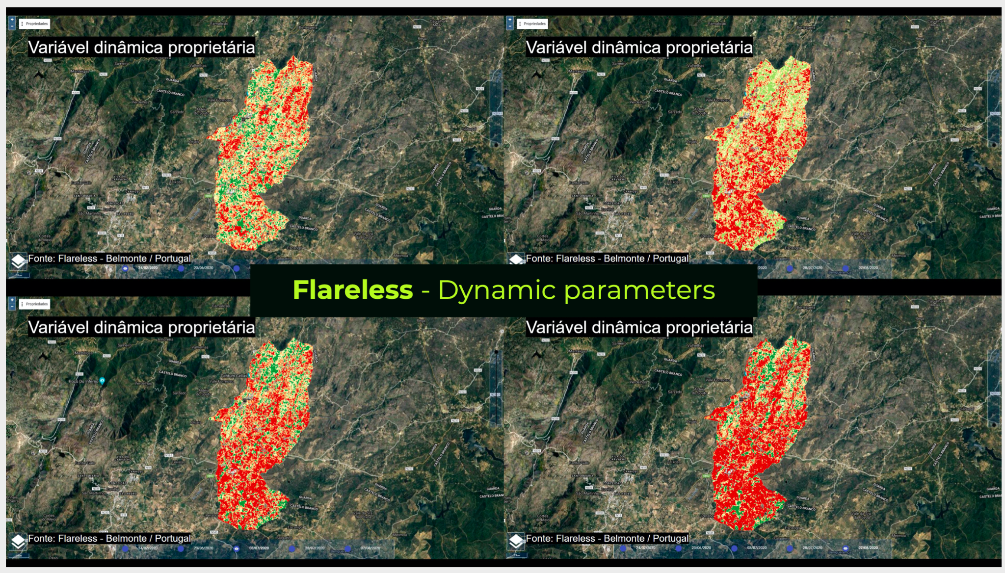

Slide 15
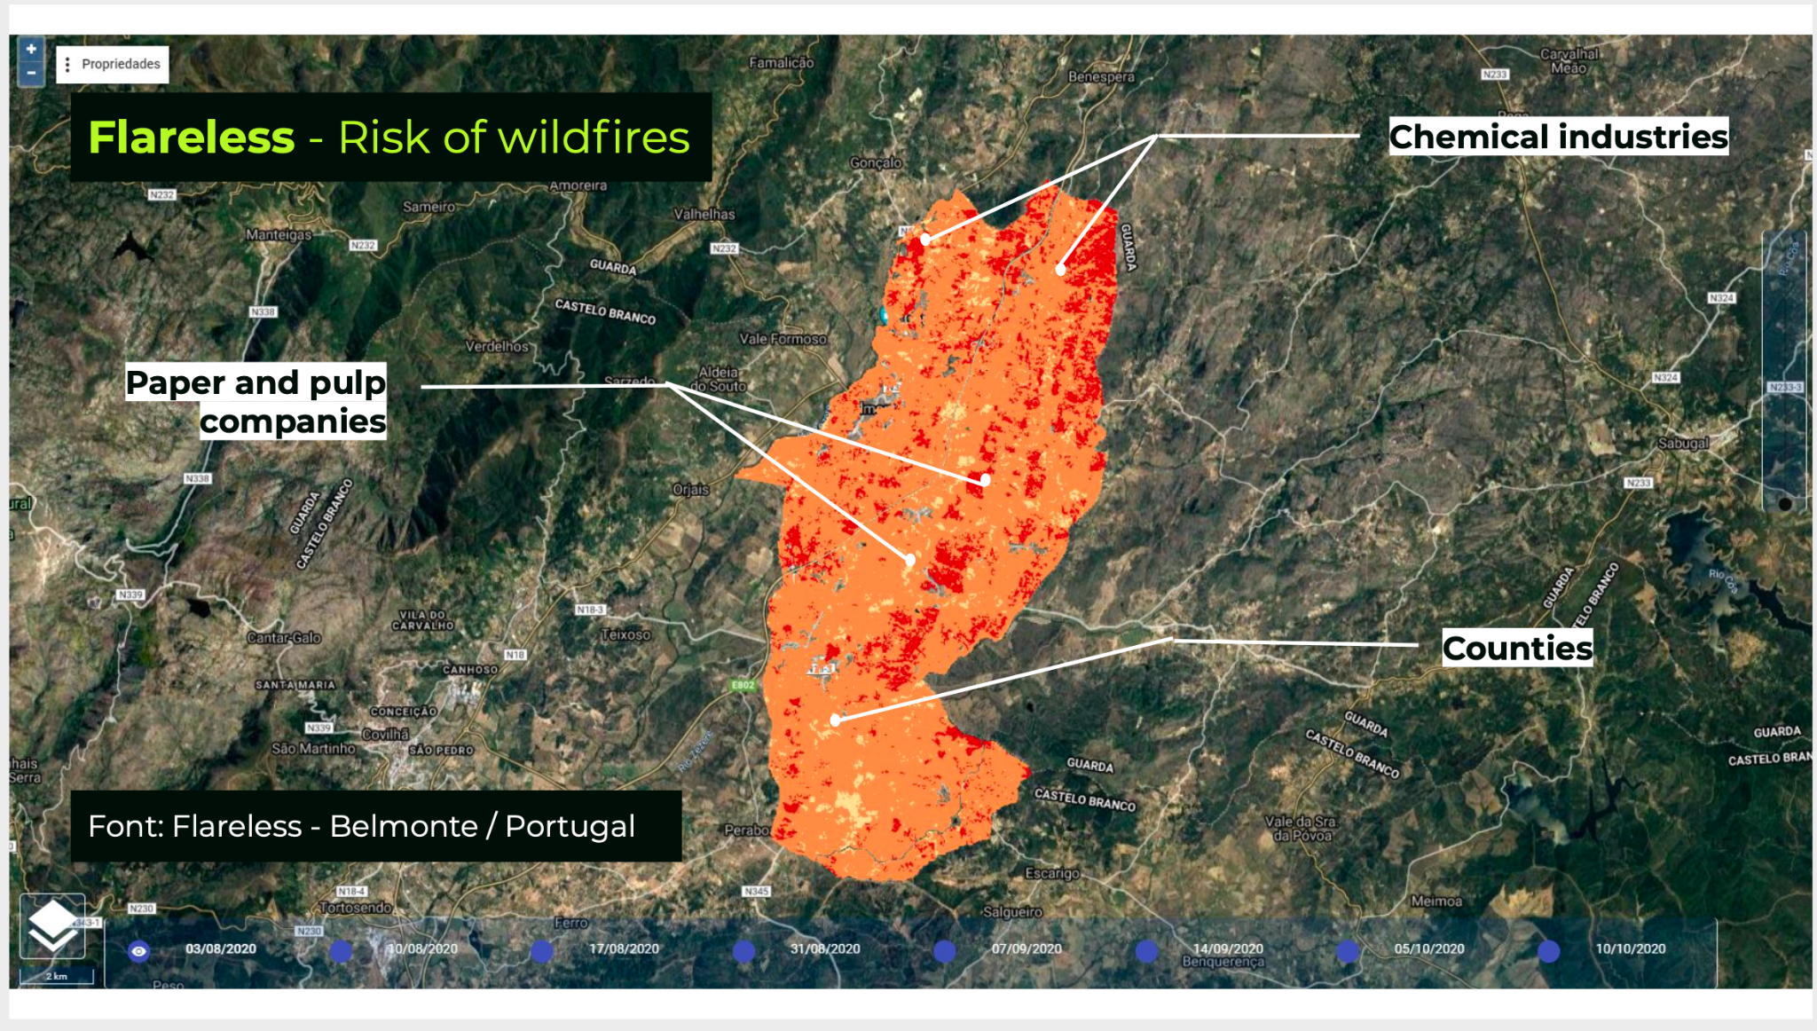

Slide 19
Wildfire OroraTech Case Study

Slide 20
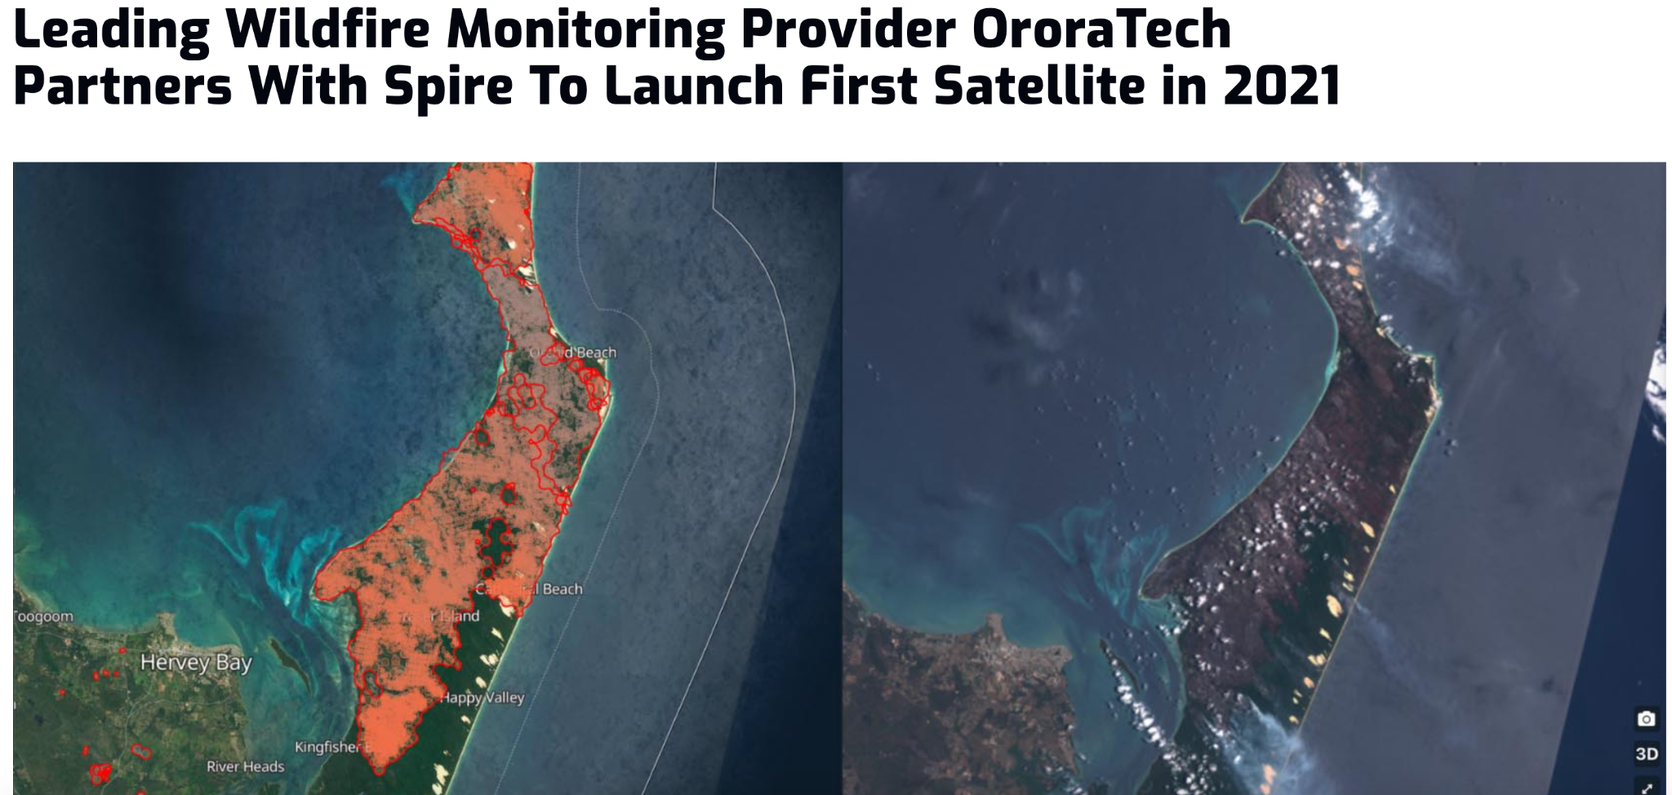

Slide 21
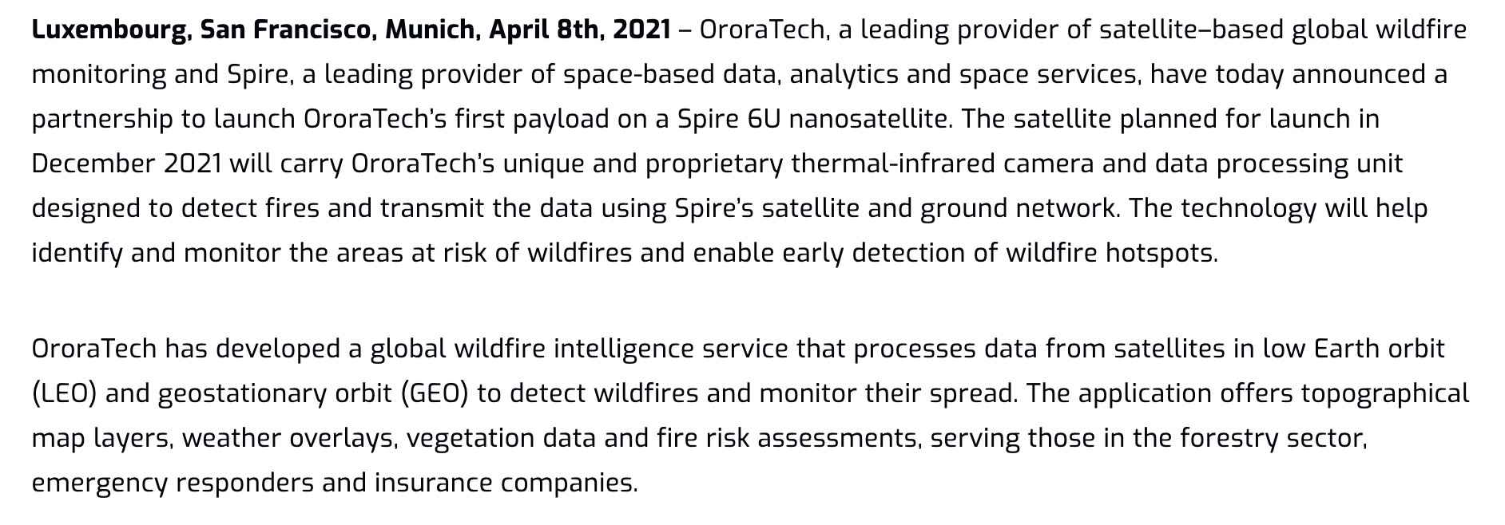

Slide 22
Thank you!
From our team, to yours.

