Slide 1
Unmanned Traffic Management
In Wildland Fire
“Keeping All Our Assets in the Fight”

Slide 2
Brief Aim
Update since Last Brief (Fall 18)
Define Next Steps

Slide 3
Re-introduce

Slide 4
Program so far…

Slide 5
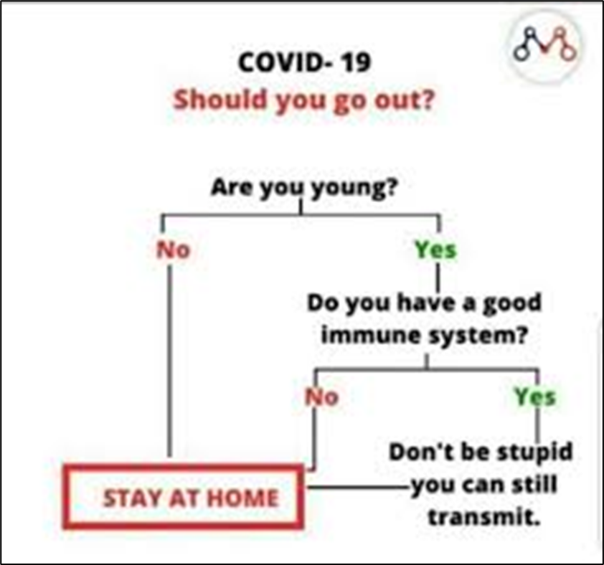
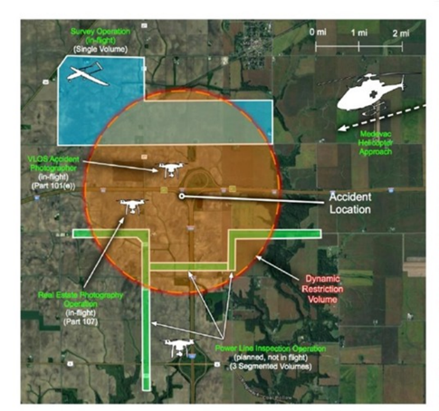
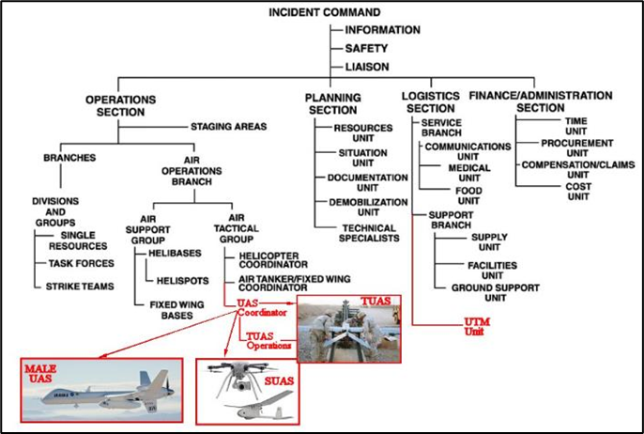
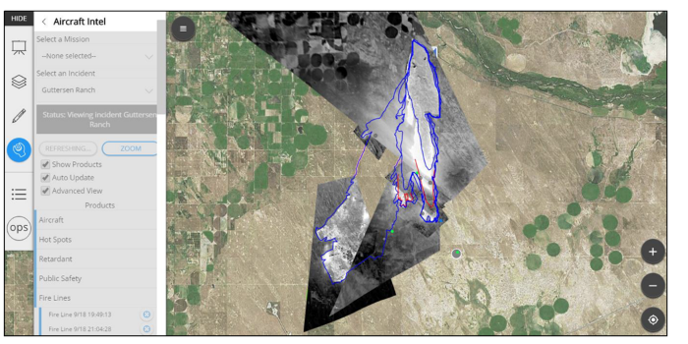
Phase II Year 2 Plan A
UTM Intent (Coordination)
BYON – TAK?
Interoperability with WFDS
CONOPS Production
Tactical / Small / USS C2
Computer-Aided-Dispatch
Decision Support/SA
Initial Attack
Extended Attack
COP
Live Fire Trials

Slide 6
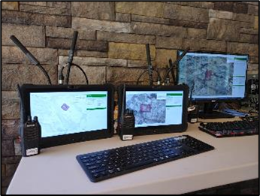
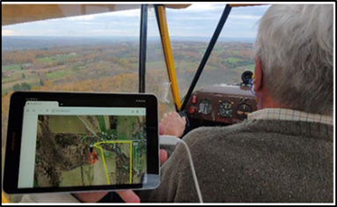
Phase II Year 2 Plan COVID
Form-Fit-Function
Engineering Prototype to Pre-Production Prototype
CONOPS
NASA STEReO Working Group
Live Flight Trials:
Multi-ship
Manned-Unmanned
TRL5 to 6
Operational Environment

Slide 7
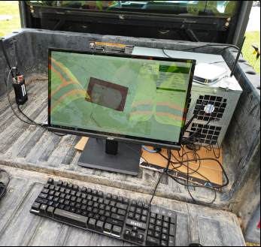
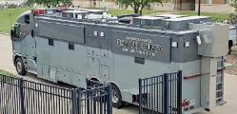
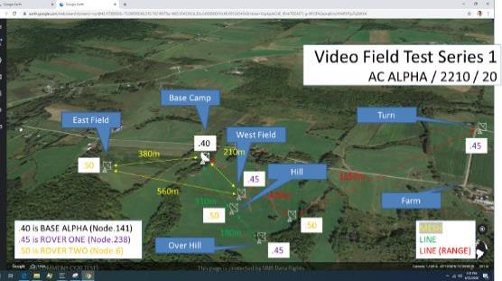
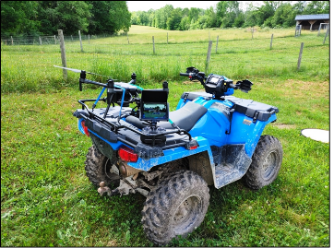
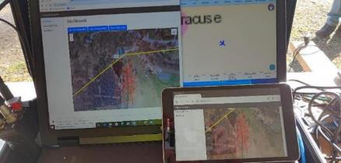
Previous Flight Trials Denton Emergency Mgt Ex, 2-3 May 2019 Manned-Unmanned, CNY 2019, 21-25 Oct 2019 Unmanned, CNY 2020, 22-25 Jun 2020

Slide 8
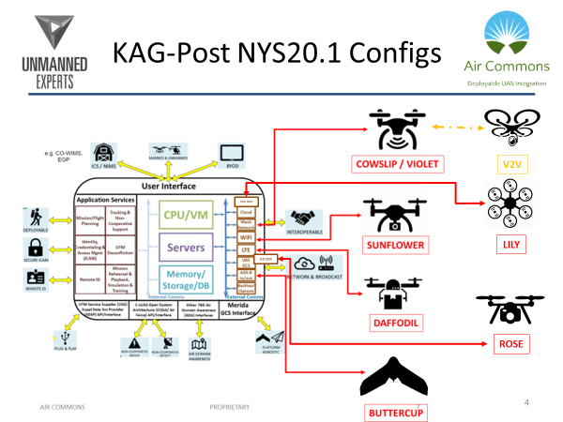
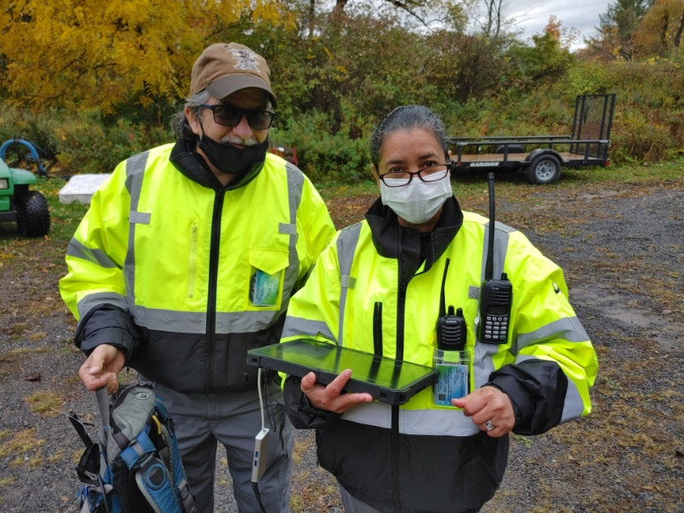
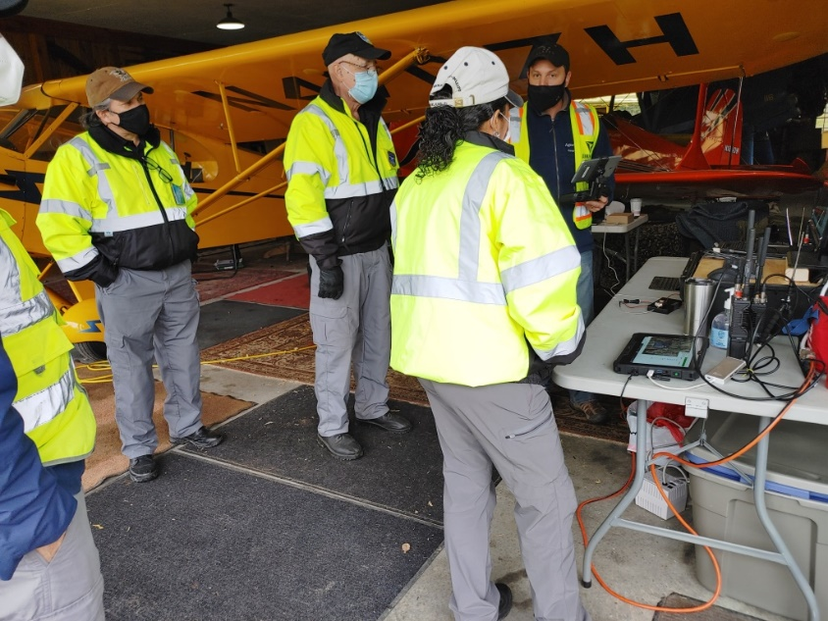
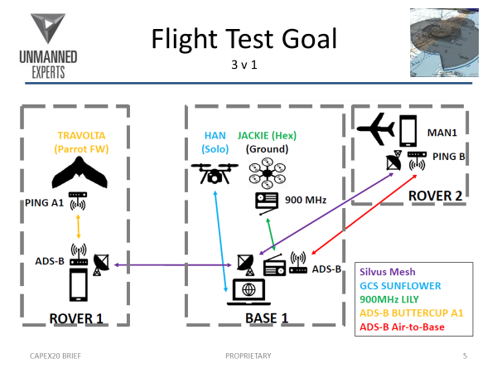
Civil Air Patrol Demo Oct 20

Slide 9
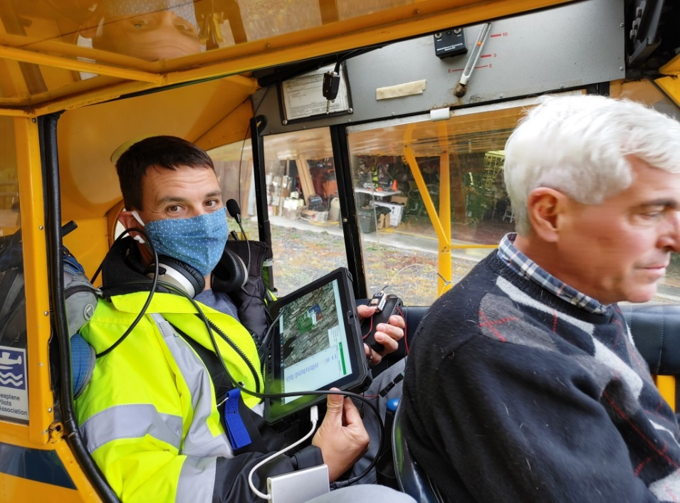
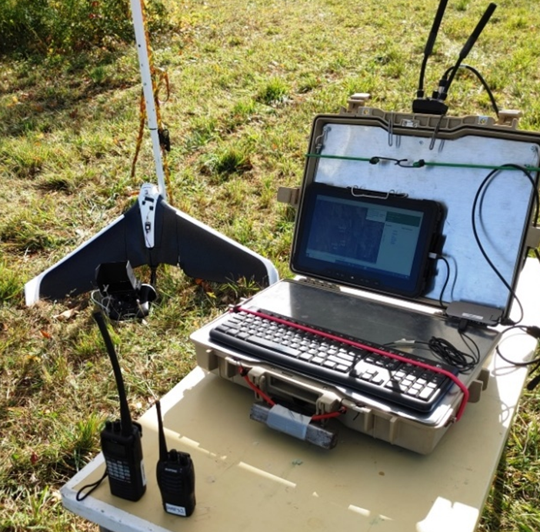
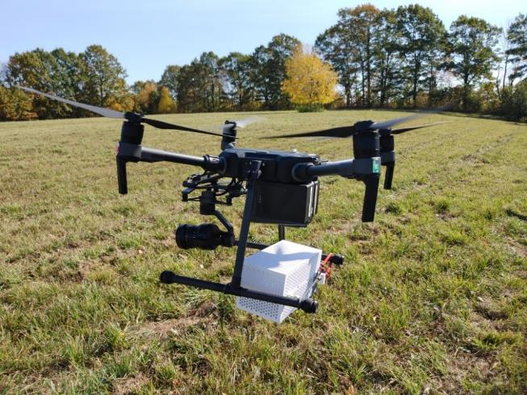
Results Final 2v1 Flight Test: Fast Iterative Tracking

Slide 10
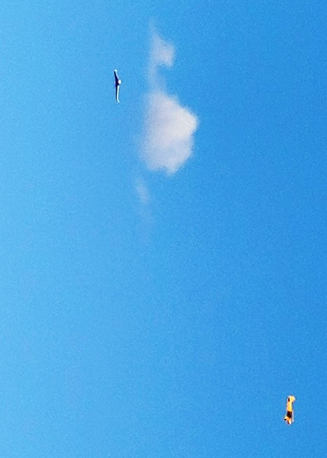

Slide 11
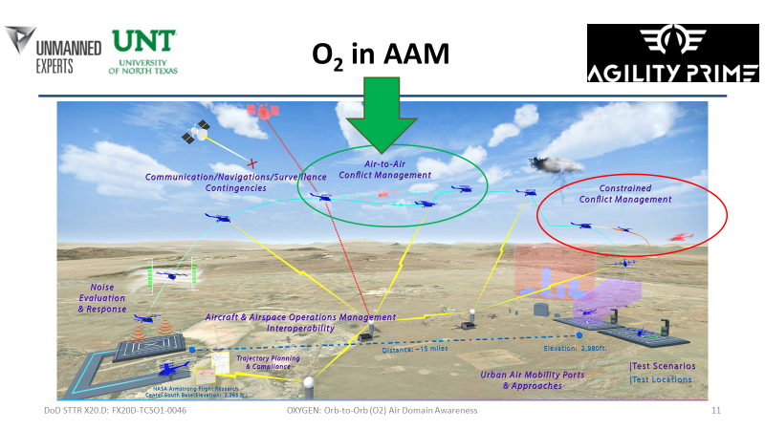
Next Steps UTM becoming AAM
Capabilities:
Ruggedized connections
ATAK integration
AeroNet integration
Mirror USS-to-USS API
Aid in WUI operations
ICAM / Remote ID:
Callsign, contact details
IC levels (for PRIORITY command & control)
Part of ICAM?

Slide 12
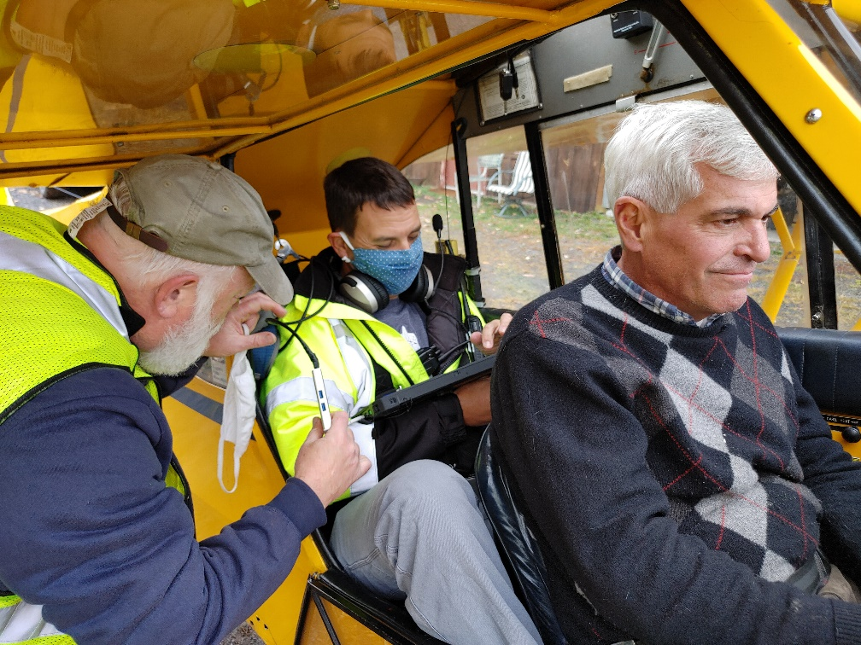
What We Need?
Vaccine
Phase III Partners
Practitioner Feedback
Air Attack Liaison
IC Support

Slide 13
Unmanned Experts Inc. Confidence at the Cutting Edge
Consultancy
Build Knowledge
RDT&E
Field New Capabilities
CONOPs
Operationalize

Slide 14
SBIR Data Rights & Disclaimers
“This material is based upon work supported by the U.S. Department of Agriculture (USDA) under Award Number: 2018-33610-28590. Any opinions, findings, and conclusions or recommendations expressed in this publication are those of the author(s) and do not necessarily reflect the views of the USDA.”
These SBIR data are furnished with SBIR rights under Funding Agreement: No. 2018-33610-28590 / Awardee Name: Unmanned Experts, Inc / Address: Denver, CO. Expiration Period of SBIR Data Rights: 4 years after acceptance of all items to be delivered under this contract, subject to section 8 of the SBA SBIR Policy Directive.
The Government may not use, modify, reproduce, release, perform, display, or disclose technical data or computer software marked with this legend for four (4) years. After expiration of the 4-year period, the Government has a royalty-free license to use, and to authorize others to use on its behalf, these data for Government purposes, and is relieved of all disclosure prohibitions and assumes no liability for unauthorized use of these data by third parties, except that any such data that is also protected and referenced under a subsequent SBIR award shall remain protected through the protection period of that subsequent SBIR award. Reproductions of these data or software must include this legend.

