Slide 1
Image to Image Translation & Wildfire Response
Dr. Alexander Moskowitz
VISIMO

Slide 2
Wildfire Response is an area primed to use Machine Learning (ML)
Wildfires are chaotic and difficult to predict
So much data, but what to do with it?
Speed is key
Scale mixing (small-scale chemistry must mesh with large-scale weather) is difficult to model
Fires and smoke spread unevenly
ML can combine data that may be hard to integrate in a physics model, such as human behavior
ML can extract patterns to help experts identify potential crises
Stopping a fire when it is small, or outright prevention, is easier and safer
There is an increasing amount of high-resolution data
ML excels at finding hard-to-model patterns
ML models work best with huge data sets
Once trained, ML models are FAST and scalable

Slide 3
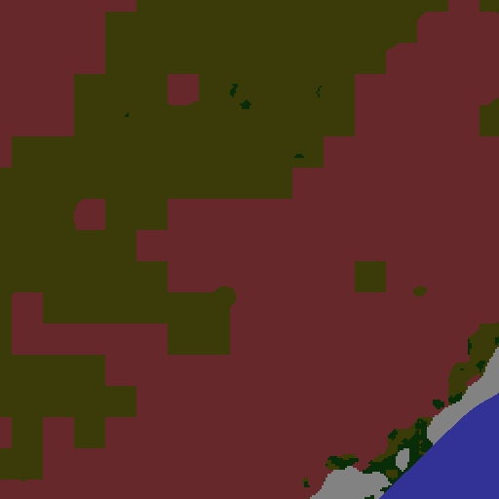
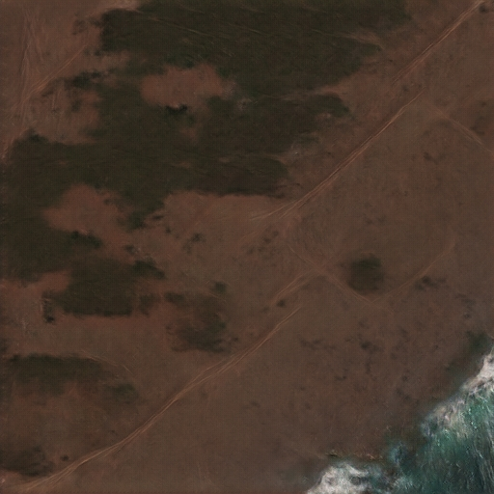
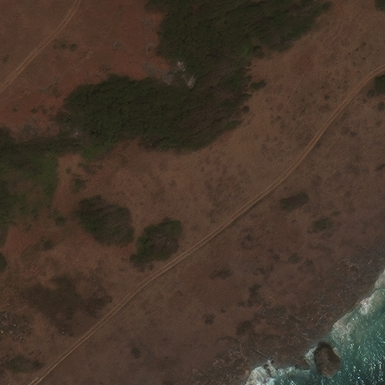
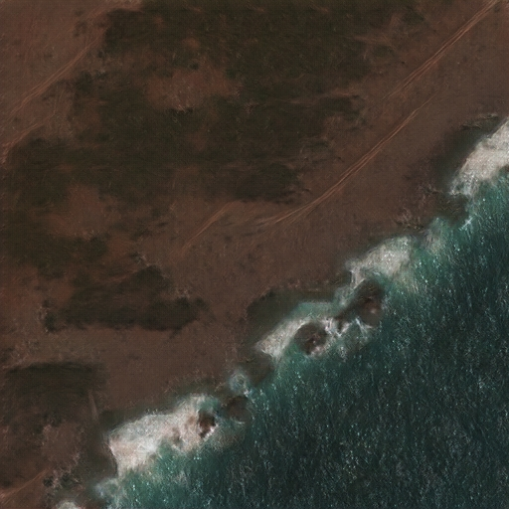
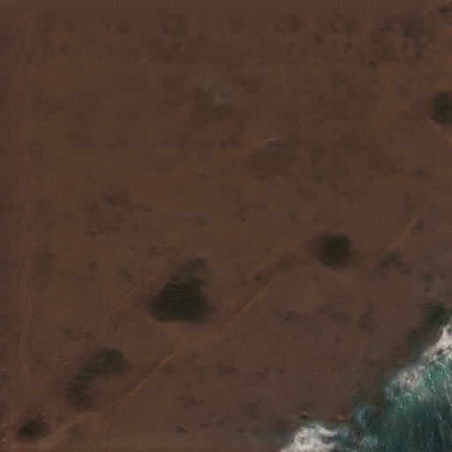
VISIMO’s Focus: Image to Image Translation
Map one or more Input Images to an Output Image
Current Project: Customizable Synthetic Satellite Images
Input to AI Model Synthetic Image Real Satellite Image
Add Coast Remove Foliage
SBIR DATA RIGHTS
Contract No: FA864921P1505
Contractor: VISIMO, LLC
Contractor Address: 520 E Main Street Suite 200, Carnegie, PA 15106
Expiration of SBIR Data Rights Period: 24 November 2027
The Government's rights to use, modify, reproduce, release, perform, display, or disclose technical data or computer software marked with this legend are restricted during the period shown as provided in paragraph (b)(4) of the Rights in Noncommercial Technical Data and Computer Software - Small Business Innovation Research (SBIR) Program clause contained in the above identified contract. No restrictions apply after the expiration date shown above. Any reproduction of technical data, computer software, or portions thereof marked with this legend must also reproduce the markings.
Our AI model can reproduce real images and make arbitrary changes to the image as well

Slide 4
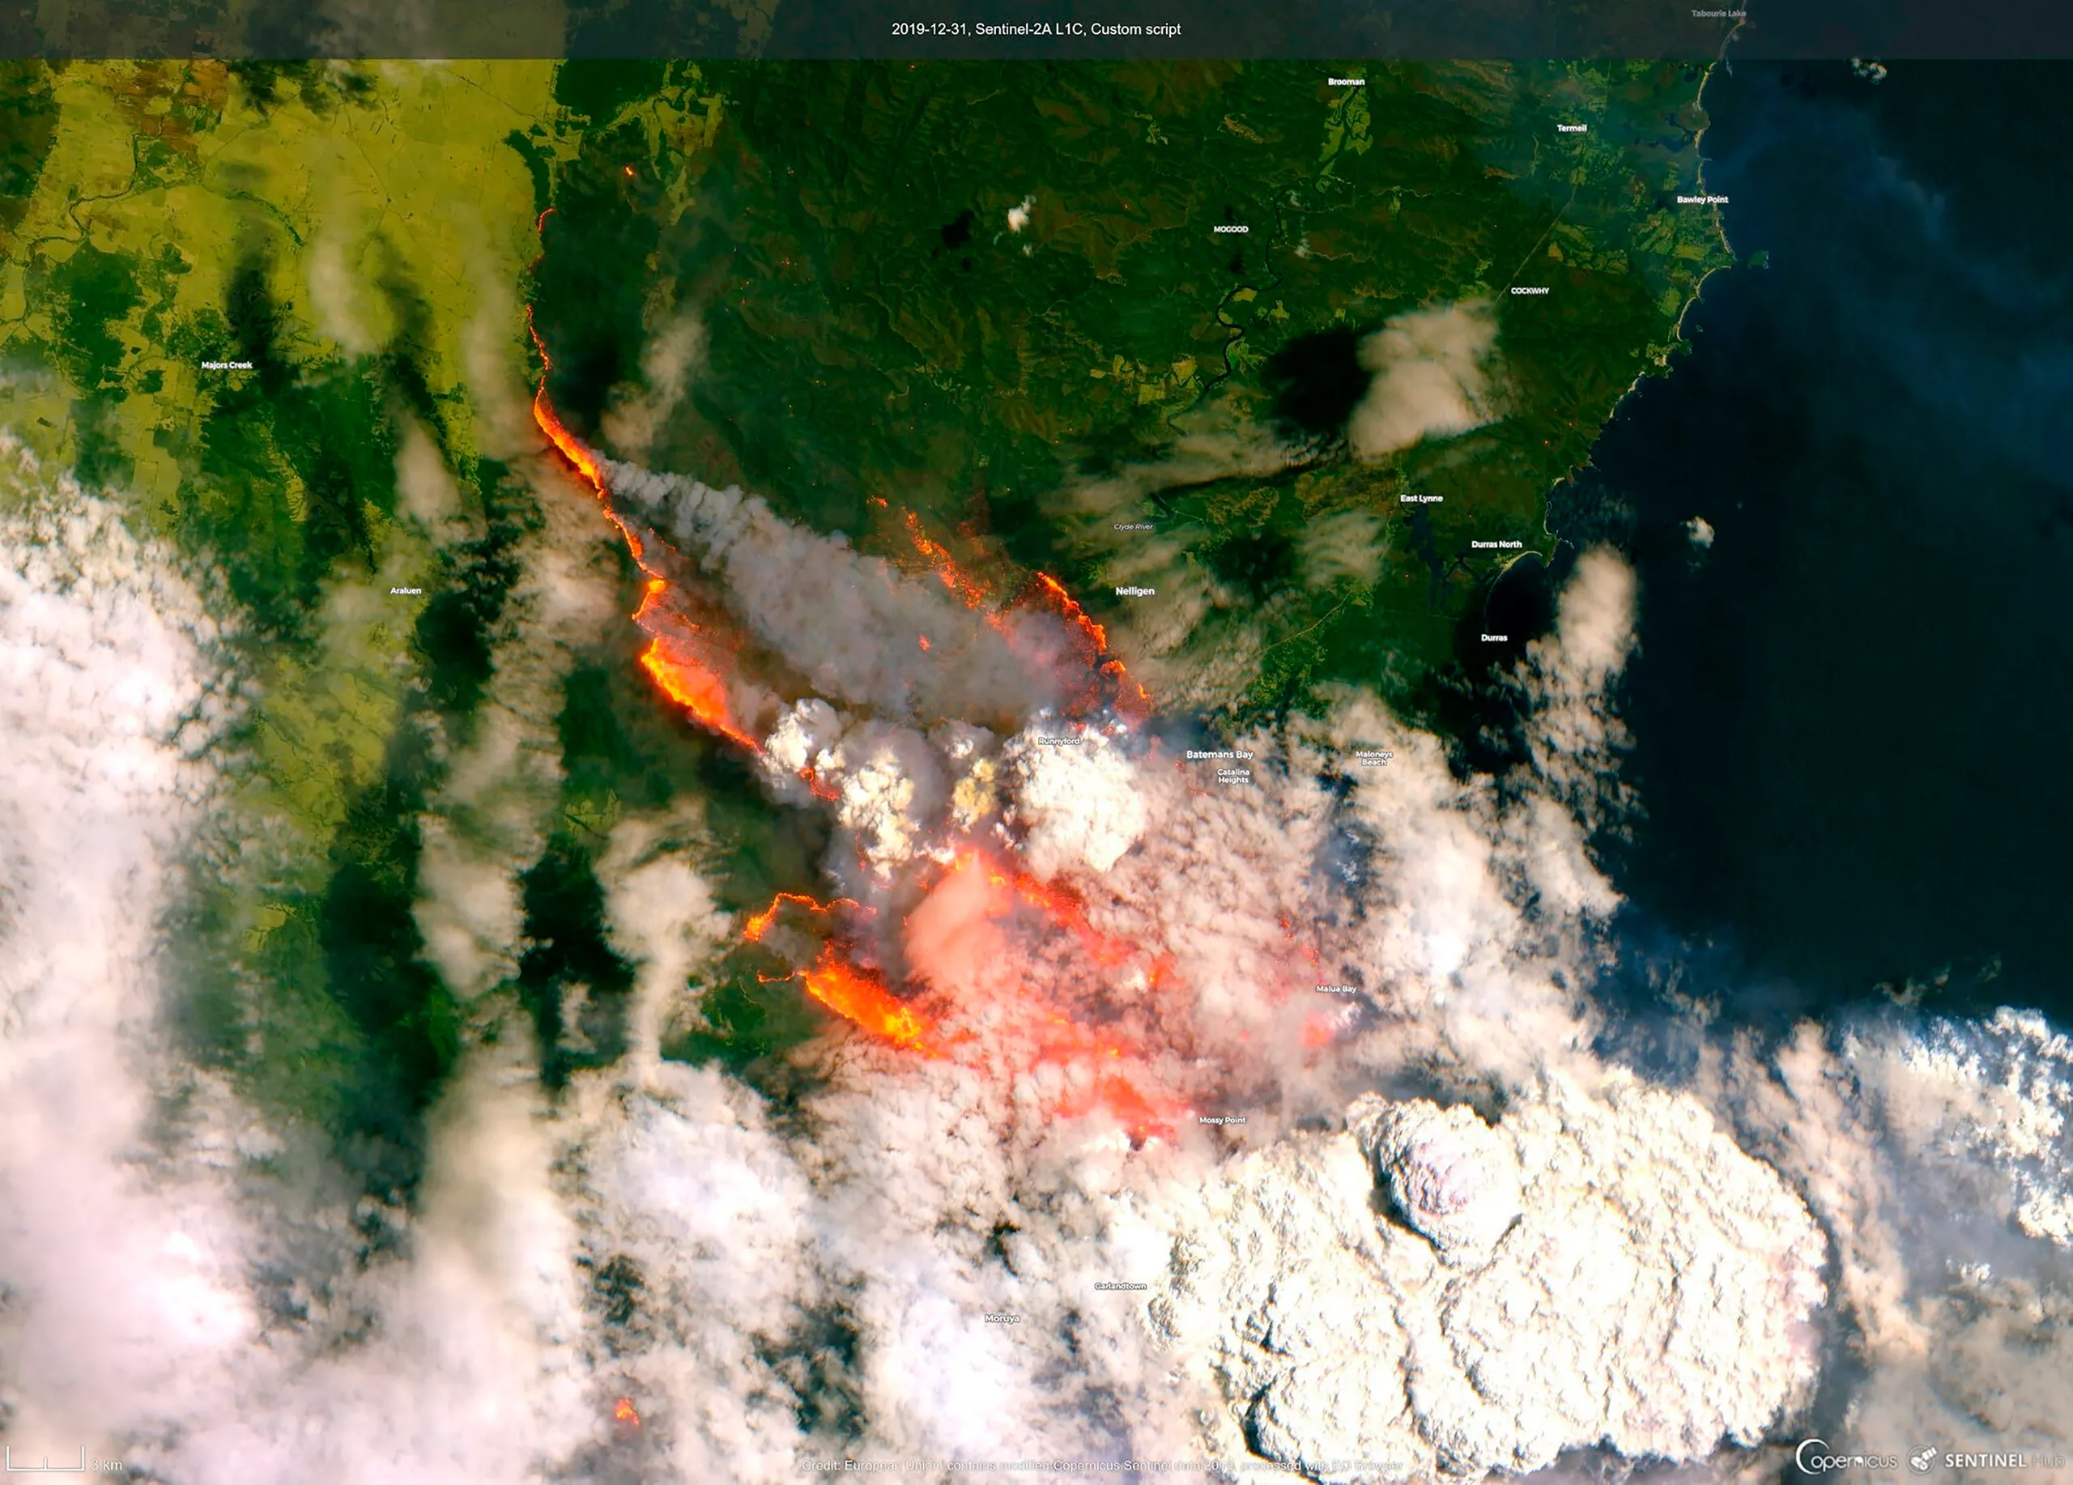
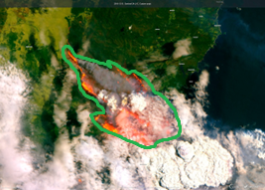
Image to Image Translation
Use Cases 1: AI learns how to transfer input maps to output maps
Combine arbitrary input channels into useful predictions
Fuel Maps
Fire Risk Map
Weather Maps
AI
Severity Estimation
Climate Data
Human Activity Maps
Quickly & accurately map wildfire perimeters
AI
ML learns patterns that are difficult to model mathematically
USA Today

Slide 5
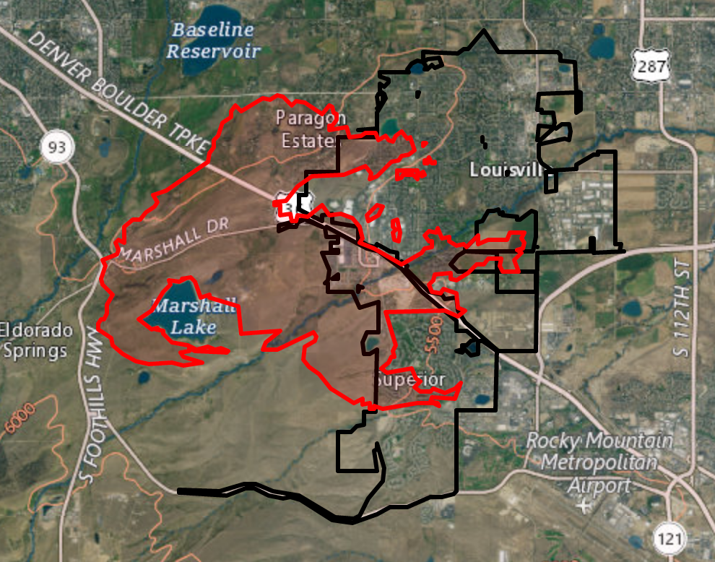
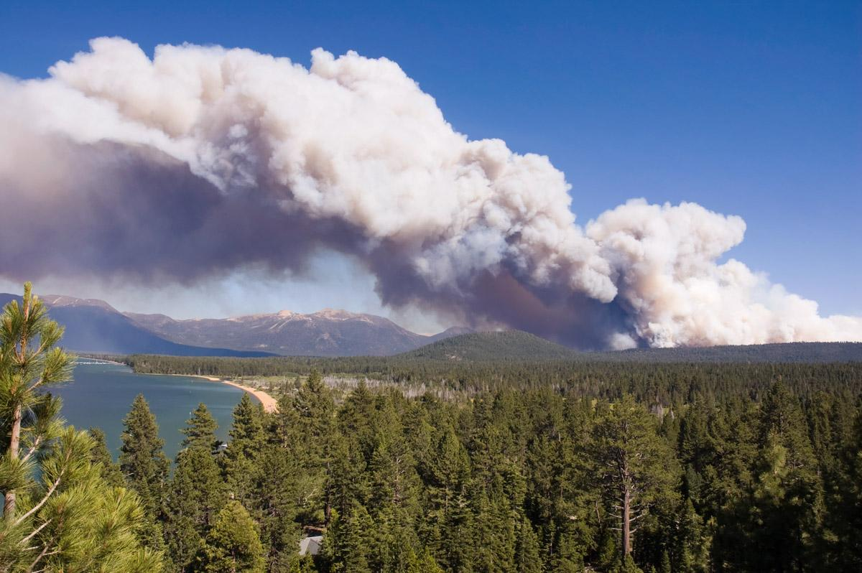
Image to Image Translation
Use Cases 2: Generate Data to train other ML models
Current data can be difficult to gather
Current data may be insufficient
Drawing boundaries by hand is slow
Physical simulations of smoke or fire can be slow to run
Need thousands of images to train ML models
Climate change brings wildfires to new areas
Don’t want to wait for hundreds of fires to happen before ML models are useable
Overlay synthetic burned areas
Add smoke to train detectors
The Denver Post
Minnesota Pollution Control Agency

Slide 6
The Technology: CGAN
Conditional Adversarial Generative Network
Step 1: The Input (the “condition”) is fed into the generator
Step 2: The generator creates a synthetic image from the input
Generated Image
Real Image
Input
Generator
Discriminator
Step 3: The discriminator is fed both real and generated images, and tries to determine which is the synthetic image
Step 4: The generator uses the result of the discriminator to learn how to make more realistic images
Both the generator and discriminator learn over time, so the generator must make increasingly real images to fool the discriminator

Slide 7
About Visimo
At VISIMO, we develop state-of-the-art, custom data science tools, algorithms, and platforms for government, commercial, and non-profit organizations. Our custom research and development services enable us to create comprehensive, innovative solutions that are easy-to-use, open-source, secure, and accessible on any device from any location.
A few of our public-sector projects:
COEUS
Custom Big Data/ML platform for Army AI Task Force
ALETHIA
Phase II SBIR to detect manipulated intelligence images using ML
CGAN/ISALD
Phase II SBIR to create synthetic satellite images to train ML models
AI LEGAL ASSISTANT
Phase I SBIR to catch targeting errors using computer vision & language AI

Slide 8
Contact Information
Alexander Moskowitz, Ph.D.
Data Scientist
alex.m@visimo.ai
Alexander Heit
Vice President - Partnerships & Strategy at VISIMO
alex@visimo.ai
VISIMO
520 E Main Street Suite 200, Carnegie, PA 15106
412.423.8324
INFO@VISIMO.AI
Background: Digital Detox

