Slide 1
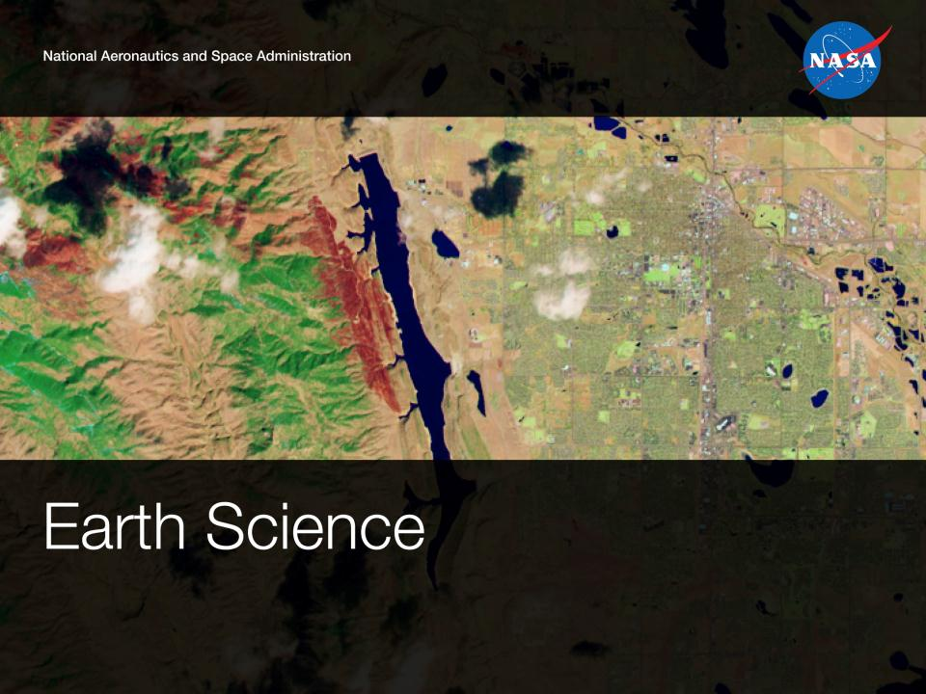
NASA Outlook and Focus
Vince Ambrosia
NASA Applied Science Program:
Assoc. Program Manager - Wildfires
Science Mission Directorate
Earth Science Division

Slide 2
New Fire Support Efforts at NASA
  ROSES 2011 A.35 Wildfires solicitation (Applied Science Program); portfolio management / program management;
  Down-select to nine (9) Phase II Wildfire Projects;
  Interface with Fire Community / Sister Agencies; develop collaborations, possible joint solicitations; Manage project efforts and metrics; Support / Represent the agency on various national /international committees to expand knowledge on NASA involvement in wildfire management efforts.
  Develop outreach of program efforts through workshops, conferences, etc.

Slide 3
ROSES-2011 A.35 Down-Select
Solicitation (Section 2)
The objective of this solicitation is to select applications and applied research projects to improve decision-making activities and actions on topics related to wildland fires, such as wildfires, rangeland fires, and prescribed fires.
Successful projects will advance organizations’ use and application of Earth observations in analysis and assessments, management strategies and actions, business practices, and policy analysis and decisions associated with wildland fires.
|‌ 3

Slide 4
ROSES-2011 A.35
|‌ 4

Slide 5
SMD/ESD Applied Sciences Program
Feasibility-to-Decision Support Projects
A two-stage approach to identify more high-reward projects with strong commitment by partner organizations. Start with multiple feasibility studies of possible applications ideas. After a year, the Program selects a subset of successful studies to pursue as in-depth applications projects.
Approach generates numerous applications ideas and focuses investments on those with high-reward potential.
Approach prioritizes partners’ “skin-in-the-game” to increase their involvement in project and commitment to adopting the project results.
|‌ 5

Slide 6
Selections of Phase II Projects
Applied Sciences – 2008 Solicitation
Zachary Holden / USDA Forest Service:
A Prototype System for Predicting Insect and Climate-Induced Impacts on Fire Hazard in Complex Terrain;
Stephen Howard / USGS EROS Center:
Utilization of Multi-Sensor Active Fire Detections to Map Fires in the US;
Mary Ellen Miller / Michigan Tech Research Institute (MTRI):
Linking Remote Sensing and Process-Based Hydrological Models to Increase Understanding of Wildfire Effects on Watersheds and Improve Post-Fire Remediation Efforts;
Birgit Peterson / USGS EROS Center:
Enhanced Wildland Fire Management Decision Support Using Lidar-Infused LANDFIRE Data;
Sher Schranz / NOAA:
Wildland Fire Behavior and Risk Prediction;
Wilfrid Schroeder / University of Maryland
Development and Application of Spatially Refined Remote Sensing Active Fire Data Sets in Support of Fire Monitoring, Management and Planning;
Karyn Tabor / Conservation International Foundation
An Integrated Forest and Fire Monitoring and Forecasting System for Improved Forest Management in the Tropics;
James Vogelmann / National Center for Earth Resources Observation and Science (USGS EROS Center);
Improving National Shrub and Grass Fuel Maps Using Remotely Sensed Data and Biogeochemical Modeling to Support Fire Risk Assessments;
Keith Weber / Idaho State University
RECOVER: Rehabilitation Capability Convergence for Ecosystem Recovery;
|‌ 6

Slide 7
Current & Upcoming Activities
Develop Phase II Project team 1st Year Review and Planning Workshop (January ‘15 at RSAC / SLC; ‘16 at NIFC / Boise; ‘17 at TBD
Futurecasting Summit: The Future of Wildfires, AFA, Colorado Springs,13-14 February. Develop trend analysis of technology and wildfire crossroads in 2024.
Discussions with NRC (Drs Elizabeth Eide and Mark Lange, Director and Program Officer (respectively), Board on Earth Sciences and Resources) about “potential NRC study to examine how science can help wildfire planning and management be more strategic, reduce costs, and increase the land’s resilience to wildfire”;

Slide 8
Active & Upcoming Activities
Participated in JFSP National Fire Science Exchange Meeting, Tucson, AZ, 6-8 May. Develop ideas for joint solicitation of projects / campaigns; build closer relationships
Participate in Large Wildland Fire Conference, Missoula, MT, 20-23 May. Expose community to NASA’s growing portfolio in wildfire remote sensing applications
Committee membership (rep NASA) on GEO 2012-2015 Work Plan, element DI-01--Disasters; Risk Reduction , Group C4: Global Wildfire Information System;
NASA repped at Wildland Fire Science & Technology Task Force (Amber Soja);
Sponsored and supported NASA exhibit at IUFRO, Salt Lake City, UT. 5-12 October 2014.

Slide 9
Active & Upcoming Activities
Participate and address NASA’s ASP-Wildfire program element at International Conference on Forest Fire Research, Coimbra, Portugal, November 2014. Possible NASA Conference support / display;
ISRSE 2015 Berlin, Program Technical Committee; Theme Chair of Disasters Theme and Airborne Theme. Organized special sessions on Wildfires (Disaster Theme) and UAS for Resource Assessment (Airborne Theme). Still open for abstract submissions.
Organized Special Session on NASA Wildfire Applications at Pecora Conference, Denver, CO, November, Amber Soja – Chair.
NASA rep on IARPC Wildfire Implementation Team; developed a document on orbital and airborne wildfire remote sensing assets that is web-served by the IARPC.

Slide 10
Wildfires as Input to NASA Decadal Survey
Major 1.5 year activity:
  Development of wildfire applications component of the NASA forthcoming Decadal Survey with wildfire community (workshops, requirements assessment for improved measurement of wildfire:
    Recommendation for new observations systems
    Improved Models
    Contributions of wildfire to climate change
  The report will be provided to NRC for implementation into NASA Decadal Survey, with recommendations of agency focul and agenda for next ten years (from implementation).

Slide 11
NASA
Questions?
AMS Washington Forum
Federal Panel
Michael H. Freilich
4 April 2013
Vince Ambrosia
Assoc. Program Manager – Wildfires
vincent.g.ambrosia@nasa.gov
1.650.604.6565
Suomi NPP VIIRS
Visible Composite
Notes:
Some topics on Human Dimensions:
Interactions among population, economic systems, production systems, political systems, and human behavior.
US National Committee on the Human Dimensions of Climate Change – adoption of remote sensing technology in social science studies (supports issue of scaling). Mooney, 2013.
Factors & Options:
-- Do Ourselves
-- Partner in Major Way
-- Partner in Minor Way
-- Stay the Same as Now
Partners: Traditional is NSF in this area. Some with EPA, USDA, others on specific topics.
Non-Traditional Opportunities: HUD, HHS/CDC, Energy, Transportation.

