Slide 1
NASA Outlook
NASA Overview

Slide 2
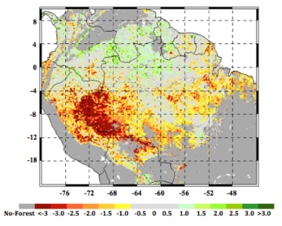
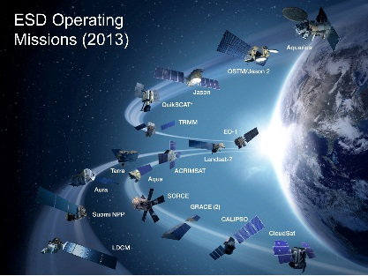
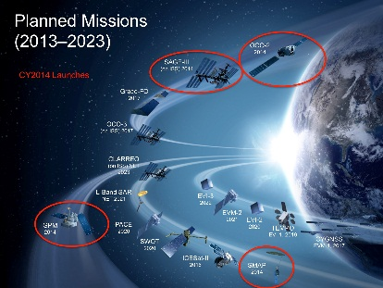
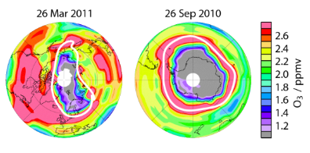
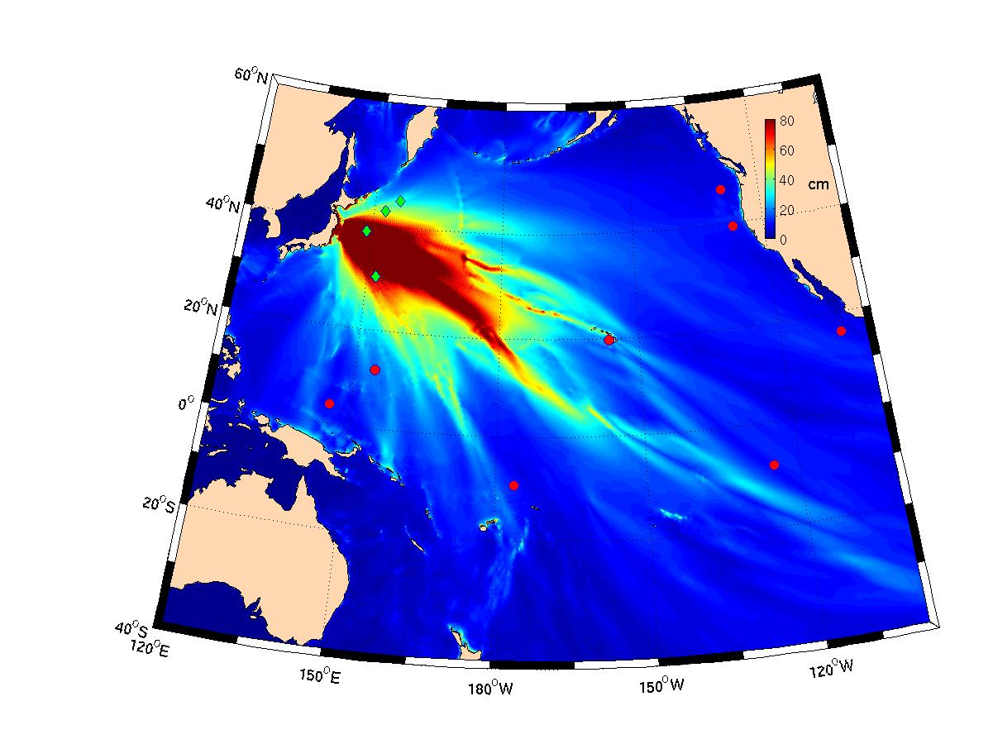
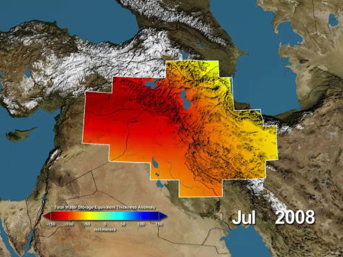
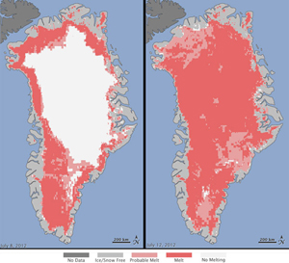
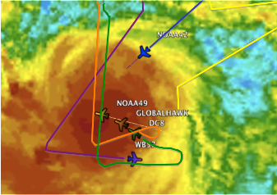
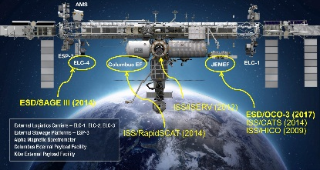

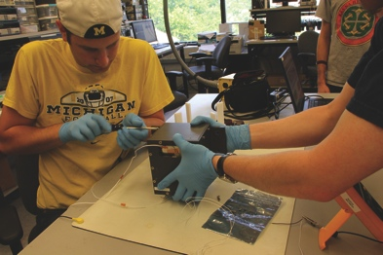
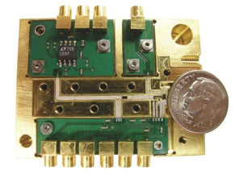
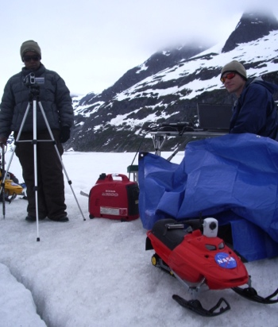

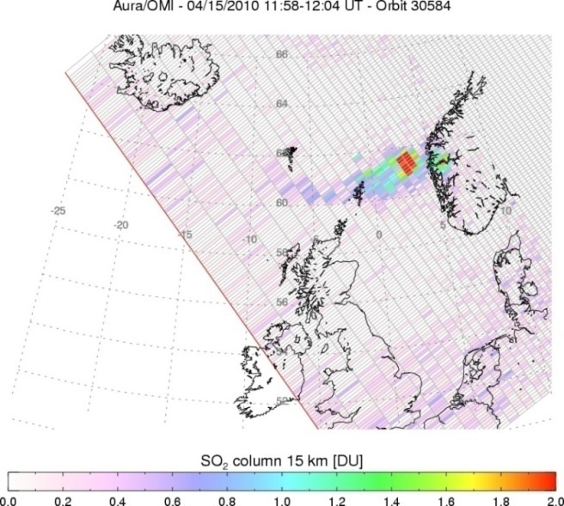
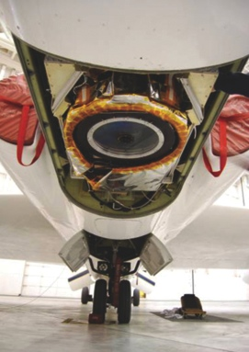
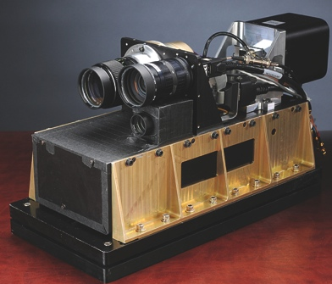



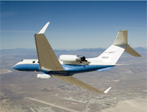
NASA’s Earth Science Division
Research
Flight
Applied Sciences
Technology
Notes:
2

Slide 3
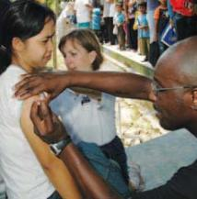
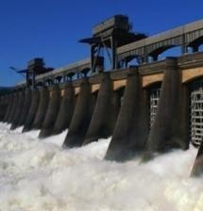
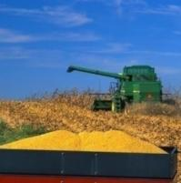
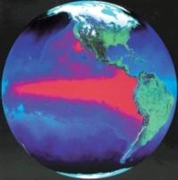
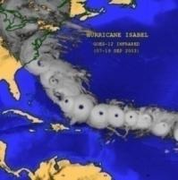
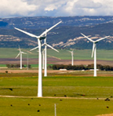

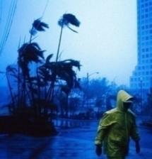

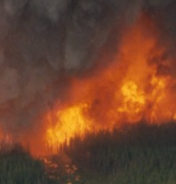
Applications Themes & Societal Benefit Areas
Emphasis in
4 Applications Areas
Support opportunities in
5 additional areas
Health &
Air Quality
Water Resources
Agriculture
Climate
Weather
Energy
Oceans
Disasters
Ecological Forecasting
Crosscutting theme:
Wildland Fires
|‌ 3
Notes:
Within the applications areas the program focuses oneconomic, health, resource management, and other themes to discover and demonstrate applications targeted at integrating EO in specific decision-making activities.
Projects are supported with Public and private organizations
The focus is on: Applications Project, Feasibility Studies, Applied Science Team formulation, Market / User Research, Mission and Science Teams,and Impact Analysis.

Slide 4

NASA ASP Wildfire Management Team
Lawrence Friedl:
NASA Applied Sciences Program Director / Wildfire Program Manager
Vince Ambrosia:
Associate Wildfire Program Manager
Amber Soja:
Associate Wildfire Program Manager

Slide 5
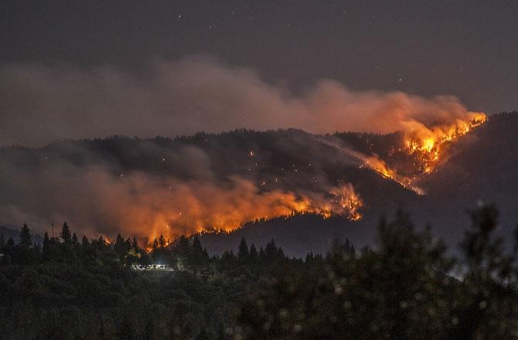
ROSES-2011 A.35 Phase II Projects
Zachary Holden / USDA Forest Service:
A Prototype System for Predicting Insect and Climate-Induced Impacts on Fire Hazard in Complex Terrain;
Sher Schranz / NOAA:
Wildland Fire Behavior and Risk Prediction;
James Vogelmann / USGS EROS Center
Improving National Shrub and Grass Fuel Maps Using Remotely Sensed Data and Biogeochemical Modeling to Support Fire Risk Assessments;
Birgit Peterson / USGS EROS Center:
Enhanced Wildland Fire Management Decision Support Using Lidar-Infused LANDFIRE Data;
Karyn Tabor / Conservation International Foundation
An Integrated Forest and Fire Monitoring and Forecasting System for Improved Forest Management in the Tropics;
Wilfrid Schroeder / University of Maryland
Development and Application of Spatially Refined Remote Sensing Active Fire Data Sets in Support of Fire Monitoring, Management and Planning;
Stephen Howard / USGS EROS Center:
Utilization of Multi-Sensor Active Fire Detections to Map Fires in the US;
Mary Ellen Miller / Michigan Tech Research Institute (MTRI):
Linking Remote Sensing and Process-Based Hydrological Models to Increase Understanding of Wildfire Effects on Watersheds and Improve Post-Fire Remediation Efforts;
Keith Weber / Idaho State University
RECOVER: Rehabilitation Capability Convergence for Ecosystem Recovery
Projects Closed out September 2017 at end of 4th year of applications development;
Most projects continuing through FY18 (till Sept 2018) via a NCE to complete their work and any SE activities they may have in augmentation.
Applications development efforts will be highlighted at the AFE & IAWF Wildfire Continuum Conference (Special Session & Open Workshop), Missoula, MT, May 21-24, 2018.
|‌ 5
Notes:
The nine projects cover the range of:
Pre-fire (predictive modeling) / forecasting (in green);
Active fire monitoring and mapping (in white);
Post-fire assessment improvements (in blue)
The projects focus on various fire regimes, including shrub and grassland fires, prescribed fire, small agricultural buring, and large wildfires in timber ecosystems.
Some of these project are across boundaries:
Pre-fire improvements of structure analysis to improve fire modeling and post-fire recovery;
Soil map inclusion to improve post-fire burn assessments
Infusion of lidar data to improve fuel characterization

Slide 6
EO Socioeconomic Impacts for Wildfire Support
Solicitation: NASA’s objectives are to exercise analytic techniques and methodologies, articulate the impacts of Earth observations applications in social and/or economic terms, contribute to the body of literature, and advance cross-disciplinary connections and collaborations.
Quantifying potential economic benefits of incorporating gridded fuel moisture and weather data into wildland fire decision support in the Northern Rocky Mountains.
Zachary Holden
Socioeconomic impact analysis of linking remote sensing and process-based hydrological models to improve post-fire remediation efforts.
Mary Ellen Miller
Using Earth Observations to Assess the Socioeconomic Impact of Human Decision Making during the Suppression of a Wildland Fire
Sher Schranz
Evaluating the Socioeconomic Impacts of Rapid Assembly and Deployment of Geospatial Data in Wildfire Emergency Response Planning: A Case Study using the NASA RECOVER Decision Support System (DSS)
Keith Weber

Slide 7
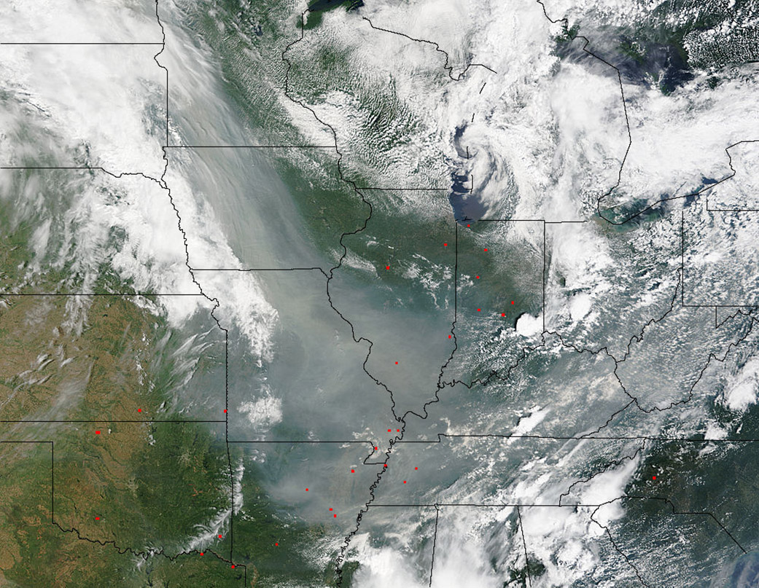
A Cooperative Wildfire
Air Quality Field Study
FIREChem:
A NASA sponsored field study to focus on the links between satellite and ground-based measurements of both fresh and aged biomass burning plumes in the continental United States.
Coordinated sampling with the NOAA FIREX and Joint Fire Science Program FASMEE field campaigns. Coordinated aircraft flights with NOAA P-3. NASA DC-8 will be ready to sample FASMEE burn in Fishlake National Forest, Richfield, UT during first 2 weeks of Sept. 2018.
Actively working with NSF and EPA to leverage opportunities for additional aircraft and ground-based measurements.
FIREChem will include NASA DC-8 & B200 aircraft for in situ sampling and remote sensing to measure upwind and downwind of natural and agricultural fires.
Goals: (1) improve our understanding of the transport of and chemical transformations in biomass burning plumes and their impact on air quality, and (2) improve the ability to incorporate wildfires into air quality forecast models using satellite products.

Slide 8
FIREChem Interaction With Other Campaigns
Smoke chemistry
FIREX
FIREChem
FASMEE
Plume
dynamics
Fire behavior
Fuels
RxCADRE
SERDP
Spatial Scale
Notes:
What are the emissions of gases, aerosols, aerosol precursors, and greenhouse gases from North American fires?
How does the composition of fire plume change as primary species are converted to secondary gas and aerosol tracers?
How is local air quality impacted by North American fires? How well do local air quality forecast models work?
What are the regional and long-term impacts of North American fires?
What are the climate-relevant properties of BB aerosols? What role does brown carbon and coatings on black carbon particles play in the optical properties? What is the composition of PM2.5?
How can satellite measurements help with #1-5? And how can we obtain better satellite estimates of plume height and fire intensity (FRP)?

Slide 9

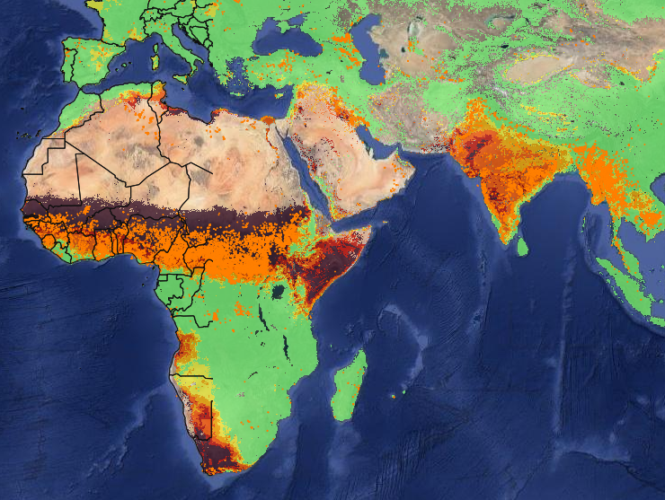

Group on Earth Observations (GEO)
Global Wildfire Information System (GWIS)

Slide 10
GWIS History
The Global Wildfire Information System was developed as a proposal in October 2011 under the GOFC (Global Observation of Forest Cover) element at the GOFC Fire Implementation Team meeting in Stresa, Italy;
In April 2013, the GWIS was conceived as a beta system under the European Forest Fire Information System (EFFIS) operated by the European Commission (EC);
November 2013: GWIS proposed under GEO for the Work Programme 2012-2015 (by C. Justice, J. San Miguel Ayanz, and F. Gaetani);
Adopted by the GEO WP in March 2014 and added under the DISASTERS component, Informing Risk Management & Disaster Reduction, Component C4 (DI-01-C4);GEO GWIS was
The GWIS was continued as a GEO Initiative in the Transitional Work Programme in 2016 (GI-04), and then adopted as a continuing component of the GEO Work Programme for 2017-2019;

Slide 11
GWIS Leads
Canada (CFS), EC (JRC), South Africa (CSIR), and GTOS (GOFC-GOLD), and U.S. (NASA)
Component Leads & Contributors
Jesus San-Miguel-Ayanz (EC-JRC, GOFC-GOLD Fire IT), Chair
Krishna Prasad Vadrevu (GOFC-GOLD Fire IT)
Antonio Martucci (FAO, NRL)
Bill de Groot (CFS, Canada)
Fang Chen (Institute of Remote Sensing and Digital Earth –RADI- CAS, China)
Paolo Fiorucci (CIMA Research Foundation, Italy)
Vince Ambrosia (NASA Applied Science Program, USA)

Slide 12
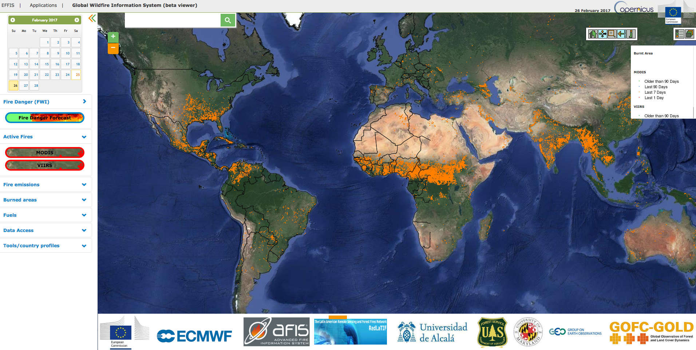
GWIS Prototype
GWIS prototype provides a beta web map service (WMS) viewer that includes real-time fire information sets such as Fire Danger, Active Fires, Fire Emissions, Burned Areas, Fuels, and other layers, on a global scale.

Slide 13
GWIS Goals in GEO WP 2017-2019
Provide harmonized fire information (e.g. fire danger) – building on initial activities of the EC in the EFFIS and the GOFC-GOLD Fire Implementation Team (GOFC-GOLD Fire IT);
Promote networking of fire information providers through annual workshop through key international organizations and initiatives and national and regional providers;
Establish operational links with other wildfire communities dealing with global wildfire aspects (e.g. burnt area assessment, emission estimation);
Integrate / harmonize regional wildfire information data sources;
Develop, implement and promote interoperability and communication among national, regional and global wildfire information systems following OGC standards and the GEOSS Data Sharing Principles;
Coordinate / promote capacity building and training activities in close cooperation with the GOFC-GOLF Fire IT regional networks and the EFFIS network.

Slide 14
NASA ROSES-16 GEO Solicitation
A.50 Group on Earth Observations Work Programme
Solicitation offered by NASA Earth Science and Applied Science Program
To demonstrate a strong ability to support and advance GEO, to further U.S. and NASA interests, and to demonstrate U.S. and NASA commitments to GEO ;
To foster broader domestic involvement in a U.S. national approach to GEO and the Work Programme;
Advance the use of Earth observations to inform decisions and actions and broaden the organizations routinely using them;
Increase international collaboration and partnering across GEO and broaden the GEO community;

Slide 15

NASA ROSES-16 GEO Solicitation
A.50 GEO Work Programme Solicitation
Funding Opportunity Number: NNH16ZDA001N-GEO
Number of New Awards: ~20-25 (increased to 32)
Max Duration of Awards: 36 months
Total Amount of NASA Funding (FY17-20): $8M (increased to ~$15M)
Expected Level of Awards: $30K - $200K per year
Proposal Due Date: March 10, 2017
Notify PIs: September 18, 2017 (about 2-3 weeks late)
Expected Project Start Date: December 1, 2017
GEO solicitation POC: Lawrence Friedl
  GEO GWIS POC: Vince Ambrosia

Slide 16
GEO GWIS Element Solicitation
A.50 GEO Work Programme--GWIS
NASA requested proposals on one or more of the two items:
  Data Compilation and Analysis. NASA requests proposals for GWIS enhancements and tools for on-demand statistics, tabular information, and graphical information at various spatial scales (sub-national to continental) and temporal domains. Information on indices and fire variables would be derived from EO and other sources.
  Workshops and Trainings. NASA requests proposals for webinars, workshops, and in-person trainings to increase awareness, familiarity, and use of GWIS, as well as to characterize users and identify needs. Such proposals should target NGO, indigenous, government, or commercial organizations. Proposals for onsite trainings and workshops should articulate approaches to leverage in-region resources, such as for training facilities and participant travel. NASA particularly encourages proposals focused on AfriGEOSS, AOGEOSS, and AmeriGEOSS member countries.

Slide 17
GEO GWIS Selected Proposals
A.50 GEO Work Programme
3.8 Global Wildfire Information System (GWIS)
Robert Field (Columbia University)
  “Enhancements to the Global Wildfire Fire Information System: Fire Danger Rating and Applications in Indonesia”
Wilfrid Schroeder, et al (University of Maryland / NOAA)
  “Development of a Harmonized Multi-Sensor Global Active Fire Data Set”
Luigi Boschetti / David Roy (U. of Idaho & So. Dakota State Univ.)
  “Using the NASA polar orbiting fire product record to enhance and expand the Global Wildfire Information System (GWIS)”
Congrats to All !!!

Slide 18
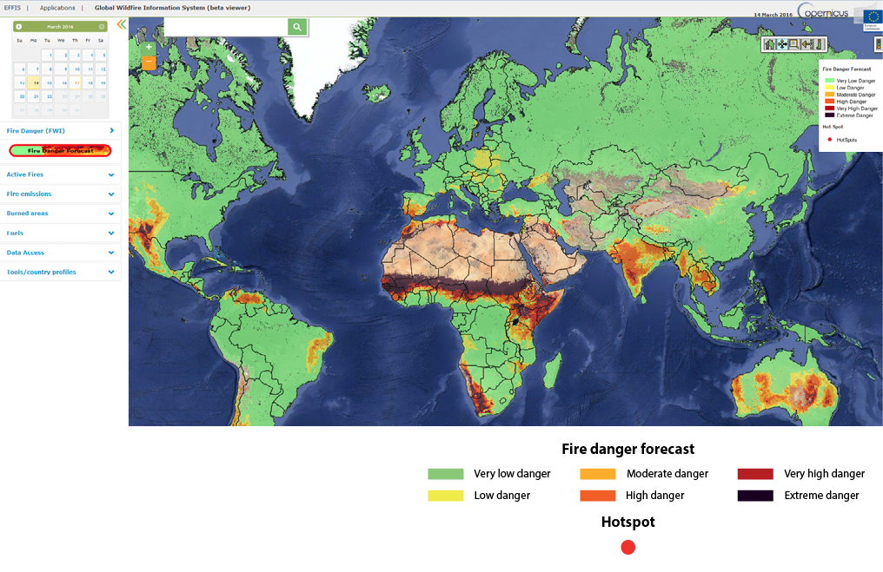
GEO GWIS: http://forest.jrc.ec.europa.eu/effis/applications/global-viewer/

Slide 19
Recent & Upcoming Activities
NASA ASP-Wildfire Program Review Mtg; Boulder, CO (28 Feb – 2 Mar 2017)
Workshop: “Opportunities to Apply Remote Sensing in Boreal / Arctic Wildfire Management & Science”; Fairbanks, AK (4-7 April 2017);
Special Sessions at ISRSE-37, Tshwane, South Africa (8-12 May 2017):
  Improving Wildfire Knowledge Through Earth Observations: From Local to Global Perspectives;
  Paradigm Shift: Autonomous Aerial Vehicles Supporting Earth Observations;
Earth Observations Summit 2017: Montreal Canada; Combines the CSRS and Quebec Association of Teledetection (AQT);
  T. Lynham organized a Remote Sensing Workshop on: The Role of Remote Sensing in Wildfire Management and Research (20-22 June 2017);
NASA ASP GEO Solicitation (GWIS) review of submitted proposals; Boulder, CO (30 May – June 2 2017);
NASA-ARC / USFS-RSAC submitted new SAA: Provides collaboration mechanism for 2017-2022.

Slide 20
Recent & Upcoming Activities (continued)
AFE 7th International Fire Ecology & Management Congress, Orlando, FL, Nov 27-Dec 1, 2017; NASA Exhibit and session discussion on NASA Role in the Federal Fire Science “Sandbox”
AFE / IAWF Fire Continuum Conference, Missoula, MT May 21-24, 2018; Special NASA Session(s) on Wildfire Applications Program Projects & “open” workshop w/ hands-on training on uses of EO supporting wildfire management;
TFRSAC Spring Meeting, Location TBD, Dates: TBD;
**********************************************************************
Wildfire Applications Program Changes: NASA Wildfire application element will likely be subsumed within various NASA Applied Science Programs (Disasters and / or Ecological Forecasting); No wildfire-specific solicitation currently expected in 2018.

Slide 21
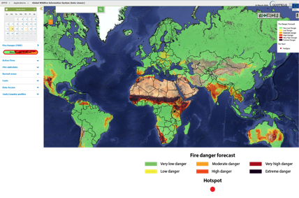

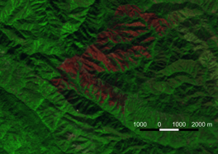
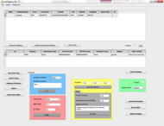
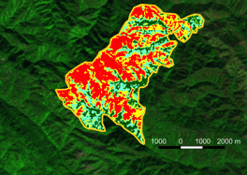
ARSET 2018 Wildfire Applications Webinars:
GEO-GWIS
Objectives: Provide an overview of relevant uses of GWIS and navigation through the GEO-GWIS tools and map services
Dates: TBD (in 2018)
Agenda / Schedule: Usually one, 1-hour session per week for 5-week. Materials can be accessed on own time following the completion of the webinar
Audience: National and international entities involved in wildfire management or responsible for providing fire statistics on regional or national wildfire events. Professionals interested in implementing satellite capabilities for wildfire management activities.
Burned Area Detections
  Objectives: Utilize an open source tool (QGIS) to download Landsat imagery to identify suitable imagers for fire mapping, and subsequently create an automatically-derived, MTBS-like threshold burn severity products. Provides a much needed tool to allow worldwide users to track and map fires.
Dates: TBD (in 2018)
Agenda / Schedule: TBD; Workshop in conjunction with Josh Picotte (USGS-EROS) Audience: National and international entities involved in burn severity assessment or providing fire statistics on regional or national wildfire events.
Source: USDA Forest Service, Remote Sensing Applications Center
https://arset.gsfc.nasa.gov
|‌ 21
Notes:
NASA ARSET has plans to support two Wildfire –related workshops in 2018 (dates to be determined), that focus on, and support the outreach of the GEO-GWIS and another to focus on burned area detections with partner investigators from USGS EROS Data Center
The ARSET team will work with the GOFC-GOLD and GEO-GWIS team to ensure the workshop is directed appropriately, and could lead to expansion to various international communities to enhance the reach of the GWIS system globally.

Slide 22
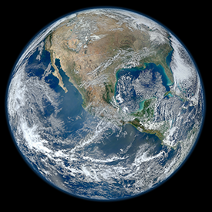
NAS Decadal Survey for ES and Apps - 2017
DECADAL SURVEY FOR EARTH SCIENCE AND APPLICATIONS FROM SPACE (ESAS 2017)
The 2017-2027 Decadal Survey for Earth Science and Applications from Space (ESAS 2017) will help shape science priorities and guide agency investments into the next decade. The survey, sponsored by NASA, NOAA, and the USGS, is driven by input from the scientific community and policy experts.
http://sites.nationalacademies.org/DEPS/esas2017/index.htm
Notes:
What / Who determines NASA’s science and applications directions?
ABOUT THE SURVEY
The National Academies of Sciences, Engineering, and Medicine, led by the Space Studies Board in collaboration with other Earth Science related boards (Board on Atmospheric Science and Climate, Board on Earth Science and Resources, Ocean Studies Board, Polar Research Board, Water Science and Technology Board), will organize a “decadal survey” that will generate consensus recommendations from the environmental monitoring and Earth science and applications community on an integrated and sustainable approach to the conduct of the U.S. government’s civilian space-based Earth-system science programs. These programs are carried out predominantly by the National Aeronautics and Space Administration (NASA), the National Oceanic and Atmospheric Administration (NOAA), and the United State Geological Survey (USGS), with supporting and complementary contributions from agencies including the National Science Foundation (NSF), Department of Agriculture (USDA), Department of Energy (DoE), and Department of Defense (DoD).

Slide 23
Earth Science Decadal Survey
Research and Management
In addition to research questions and reasons for measurements, input from Wildfires users/managers on needs for advancement and what that impact can mean on the ground, can provide language to the Decadal Survey panels to:
a) help with influence within panel discussions, and
b) write more cogent, compelling rationales.
What key questions and advancements does the Wildfires science and applications community need to address in the next 10-15 years?
What key questions – if addressed well or answered – would make major advances in our knowledge and its use in decisions and actions?
What are key questions and challenges that address both scientific needs and societal decisions?
|‌ 23

Slide 24
Decadal Survey Wildfire Submissions
The Wildfire Science and Applications community submitted five (5) documents that refer to the importance of wildland fire science and applications for the next NAS Decadal Survey:
  “Burning Questions: Critical Needs for Remote Sensing of Fire Impacts on Ecosystems” (P. Dennison, et al);
  “Prudent Observations Necessary to Address Wildland Fire Science and Applications Grand Challenges: Critical Feedbacks with the Climate System” (A. Soja, et al);
  “Input to NRC Decadal Survey from a Broad Audience of Remote Sensing Scientists – Air Quality-Fire Themes” (Amy Thomas, et al);
  “Views of the Fire, Fuels, Smoke, and Air Quality Community for the 2017 NRC Decadal Survey in Earth Science and Applications from Space” (D. Sullivan, et al)
  “The Role of Fire in the Earth System” (Stavros, et al.)

Slide 25

Points of Contact
NASA Applied Science Program - Wildfire
http://appliedsciences.nasa.gov/
Vince Ambrosia
NASA Ames
vincent.g.ambrosia@
nasa.gov
Lawrence Friedl
NASA Headquarters
LFriedl@nasa.gov
Amber Soja
NASA Langley
amber.j.soja@nasa.gov
Suomi NPP VIIRS
Visible Composite

