Slide 1
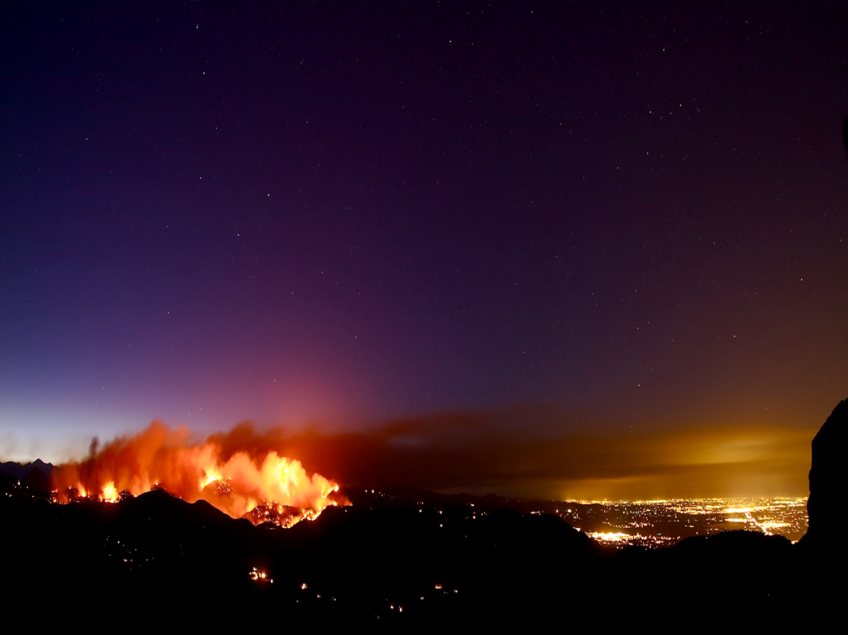


Welcome to the:
Twenty-Third Tactical Fire Remote Sensing
Advisory Committee (TFRSAC) Meeting
Hosted By:
USDA-Forest Service: Everett Hinkley and Brad Quayle
NASA Applied Science Program: Vince Ambrosia
27-28 May 2015
NASA- Ames Research Center
Moffett Field, CA

Slide 2
TFRSAC Schedule: 27 May (AM)
7:30 AM Breakfast Provided at Conference Facility (Bld 152, Rm 171)
8:30 AM Meeting start:
Morning Session (~20 minutes each)
Welcome and Introductions Vince & Everett
NASA Outlook Vince Ambrosia
NASA Decadal Survey “
Forest Service Outlook F&AM Representative
10:00 AM Break (15 min)
10:15 AM Continue Briefings (20 Minutes each)
View from NIFC / National IR Program Manager T. Mellin - USFS
Multi-Mission Aircraft Proposal B. Quayle & Caleb Berry AMS Update Brad, Woody, Kaz, Sally
DOI UAS Update L. Brady / B. Quirk
CalFire Update R. Strazzo / Jana Luis
12:00 PM - 1:15 PM Lunch (Provided)
CBP Predator B

Slide 3
TFRSAC Schedule: 27 May (PM)
1:15 PM Afternoon Briefings Resume (20 Minutes Each)
Update on NASA Wildfire Proposals – Phase II V. Ambrosia & A. Soja
2017 AK Ikhana Deployment V. Ambrosia
NASA DEVELOP National Program Christine Rains
Progress on UAS Testbed on the Front Range Ed Freeborn
3:10 PM Break
3:20 PM Continue Briefings (20 Minutes Each)
XIOMAS Sensors Update John Green
Aviatrix Fire Mapping Technology Ron Palumbo
UAS Bridge Mapping Project Mark Riley
Designing Sensorsfor UAV and Etc.
Drone America Octo-copter static display Tim Ball
5:00 PM Adjourn for the day
6;45 PM Meet for dinner at Tied House, Mountain View
CBP Predator B

Slide 4
TFRSAC Schedule: 28 May
7:30 AM Breakfast Provided at Conference Facility (Bld 152, Rm 171)
9:00 AM Meeting start:
Morning Session (~20 minutes each)
Tuesday recap Vince & Everett
Carry-Over Presentations from Tuesday (if any)
International Partner Activities Update (20 Minutes) Hungary Restas Agoston
Spain Enric Pastor
Australia Terry Cocks
Update of Fire Work at Naval Research Lab Dr. D. Peterson
10:30 AM Break (15 min)
10:45 AM Late Morning Panel – TFRSAC – Looking Ahead
Panel: V. Ambrosia, E. Hinkley, J. Brass, B. Quayle, B. Roth, C. Berry, K. Guerrero
11:30 AM TFRSAC Wrap-Up: recommendations and Action Items
12:00 PM - 1:15 PM Lunch (Off Site)
1:30 PM AMS Integration Team Meeting
CBP Predator B

Slide 5
NASA Outlook
NASA Outlook

Slide 6
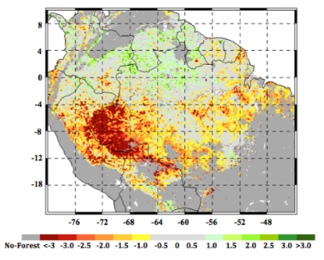
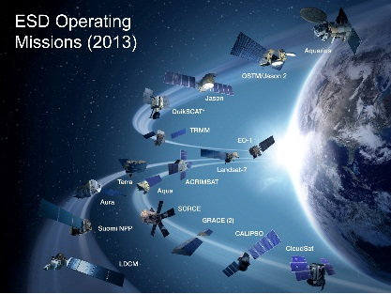
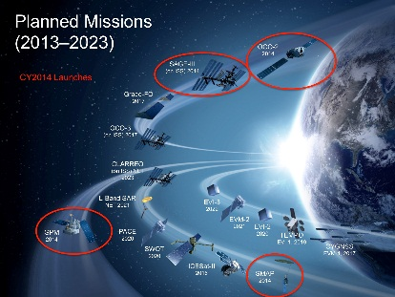
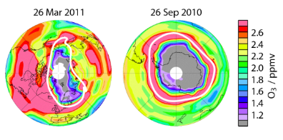
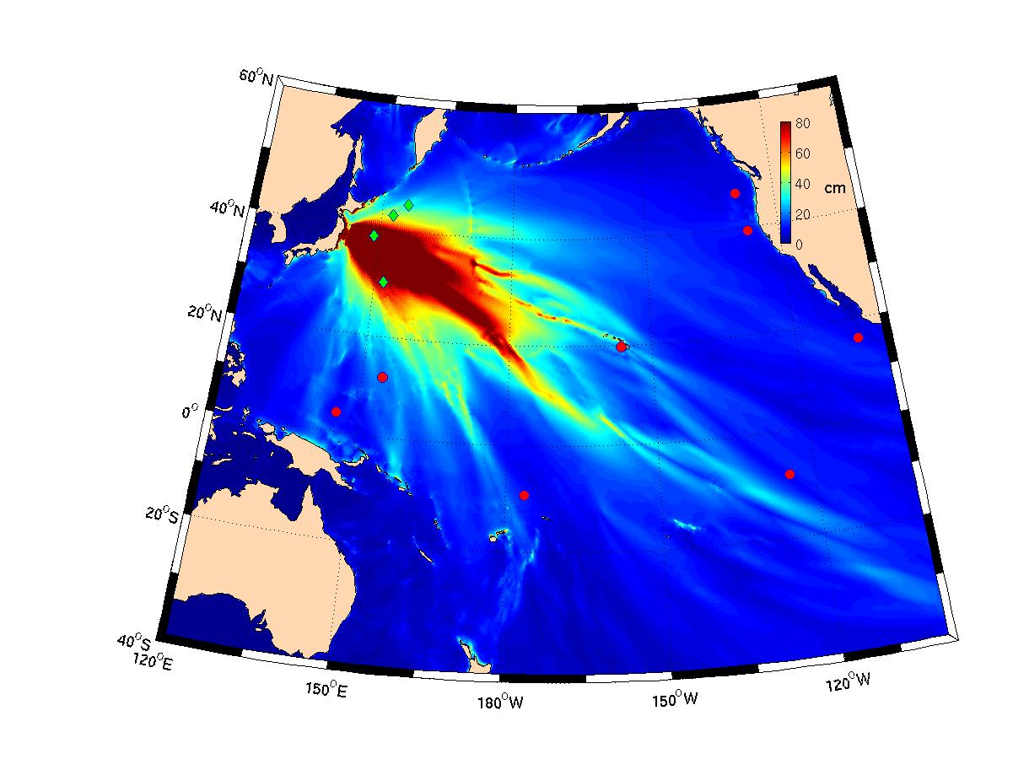
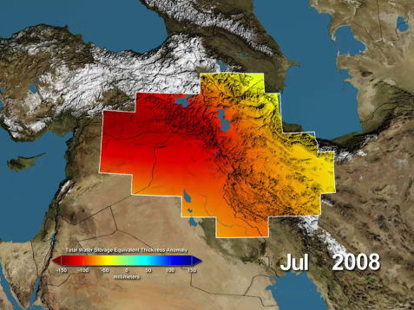
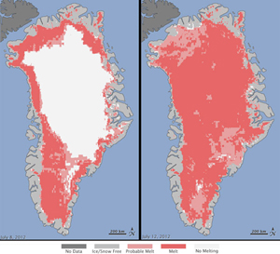
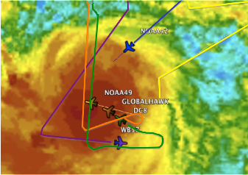
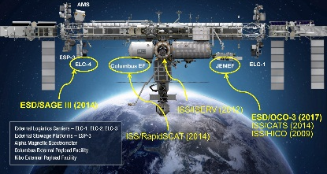

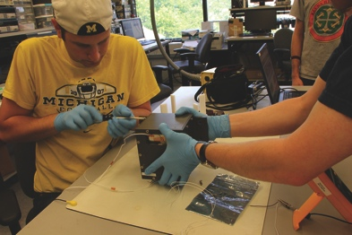
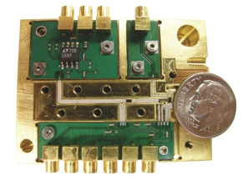
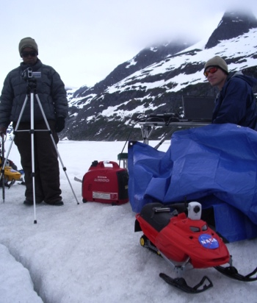

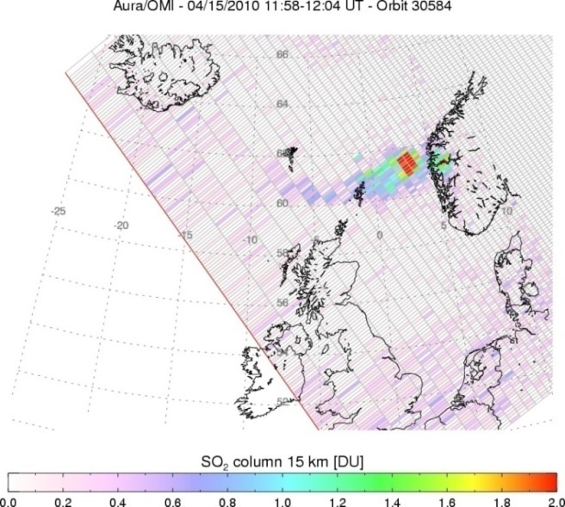
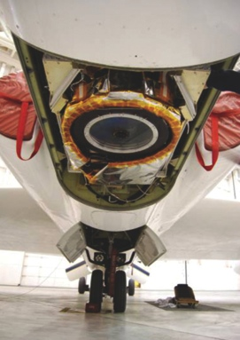
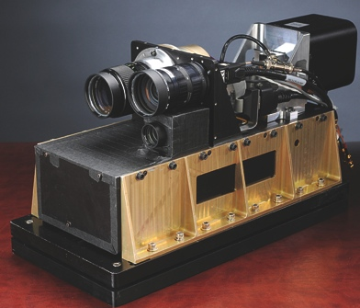



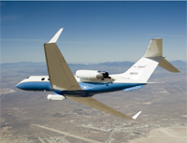
NASA’s Earth Science Division
Research
Flight
Applied Sciences
Technology
Notes:
6

Slide 7
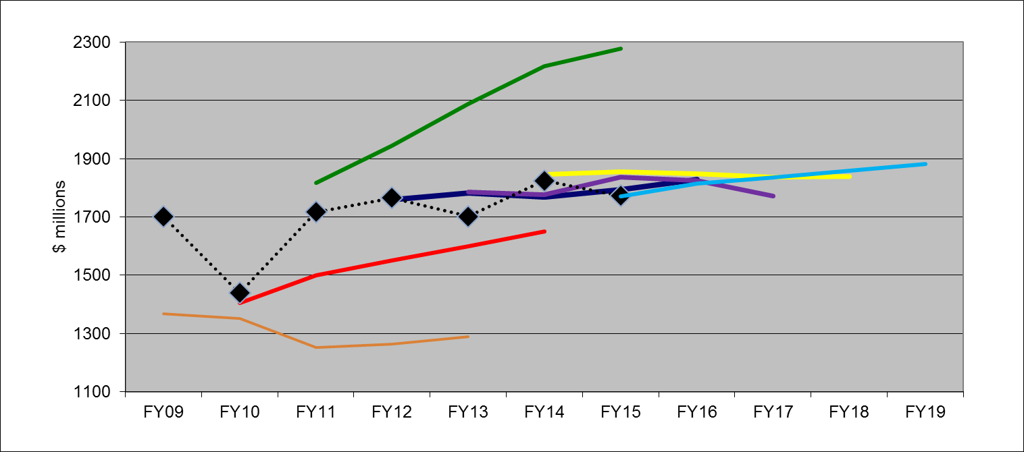
Earth Science Budget:
FY15 Request/Appropriation
FY11 request
FY14 request
FY15 request
Appropriation
FY13 request
FY12 request
FY10 request
FY09 request
(previous Admin)

Slide 8

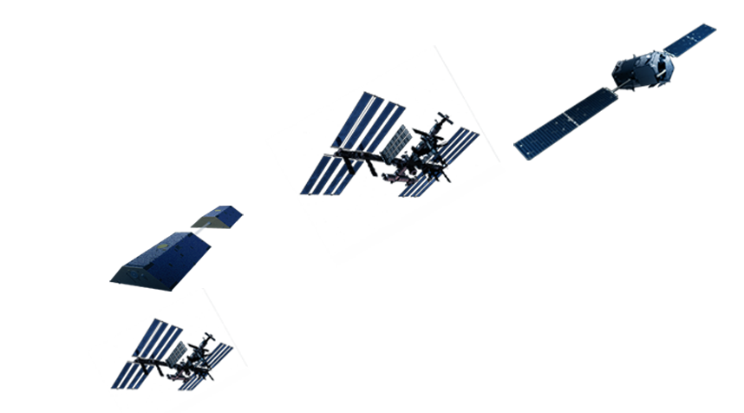
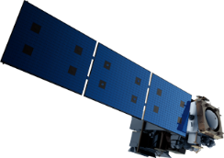

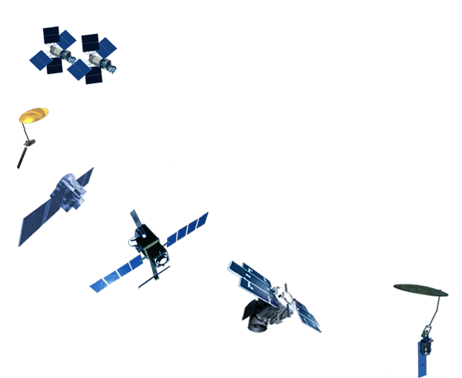

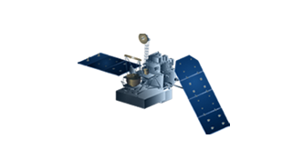
3 ESD-developed EO missions launch in CY 2014
2 ISS-developed EO instruments in 2014, 1 in 2016
11+ more ESD EO launches before 2022
✔
OCO-2
7/2014
SAGE-III
(on ISS)
mid-CY2016
JPSS-2 (NOAA)
Grace-FO
Aug 2017
RBI
OMPS-Limb
[[TSIS-2]]
✔
RapidSCAT, CATS
(on ISS) CY2014
LIS
(on ISS) 2016
SLI-TBD
Formulation in 2015
(NOTIONAL)
CLARREO
NET 2023
✔
NI-SAR
2021
GEDI/ISS
ECOSTRESS/ISS
EVI-3
2022
EVM-2
2021
EVI-2
2020
PACE
CY2022
GPM
2/2014
TEMPO
EVI-1,
CY2018 LRD
SWOT
CY2020
CYGNSS
EVM-1,
Oct 2016 LRD
ICESat-2
June 2018
SMAP
1/2015

Slide 9
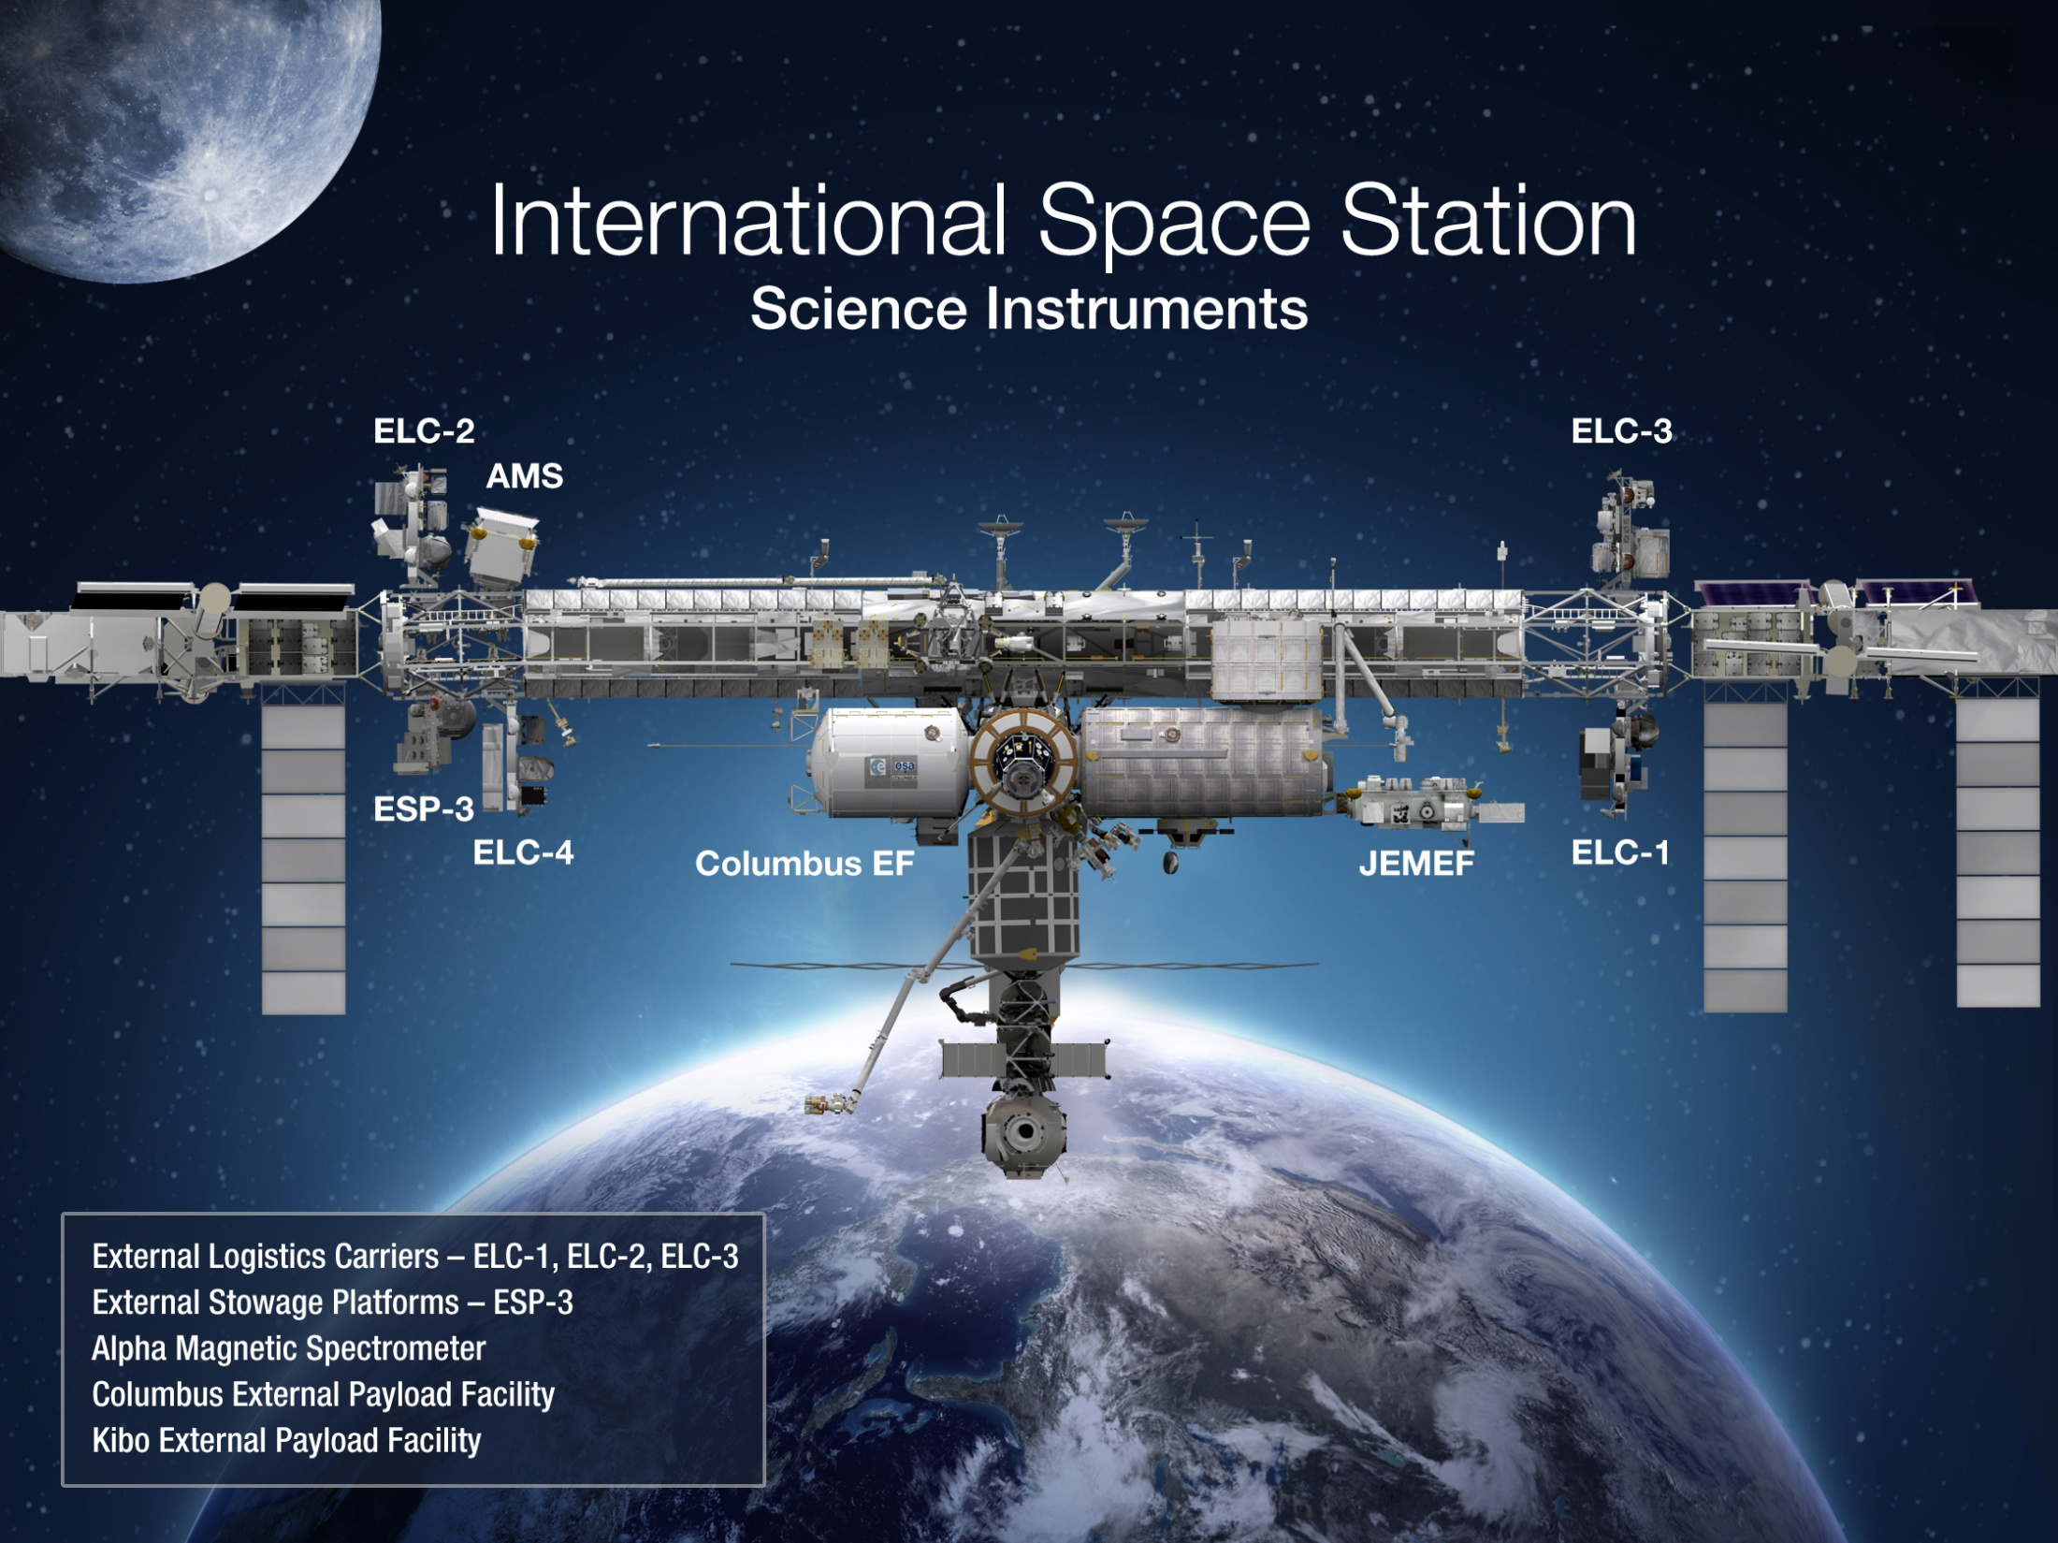
Earth
LIS (2016)
SAGE III (CY2016)
ISERV (2012-2015)
CATS (2014)
HICO (2009)
GEDI (2020)
ECOSTRESS (2020)
RapidSCAT (2014)

Slide 10
SMAP Launched 29 January 2015
(c) 2014 California Institute of Technology. Government sponsorship acknowledged. Email docrev(at)jpl.nasa.gov with any permission, license, or copyright transfer requests.

Slide 11
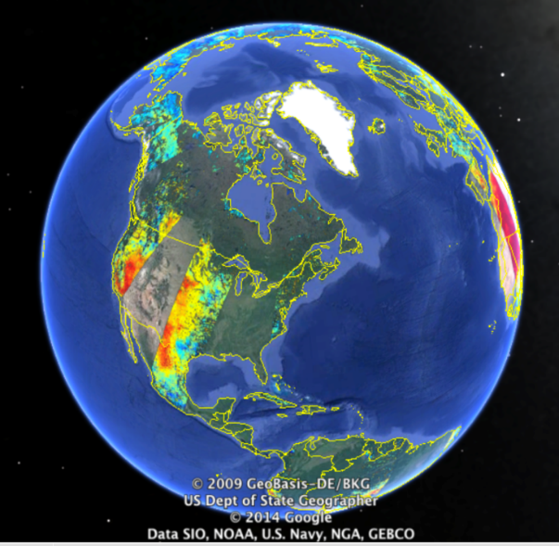
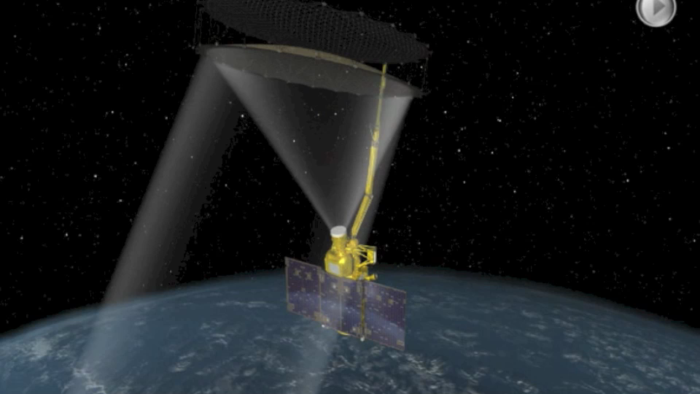
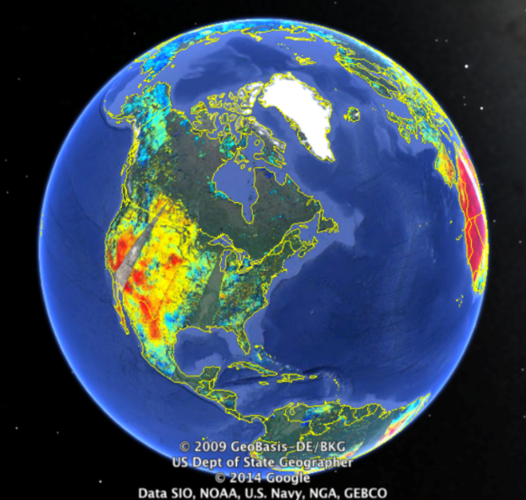
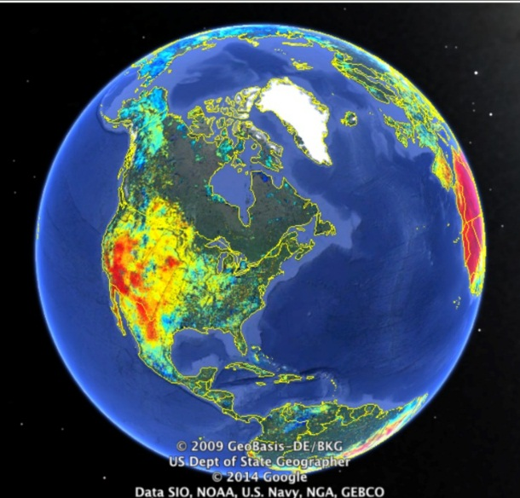
SMAP Soil Moisture Products
SMAP will provide moisture content measurement in the top 5 cm of soil at 10 km resolution globally every 3 days
Day 1
Days 1+2
Days 1-3
SMAP measurements of soil moisture address a wide range of water cycle research and science applications, such as weather predictions, drought/flood monitoring, and food production.
The illustrations provide the soil moisture color-coded with orange for dry conditions and blue for wet conditions.
Notes:
11

Slide 12
Land Imaging in FY 2015 Appropriation
The agreement supports Senate Direction on Landsat Data Continuity, but provides the requested amount of $64,100,000 and clarifies Senate direction on development parameters. Instead of a firm cost cap boundary, the mission shall: cost substantially less than Landsat-8; provide the same data quality as Landsat-8 so as not to require an overhaul of associated ground systems; and provide no degradation or gap in data including the 8-day continuous terrestrial coverage. The agreement does not endorse any efforts to develop alternative approaches to this data acquisition that would increase risk of a coverage gap and not meet the needs of the Landsat user community.
- Congressional FY2015 Appropriation Explanatory Language for NASA

Slide 13
NASA Wildfire Proposals: Update
Decadal Survey

Slide 14

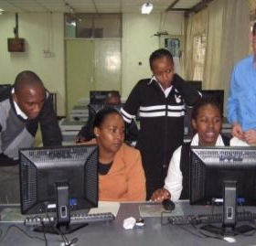
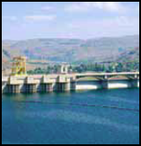

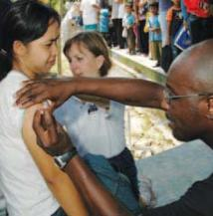


NASA Earth Science
Applied Sciences Program
Wildfires and
2017 Earth Science Decadal Survey
Wildfires Applications Meeting • February 10-12, 2015

Slide 15
Decadal Survey: Intro
Earth Science Decadal Survey
  Two Sections to the Intro:
  What is Decadal Survey
  What is the opportunity for Wildfires Community
Meeting Outcome:
Plan by attendees to engage broader wildfires community on organizing their preparation and eventual inut to Decadal Survey; discuss possible people from the community to nominate as DS committee/panel members; identify specific people to carry things forward
|‌ 15

Slide 16

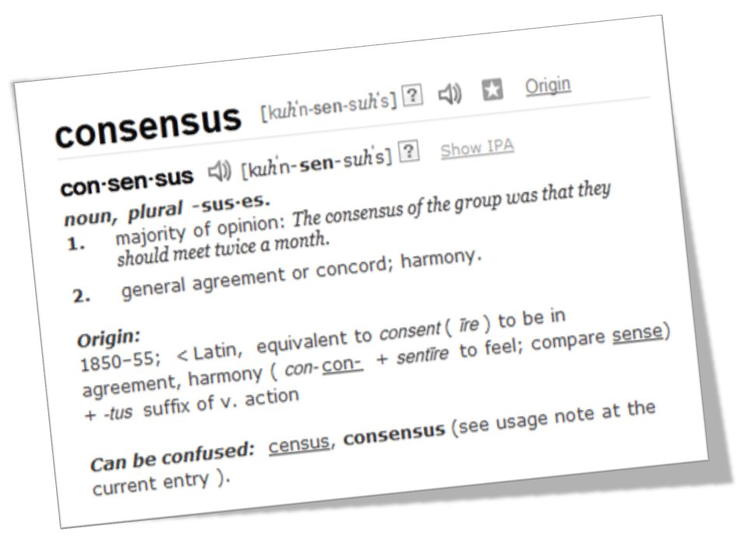
Earth Science & Applications from Space
Earth Science “Decadal Survey”
Opportunity for wide array of fields within the Earth Science community to propose, discuss, debate, and reach consensus on priorities
Aids Administration and
Congress by having a
documented consensus of
scientific experts
|‌ 16

Slide 17


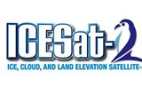
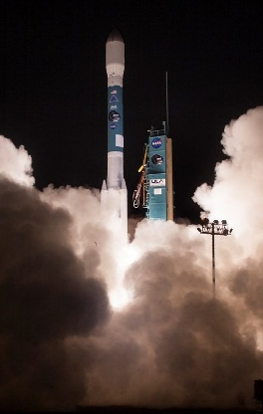
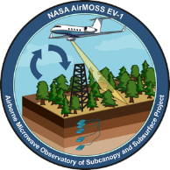

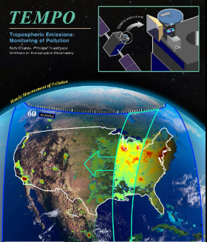
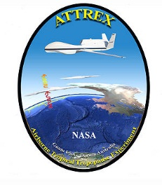
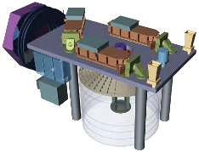
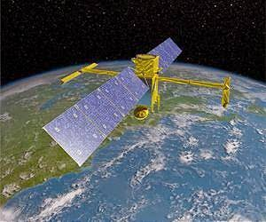

Earth Science & Applications from Space
Earth Science Decadal Survey:
First One in 2007
17 recommended space-based missions for Earth Observations
New “Earth Venture” line of low-cost, PI-led investigator missions
Increased support for airborne measurements
Additional recommendations on data, information systems, technology development, etc.
|‌ 17
Notes:
Main Recommendation: The U.S. government, working in concert with the private sector, academe, the public, and its international partners, should renew its investment in Earth-observing systems

Slide 18
Earth Science & Applications from Space
… a decadal program of Earth science research and applications in support of society – a vision that includes advances in fundamental understanding of the Earth system and increased application of this understanding to serve the nation and the people of the world.
- 2007 Earth Science Decadal Survey
Significant efforts for applications-oriented users to engage throughout the satellite mission lifecycle, especially planning, formulation, and development phases. Examples include:
Community Meetings
Webinars
Science & Applications Workshops
Tutorials
Applications Traceability Matrices
Early Adopters
Applications opportunities for a mission can support the design choices and inform trade-offs.
|‌ 18
Notes:
ESD has initiated several approaches and activities to engage the applications community and to integrate them into the mission planning, formulation, and development efforts. The “applications value” of a mission can support the design choices and trade-offs.
The national strategy outlined here has as its overarching objective a program of scientific discovery and development of applications that will enhance economic competitiveness, protect life and property, and assist in the stewardship of the planet for this and future generations. Earth Science Decadal Survey 2007

Slide 19
2nd Earth Science Decadal Survey
Preparing for 2017 Earth Science Decadal Survey:
What key questions and advancements does the Earth science and applications community need to address in the next 10-15 years?
What key questions – if addressed well or answered – would make major advances in our knowledge and its use in decisions and actions?
What are key questions and challenges that address both scientific needs and societal decisions?
|‌ 19

Slide 20


2017 Decadal Survey: Opportunity
Members of National Research Council Panels
Request for Information
Additional Avenues to Support/Inform DS Panelists
|‌ 20
Notes:
What’s the opportunity for Wildfires
Influence
Examples of res/apps
Showcase how organized wildfires res/apps community is
People on committee
Results of the study

Slide 21
Second Earth Science Decadal Survey
Ten-year anniversary is 2017, preceded by years of preparation and data gathering. Statement of Task developed in 2014.
Notional Schedule (NOT official – estimated by NASA)
|‌ 21

Slide 22
Decadal Survey: 2007 Organization
Committee on Earth Science and Applications from Space
Panel On Land-Use Change, Ecosystem Dynamics, And Biodiversity
Panel On Weather Science And Applications
Panel On Climate Variability And Change
Panel On Earth Science Applications And Societal Benefits
Panel On Water Resources And The Global Hydrologic Cycle
Panel On Human Health And Security
Panel On Solid-Earth Hazards, Natural Resources, And Dynamics
Note: Organization for 2017 Decadal Survey is TBD

Slide 23
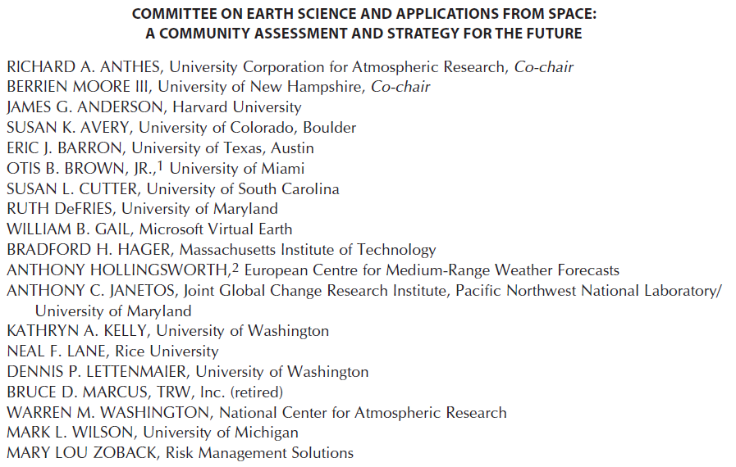
Decadal Survey: 2007 Committee/Panels

Slide 24
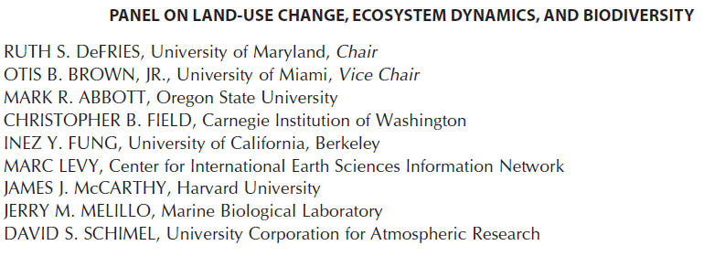
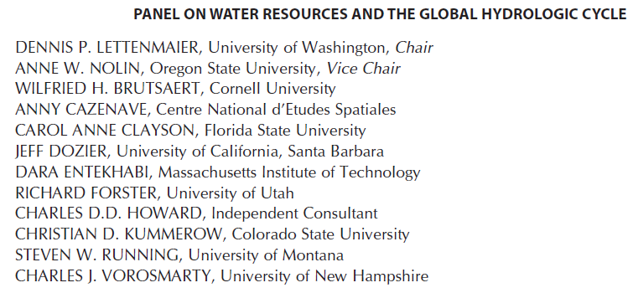
Decadal Survey: 2007 Committee/Panels

Slide 25
Earth Science Decadal Survey
Communities Organizing
What does Wildfires Community want this 2017 Decadal Survey to say?
What guidance does the Wildfires Community want it to give? What priorities to state or confirm?
Workshop: Water Cycle Missions for the Next Decade
April 2013
Ten Ways Remote Sensing Can Contribute to Conservation
2013 Workshop; 2014 paper in Conservation Biology journal
Atmospheric Composition Community Meeting
(for Decadal Survey)
Summer 2014
|‌ 25

Slide 26
Earth Science Decadal Survey
Research and Management
In addition to research questions and reasons for measurements, input from Wildfires users/managers on needs for advancement and what that impact can mean on the ground can provide language to the Decadal Survey panels to
a) help with influence within panel discussions and
b) write more cogent, compelling rationales.
What key questions and advancements does the Wildfires science and applications community need to address in the next
10-15 years?
What key questions – if addressed well or answered – would make major advances in our knowledge and its use in decisions and actions?
What are key questions and challenges that address both scientific needs and societal decisions?
|‌ 26

Slide 27



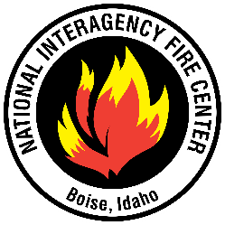

Wildfires: Decadal Survey
Wildfires Community is Rich in Research & Applications
Community is Skilled in Connecting Science and Management
Fire Research and Management Exchange System
Missoula Fire Sciences Lab
Global Fire Information Management System
and others …
|‌ 27
Notes:
Joint Fire Science Program, http://www.firescience.gov/;
Fire Research and Management Exchange System, http://frames.nbii.gov;
Smoke and Emission Model Intercomparison Project, http://semip.org/;
National Interagency Fire Center, www.nifc.gov;
Remote Sensing Applications Center, http://www.fs.fed.us/eng/rsac/;
EROS Fire Science, http://eros.usgs.gov/#/Science/Landscape_Dynamics/Fire_Science;
Missoula Fire Lab, http://www.firelab.org/science-applications;
Pacific Northwest AirFIRE, http://www.fs.fed.us/pnw/about/programs/mdr/airfire.shtml;
Center for Forest Disturbance Science, http://www.forestdisturbance.net;
Global Fire Information Management System, http://www.fao.org/nr/gfims/en/;
Wildland Fire Decision Support System, http://wfdss.usgs.gov/.

Slide 28
Earth Science Decadal Survey
Next Steps
Who, what, and how to organize the Wildfires community for this next decadal survey?
Beyond Feb. 10-12, what community events for research and managers/apps. users?
Need to identify concrete steps, events, etc. very soon and begin organizing them to be prepared for Decadal Survey nominations and RFI.
The Wildfires community (rather than NASA) is the one to submit any input and convey priorities.
Can the group this week identify someone or a small group to carry things forward and maintain momentum?
|‌ 28

Slide 29
Earth Science Decadal Survey
Next Steps
Who, what, and how to organize the Wildfires community for this next decadal survey?
Beyond Feb. 10-12, what community events for research and managers/apps. users?
Need to identify concrete steps, events, etc. very soon and begin organizing them to be prepared for Decadal Survey nominations and RFI.
At a minimum, someone will need to prepare a summary report from Feb. 10-12 events to submit to the NRC’s Decadal Survey Committee when the Request for Information is issued later in 2015.
|‌ 29

Slide 30
Earth Science Decadal Survey: Next Steps
The NRC will appoint an ad-hoc steering committee and a series of discipline-oriented panels to carry out the survey; the disciplines for the panels are yet to be determined. Overall, the NRC expects ~100 members serving on a steering committee or one of its panels;
The NRC just began to take nominations, and the wildfires community can nominate people. The website is: http://tinyurl.com/nzmgozd.
Rather than NASA, it’s the wildfires community that needs to organize itself on its priorities and provide any inputs to the Decadal Survey Committee;
Visit the FRAMES site to share comments about the Decadal Survey: (https://www.frames.gov/myframes/content/welcome-myframes-collaboration-space?destination=node/819).

Slide 31
NASA Wildfire Proposals: Update
Update of NASA Wildfire Projects

Slide 32
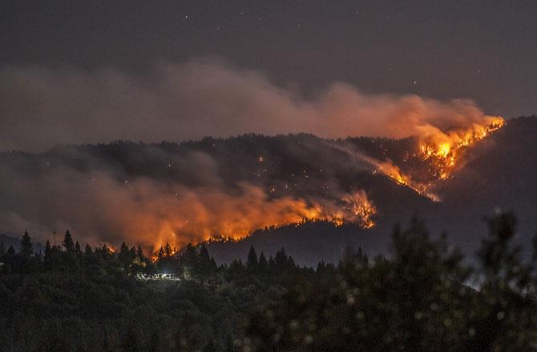
NASA Wildland Fire Phase II Projects
Zachary Holden / USDA Forest Service:
A Prototype System for Predicting Insect and Climate-Induced Impacts on Fire Hazard in Complex Terrain;
Sher Schranz / NOAA:
Wildland Fire Behavior and Risk Prediction;
James Vogelmann / USGS EROS Center
Improving National Shrub and Grass Fuel Maps Using Remotely Sensed Data and Biogeochemical Modeling to Support Fire Risk Assessments;
Birgit Peterson / USGS EROS Center:
Enhanced Wildland Fire Management Decision Support Using Lidar-Infused LANDFIRE Data;
Karyn Tabor / Conservation International Foundation
An Integrated Forest and Fire Monitoring and Forecasting System for Improved Forest Management in the Tropics;
Wilfrid Schroeder / University of Maryland
Development and Application of Spatially Refined Remote Sensing Active Fire Data Sets in Support of Fire Monitoring, Management and Planning;
Stephen Howard / USGS EROS Center:
Utilization of Multi-Sensor Active Fire Detections to Map Fires in the US;
Mary Ellen Miller / Michigan Tech Research Institute (MTRI):
Linking Remote Sensing and Process-Based Hydrological Models to Increase Understanding of Wildfire Effects on Watersheds and Improve Post-Fire Remediation Efforts;
Keith Weber / Idaho State University;
RECOVER: Rehabilitation Capability Convergence for Ecosystem Recovery;
|‌ 32
Notes:
The nine projects cover the range of:
Pre-fire (predictive modeling) / forecasting (in green);
Active fire monitoring and mapping (in white);
Post-fire assessment improvements (in blue)
The projects focus on various fire regimes, including shrub and grassland fires, prescribed fire, small agricultural buring, and large wildfires in timber ecosystems.
Some of these project are across boundaries:
Pre-fire improvements of structure analysis to improve fire modeling and post-fire recovery;
Soil map inclusion to improve post-fire burn assessments
Infusion of lidar data to improve fuel characterization

Slide 33
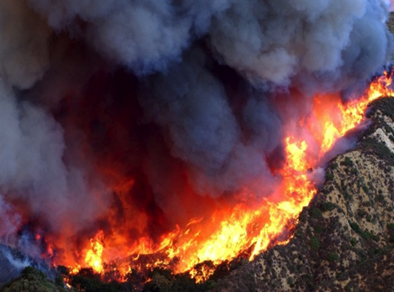
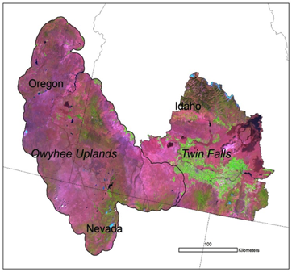
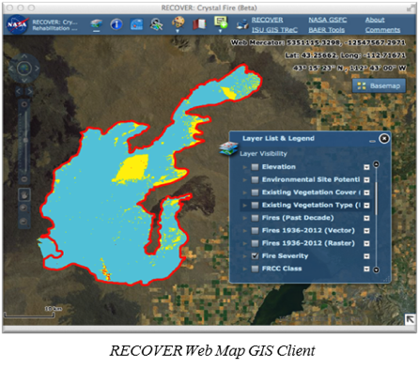
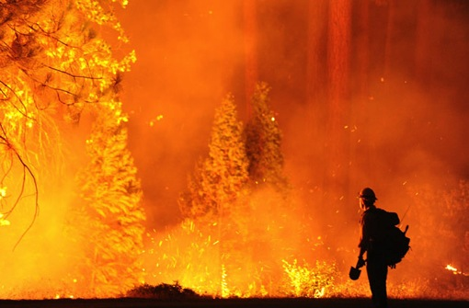
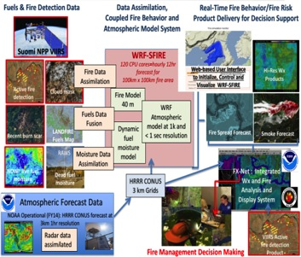
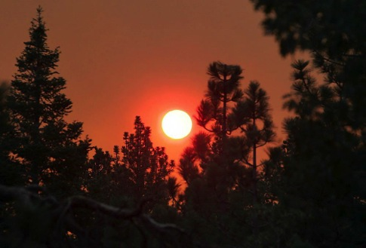
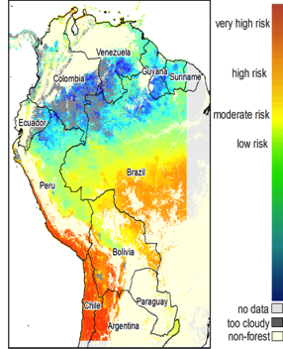


NASA ASP Wildland Fire Applications:
9 Phase II Projects
Improving Shrub and Grass Fuel Maps Using Remotely Sensed Data to Support Fire Risk Assessments
Web-enabled Post-Fire Rehabilitation Planning Application
Fire Behavior and Risk Forecasting
Erosion Model Prediction
International R/T Fire Alerts
Notes:
(1) Karen Tabor (CI): The Conservation International “Firecast” is a tool designed to help prevent the destructive effects of fires on natural habitats and human well-being. Firecast uses emerging technologies (NASA satellite data (MODIS / VIIRS) and cutting-edge research to empower local stakeholders with timely monitoring and forecasting information on fires. The system delivers short-term, fire-risk forecasting and near-real-time (NRT) detection of fires, droughts, and deforestation to subscribers through email alerts, maps, and reports.
(2) Weber (Idaho State): The RECOVER web-map-based tool uses NASA satellite observational data and Geographic Information System (GIS) technologies to allow managers quick access to pertinent information for post-fire rehabilitation assessment and work. Wildfire managers and firefighters now also have the ability to update GIS maps almost instantaneously using their mobile devices.
(3) Jim Vogelmann (USGS-EROS): The primary objectives of the project includes Improving upon shrub and grassland mapping for fire applications; 2) Develop intra-seasonal (e.g. monthly) fuel data sets in shrub and grassland areas using a combination of Landsat and MODIS data; and 3) Determine if improvements in shrub and grassland data layers will alter and improve fire behavior model results. Phase II is expanding to other western US shrub and grassland areas and expanding the corsortia of partners using the data, and operationalizing through interactions with LANDFIRE
(4) Sher Schranz (CIRA - CSU): Automate WRF-SFIRE with initialization from NASA Earth observations for operational use by NOAA and delivery of model output via FX-Net to operational wildfire response entities such as the National Interagency Fire Center (NIFC). Specific satellite data to be used include MODIS and VIIRS active fires, Normalized Distributed Water Index (NDWI) as a proxy for live fuel moisture, and NDVI used to modify fuel loading in previously burned areas.
(5) Mary Ellen Miller (MTRI): Create an online spatial database to support post-fire remediation through erosion modeling. Their database for Colorado is online and allows users to import burn severity maps which are combined with soils and land cover to rapidly provide spatial model inputs. By preparing ahead of time, the modeling work can be carried out quickly and the results can be used for decision-making activities related to post-fire risk assessment and rehabilitation. The new website and datasets deliver model inputs in mere seconds; previously assembling and formatting this type of data would have taken at least several hours if not multiple days.

Slide 34















NASA ASP Wildland Fire Applications:
9 Phase II Projects
Enhanced Wildland Fire Management Decision Support Using Lidar-Infused LANDFIRE Data
TOPOFIRE: A System for Monitoring Insect and Climate Induced Impacts on Fire Danger in Complex Terrain
Development and Application of Spatially Refined Remote Sensing Active Fire Data Sets in Support of Fire Monitoring, Management and Planning
Utilization of Multi-Sensor Active Fire Detections to Map Fires in U.S.
Notes:
Wilfrid Schroeder (UMd): This effort integrates the VIIRS data at spatial resolutions of 375 m and 750 m for improving on the MODIS active fire product. Compared to coarser resolution products, the new VIIRS 375 m active fire detection product enables early detection of small fires and improved mapping of large wildfires. These data are being used to complement other spatially refined airborne (e.g., NIROPS, FireMapper) and spaceborne (e.g., Landsat-8 and upcoming Sentinel-2) fire data sets of more limited geographic and/or temporal coverage.
(CLICK): The NCAR’s Coupled Atmosphere-Wildland Fire Environment (CAWFE) model and the Weather Research and Forecasting (WRF) model have been successfully initialized and validated using the new VIIRS 375 m fire data, enabling accurate simulation of complex fire behavior during long-lasting wildfires.
(CLICK): Compared to traditional models, this approach can now be applied to monitor and predict the growth of a fire or a group of simultaneous wildfires in a management unit from first detection until containment – a previously unattainable goal due to accumulation of model error. This project will improve the value and utility of VIIRS data for more refined fire characterization.
(2) Zack Holden (USFS): The team has developed an open source interactive web server called TOPOFIRE, designed as the next generation of the Wildland Fire Assessment System (WFAS). TOPOFIRE integrates very high resolution climate data, NASA imagery, and gridded FASST hydrologic model outputs with national decision support tools to provide spatial information critical to nearly every aspect of wildland fire management decision support. The primary goal of the system is to provide more finely resolved spatial information about fuel conditions in the wildland fire environment.
(CLICK): TOPOFIRE harnesses smartphone technology by assimilating weather observations and photos collected during fire incidents. Additionally, firefighters will be able to request Windninja wind speed simulation forecasts as well as maps of fire danger and potential fire behavior. Outputs from simulations run on TOPOFIRE will be delivered to user phones in near real time.
(CLICK): TOPOFIRE integrates aerial survey maps with MODIS VI time series to produce annual maps of MPB attack.
Birgit Peterson (USGS-EROS): The primary objectives of the project are to develop and integrate detailed vegetation structure information derived from lidar, to be integrated with the LANDFIRE product suite to generate locally enhanced vegetation structure and fuels maps. This project is developing the Creating Hybrid Structure from LANDFIRE/lidar Combinations (CHISLIC) tool, to enable the easy integration of lidar data into LANDFIRE canopy height, canopy cover, and canopy base height products. This will enable an improved classification of burned area conditions by integrating canopy height measurements into the models. CHISLIC will also be ported to a web server-based platform to make it more accessible to a larger group of users.
(4) Steve Howard (USGS-EROS): It was necessary to develop a national baseline of consistent fire information from which to base management decisions at local, regional, and national scale utilizing Landsat 30 meter imagery to map and assess all “large” fires (greater than 1,000 acres in the West and 500 acres in the East) across the nation for the MTBS program. Currently, MTBS relies upon state and federal fire occurrence data to guide Landsat scene selection and manual procedures to assess the fires. However, many fires on private lands are not reported and escape evaluation (especially in SE US). Additionally, manual procedures limit the potential to increase the number of fires assessed. This multi-sensor project will utilize NOAA’s Hazard Mapping System (HMS) active fire detections to augment Federal and state fire records and improve the nationwide etimate of fires at smaller to large scales.

Slide 35
Wildfire Rapid Response Proposal
NASA Open-ended Solicitation: Rapid Response and Novel Research in Earth Science (NNH14ZDA001N-RRNES); one-year funding opportunities (FY15)
Proposal submitted by D. Schimel (NASA JPL), C. Ramirez (USFS-R5), and J. Coen (UCAR), N. Stavros (JPL) on 11-1-14
Peer-reviewed at NASA HQ, funded quickly
Title: Rapid Response to the 2014 King Fire
Cost-sharing proposal between USFS and NASA (50/50 budget split)

Slide 36




Megafire Disaster Response: NASA / USFS Aid Fire Recovery
Objective: characterize pre, active and post-burn conditions of megafires, to observe ecosystem properties influencing fire probability, behavior and recovery as a basis for aiding management
Coverage: California King (2014) and Rim (2013) megafires
Data collection, processing and dissemination (wildfire.jpl.nasa.gov) is a collaborative effort that aids disaster response and post-fire recovery planning such as:
  Identify endangered species habitat
  Water quality assessment
  Erosion assessment
  Removal of hazardous logs
  Timber harvesting
AVIRIS hyperspectral improves burn area imaging over Rim Fire
LiDAR before (left) and after (right) King Fire

Slide 37









Interagency Partnerships
NASA collaborates with numerous land management agencies and other partners in the United States to improve wildfire characterization
|‌ 37
Notes:
NASA is integrated into many national and international research and applications committees that have sub-focus areas in wildfire. Their role is to increase the visibility of data and information, derived from NASA observations and models to improve wildfire understanding and ecosystem effects.

Slide 38





NASA Participation in Research / Applications Committees
Group on Earth Observations (GEO), Global Wildfire Information System (GWIS);
National Science & Technology Council (NSTC) Subcommittee on Disaster Reduction (SDR) Wildland Fire Science and Technology Task Force (WFST TF);
Interagency Arctic Research Policy Committee (IARPC); Wildfire Implementation Team (WIT);
NRC, Div. of Earth & Life Sciences, Wildfire Study Team;
|‌ 38
Notes:
NASA is integrated into many national and international research and applications committees that have sub-focus areas in wildfire. Their role is to increase the visibility of data and information, derived from NASA observations and models to improve wildfire understanding and ecosystem effects.

Slide 39
Active & Upcoming Activities
Committee Member (rep NASA) on GEO 2012-2015 Work Plan, element DI-01--Disasters; Risk Reduction , Group C4: Global Wildfire Information System;
NASA represented on Wildland Fire Science & Technology Task Force (Amber Soja);
Sponsored and supported NASA exhibit at IUFRO, Salt Lake City, UT. 5-12 October 2014.
Phase II Project team 1st Year Review and Planning Workshop (January ‘15 at RSAC / SLC; ‘16 at NIFC / Boise; ‘17 at TBD

Slide 40
Active & Upcoming Activities
Speaker on NASA’s ASP-Wildfire program element at International Conference on Forest Fire Research, Coimbra, Portugal, November 2014.
Organized Special Session on NASA Wildfire Applications at Pecora Conference, Denver, CO, November, Amber Soja – Chair.
ISRSE 2015 Berlin, Program Technical Committee; Theme Chair of Disasters Theme and Airborne Theme. Organized three (3) Special Sessions on “Wildfires” and two (2) “UAS for Resource Assessment” Special Sessions
NASA rep on IARPC Wildfire Implementation Team; developed a document on orbital and airborne wildfire remote sensing assets that is web-served by the IARPC; and development of a workshop on “Arctic Wildfires and Assessment tools”.

Slide 41
Subcommittee on Disaster Reduction (SDR)
Wildland Fire Science and Technology Task Force
Task Force established to increase coordination and cooperation between Federal agencies, specifically between wildland fire management and wildfire mitigation, response, and recovery responsibilities (fire science consumers) and the Federal organizations with science and technology functions (fire science producers).
49 participants from 28 Federal departments and agencies
A primary goal - Identify and catalog a baseline of Federal roles and responsibilities related to fire to serve as a foundation for more formal and inclusive coordination between fire science producers and consumers in the future.
Report being finalized now that will serve as a roadmap for future coordination and cooperation.
Notes:
What is in this for NASA?
A seat at the table allows us to have input into a widely-viewed overarching plan that can be both beneficial to wildfire science and applications, and to increase the dissemination and use of relevant NASA satellite and airborne data, models and technology.
Provides an opportunity to define “NASA Wildland Fire Success” to other Federal agencies.
Organizations represented (no particular order):
Department of Agriculture (FS)
Department of Commerce (NOAA, NWS, NIST)
Department of Defense
Department of Energy
Department of Homeland Security (FEMA, DHS S&T)
Department of the Interior (BLM, OWF, BIA, OEM)
U.S. Environmental Protection Agency
National Aeronautics and Space Administration
National Science Foundation
Council on Environmental Quality
National Security Council Staff
Office of Science and Technology Policy
U.S. Geologic Survey
National Science Foundation
National Science and Technology Council
Science and Technology Policy Institute
U.S. Department of Health and Human Service
Council on Environmental Quality
Office of Management and Budget
National Security Staff
Suggested: Naval Research Laboratory

Slide 42
Idaho Wildfire Remote Sensing Workshop
How to locate and download satellite imagery
Use ArcGIS to view imagery
Create an NDVI layer
Explore and visualize various imagery to view spatial resolution differences and temporal resolution differences
View a pre-fire NDVI layer(s) for a fire area
View the changes in NDVI leading up to the fire
Create a pre-fire NBR layer
Complete an exercise draping imagery over a topography layer. Investigate the interaction between aspect and NDVI
Complete an exercise using exploring the topics and technologies introduced in the previous section
Explore post-fire imagery
Create/explore post-fire NDVI
Create post-fire NBR
Create differenced NBR and explore
Explore the RECOVER post-fire DSS web map
Explore RECOVER web services in ArcGIS
Complete an exercise exploring various primary productivity layers (NDVI, fPAR, etc) from various satellites. Consider the relationship to field observations
Notes:
Additionally, NASA Wildfire Program is planning a Arctic Fires Workshop in March 2016, similar to the Idaho State Workshop. Working with the JFSP AK Consortium Team Members on organizing such.

Slide 43

Points of Contact
NASA Applied Science Program - Wildfire
http://appliedsciences.nasa.gov/
Vince Ambrosia
NASA Ames
vincent.g.ambrosia@
nasa.gov
Lawrence Friedl
NASA Headquarters
LFriedl@nasa.gov
Amber Soja
NASA Langley
amber.j.soja@nasa.gov
Suomi NPP VIIRS
Visible Composite

Slide 44



DLR Firebird System

Slide 45
Ikhana AK Deployment

Slide 46



2017 Alaska Ikhana Deployment
Ikhana in initial planning to support “Northern Edge” DoD Mission in AK in summer 2017;
Potential synergy with wildfire imaging scenarios, including the NASA Arctic-Boreal Vulnerability Experiment (ABoVE) Science Campaign (http://above.nasa.gov/);
NASA AFRC trying to develop “coalition-of-the-willing” to take advantage of cost-sharing opportunities for missions in AK during Northern Edge;
Proposition to have AMS in pod on Ikhana, operated by USFS / NASA-ARC team;
Cost-sharing potential with AK parties (national and state entities)
Planning telecons to discuss issues, questions, concerns, etc. from AK community;

Slide 47
Extra slides

