Slide 1
VIIRS Fire Developments
Ivan Csiszar
NOAA/NESDIS Center for Satellite Applications and Research (STAR), College Park, Maryland, USA
W. Schroeder, L. Giglio, E. Ellicott, C.O. Justice
University of Maryland, Department of Geographical Sciences, College Park, Maryland, USA

Slide 2
VIIRS active fire product development
NOAA: real-time NOAA operational applications
NASA: science, long-term continuity + added value NRT
Current operational M-band product generated by IDPS¹
Part of integrated processing chain
Low latency; detections only
Locations only (no fire mask)
New operational product within NDE²; consistent with NASA product
VIIRS Fire Team
M-band MODIS continuity product at Land SIPS³
Detections, Fire Mask and Fire Radiative Power, CMG
Spatially explicit fire mask
Spatial and temporal aggregates – heritage delivery systems (RR, FIRMS)
Experimental I-band product
Algorithm updates
Upstream processing updates
NOAA Proving Ground
NASA Applied Science
algorithm synchronization, end user feedback
DIRECT READOUT (CSPP, IPOPP)
Can run IDPS, NASA or locally developed code
Stand-alone
¹Interface Data Processing Segment; ²Suomi NPP Data Exploitation; ³Science Investigator-led Processing System

Slide 3
NOAA VIIRS product status
The IDPS Suomi NPP 750m Active Fire product has reached Validated 1 maturity status with an effectivity date (i.e. IDPS implementation) of August 13, 2014.
The IDPS Suomi NPP Active Fire ARP was declared Operational in September 2014
A new 750m VIIRS fire algorithm is transitioning into NOAA operations
  global mask of thematic classes including water, cloud, non-fire clear land and fire at three confidence levels
  fire radiative power for each fire-affected pixel
  new algorithm elements to improve detection performance
The product is tailored subset of the NASA science product for real-time NOAA operations
Plans to support implementation in CSPP

Slide 4
NASA VIIRS Active Fire Background
Baseline 750 m product builds on MODIS C6 Fire and Thermal Anomalies (MOD14/MYD14) algorithm
  Provides fire mask, fire radiative power retrievals, plus additional metadata
    Mimics MOD14/MYD14 science data format & nomenclature
  Currently implemented/maintained at Land SIPS (NPP_VAFIRE_L2D)
  Currently implemented/maintained in IPOPP serving the DB community
  Latest algorithm being ported to NESDIS in order to replace operational version in IDPS (based on outdated Collection 4 version)
New 375 m product based on similar MOD14/MYD14 architecture
  Provides fire mask, limited fire retrievals (frequent saturation), plus additional metadata
    Resembles MOD14/MYD14 science data format & nomenclature
  Currently running at the USDA Remote Sensing Applications Center (RSAC), and in fire monitoring systems in South Africa and Brazil
  Being ported to IPOPP
  To be ported to Land SIPS
  Long-term plan is to implement in NOAA operations

Slide 5
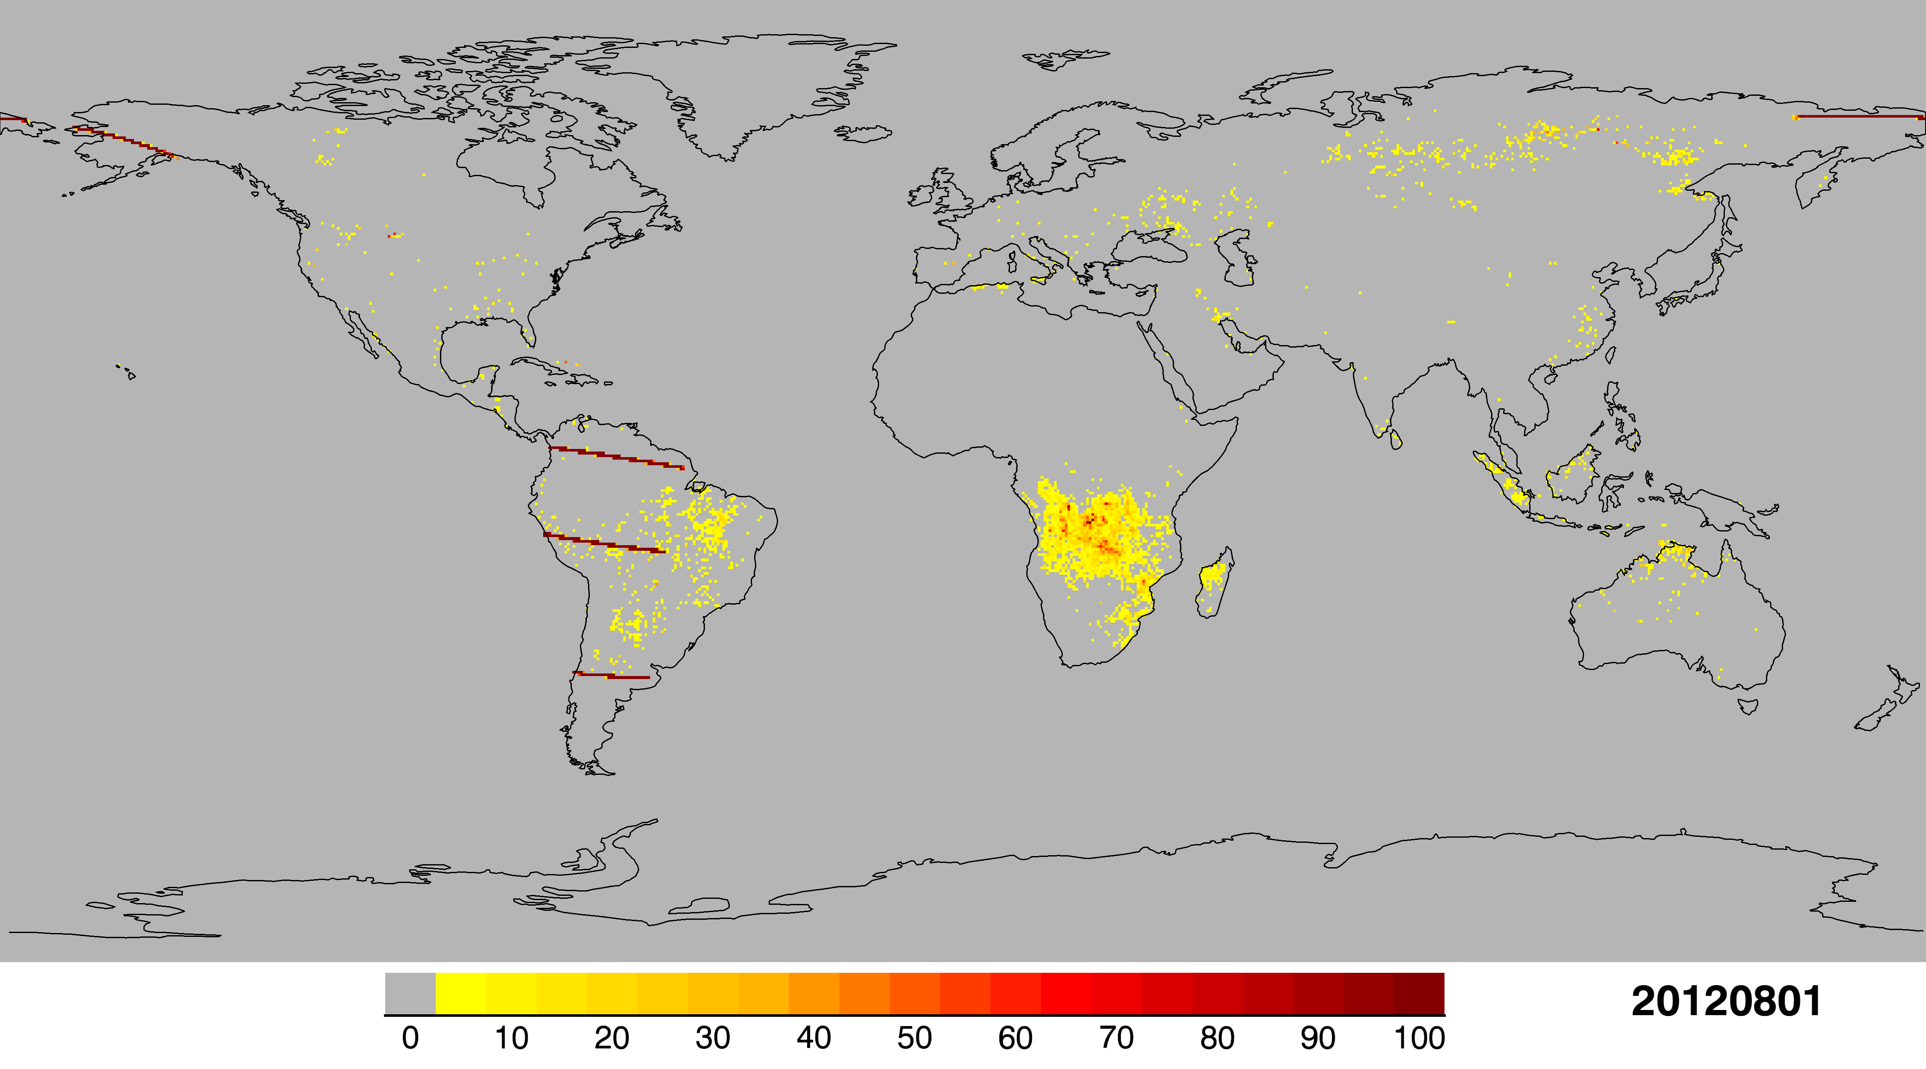
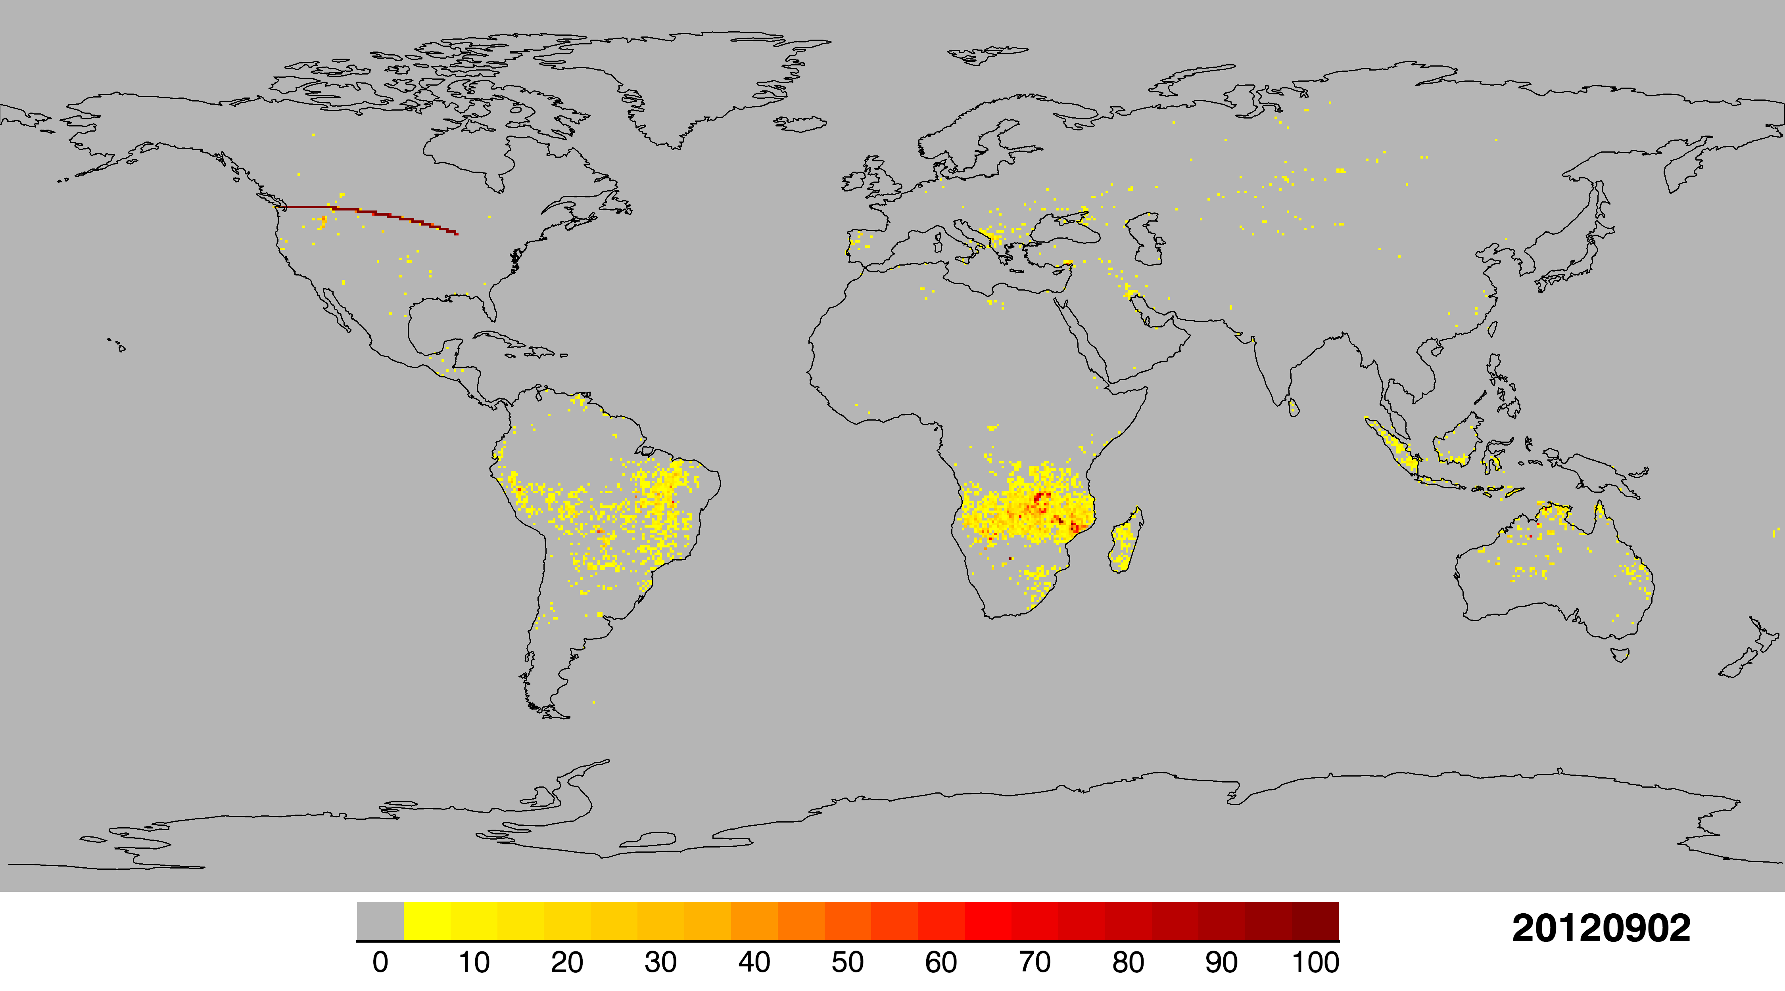
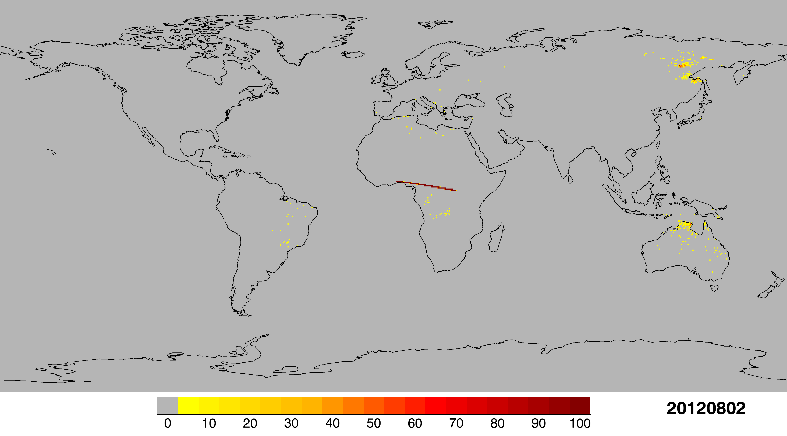

Examples of IDPS Beta product
Frequent occurrence of spurious scanlines during the first ~10 months of production
The active fire team has been working with the VIIRS SDR team to diagnose and reduce input data anomalies; and improve quality flagging to enable filtering of corrupt data.

Slide 6
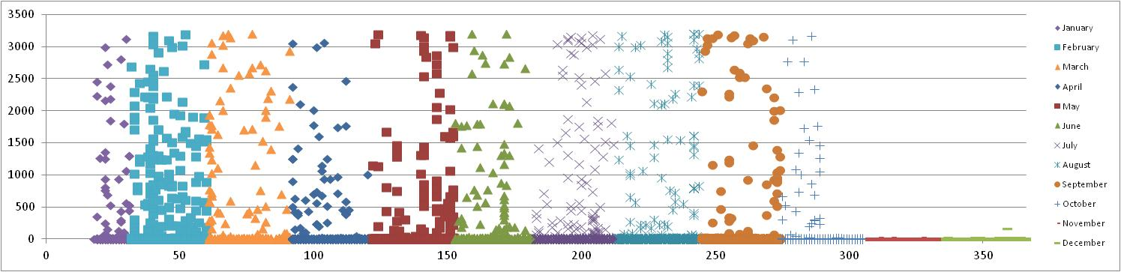
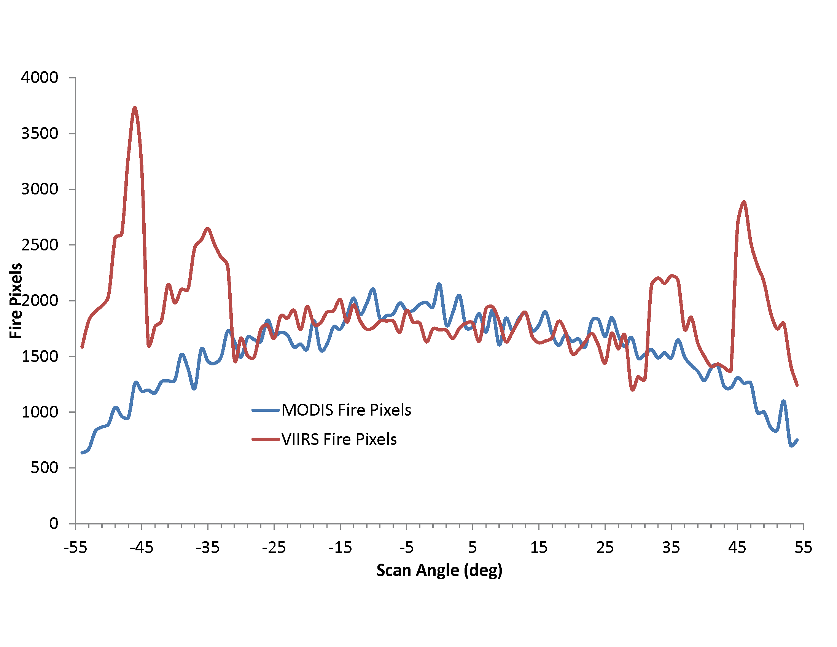
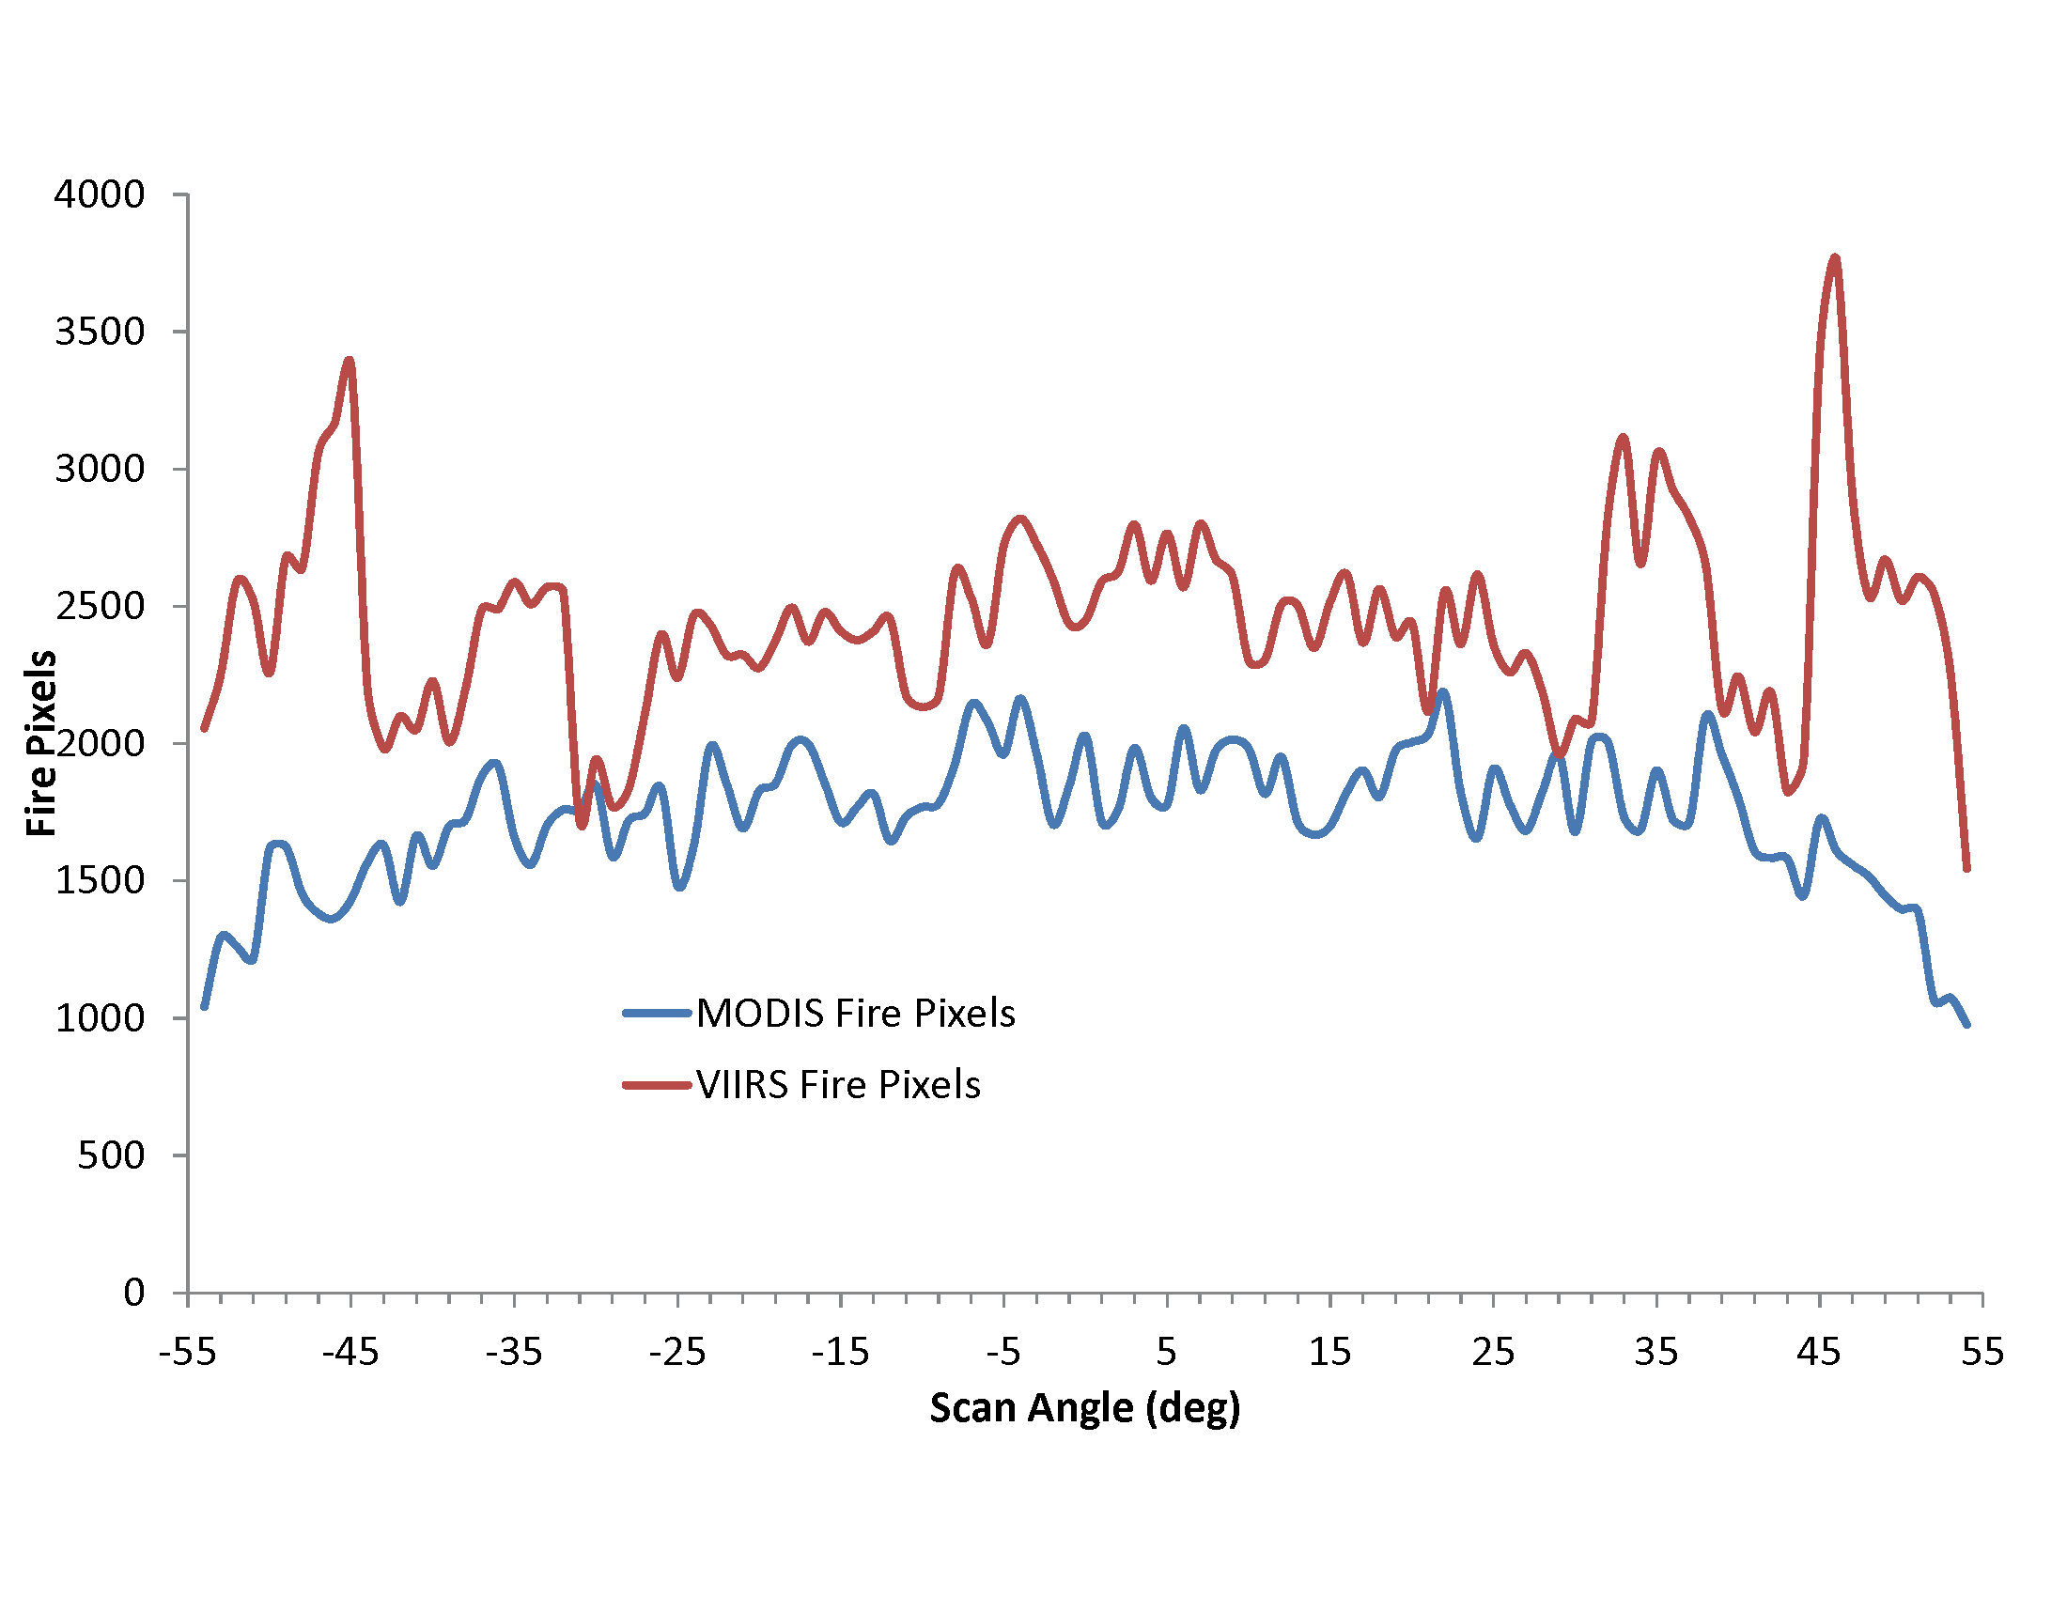
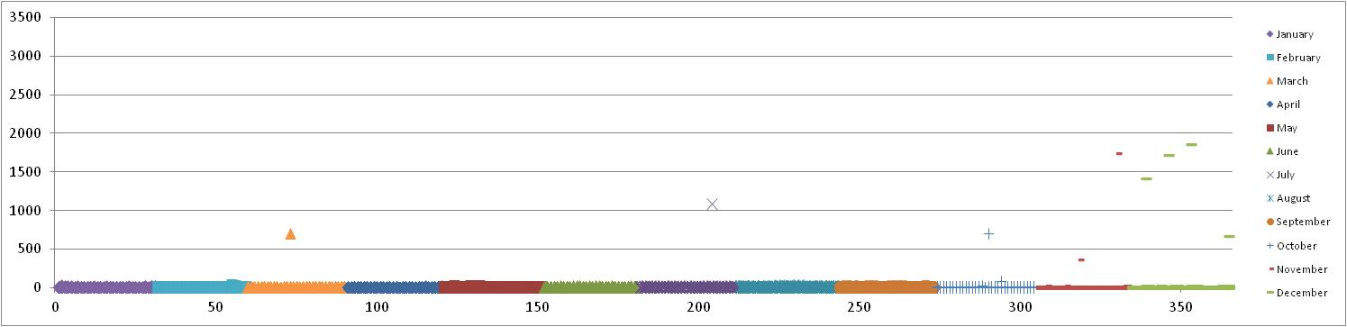
IDPS Suomi NPP Active Fire Product: data anomalies and product maturity (2/1)
2012
April 3, 2012
IDPS Mx5.3
October 16, 2012
IDPS Mx6.3
N_{max}
Pre-Beta
Beta
Provisional
2013
Day of Year
N_{max}
Provisional
N_{max}: maximum number of detections within a scanline
Day of Year

Slide 7
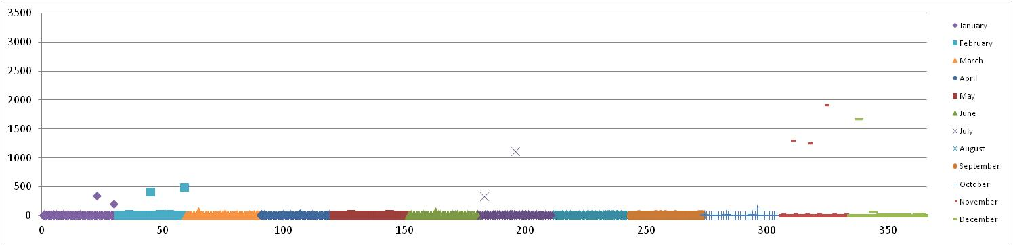
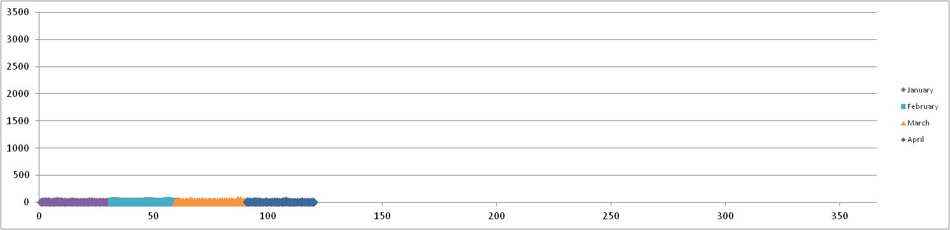
IDPS Suomi NPP Active Fire Product:
data anomalies and product maturity (2/2)
2014
August 13, 2014
IDPS Mx8.5
N_{max}
Provisional
Validated stage 1
Removed by Mx8.5 SDR fix
2015
Day of Year
N_{max}
Validated stage 1
N_{max}: maximum number of detections within a scanline
Day of Year

Slide 8
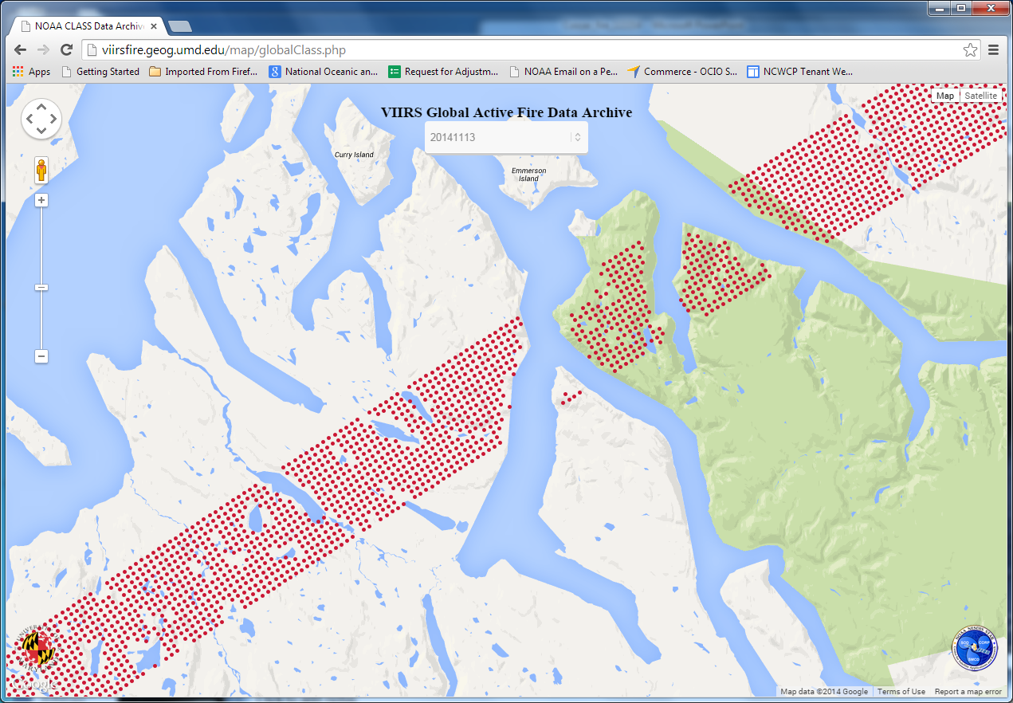
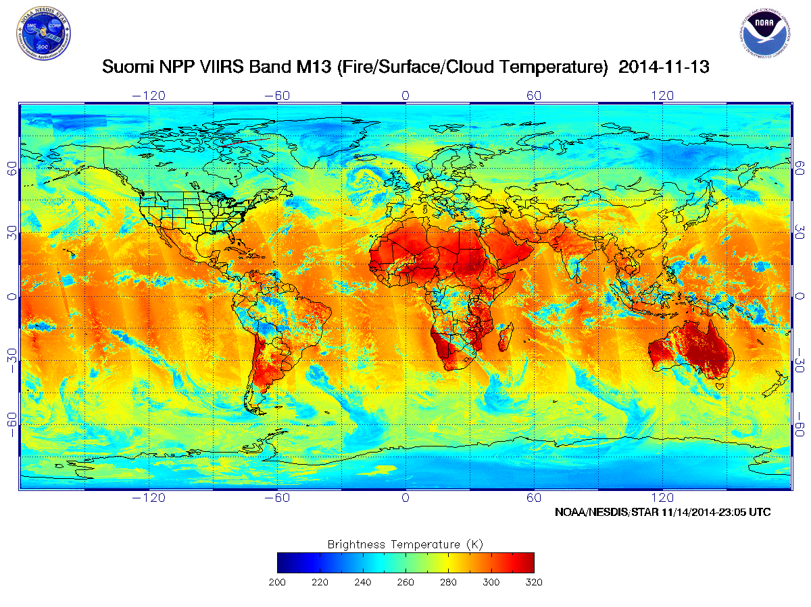
Remaining data anomalies: high latitudes
Spurious scanlines are associated with anomalous calibration of the dual-gain M13 SDR data and/or incorrect quality flagging, typically at the beginning of data granules or transmission, of after missing data packets.
http://viirsfire.geog.umd.edu
http://www.star.nesdis.noaa.gov/icvs/index.php
ICVS: Integrated Calibration / Validation System

Slide 9
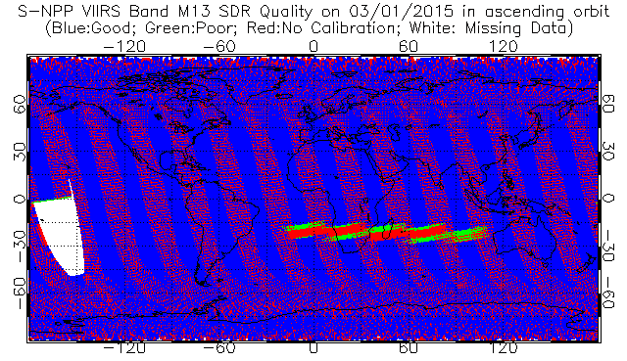
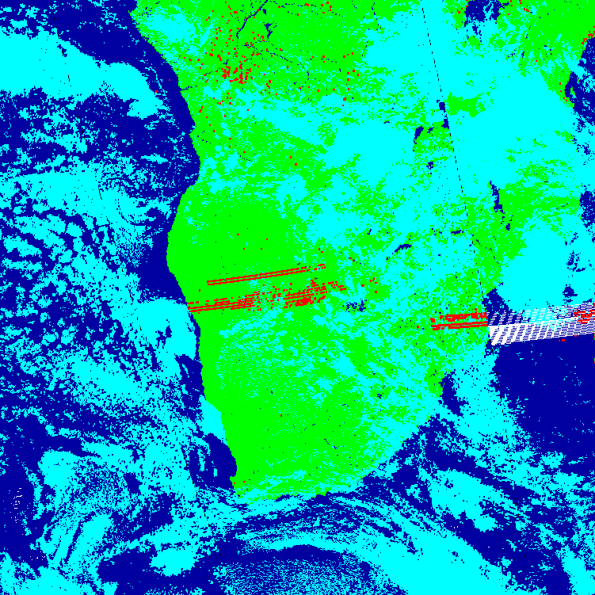
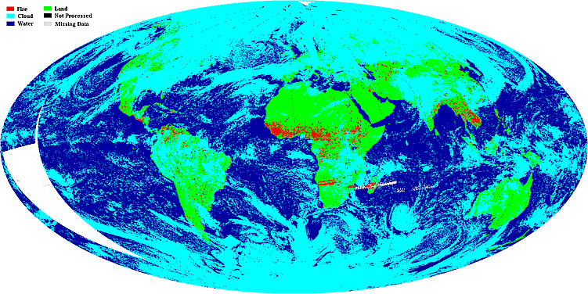
Remaining data anomalies: lunar intrusion
An example of false detections during a lunar intrusion event on March 1, 2015. The fire product shown was generated within NASA Land Science Investigator-led Processing System (SIPS).
http://www.star.nesdis.noaa.gov/icvs/index.php
http://landweb.nascom.nasa.gov/NPP_QA/

Slide 10
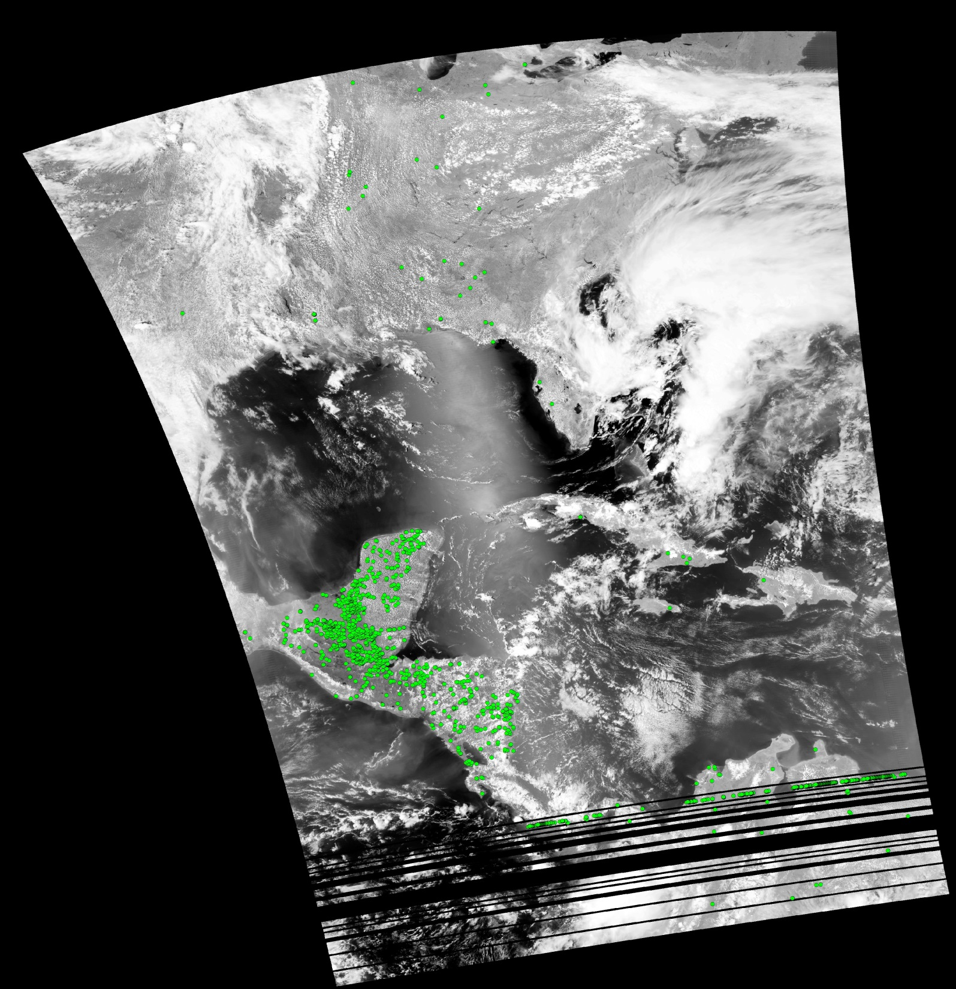
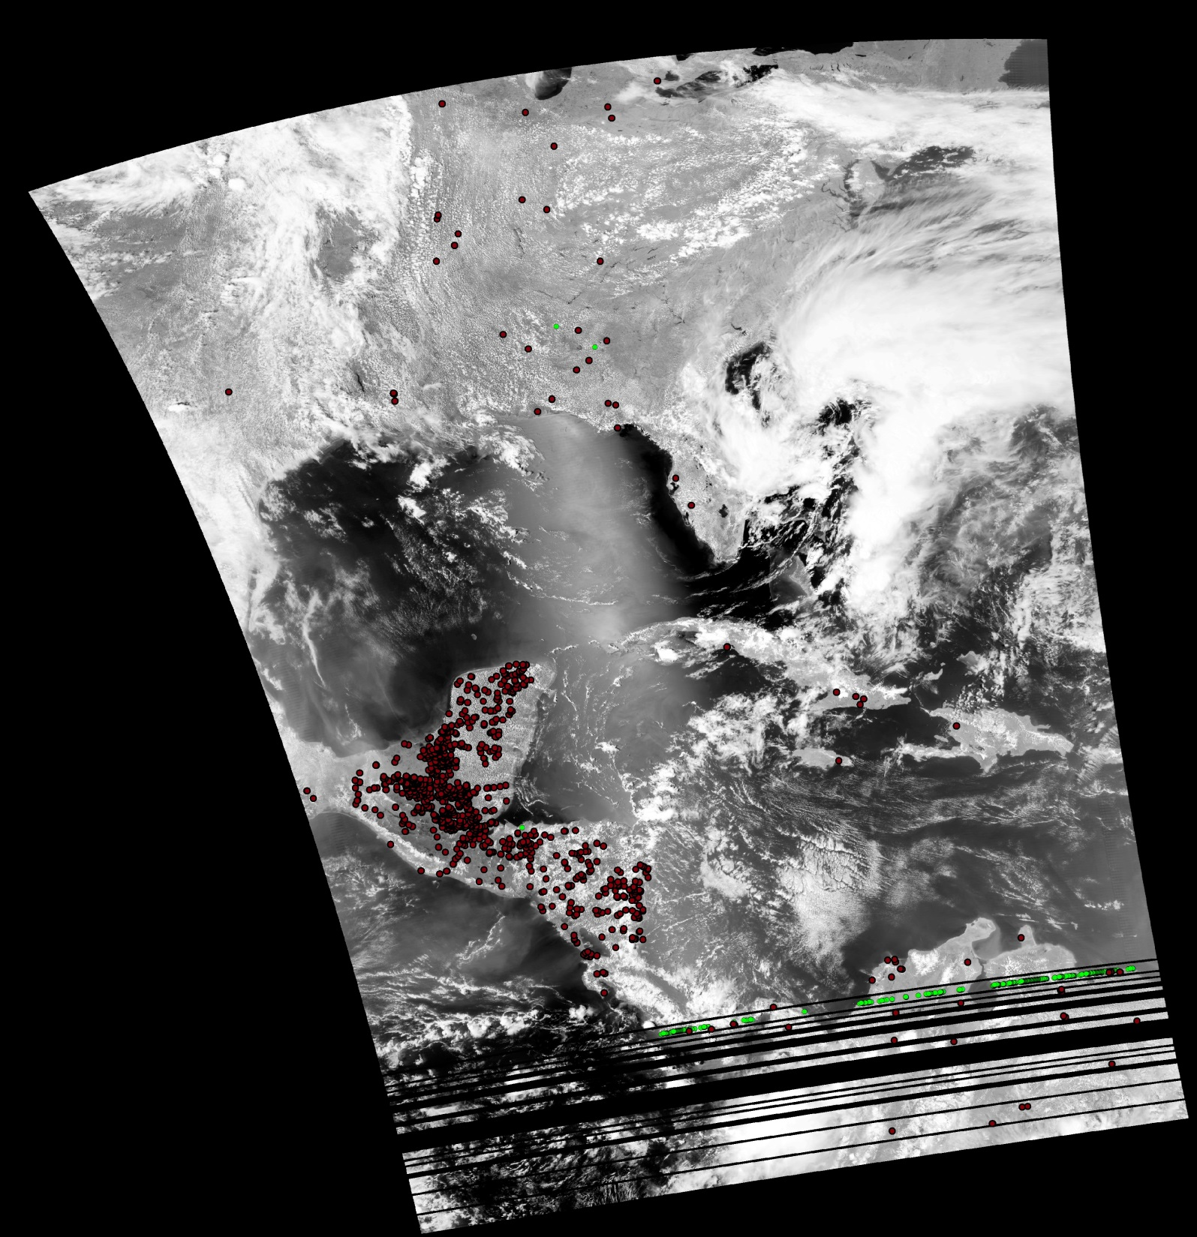
Remaining data anomalies: direct broadcast
Missing / noisy data in Direct Broadcast transmission can result in incorrect SDR calibration and spurious detections.
The frequency of DB data anomalies depend on the performance of the local DB processing system.
Adjustments in the DB processing code are being implemented to improve SDR quality and spurious fire detections.
Spurious detections can also be filtered by empirical techniques.
Regular updates to include algorithm improvements is critical.
CSPP V2.0 (SDR Mx8.4)
CSPP V2.1 (SDR Mx8.6)
CSPP: Community Satellite
Processing Package (UW-Madison)
Courtesy Isabel Cruz
CONABIO, Mexico

Slide 11
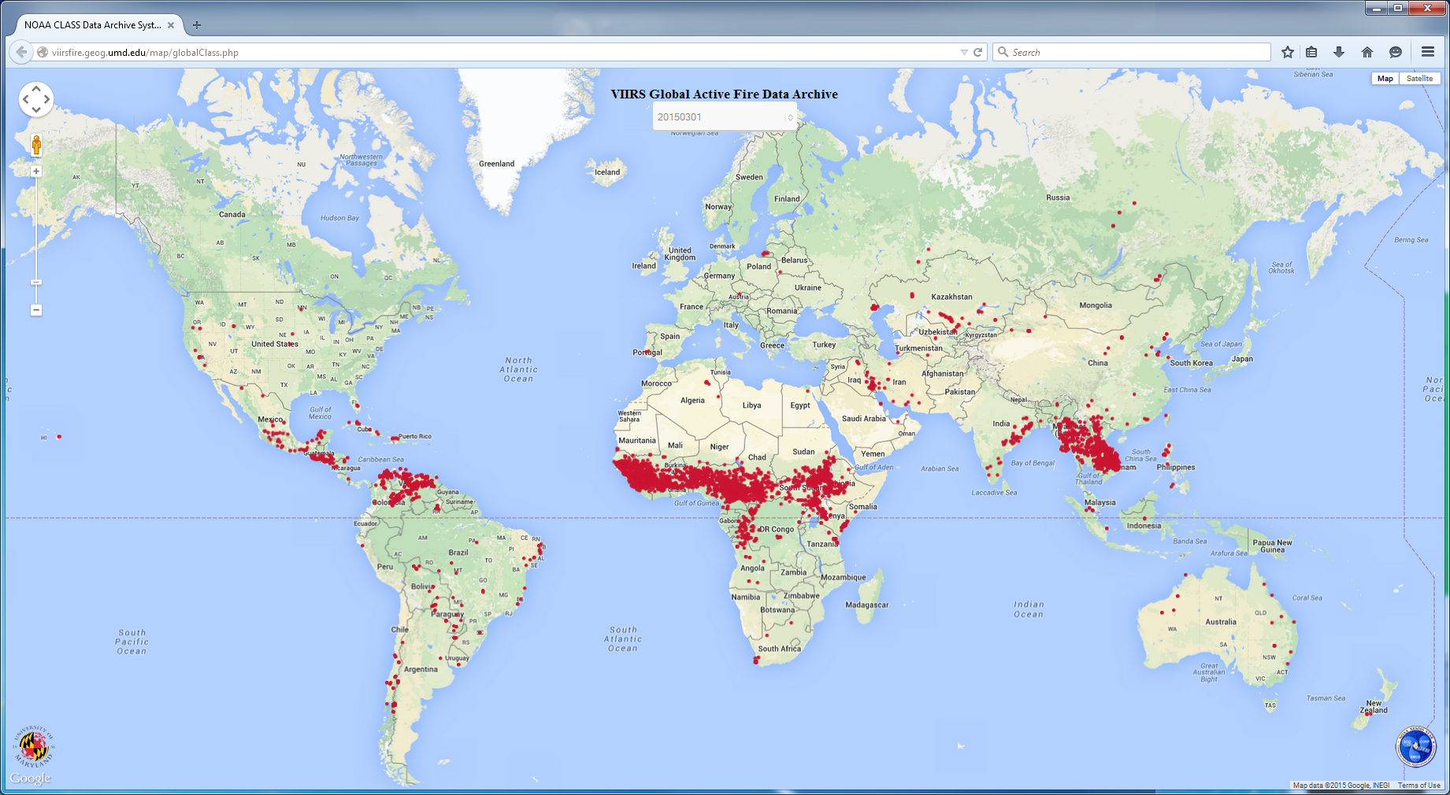
NOAA NDE VIIRS Active Fire Product testing
15 granules covering daytime (1-12), nighttime (13-15), land, water and corrupt (5,12) data were tested for overall performance and consistency between the NOAA and NASA output. The global map shown for reference is the current IDPS product.
clouds
4
14
3
13
10
7
2
1
March 1, 2015
11
8
6
daytime
nighttime
corrupt (lunar intrusion)
12
5
9
15
http://viirsfire.geog.umd.edu/
Data from NOAA CLASS: http://www.nsof.class.noaa.gov/

Slide 12
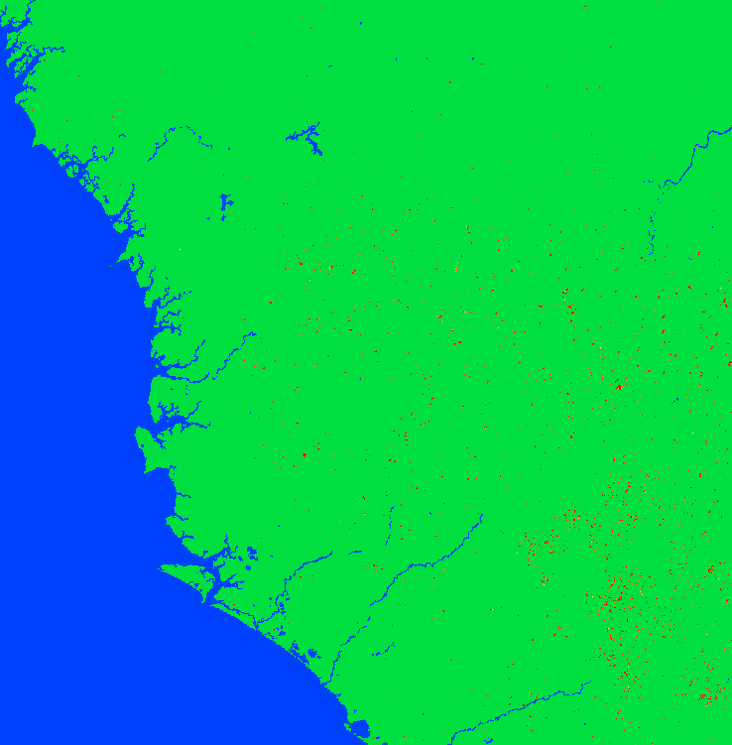
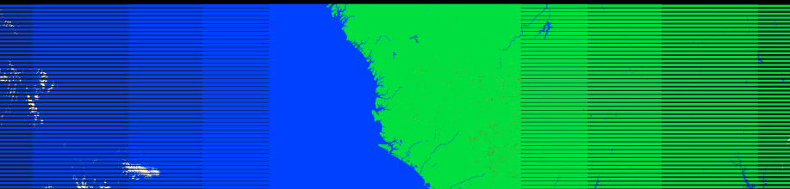
NOAA NDE VIIRS Active Fire Product
fires
clouds
clear land
VIIRS fire mask over West Africa on 3/1/2015 at 14:15 UTC, generated by the STAR Algorithm Integration Team (AIT) from IDPS input data and the NOAA version of the VIIRS fire replacement code
The NOAA Level-2 product is consistent with the NASA science product
VIIRS fire mask over West Africa on 3/1/2015 at 14:15 UTC
FRP: 3.11 – 573.35 MW
(daytime)
water
Data processed by STAR Algorithm Integration Team from IDPS input

Slide 13
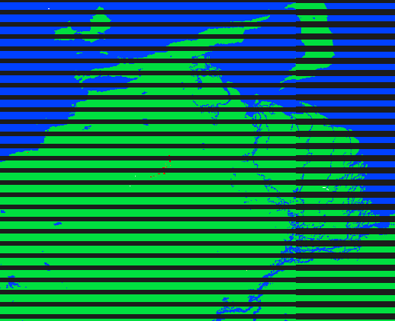
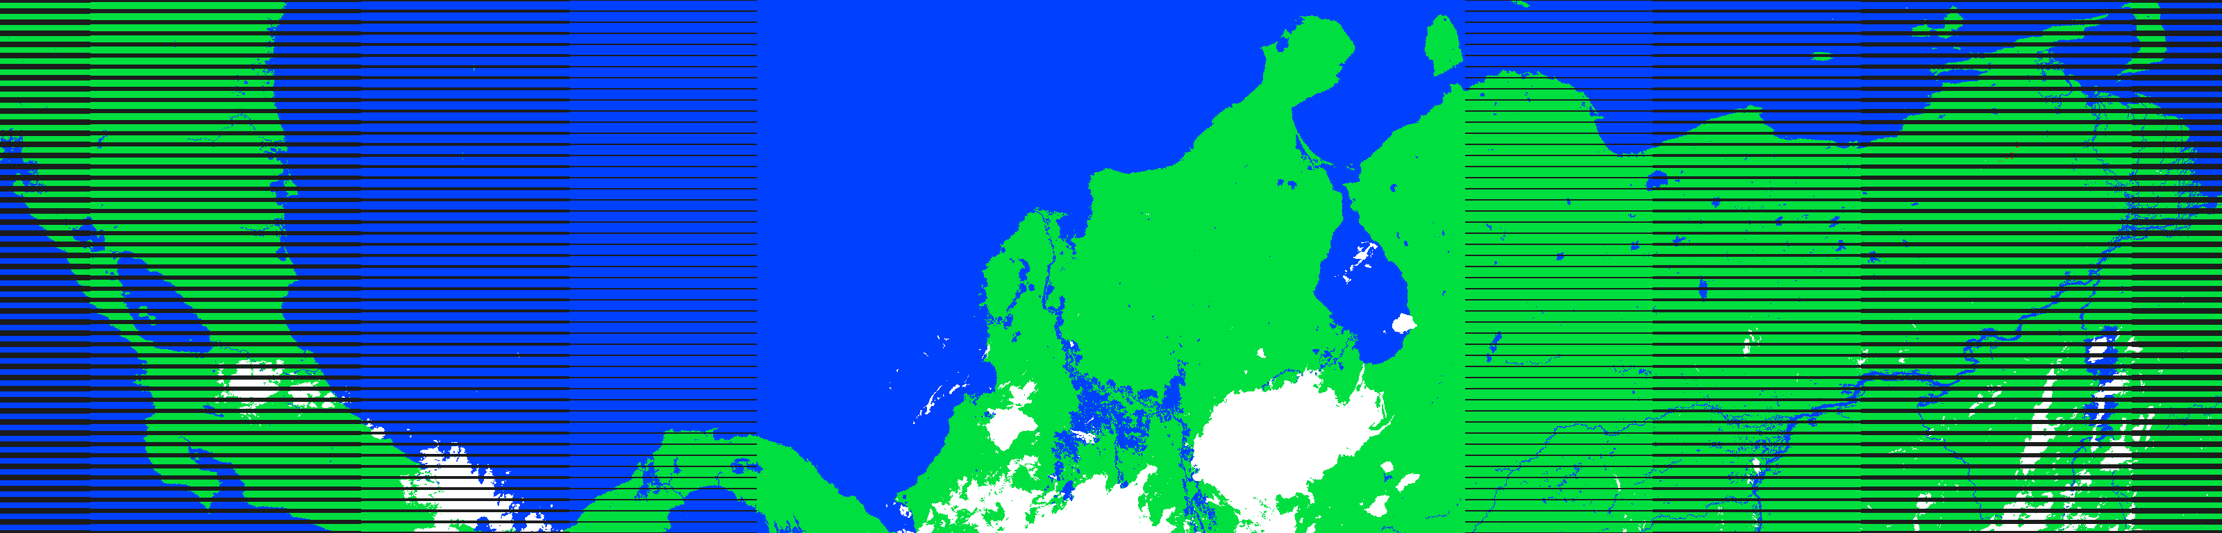
NOAA NDE VIIRS Active Fire Product
VIIRS fire mask over Central America and North-West South America on 3/1/2015 at 6:33 UTC, generated by the STAR Algorithm Integration Team (AIT) from IDPS input data and the NOAA version of the VIIRS fire replacement code. The horizontal lines are bow-tie deletions in the VIIRS granule.
The NOAA Level-2 product is consistent with the NASA science product
clear land
fires
fires
VIIRS fire mask over West Africa on 3/1/2015 at 14:15 UTC
(nighttime)
FRP: 4.36 – 212.39 MW
water
Data processed by STAR Algorithm Integration Team from IDPS input
water
clear land
clouds
clouds

Slide 14
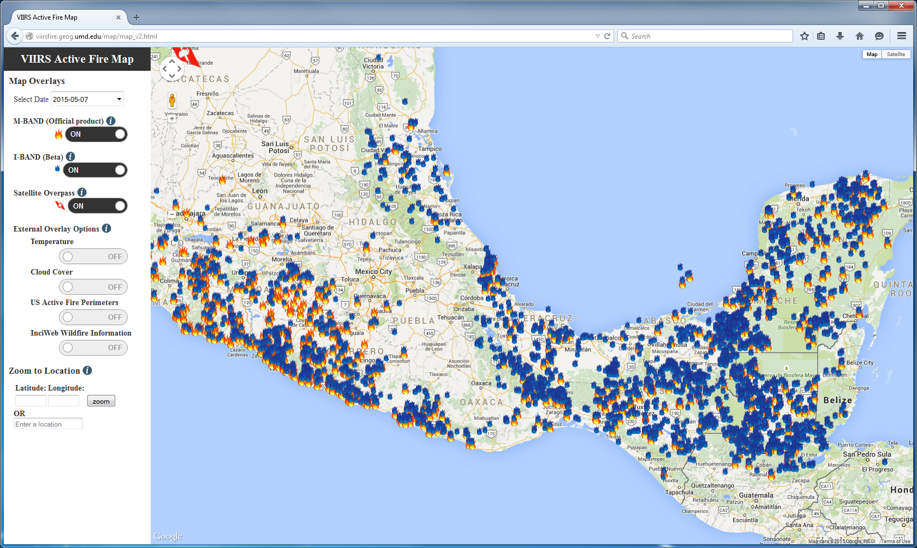
VIIRS Fire Data and Evaluation Portal
viirsfire.geog.umd.edu

Slide 15
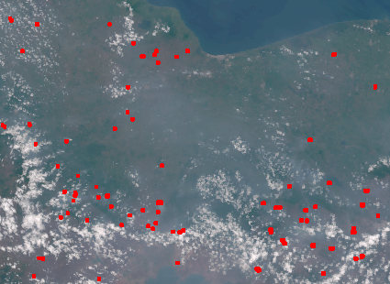
VIIRS M-band RGB (bands 3-2-1) + fire mask:
May 7, 2015 at 2050 UTC

Slide 16
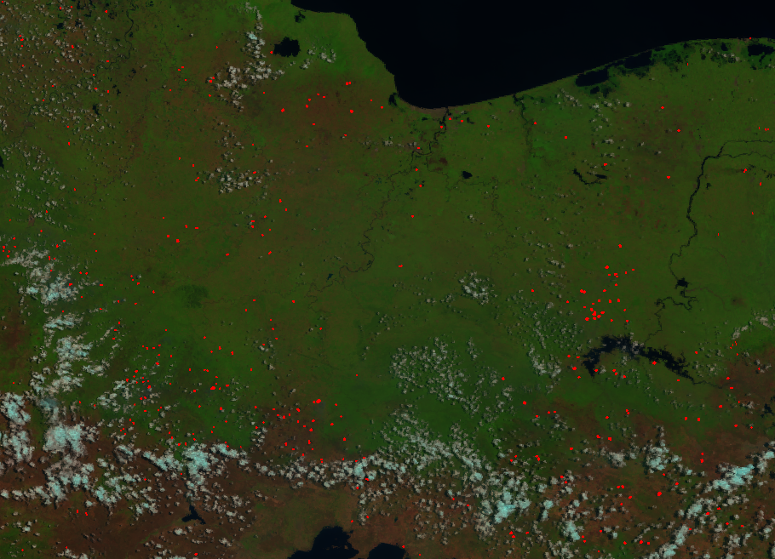
VIIRS I-band RGB (bands 3-2-1) + fire mask:
May 7, 2015 at 2050 UTC

Slide 17
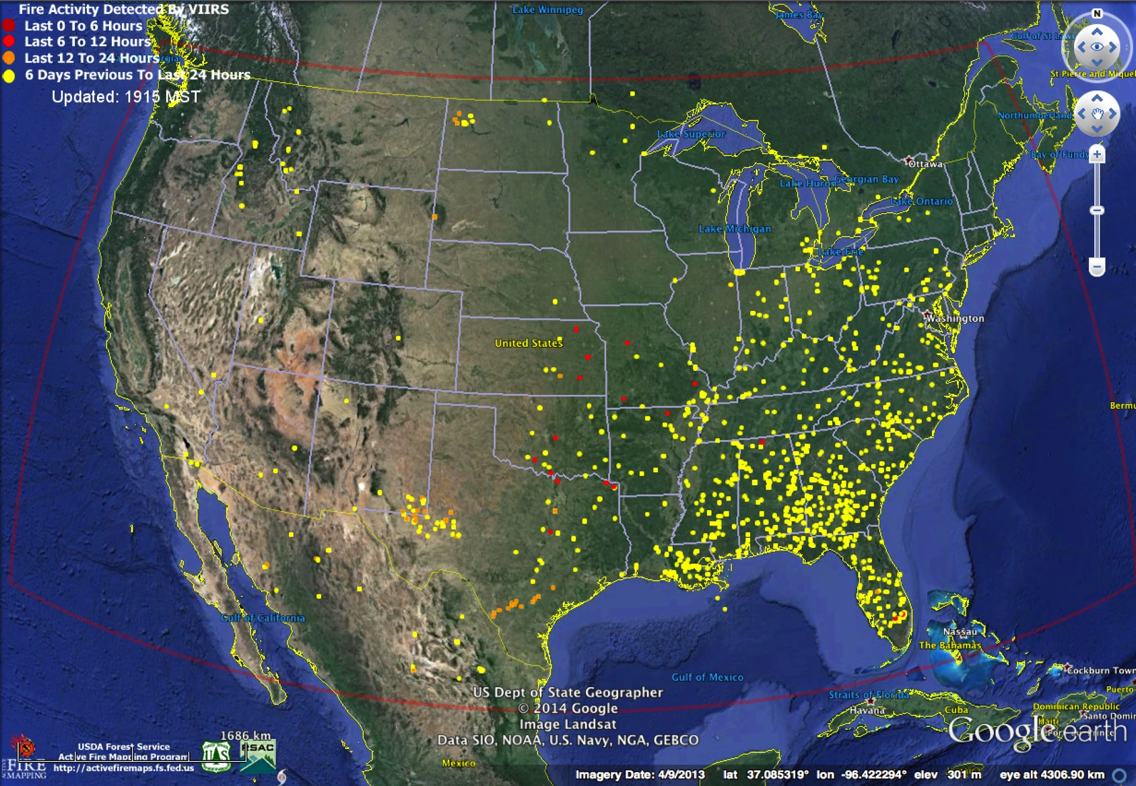
VIIRS 375 m NRT Fire Data Implemented for North America USDA-Remote Sensing Applications Center
http://activefiremaps.fs.fed.us/

Slide 18
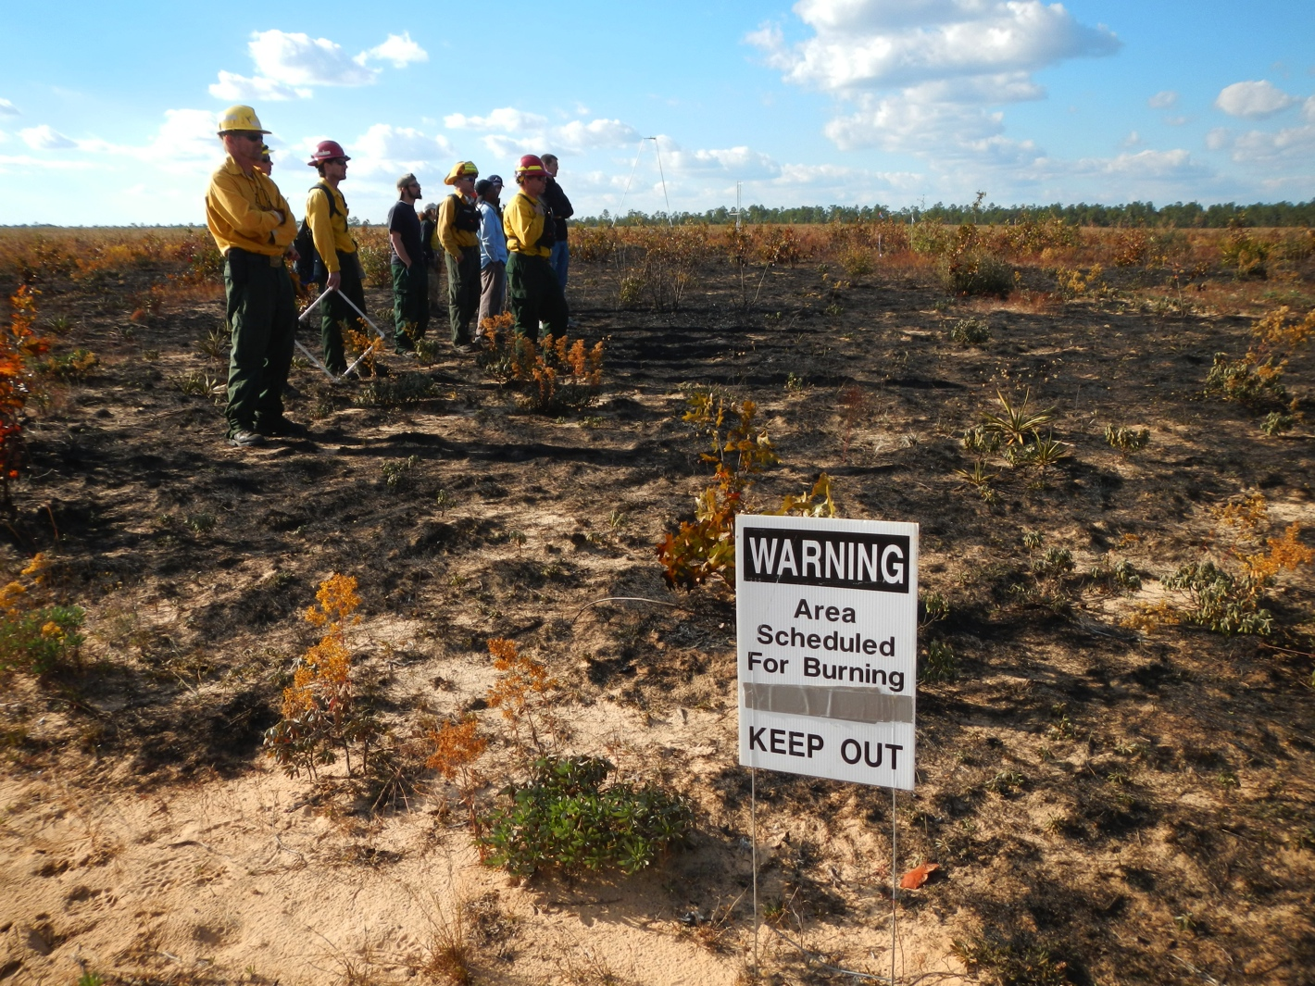
Active Fire Data Validation
Use of Landsat-class data to validate VIIRS is not an option due to prohibitively large time separation between same-day acquisitions
  We won’t match the MODIS validation status for VIIRS ( ≤ stage 2)
Use of prescribed fires (easy/accessible)
Coincident ground, airborne, spaceborne data acquisitions
Community-organized (reduce spending, maximize output)

Slide 19
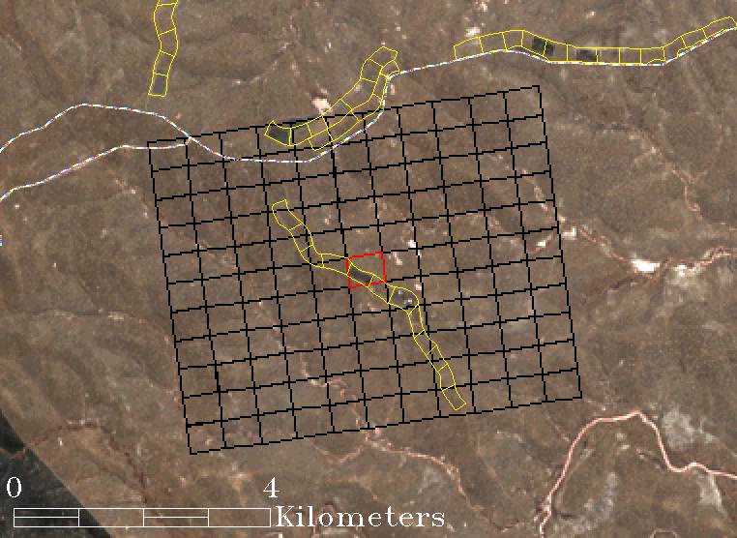
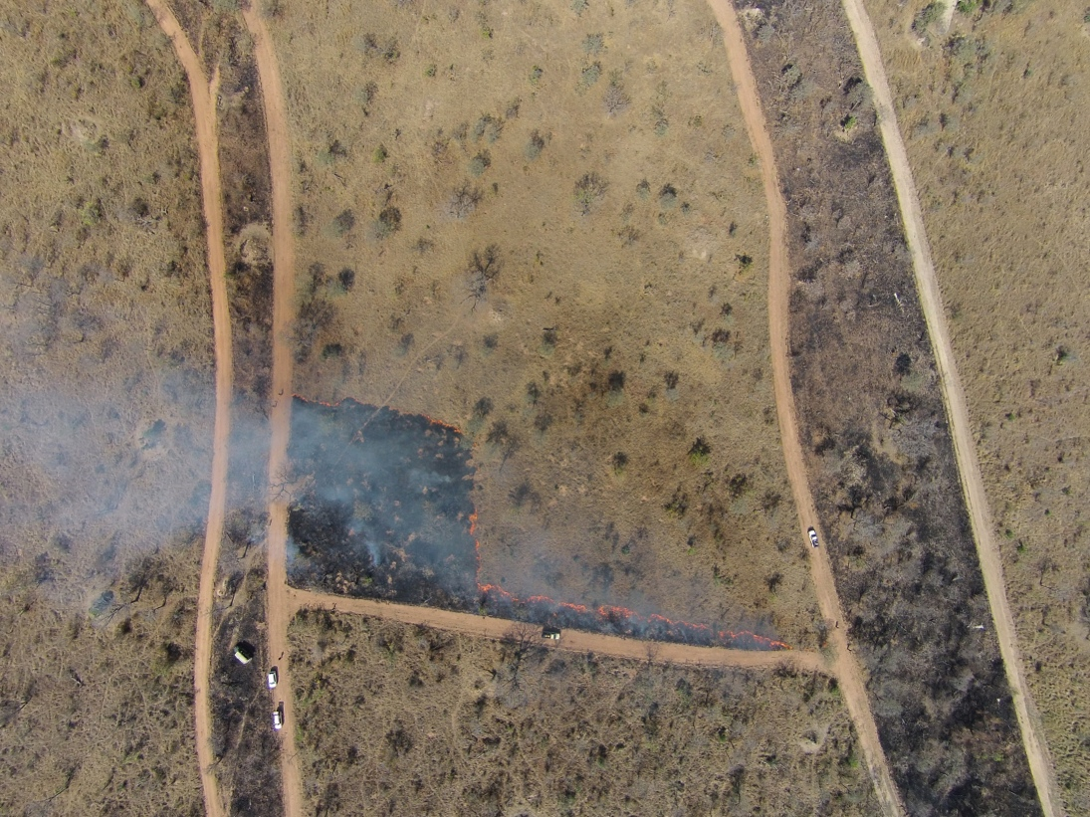
Landsat-8
Kruger National Park
19 August 2014
Lat: 25.131º S
Lon: 31.411ºW
N
N
View from
remote- controlled helicopter
Subset of VIIRS 375 m pixel grid (fire detection in red)
Surface-leaving FRP (VIIRS): 4.4±0.2MW
@ 13:24:26 h local time
Ground Radiometers
Length of active (back) fire front at time of VIIRS overpass: 200 m

Slide 20
Conclusions
VIIRS active fire products on track
  NOAA 750m IDPS product is stable, but updates are required
  375 m and 750 m algorithms successfully implemented by the NASA ST
  Latest 750m science algorithm ported to NOAA, 375m to follow
  Fire user community already benefiting from VIIRS data
  Inter-comparison with MODIS fire product and initial validation results indicating good overall performance
  Provisions added to MODIS (C6) and VIIRS active fire product files in order to facilitate atmospheric correction of fire retrievals
Future work
  Continue monitoring of/responding to outstanding issues affecting Level 1 input data
  Implement tuning of 750 m fire algorithm
  Further develop/promote 375 m fire algorithm, continue investigation of hybrid algorithm
  Begin implementation of Level 3 product
  Expand validation analyses
    Using drones over relatively small (< 10 ha) fires
    Using field data to verify data simulation techniques

