Slide 1
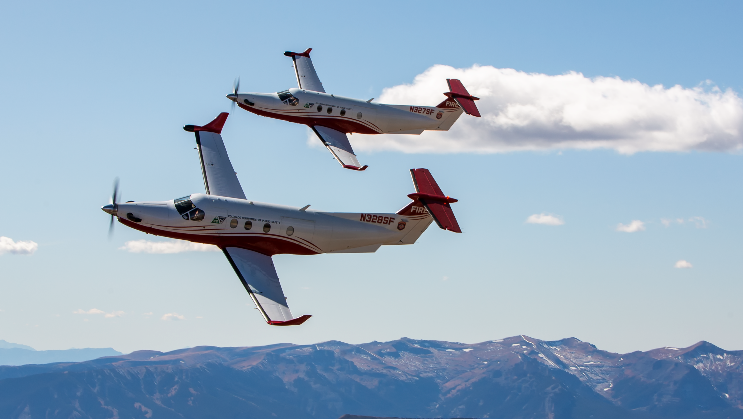
Colorado Multi-Mission Aircraft
2020 Fire Season Update

Slide 2
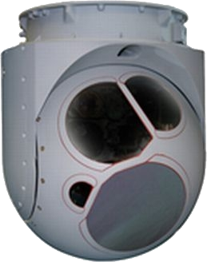
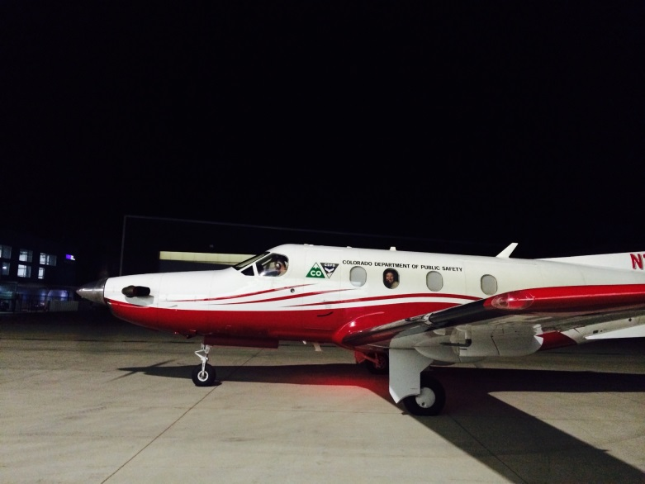
The MMA Aircraft & Equipment
Pilatus PC-12/45
Wescam MX-15 – EO and Mid-Wave IR
Churchill Atom Mission Computer
ION Video Recorder
Airborne Displays 21” and 17” Touchscreen Monitors
GoGo ATG-5000
3G Cellular
Three VHF-FM radios
One 800 MHZ Radio
State Owned – Contractor Operated
State program management and system
operators
Bode Aviation operation and maintenance
MX-15HDi Sensor

Slide 3
Mission Capabilities
All products are collected, processed, and disseminated while in flight. Normally delivered within minutes of being collected.
Products can be delivered to EGP/CO-WIMS, or by email.
Capable of collecting color and infrared photos and video, and of creating polygons, lines, and points representing fire perimeters, spot fires, values at risk, etc.
Spatial products can be formatted as KML or Shapefile.
Can create and distribute a Geo-Referenced PDF map while in flight
Incident Awareness and Assessment – Direct contact with ground personnel via radio to experienced firefighters on the MMA.

Slide 4
2020 Activities
1334 total flight hours
761 individual missions / taskings
98 new fires located
32 days in Northern California

Slide 5
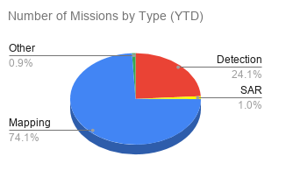

Slide 7
Potential Future Upgrades
ATAK Integration
MX-15 Upgrades
Additional sensors
Data Transmission

Slide 8
DFPC Multi-Mission Aircraft Program
Bruce Dikken, Unit Chief
bruce.Dikken@state.co.us
720.749.7685

