Slide 1
FireFlight
By Spatial Scientific Technologies
An Innovative Airborne Fire Mapping Solution
Presented by :
Richard W. McCreight
Near Earth Observation Systems, Ltd
27 May 2015
Tactical Fire Remote Sensing Advisory Committee Meeting (TFRSAC)
www.fire.aero

Slide 2
Executive summary
Spatial Scientific, an Australian company, has developed a system (FireFlight) for wild fire mapping using low cost thermal sensors (<$25k) mounted on light aircraft.
The FireFlight system has two main components:
multiple light aircraft (single/twin engine) equipped with thermal sensors, flight management software, and data communications
ground-based software and hardware for processing client requests for data, and delivery of geometric fire maps to clients
The fire mapping system is designed to deliver:
vector data (geographic locations) of fire hot spots in real time
raster data (georectified thermal imagery) in near real time

Slide 3
Philosophy
Multiple, small calibrated fire mapping systems, geographically spread over a wide area, are better than one or two big fire mapping systems
The cost of each fire mapping system cost is low (<$25K), easy to install, simple to use using COTS components
Real time data need only show the location of hot spots in an easy to interpret format: KML or KMZ for display in Google Maps/Earth
Georectified thermal mosaics should be made available in near real time (e.g., between 1 or 2 hours after acquisition)

Slide 4
Project partners
Spatial Scientific Pty. Ltd., Adelaide, Australia
An Australian spatial technology company founded in 2005
Developer of flight management and camera control systems
Considerable experience in airborne thermal imaging
Authorised reseller of FLIR thermal imaging cameras
Ascend XYZ, Copenhagen, Denmark
Developer of ground segment (data requests and data delivery)

Slide 5
Project partners
Image Air Pty. Ltd., Queensland, Australia
Operator of single and twin engine aircraft (Cessna C172, Piper Comanche, Piper Seneca)
Thousands of hours of data acquisition
Thousands of hours of aerial fire suppression
NEOS Ltd., Arizona, USA
7-years experience in wildfire research and suppression
Operator of light experimental aircraft for US Government
Thousands of hours of science research and data acquisition
Beta tester and reseller of Spatial Scientific’s software products

Slide 6
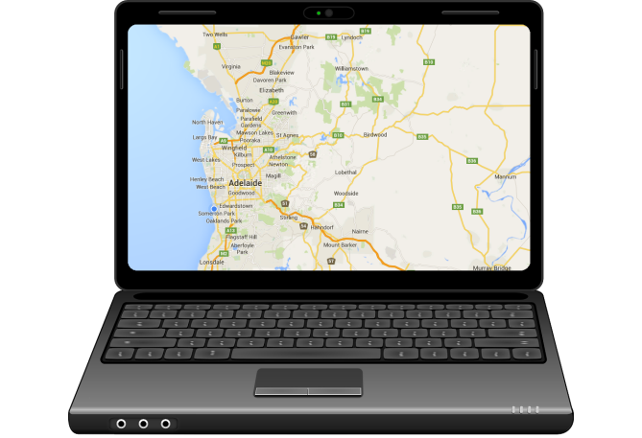
Methodology
Multiple light aircraft, equipped with fire mapping systems remain on standby in the fire danger region.
When a fire starts, clients request fire mapping data via an online ordering system.
The aircraft closest to the fire are sent out to undertake mapping operations. The others remain on standby.

Slide 7
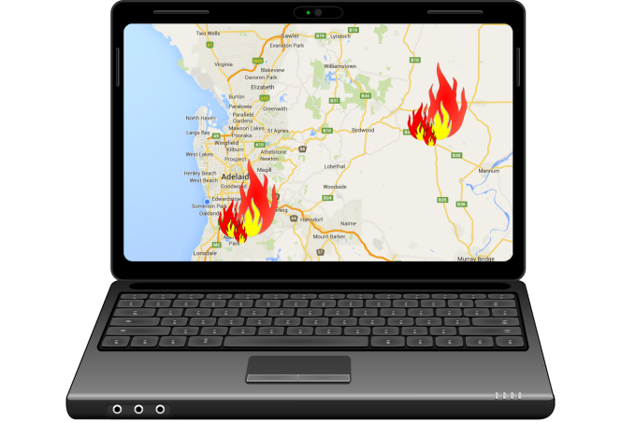
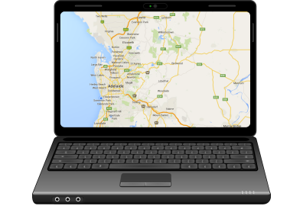
Methodology
Data is acquired over the fire and automatically analysed in real time.
The geographic locations of fires are uploaded to a website directly from the acquisition aircraft.
On landing, data is further processed to create georectified fire maps, which are uploaded to a website in near real time (1-2 hours).

Slide 8
Workflow (overview)
Web interface
Ground segment
Clients
Acquisition partners
Data request
Data request
Real time vector data
Data upload from aircraft
Post processed image data
Data uploaded after landing

Slide 9
Data acquisition procedure
Acquisition aircraft are tasked with data acquisition. Flight planning takes place either on the ground or inflight.
Data is acquired over the fire using the ‘Aviatrix’ FMS, which provides real time feedback to the pilot.
Data is analysed in real time using FireFlight: coverage and resolution data in presented to the camera operator.
Hotspots are automatically detected in the imagery and uploaded to a secure web server using a cell phone.
Image data is processed on the ground after landing. A GIS-ready image product is delivered within 1-2 hours.

Slide 10
Components of the acquisition system
FLIR A65 uncooled (micro bolometer) thermal imaging camera
Laptop computer, non-differential GPS, low cost IMU (<$5K), cell phone or satellite phone for real time data transmission
AeroScientific software:
“Aviatrix” flight management and camera control system
“FireFlight” real time fire image analysis software
Single engine or light twin aircraft, with pilot and camera operator

Slide 11
Components of the acquisition system
USB
External
pilot’s
display
GPS / IMU
VGA
WiFi
Cell phone (WiFi hotspot)
Ethernet
FLIR A65

Slide 12
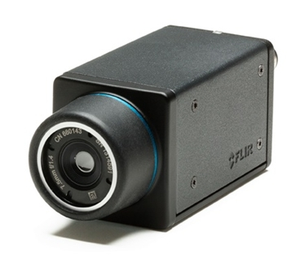
FLIR A65
Uncooled micro bolometer sensor
640 x 512 pixels
14 bit thermal data with absolute temperature accuracy of approx. 5 degrees C
Less than $10K

Slide 13
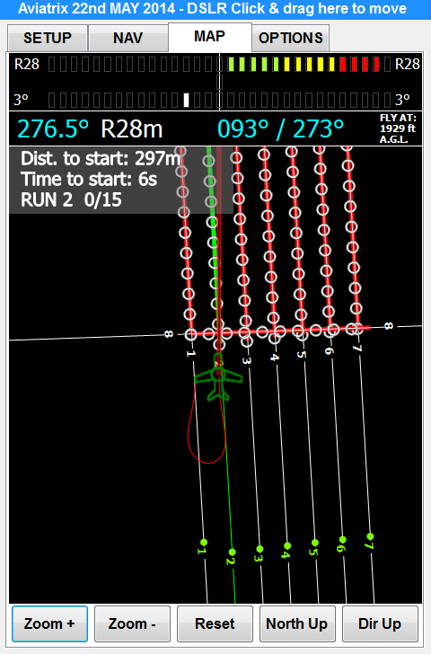
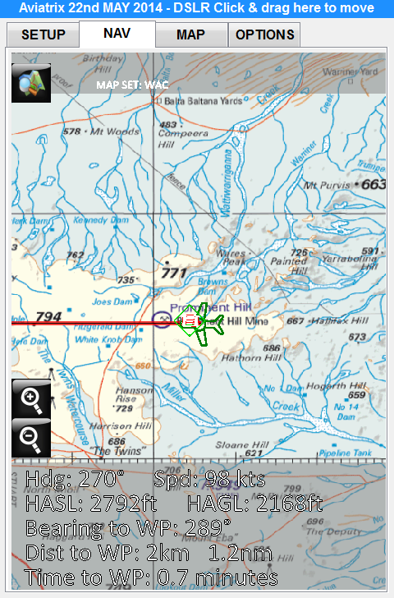
“Aviatrix” flight management system
Key functionality:
Pilot navigation to/from the area of interest
Guidance for flying flight runs
Camera control (thermal and DSLR)
Recording of all imagery and meta data

Slide 14
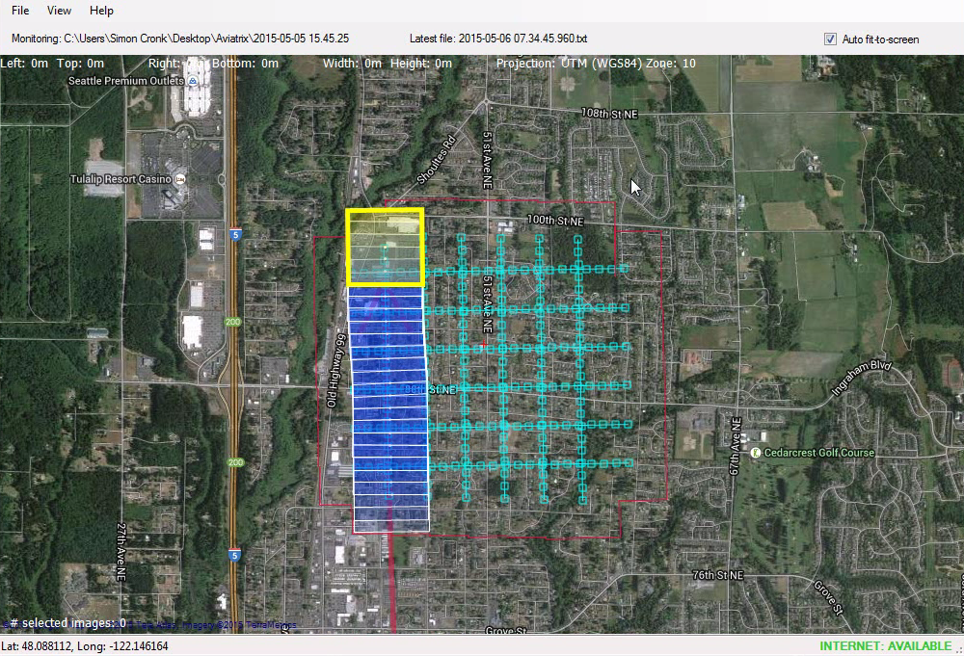
“FireFlight” real time analysis
Key functionality:
Real time display of camera footprints on the ground
Real time detection of hotspots in thermal imagery
Real time uploading of hotspot data to secure webserver

Slide 15
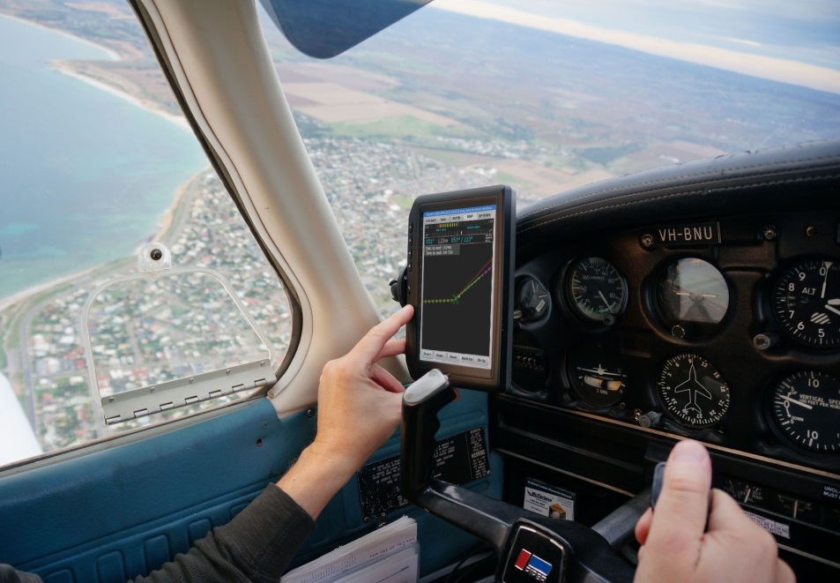
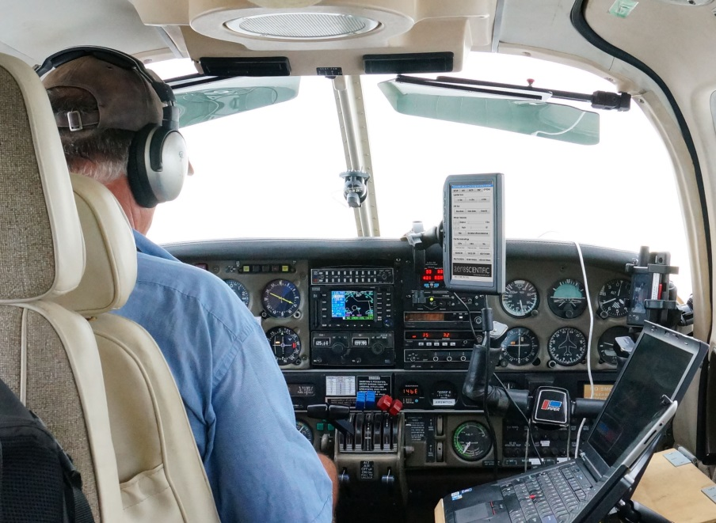
Use in small aircraft
Piper Warrior
Piper Seneca

Slide 16
Technical details
Two person crew is preferred but single pilot ops are possible.
Data is acquired at approx. 10,000ft, therefore above any other aerial fire fighting assets.
Pixel size of 2m (6 feet) and swath width of 1280m (4200 feet).
Thermal spectral response of 8 to 13µm (smoke penetrating).
Hotspots above a predefined temperature are automatically detected in the imagery.

Slide 17
Components of the ground segment
Web portal (powered by Ascend XYZ) enables:
On line ordering of data
Distribution of data requests to acquisition aircraft
Display of vector data (fire hotspots) in real time
Display of raster data (image mosaics) in near real time

Slide 18
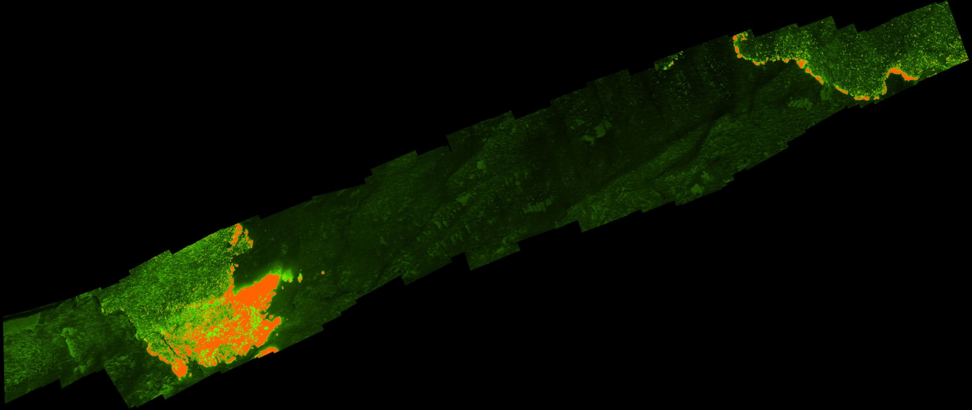
Sample results – raster data
Mosaic of over 100 images acquired at 50cm resolution
Fully automatic mosaicking
Georectified to ground coordinates
Orange shows burning vegetation
Light green is recently burnt vegetation
Dark green is vegetation that has a low heat signature: no fire or burning detected

Slide 19
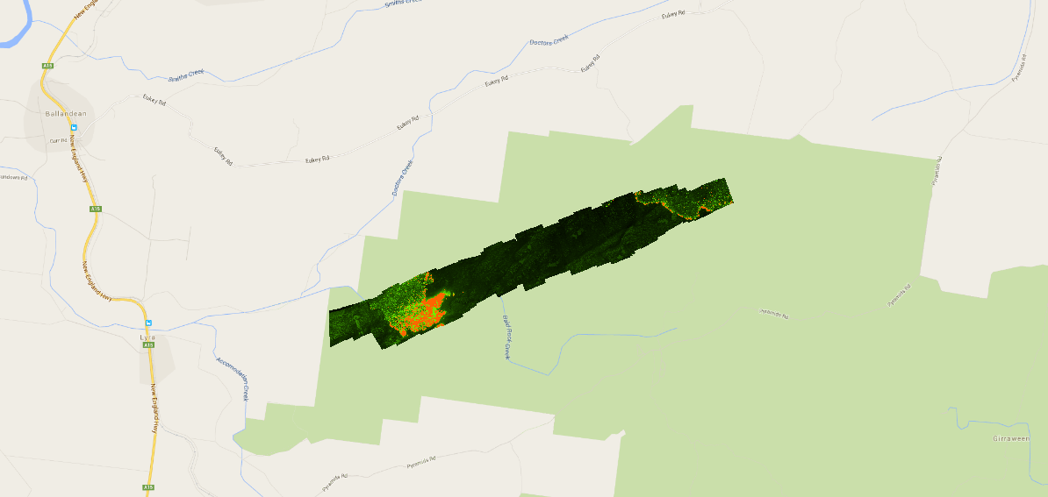
Raster data in Google Maps

Slide 20
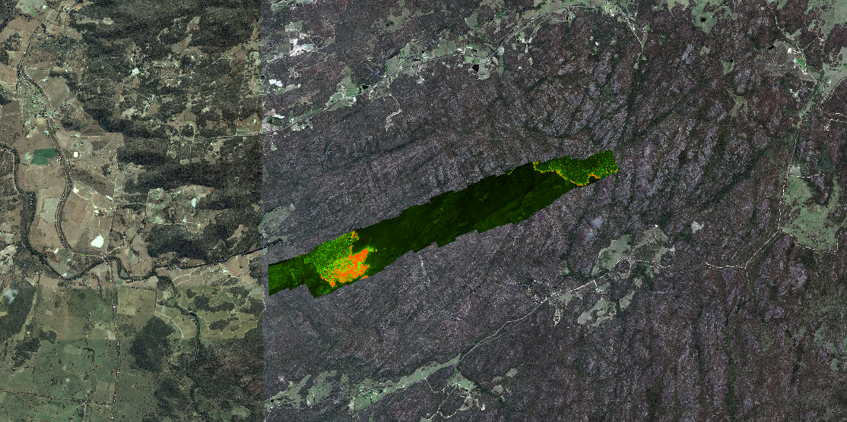
Raster data in Google Earth

Slide 21
Current status
Completed items:
Flight planning software for use in the air or on the ground
Thermal data acquisition software and flight management system
Image mosaicking for visualisation of fires
Beta version of “FireFlight” (in flight fire management software)
Web interface for data requests and data delivery
To be completed soon:
Real time conversion of hotspots in imagery to vector data
Release version of FireFlight

Slide 22
FireFlight Status
Spatial Scientific has funded the development of a unique fire mapping system using low cost COTS components
Successful trials have been undertaken in Australia (October 2014)
Further trials in operational environments are required, preferably in multiple countries
Further funding to accelerate the development and implementation of the system is required

Slide 23
Contact us!
In Australia:
Dr. Paul Dare, Spatial Scientific Pty. Ltd.
Email: info@fire.aero
Cell phone: +61 405 141 647
In the United States:
Mr. Richard McCreight, NEOS Ltd.
Email: neos500@gmail.com
Cell phone: 858-344-5161

Slide 24
FireFlight
Aerial fire mapping
An Innovative Airborne Fire Mapping Solution
from
Spatial Scientific Technologies
May 2015
www.fire.aero

